Slide 1
Weighted Scheduling

Slide 2
You are given n intervals with their start and end times. The start and end times are integers. Each interval has a credit associated with it.
Schedule non-overlapping intervals to maximize the total number of credits.

Slide 3
1
2
20
10
10
5
3
What is the solution to this problem?

Slide 4
1
2
20
10
10
5
3
How will you solve this problem?
Greedy: Pick the interval that ends first
But this strategy does not work even for the above example.

Slide 5
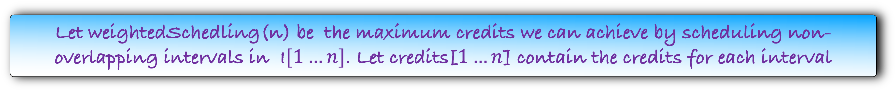
Sort the intervals according their ending times
Let weightedSchedling(n) be the maximum credits we can achieve by scheduling non-overlapping intervals in I$[1…n]$. Let credits[$1…n$] contain the credits for each interval
If the optimal answer does not contain the n-th interval, then what is weightedScheduling(n) ?
w$eightedScheduling$($n$)=

Slide 6
Sort the intervals according their ending times
Let weightedSchedling(n) be the maximum credits we can achieve by scheduling non-overlapping intervals in I$[1…n]$. Let credits[$1…n$] contain the credits for each interval
If the optimal answer does not contain the n-th interval, then what is weightedScheduling(n) ?
w$eightedScheduling$($n$)=w$eightedScheduling(n−1$)

Slide 7
Sort the intervals according their ending times
Let weightedSchedling(n) be the maximum credits we can achieve by scheduling non-overlapping intervals in I$[1…n]$. Let credits[$1…n$] contain the credits for each interval
If the optimal answer does not contain the n-th interval, then what is weightedScheduling(n) ?
w$eightedScheduling$($n$)=w$eightedScheduling(n−1$)
If the optimal answer contains the n-th interval, then what is weightedScheduling(n) ?
Let j be the latest-ending interval that doesn't overlap with $I[n]$
w$eightedScheduling$($n$)=

Slide 8
Sort the intervals according their ending times
Let weightedSchedling(n) be the maximum credits we can achieve by scheduling non-overlapping intervals in I$[1…n]$. Let credits[$1…n$] contain the credits for each interval
If the optimal answer does not contain the n-th interval, then what is weightedScheduling(n) ?
w$eightedScheduling$($n$)=w$eightedScheduling(n−1$)
If the optimal answer contains the n-th interval, then what is weightedScheduling(n) ?
Let j be the latest-ending interval that doesn't overlap with $I[n]$
w$eightedScheduling$($n$)= credits[$n$] + w$eightedScheduling$($j$)

Slide 9
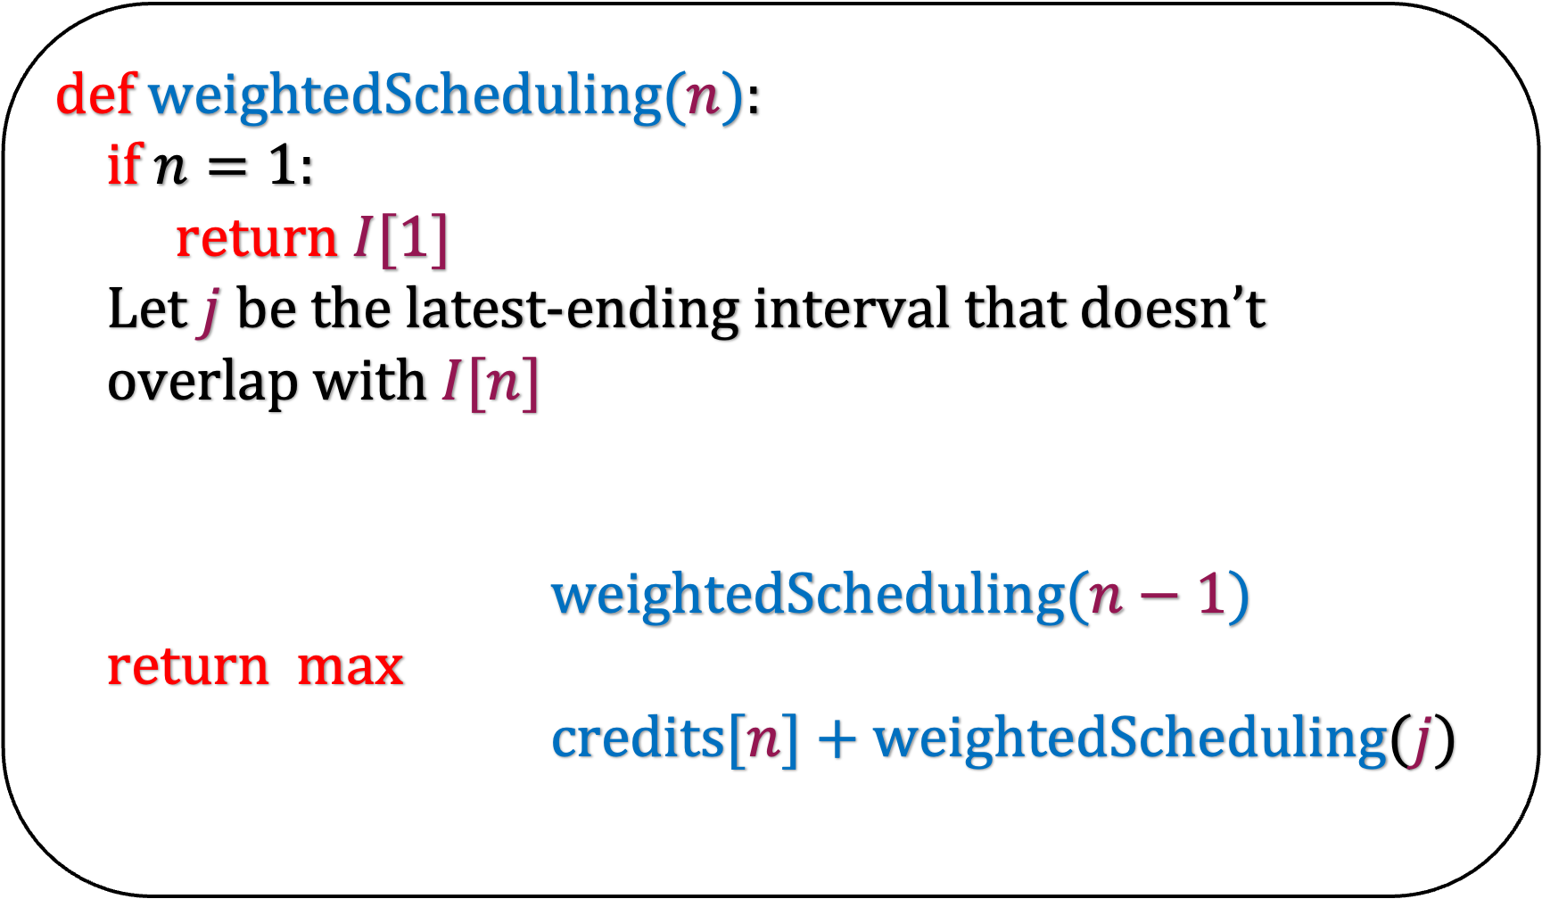
Sort the intervals according their ending times
def w$eightedScheduling(n$):
if $n=1$:
return $I[1]$
Let $j$ be the latest-ending interval that doesn’t
overlap with $I[n]$
w$eightedScheduling(n−1$)
return max
credits[$n$] + w$eightedScheduling$($j$)
What is the running time of this algorithm?
$O(n\log{n)}$ if we use memoization

Slide 10
Remember that every dynamic programming algorithm can be represented using an implicit DAG
This DAG also gives us the execution order of the non-recursive algorithm
What is the DAG for this problem?

Slide 11
1
2
20
10
10
5
3
1
2
3
4
5
6
7

Slide 12
1
2
20
10
10
5
3
1
2
3
4
5
6
7

Slide 13
1
2
20
10
10
5
3
1
2
3
4
5
6
7

Slide 14
1
2
20
10
10
5
3
1
2
3
4
5
6
7
Let us write a non-recursive algorithm for this problem

Slide 15
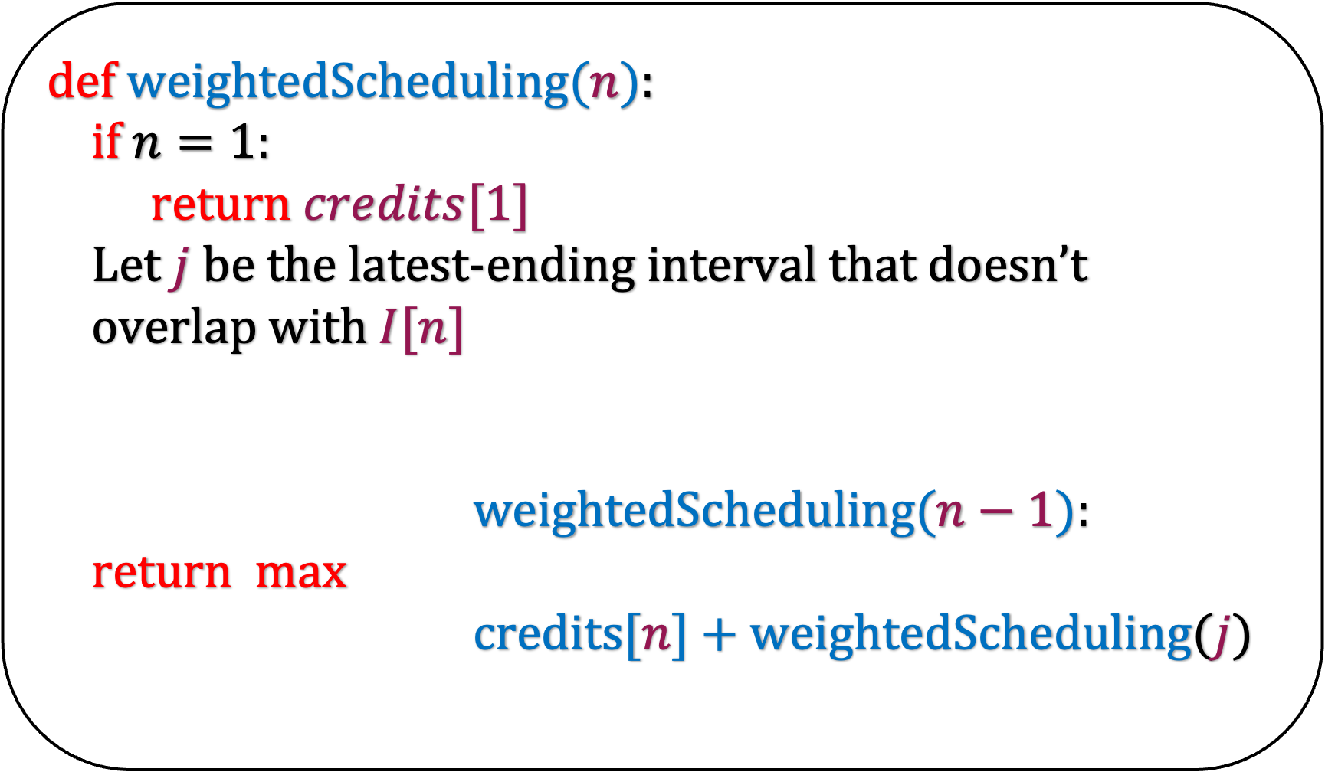
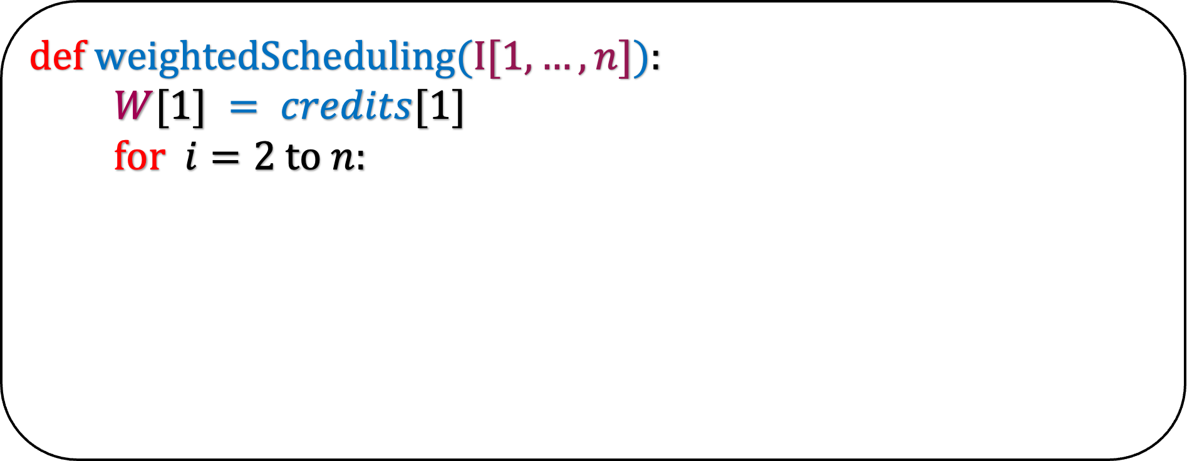
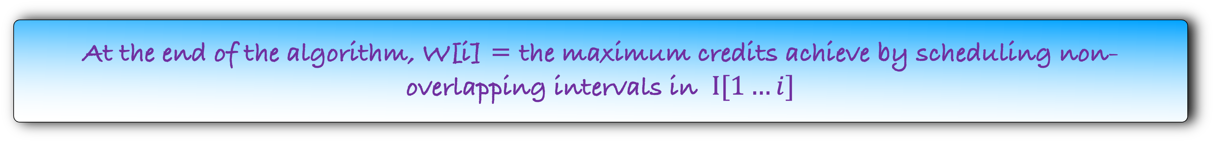
Sort the intervals according their ending times
def w$eightedScheduling(n$):
if $n=1$:
return $credits[1]$
Let $j$ be the latest-ending interval that doesn’t
overlap with $I[n]$
w$eightedScheduling(n−1$):
return max
credits[$n$] + w$eightedScheduling$($j$)
def w$eightedScheduling(I[1,…,n]$):
$W[1] = credits[1]$
for $i=2$ to $n$:
At the end of the algorithm, W[i] = the maximum credits achieve by scheduling non-overlapping intervals in $I[1…i]$

Slide 16
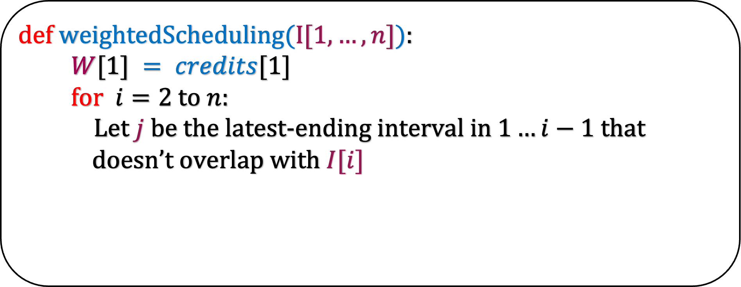
Sort the intervals according their ending times
def w$eightedScheduling(n$):
if $n=1$:
return $credits[1]$
Let $j$ be the latest-ending interval that doesn’t
overlap with $I[n]$
w$eightedScheduling(n−1$):
return max
credits[$n$] + w$eightedScheduling$($j$)
def w$eightedScheduling(I[1,…,n]$):
$W[1] = credits[1]$
for $i=2$ to $n$:
Let $j$ be the latest-ending interval in $1…i−1$ that
doesn’t overlap with $I[i]$
At the end of the algorithm, W[i] = the maximum credits achieve by scheduling non-overlapping intervals in $I[1…i]$

Slide 17
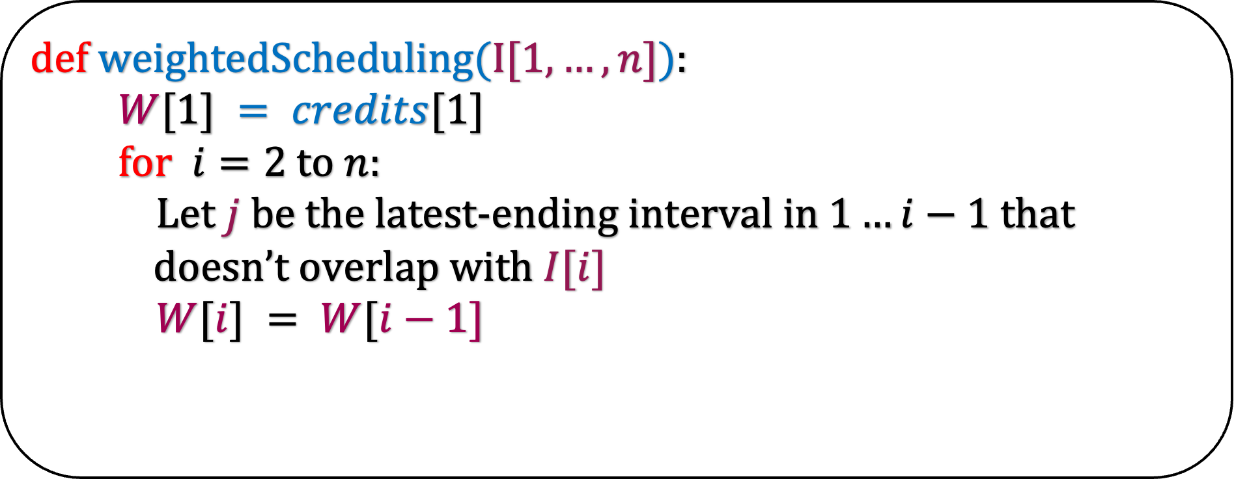
Sort the intervals according their ending times
def w$eightedScheduling(n$):
if $n=1$:
return $credits[1]$
Let $j$ be the latest-ending interval that doesn’t
overlap with $I[n]$
w$eightedScheduling(n−1$):
return max
credits[$n$] + w$eightedScheduling$($j$)
def w$eightedScheduling(I[1,…,n]$):
$W[1] = credits[1]$
for $i=2$ to $n$:
Let $j$ be the latest-ending interval in $1…i−1$ that
doesn’t overlap with $I[i]$
$W[i] = W[i−1]$
At the end of the algorithm, W[i] = the maximum credits achieve by scheduling non-overlapping intervals in $I[1…i]$

Slide 18
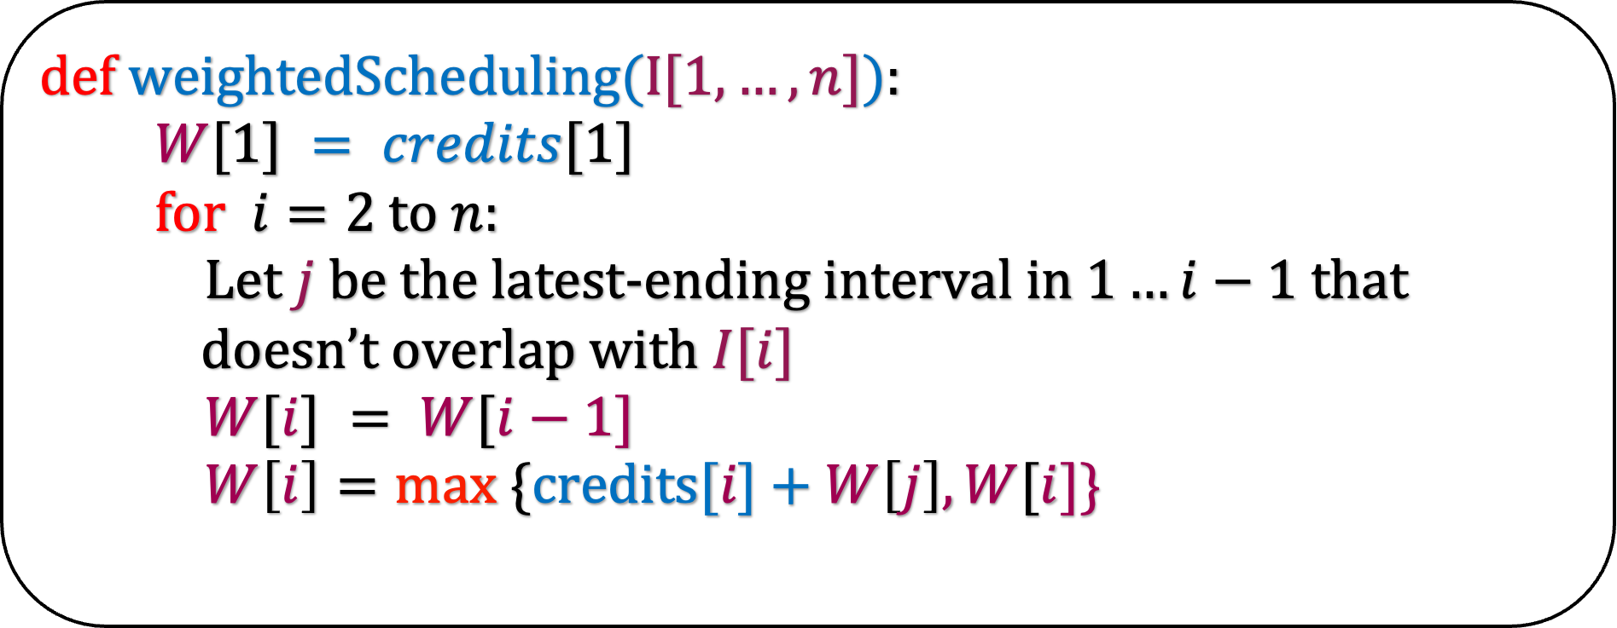
Sort the intervals according their ending times
def w$eightedScheduling(n$):
if $n=1$:
return $credits[1]$
Let $j$ be the latest-ending interval that doesn’t
overlap with $I[n]$
w$eightedScheduling(n−1$):
return max
credits[$n$] + w$eightedScheduling$($j$)
def w$eightedScheduling(I[1,…,n]$):
$W[1] = credits[1]$
for $i=2$ to $n$:
Let $j$ be the latest-ending interval in $1…i−1$ that
doesn’t overlap with $I[i]$
$W[i] = W[i−1]$
$W\left[i\right]=max ⁡\{\text{credits}\text{[}i\text{]}+W\left[j\right],W[i]\text{\}}$
At the end of the algorithm, W[i] = the maximum credits achieve by scheduling non-overlapping intervals in $I[1…i]$

Slide 19
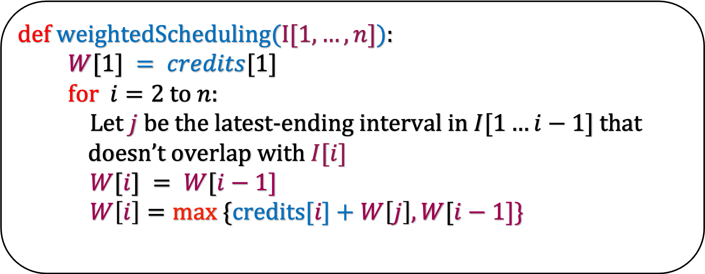
Sort the intervals according their ending times
def w$eightedScheduling(I[1,…,n]$):
$W[1] = credits[1]$
for $i=2$ to $n$:
Let $j$ be the latest-ending interval in $I[1…i−1]$ that
doesn’t overlap with $I[i]$
$W[i] = W[i−1]$
$W\left[i\right]=max ⁡\{\text{credits}\text{[}i\text{]}+W\left[j\right],W[i−1]\text{\}}$
The running time is clearly O(n log n)
For correctness try to prove the obvious.
Lemma: After the i-th iteration of our algorithm, W[i] stores max credits received from scheduling non-overlapping intervals in I[1...i]

