Slide 1
More Reductions

Slide 2
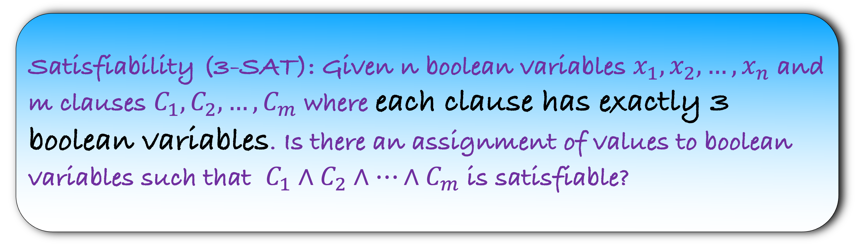
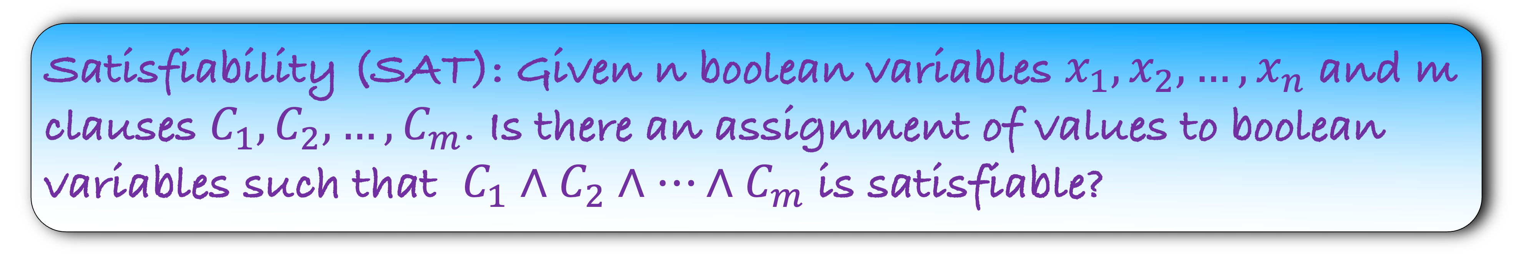
Satisfiability (SAT): Given n boolean variables $x_{1},x_{2},…,x_{n}$ and m clauses $C_{1},C_{2},…,C_{m}$. Is there an assignment of values to boolean variables such that $C_{1}∧C_{2}∧…∧C_{m}$ is satisfiable?
Satisfiability (3-SAT): Given n boolean variables $x_{1},x_{2},…,x_{n}$ and m clauses $C_{1},C_{2},…,C_{m}$ where each clause has exactly 3 boolean variables. Is there an assignment of values to boolean variables such that $C_{1}∧C_{2}∧…∧C_{m}$ is satisfiable?

Slide 3
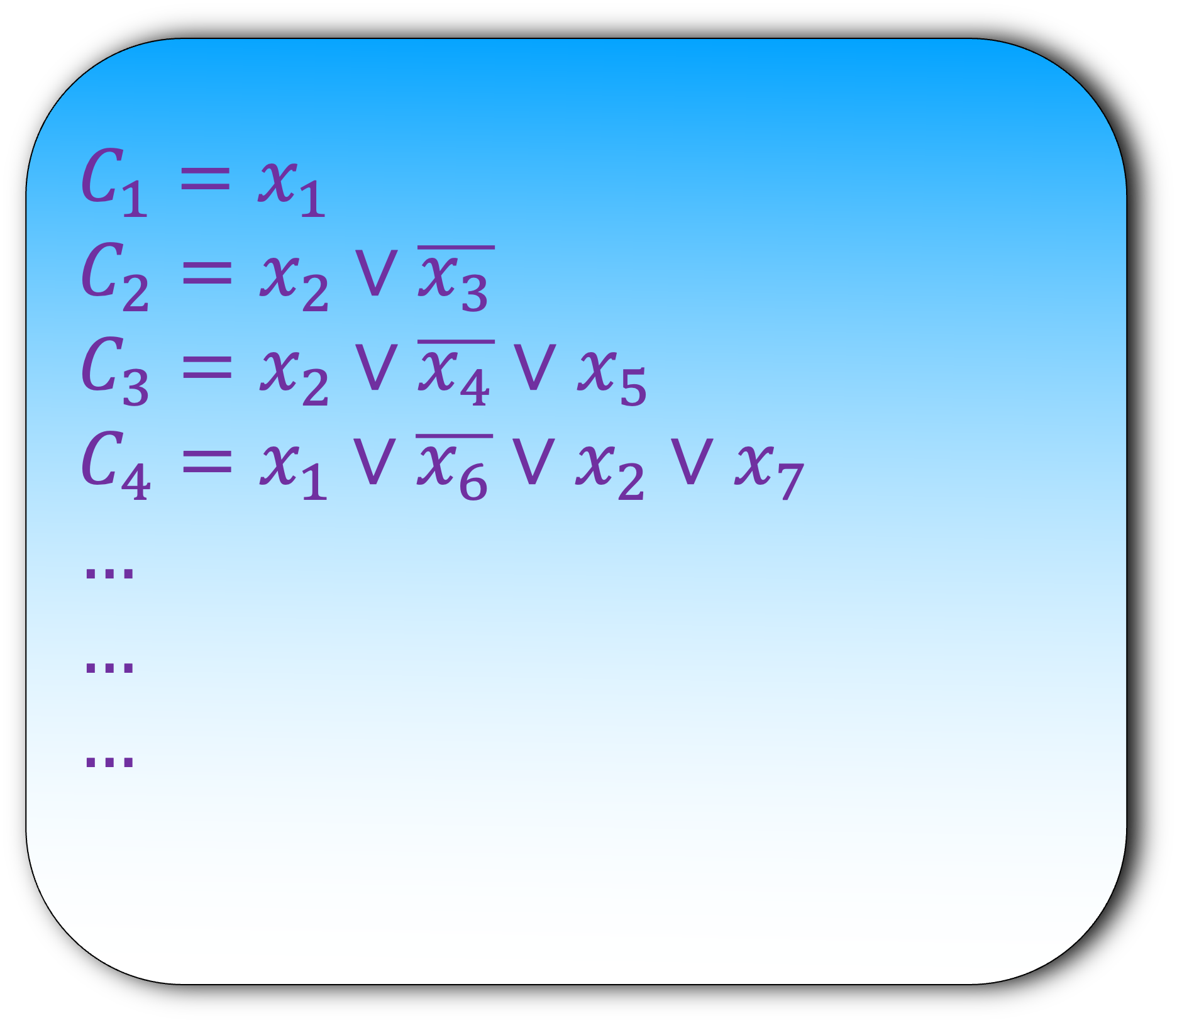

SAT $≤_{p}$ 3-SAT
$$C_{1}=x_{1}$$
$$C_{2}=x_{2}∨\overline{x_{3}}$$
$$C_{3}=x_{2}∨\overline{x_{4}}∨x_{5}$$
$$C_{4}=x_{1}∨\overline{x_{6}}∨x_{2}∨x_{7}$$
$$…$$
$$…$$
$$…$$
Step 1) Construct an instance of 3-SAT using an instance of SAT
How do you convert an instance of SAT to an equivalent 3-SAT instance?

Slide 4

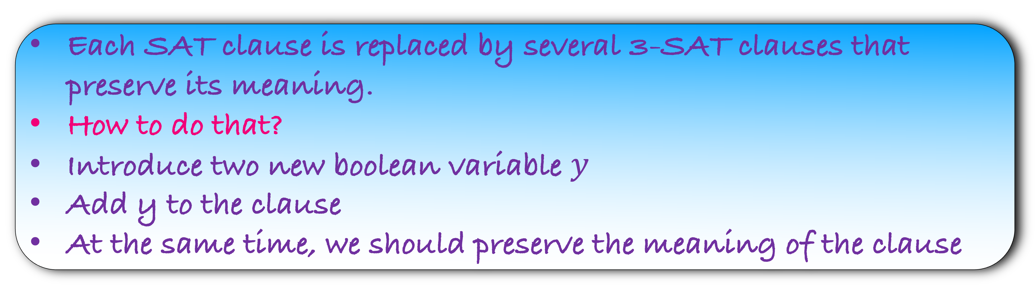
SAT $≤_{p}$ 3-SAT
$$C_{2}=x_{2}∨\overline{x_{3}}$$
Each SAT clause is replaced by several 3-SAT clauses that preserve its meaning.
How to do that?
Introduce two new boolean variable $y$
Add y to the clause
At the same time, we should preserve the meaning of the clause

Slide 5
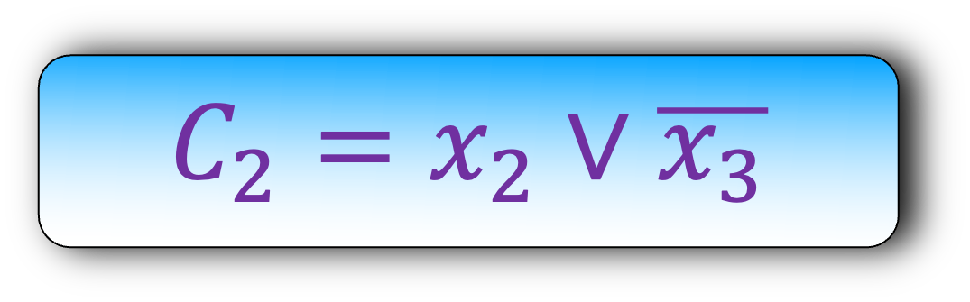
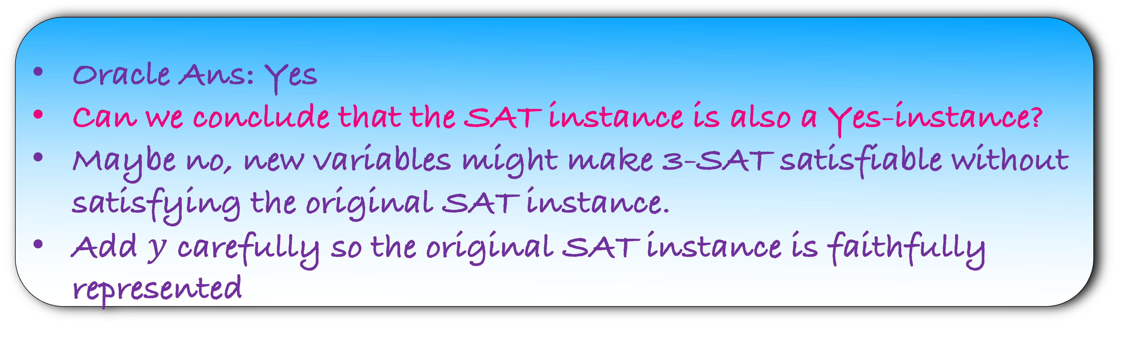
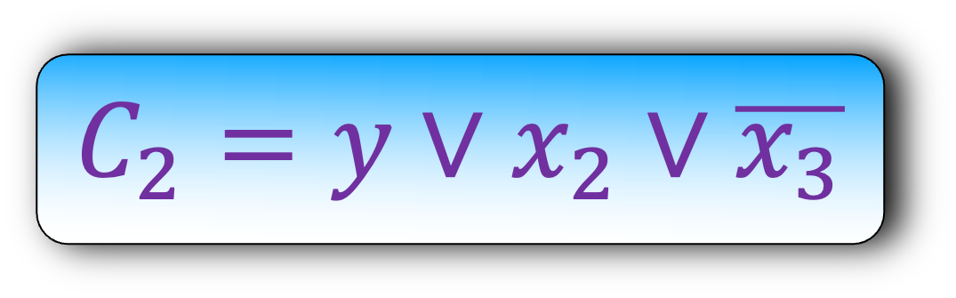
SAT $≤_{p}$ 3-SAT
$$C_{2}=x_{2}∨\overline{x_{3}}$$
$$C_{2}={y∨x}_{2}∨\overline{x_{3}}$$
Oracle Ans: Yes
Can we conclude that the SAT instance is also a Yes-instance?
Maybe no, new variables might make 3-SAT satisfiable without satisfying the original SAT instance.
Add $y$ carefully so the original SAT instance is faithfully represented

Slide 6
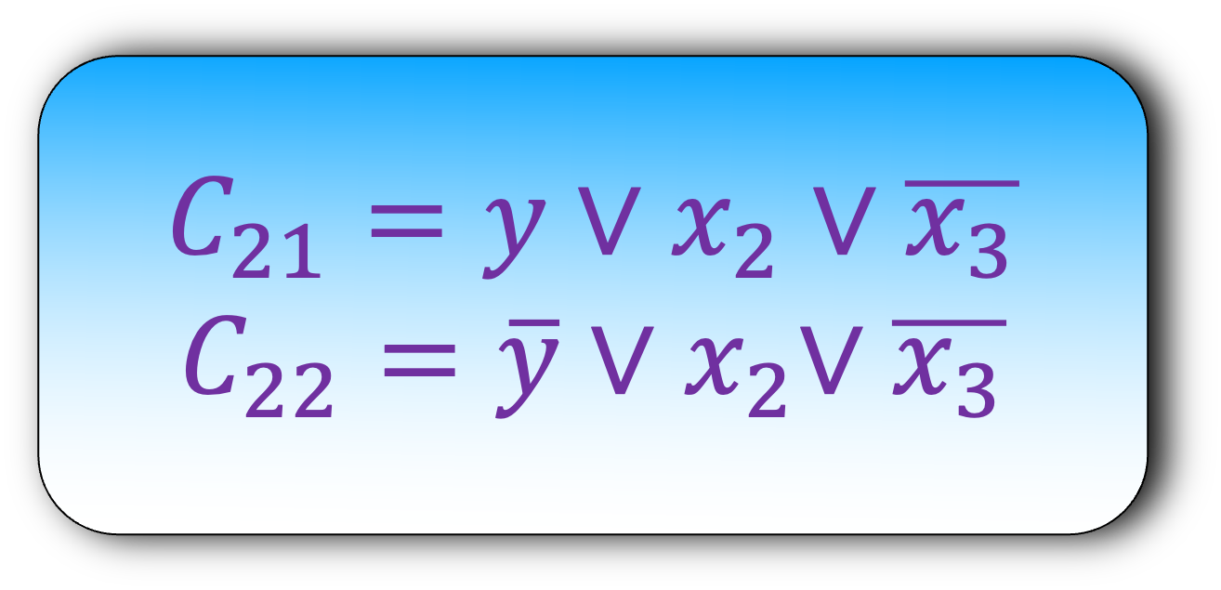
SAT $≤_{p}$ 3-SAT
$$C_{21}={y∨x}_{2}∨\overline{x_{3}}$$
$$C_{22}=\overline{y}{∨x}_{2}∨\overline{x_{3}}$$
$$C_{2}=x_{2}∨\overline{x_{3}}$$
Oracle Ans: Yes
Can we conclude that the SAT instance is also a Yes-instance?
Yes, now the variable y is irrelevant in the 3-SAT instance

Slide 7


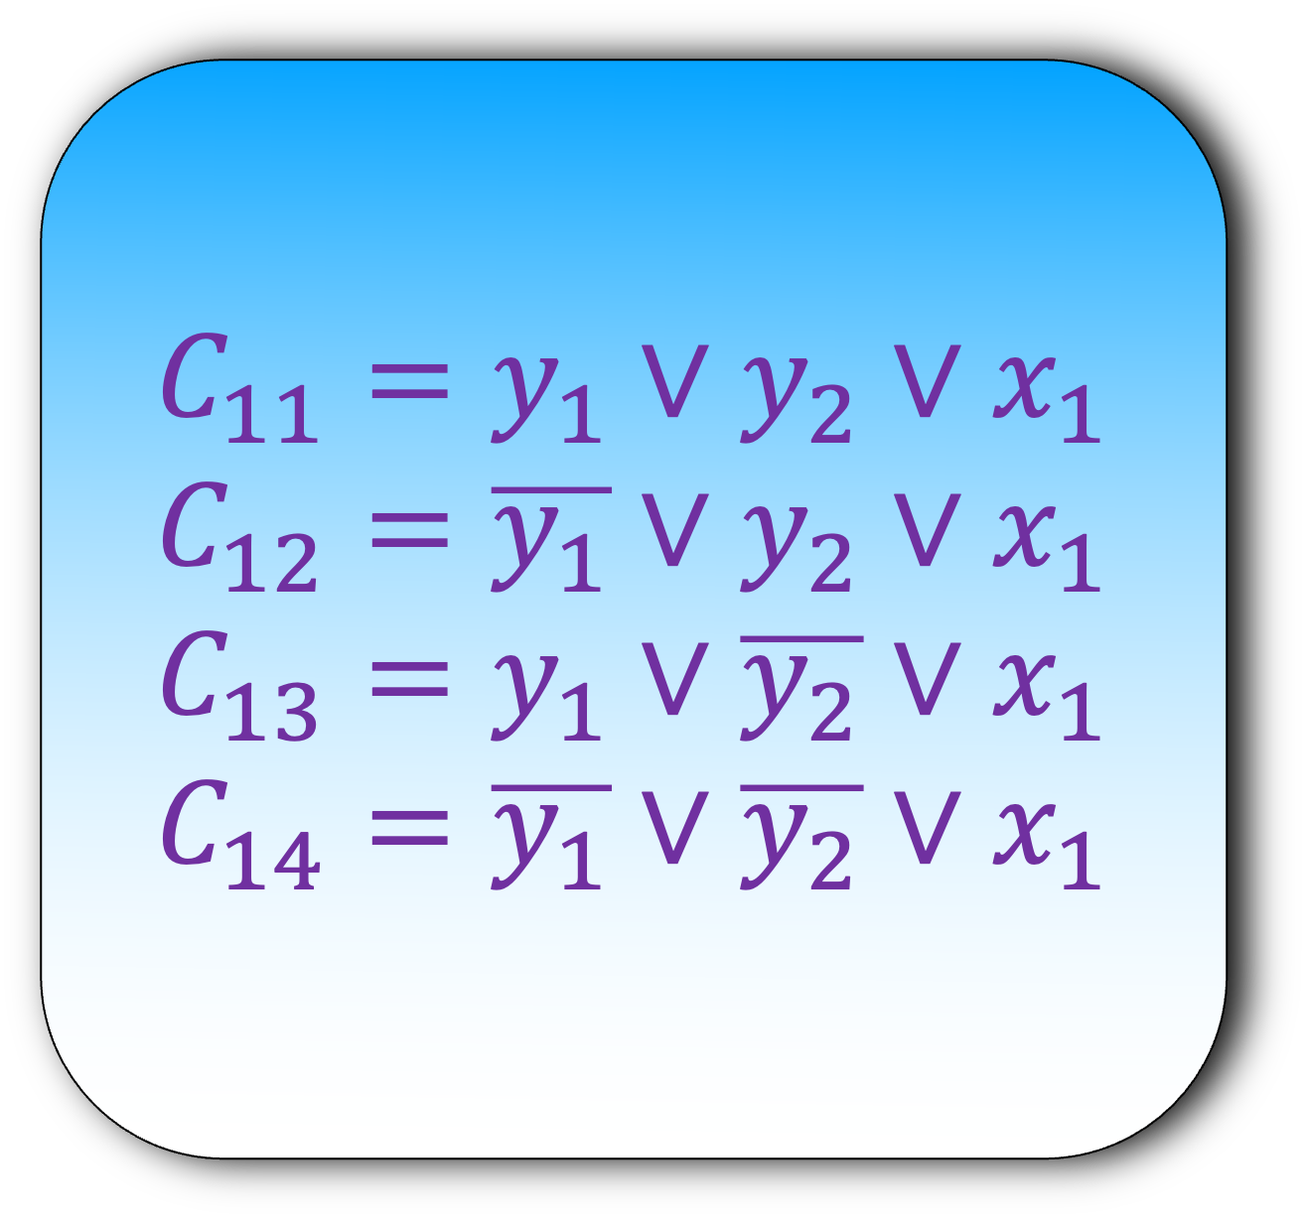
SAT $≤_{p}$ 3-SAT
$$C_{11}={y_{1}∨y}_{2}∨x_{1}$$
$$C_{12}={\overline{y_{1}}∨y}_{2}∨x_{1}$$
$$C_{13}=y_{1}∨\overline{y_{2}}∨x_{1}$$
$$C_{14}=\overline{y_{1}}∨\overline{y_{2}}∨x_{1}$$
$$C_{1}=x_{1}$$
Use two new Boolean variables $y_{1},y_{2}$

Slide 8
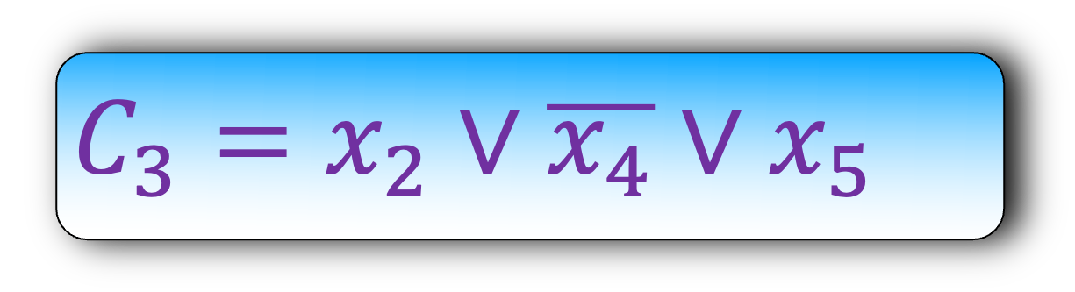

SAT $≤_{p}$ 3-SAT
$$C_{3}=x_{2}∨\overline{x_{4}}∨x_{5}$$
$$C_{3}=x_{2}∨\overline{x_{4}}∨x_{5}$$

Slide 9
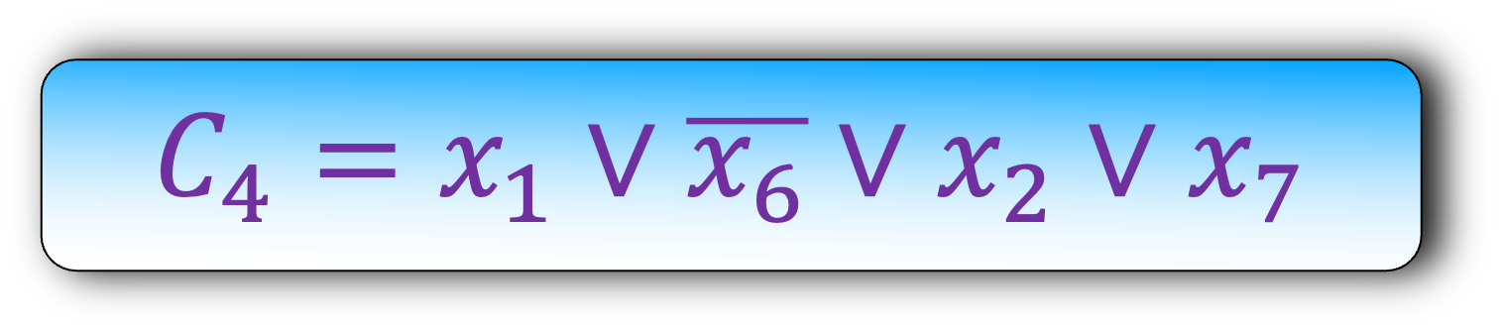

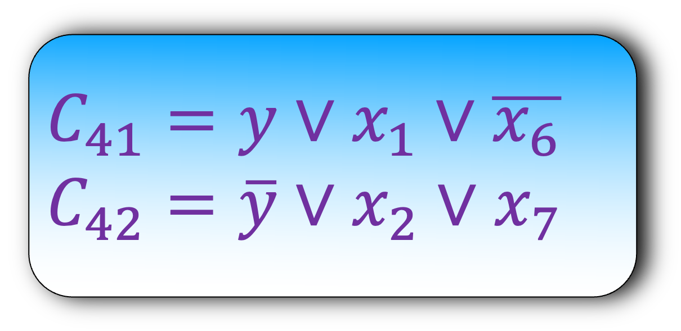
SAT $≤_{p}$ 3-SAT
$$C_{41}=y∨x_{1}∨\overline{x_{6}}$$
$$C_{42}=\overline{y}∨x_{2}∨x_{7}$$
$$C_{4}=x_{1}∨\overline{x_{6}}∨x_{2}∨x_{7}$$
Use one new Boolean variables $y$

Slide 10
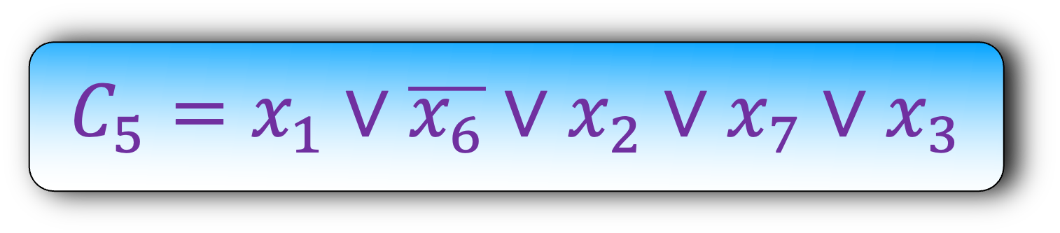
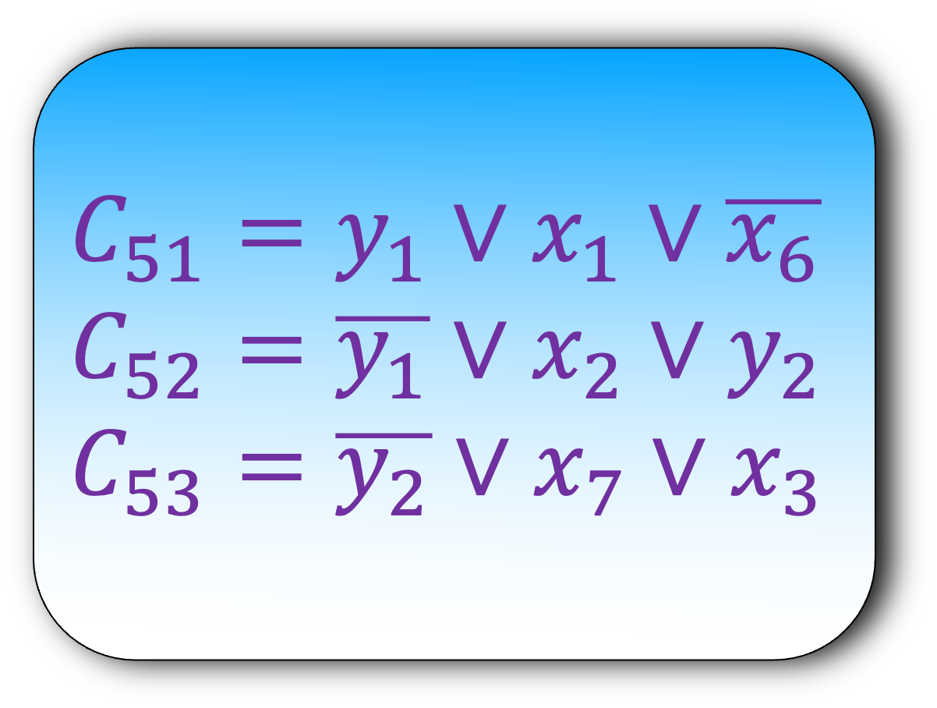
SAT $≤_{p}$ 3-SAT
$$C_{51}=y_{1}∨x_{1}∨\overline{x_{6}}$$
$$C_{52}=\overline{y_{1}}∨x_{2}∨y_{2}$$
$$C_{53}=\overline{y_{2}}∨x_{7}∨x_{3}$$
$$C_{5}=x_{1}∨\overline{x_{6}}∨x_{2}∨x_{7}∨x_{3}$$
Use two new Boolean variables $y_{1},y_{2}$

Slide 11
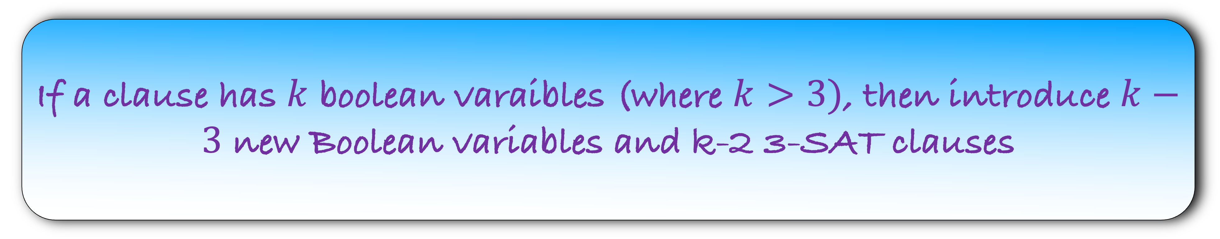
SAT $≤_{p}$ 3-SAT
If a clause has $k$ boolean varaibles (where $k>3)$, then introduce $k−3$ new Boolean variables and k-2 3-SAT clauses

Slide 12
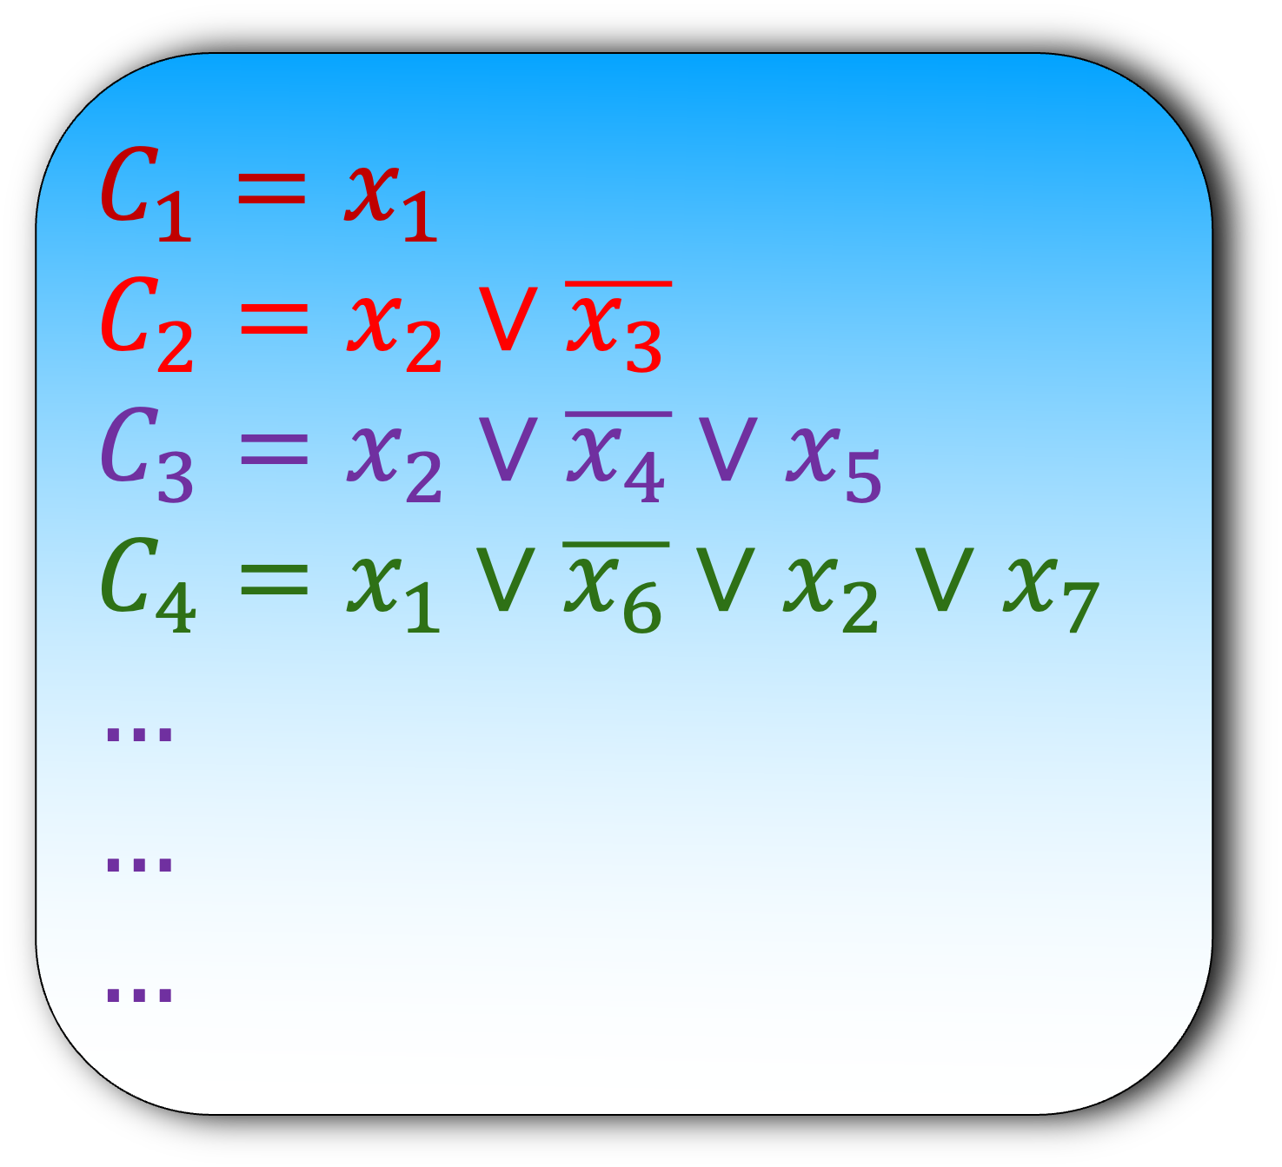
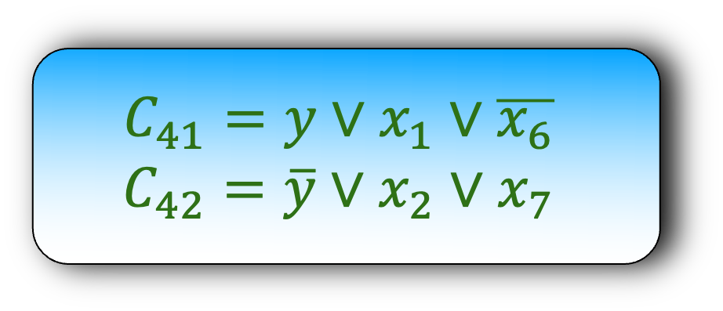
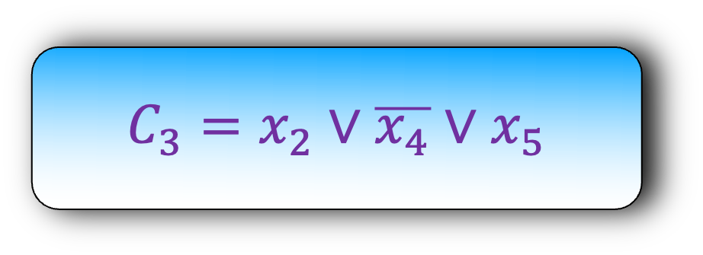
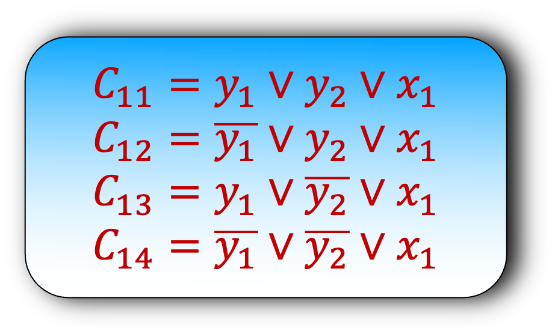
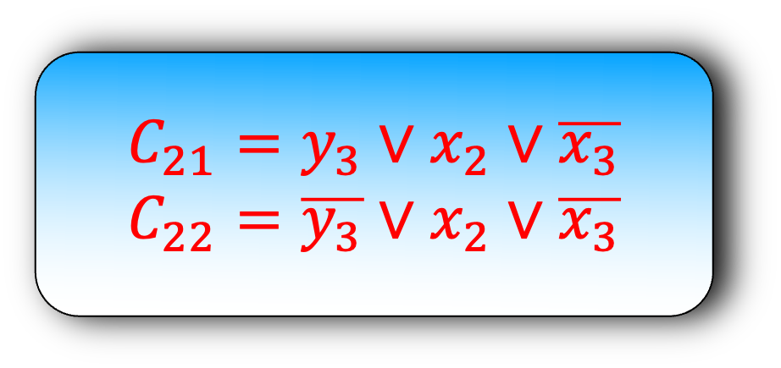
SAT $≤_{p}$ 3-SAT
$$C_{11}={y_{1}∨y}_{2}∨x_{1}$$
$$C_{12}={\overline{y_{1}}∨y}_{2}∨x_{1}$$
$$C_{13}=y_{1}∨\overline{y_{2}}∨x_{1}$$
$$C_{14}=\overline{y_{1}}∨\overline{y_{2}}∨x_{1}$$
$$C_{1}=x_{1}$$
$$C_{2}=x_{2}∨\overline{x_{3}}$$
$$C_{3}=x_{2}∨\overline{x_{4}}∨x_{5}$$
$$C_{4}=x_{1}∨\overline{x_{6}}∨x_{2}∨x_{7}$$
$$…$$
$$…$$
$$…$$
Step 2) Assume that an oracle solves the 3-SAT instance
$$C_{21}={y_{3}∨x}_{2}∨\overline{x_{3}}$$
$$C_{22}={\overline{y_{3}}∨x}_{2}∨\overline{x_{3}}$$
$$C_{3}=x_{2}∨\overline{x_{4}}∨x_{5}$$
$$C_{41}=y∨x_{1}∨\overline{x_{6}}$$
$$C_{42}=\overline{y}∨x_{2}∨x_{7}$$
Is this 3-SAT instance satisfiable?

Slide 13
SAT $≤_{p}$ 3-SAT
$$C_{11}={y_{1}∨y}_{2}∨x_{1}$$
$$C_{12}={\overline{y_{1}}∨y}_{2}∨x_{1}$$
$$C_{13}=y_{1}∨\overline{y_{2}}∨x_{1}$$
$$C_{14}=\overline{y_{1}}∨\overline{y_{2}}∨x_{1}$$
$$C_{1}=x_{1}$$
$$C_{2}=x_{2}∨\overline{x_{3}}$$
$$C_{3}=x_{2}∨\overline{x_{4}}∨x_{5}$$
$$C_{4}=x_{1}∨\overline{x_{6}}∨x_{2}∨x_{7}$$
$$…$$
$$…$$
$$…$$
Step 3) Recover the SAT answer using 3-SAT answer
$$C_{21}={y_{3}∨x}_{2}∨\overline{x_{3}}$$
$$C_{22}={\overline{y_{3}}∨x}_{2}∨\overline{x_{3}}$$
$$C_{3}=x_{2}∨\overline{x_{4}}∨x_{5}$$
$$C_{41}=y∨x_{1}∨\overline{x_{6}}$$
$$C_{42}=\overline{y}∨x_{2}∨x_{7}$$
If the oracle says Yes, then the answer to our SAT instance is Yes, else no

Slide 14
SAT $≤_{p}$ 3-SAT
$$C_{11}={y_{1}∨y}_{2}∨x_{1}$$
$$C_{12}={\overline{y_{1}}∨y}_{2}∨x_{1}$$
$$C_{13}=y_{1}∨\overline{y_{2}}∨x_{1}$$
$$C_{14}=\overline{y_{1}}∨\overline{y_{2}}∨x_{1}$$
$$C_{1}=x_{1}$$
$$C_{2}=x_{2}∨\overline{x_{3}}$$
$$C_{3}=x_{2}∨\overline{x_{4}}∨x_{5}$$
$$C_{4}=x_{1}∨\overline{x_{6}}∨x_{2}∨x_{7}$$
$$…$$
$$…$$
$$…$$
Step 4) Prove that your answer is correct
$$C_{21}={y_{3}∨x}_{2}∨\overline{x_{3}}$$
$$C_{22}={\overline{y_{3}}∨x}_{2}∨\overline{x_{3}}$$
$$C_{3}=x_{2}∨\overline{x_{4}}∨x_{5}$$
$$C_{41}=y∨x_{1}∨\overline{x_{6}}$$
$$C_{42}=\overline{y}∨x_{2}∨x_{7}$$
Lemma: There is a satisfiable SAT assignment, iff there is a satisfiable 3-SAT assignment

Slide 15

Lemma: If there is a satisfiable SAT assignment, then there is a satisfiable 3-SAT assignment
$$C_{11}={y_{1}∨y}_{2}∨x_{1}$$
$$C_{12}={\overline{y_{1}}∨y}_{2}∨x_{1}$$
$$C_{13}=y_{1}∨\overline{y_{2}}∨x_{1}$$
$$C_{14}=\overline{y_{1}}∨\overline{y_{2}}∨x_{1}$$
$$C_{1}=x_{1}$$
$$C_{2}=x_{2}∨\overline{x_{3}}$$
$$C_{3}=x_{3}∨\overline{x_{4}}∨x_{5}$$
$$C_{4}=x_{1}∨\overline{x_{6}}∨x_{2}∨x_{7}$$
$$…$$
$$…$$
$$…$$
1
1
1
1
1
1
1
$$C_{21}={y_{3}∨x}_{2}∨\overline{x_{3}}$$
$$C_{22}={\overline{y_{3}}∨x}_{2}∨\overline{x_{3}}$$
1
$$C_{3}=x_{2}∨\overline{x_{4}}∨x_{5}$$
$$C_{41}=y∨x_{1}∨\overline{x_{6}}$$
$$C_{42}=\overline{y}∨x_{2}∨x_{7}$$
Start with a SAT assignment and build a satisfiable 3-SAT assignment using it.

Slide 16

Lemma: If there is a satisfiable SAT assignment, then there is a satisfiable 3-SAT assignment
$$C_{11}={y_{1}∨y}_{2}∨x_{1}$$
$$C_{12}={\overline{y_{1}}∨y}_{2}∨x_{1}$$
$$C_{13}=y_{1}∨\overline{y_{2}}∨x_{1}$$
$$C_{14}=\overline{y_{1}}∨\overline{y_{2}}∨x_{1}$$
$$C_{1}=x_{1}$$
$$C_{2}=x_{2}∨\overline{x_{3}}$$
$$C_{3}=x_{2}∨\overline{x_{4}}∨x_{5}$$
$$C_{4}=x_{1}∨\overline{x_{6}}∨x_{2}∨x_{7}$$
$$…$$
$$…$$
$$…$$
1
1
1
1
$$C_{21}={y_{3}∨x}_{2}∨\overline{x_{3}}$$
$$C_{22}={\overline{y_{3}}∨x}_{2}∨\overline{x_{3}}$$
1
1
$$C_{3}=x_{2}∨\overline{x_{4}}∨x_{5}$$
1
What about clause $C_{41}$?
$$C_{41}=y∨x_{1}∨\overline{x_{6}}$$
$$C_{42}=\overline{y}∨x_{2}∨x_{7}$$
1
Start with a SAT assignment and build a satisfiable 3-SAT assignment using it.

Slide 17
Lemma: If there is a satisfiable SAT assignment, then there is a satisfiable 3-SAT assignment
$$C_{11}={y_{1}∨y}_{2}∨x_{1}$$
$$C_{12}={\overline{y_{1}}∨y}_{2}∨x_{1}$$
$$C_{13}=y_{1}∨\overline{y_{2}}∨x_{1}$$
$$C_{14}=\overline{y_{1}}∨\overline{y_{2}}∨x_{1}$$
$$C_{1}=x_{1}$$
$$C_{2}=x_{2}∨\overline{x_{3}}$$
$$C_{3}=x_{2}∨\overline{x_{4}}∨x_{5}$$
$$C_{4}=x_{1}∨\overline{x_{6}}∨x_{2}∨x_{7}$$
$$…$$
$$…$$
$$…$$
1
1
1
1
$$C_{21}={y_{3}∨x}_{2}∨\overline{x_{3}}$$
$$C_{22}={\overline{y_{3}}∨x}_{2}∨\overline{x_{3}}$$
1
1
$$C_{3}=x_{2}∨\overline{x_{4}}∨x_{5}$$
1
$$C_{41}=y∨x_{1}∨\overline{x_{6}}$$
$$C_{42}=\overline{y}∨x_{2}∨x_{7}$$
1
1
Start with a SAT assignment and build a satisfiable 3-SAT assignment using it.

Slide 18

$$C_{51}=y_{1}∨\overline{x_{4}}∨x_{5}$$
$$C_{52}=\overline{y_{1}}∨x_{2}∨y_{2}$$
$$C_{53}=\overline{y_{2}}∨x_{7}∨x_{3}$$
$$C_{5}=x_{1}∨\overline{x_{6}}∨x_{2}∨x_{7}∨x_{3}$$

Slide 19
$$C_{51}=y_{1}∨x_{1}∨\overline{x_{6}}$$
$$C_{52}=\overline{y_{1}}∨x_{2}∨y_{2}$$
$$C_{53}=\overline{y_{2}}∨x_{7}∨x_{3}$$
$$C_{5}=x_{1}∨\overline{x_{6}}∨x_{2}∨x_{7}∨x_{3}$$
1

Slide 20
$$C_{51}=y_{1}∨\overline{x_{4}}∨x_{5}$$
$$C_{52}=\overline{y_{1}}∨x_{2}∨y_{2}$$
$$C_{53}=\overline{y_{2}}∨x_{7}∨x_{3}$$
$$C_{5}=x_{1}∨\overline{x_{6}}∨x_{2}∨x_{7}∨x_{3}$$
1

Slide 21
$$C_{51}=y_{1}∨\overline{x_{4}}∨x_{5}$$
$$C_{52}=\overline{y_{1}}∨x_{2}∨y_{2}$$
$$C_{53}=\overline{y_{2}}∨x_{7}∨x_{3}$$
$$C_{5}=x_{1}∨\overline{x_{6}}∨x_{2}∨x_{7}∨x_{3}$$
1
1
1

Slide 22

Lemma: If there is a satisfiable SAT assignment, then there is a satisfiable 3-SAT assignment
Lemma(HW): If a 3-SAT instance is satisfiable, then the original SAT instance is also satisfiable.
SAT $≤_{p}$ 3-SAT

Slide 23
Even More Reductions

Slide 24
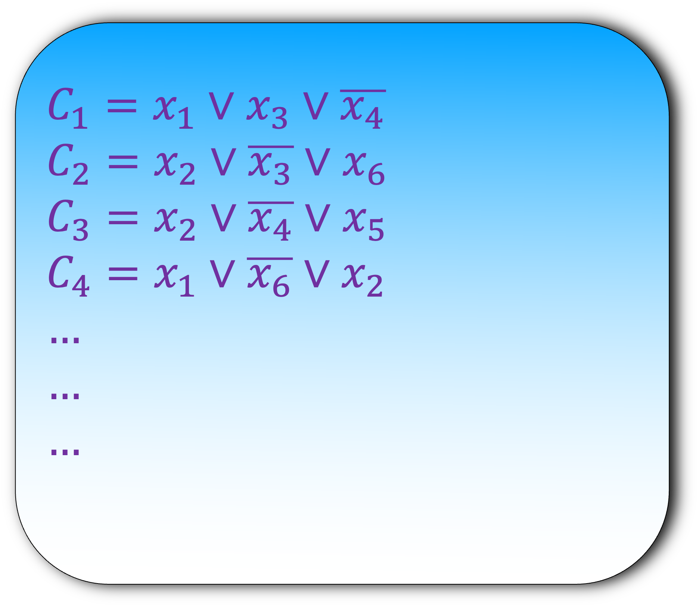

3-SAT $≤_{p}$ Independent Set
$$C_{1}=x_{1}∨x_{3}∨\overline{x_{4}}$$
$$C_{2}=x_{2}∨\overline{x_{3}}∨x_{6}$$
$$C_{3}=x_{2}∨\overline{x_{4}}∨x_{5}$$
$$C_{4}=x_{1}∨\overline{x_{6}}∨x_{2}$$
$$…$$
$$…$$
$$…$$
Step 1) Construct a graph using an instance of 3-SAT
How to do that?

Slide 25
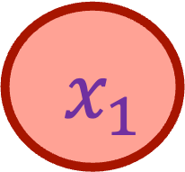
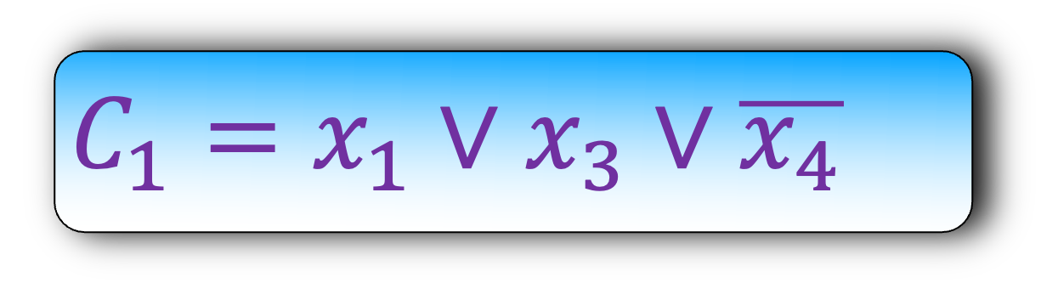
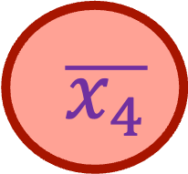

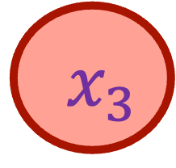
Imagine if there was only one clause
$x_{1}$
$x_{3}$
$$C_{1}=x_{1}∨x_{3}∨\overline{x_{4}}$$
$\overline{x_{4}}$
Is there an independent set of size $≥1$?
If the oracle says yes, then the answer to 3-SAT is yes

Slide 26

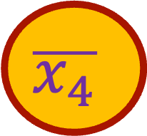
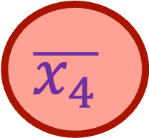
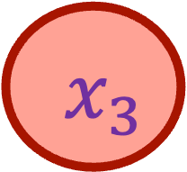
Lemma: If there is an independent set of size 1, then there is a satisfiable assignment
$x_{1}$
$x_{3}$
$$C_{1}=x_{1}∨x_{3}∨\overline{x_{4}}$$
$$\overline{x_{4}}$$
$$\overline{x_{4}}$$

Slide 27
Lemma: If there is an independent set of size 1, then there is a satisfiable assignment
$x_{1}$
$x_{3}$
$$C_{1}=x_{1}∨x_{3}∨\overline{x_{4}}$$
1
$$\overline{x_{4}}$$
$$\overline{x_{4}}$$

Slide 28
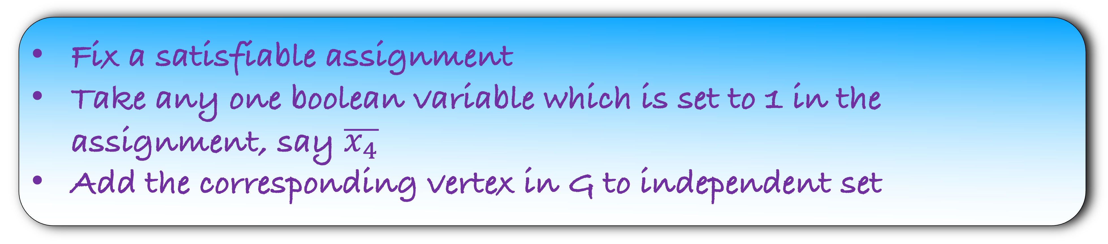
Lemma: If there is a satisfiable assignment, then there is an independent set of size 1
$x_{1}$
$x_{3}$
$$C_{1}=x_{1}∨x_{3}∨\overline{x_{4}}$$
1
0
1
$$\overline{x_{4}}$$
Fix a satisfiable assignment
Take any one boolean variable which is set to 1 in the assignment, say $\overline{x_{4}}$
Add the corresponding vertex in G to independent set

Slide 29
Lemma: If there is a satisfiable assignment, then there is an independent set of size 1
$x_{1}$
$x_{3}$
$$C_{1}=x_{1}∨x_{3}∨\overline{x_{4}}$$
1
0
1
$$\overline{x_{4}}$$
$$\overline{x_{4}}$$

Slide 30
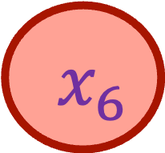
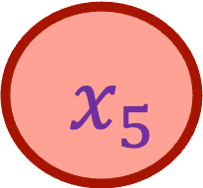
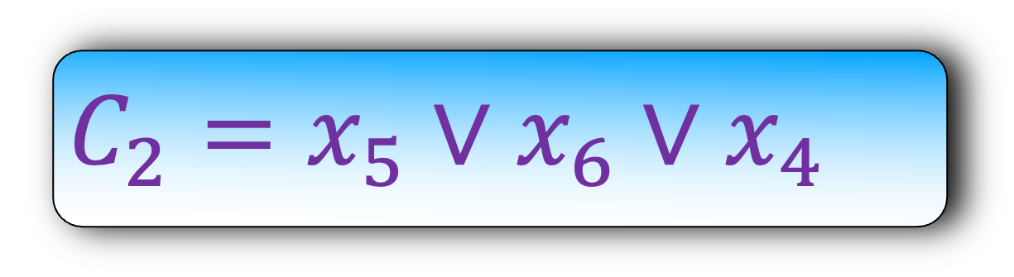
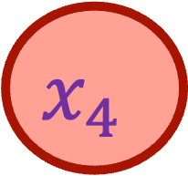
Lemma: If there is a satisfiable assignment, then there is an independent set of size 1
$x_{1}$
$x_{3}$
$$C_{1}=x_{1}∨x_{3}∨\overline{x_{4}}$$
$$\overline{x_{4}}$$
$x_{5}$
$x_{6}$
$$C_{2}=x_{5}∨x_{6}∨x_{4}$$
$$x_{4}$$

Slide 31

Lemma: If there is a satisfiable assignment, then there is an independent set of size 1
$x_{1}$
$x_{3}$
$$C_{1}=x_{1}∨x_{3}∨\overline{x_{4}}$$
$$\overline{x_{4}}$$
$x_{5}$
$x_{6}$
$$C_{2}=x_{5}∨x_{6}∨x_{4}$$
Is there an independent set of size $≥2$?
$$x_{4}$$
If the oracle says yes, then the answer to 3-SAT is yes

Slide 32
Lemma: If there is an independent set of size 2, then there is a satisfiable assignment
$x_{1}$
$x_{3}$
$$C_{1}=x_{1}∨x_{3}∨\overline{x_{4}}$$
$$\overline{x_{4}}$$
$x_{5}$
$x_{6}$
$$C_{2}=x_{5}∨x_{6}∨x_{4}$$
$$x_{4}$$

Slide 33

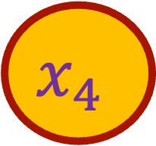
Lemma: If there is an independent set of size 2, then there is a satisfiable assignment
$x_{1}$
$x_{3}$
$$C_{1}=x_{1}∨x_{3}∨\overline{x_{4}}$$
$$\overline{x_{4}}$$
$$\overline{x_{4}}$$
So, what should we do?
$x_{5}$
$x_{6}$
$$C_{2}=x_{5}∨x_{6}∨x_{4}$$
$$x_{4}$$
We cannot set $x_{4}$ and $\overline{x_{4}}$ to 1 in our answer
Somehow, we should not allow such answers
$$x_{4}$$

Slide 34
Lemma: If there is an independent set of size 2, then there is a satisfiable assignment
$x_{1}$
$x_{3}$
$$C_{1}=x_{1}∨x_{3}∨\overline{x_{4}}$$
$$\overline{x_{4}}$$
$x_{5}$
$x_{6}$
$$C_{2}=x_{5}∨x_{6}∨x_{4}$$
$$x_{4}$$

Slide 35
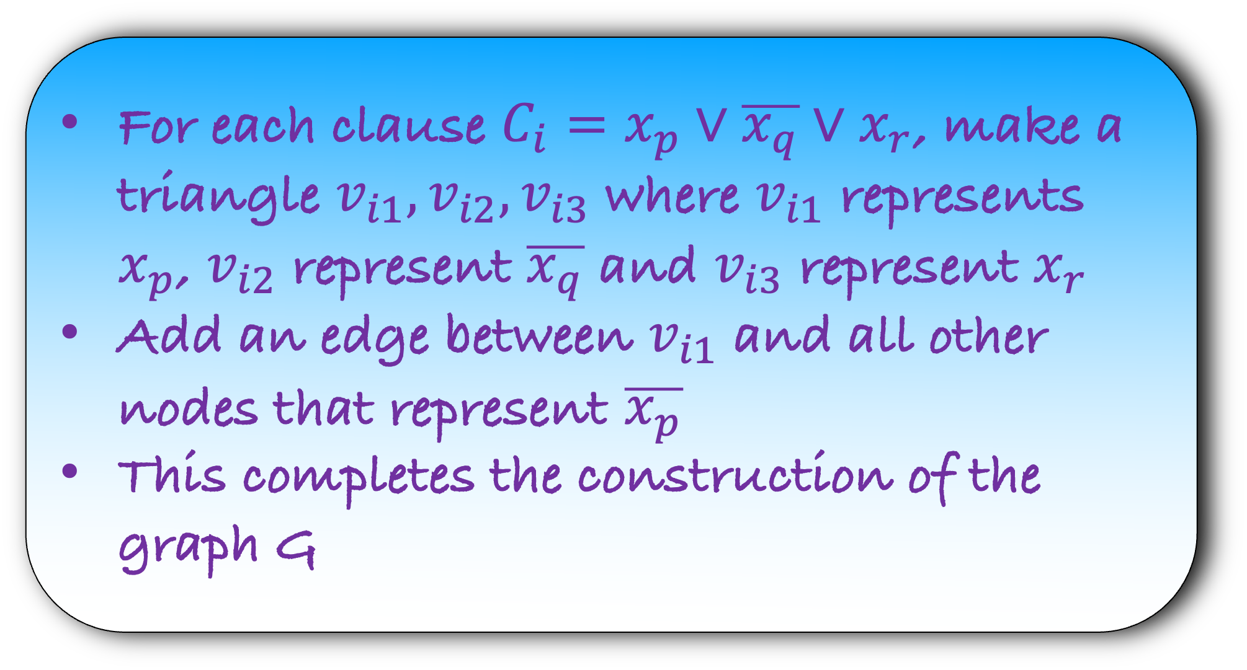
3-SAT $≤_{p}$ Independent Set
$$C_{1}=x_{1}∨x_{3}∨\overline{x_{4}}$$
$$C_{2}=x_{2}∨\overline{x_{3}}∨x_{6}$$
$$C_{3}=x_{2}∨\overline{x_{4}}∨x_{5}$$
$$C_{4}=x_{1}∨\overline{x_{6}}∨x_{2}$$
$$…$$
$$…$$
$$…$$
Step 1) Construct a graph using an instance of 3-SAT
For each clause $C_{i}=x_{p}∨\overline{x_{q}}∨x_{r}$, make a triangle $v_{i1},v_{i2},v_{i3}$ where $v_{i1}$ represents $x_{p}$, $v_{i2}$ represent $\overline{x_{q}}$ and $v_{i3}$ represent $x_{r}$
Add an edge between $v_{i1}$ and all other nodes that represent $\overline{x_{p}}$
This completes the construction of the graph G

Slide 36
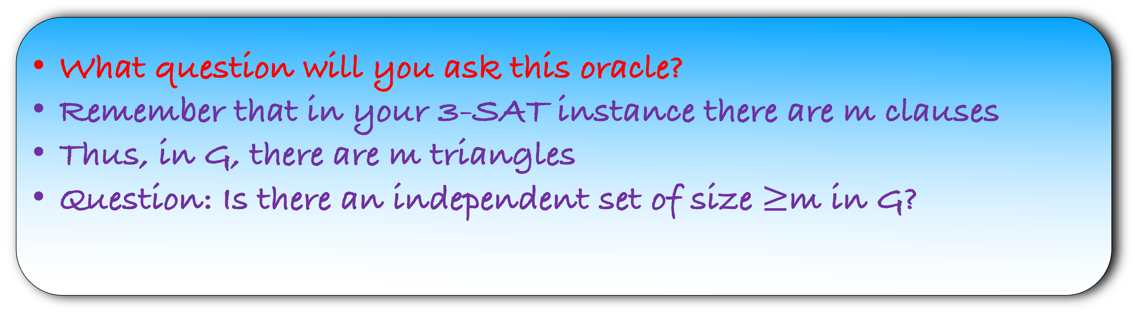
3-SAT $≤_{p}$ Independent Set
Step 2) Assume that an oracle solves the Independent Set instance
What question will you ask this oracle?
Remember that in your 3-SAT instance there are m clauses
Thus, in G, there are m triangles
Question: Is there an independent set of size $≥$m in G?

Slide 37
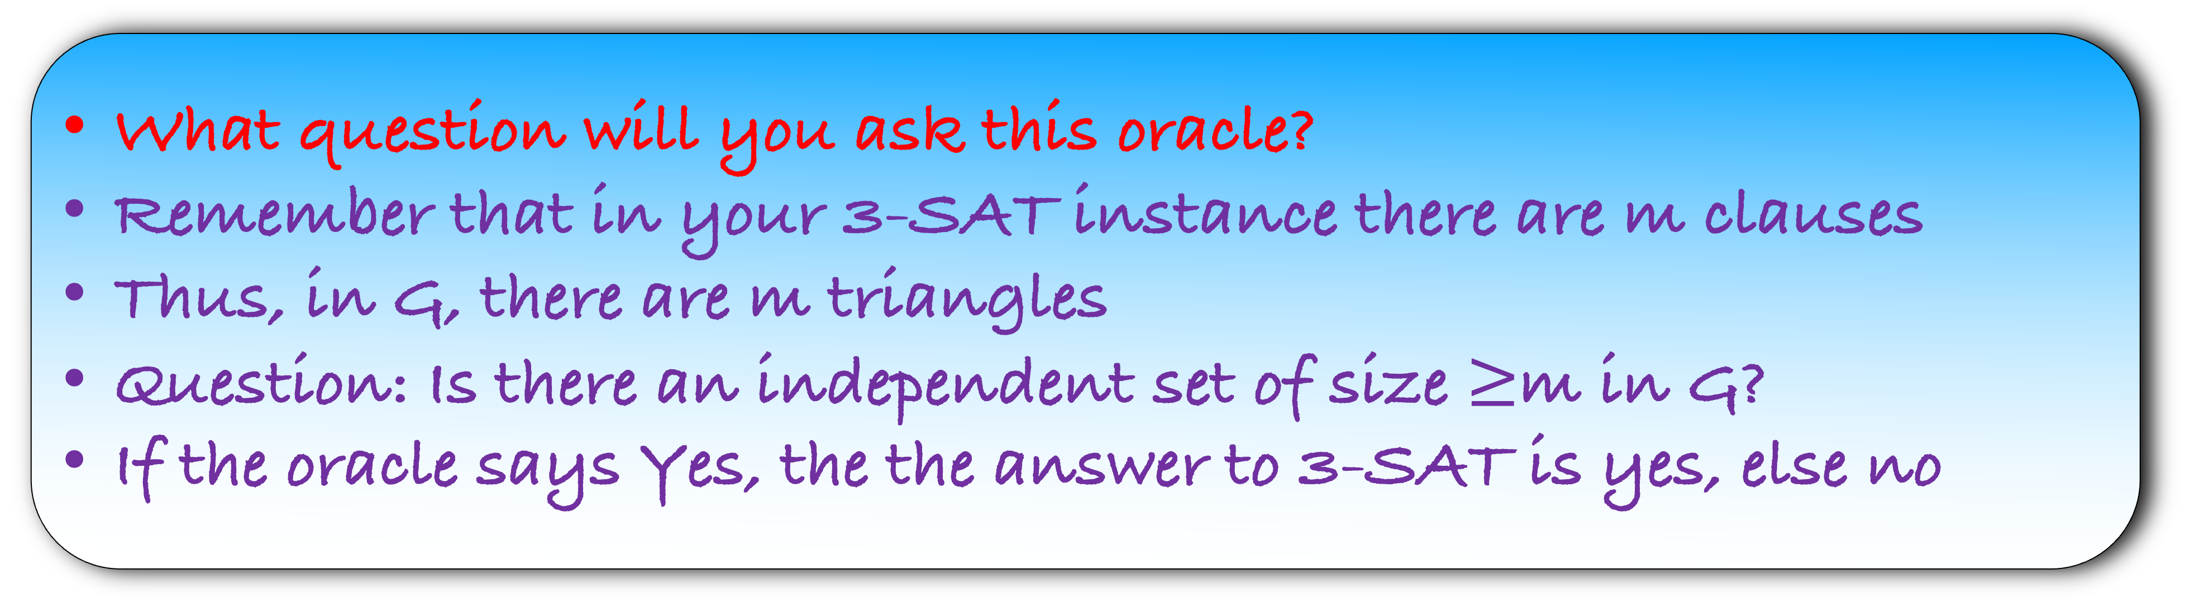
3-SAT $≤_{p}$ Independent Set
Step 3) Recover the 3-SAT answer using Independent Set answer
What question will you ask this oracle?
Remember that in your 3-SAT instance there are m clauses
Thus, in G, there are m triangles
Question: Is there an independent set of size $≥$m in G?
If the oracle says Yes, the the answer to 3-SAT is yes, else no

Slide 38
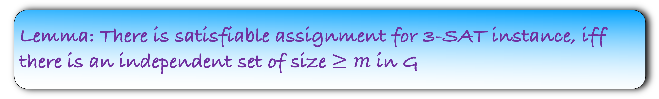
3-SAT $≤_{p}$ Independent Set
Step 4) Prove that your answer is correct
Lemma: There is satisfiable assignment for 3-SAT instance, iff there is an independent set of size $≥m$ in G

Slide 39
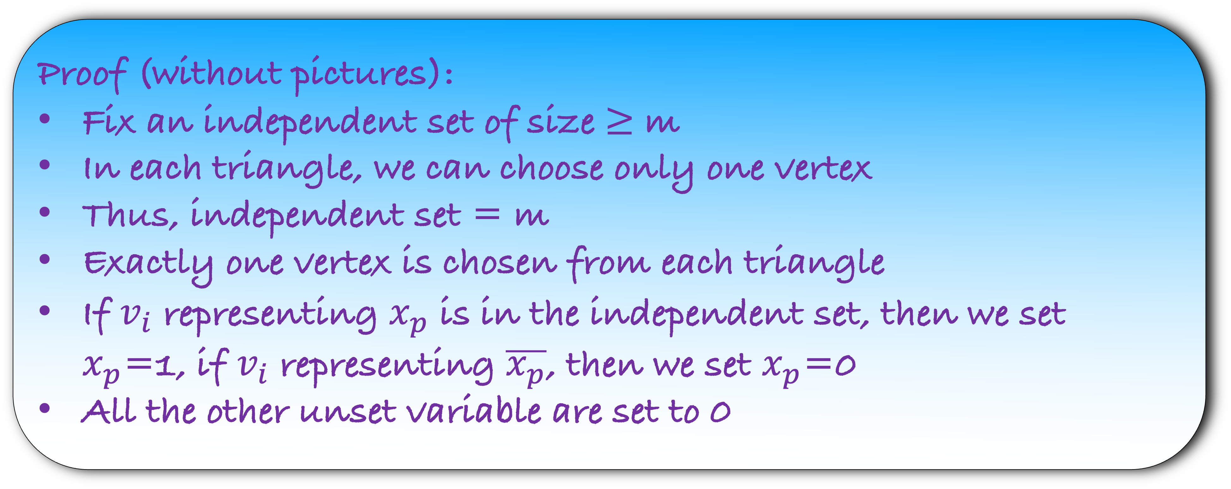

Lemma: If there is an independent set of size $≥m$ in G, then there is satisfiable assignment for 3-SAT instance
Proof (without pictures):
Fix an independent set of size $≥$ m
In each triangle, we can choose only one vertex
Thus, independent set = m
Exactly one vertex is chosen from each triangle
If $v_{i}$ representing $x_{p}$ is in the independent set, then we set $x_{p}$=1, if $v_{i}$ representing $\overline{x_{p}}$, then we set $x_{p}$=0
All the other unset variable are set to 0

Slide 40
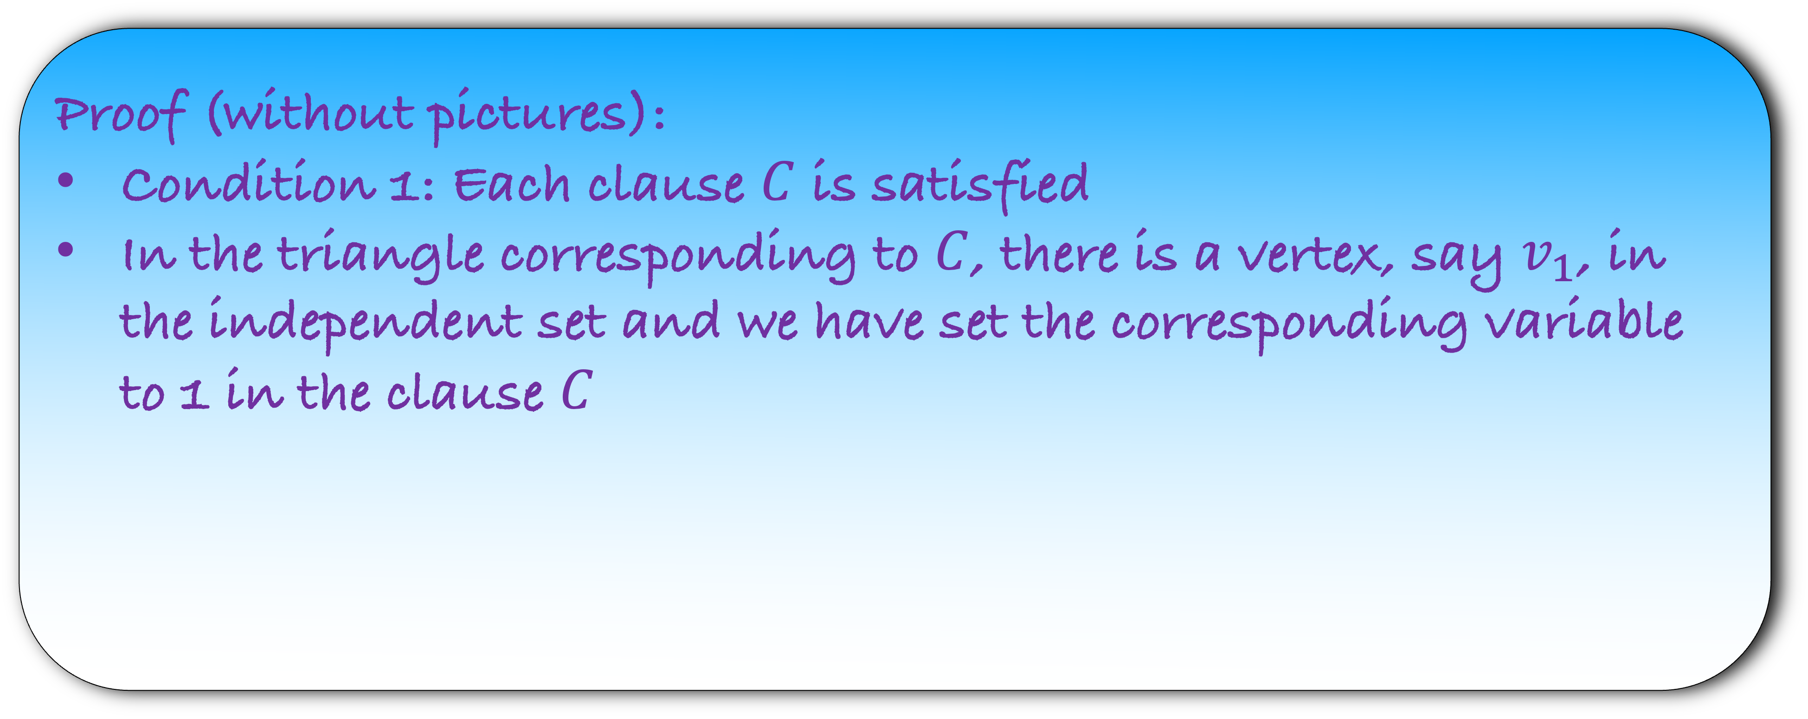
Lemma: If there is an independent set of size $≥m$ in G, then there is satisfiable assignment for 3-SAT instance
Proof (without pictures):
Condition 1: Each clause $C$ is satisfied
In the triangle corresponding to $C$, there is a vertex, say $v_{1}$, in the independent set and we have set the corresponding variable to 1 in the clause $C$

Slide 41
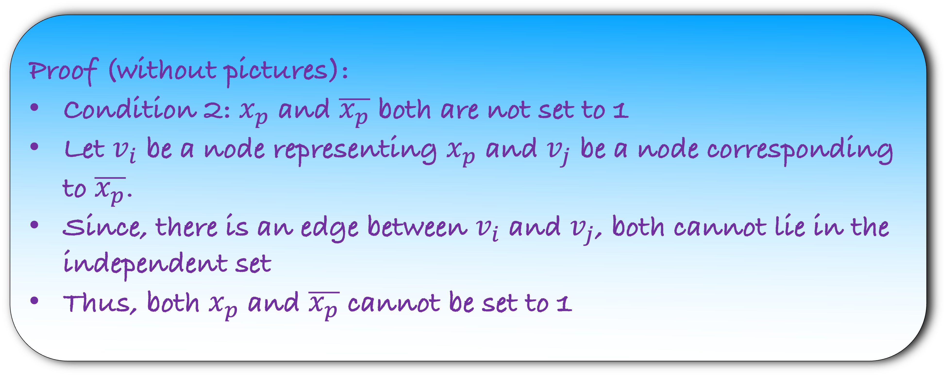
Lemma: If there is an independent set of size $≥m$ in G, then there is satisfiable assignment for 3-SAT instance
Proof (without pictures):
Condition 2: $x_{p}$ and $\overline{x_{p}}$ both are not set to 1
Let $v_{i}$ be a node representing $x_{p}$ and $v_{j}$ be a node corresponding to $\overline{x_{p}}$.
Since, there is an edge between $v_{i}$ and $v_{j}$, both cannot lie in the independent set
Thus, both $x_{p}$ and $\overline{x_{p}}$ cannot be set to 1

Slide 42
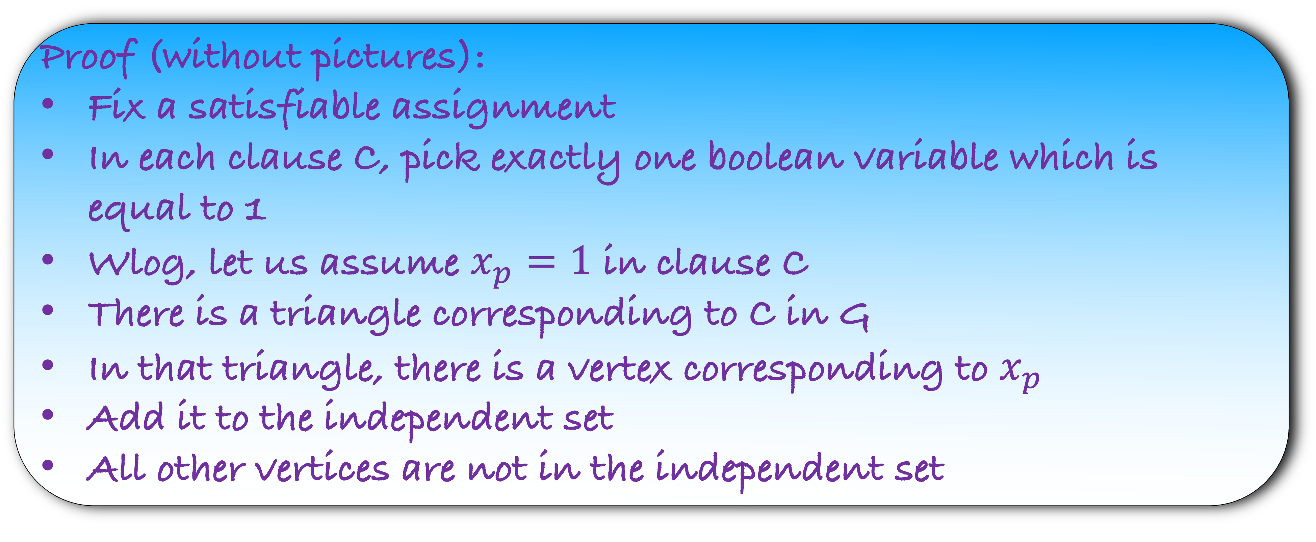
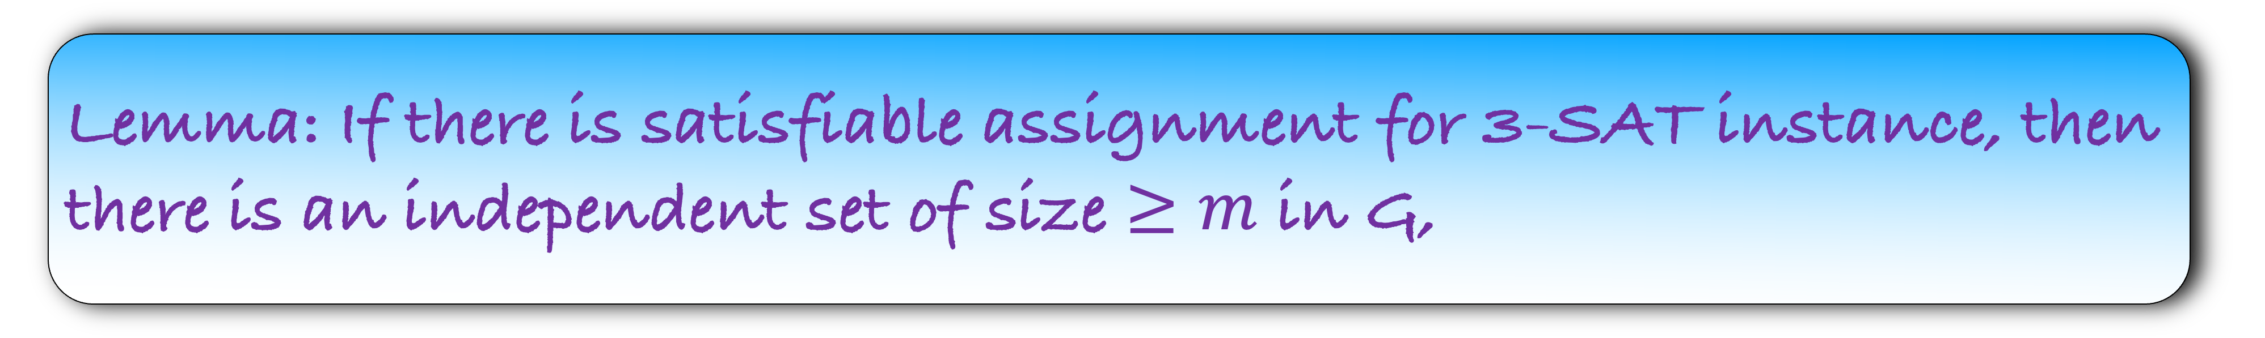
Lemma: If there is satisfiable assignment for 3-SAT instance, then there is an independent set of size $≥m$ in G,
Proof (without pictures):
Fix a satisfiable assignment
In each clause C, pick exactly one boolean variable which is equal to 1
Wlog, let us assume $x_{p}=1$ in clause C
There is a triangle corresponding to C in G
In that triangle, there is a vertex corresponding to $x_{p}$
Add it to the independent set
All other vertices are not in the independent set

Slide 43
Lemma: If there is satisfiable assignment for 3-SAT instance, then there is an independent set of size $≥m$ in G,
Proof (without pictures):
Condition 1: Size of the independent set = m
In each triangle, we pick exactly one vertex in the independent set
Thus, the size of the set is = m

Slide 44
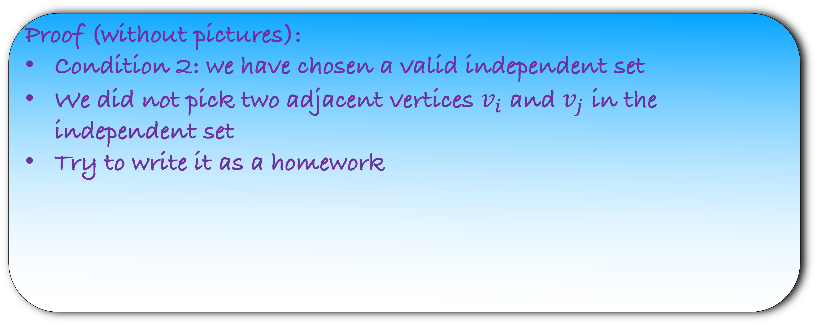
Lemma: If there is satisfiable assignment for 3-SAT instance, then there is an independent set of size $≥m$ in G,
Proof (without pictures):
Condition 2: we have chosen a valid independent set
We did not pick two adjacent vertices $v_{i}$ and $v_{j}$ in the independent set
Try to write it as a homework

