Slide 1
NP-Completeness

Slide 2
A problem A is polynomially time reducible to another problem B if
an instance of A can be solved in:
polynomial time and
using polynomial call to instances of B
In short, we write $A≤_{p}B$
Very Important Observation: If B is solvable in polynomial time, then

Slide 3
A problem A is polynomially time reducible to another problem B if
an instance of A can be solved in:
polynomial time and
using polynomial call to instances of B
In short, we write $A≤_{p}B$
Very Important Observation: If B is solvable in polynomial time, then A is solvable in polynomial time
Very Important Observation: If A is not solvable in polynomial time, then

Slide 4
A problem A is polynomially time reducible to another problem B if
an instance of A can be solved in:
polynomial time and
using polynomial call to instances of B
In short, we write $A≤_{p}B$
Very Important Observation: If B is solvable in polynomial time, then A is solvable in polynomial time
Very Important Observation: If A is not solvable in polynomial time, then B is not solvable in polynomial time

Slide 5
You are working in a company
Your boss gives you a new problem X and asks you to find an efficient solution to this problem
You think about it for a month but are unable to solve it
But one day, you come to know why you are not able to solve the problem
You show that Vertex Cover $≤_{p}$ X

Slide 6
You show that Vertex Cover $≤_{p}$ X
$$A≤_{p}B$$
Very Important Observation: If B is solvable in polynomial time, then A is solvable in polynomial time
Very Important Observation: If A is not solvable in polynomial time, then B is not solvable in polynomial time
You go back to your boss and say that it is highly unlikely that X is solvable efficiently

Slide 7
The most important problem in NP

Slide 8




Vertex Cover
$$≤$$
$$≤$$
Satisfiability
Independent Set
$$≤$$
$$≤$$
Class P
Clique
$$≤$$
Coloring
NP

Slide 9

Vertex Cover
$$≤$$
$$≤$$
Satisfiability
Independent Set
$$≤$$
$$≤$$
Class P
Clique
Coloring
NP

Slide 10
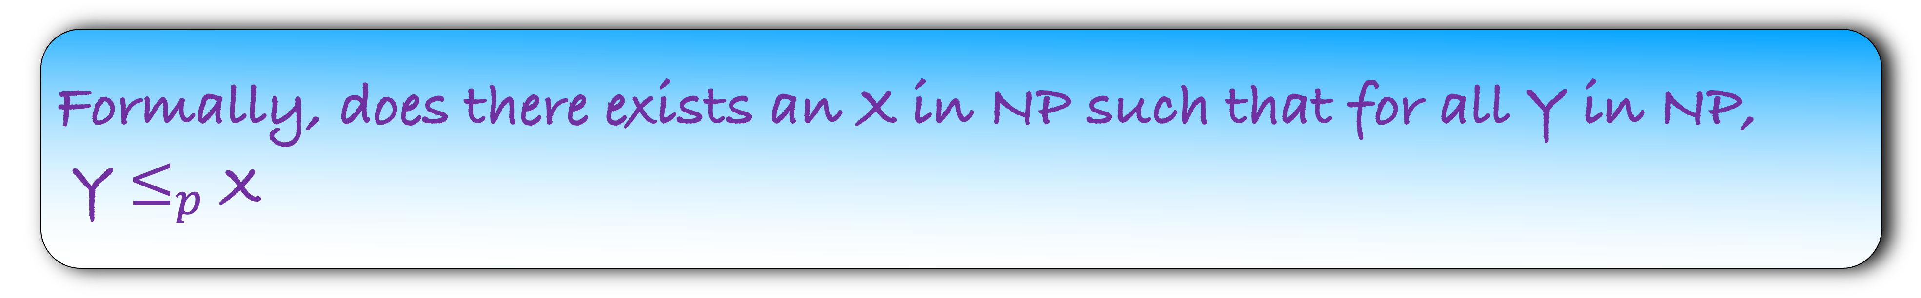
Is there a problem in NP such that all other problems in NP can be reduced to it?
Formally, does there exists an X in NP such that for all Y in NP,
Y $≤_{p}$ X
My intuition would be that such a problem does not exists
There may be crores of problems in NP each with different degree of difficulty
How can all of them reduce to one single problem?
But surprisingly, such a problem exists

Slide 11
Is there a problem in NP such that all other problems in NP can be reduced to it?
Formally, does there exists an X in NP such that for all Y in NP,
Y $≤_{p}$ X
Circuit Satisfiability
A remarkable result proved by Cook and Levin (1971)
We will not prove this result as it is out of scope of this course
Let us see the problem

Slide 12
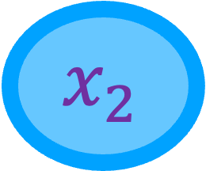
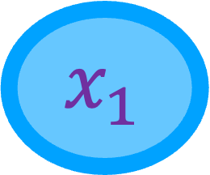
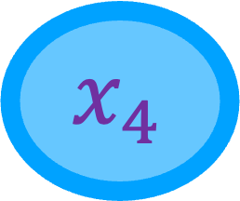
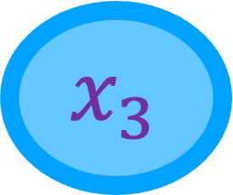
You have k Boolean variables
$${ x}_{1}$$
$${ x}_{2}$$
$${ x}_{3}$$
$${ x}_{4}$$

Slide 13

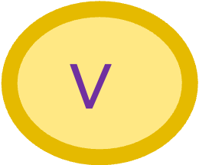
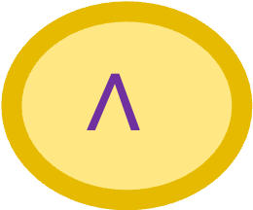
You have k Boolean variables
And three gates, AND, OR and NOT
$${ x}_{1}$$
$${ x}_{2}$$
$${ x}_{3}$$
$${ x}_{4}$$
$$∧$$
$$∨$$
$$¬$$

Slide 14

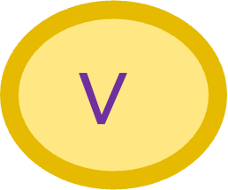
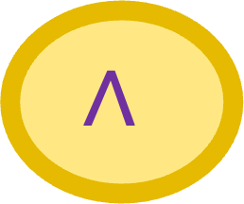
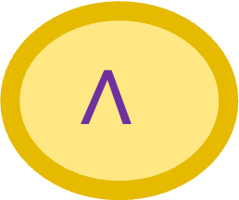
You have k Boolean variables
And three gates, AND, OR and NOT
The variables and gates form a circuit
$${ x}_{1}$$
$${ x}_{2}$$
$${ x}_{3}$$
$${ x}_{4}$$
$$∧$$
$$∨$$
$$∧$$
$$¬$$
Does there exists an input for which the output=1?
Output

Slide 15
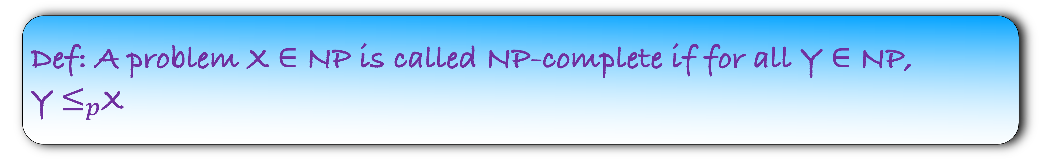
Circuit Satisfiability is the most important problem in NP
But we use a CS jargon for it
It is NP-complete
Def: A problem X $∈$ NP is called NP-complete if for all Y $∈$ NP, Y$≤_{p}$X

Slide 16
Circuit Satisfiability is NP-Complete
But we use a CS jargon for it
It is NP-complete
Def: A problem X $∈$ NP is called NP-complete if for all Y $∈$ NP, Y$≤_{p}$X

Slide 17
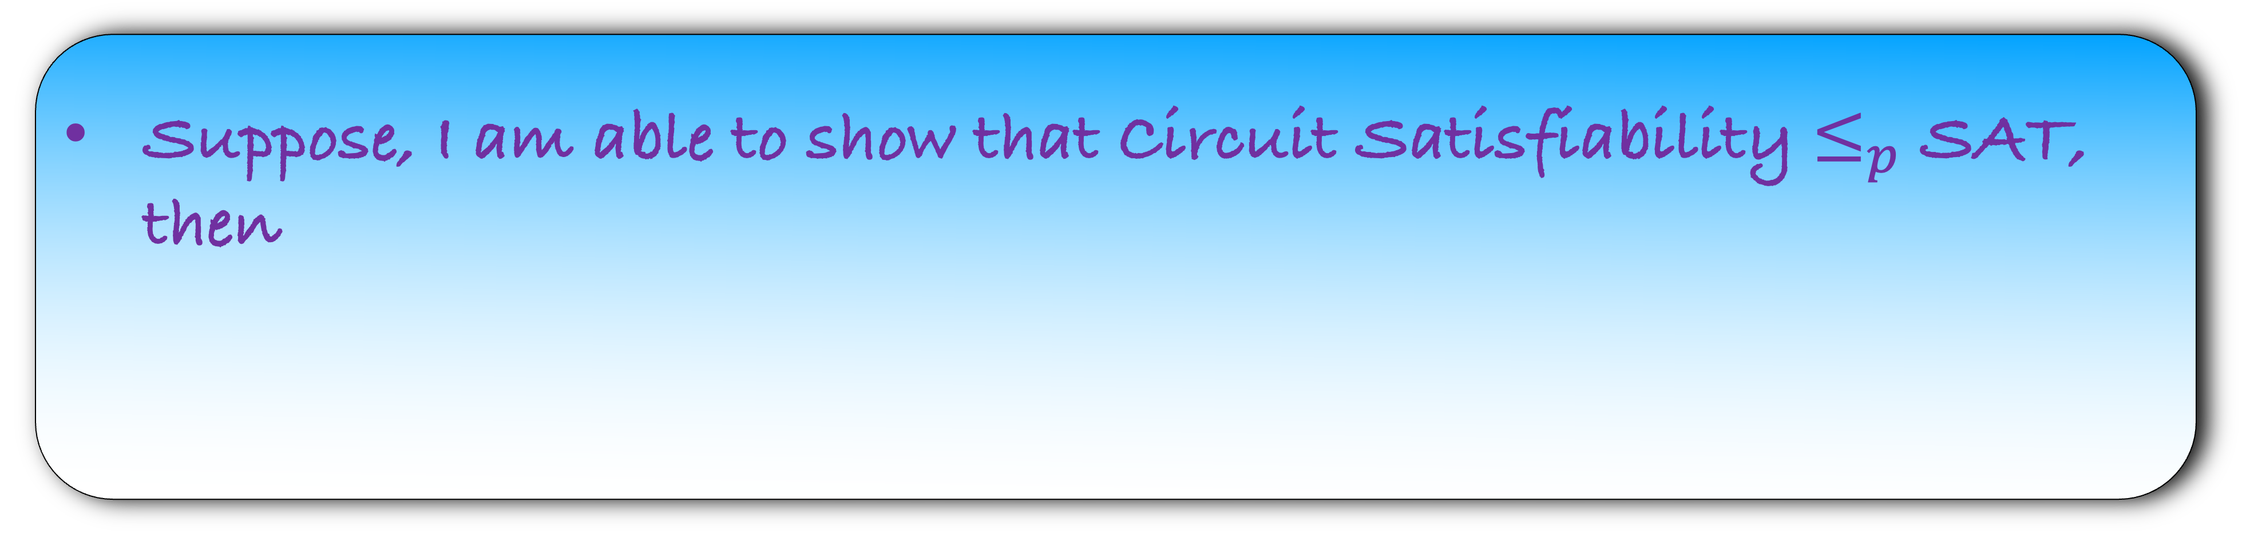
Circuit Satisfiability is NP-Complete
But we use a CS jargon for it
It is NP-complete
Def: A problem X $∈$ NP is called NP-complete if for all Y $∈$ NP, Y$≤_{p}$X
Suppose, I am able to show that Circuit Satisfiability $≤_{p}$ SAT, then

Slide 18
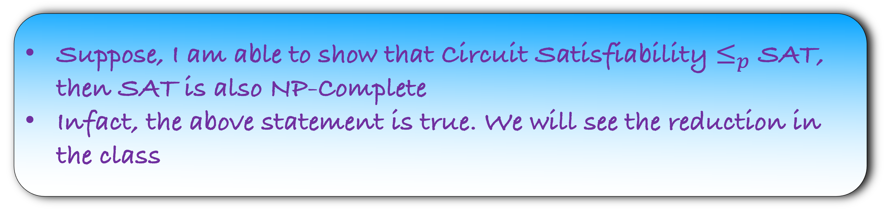
Circuit Satisfiability is NP-Complete
But we use a CS jargon for it
It is NP-complete
Def: A problem X $∈$ NP is called NP-complete if for all Y $∈$ NP, Y$≤_{p}$X
Suppose, I am able to show that Circuit Satisfiability $≤_{p}$ SAT, then SAT is also NP-Complete
Infact, the above statement is true. We will see the reduction in the class

Slide 19
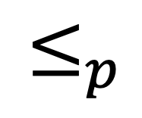
NP-complete Problems
Circuit Satisfiability
SAT
Vertex Cover
$$≤_{p}$$

Slide 20
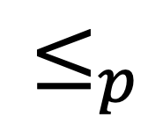
NP-complete Problems
Circuit Satisfiability
SAT
Vertex Cover
Independent Set
$$≤_{p}$$

Slide 21
NP-complete Problems
In fact, there are thousands of problems that are NP-Complete
We have seen few of them in the class
Circuit Satisfiability
SAT
Vertex Cover
Independent Set

Slide 22
SAT is NP-Complete

Slide 23

SAT is NP-Complete
To show this, we need to show two things:
SAT is in NP
Take any NP-Complete Problem X
Show that X $≤_{p}$ SAT

Slide 24
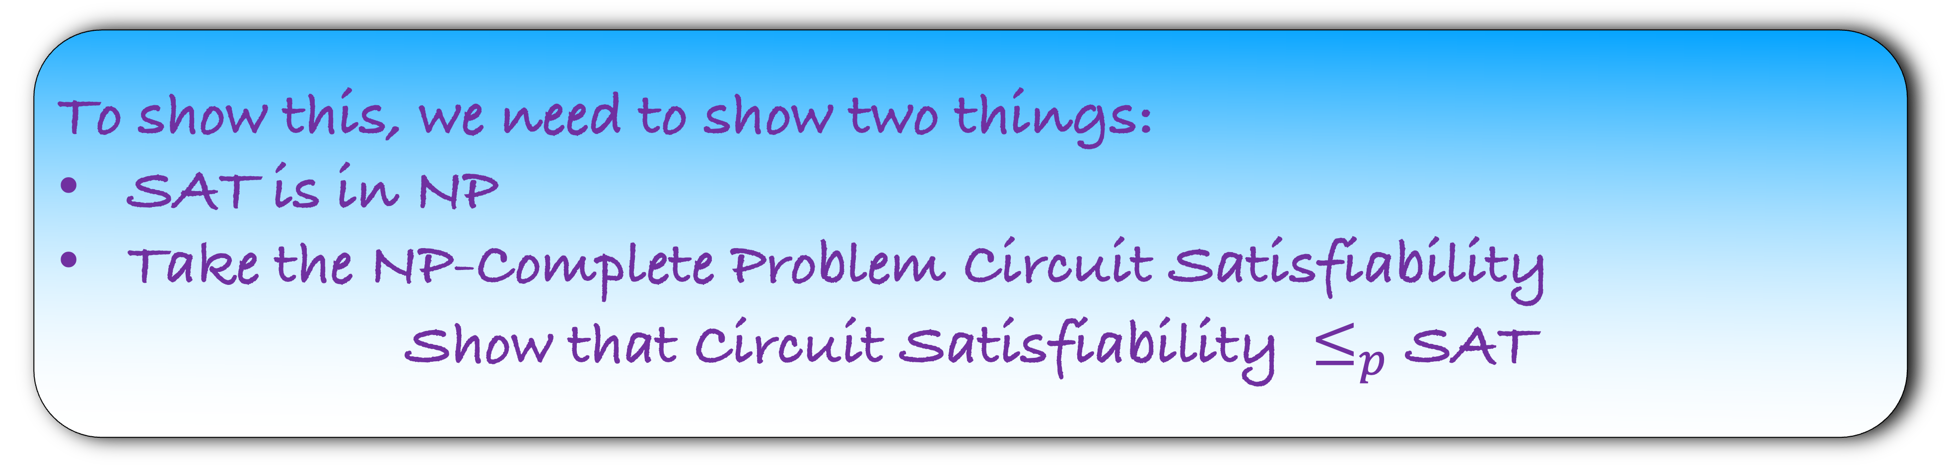
SAT is NP-Complete
To show this, we need to show two things:
SAT is in NP
Take the NP-Complete Problem Circuit Satisfiability
Show that Circuit Satisfiability $≤_{p}$ SAT

Slide 25
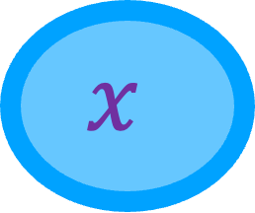

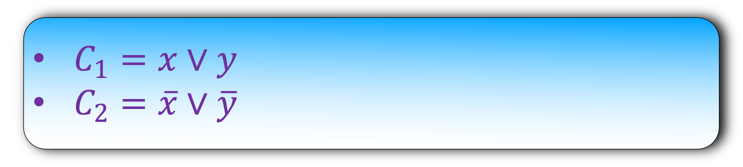
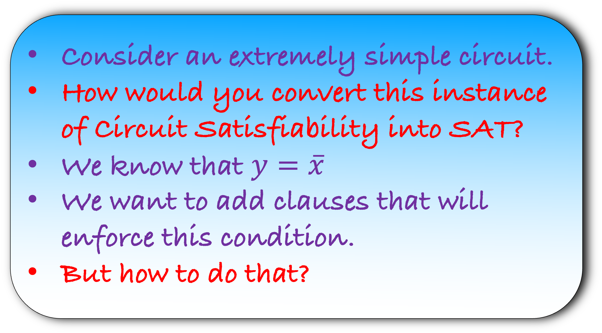
Consider an extremely simple circuit.
How would you convert this instance of Circuit Satisfiability into SAT?
We know that $y=\overline{x}$
We want to add clauses that will enforce this condition.
But how to do that?
$$x$$
$$¬$$
y
$C_{1}=x∨y$
$C_{2}=\overline{x}∨\overline{y}$

Slide 26
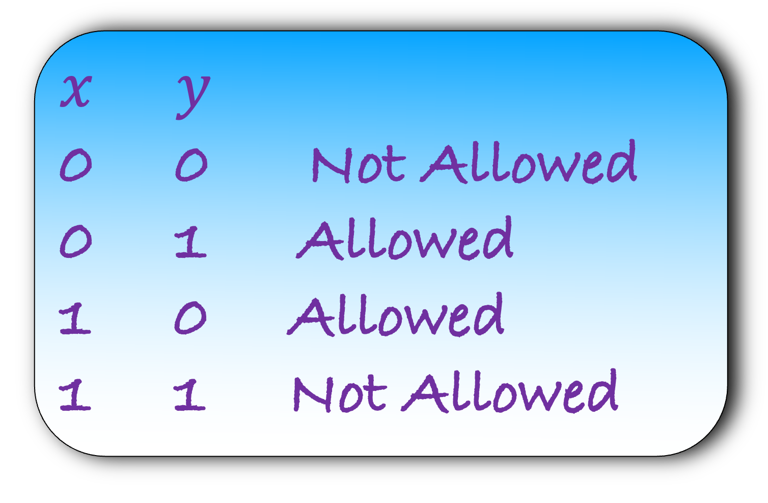

$$y=\overline{x}$$
$$x$$
$x$ $y$
0 0 Not Allowed
0 1 Allowed
1 0 Allowed
1 1 Not Allowed
$$¬$$
y

Slide 27


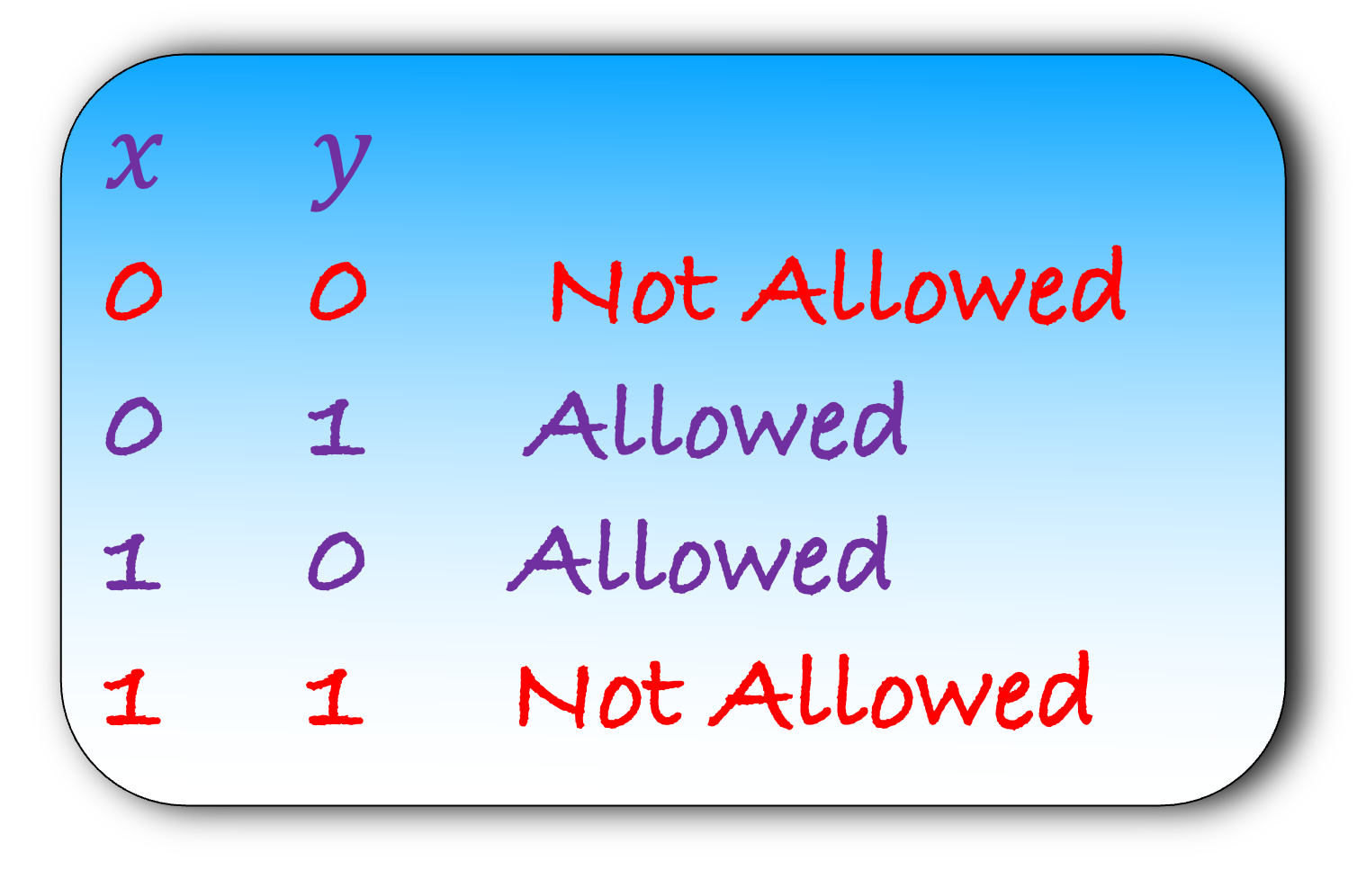
$$y=\overline{x}$$
$$x$$
$x$ $y$
0 0 Not Allowed
0 1 Allowed
1 0 Allowed
1 1 Not Allowed
$$x∨y$$
$$¬$$
y
$$\overline{x}∨\overline{y}$$

Slide 28
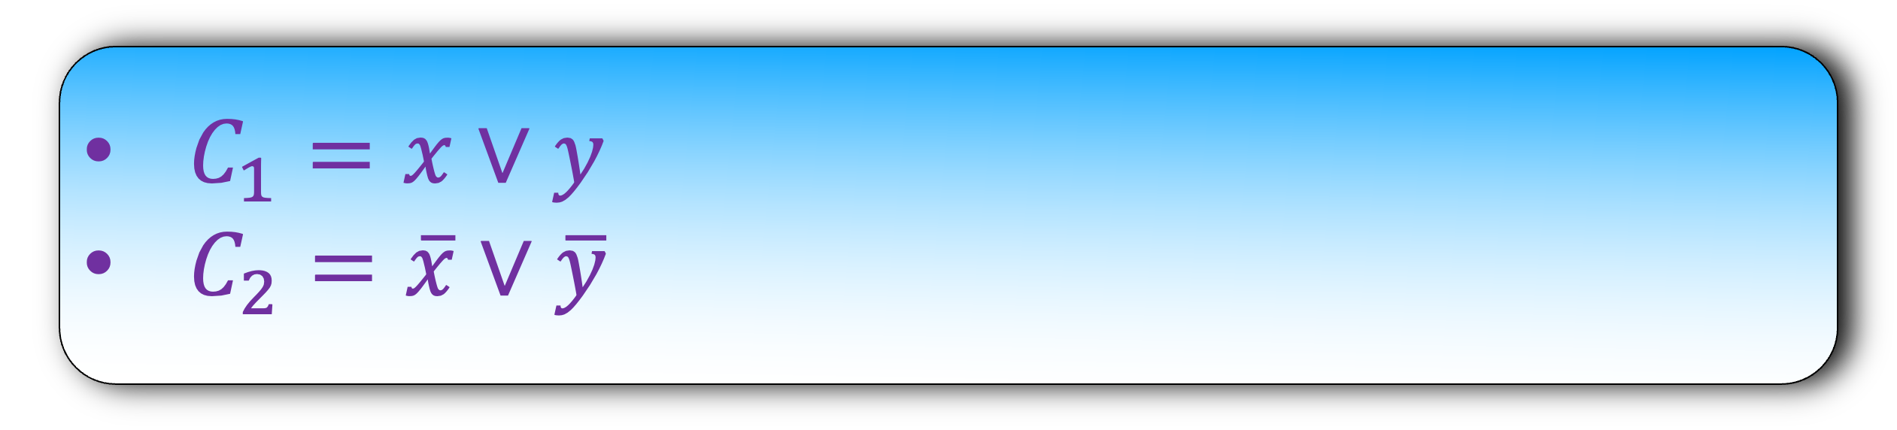
$C_{1}=x∨y$
$C_{2}=\overline{x}∨\overline{y}$
$$x$$
$$¬$$
What question will you ask the oracle?
y
Is this SAT instance satisfiable?
If the oracle says Yes, we will return Yes, else no

Slide 29

$C_{1}=x∨y$
$C_{2}=\overline{x}∨\overline{y}$
$$x$$
$$¬$$
Lemma: The SAT instance is satisfiable, iff the Circuit satisfiability instance is a Yes instance.
y

Slide 30
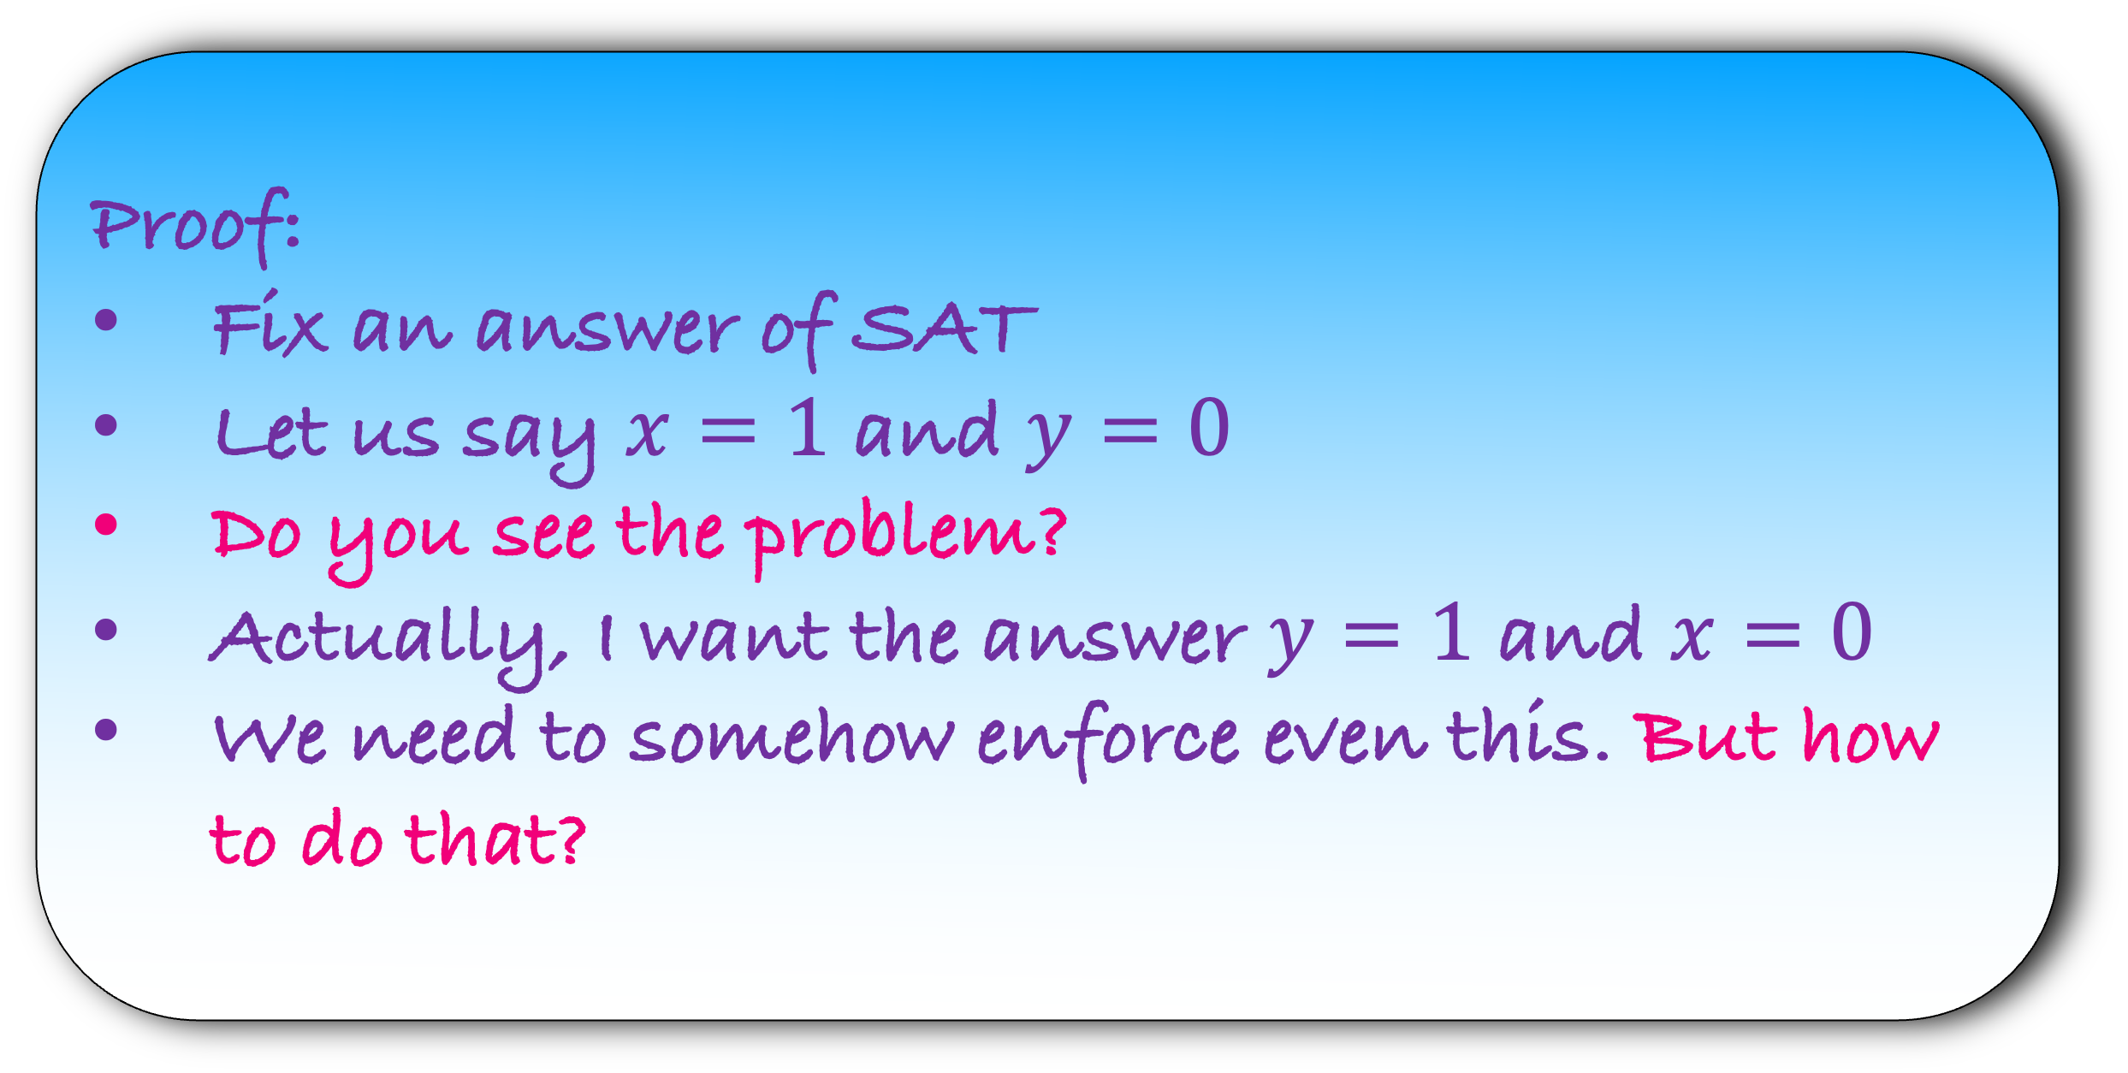
$C_{1}=x∨y$
$C_{2}=\overline{x}∨\overline{y}$
$$x$$
Lemma: If the SAT instance is satisfiable, then Circuit satisfiability instance is a Yes instance.
$$¬$$
y
Proof:
Fix an answer of SAT
Let us say $x=1$ and $y=0$
Do you see the problem?
Actually, I want the answer $y=1$ and $x=0$
We need to somehow enforce even this. But how to do that?

Slide 31
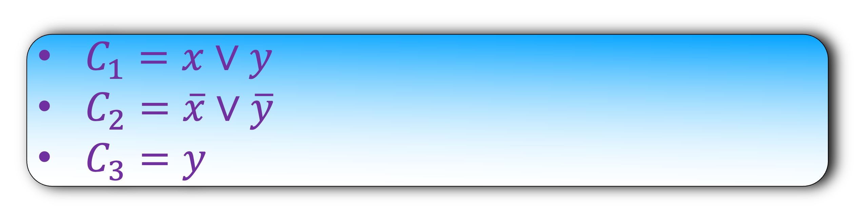
$C_{1}=x∨y$
$C_{2}=\overline{x}∨\overline{y}$
$C_{3}=y$
$$x$$
$$¬$$
y

Slide 32
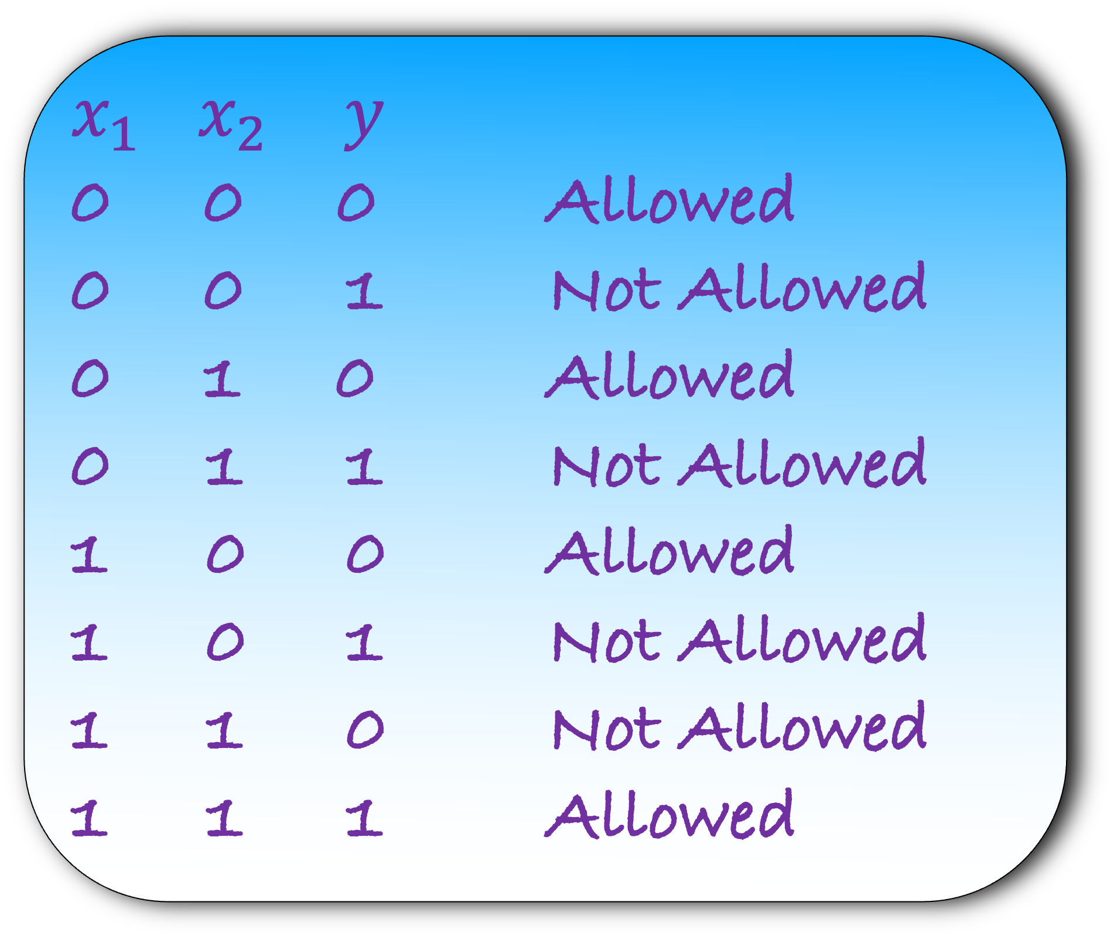
$${ x}_{1}$$
$${ x}_{2}$$
$x_{1}$ $x_{2}$ $y$
0 0 0 Allowed
0 0 1 Not Allowed
0 1 0 Allowed
0 1 1 Not Allowed
1 0 0 Allowed
1 0 1 Not Allowed
1 1 0 Not Allowed
1 1 1 Allowed
$$∧$$
y

Slide 33
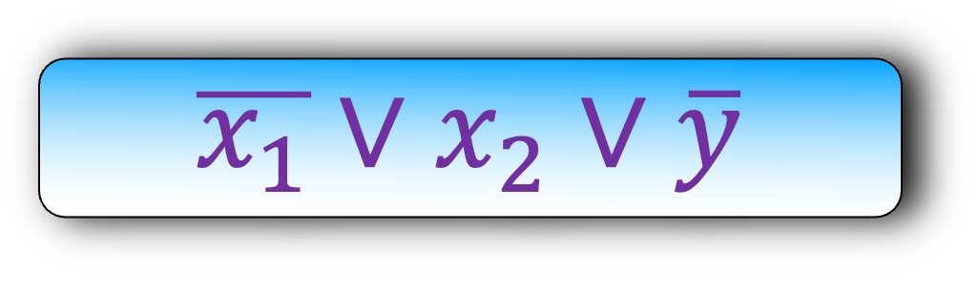
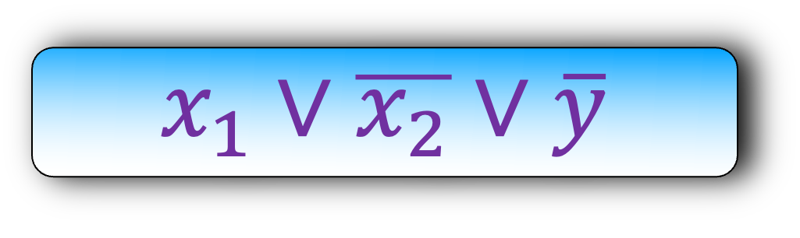
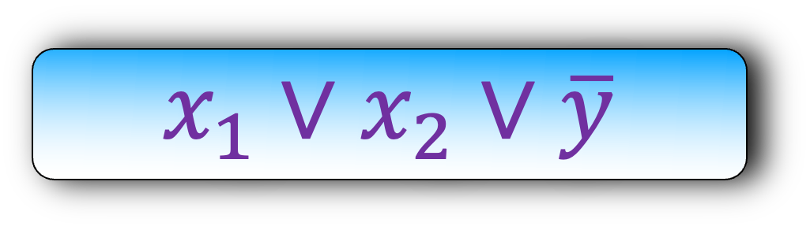
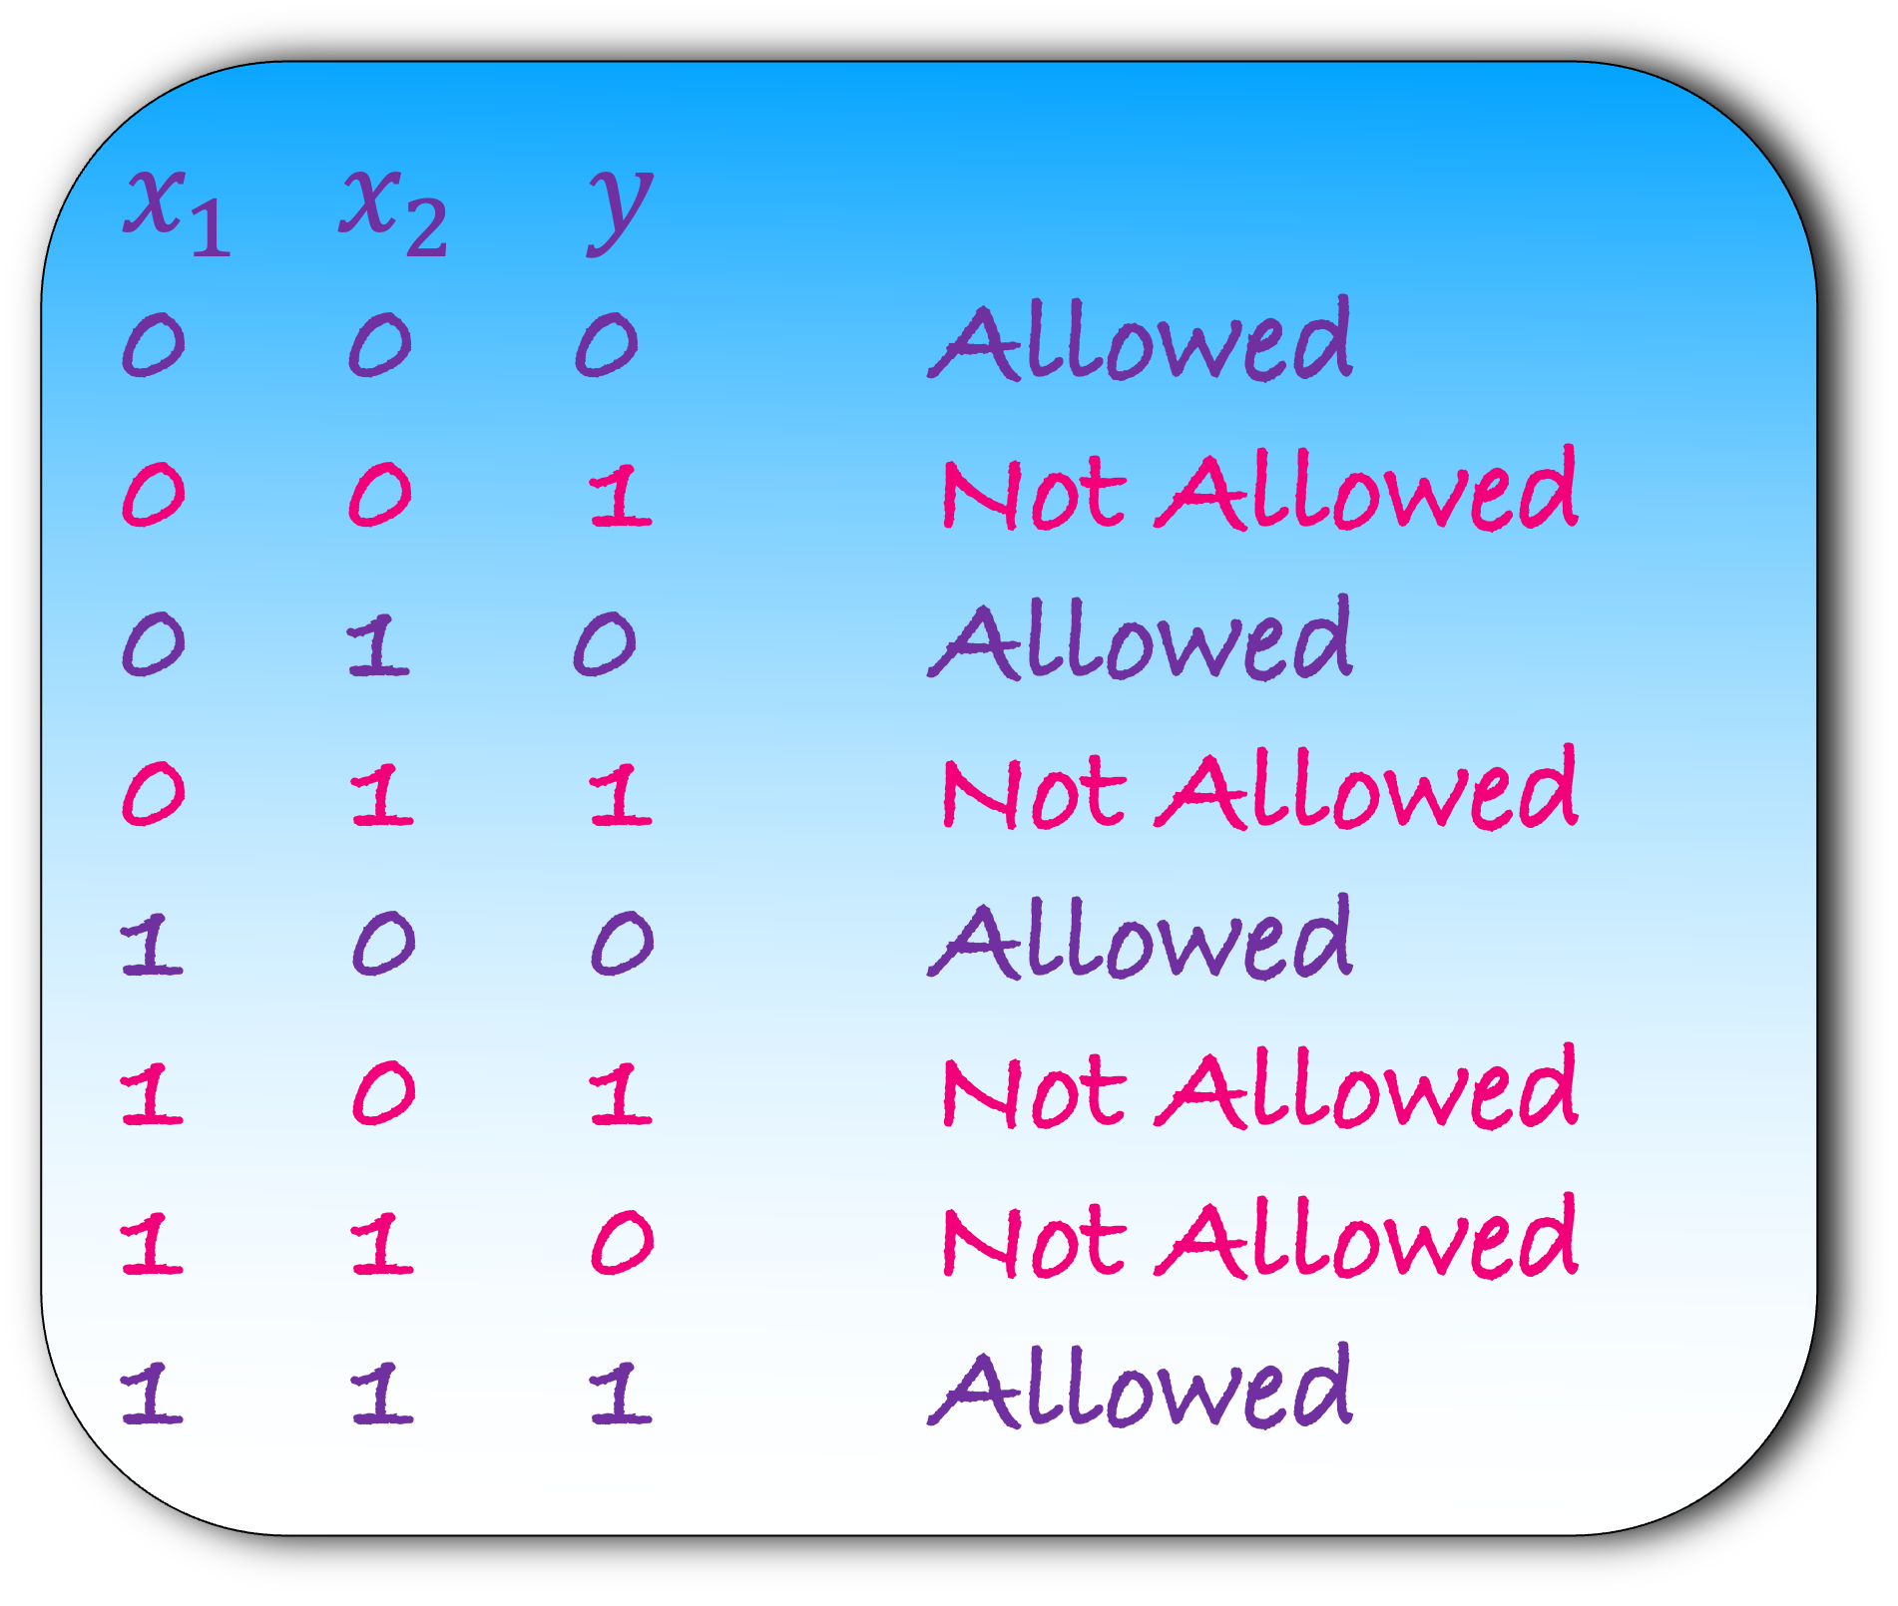
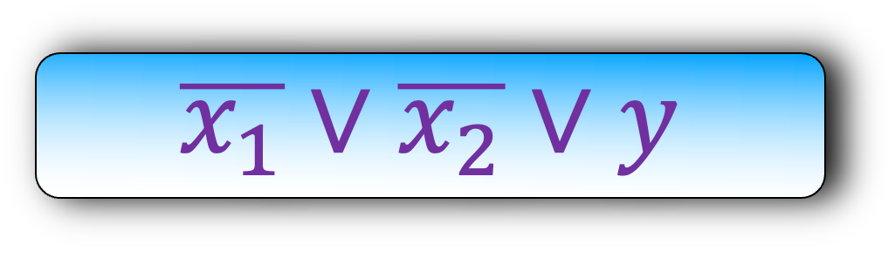
$${ x}_{1}$$
$${ x}_{2}$$
$x_{1}$ $x_{2}$ $y$
0 0 0 Allowed
0 0 1 Not Allowed
0 1 0 Allowed
0 1 1 Not Allowed
1 0 0 Allowed
1 0 1 Not Allowed
1 1 0 Not Allowed
1 1 1 Allowed
$$x_{1}∨x_{2}∨\overline{y}$$
$$∧$$
$$x_{1}∨\overline{x_{2}}∨\overline{y}$$
y
$$\overline{x_{1}}∨x_{2}∨\overline{y}$$
$$\overline{x_{1}}∨\overline{x_{2}}∨y$$

Slide 34

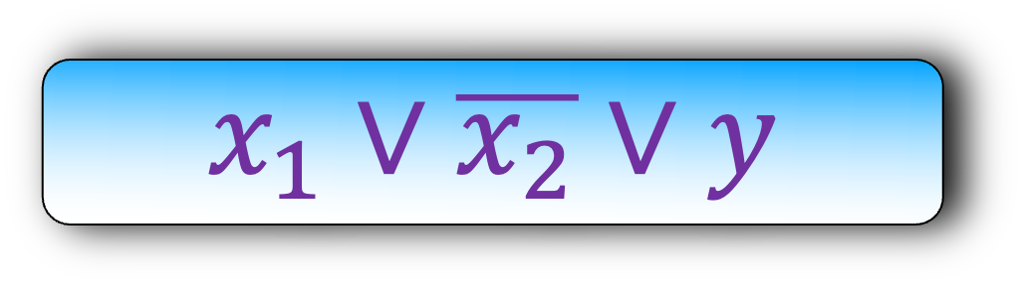
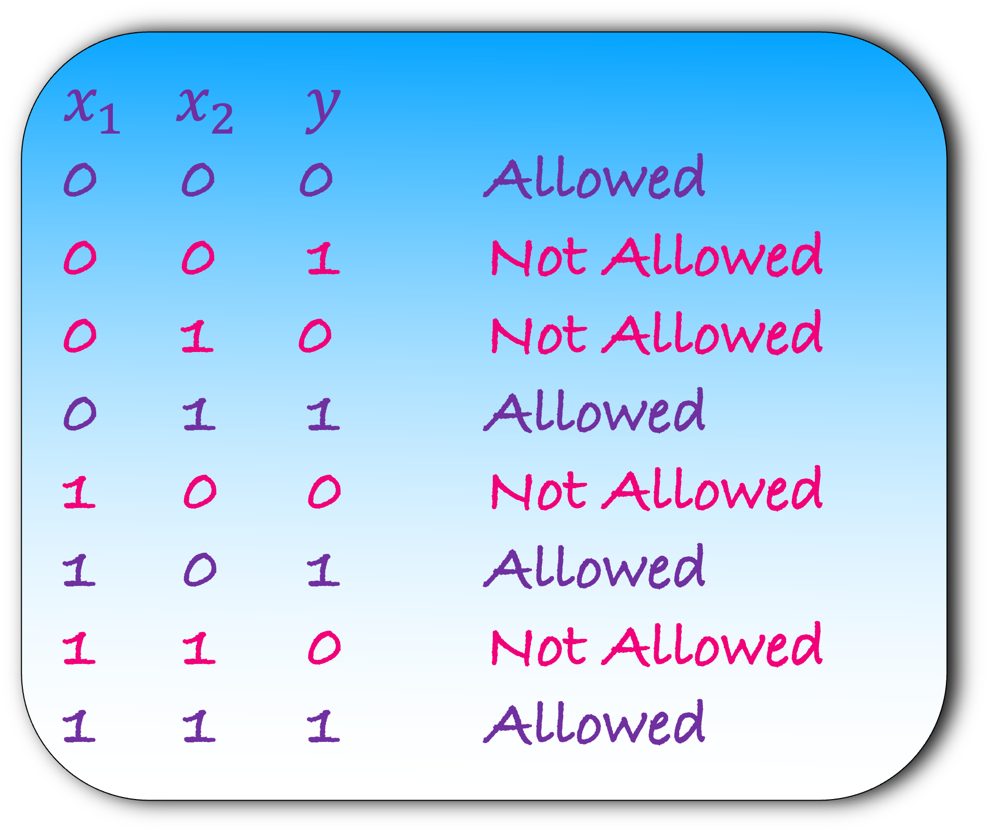
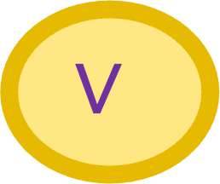
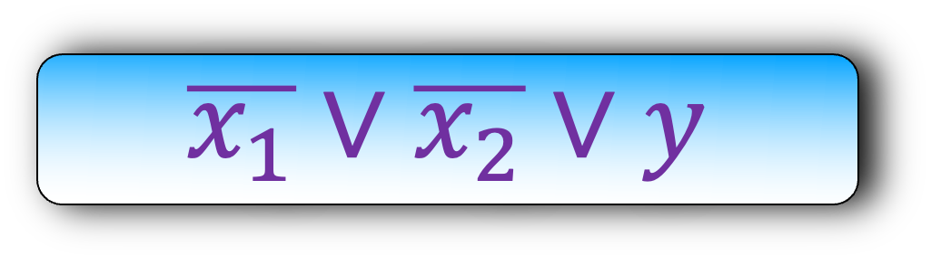
$${ x}_{1}$$
$${ x}_{2}$$
$x_{1}$ $x_{2}$ $y$
0 0 0 Allowed
0 0 1 Not Allowed
0 1 0 Not Allowed
0 1 1 Allowed
1 0 0 Not Allowed
1 0 1 Allowed
1 1 0 Not Allowed
1 1 1 Allowed
$$x_{1}∨x_{2}∨\overline{y}$$
$$∨$$
$$x_{1}∨\overline{x_{2}}∨y$$
y
$$\overline{x_{1}}∨x_{2}∨y$$
$$\overline{x_{1}}∨\overline{x_{2}}∨y$$

Slide 35
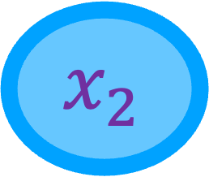
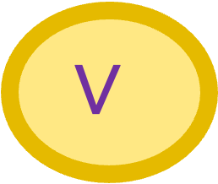
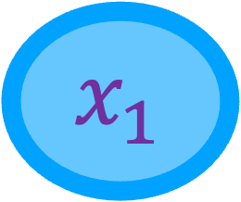

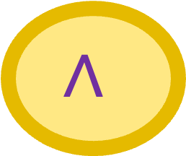
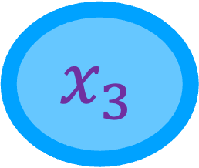
Let us now put all our trick together.
What will you do when you get the entire circuit?
$${ x}_{1}$$
$${ x}_{2}$$
$${ x}_{3}$$
Make a new variable for output of each gate
Now construct clauses for each gate
$$∧$$
$$¬$$
$$∨$$
Output

Slide 36
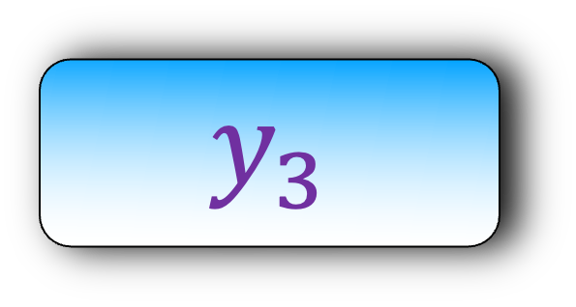
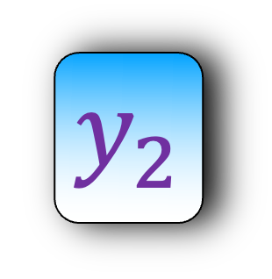

Let us now put all our trick together.
What will you do when you get the entire circuit?
$${ x}_{1}$$
$${ x}_{2}$$
$${ x}_{3}$$
Make a new variable for output of each gate
Now construct clauses for each gate
$$∧$$
$$¬$$
$$y_{1}$$
$$y_{2}$$
$$∨$$
$$y_{3}$$

Slide 37
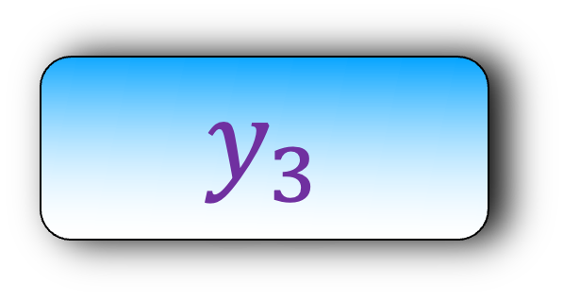
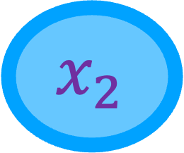
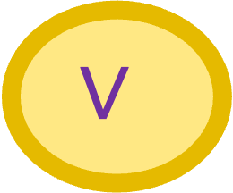
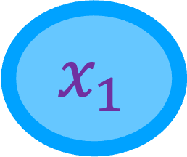
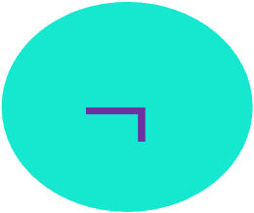
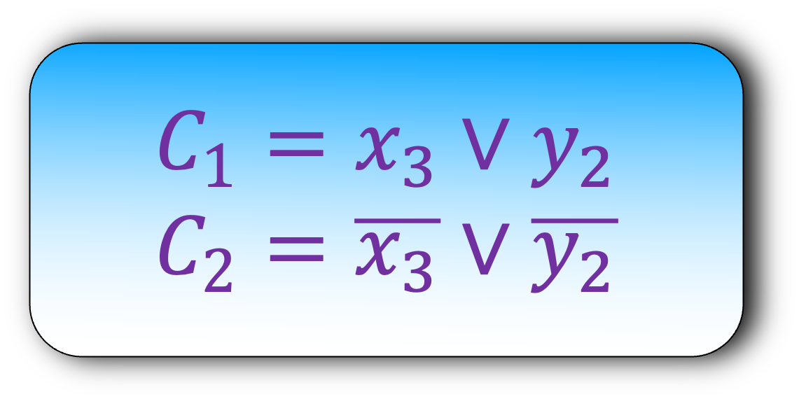
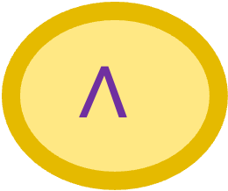
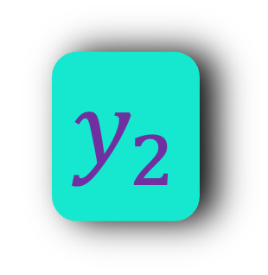
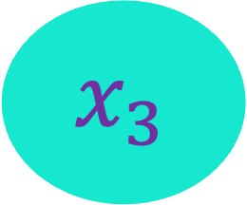

$${ x}_{1}$$
$${ x}_{2}$$
$${ x}_{3}$$
$$C_{1}=x_{3}∨y_{2}$$
$$C_{2}=\overline{x_{3}}∨\overline{y_{2}}$$
$$∧$$
$$¬$$
$$y_{1}$$
$$y_{2}$$
$$∨$$
$$y_{3}$$

Slide 38








$${ x}_{1}$$
$${ x}_{2}$$
$${ x}_{3}$$
$$C_{1}=x_{3}∨y_{2}$$
$$C_{2}=\overline{x_{3}}∨\overline{y_{2}}$$
$$∧$$
$$¬$$
$$C_{3}=x_{1}∨x_{2}∨\overline{y_{1}}$$
$$C_{4}=x_{1}∨\overline{x_{2}}∨\overline{y_{1}}$$
$$C_{5}=\overline{x_{1}}∨x_{2}∨\overline{y_{1}}$$
$$C_{6}=\overline{x_{1}}∨\overline{x_{2}}∨y_{1}$$
$$y_{1}$$
$$y_{2}$$
$$∨$$
$$y_{3}$$

Slide 39








$${ x}_{1}$$
$${ x}_{2}$$
$${ x}_{3}$$
$$C_{1}=x_{3}∨y_{2}$$
$$C_{2}=\overline{x_{3}}∨\overline{y_{2}}$$
$$∧$$
$$¬$$
There is one more clause to add
What is that?
$$C_{3}=x_{1}∨x_{2}∨\overline{y_{1}}$$
$$C_{4}=x_{1}∨\overline{x_{2}}∨\overline{y_{1}}$$
$$C_{5}=\overline{x_{1}}∨x_{2}∨\overline{y_{1}}$$
$$C_{6}=\overline{x_{1}}∨\overline{x_{2}}∨y_{1}$$
$$y_{1}$$
$$y_{2}$$
$$∨$$
$$y_{3}$$
$$C_{7}=y_{1}∨y_{2}∨\overline{y_{3}}$$
$$C_{8}= y_{1}∨\overline{y_{2}}∨y_{3}$$
$$C_{9}= \overline{y_{1}}∨y_{2}∨y_{3}$$
$$C_{10}=\overline{y_{1}}∨\overline{y_{2}}∨y_{3}$$

Slide 40




$${ x}_{1}$$
$${ x}_{2}$$
$${ x}_{3}$$
$$C_{1}=x_{3}∨y_{2}$$
$$C_{2}=\overline{x_{3}}∨\overline{y_{2}}$$
$$C_{11}=y_{3}$$
What question will you ask the oracle?
$$∧$$
$$¬$$
$$C_{3}=x_{1}∨x_{2}∨\overline{y_{1}}$$
$$C_{4}=x_{1}∨\overline{x_{2}}∨\overline{y_{1}}$$
$$C_{5}=\overline{x_{1}}∨x_{2}∨\overline{y_{1}}$$
$$C_{6}=\overline{x_{1}}∨\overline{x_{2}}∨y_{1}$$
$$y_{1}$$
$$y_{2}$$
$$∨$$
Is this SAT instance satisfiable?
$$y_{3}$$
$$C_{7}=y_{1}∨y_{2}∨\overline{y_{3}}$$
$$C_{8}= y_{1}∨\overline{y_{2}}∨y_{3}$$
$$C_{9}= \overline{y_{1}}∨y_{2}∨y_{3}$$
$$C_{10}=\overline{y_{1}}∨\overline{y_{2}}∨y_{3}$$
If the oracle says Yes, we will return Yes, else no

Slide 41

Lemma: The SAT instance is satisfiable, iff the Circuit satisfiability instance is a Yes instance.
Lemma: If the SAT instance is satisfiable, then the Circuit satisfiability instance is a Yes instance.
Proof:
Start with the SAT instance
Copy the value of variable $x_{i}$’s from the SAT instance to the Circuit Satisfiability instance
Show that the output of the Circuit Satisfiability instance = 1

Slide 42

$${ x}_{1}$$
$${ x}_{2}$$
$${ x}_{3}$$
$$C_{1}=x_{3}∨y_{2}$$
$$C_{2}=\overline{x_{3}}∨\overline{y_{2}}$$
$$C_{11}=y_{3}$$
1
This clause ensure $y_{3}=1$
$$∧$$
$$¬$$
$$C_{3}=x_{1}∨x_{2}∨\overline{y_{1}}$$
$$C_{4}=x_{1}∨\overline{x_{2}}∨\overline{y_{1}}$$
$$C_{5}=\overline{x_{1}}∨x_{2}∨\overline{y_{1}}$$
$$C_{6}=\overline{x_{1}}∨\overline{x_{2}}∨y_{1}$$
$$y_{1}$$
$$y_{2}$$
$$∨$$
$$y_{3}$$
$$C_{7}=y_{1}∨y_{2}∨\overline{y_{3}}$$
$$C_{8}= y_{1}∨\overline{y_{2}}∨y_{3}$$
$$C_{9}= \overline{y_{1}}∨y_{2}∨y_{3}$$
$$C_{10}=\overline{y_{1}}∨\overline{y_{2}}∨y_{3}$$

Slide 43

0
1
0
$${ x}_{1}$$
$${ x}_{2}$$
$${ x}_{3}$$
$$C_{1}=x_{3}∨y_{2}$$
$$C_{2}=\overline{x_{3}}∨\overline{y_{2}}$$
1
$$C_{11}=y_{3}$$
1
1
We need to ensure the the output of each gate is valid
Take any one gate
Is $y_{1}=x_{1}∧x_{2}$?
Yes, else one of the clause corresponding to this AND gate will not be satisfied
$$∧$$
$$¬$$
$$C_{3}=x_{1}∨x_{2}∨\overline{y_{1}}$$
$$C_{4}=x_{1}∨\overline{x_{2}}∨\overline{y_{1}}$$
$$C_{5}=\overline{x_{1}}∨x_{2}∨\overline{y_{1}}$$
$$C_{6}=\overline{x_{1}}∨\overline{x_{2}}∨y_{1}$$
1
$$y_{1}$$
$$y_{2}$$
$$∨$$
1
0
1
1
1
$$y_{3}$$
$$C_{7}=y_{1}∨y_{2}∨\overline{y_{3}}$$
$$C_{8}= y_{1}∨\overline{y_{2}}∨y_{3}$$
$$C_{9}= \overline{y_{1}}∨y_{2}∨y_{3}$$
$$C_{10}=\overline{y_{1}}∨\overline{y_{2}}∨y_{3}$$
1
1
1
1
1

Slide 44
Lemma: The SAT instance is satisfiable, iff the Circuit satisfiability instance is a Yes instance.
Lemma: If the SAT instance is satisfiable, then the Circuit satisfiability instance is a Yes instance.
Lemma: If the Circuit satisfiability instance is a Yes instance, then the SAT instance is satisfiable.

Slide 45
Another Example: Suspicious User Problem

Slide 46

You are administrator of a bank
You have access to the website logs
The logs are of the form:
(User: x, time: 12:45 pm, www.bank.com/secret)
We say that there is an attack on the bank if there are $≤k$ users that access $m$ specific websites of the bank over some time period

Slide 47

(User: a, time: 12:45 pm, www.bank.com/secret1)
(User: b, time: 12:45 pm, www.bank.com/open1)
(User: c, time: 12:45 pm, www.bank.com/secret1)
(User: d, time: 12:45 pm, www.bank.com/open2)
(User: e, time: 12:45 pm, www.bank.com/ open1)
(User: b, time: 12:45 pm, www.bank.com/secret2)
(User: b, time: 12:45 pm, www.bank.com/open3)
(User: e, time: 12:45 pm, www.bank.com/secret2)
(User: f, time: 12:45 pm, www.bank.com/open4)
(User: a, time: 12:45 pm, www.bank.com/open5)
(User: b, time: 12:45 pm, www.bank.com/open1)
(User: d, time: 12:45 pm, www.bank.com/secret3)
(User: d, time: 12:45 pm, www.bank.com/open2)
$$k=2$$
Are there at most 2 users that have accessed three websites over some minutes?
No

Slide 48

(User: a, time: 12:45 pm, www.bank.com/secret1)
(User: b, time: 12:45 pm, www.bank.com/open1)
(User: c, time: 12:45 pm, www.bank.com/secret1)
(User: d, time: 12:45 pm, www.bank.com/open2)
(User: e, time: 12:45 pm, www.bank.com/ open1)
(User: b, time: 12:45 pm, www.bank.com/secret2)
(User: b, time: 12:45 pm, www.bank.com/open3)
(User: e, time: 12:45 pm, www.bank.com/secret2)
(User: f, time: 12:45 pm, www.bank.com/open4)
(User: a, time: 12:45 pm, www.bank.com/open5)
(User: b, time: 12:45 pm, www.bank.com/open1)
(User: d, time: 12:45 pm, www.bank.com/secret3)
(User: d, time: 12:45 pm, www.bank.com/open2)
$$k=3$$
Are there at most 2 users that have accessed three websites over some minutes?
Yes
Show that Suspicious User Problem (SUP) is NP-Complete

Slide 49

Show that Suspicious User Problem (SUP) is NP-Complete
To show this, we need to show two things:
SUP is in NP
Take any NP-Complete Problem X
Show that X $≤_{p}$ SUP
Its easy to see that SUP is in NP
What known NP-Complete problem will you choose?
Vertex Cover (VC)

Slide 50

Show that Suspicious User Problem (SUP) is NP-Complete
To show this, we need to show two things:
SUP is in NP
Take the NP-Complete Problem VC
Show that VC $≤_{p}$ SUP
Its easy to see that SUP is in NP
What known NP-Complete problem will you choose?
Vertex Cover (VC)

Slide 51

d
Step 1) Construct an instance of SUP using G
e
1
b
5
a
4
Label all edges
a and d access site 1 at time $t_{1}$ and $t_{2}$
(a,$t_{1}$,1)
(d,$t_{2}$,1)
a and c access site 2 at time $t_{3}$ and $t_{4}$
And so on
2
c
3
f
G

Slide 52


d
(a,$t_{1}$,1)
(d,$t_{2}$,1)
(a,$t_{3},$2)
(c,$t_{4}$,2)
(c,$t_{5}$,3)
(f,$t_{6}$,3)
(f,$t_{7},$4)
(b,$t_{8}$,4)
(b,$t_{9}$,5)
(e,$t_{10},$5)
e
1
b
5
a
4
4
2
c
3
f
G
What question will you ask the oracle?
Are there at most $k$ users that access all $m$ websites over some time?

Slide 53
d
(a,$t_{1}$,1)
(d,$t_{2}$,1)
(a,$t_{3},$2)
(c,$t_{4}$,2)
(c,$t_{5}$,3)
(f,$t_{6}$,3)
(f,$t_{7},$4)
(b,$t_{8}$,4)
(b,$t_{9}$,5)
(e,$t_{10},$5)
e
1
b
5
a
4
4
2
c
3
f
G
What question will you ask the oracle?
Are there at most $k$ users that access all $m$ websites over some time?
If the oracle answers Yes, then the answer to the VC problem is also Yes, else no

Slide 54
d
(a,$t_{1}$,1)
(d,$t_{2}$,1)
(a,$t_{3},$2)
(c,$t_{4}$,2)
(c,$t_{5}$,3)
(f,$t_{6}$,3)
(f,$t_{7},$4)
(b,$t_{8}$,4)
(b,$t_{9}$,5)
(e,$t_{10},$5)
e
1
b
5
a
4
4
2
c
3
f
G
Step 4) Prove that your answer is correct
Lemma: SUP is a Yes instance, iff VC is a Yes instance.

Slide 55
Lemma: SUP is a Yes instance, iff VC is a Yes instance.
Lemma: If SUP is a Yes instance, then VC is a Yes instance.
Lemma: If VC is a Yes instance, then SUP is a Yes instance.
Try to prove these two lemmas as a homework

