Slide 1
Marathon Runner

Slide 2

Day 1
30
Day 2
40
Day 0
Day 3
50
Day 4
20
0

Slide 3
Day 1
30
Day 2
40
Day 1
Day 3
50
Day 4
20
30

Slide 4
Day 1
30
Day 2
40
Day 2
Day 3
50
Day 4
20
70

Slide 5
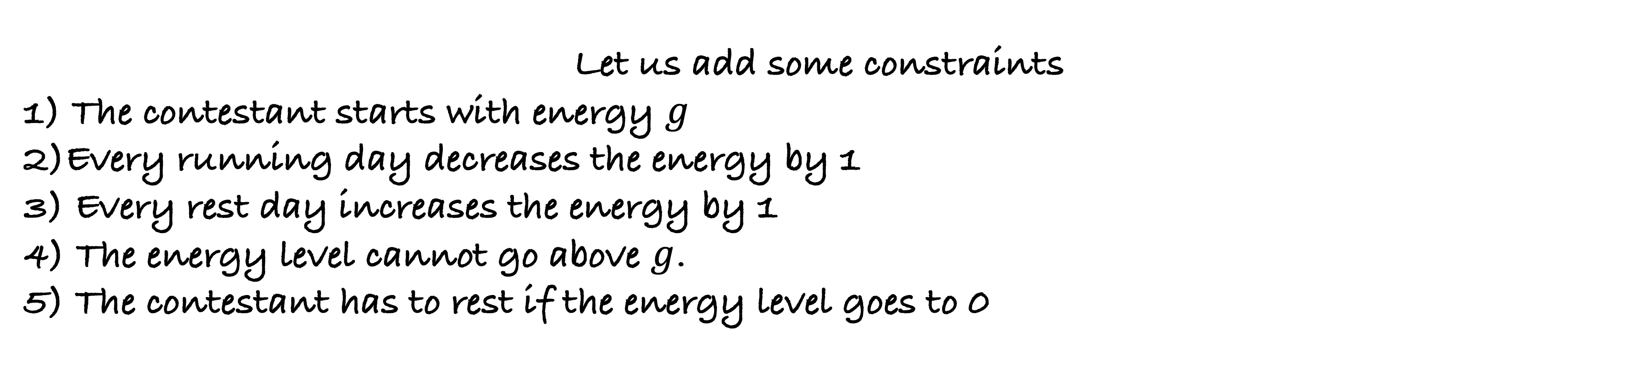
Day 1
30
Day 2
40
Day 4
Day 3
50
Day 4
20
140
Let us add some constraints
1) The contestant starts with energy $g$
2)Every running day decreases the energy by 1
3) Every rest day increases the energy by 1
4) The energy level cannot go above $g$.
5) The contestant has to rest if the energy level goes to 0

Slide 6
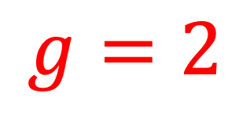
Day 1
30
Day 2
40
Day 0
Day 3
50
Day 4
20
$$g=2$$
0

Slide 7
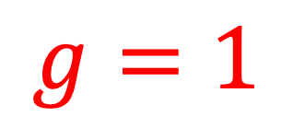
Day 1
30
Day 2
40
Day 1
Day 3
50
Day 4
20
$$g=1$$
30

Slide 8
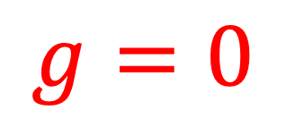
Day 1
30
Day 2
40
Day 2
Day 3
50
Day 4
20
$$g=0$$
70

Slide 9
Day 1
30
Day 2
40
Day 3
Day 3
50
Day 4
20
$$g=1$$
70

Slide 10
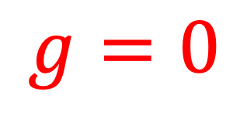
Day 1
30
Day 2
40
Day 4
Day 3
50
Day 4
20
$$g=0$$
90

Slide 11
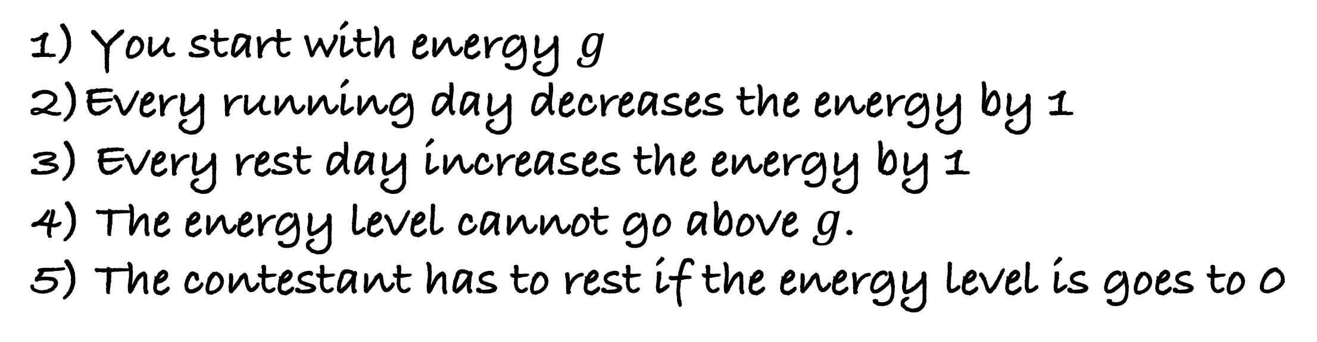
You are given an array days of size n. days[i] denotes the distance you can run on the i-th day. There are following constraints:
1) You start with energy $g$
2)Every running day decreases the energy by 1
3) Every rest day increases the energy by 1
4) The energy level cannot go above $g$.
5) The contestant has to rest if the energy level is goes to 0
What is the maximum distance you can run in the marathon?
How would you solve this problem?

Slide 12
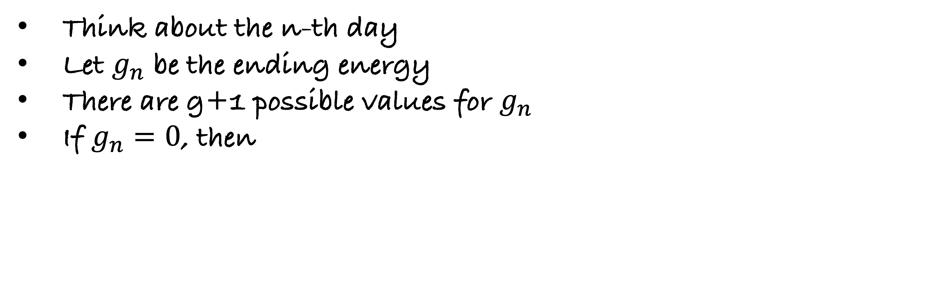
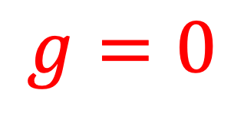
Think about the n-th day
Let $g_{n}$ be the ending energy
There are g+1 possible values for $g_{n}$
If $g_{n}=0$, then
Day n
Day n
$$g=0$$
$$g=0$$
70
70

Slide 13

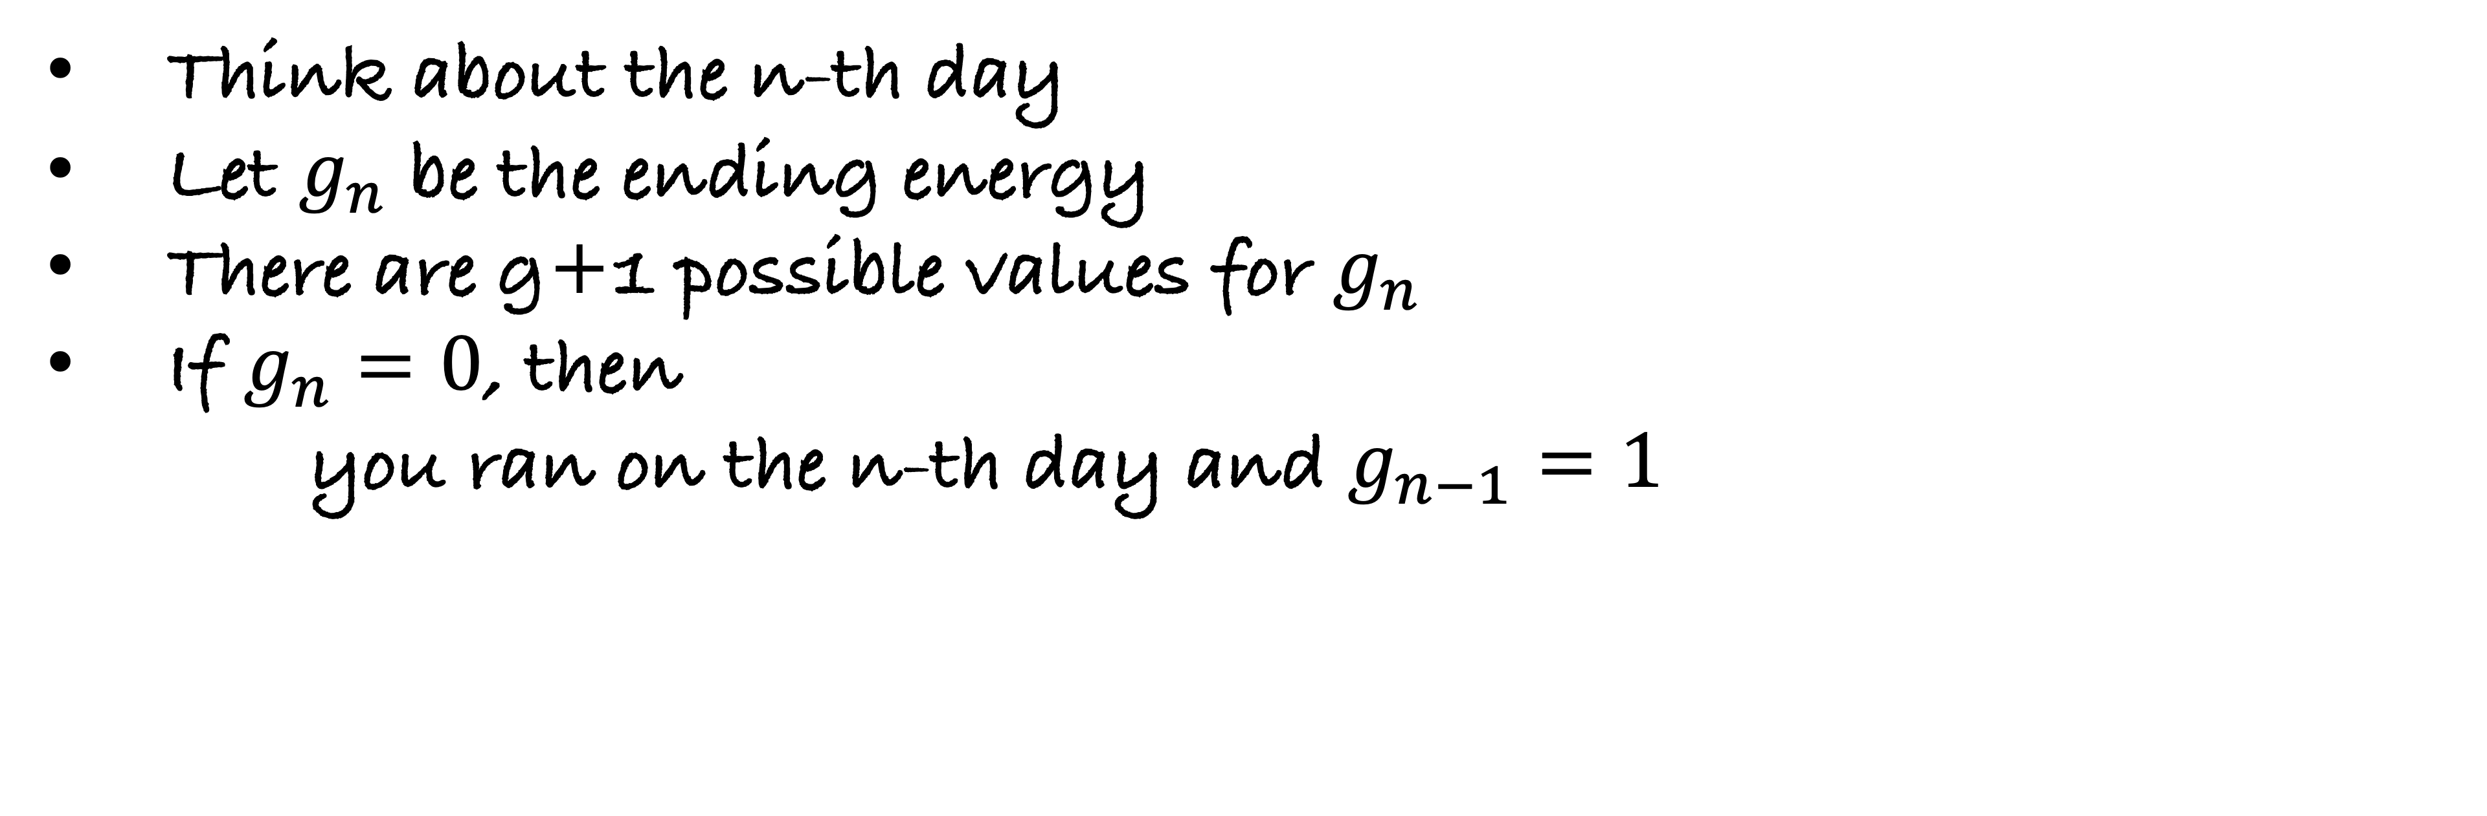

Think about the n-th day
Let $g_{n}$ be the ending energy
There are g+1 possible values for $g_{n}$
If $g_{n}=0$, then
  you ran on the n-th day and $g_{n−1}=1$
Day n-1
Day n
$$g=1$$
$$days\left[n\right]=40$$
$$g=0$$
30
70

Slide 14
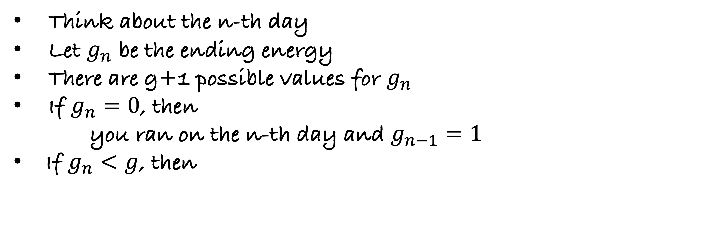
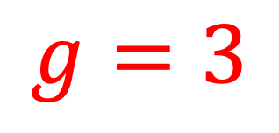
Think about the n-th day
Let $g_{n}$ be the ending energy
There are g+1 possible values for $g_{n}$
If $g_{n}=0$, then
  you ran on the n-th day and $g_{n−1}=1$
  If $g_{n}<g$, then
Day n
Day n
$$g=3$$
$$g=3$$
70
70

Slide 15

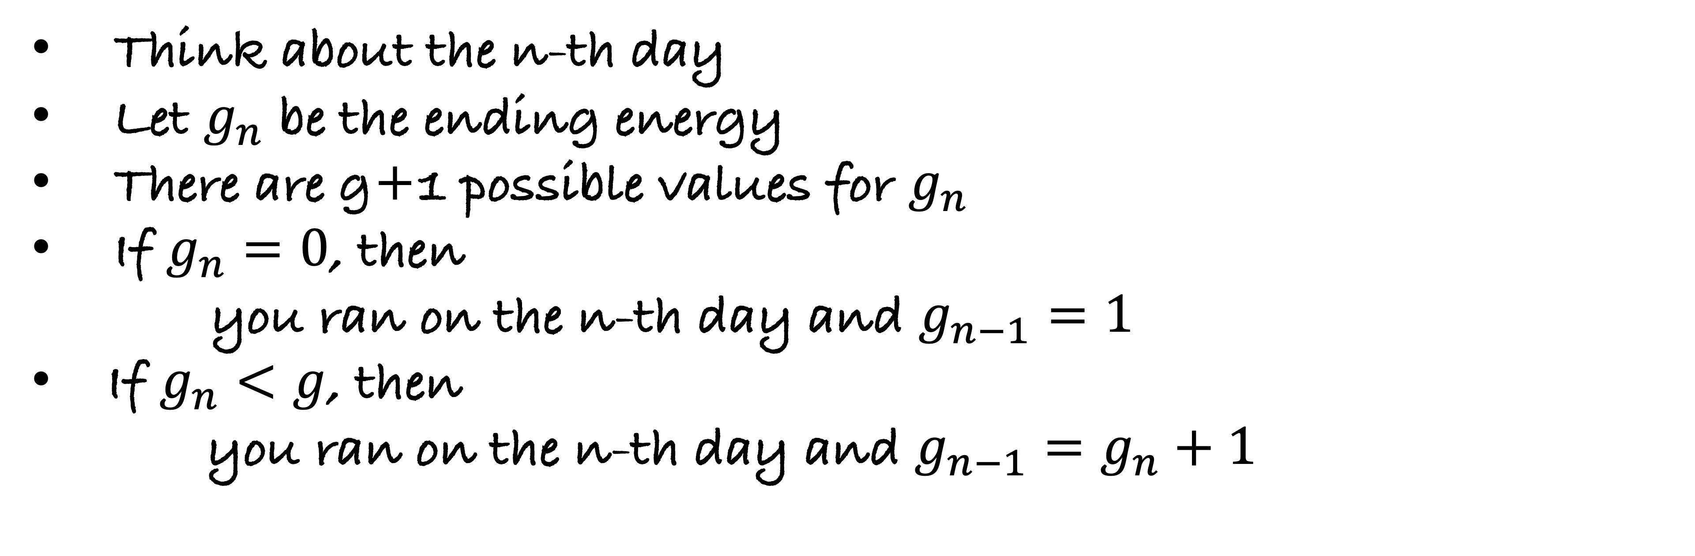
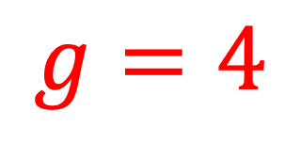
Think about the n-th day
Let $g_{n}$ be the ending energy
There are g+1 possible values for $g_{n}$
If $g_{n}=0$, then
  you ran on the n-th day and $g_{n−1}=1$
  If $g_{n}<g$, then
  you ran on the n-th day and $g_{n−1}=g_{n}+1$
Day n-1
Day n
$$g=4$$
$$g=3$$
Possibility (1)
$$days\left[n\right]=40$$
30
70

Slide 16
Think about the n-th day
Let $g_{n}$ be the ending energy
There are g+1 possible values for $g_{n}$
If $g_{n}=0$, then
  you ran on the n-th day and $g_{n−1}=1$
  If $g_{n}<g$, then
  you ran on the n-th day and $g_{n−1}=g_{n}+1$
Day n
Day n
$$g=3$$
Possibility (2)
$$g=3$$
70

Slide 17
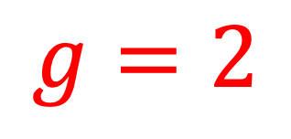
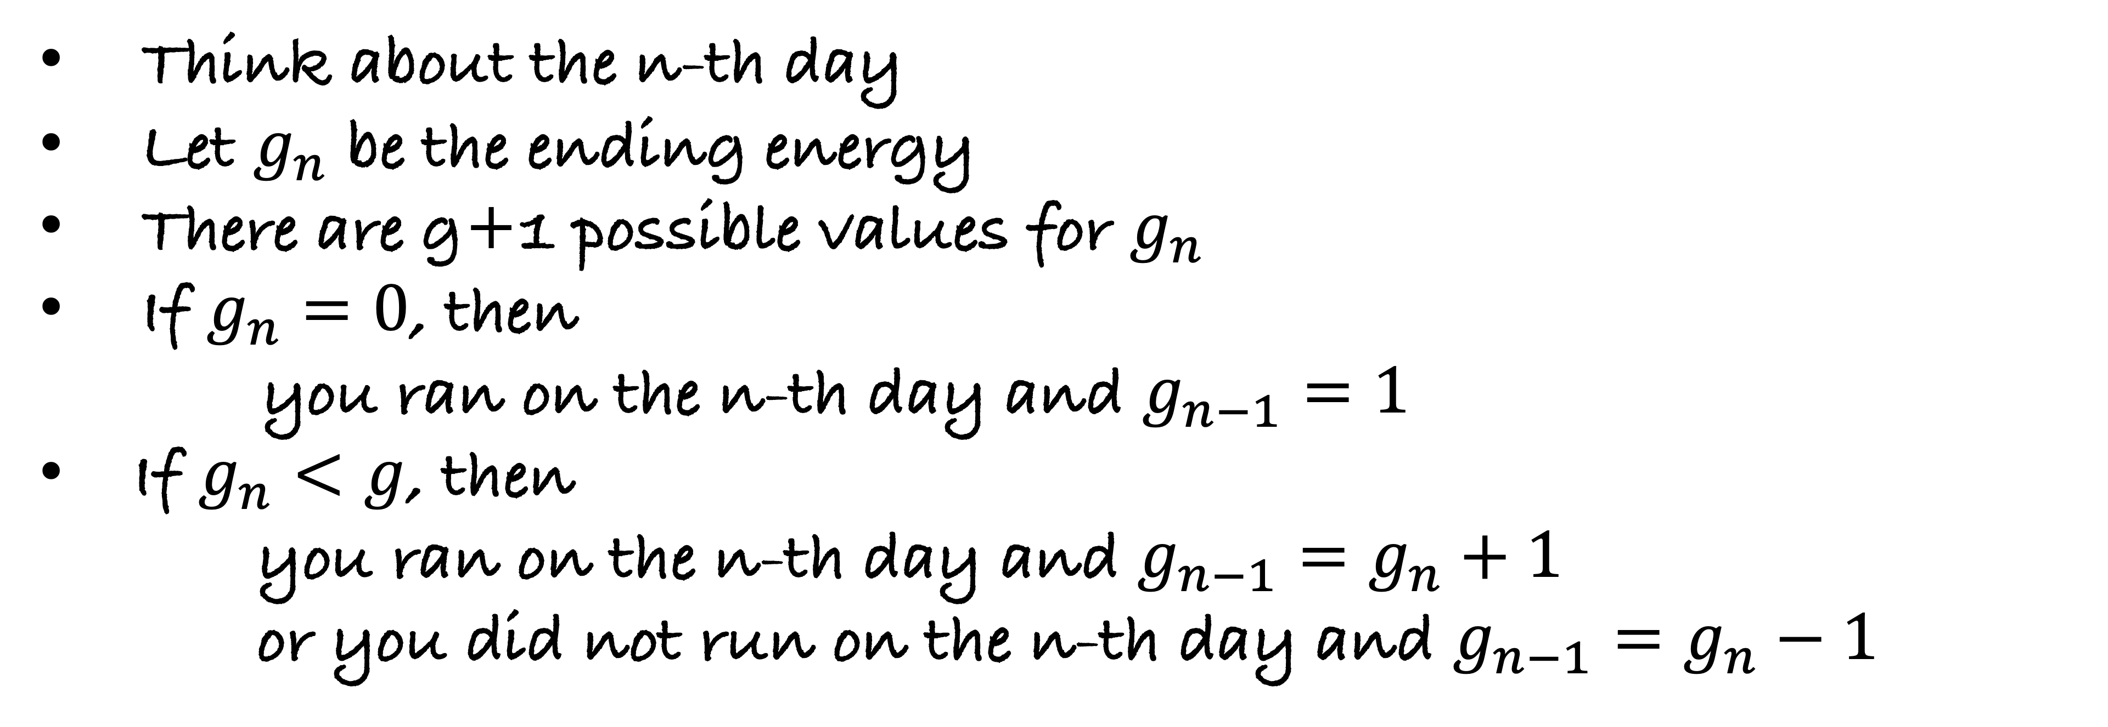

Think about the n-th day
Let $g_{n}$ be the ending energy
There are g+1 possible values for $g_{n}$
If $g_{n}=0$, then
  you ran on the n-th day and $g_{n−1}=1$
  If $g_{n}<g$, then
  you ran on the n-th day and $g_{n−1}=g_{n}+1$
  or you did not run on the n-th day and $g_{n−1}=g_{n}−1$
Day n-1
Day n
$$g=3$$
Possibility (2)
$$g=2$$
Did not run on the $n^{th}$ day
70
70

Slide 18

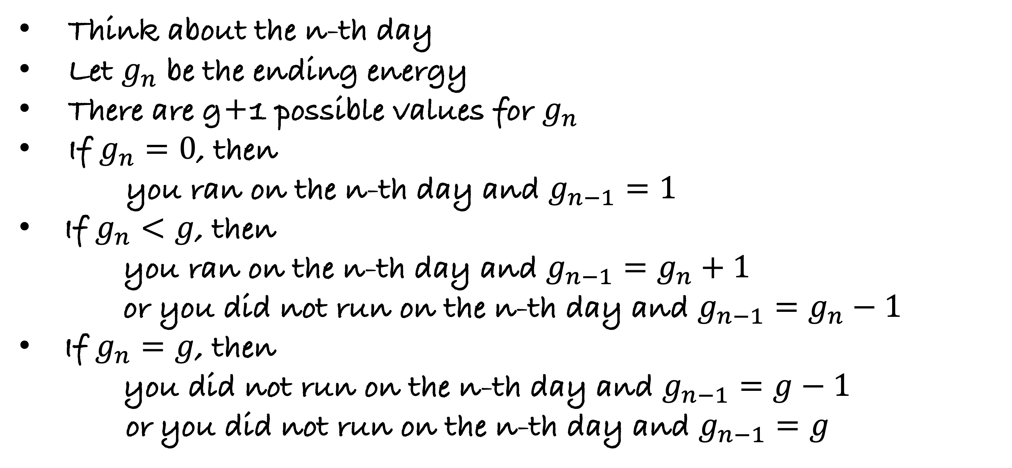
Think about the n-th day
Let $g_{n}$ be the ending energy
There are g+1 possible values for $g_{n}$
If $g_{n}=0$, then
  you ran on the n-th day and $g_{n−1}=1$
  If $g_{n}<g$, then
  you ran on the n-th day and $g_{n−1}=g_{n}+1$
  or you did not run on the n-th day and $g_{n−1}=g_{n}−1$
  If $g_{n}=g$, then
  you did not run on the n-th day and $g_{n−1}=g−1$
  or you did not run on the n-th day and $g_{n−1}=g$
finddistance(i,$g_{i}$): returns the maximum distance you can run till
i-th day with an ending energy $g_{i}$

Slide 19
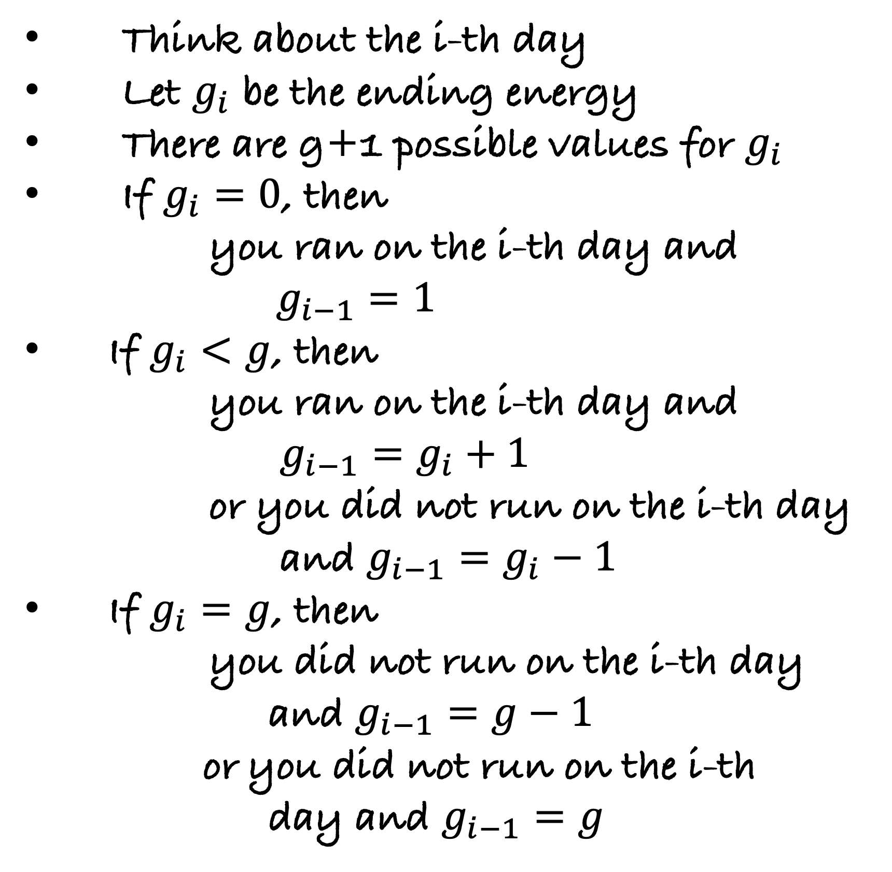


def finddistance($i,g_{i}$):
if $g_{i}=0$:
Think about the i-th day
Let $g_{i}$ be the ending energy
There are g+1 possible values for $g_{i}$
If $g_{i}=0$, then
  you ran on the i-th day and $g_{i−1}=1$
  If $g_{i}<g$, then
  you ran on the i-th day and $g_{i−1}=g_{i}+1$
  or you did not run on the i-th day
  and $g_{i−1}=g_{i}−1$
  If $g_{i}=g$, then
  you did not run on the i-th day
  and $g_{i−1}=g−1$
  or you did not run on the i-th
  day and $g_{i−1}=g$
finddistance(i,$g_{i}$): returns the maximum distance you can run till
i-th day with an ending energy $g_{i}$

Slide 20

def finddistance($i,g_{i}$):
if $g_{i}=0$:
return $days[i]$ + __________________________________
Think about the i-th day
Let $g_{i}$ be the ending energy
There are g+1 possible values for $g_{i}$
If $g_{i}=0$, then
  you ran on the i-th day and $g_{i−1}=1$
  If $g_{i}<g$, then
  you ran on the i-th day and $g_{i−1}=g_{i}+1$
  or you did not run on the i-th day
  and $g_{i−1}=g_{i}−1$
  If $g_{i}=g$, then
  you did not run on the i-th day
  and $g_{i−1}=g−1$
  or you did not run on the i-th
  day and $g_{i−1}=g$
finddistance(i,$g_{i}$): returns the maximum distance you can run till
i-th day with an ending energy $g_{i}$

Slide 21

def finddistance($i,g_{i}$):
if $g_{i}=0$:
return $days[i]$ + finddistance($i−1$, $g_{i−1}=1$)
Think about the i-th day
Let $g_{i}$ be the ending energy
There are g+1 possible values for $g_{i}$
If $g_{i}=0$, then
  you ran on the i-th day and $g_{i−1}=1$
  If $g_{i}<g$, then
  you ran on the i-th day and $g_{i−1}=g_{i}+1$
  or you did not run on the i-th day
  and $g_{i−1}=g_{i}−1$
  If $g_{i}=g$, then
  you did not run on the i-th day
  and $g_{i−1}=g−1$
  or you did not run on the i-th
  day and $g_{i−1}=g$
finddistance(i,$g_{i}$): returns the maximum distance you can run till
i-th day with an ending energy $g_{i}$

Slide 22

def finddistance($i,g_{i}$):
if $g_{i}=0$:
return $days[i]$ + finddistance($i−1$, $g_{i−1}=1$)
else if $g_{i}< g$:
Think about the i-th day
Let $g_{i}$ be the ending energy
There are g+1 possible values for $g_{i}$
If $g_{i}=0$, then
  you ran on the i-th day and $g_{i−1}=1$
  If $g_{i}<g$, then
  you ran on the i-th day and $g_{i−1}=g_{i}+1$
  or you did not run on the i-th day
  and $g_{i−1}=g_{i}−1$
  If $g_{i}=g$, then
  you did not run on the i-th day
  and $g_{i−1}=g−1$
  or you did not run on the i-th
  day and $g_{i−1}=g$
finddistance(i,$g_{i}$): returns the maximum distance you can run till
i-th day with an ending energy $g_{i}$

Slide 23

def finddistance($i,g_{i}$):
if $g_{i}=0$:
return $days[i]$ + finddistance($i−1$, $g_{i−1}=1$)
else if $g_{i}< g$:
return max{
$days[i]$ +_______________________________________,
Think about the i-th day
Let $g_{i}$ be the ending energy
There are g+1 possible values for $g_{i}$
If $g_{i}=0$, then
  you ran on the i-th day and $g_{i−1}=1$
  If $g_{i}<g$, then
  you ran on the i-th day and $g_{i−1}=g_{i}+1$
  or you did not run on the i-th day
  and $g_{i−1}=g_{i}−1$
  If $g_{i}=g$, then
  you did not run on the i-th day
  and $g_{i−1}=g−1$
  or you did not run on the i-th
  day and $g_{i−1}=g$
finddistance(i,$g_{i}$): returns the maximum distance you can run till
i-th day with an ending energy $g_{i}$

Slide 24
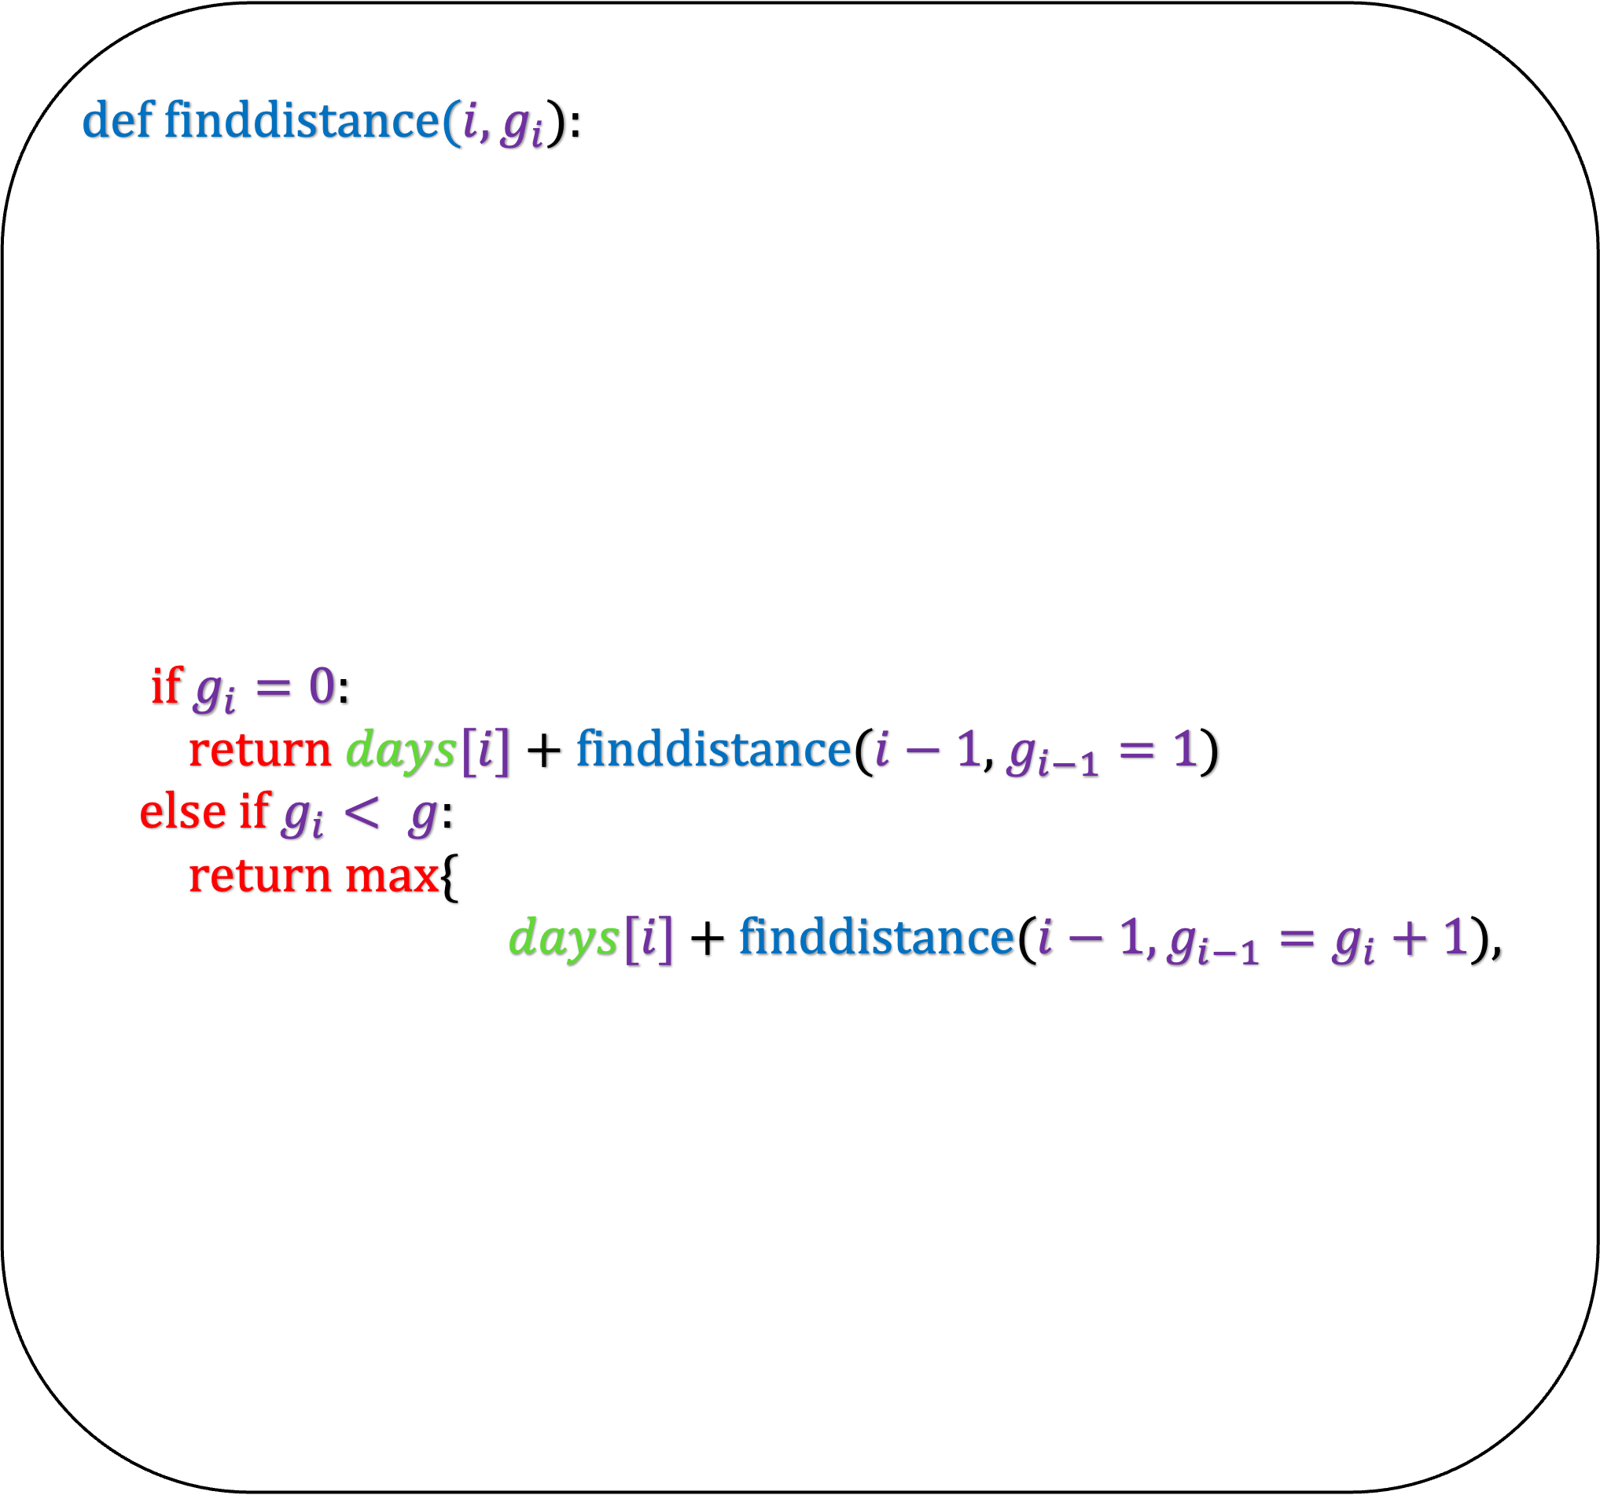
def finddistance($i,g_{i}$):
if $g_{i}=0$:
return $days[i]$ + finddistance($i−1$, $g_{i−1}=1$)
else if $g_{i}< g$:
return max{
$days[i]$ + finddistance($i−1, g_{i−1}=g_{i}+1$),
Think about the i-th day
Let $g_{i}$ be the ending energy
There are g+1 possible values for $g_{i}$
If $g_{i}=0$, then
  you ran on the i-th day and $g_{i−1}=1$
  If $g_{i}<g$, then
  you ran on the i-th day and $g_{i−1}=g_{i}+1$
  or you did not run on the i-th day
  and $g_{i−1}=g_{i}−1$
  If $g_{i}=g$, then
  you did not run on the i-th day
  and $g_{i−1}=g−1$
  or you did not run on the i-th
  day and $g_{i−1}=g$
finddistance(i,$g_{i}$): returns the maximum distance you can run till
i-th day with an ending energy $g_{i}$

Slide 25
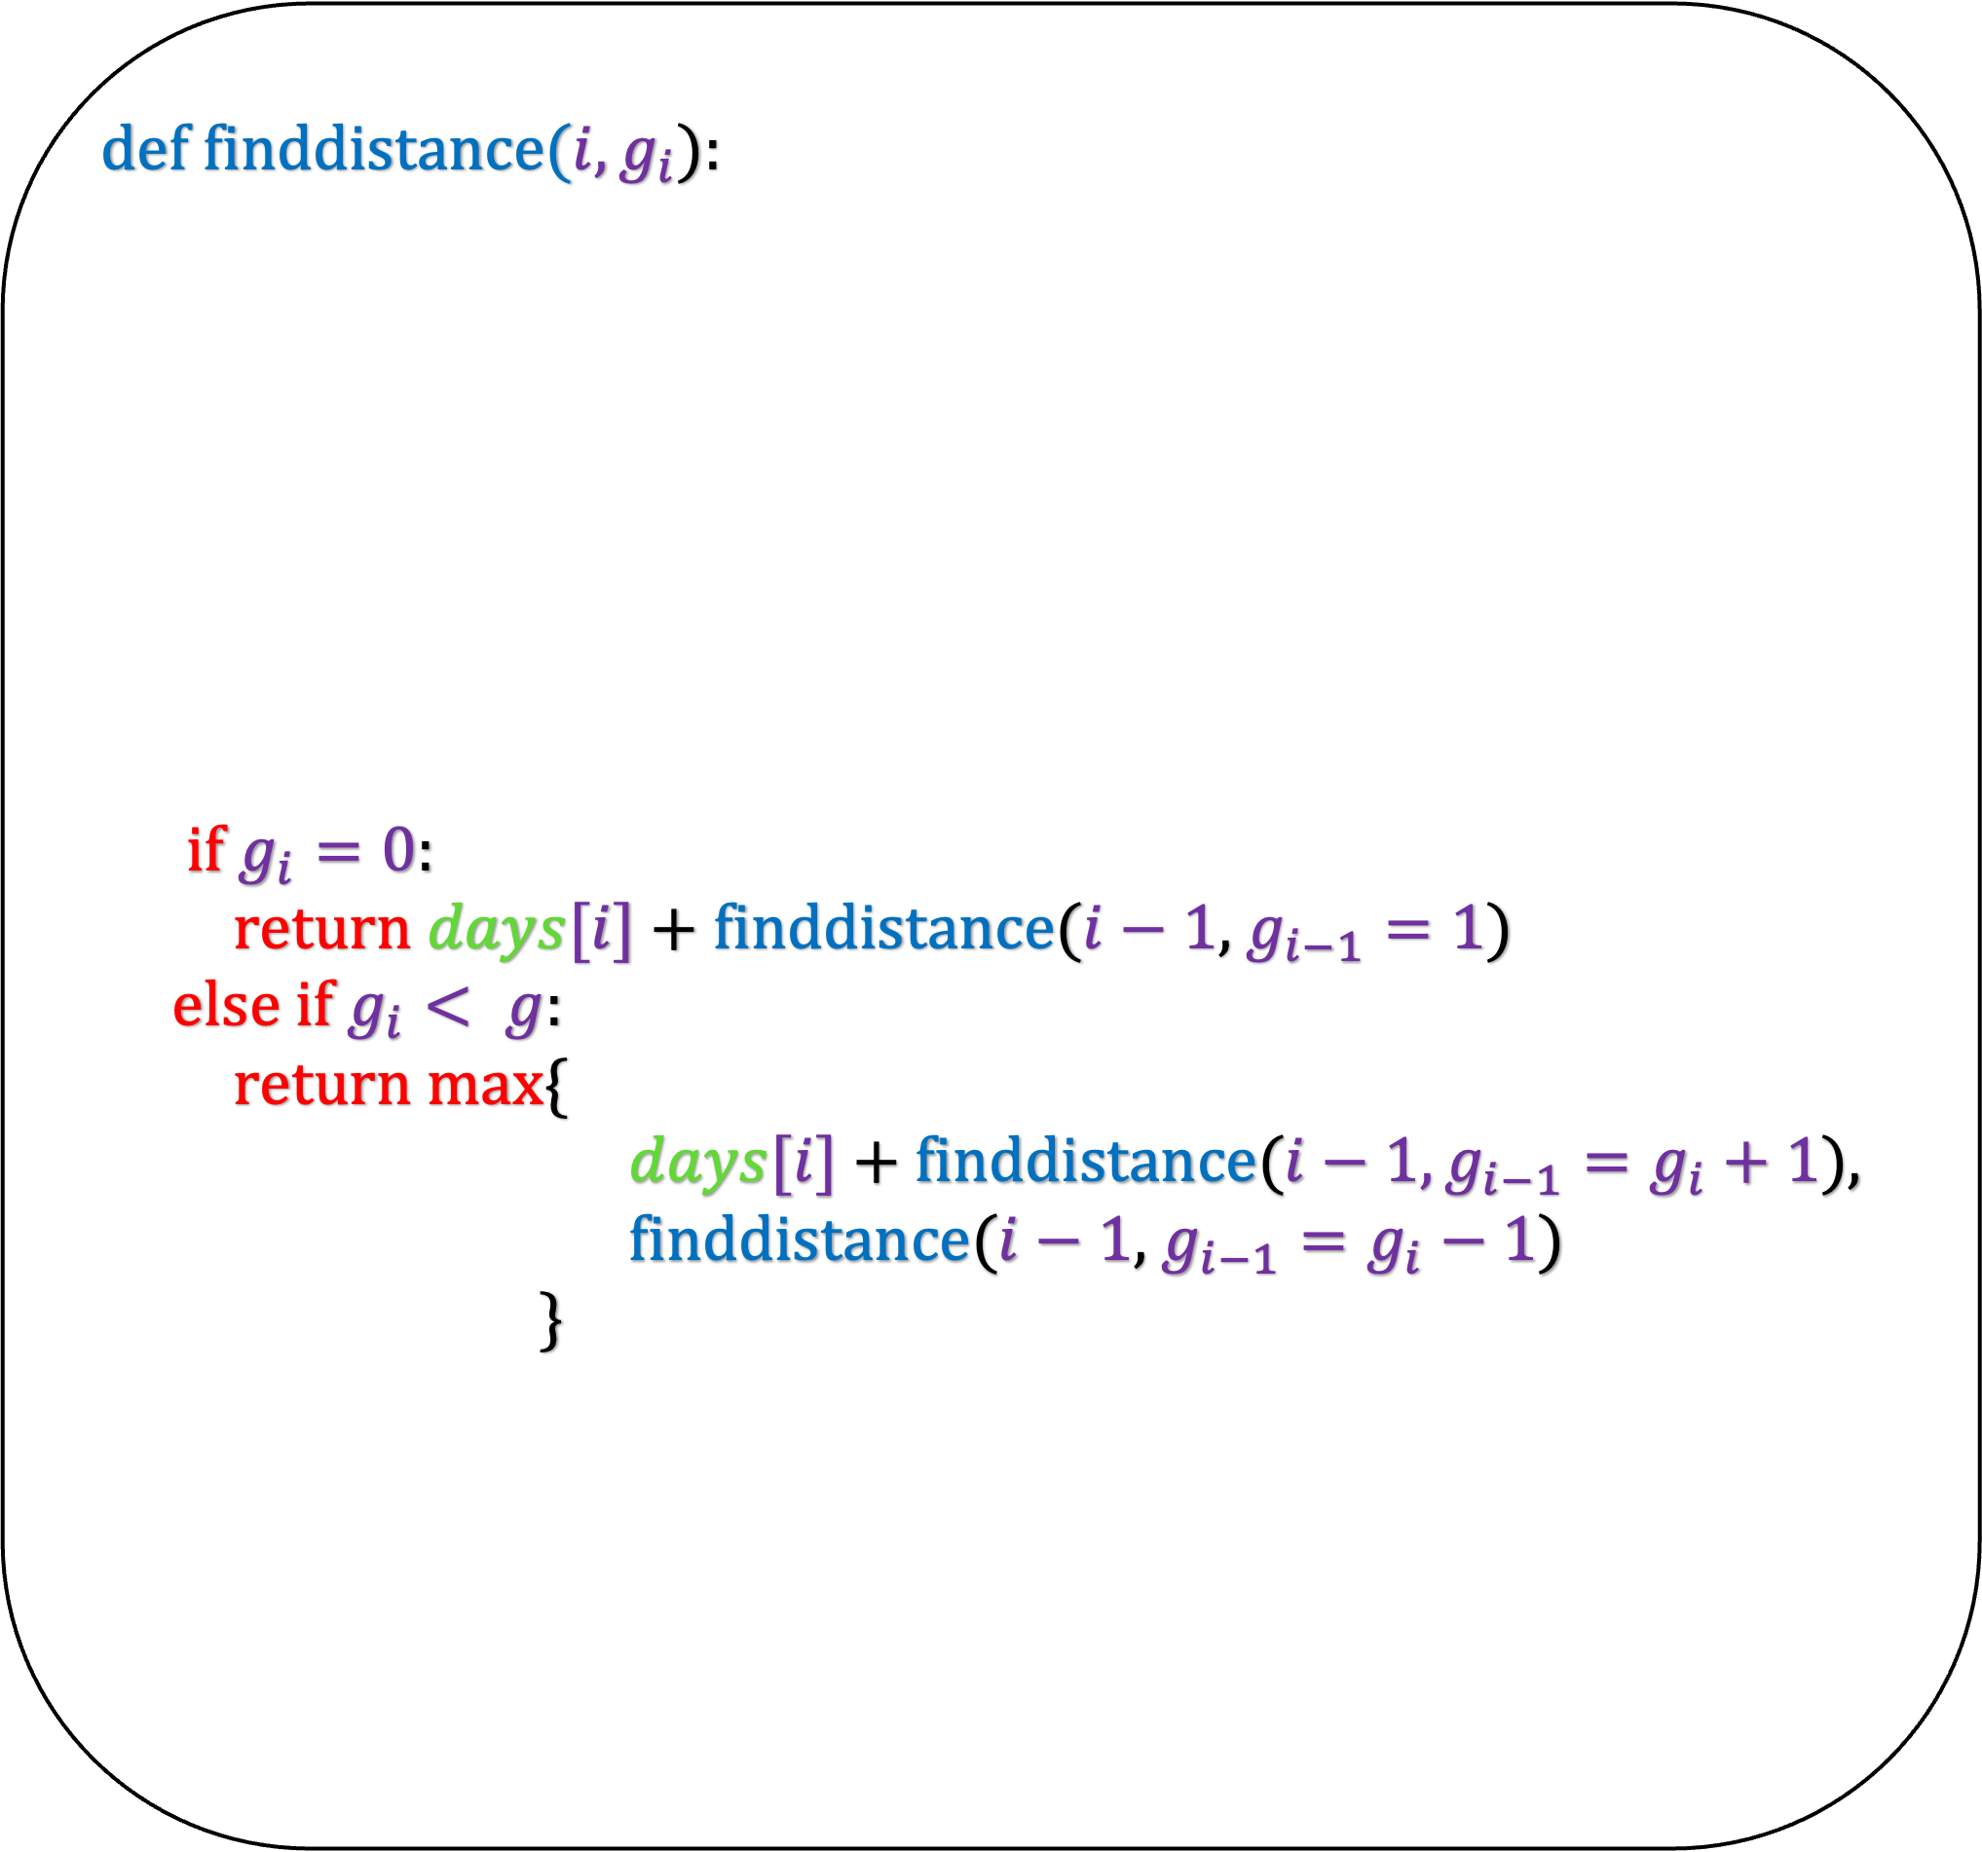
def finddistance($i,g_{i}$):
if $g_{i}=0$:
return $days[i]$ + finddistance($i−1$, $g_{i−1}=1$)
else if $g_{i}< g$:
return max{
$days[i]$ + finddistance($i−1, g_{i−1}=g_{i}+1$),
finddistance($i−1$, $g_{i−1}=g_{i}−1$)
}
Think about the i-th day
Let $g_{i}$ be the ending energy
There are g+1 possible values for $g_{i}$
If $g_{i}=0$, then
  you ran on the i-th day and $g_{i−1}=1$
  If $g_{i}<g$, then
  you ran on the i-th day and $g_{i−1}=g_{i}+1$
  or you did not run on the i-th day
  and $g_{i−1}=g_{i}−1$
  If $g_{i}=g$, then
  you did not run on the i-th day
  and $g_{i−1}=g−1$
  or you did not run on the i-th
  day and $g_{i−1}=g$
finddistance(i,$g_{i}$): returns the maximum distance you can run till
i-th day with an ending energy $g_{i}$

Slide 26
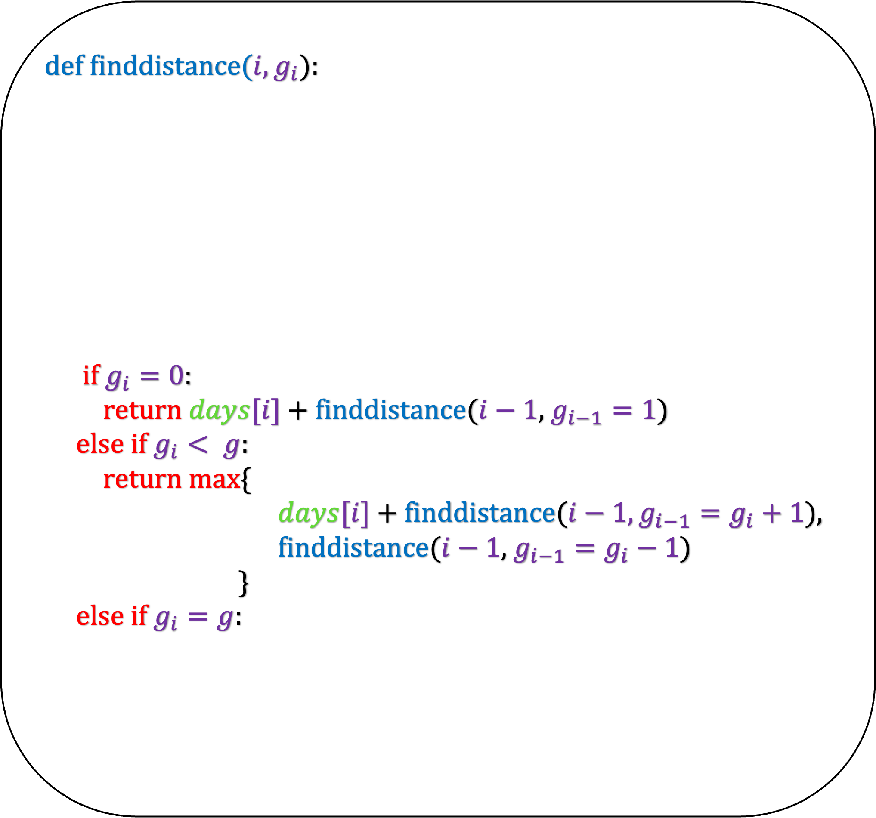
def finddistance($i,g_{i}$):
if $g_{i}=0$:
return $days[i]$ + finddistance($i−1$, $g_{i−1}=1$)
else if $g_{i}< g$:
return max{
$days[i]$ + finddistance($i−1, g_{i−1}=g_{i}+1$),
finddistance($i−1$, $g_{i−1}=g_{i}−1$)
}
else if $g_{i}=g$:
Think about the i-th day
Let $g_{i}$ be the ending energy
There are g+1 possible values for $g_{i}$
If $g_{i}=0$, then
  you ran on the i-th day and $g_{i−1}=1$
  If $g_{i}<g$, then
  you ran on the i-th day and $g_{i−1}=g_{i}+1$
  or you did not run on the i-th day
  and $g_{i−1}=g_{i}−1$
  If $g_{i}=g$, then
  you did not run on the i-th day
  and $g_{i−1}=g−1$
  or you did not run on the i-th
  day and $g_{i−1}=g$
finddistance(i,$g_{i}$): returns the maximum distance you can run till
i-th day with an ending energy $g_{i}$

Slide 27
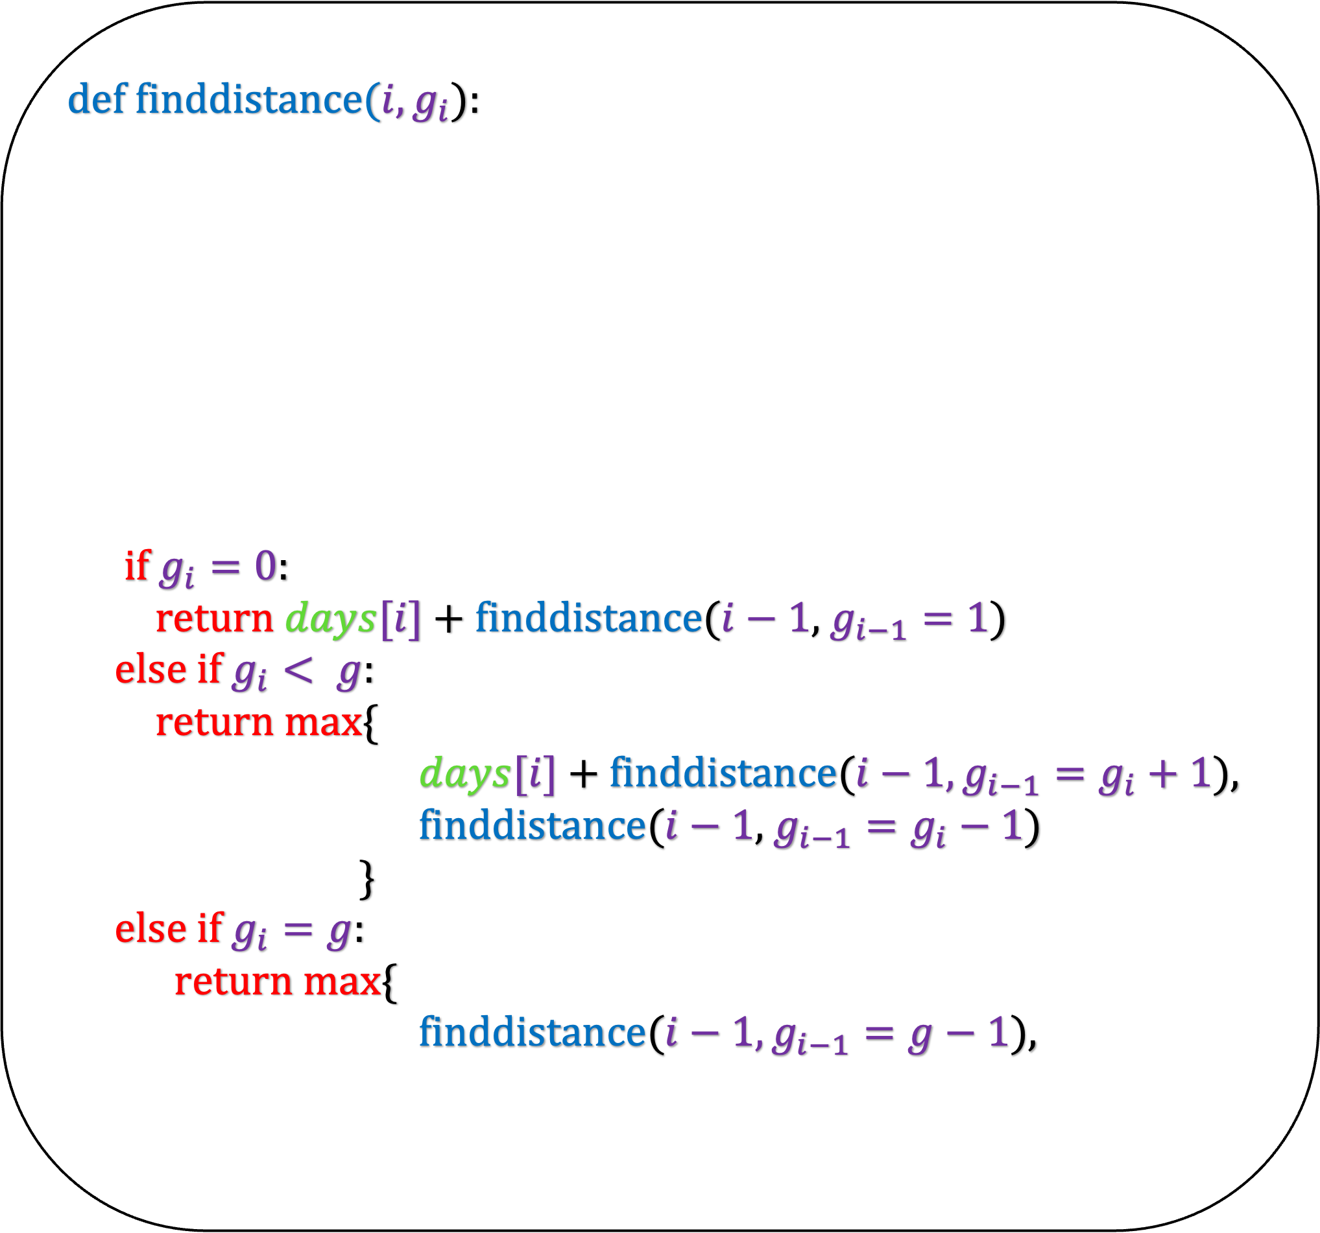
def finddistance($i,g_{i}$):
if $g_{i}=0$:
return $days[i]$ + finddistance($i−1$, $g_{i−1}=1$)
else if $g_{i}< g$:
return max{
$days[i]$ + finddistance($i−1, g_{i−1}=g_{i}+1$),
finddistance($i−1$, $g_{i−1}=g_{i}−1$)
}
else if $g_{i}=g$:
return max{
finddistance($i−1, g_{i−1}=g−1$),
Think about the i-th day
Let $g_{i}$ be the ending energy
There are g+1 possible values for $g_{i}$
If $g_{i}=0$, then
  you ran on the i-th day and $g_{i−1}=1$
  If $g_{i}<g$, then
  you ran on the i-th day and $g_{i−1}=g_{i}+1$
  or you did not run on the i-th day
  and $g_{i−1}=g_{i}−1$
  If $g_{i}=g$, then
  you did not run on the i-th day
  and $g_{i−1}=g−1$
  or you did not run on the i-th
  day and $g_{i−1}=g$
finddistance(i,$g_{i}$): returns the maximum distance you can run till
i-th day with an ending energy $g_{i}$

Slide 28
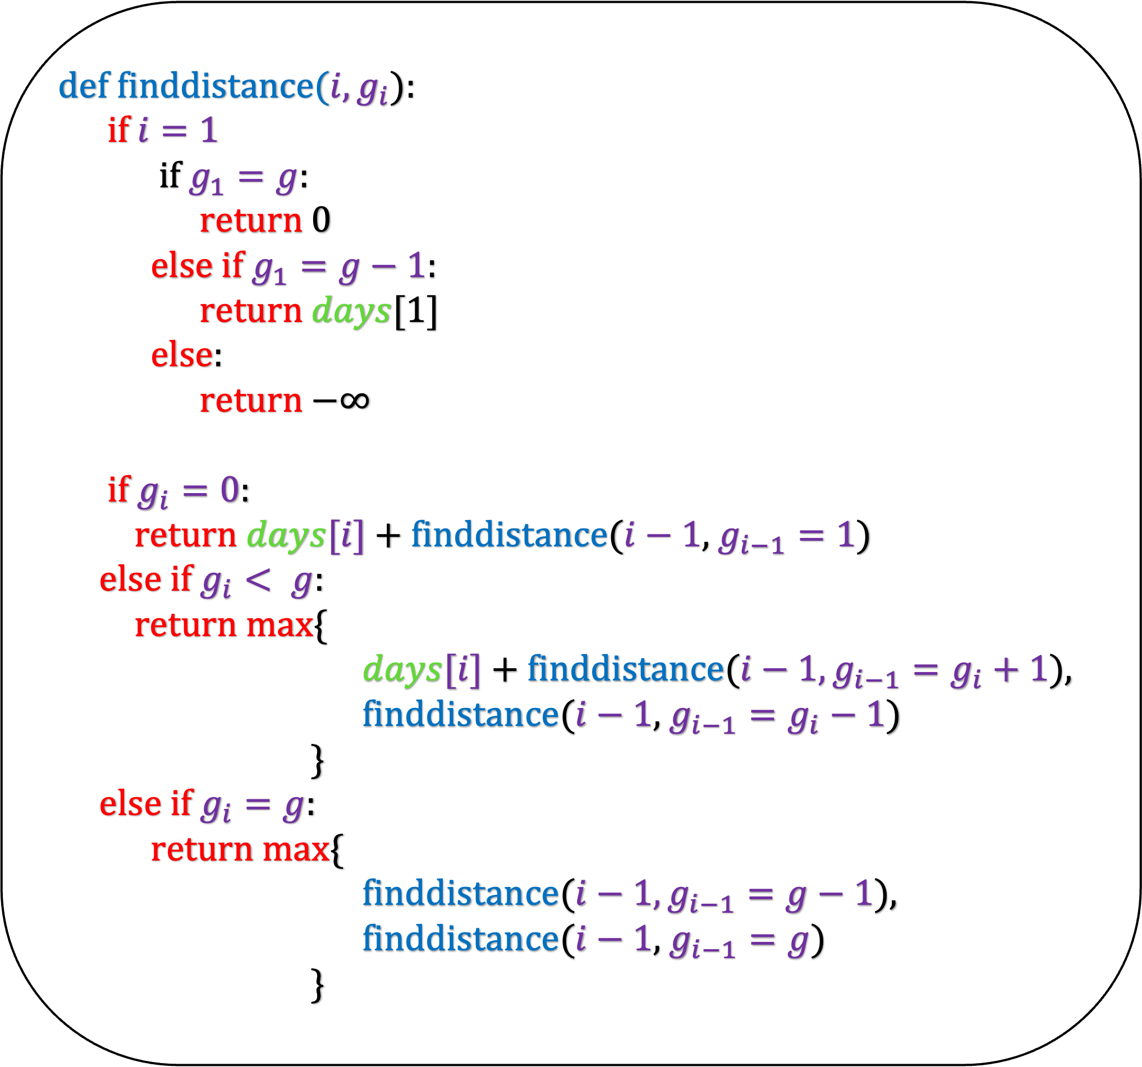
def finddistance($i,g_{i}$):
if $i=1$
if $g_{1}=g$:
return 0
else if $g_{1}=g−1$:
return $days[1]$
else:
return $−∞$
if $g_{i}=0$:
return $days[i]$ + finddistance($i−1$, $g_{i−1}=1$)
else if $g_{i}< g$:
return max{
$days[i]$ + finddistance($i−1, g_{i−1}=g_{i}+1$),
finddistance($i−1$, $g_{i−1}=g_{i}−1$)
}
else if $g_{i}=g$:
return max{
finddistance($i−1, g_{i−1}=g−1$),
finddistance($i−1$, $g_{i−1}=g$)
}
Think about the i-th day
Let $g_{i}$ be the ending energy
There are g+1 possible values for $g_{i}$
If $g_{i}=0$, then
  you ran on the i-th day and $g_{i−1}=1$
  If $g_{i}<g$, then
  you ran on the i-th day and $g_{i−1}=g_{i}+1$
  or you did not run on the i-th day
  and $g_{i−1}=g_{i}−1$
  If $g_{i}=g$, then
  you did not run on the i-th day
  and $g_{i−1}=g−1$
  or you did not run on the i-th
  day and $g_{i−1}=g$
What is the base case?

Slide 29
def finddistance($i,g_{i}$):
if $i=1$
if $g_{1}=g$:
return 0
else if $g_{1}=g−1$:
return $days[1]$
else:
return $−∞$
if $g_{i}=0$:
return $days[i]$ + finddistance($i−1$, $g_{i−1}=1$)
else if $g_{i}< g$:
return max{
$days[i]$ + finddistance($i−1, g_{i−1}=g_{i}+1$),
finddistance($i−1$, $g_{i−1}=g_{i}−1$)
}
else if $g_{i}=g$:
return max{
finddistance($i−1, g_{i−1}=g−1$),
finddistance($i−1$, $g_{i−1}=g$)
}
Your answer is finddistance(n,0) or finddistance(n,1) or …. or finddistance(n,g)
What is the running time of this algorithm?
O(ng) if you use memoization
Let us now implement non-recursive algorithm for this problem.

Slide 30
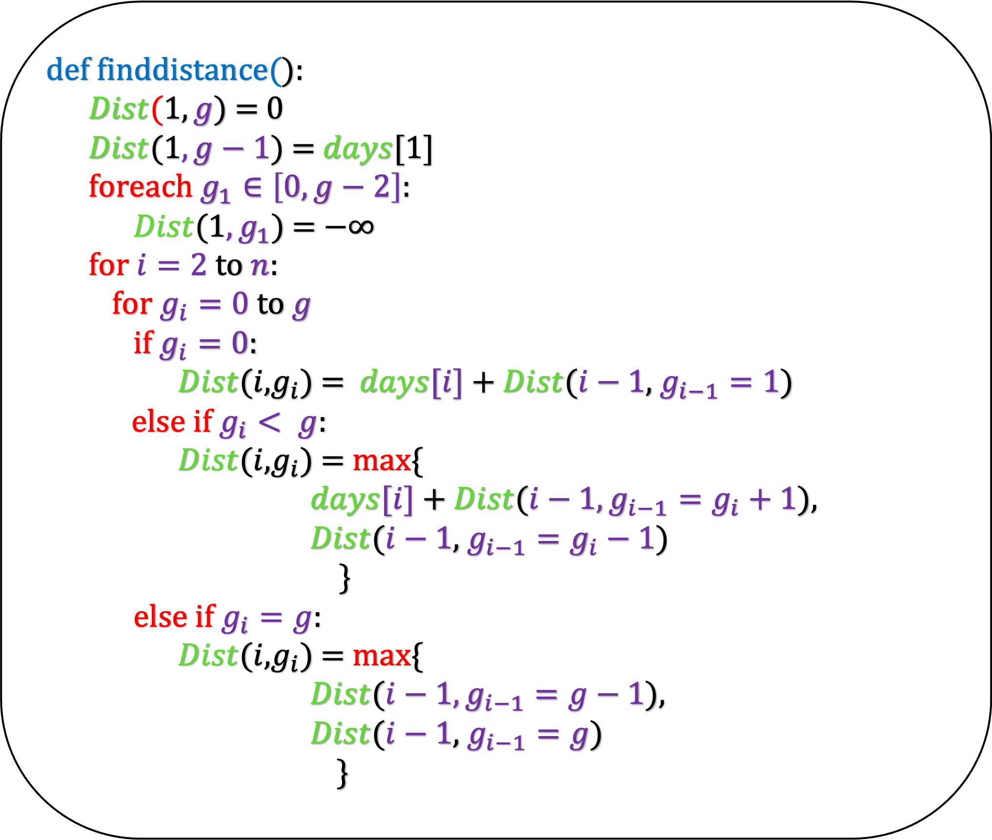
def finddistance($i,g_{i}$):
if $i=1$
if $g_{1}=g$:
return 0
else if $g_{1}=g−1$:
return $days[1]$
else:
return $−∞$
if $g_{i}=0$:
return $days[i]$ + finddistance($i−1$, $g_{i−1}=1$)
else if $g_{i}< g$:
return max{
$days[i]$ + finddistance($i−1, g_{i−1}=g_{i}+1$),
finddistance($i−1$, $g_{i−1}=g_{i}−1$)
}
else if $g_{i}=g$:
return max{
finddistance($i−1, g_{i−1}=g−1$),
finddistance($i−1$, $g_{i−1}=g$)
}
def finddistance():
$Dist$($1,g$) = 0
$Dist$(1$,g−1$) = $days$[1]
foreach $g_{1}∈\left[0,g−2\right]$:
$Dist$(1$,g_{1}$) = $−∞$
for $i=2$ to $n$:
for $g_{i}=0$ to $g$
if $g_{i}=0$:
$Dist$($i$,$g_{i}$) = $days[i]$ + $Dist$($i−1$, $g_{i−1}=1$)
else if $g_{i}< g$:
$Dist$($i$,$g_{i}$) = max{
$days[i]$ + $Dist$($i−1, g_{i−1}=g_{i}+1$),
$Dist$($i−1$, $g_{i−1}=g_{i}−1$)
}
else if $g_{i}=g$:
$Dist$($i$,$g_{i}$) = max{
$Dist$($i−1, g_{i−1}=g−1$),
$Dist$($i−1$, $g_{i−1}=g$)
}
Dist($i,g_{i}$) : The maximum distance you can cover till the i-th day with ending energy $g_{i}$

Slide 31
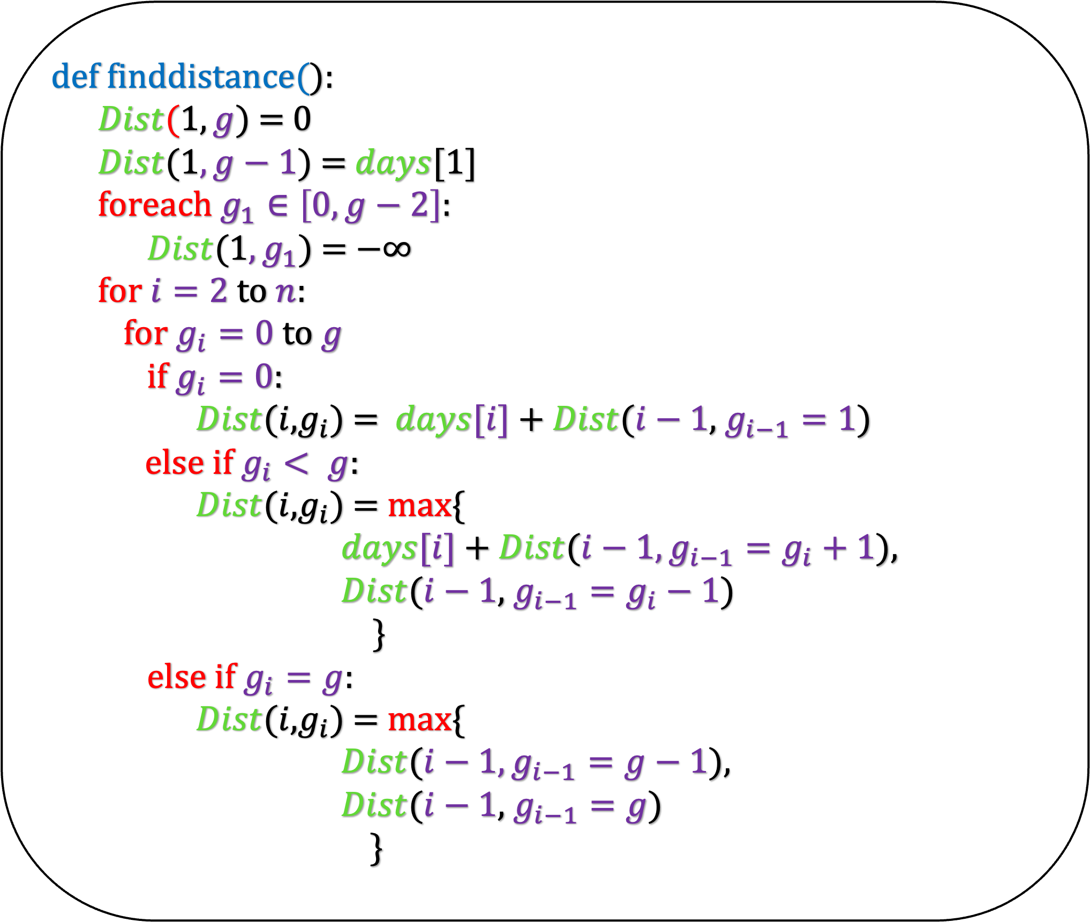
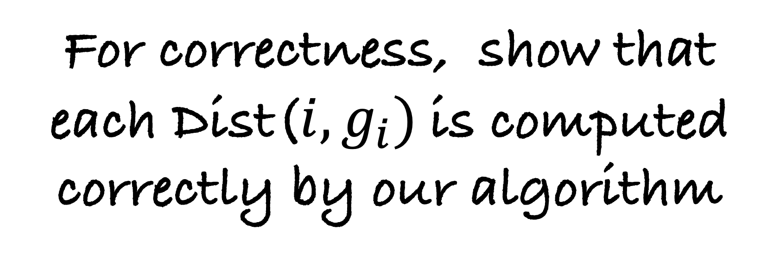
def finddistance():
$Dist$($1,g$) = 0
$Dist$(1$,g−1$) = $days$[1]
foreach $g_{1}∈\left[0,g−2\right]$:
$Dist$(1$,g_{1}$) = $−∞$
for $i=2$ to $n$:
for $g_{i}=0$ to $g$
if $g_{i}=0$:
$Dist$($i$,$g_{i}$) = $days[i]$ + $Dist$($i−1$, $g_{i−1}=1$)
else if $g_{i}< g$:
$Dist$($i$,$g_{i}$) = max{
$days[i]$ + $Dist$($i−1, g_{i−1}=g_{i}+1$),
$Dist$($i−1$, $g_{i−1}=g_{i}−1$)
}
else if $g_{i}=g$:
$Dist$($i$,$g_{i}$) = max{
$Dist$($i−1, g_{i−1}=g−1$),
$Dist$($i−1$, $g_{i−1}=g$)
}
The running time of this algorithm is clearly O(ng)
For correctness, show that each Dist($i,g_{i})$is computed correctly by our algorithm

Slide 32
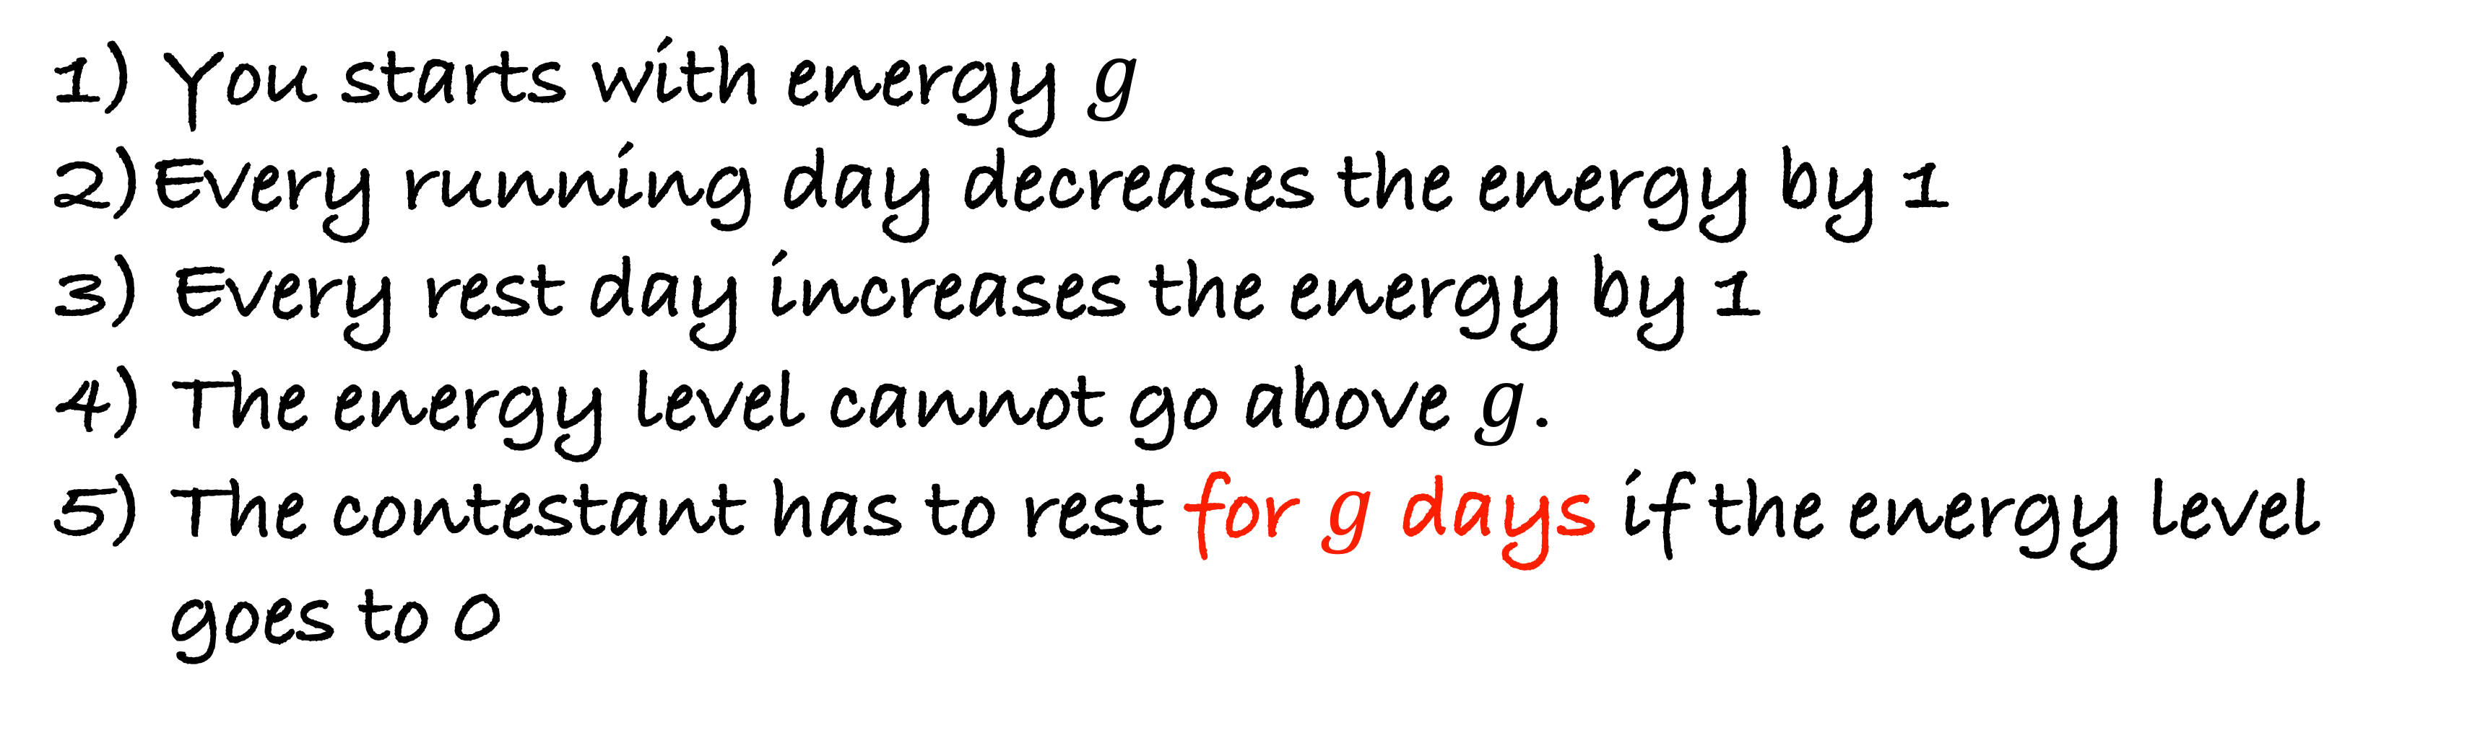
You are given an array days of size n. days[i] denotes the distance you can run on the i-th day. There are following constraints:
1) You starts with energy $g$
2)Every running day decreases the energy by 1
3) Every rest day increases the energy by 1
4) The energy level cannot go above $g$.
5) The contestant has to rest for $g$ days if the energy level
goes to 0
One more addition to the constraint in the problem
Homework: Solve this problem.

