Slide 1
Majority

Slide 2



You are given an array that contains some objects.

Slide 3
You also have access to a function equal which is defined as follows

Slide 4
(
)
,
= 0
equal
You also have access to a function equal which is defined as follows

Slide 5
(
)
,
= 0
equal
You also have access to a function equal which is defined as follows
(
)
,
= 1
equal

Slide 6
1 if a=b
equal(a,b) =
0 otherwise
We can assume that the function equal takes O(1) time.

Slide 7

An element is called a majority element if it appears more than $\left\lfloor \frac{n}{2}\right\rfloor$ times in the array.
Design an algorithm to find the majority element in the array. If the array does not contain a majority elements, return NULL.

Slide 8
How would you solve this problem?

Slide 9

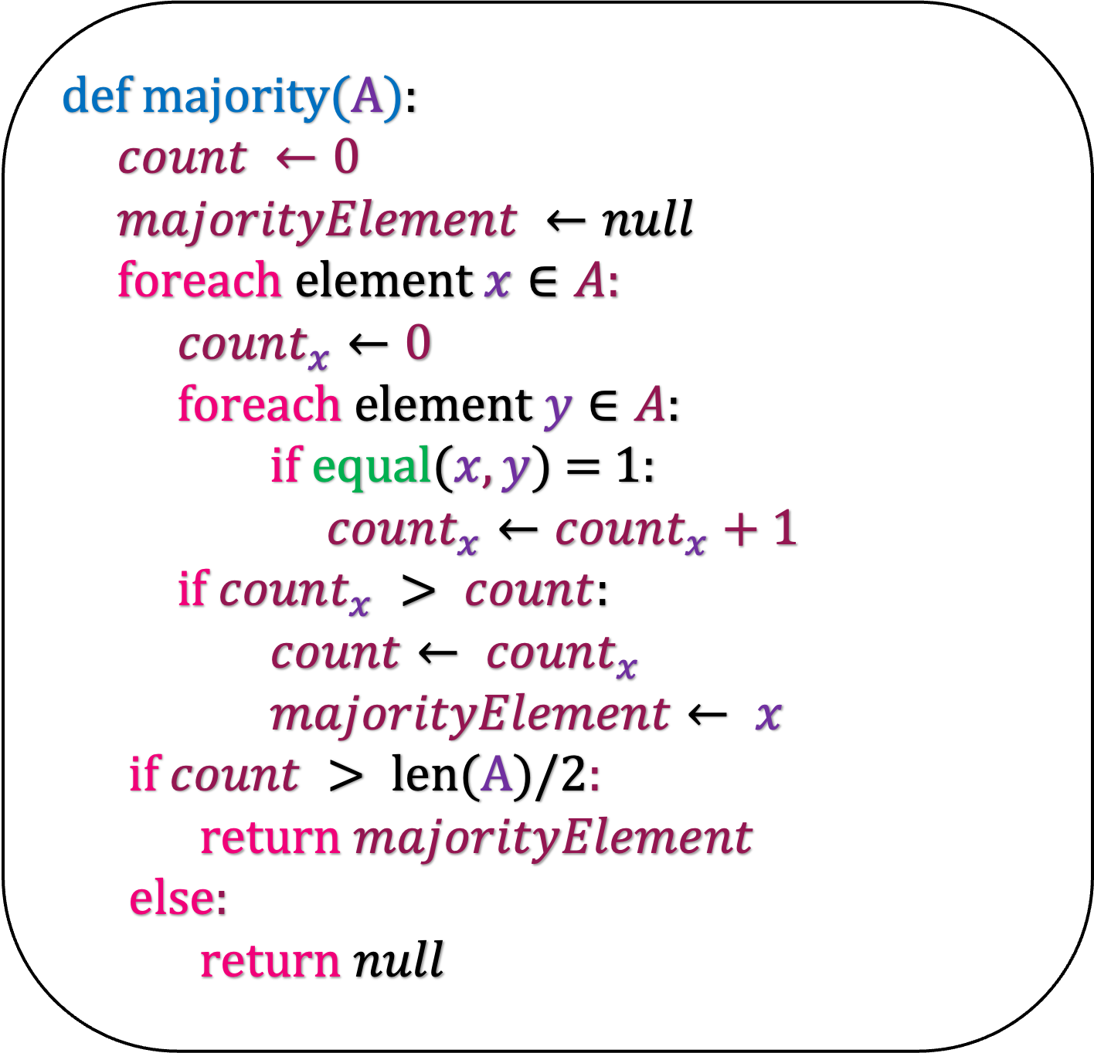
def m$ajority(A$):
$count ←0$
$majorityElement ←null$
foreach element $x∈A:$
$count_{x}←0$
foreach element $y∈A$:
if equal($x,y$) = 1:
$count_{x}←count_{x}+1$
if $count_{x} > count$:
$count← count_{x}$
$majorityElement← x$
if $count > len(A)/2$:
return $majorityElement$
else:
return $null$
What is the running time of this algorithm?
O($n^{2}$)
Can you do something better? Think about divide and conquer.

Slide 11
Left Half
Right Half

Slide 12
Right Half
Recursively solve the problem in the left half

Slide 13

Right Half
Recursively solve the problem in the left half

Slide 14
Recursively solve the problem in the left half
Recursively solve the problem in the right half

Slide 15

Recursively solve the problem in the left half
Recursively solve the problem in the right half
$$∅$$
How do you combine these two answers?

Slide 16
Recursively solve the problem in the left half
Recursively solve the problem in the right half
$$∅$$
Find the count of left half answer and right half answer in the full array using the equal function.
How do you combine these two answers?

Slide 17
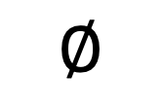

Recursively solve the problem in the left half
Recursively solve the problem in the right half
$$∅$$
count = 13
$>12$
Count = 0
$$∅$$
Find the count of left half answer and right half answer in the full array using the equal function.
How do you combine these two answers?

Slide 18
Majority Element

Slide 19
Implementation

Slide 20
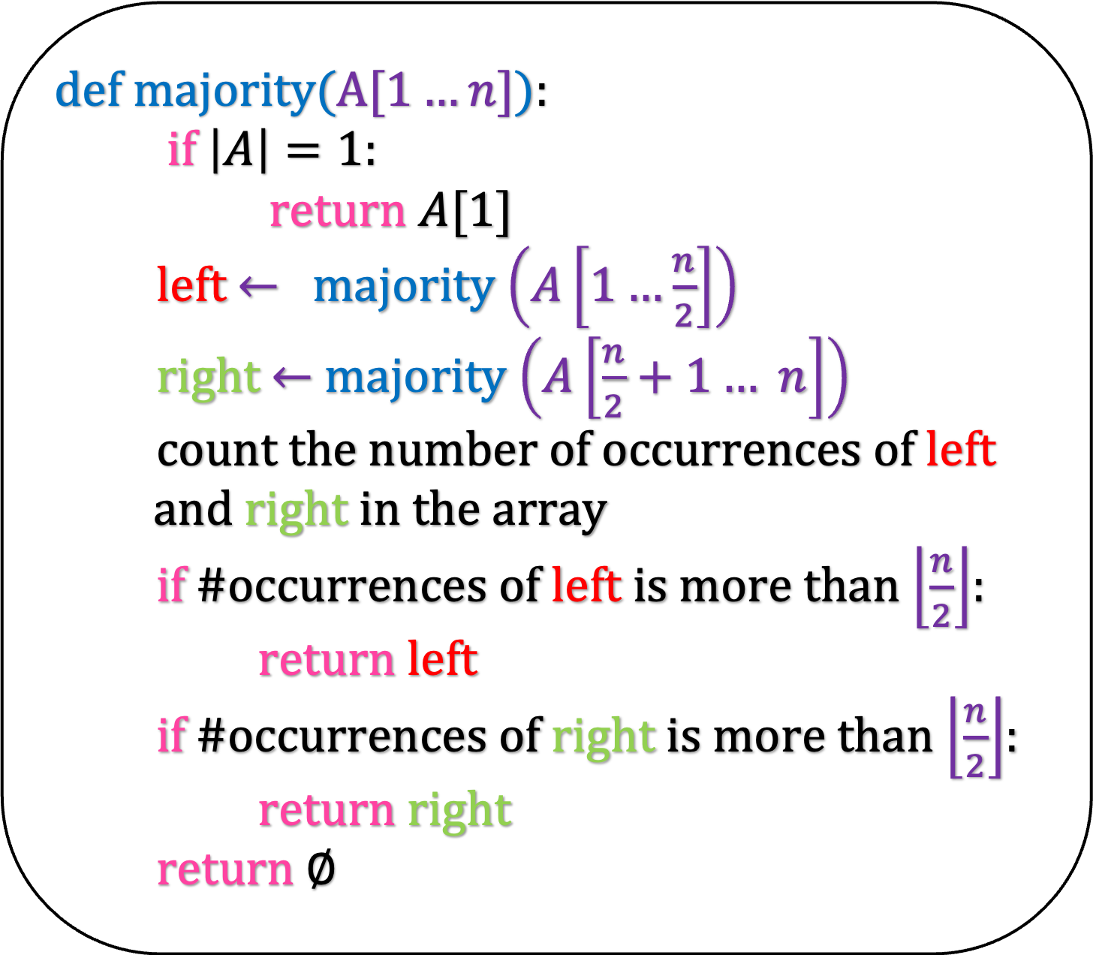
def m$ajority(A[1…n]$):
if $\left|A\right|=1:$
return $A[1]$
left $←$majority $\left(A\left[1…\frac{n}{2}\right]\right)$
right $←$ majority $\left(A\left[\frac{n}{2}+1… n\right]\right)$
count the number of occurrences of left
and right in the array
if #occurrences of left is more than $\left\lfloor \frac{n}{2}\right\rfloor$:
return left
if #occurrences of right is more than $\left\lfloor \frac{n}{2}\right\rfloor$:
return right
return $∅$

Slide 21
Running Time

Slide 22
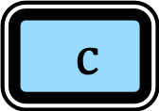

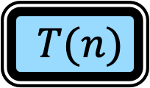
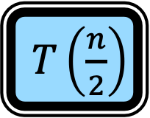
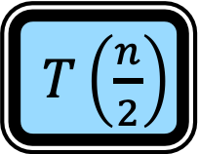
def m$ajority(A[1…n]$):
if $\left|A\right|=1:$
return $A[1]$
left $←$majority $\left(A\left[1…\frac{n}{2}\right]\right)$
right $←$ majority $\left(A\left[\frac{n}{2}+1… n\right]\right)$
count the number of occurrences of left
and right in the array
if #occurrences of left is more than $\left\lfloor \frac{n}{2}\right\rfloor$:
return left
if #occurrences of right is more than $\left\lfloor \frac{n}{2}\right\rfloor$:
return right
return $∅$
$T(n)$
$c$
$T\left(\frac{n}{2}\right)$
$T\left(\frac{n}{2}\right)$
$cn$

Slide 23
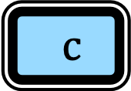
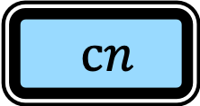
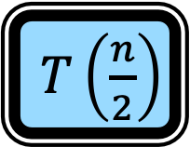
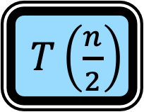
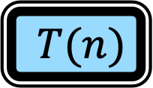
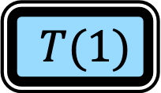
def m$ajority(A[1…n]$):
if $\left|A\right|=1:$
return $A[1]$
left $←$majority $\left(A\left[1…\frac{n}{2}\right]\right)$
right $←$ majority $\left(A\left[\frac{n}{2}+1… n\right]\right)$
count the number of occurrences of left
and right in the array
if #occurrences of left is more than $\left\lfloor \frac{n}{2}\right\rfloor$:
return left
if #occurrences of right is more than $\left\lfloor \frac{n}{2}\right\rfloor$:
return right
return $∅$
$T(n)$
$T\left(\frac{n}{2}\right)$
$T\left(\frac{n}{2}\right)$
$cn$
$T(1)$
$c$

Slide 24
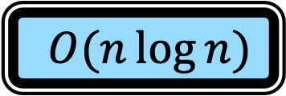
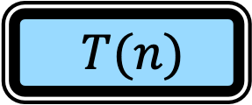
def m$ajority(A[1…n]$):
if $\left|A\right|=1:$
return $A[1]$
left $←$majority $\left(A\left[1…\frac{n}{2}\right]\right)$
right $←$ majority $\left(A\left[\frac{n}{2}+1… n\right]\right)$
count the number of occurrences of left
and right in the array
if #occurrences of left is more than $\left\lfloor \frac{n}{2}\right\rfloor$:
return left
if #occurrences of right is more than $\left\lfloor \frac{n}{2}\right\rfloor$:
return right
return $∅$
$T(n)$
$T\left(\frac{n}{2}\right)$
$T\left(\frac{n}{2}\right)$
$cn$
$T(1)$
$c$
$T(n)$
$O(n\log{n)}$

Slide 25
Correctness

Slide 26

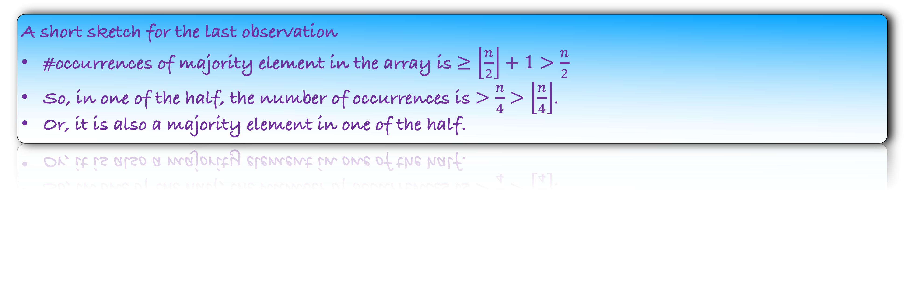
Some Observations:
The number of majority elements in the array is
If there is a majority element in the array then it is a majority element in
$≤1$
either the left half or the right half of the array
A short sketch for the last observation
#occurrences of majority element in the array is $≥\left\lfloor \frac{n}{2}\right\rfloor +1>\frac{n}{2}$
So, in one of the half, the number of occurrences is $>\frac{n}{4}>\left\lfloor \frac{n}{4}\right\rfloor$.
Or, it is also a majority element in one of the half.

Slide 27
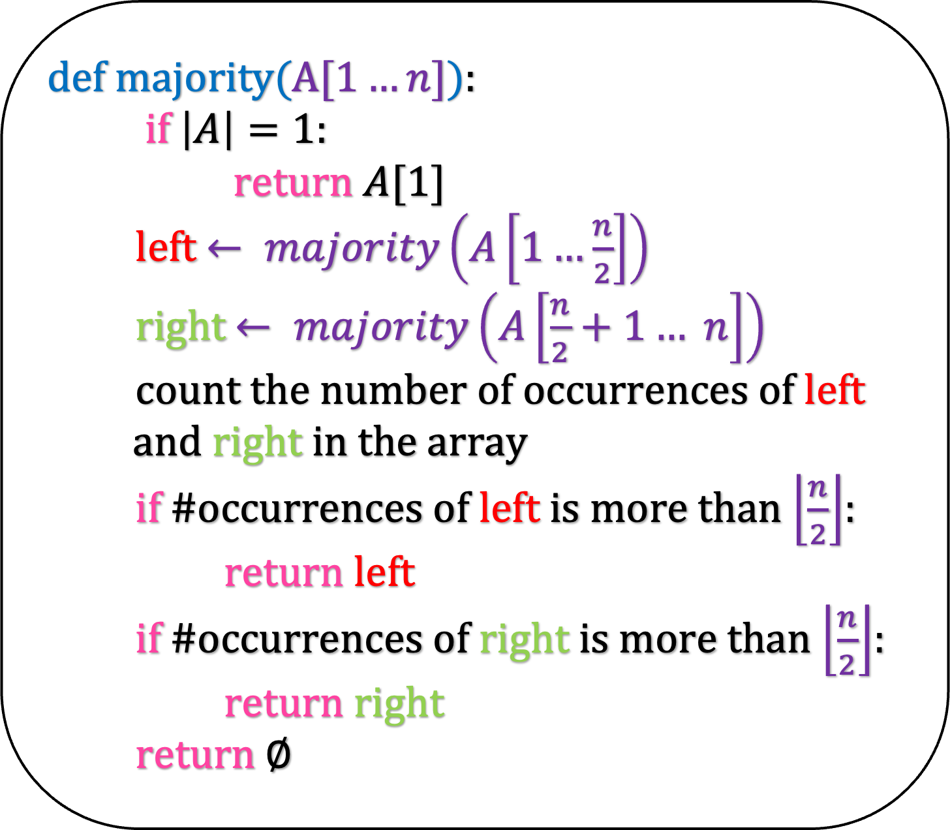
Lemma: Our algorithm finds a majority element in an array of size n, if it exists.
def m$ajority(A[1…n]$):
if $\left|A\right|=1:$
return $A[1]$
left $← majority\left(A\left[1…\frac{n}{2}\right]\right)$
right $← majority\left(A\left[\frac{n}{2}+1… n\right]\right)$
count the number of occurrences of left
and right in the array
if #occurrences of left is more than $\left\lfloor \frac{n}{2}\right\rfloor$:
return left
if #occurrences of right is more than $\left\lfloor \frac{n}{2}\right\rfloor$:
return right
return $∅$
We will prove using induction on n.

Slide 28
Lemma: Our algorithm finds a majority element in an array of size n, if it exists.
def m$ajority(A[1…n]$):
if $\left|A\right|=1:$
return $A[1]$
left $← majority\left(A\left[1…\frac{n}{2}\right]\right)$
right $← majority\left(A\left[\frac{n}{2}+1… n\right]\right)$
count the number of occurrences of left
and right in the array
if #occurrences of left is more than $\left\lfloor \frac{n}{2}\right\rfloor$:
return left
if #occurrences of right is more than $\left\lfloor \frac{n}{2}\right\rfloor$:
return right
return $∅$
We will prove using induction on n.
When n=1, there is only one element in the array and our algorithm returns it as the majority element.

Slide 29
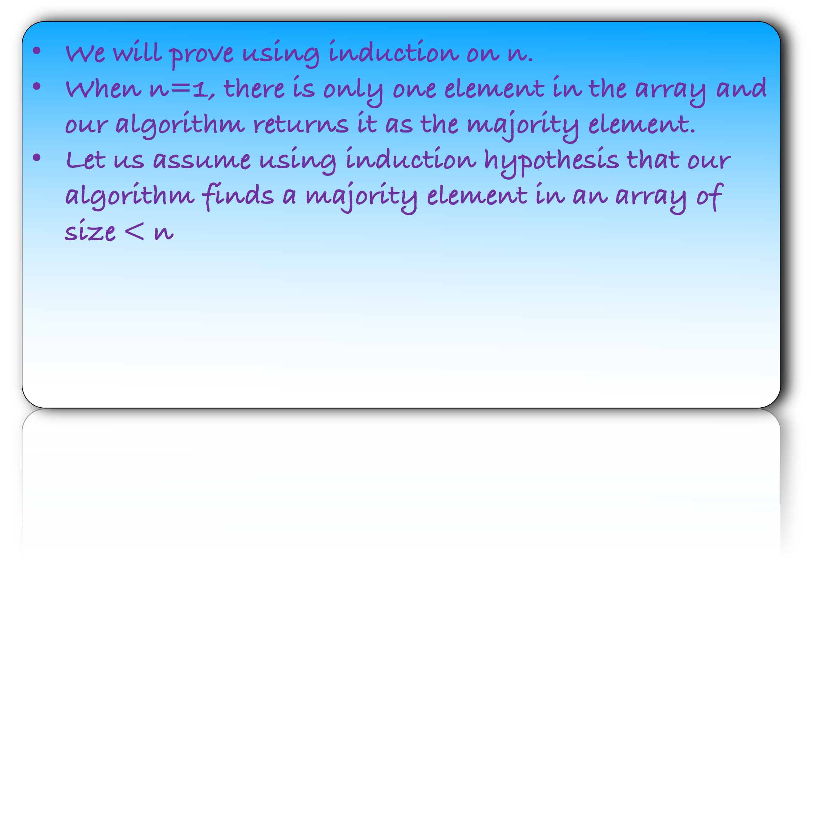
Lemma: Our algorithm finds a majority element in an array of size n, if it exists.
def m$ajority(A[1…n]$):
if $\left|A\right|=1:$
return $A[1]$
left $← majority\left(A\left[1…\frac{n}{2}\right]\right)$
right $← majority\left(A\left[\frac{n}{2}+1… n\right]\right)$
count the number of occurrences of left
and right in the array
if #occurrences of left is more than $\left\lfloor \frac{n}{2}\right\rfloor$:
return left
if #occurrences of right is more than $\left\lfloor \frac{n}{2}\right\rfloor$:
return right
return $∅$
We will prove using induction on n.
When n=1, there is only one element in the array and our algorithm returns it as the majority element.
Let us assume using induction hypothesis that our algorithm finds a majority element in an array of size $<$ n

Slide 30
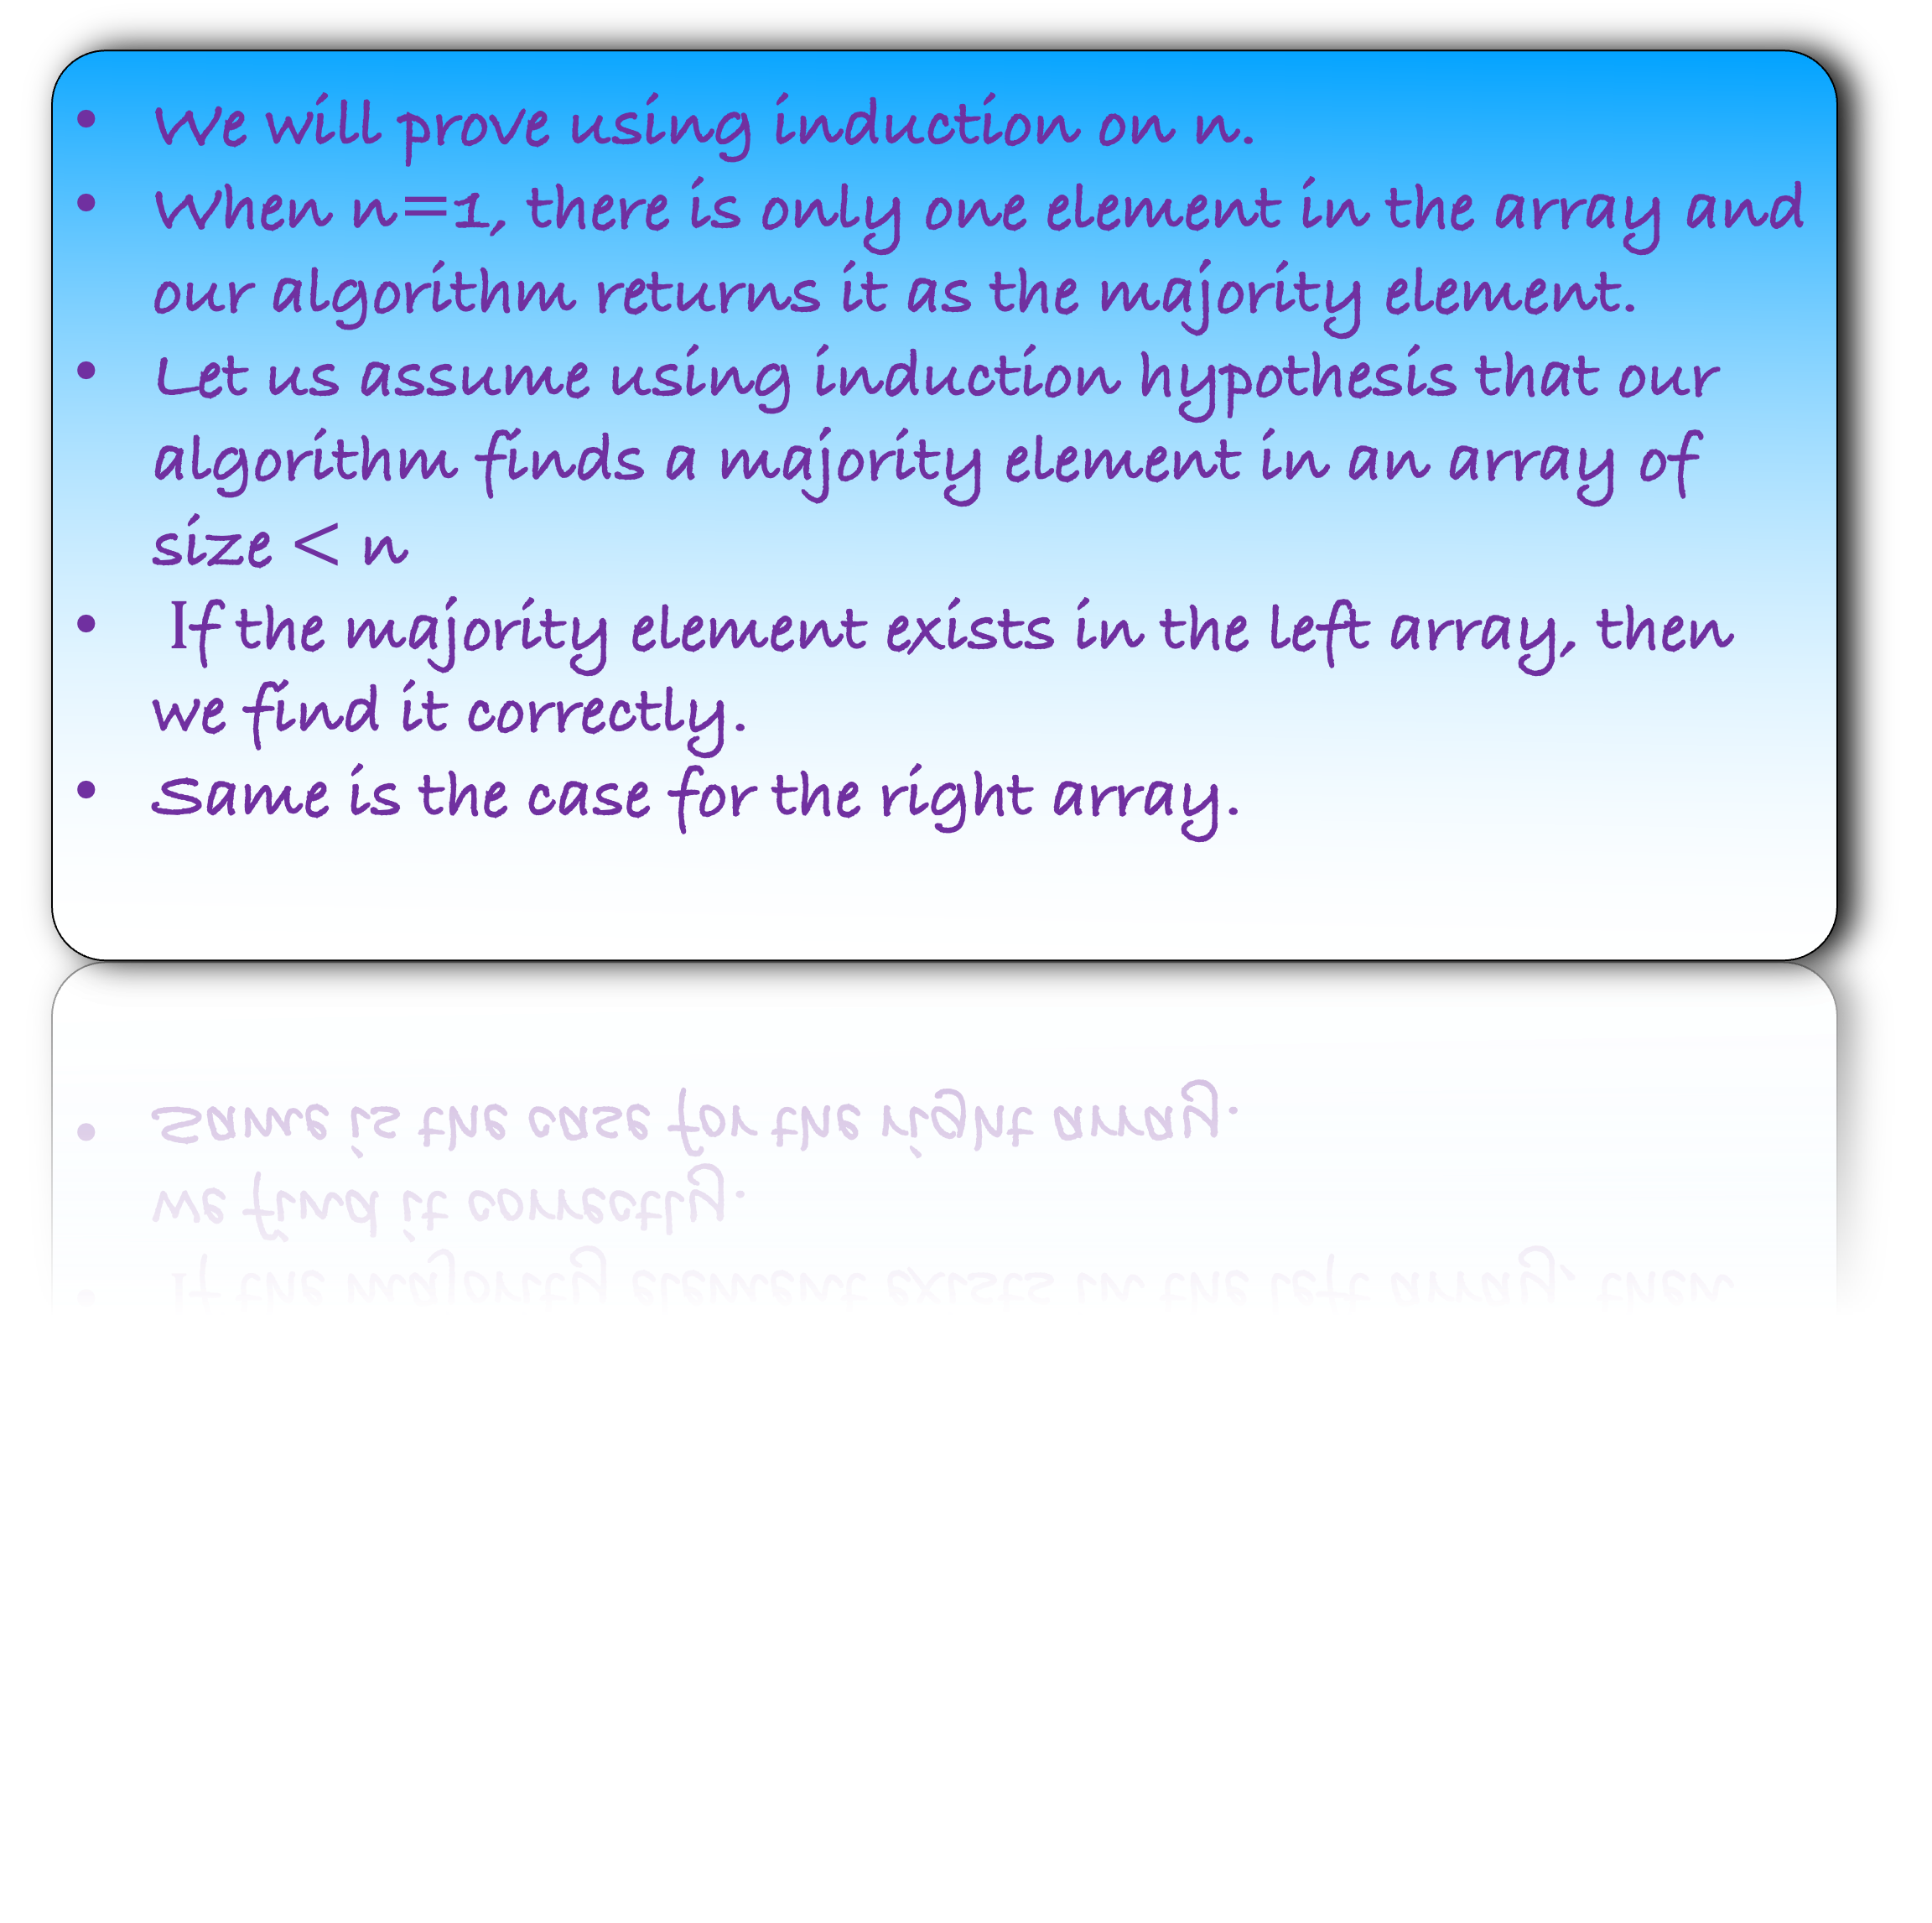
Lemma: Our algorithm finds a majority element in an array of size n, if it exists.
def m$ajority(A[1…n]$):
if $\left|A\right|=1:$
return $A[1]$
left $← majority\left(A\left[1…\frac{n}{2}\right]\right)$
right $← majority\left(A\left[\frac{n}{2}+1… n\right]\right)$
count the number of occurrences of left
and right in the array
if #occurrences of left is more than $\left\lfloor \frac{n}{2}\right\rfloor$:
return left
if #occurrences of right is more than $\left\lfloor \frac{n}{2}\right\rfloor$:
return right
return $∅$
We will prove using induction on n.
When n=1, there is only one element in the array and our algorithm returns it as the majority element.
Let us assume using induction hypothesis that our algorithm finds a majority element in an array of size $<$ n
$I$f the majority element exists in the left array, then we find it correctly.
Same is the case for the right array.
Remember our observation:
If there is a majority element in the array then it is a majority element in either the left or the right array

Slide 31
Lemma: Our algorithm finds a majority element in an array of size n, if it exists.
def m$ajority(A[1…n]$):
if $\left|A\right|=1:$
return $A[1]$
left $← majority\left(A\left[1…\frac{n}{2}\right]\right)$
right $← majority\left(A\left[\frac{n}{2}+1… n\right]\right)$
count the number of occurrences of left
and right in the array
if #occurrences of left is more than $\left\lfloor \frac{n}{2}\right\rfloor$:
return left
if #occurrences of right is more than $\left\lfloor \frac{n}{2}\right\rfloor$:
return right
return $∅$
If the majority element exists in the left array, then we find it correctly.
Same is the case for the right array.
If there is a majority element in the array, then either left or right is our answer.
Remember our observation:
If there is a majority element in the array then it is a majority element in either the left or the right array

Slide 32
Lemma: Our algorithm finds a majority element in an array of size n, if it exists.
def m$ajority(A[1…n]$):
if $\left|A\right|=1:$
return $A[1]$
left $← majority\left(A\left[1…\frac{n}{2}\right]\right)$
right $← majority\left(A\left[\frac{n}{2}+1… n\right]\right)$
count the number of occurrences of left
and right in the array
if #occurrences of left is more than $\left\lfloor \frac{n}{2}\right\rfloor$:
return left
if #occurrences of right is more than $\left\lfloor \frac{n}{2}\right\rfloor$:
return right
return $∅$
If the majority element exists in the left array, then we find it correctly.
Same is the case for the right array.
If there is a majority element in the array, then either left or right is our answer.
We then use the brute-force method to find the answer.
But what if there is no majority element?
Remember our observation:
If there is a majority element in the array then it is a majority element in either the left or the right array

Slide 33
Lemma: Our algorithm finds a majority element in an array of size n, if it exists.
def m$ajority(A[1…n]$):
if $\left|A\right|=1:$
return $A[1]$
left $← majority\left(A\left[1…\frac{n}{2}\right]\right)$
right $← majority\left(A\left[\frac{n}{2}+1… n\right]\right)$
count the number of occurrences of left
and right in the array
if #occurrences of left is more than $\left\lfloor \frac{n}{2}\right\rfloor$:
return left
if #occurrences of right is more than $\left\lfloor \frac{n}{2}\right\rfloor$:
return right
return $∅$
But what if there is no majority element?
Then, both the if conditions will be evaluated to false.
Remember our observation:
If there is a majority element in the array then it is a majority element in either the left or the right array

Slide 34
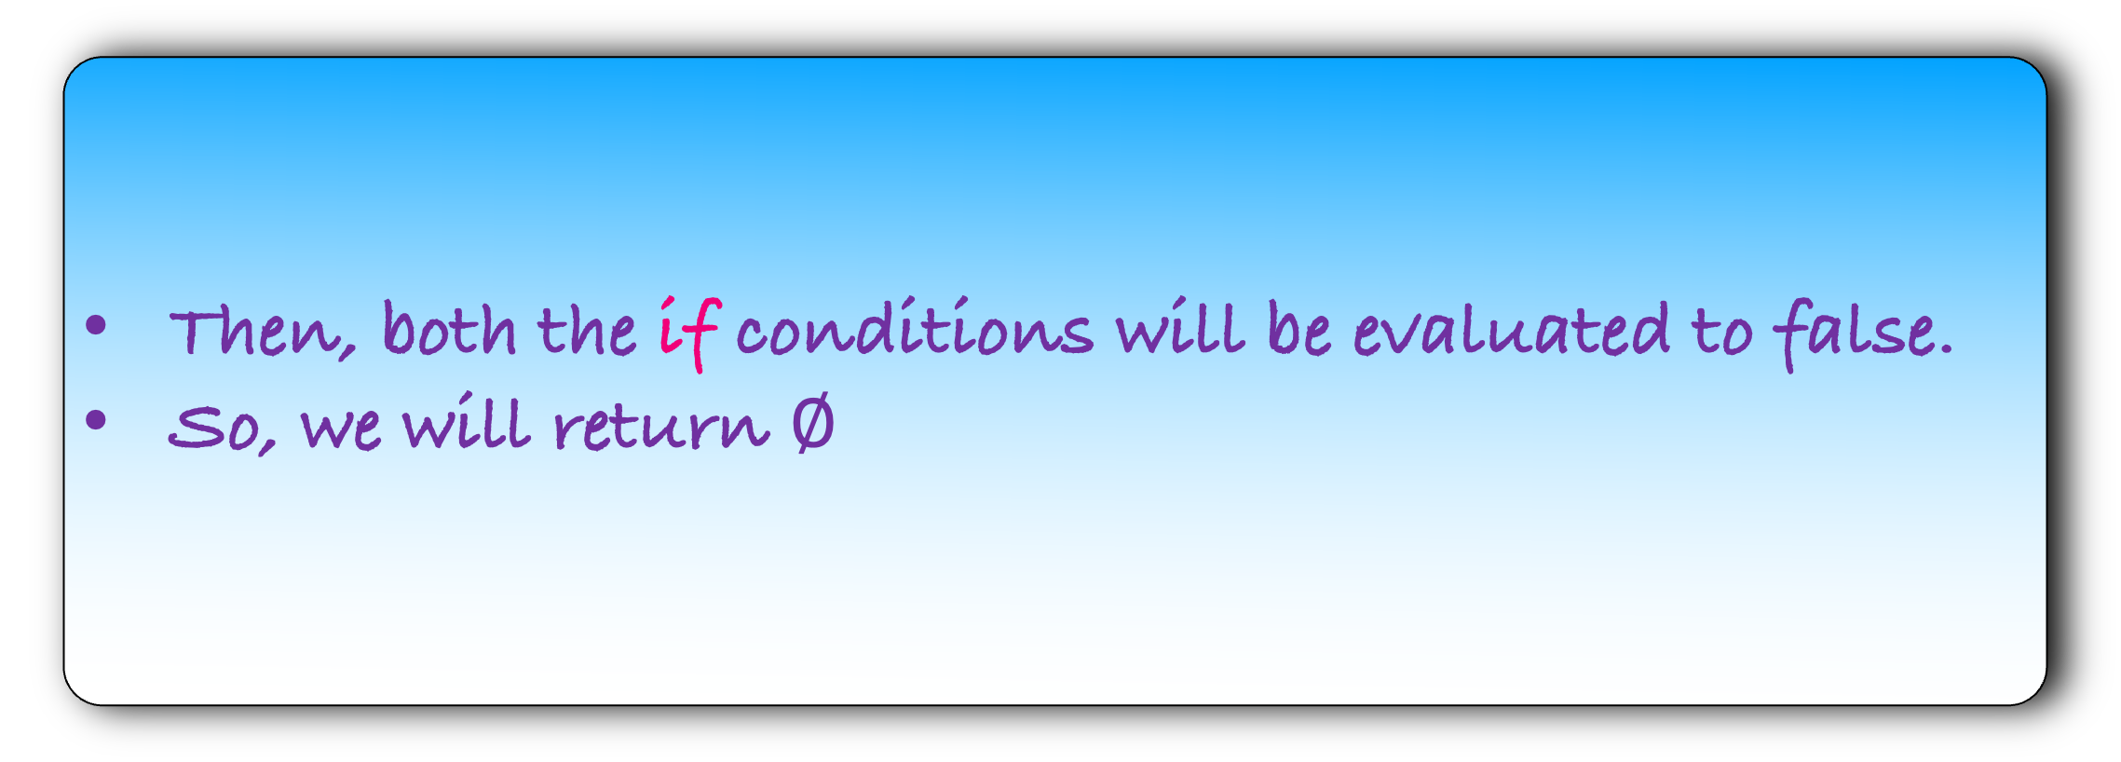
Lemma: Our algorithm finds a majority element in an array of size n, if it exists.
def m$ajority(A[1…n]$):
if $\left|A\right|=1:$
return $A[1]$
left $← majority\left(A\left[1…\frac{n}{2}\right]\right)$
right $← majority\left(A\left[\frac{n}{2}+1… n\right]\right)$
count the number of occurrences of left
and right in the array
if #occurrences of left is more than $\left\lfloor \frac{n}{2}\right\rfloor$:
return left
if #occurrences of right is more than $\left\lfloor \frac{n}{2}\right\rfloor$:
return right
return $∅$
But what if there is no majority element?
Then, both the if conditions will be evaluated to false.
So, we will return $∅$
Remember our observation:
If there is a majority element in the array then it is a majority element in either the left or the right array

Slide 35
History
In 1981, Boyer and Moore designed an O(n) algorithm to find the majority element in the array if it exists.
Unfortunately, they could not publish their result. Here is their experience on publishing their paper.
In this paper we have described a linear time majority vote algorithm and discussed the mechanically checked correctness proof of a Fortran implementation of it. This work has a rather convoluted history which we would here like to clarify.
……..
……..
However, our paper was repeatedly rejected for publication, largely because of its emphasis on Fortran and mechanical verification. A rewritten version emphasizing the algorithm itself was rejected on the grounds that the work was superceded by the paper of Misra and Gries!

Slide 36
History
In 1981, Boyer and Moore designed an O(n) algorithm to find the majority element in the array if it exists.
Unfortunately, they could not publish their result. Here is their experience on publishing their paper.
Can you design an algorithm for the majority problem in O(n) time?

