Slide 1
Interval Scheduling

Slide 2



Customer 1
Customer 2
Server
Customer 3

Slide 3





Server

Slide 4
Server

Slide 5








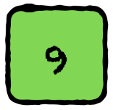


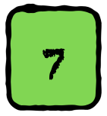
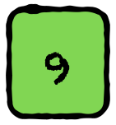


Slide 6
1
2
3
4
5
6
7
8
9
10
11

Slide 7
Given a set $I$ of $n$ customers each with a starting and ending time, find the maximum number of customers that a server can serve.
Condition: Cannot serve two customers whose intervals overlap

Slide 8
Interval Scheduling:
Given a set $I$ of $n$ intervals each having a starting and ending time, find maximum number of non-overlapping intervals.
Question: How will you solve this problem?

Slide 9
Be Greedy: Choose the interval that starts first

Slide 10
Chosen

Slide 11
Chosen
Cannot be Chosen

Slide 12
Chosen
Cannot be Chosen

Slide 13
Chosen
Cannot be Chosen

Slide 14
Chosen
Cannot be Chosen

Slide 15
Chosen
Cannot be Chosen

Slide 16
But we can do better than 4. Clearly our strategy is bad.
Chosen
Cannot be Chosen

Slide 17
Be Greedy: Choose the interval that ends first

Slide 18
Chosen
Cannot be Chosen

Slide 19
Chosen
Cannot be Chosen

Slide 20
Chosen
Cannot be Chosen

Slide 21
Chosen
Cannot be Chosen

Slide 22
Chosen
Cannot be Chosen

Slide 23
Chosen
Cannot be Chosen

Slide 24
Chosen
Cannot be Chosen

Slide 25
Chosen
Cannot be Chosen

Slide 26
Ans: 6
But is this algorithm correct?
Chosen
Cannot be Chosen

Slide 27
Proof: Greedy is always ahead

Slide 28
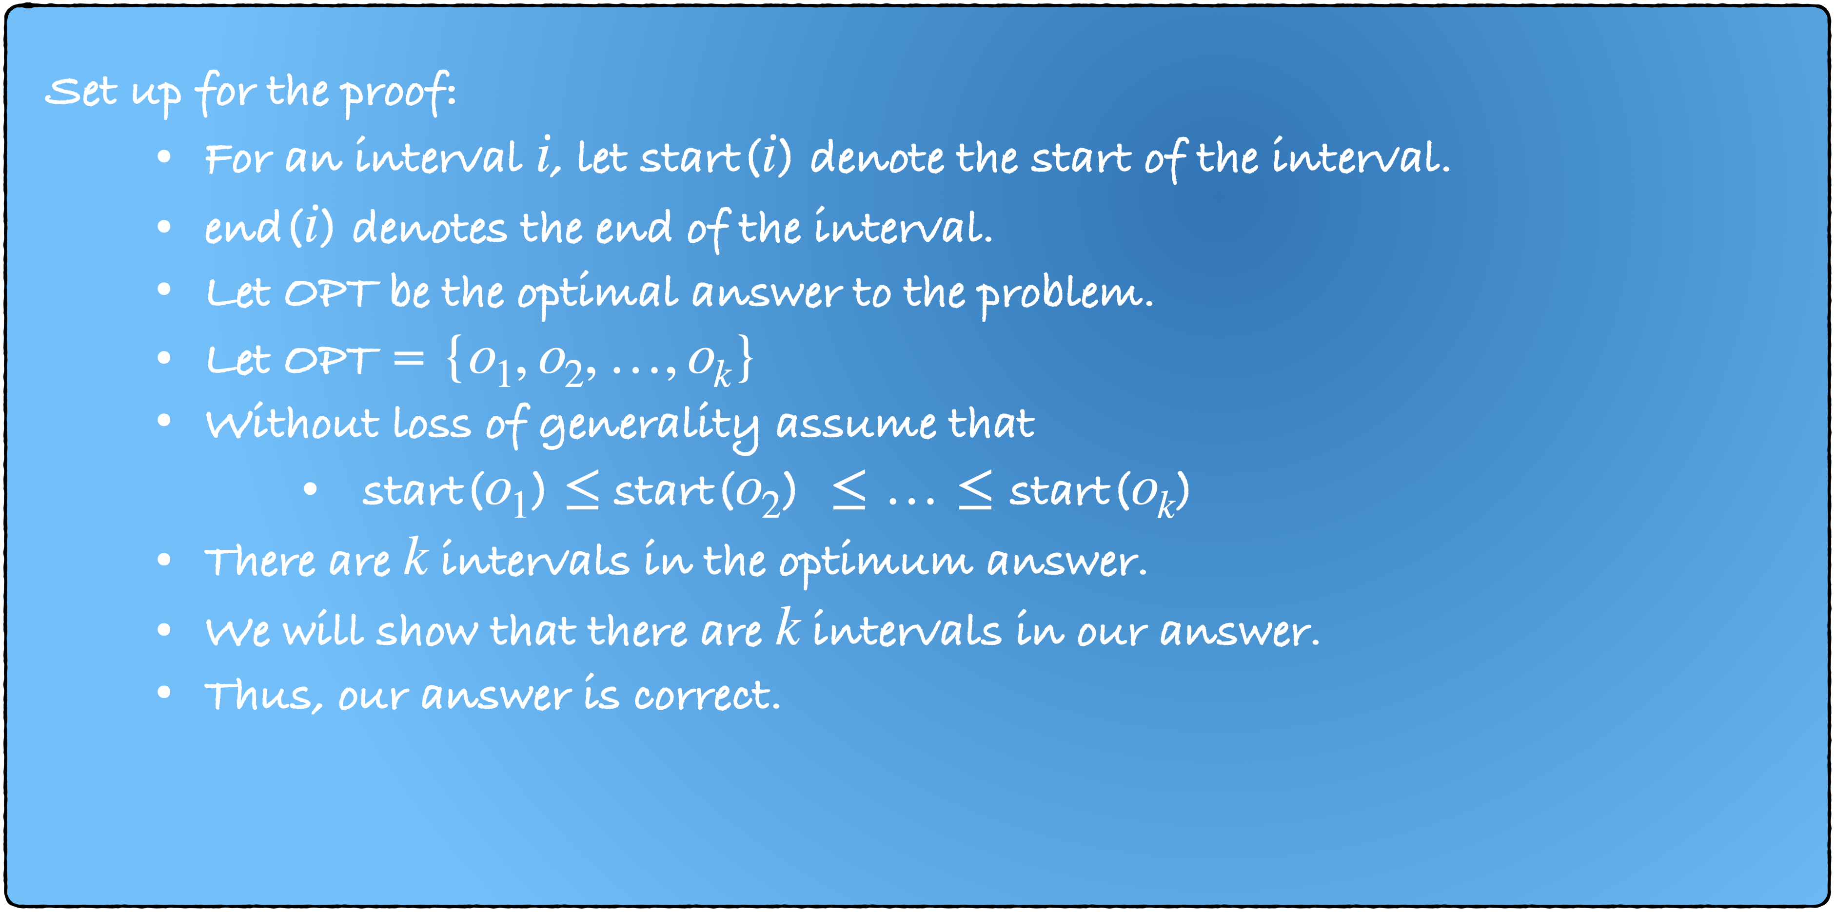

Slide 30
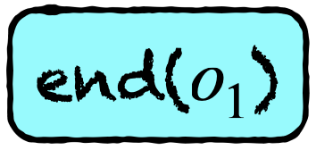

$$o_{1}$$
$$o_{2}$$
$$o_{3}$$
$$o_{4}$$
$$o_{5}$$
$$a_{1}$$
$$a_{2}$$
$$a_{3}$$
$$a_{4}$$
$$a_{5}$$
Can end($o_{1}$) $<$ end($a_{1}$)?

Slide 31
$$o_{1}$$
$$o_{2}$$
$$o_{3}$$
$$o_{4}$$
$$o_{5}$$
$$a_{1}$$
$$a_{2}$$
$$a_{3}$$
$$a_{4}$$
$$a_{5}$$

Slide 32

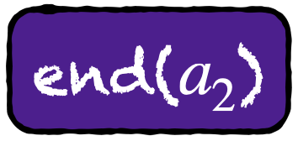
$$o_{1}$$
$$o_{2}$$
$$o_{3}$$
$$o_{4}$$
$$o_{5}$$
$$a_{1}$$
$$a_{2}$$
$$a_{3}$$
$$a_{4}$$
$$a_{5}$$
Can end($o_{2}$) $<$ end($a_{2}$)?

Slide 33
$$o_{1}$$
$$o_{2}$$
$$o_{3}$$
$$o_{4}$$
$$o_{5}$$
$$a_{1}$$
$$a_{2}$$
$$a_{3}$$
$$a_{4}$$
$$a_{5}$$
Can end($o_{2}$) $<$ end($a_{2}$)?

Slide 34
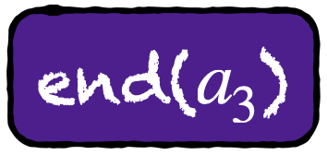
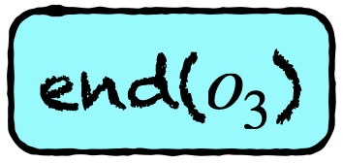
$$o_{1}$$
$$o_{2}$$
$$o_{3}$$
$$o_{4}$$
$$o_{5}$$
$$a_{1}$$
$$a_{2}$$
$$a_{3}$$
$$a_{4}$$
$$a_{5}$$

Slide 35


$$o_{1}$$
$$o_{2}$$
$$o_{3}$$
$$o_{4}$$
$$o_{5}$$
$$a_{1}$$
$$a_{2}$$
$$a_{3}$$
$$a_{4}$$
$$a_{5}$$

Slide 36


$$o_{1}$$
$$o_{2}$$
$$o_{3}$$
$$o_{4}$$
$$o_{5}$$
$$a_{1}$$
$$a_{2}$$
$$a_{3}$$
$$a_{4}$$
$$a_{5}$$

Slide 37
$$o_{1}$$
$$o_{2}$$
$$o_{3}$$
$$o_{4}$$
$$o_{5}$$
$$o_{6}$$
$$a_{1}$$
$$a_{2}$$
$$a_{3}$$
$$a_{4}$$
$$a_{5}$$
Can there be an interval $o_{6}$?

Slide 38
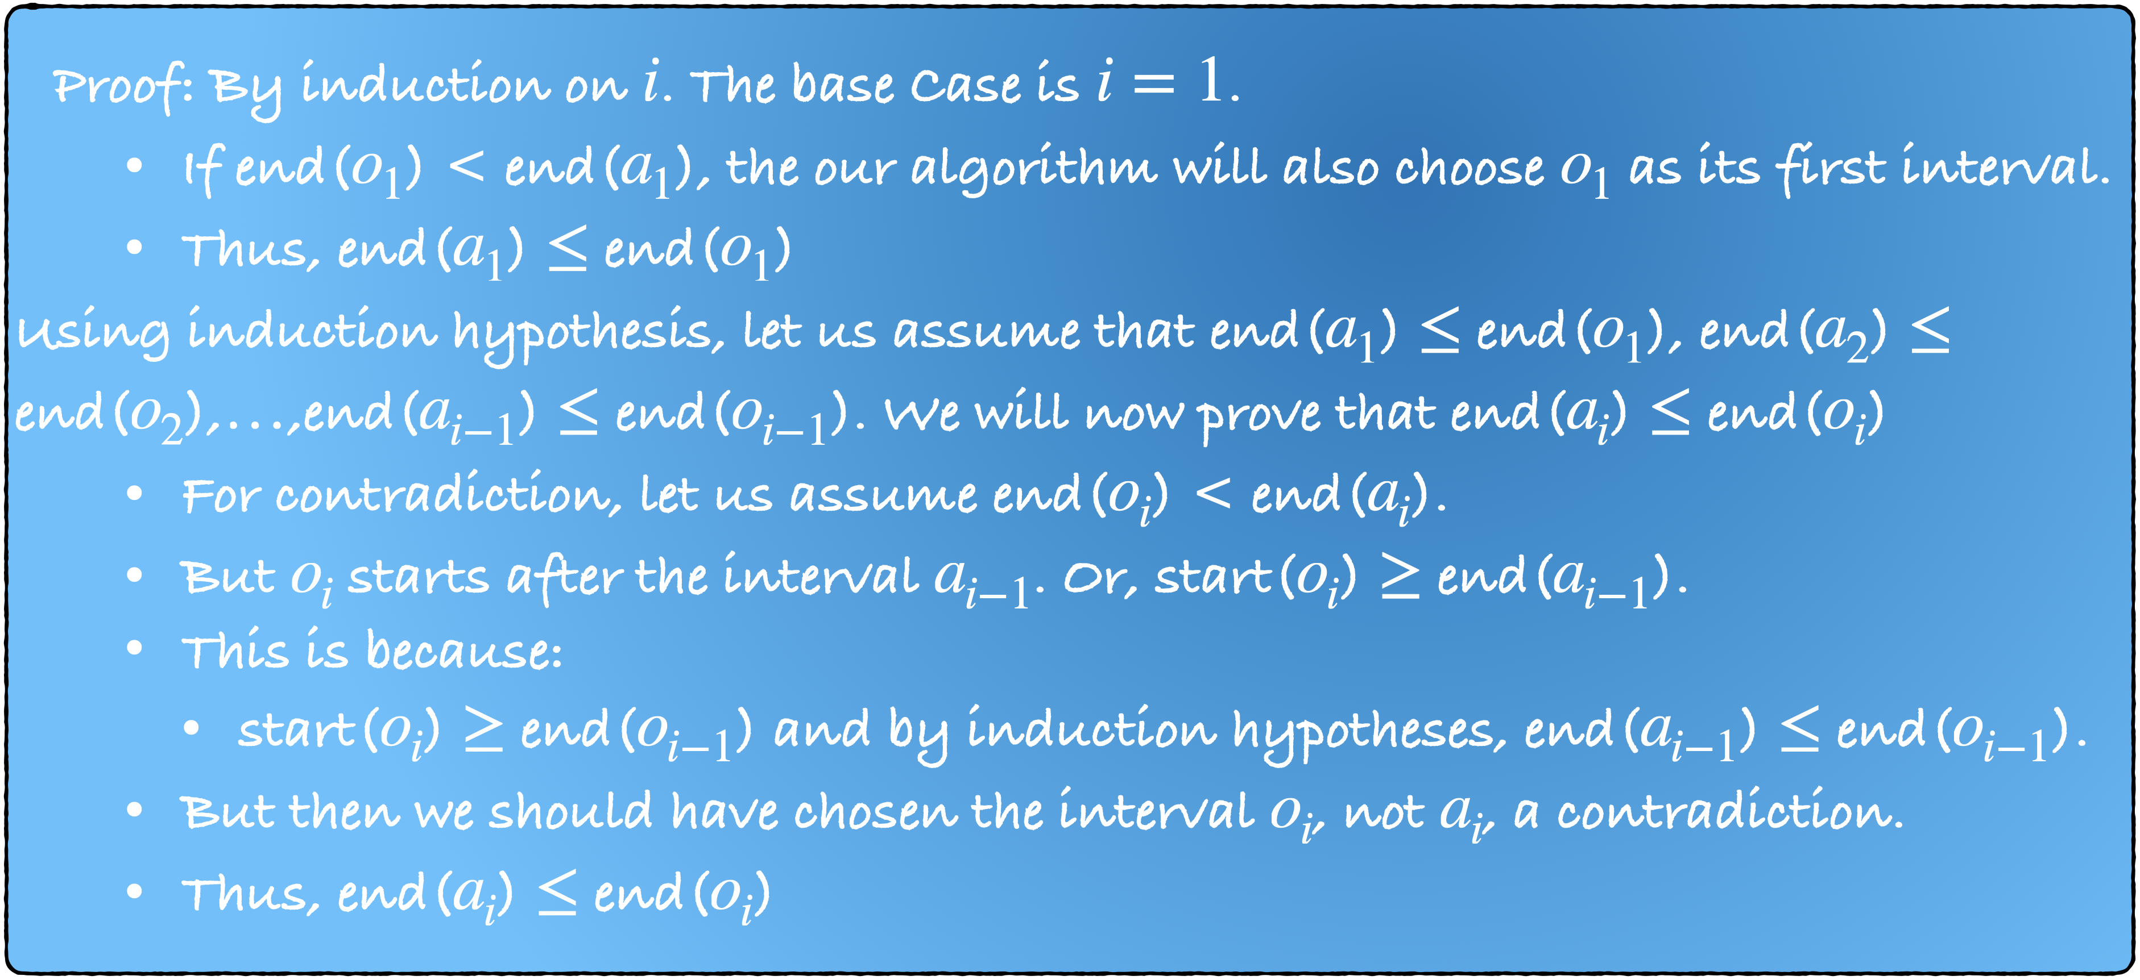

Slide 39
Prove yourself.
It is same as the second case in the previous proof.
Try to prove that is $o_{ℓ+1}$ exists then, we would also have added $o_{ℓ+1}$ in our answer.

Slide 40
Implementation

Slide 41
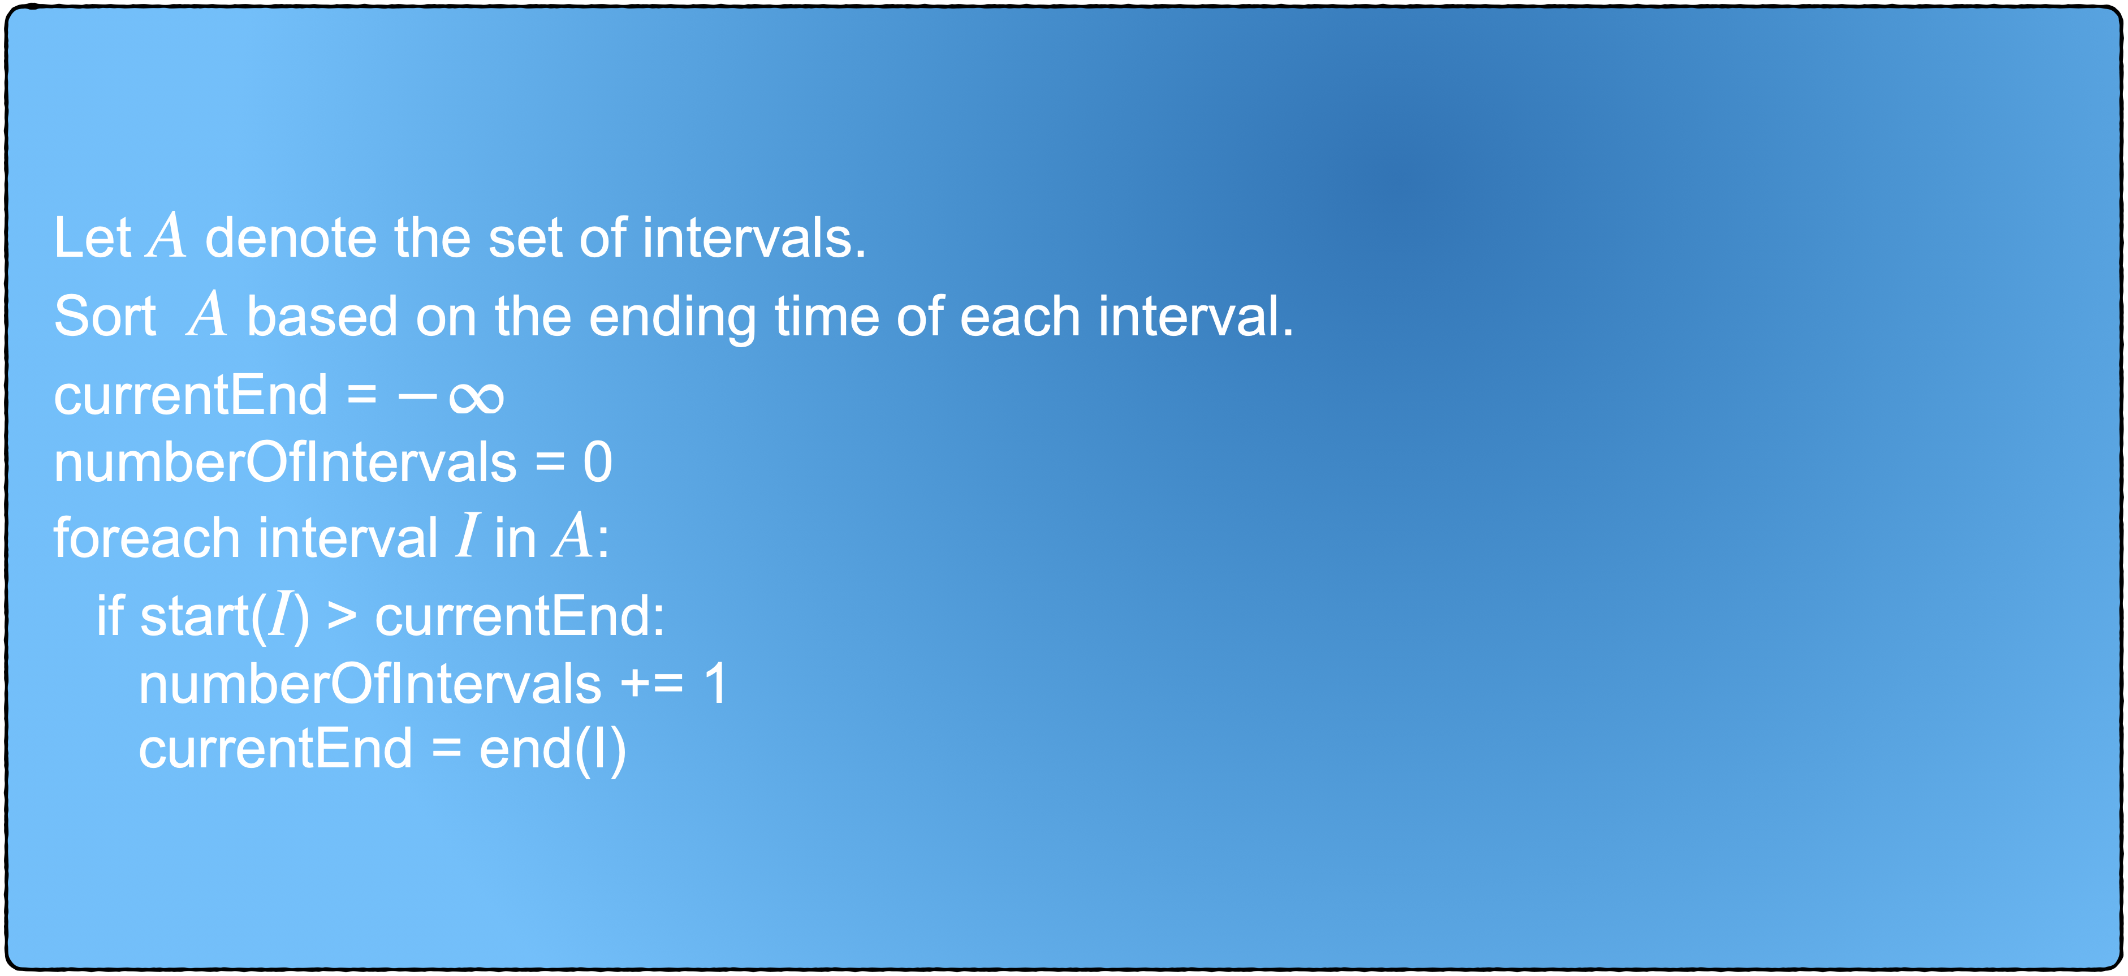

Slide 42
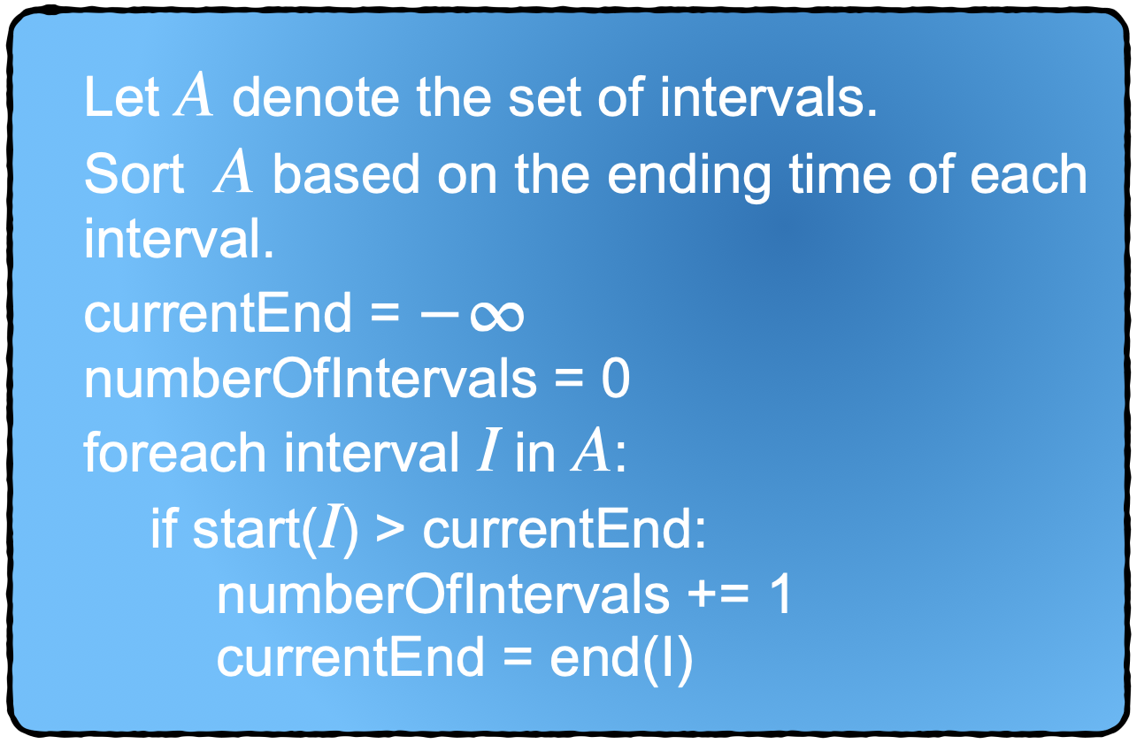




Slide 44


Slide 45


Slide 49


Slide 50


Slide 55


Slide 56
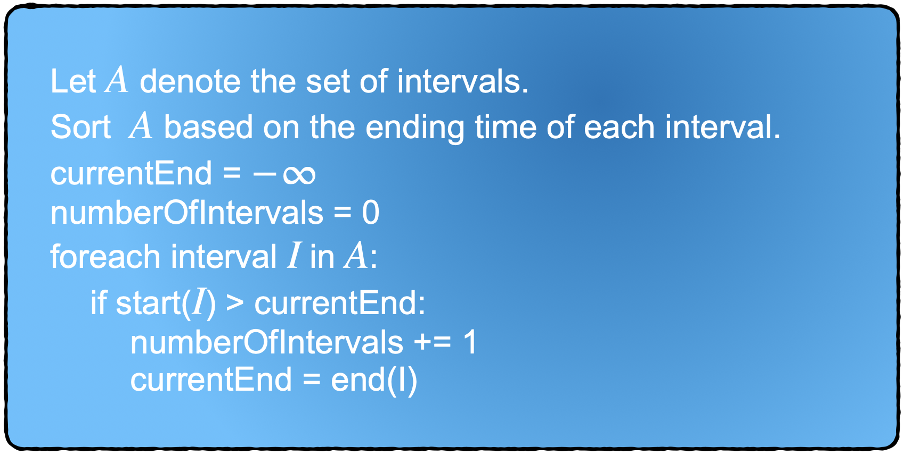


}
What is the running time of this algorithm?

