Slide 1
Applications of Maximum flow: Circulation with demand

Slide 2
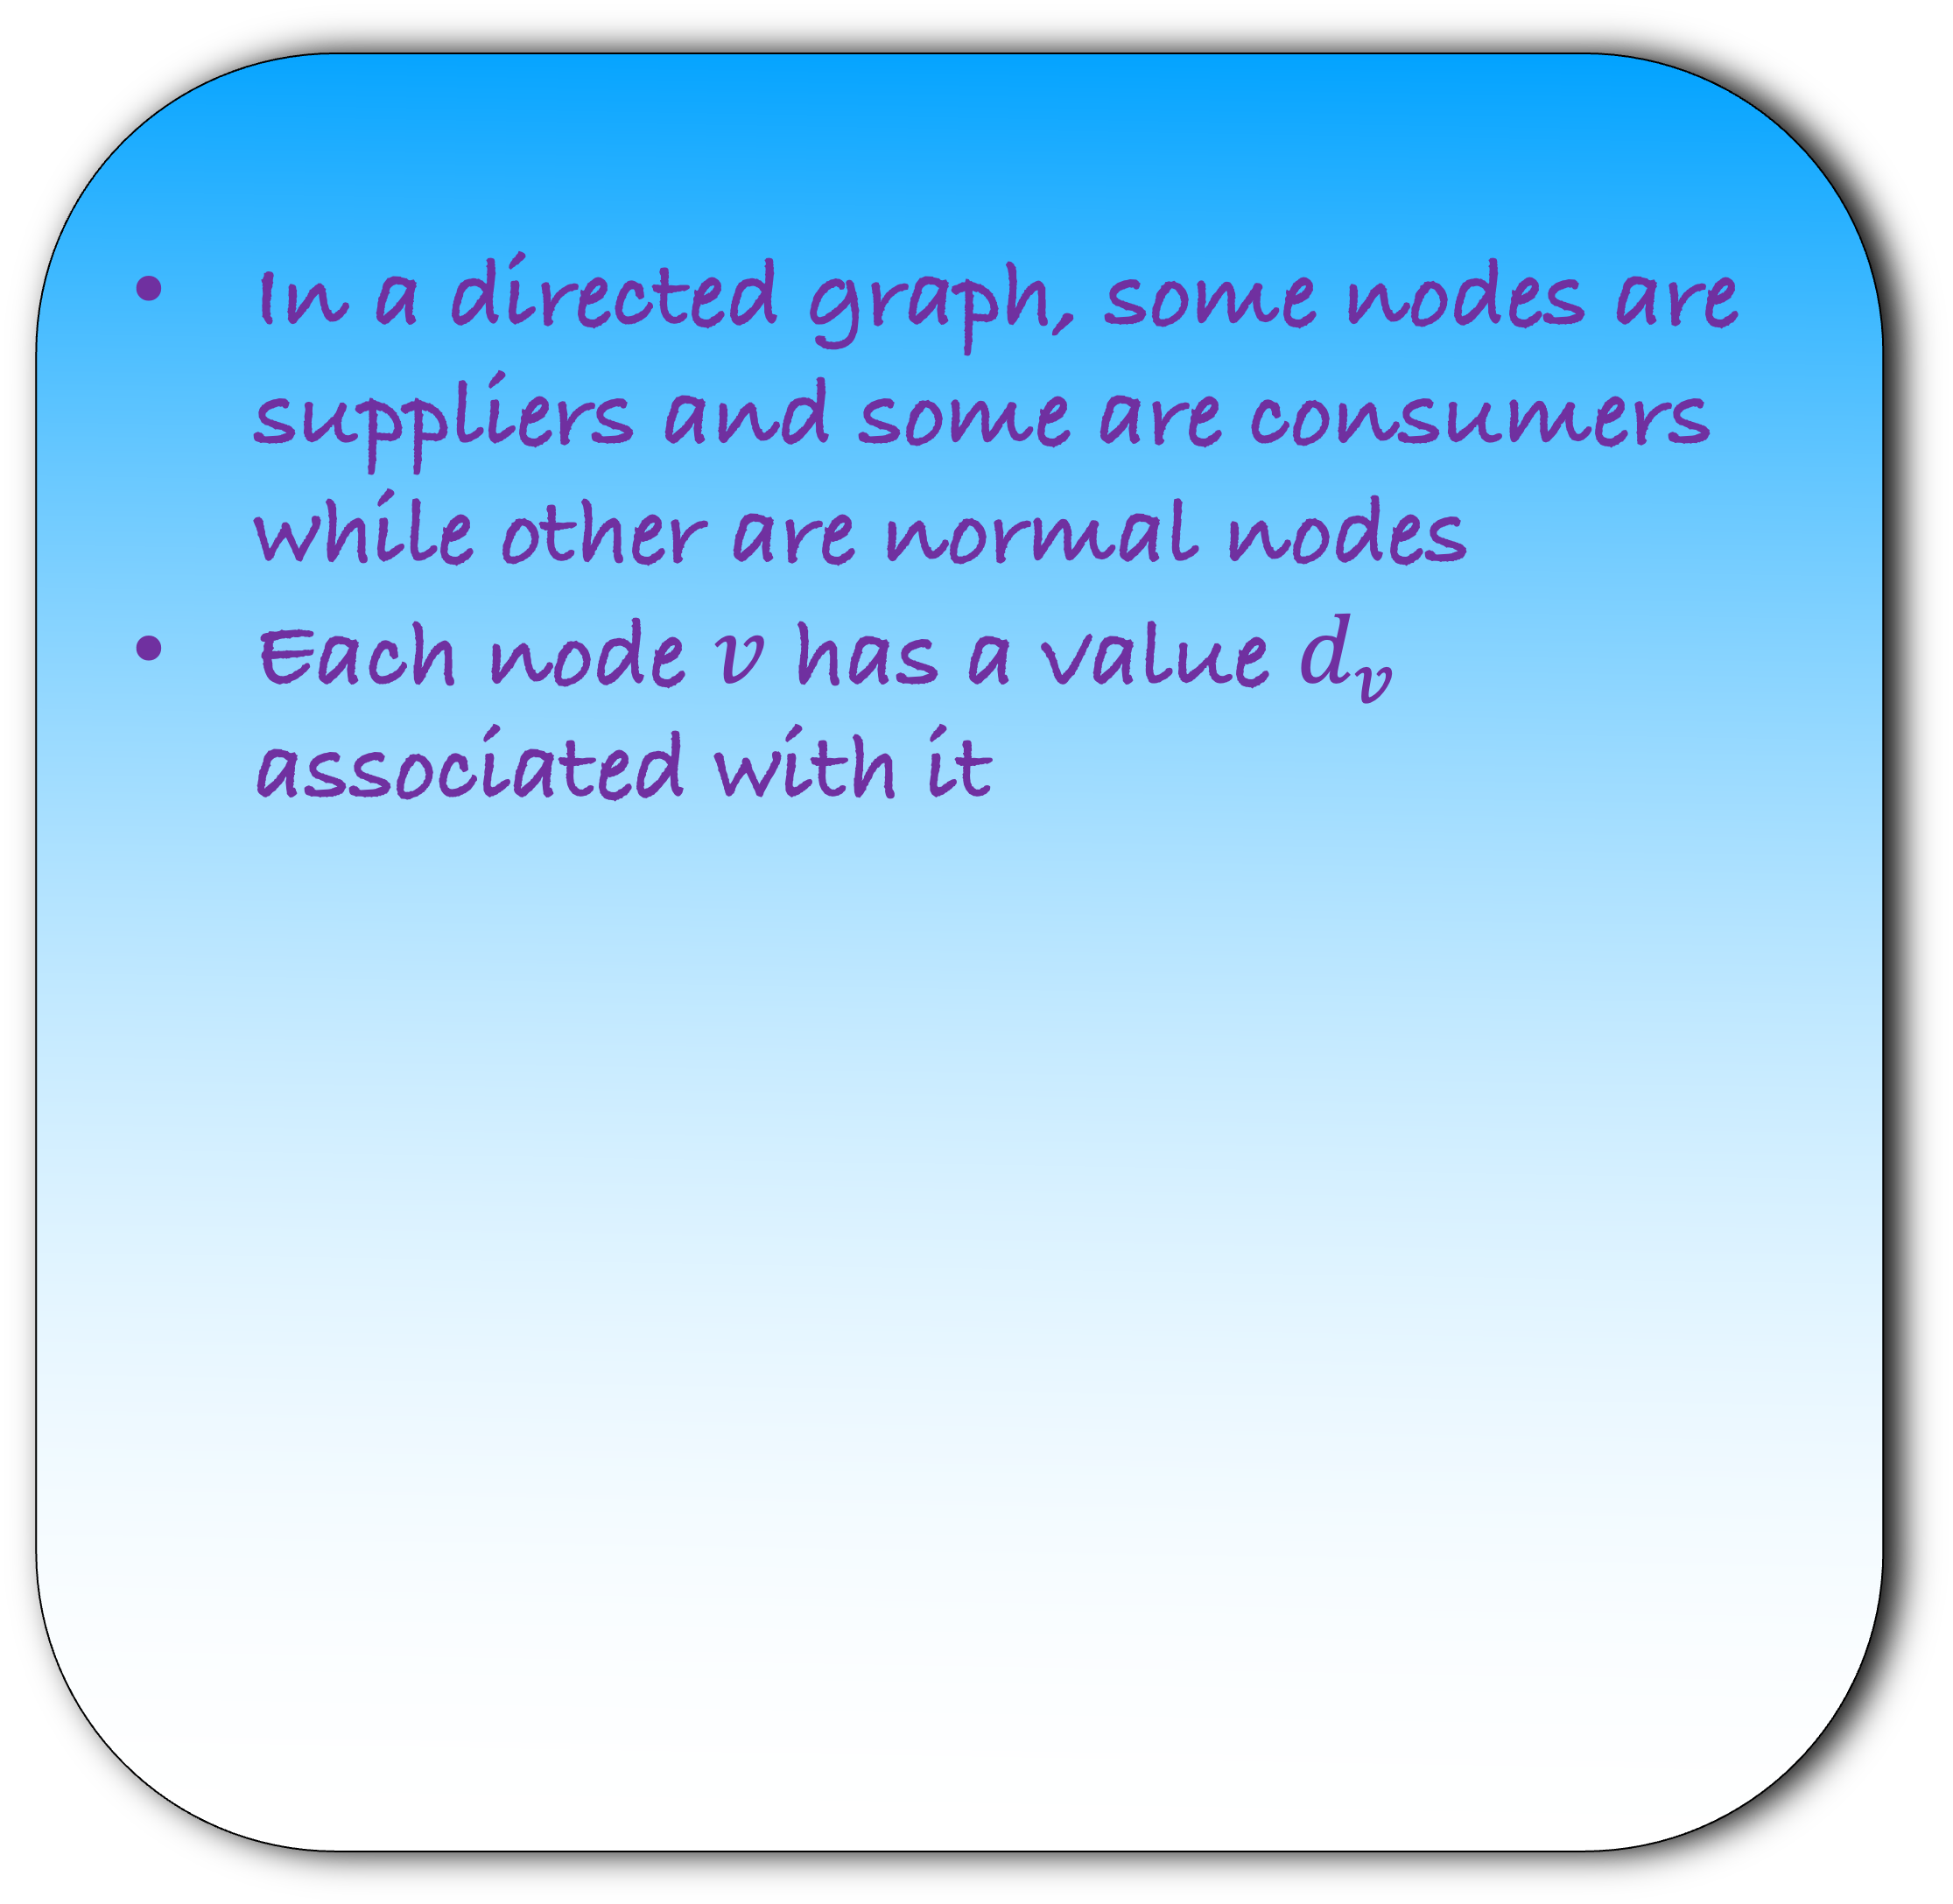
In a directed graph, some nodes are suppliers and some are consumers while other are normal nodes
Each node $v$ has a value $d_{v}$ associated with it
a|-3
3
3
b|-3
c|0
d|2
2
2
3
3
e|4

Slide 3
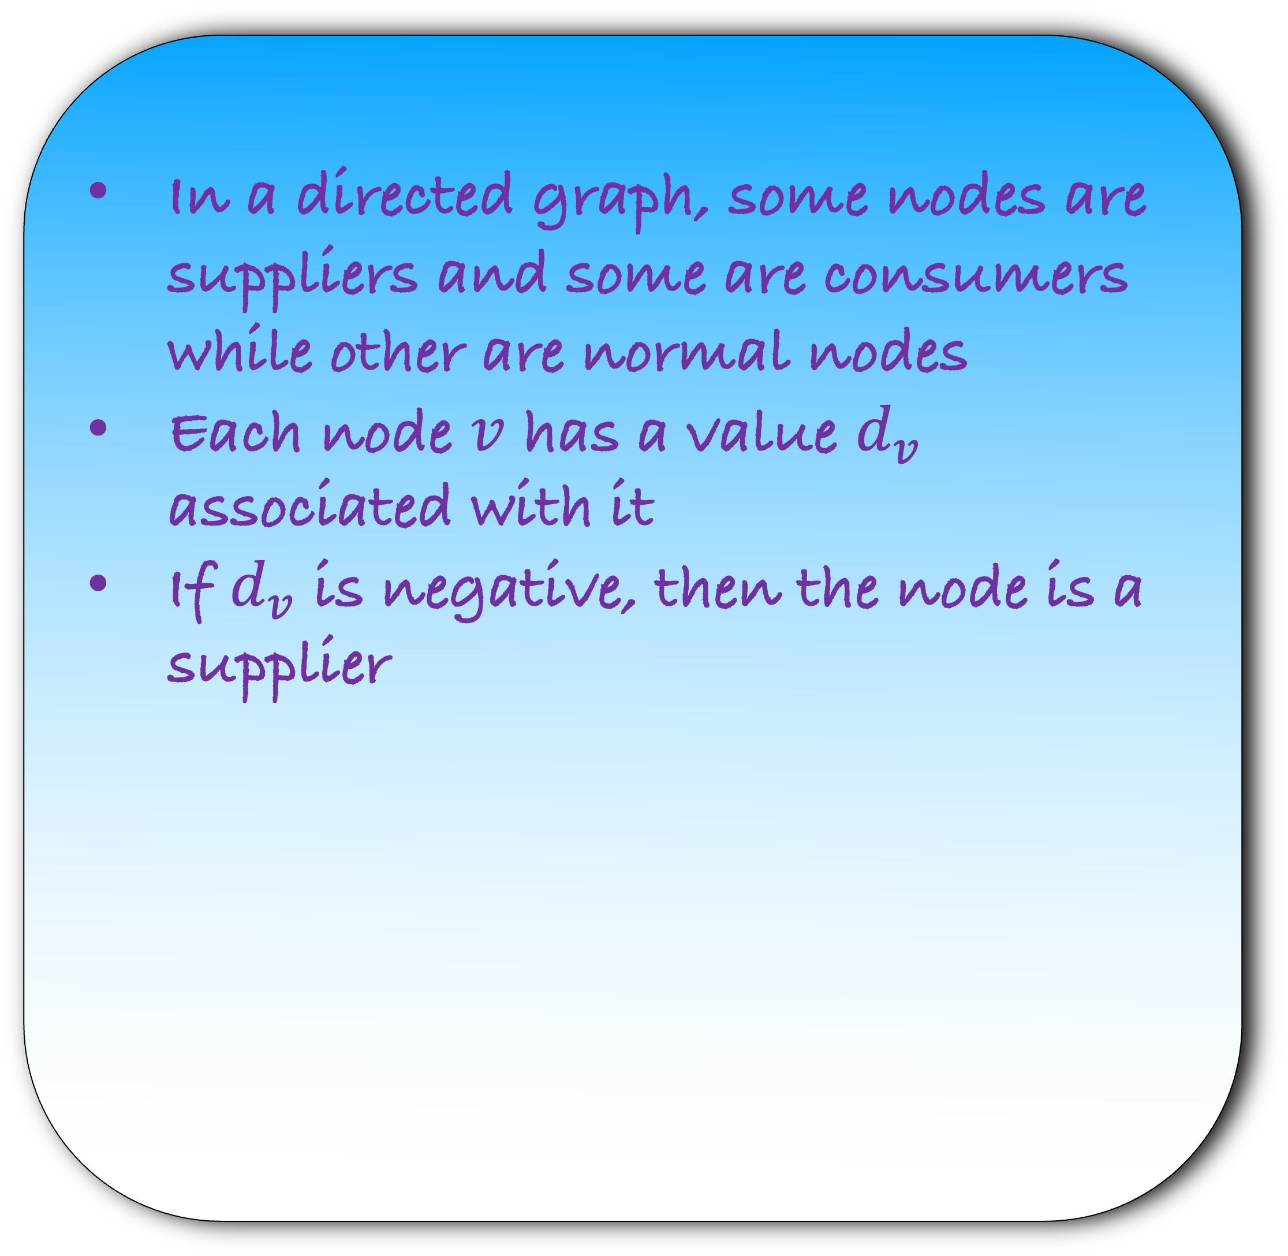
In a directed graph, some nodes are suppliers and some are consumers while other are normal nodes
Each node $v$ has a value $d_{v}$ associated with it
If $d_{v}$ is negative, then the node is a supplier
a|-3
3
3
b|-3
c|0
d|2
2
2
3
3
e|4

Slide 4
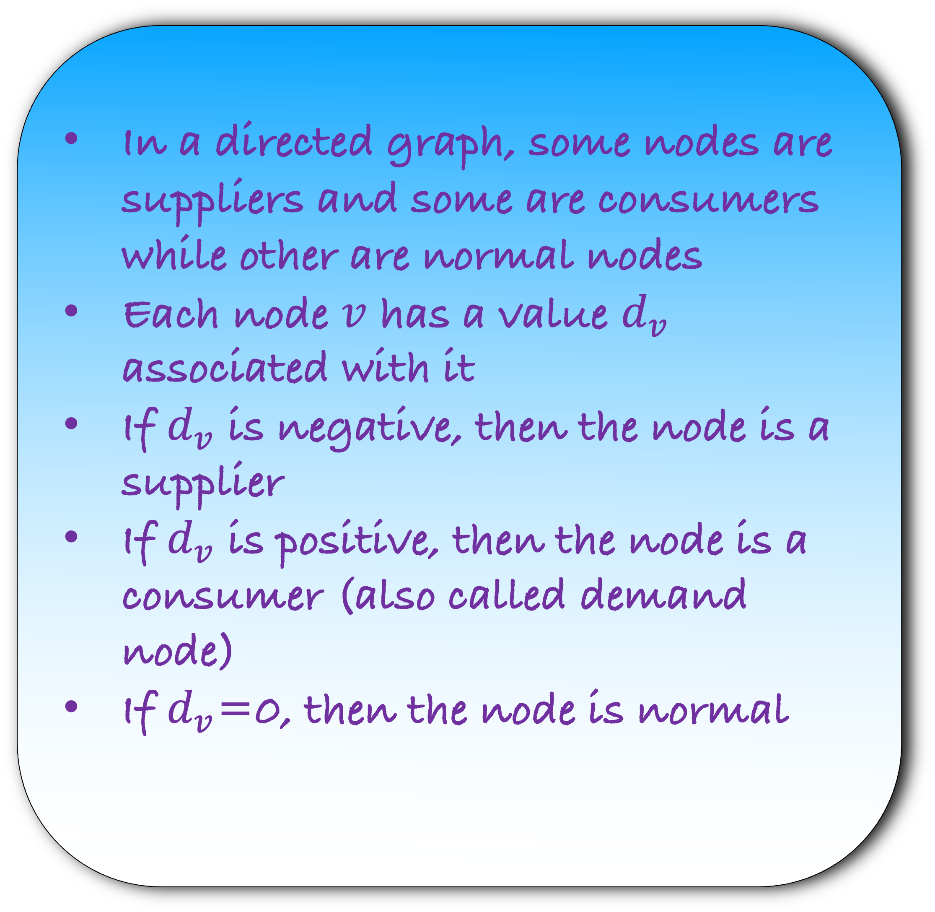
In a directed graph, some nodes are suppliers and some are consumers while other are normal nodes
Each node $v$ has a value $d_{v}$ associated with it
If $d_{v}$ is negative, then the node is a supplier
If $d_{v}$ is positive, then the node is a consumer (also called demand node)
If $d_{v}$=0, then the node is normal
a|-3
3
3
b|-3
c|0
d|2
2
2
3
3
e|4

Slide 5
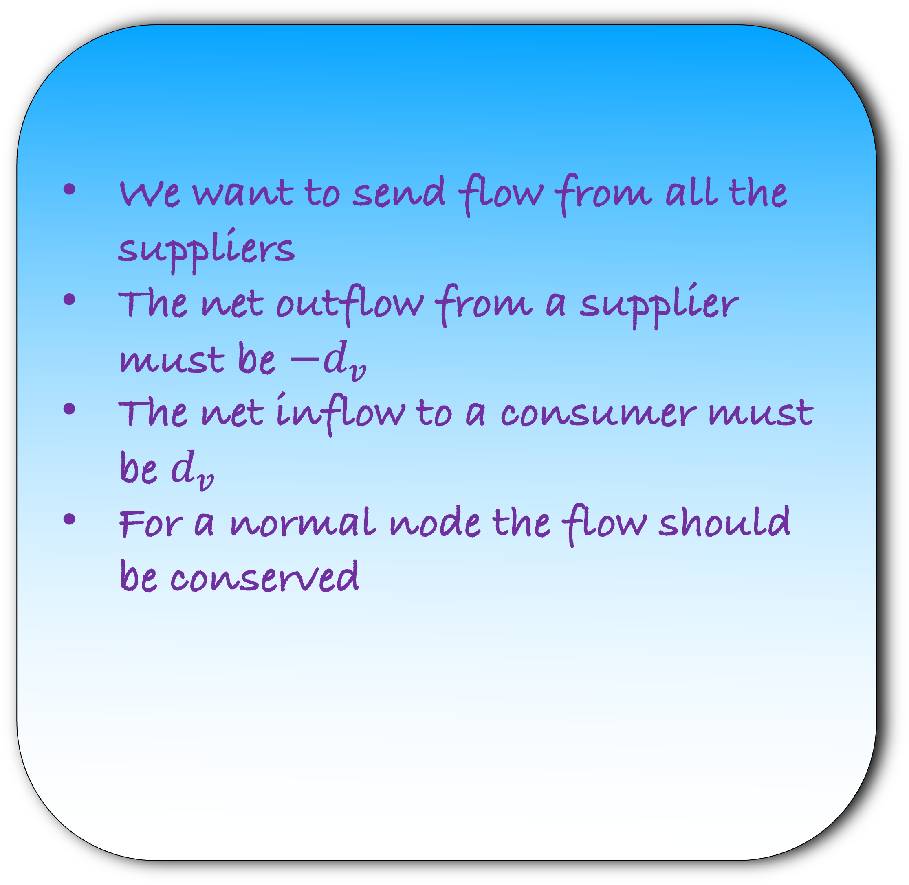
We want to send flow from all the suppliers
The net outflow from a supplier must be $−d_{v}$
The net inflow to a consumer must be $d_{v}$
For a normal node the flow should be conserved
a|-3
3
3
b|-3
c|0
d|2
2
2
3
3
e|4

Slide 6
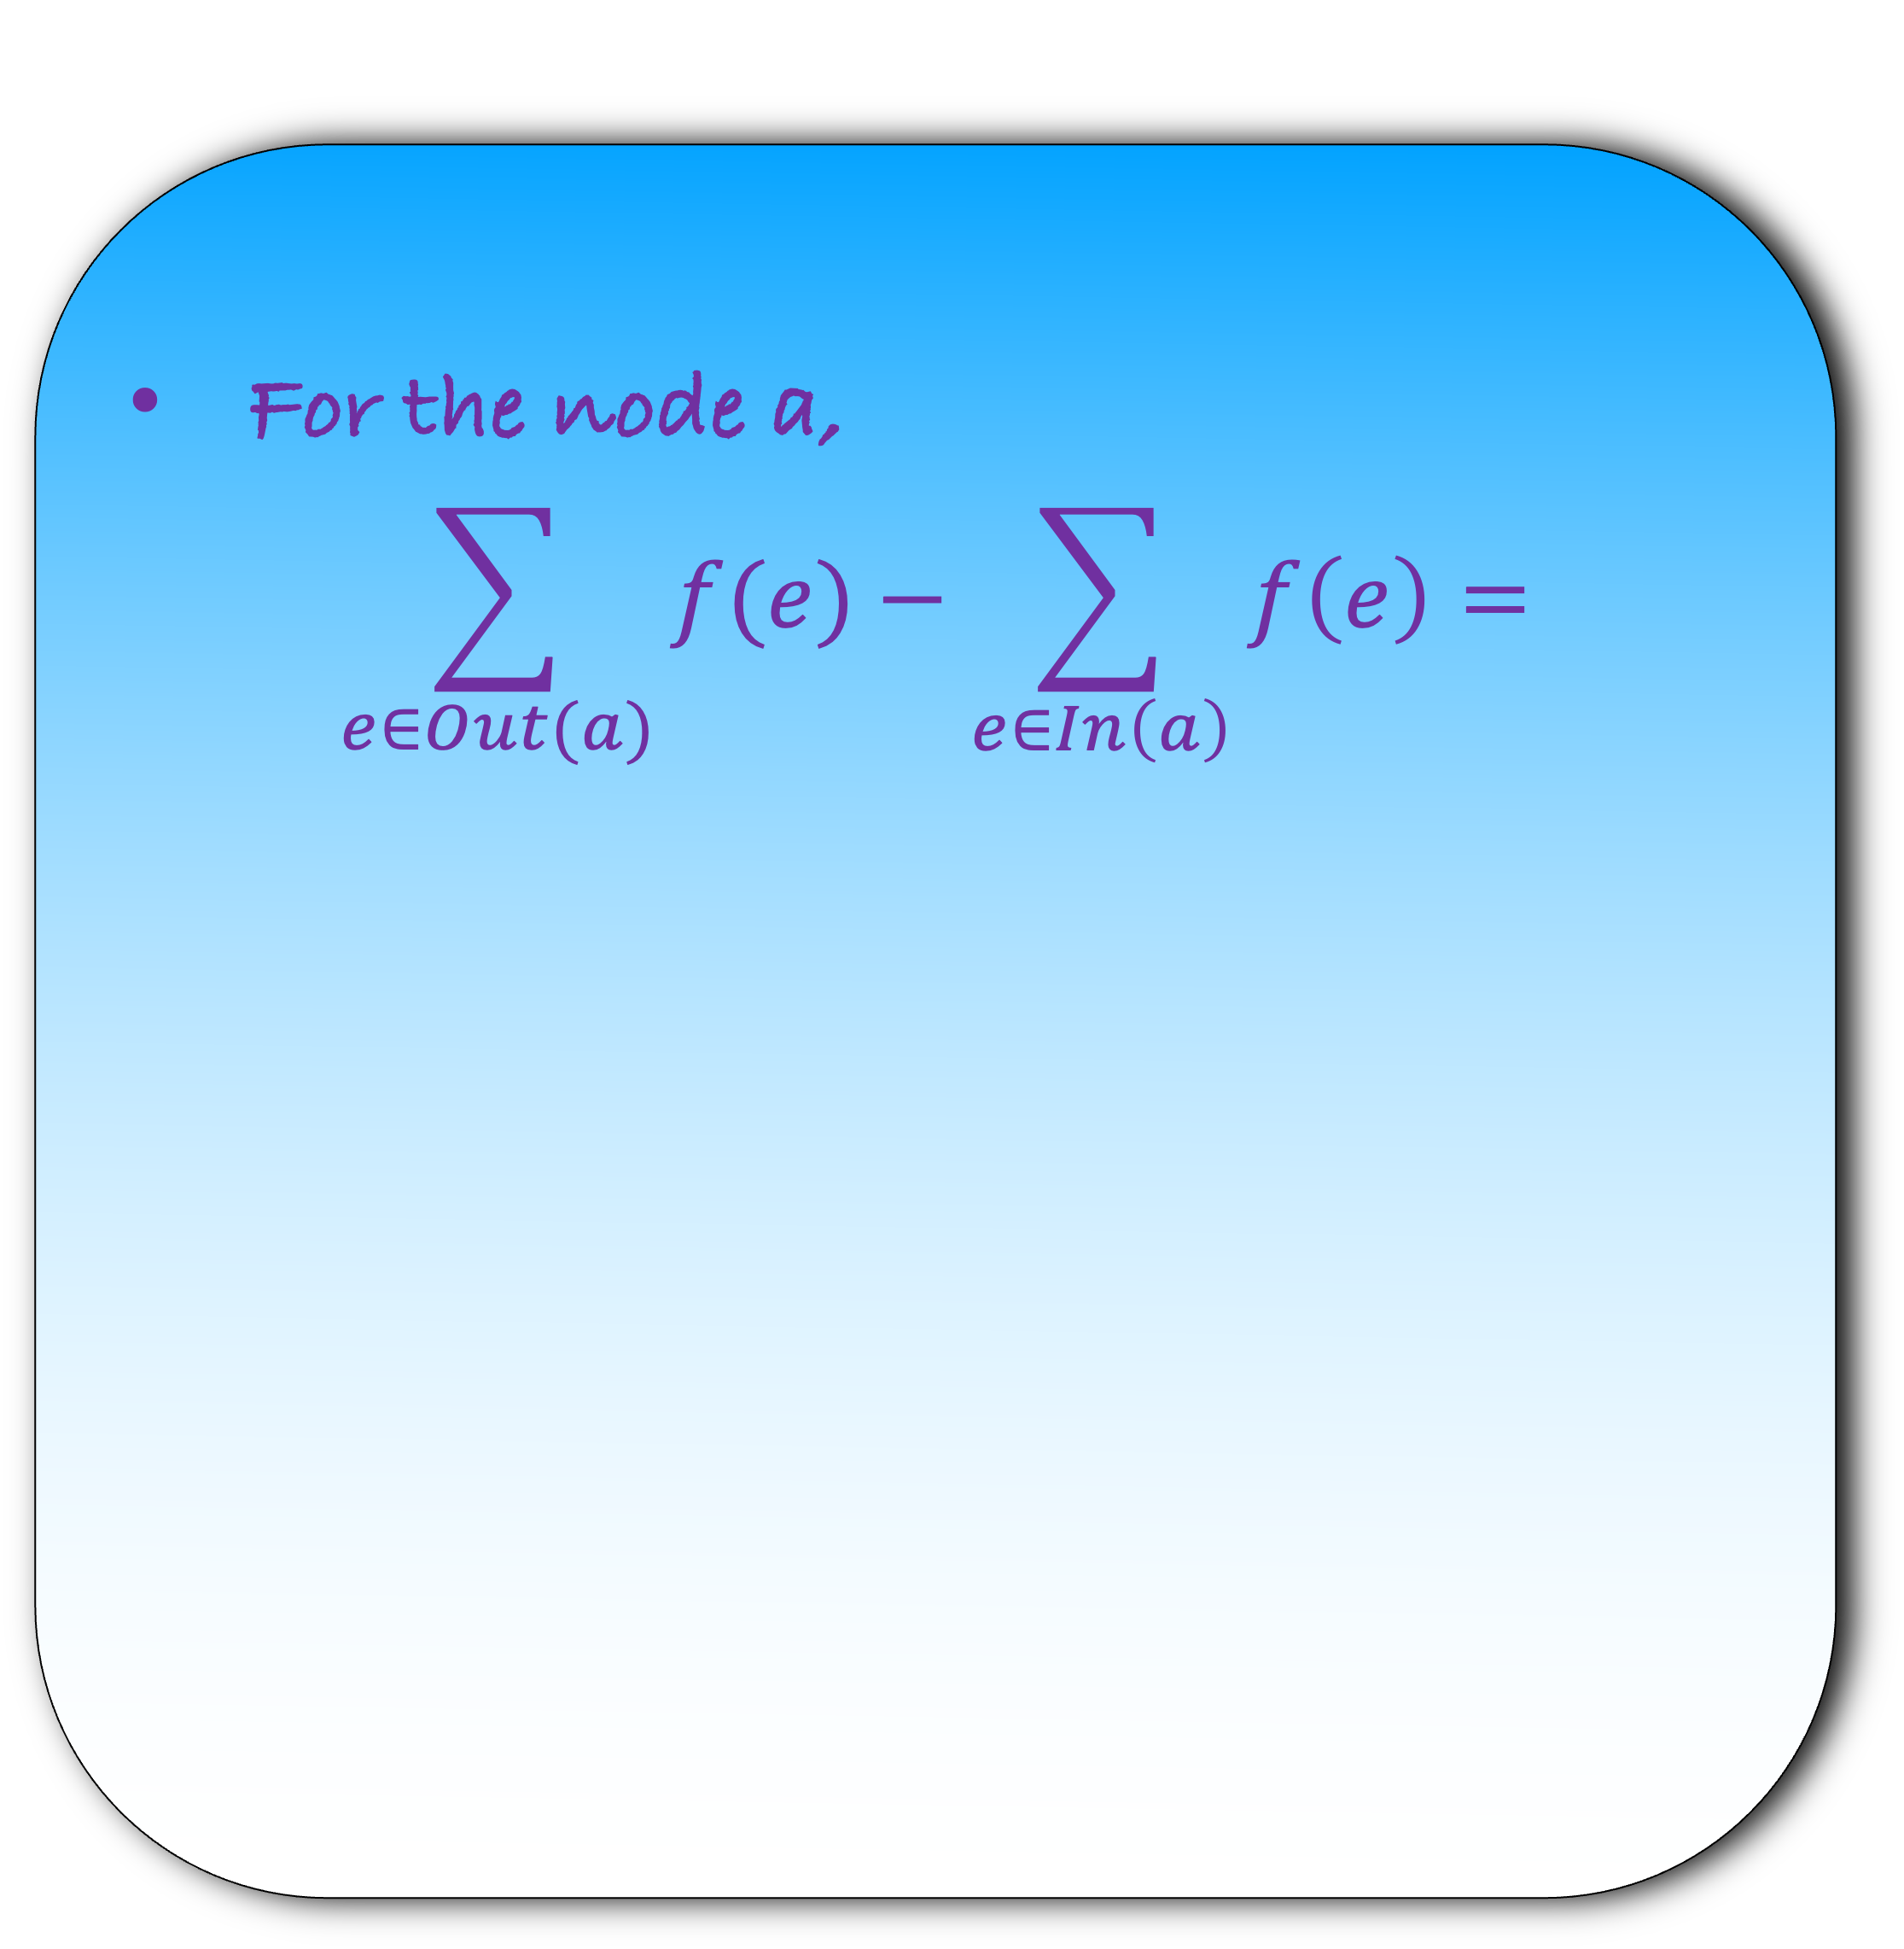
For the node a,
$$\sum_{e∈Out(a)}{f(e)}−\sum_{e∈In\left(a\right)}{f\left(e\right)}=$$
a|-3
3
3
b|-3
c|0
d|2
2
2
3
3
e|4

Slide 7
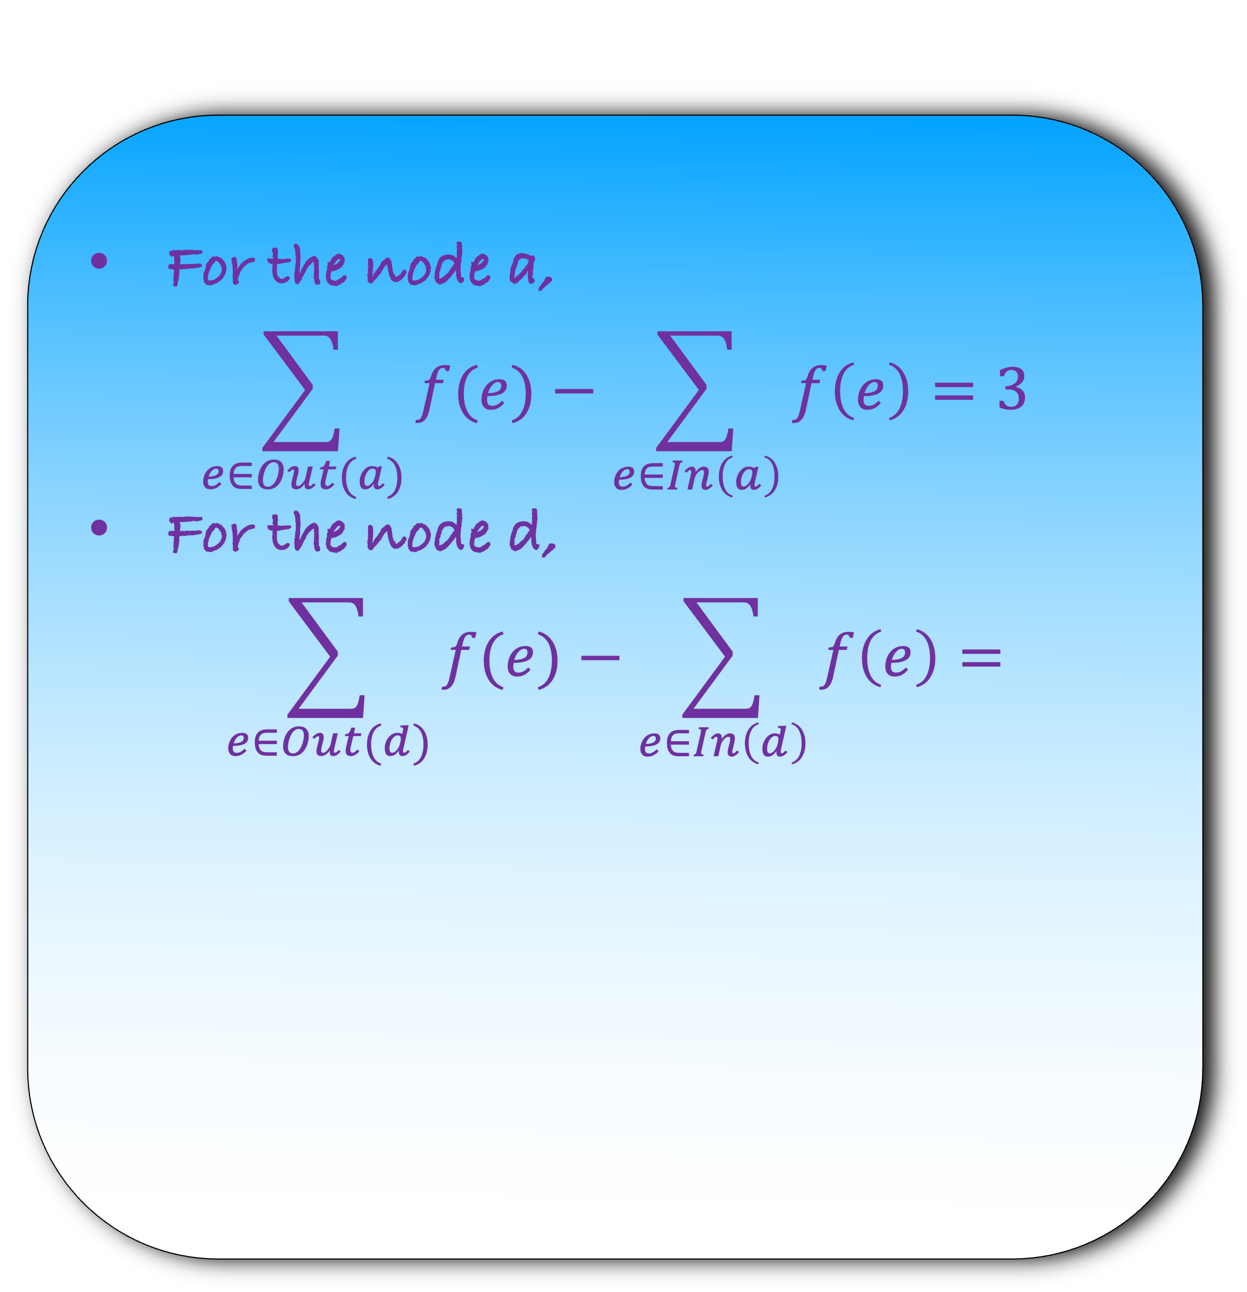
For the node a,
$$\sum_{e∈Out(a)}{f(e)}−\sum_{e∈In\left(a\right)}{f\left(e\right)}=3$$
For the node d,
$$\sum_{e∈Out(d)}{f(e)}−\sum_{e∈In\left(d\right)}{f\left(e\right)=}$$
a|-3
3
3
b|-3
c|0
d|2
2
2
3
3
e|4

Slide 8
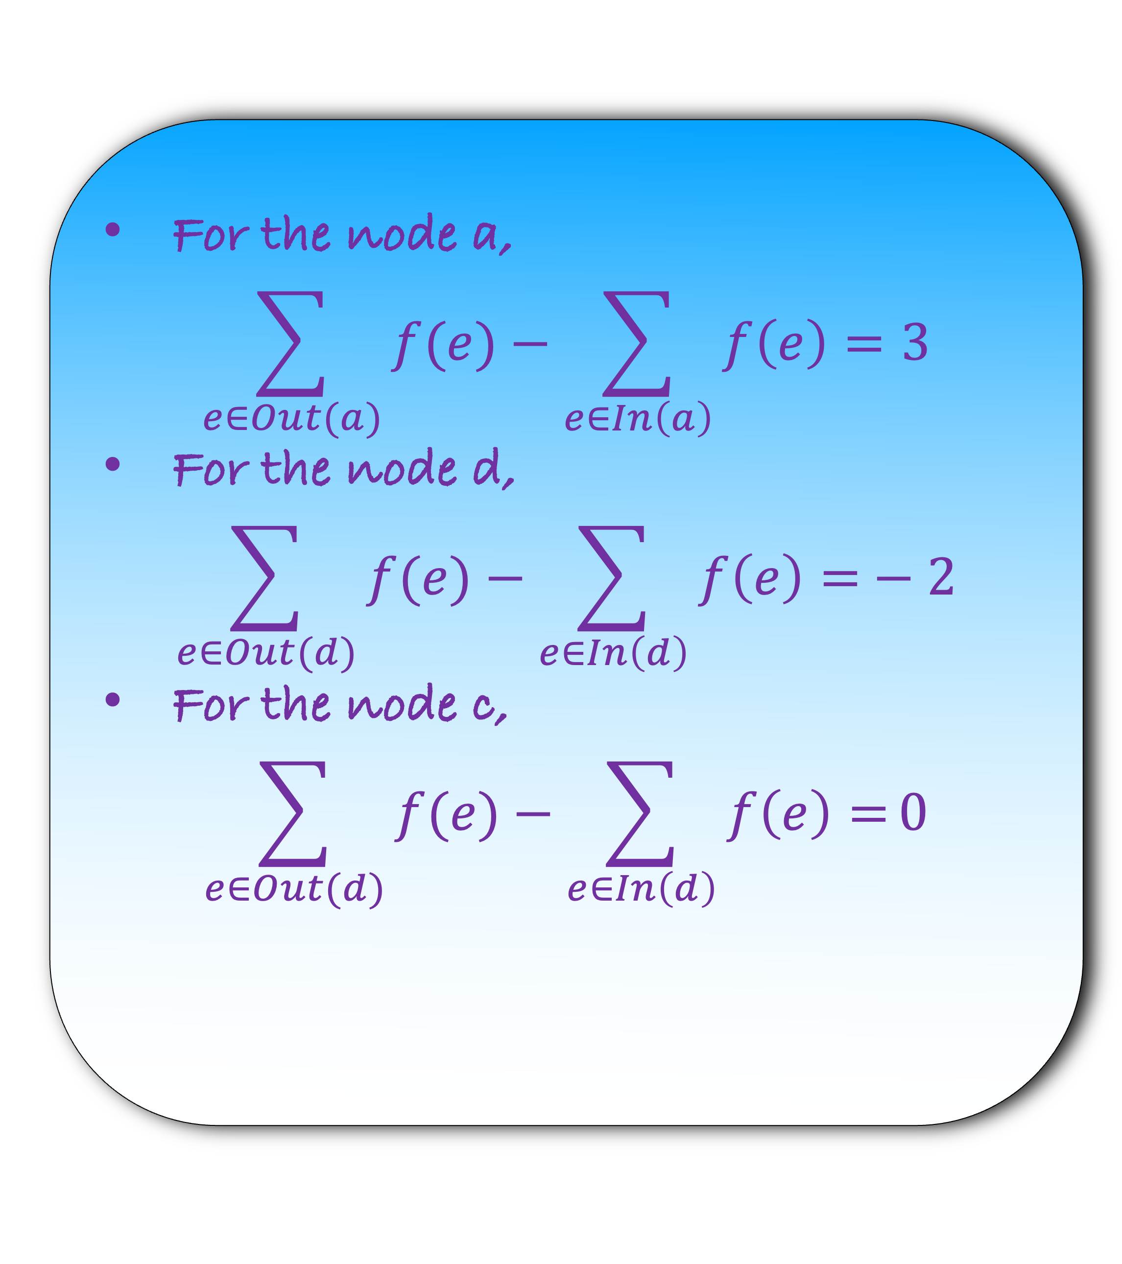
For the node a,
$$\sum_{e∈Out(a)}{f(e)}−\sum_{e∈In\left(a\right)}{f\left(e\right)}=3$$
For the node d,
$$\sum_{e∈Out(d)}{f(e)}−\sum_{e∈In\left(d\right)}{f\left(e\right)=}−2$$
For the node c,
$$\sum_{e∈Out(d)}{f(e)}−\sum_{e∈In\left(d\right)}{f\left(e\right)=}0$$
a|-3
3
3
b|-3
c|0
d|2
2
2
3
3
e|4

Slide 9
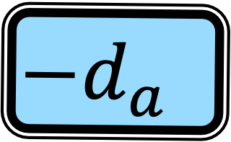
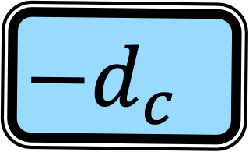
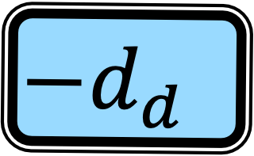
For the node a,
$$\sum_{e∈Out(a)}{f(e)}−\sum_{e∈In\left(a\right)}{f\left(e\right)}=3$$
For the node d,
$$\sum_{e∈Out(d)}{f(e)}−\sum_{e∈In\left(d\right)}{f\left(e\right)=}−2$$
For the node c,
$$\sum_{e∈Out(d)}{f(e)}−\sum_{e∈In\left(d\right)}{f\left(e\right)=}0$$
a|-3
3
3
$$−d_{a}$$
b|-3
c|0
d|2
2
2
$$−d_{d}$$
3
3
e|4
$$−d_{c}$$

Slide 10
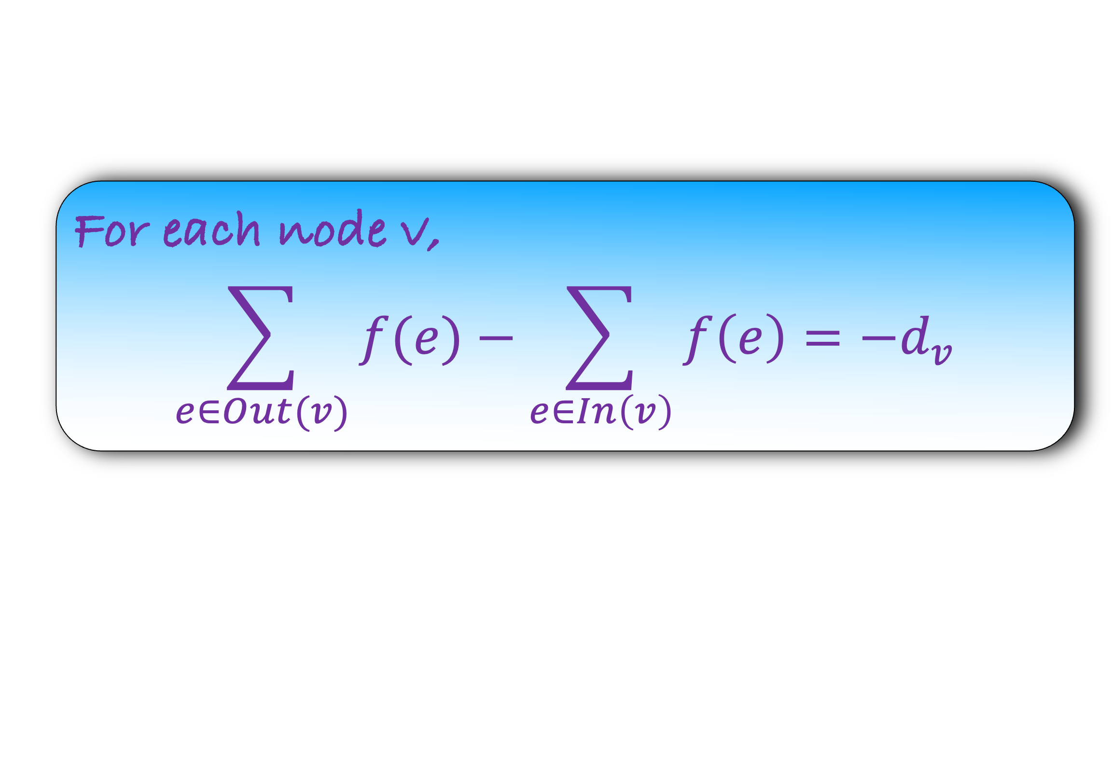
For each node v,
$$\sum_{e∈Out(v)}{f(e)}−\sum_{e∈In\left(v\right)}{f\left(e\right)}=−d_{v}$$
a|-3
3
3
Find a flow f on each edge so that each node v satisfy the above equation.
Such a flow is called a circulation.
b|-3
c|0
d|2
2
2
3
3
e|4
Find a circulation in this graph

Slide 11
For each node v,
$$\sum_{e∈Out(v)}{f(e)}−\sum_{e∈In\left(v\right)}{f\left(e\right)}=−d_{v}$$
a|-3
1
3
2
3
Find a flow f on each edge so that each node v satisfy the above equation.
Such a flow is called a circulation.
b|-3
c|0
d|2
2
2
2
2
2
3
2
3
e|4
Find a circulation in this graph

Slide 12
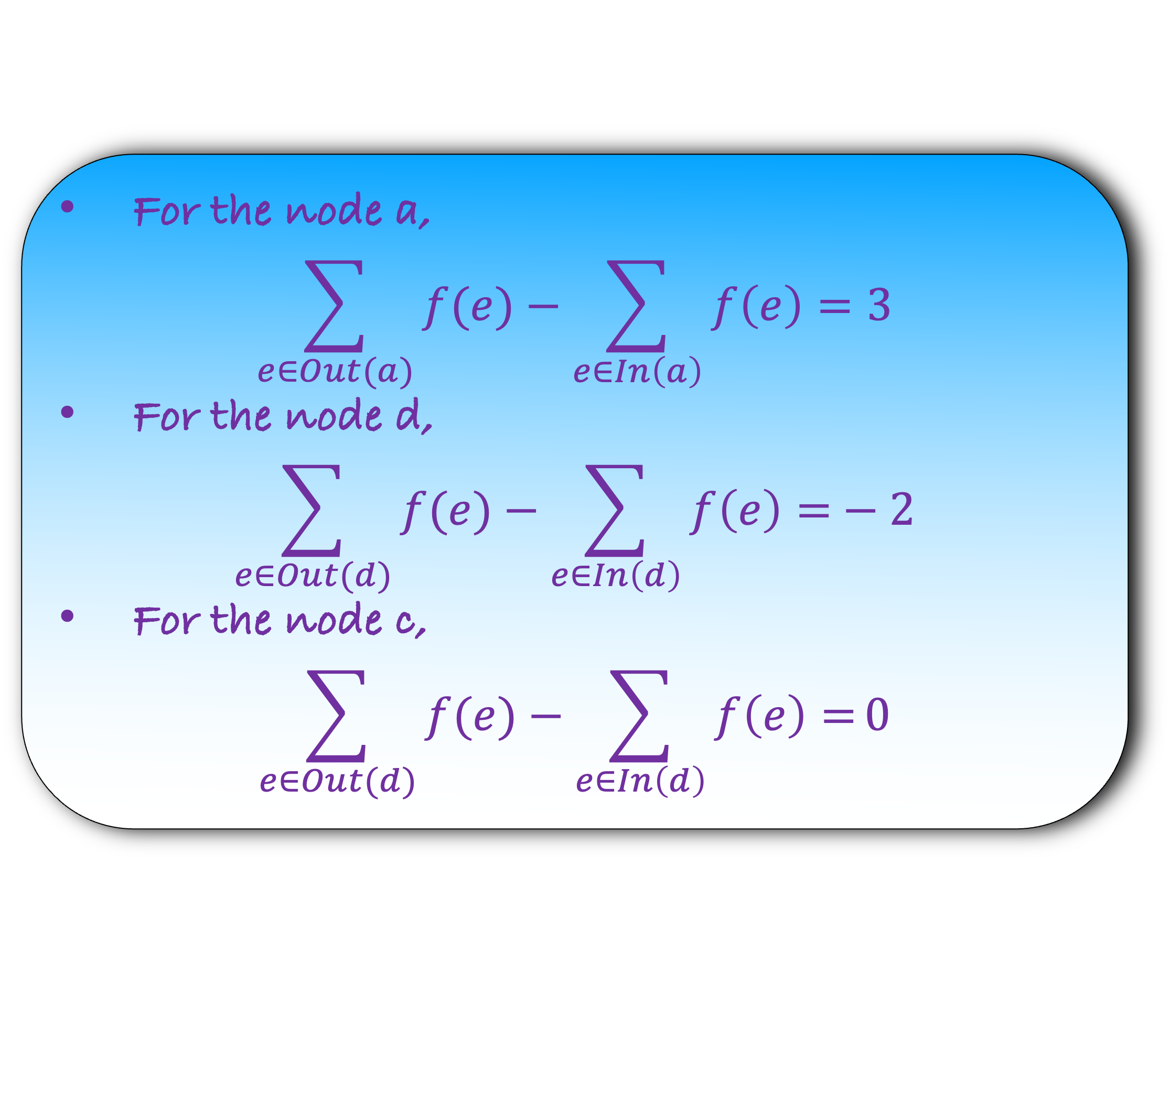
For the node a,
$$\sum_{e∈Out(a)}{f(e)}−\sum_{e∈In\left(a\right)}{f\left(e\right)}=3$$
For the node d,
$$\sum_{e∈Out(d)}{f(e)}−\sum_{e∈In\left(d\right)}{f\left(e\right)=}−2$$
For the node c,
$$\sum_{e∈Out(d)}{f(e)}−\sum_{e∈In\left(d\right)}{f\left(e\right)=}0$$
a|-3
1
3
2
3
b|-3
c|0
d|2
2
2
2
2
2
3
2
3
e|4
Check that we satisfy all the constraints

Slide 13
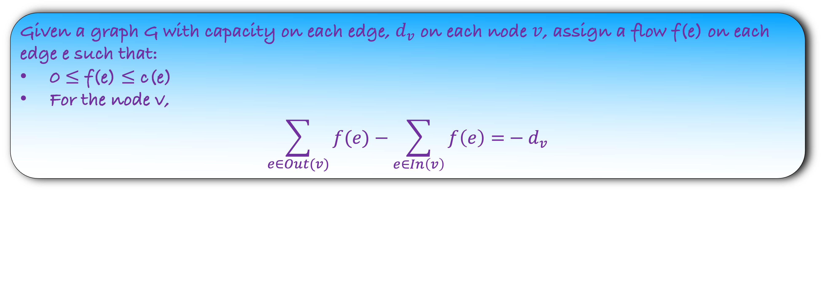
Given a graph G with capacity on each edge, $d_{v}$ on each node $v$, assign a flow f(e) on each edge e such that:
0 $≤$ f(e) $≤$ c(e)
For the node v,
$$\sum_{e∈Out(v)}{f(e)}−\sum_{e∈In\left(v\right)}{f\left(e\right)=}−d_{v}$$
Such a flow is called a circulation. Find if there exists a circulation in G
Note that this is just a feasibility problem
We are not trying to find maximum flow, just a feasible circulation
How would you solve the problem?

Slide 14
A simple fact: A circulation exists if
a|-3
Total supply =
3
3
G
b|-3
c|0
d|2
2
2
3
3
e|4

Slide 15
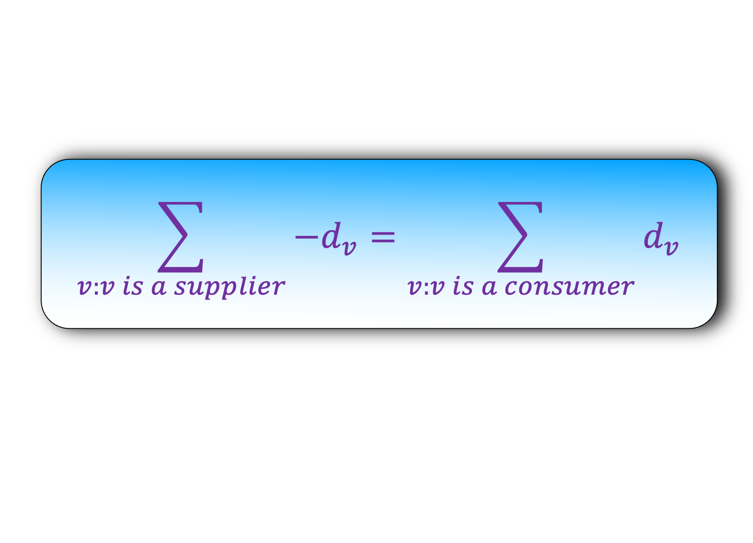
A simple fact: A circulation exists if
a|-3
Total supply = Total demand
3
3
G
b|-3
c|0
d|2
2
2
$$\sum_{v:v is a supplier}{−d_{v}}=\sum_{v:v is a consumer}{d_{v}}$$
3
3
e|4
We will assume that the above equality is satisfied as other we can return no

Slide 16
We will reduce the problem the maximum flow problem
a|-3
3
3
Step 1) Construct the graph H using G
G
b|-3
c|0
d|2
2
2
3
3
e|4

Slide 17
We will reduce the problem the maximum flow problem
s
3
a|-3
3
Step 1) Construct the graph H using G
3
3
G
b|-3
c|0
d|2
2
2
3
3
2
e|4
t
4

Slide 18
We will reduce the problem the maximum flow problem
s
3
a|-3
H
3
Step 1) Construct the graph H using G
3
3
b|-3
c|0
d|2
2
2
3
3
2
e|4
t
4

Slide 19
Step 2) Solve the maximum flow problem
s
3
a|-3
H
3
3
3
b|-3
c|0
d|2
2
2
3
3
2
e|4
t
4

Slide 20
Step 2) Solve the maximum flow problem
s
3
3
a|-3
H
Running Time?
3
3
1
3
2
3
b|-3
c|0
d|2
O(m #total supply)
2
2
2
2
2
3
2
3
2
2
e|4
t
4
4

Slide 21
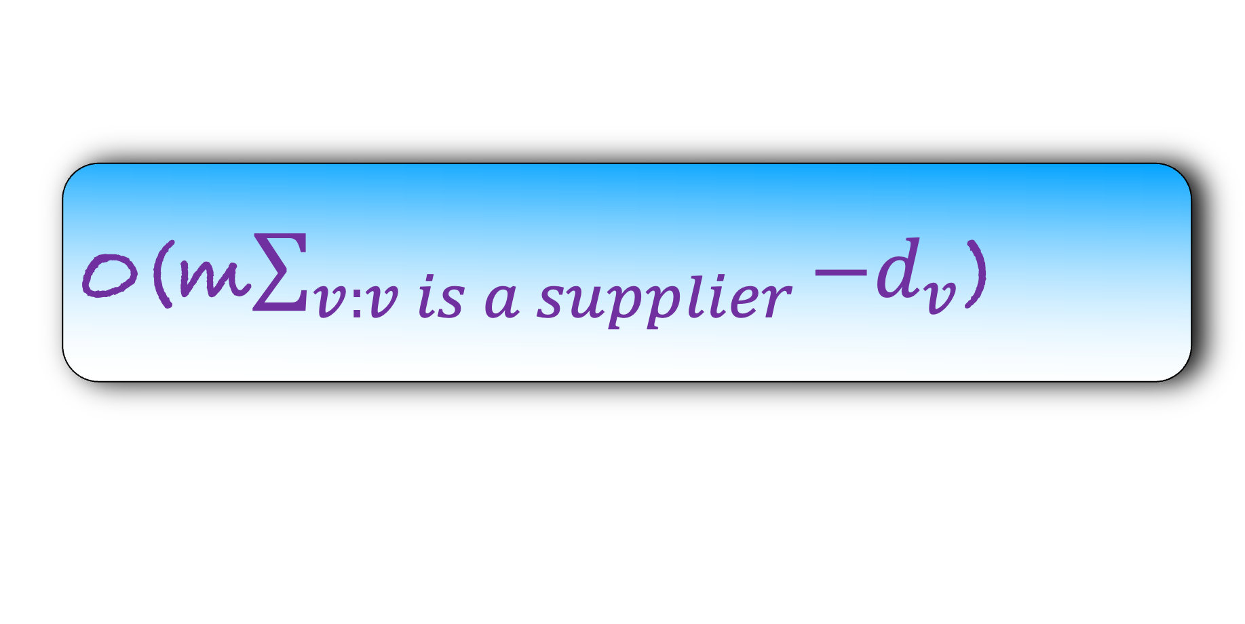
Step 2) Solve the maximum flow problem
s
3
3
a|-3
H
Running Time?
3
3
1
3
2
3
b|-3
c|0
d|2
O(m$\sum_{v:v is a supplier}{−d_{v}}$)
2
2
2
2
2
3
2
3
2
2
e|4
t
4
4

Slide 22
Step 3) Recover the circulation answer from the maximum flow answer
s
3
3
a|-3
H
How?
3
3
1
3
2
3
Step 3) If there is a flow of value 6 in H, then there is a circulation in G
If the flow in H is less than 6, then there is no circulation in G
b|-3
c|0
d|2
2
2
2
2
2
3
2
3
2
2
e|4
t
4
4

Slide 23
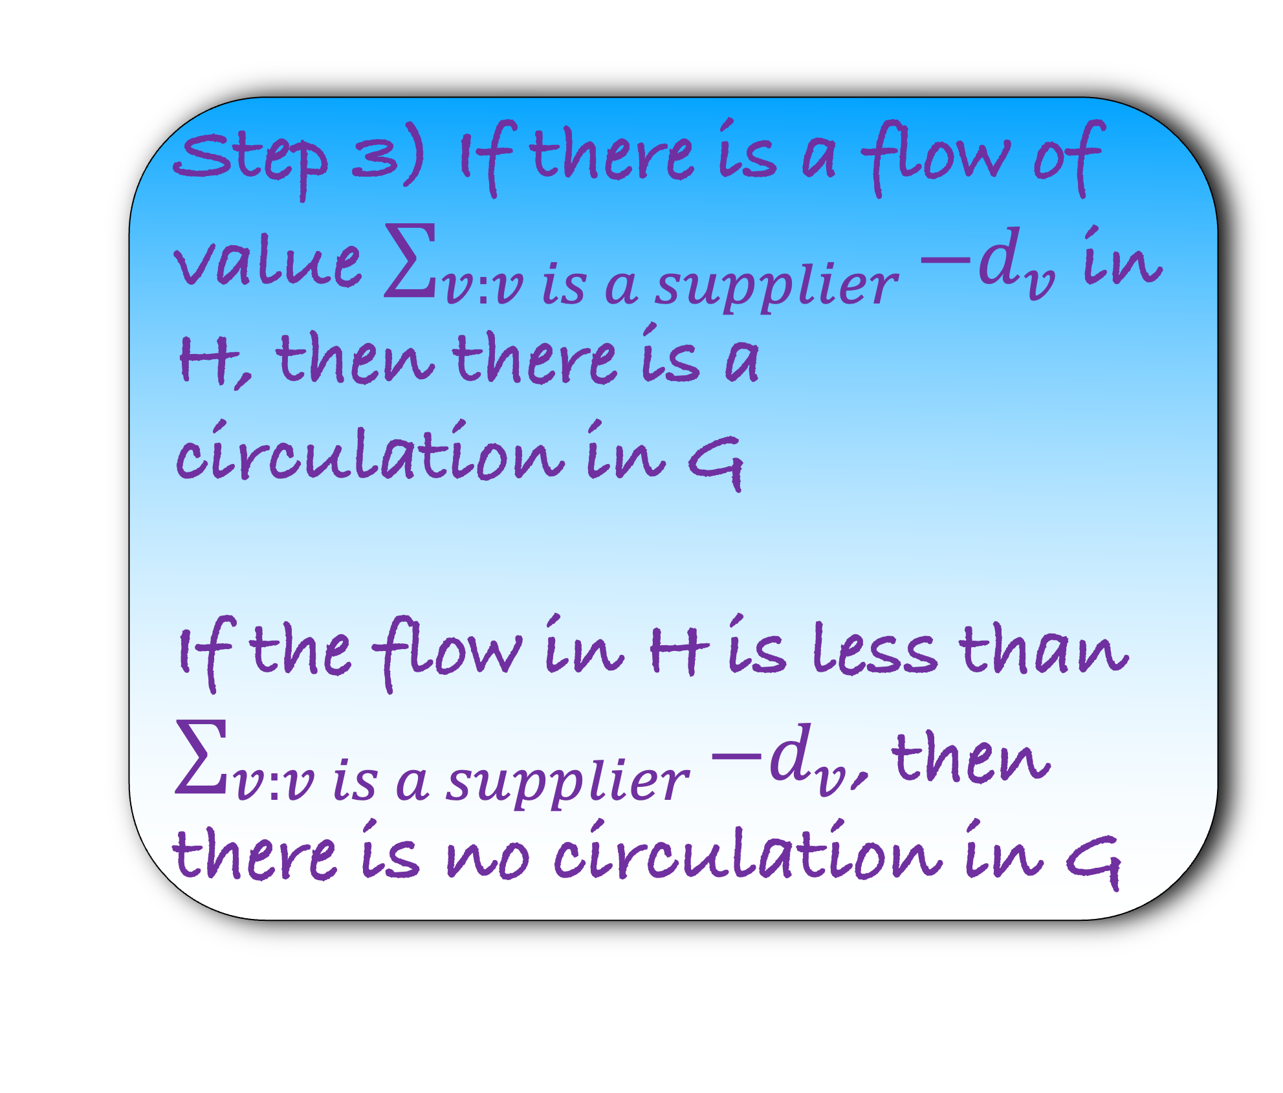
Step 3) Recover the circulation answer from the maximum flow answer
s
3
3
a|-3
H
How?
3
3
1
3
2
3
Step 3) If there is a flow of value $\sum_{v:v is a supplier}{−d_{v}}$ in H, then there is a circulation in G
If the flow in H is less than $\sum_{v:v is a supplier}{−d_{v}}$, then there is no circulation in G
b|-3
c|0
d|2
2
2
2
2
2
3
2
3
2
2
e|4
t
4
4

Slide 24
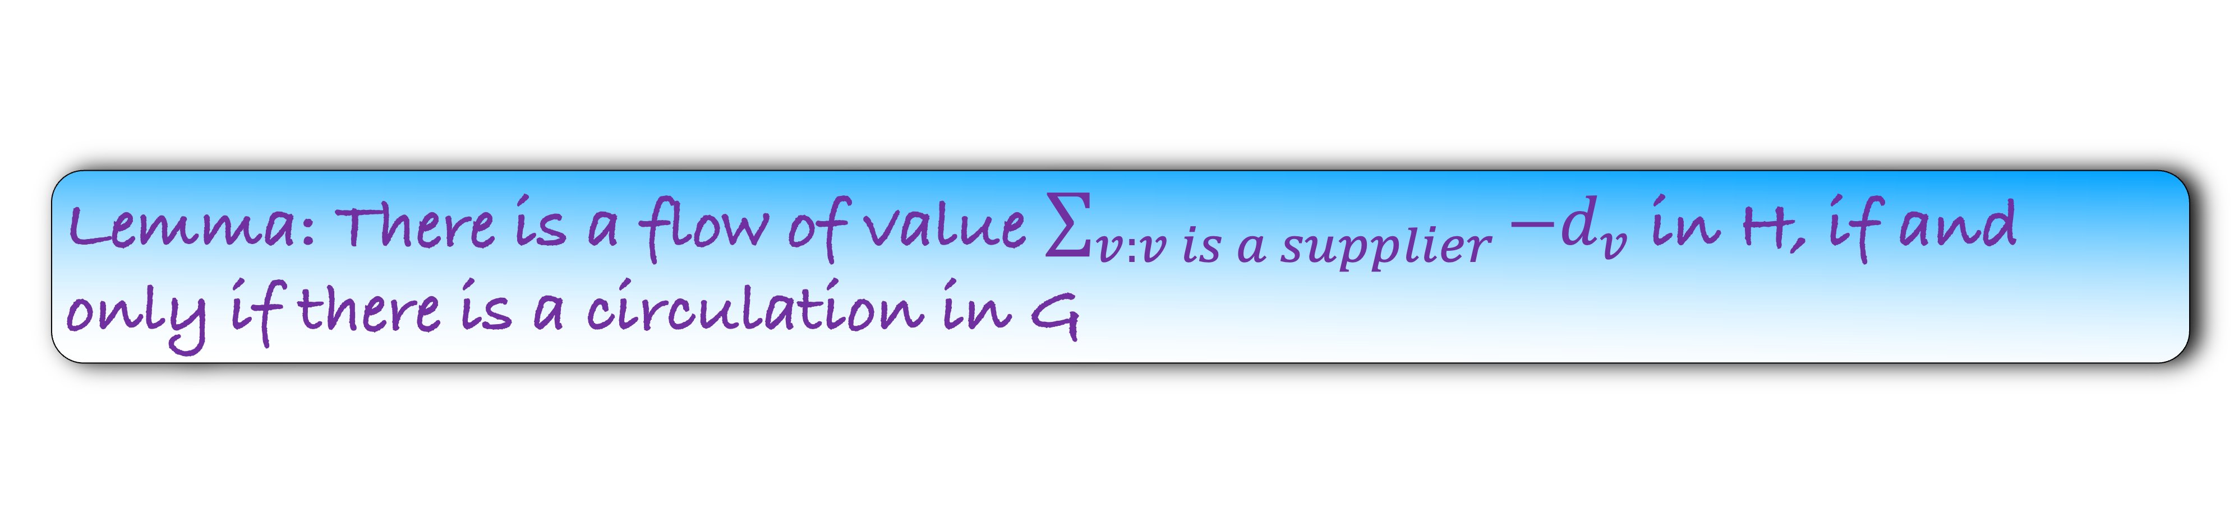
Lemma: There is a flow of value $\sum_{v:v is a supplier}{−d_{v}}$ in H, if and only if there is a circulation in G
Step 4) Prove that your answer is correct

Slide 25
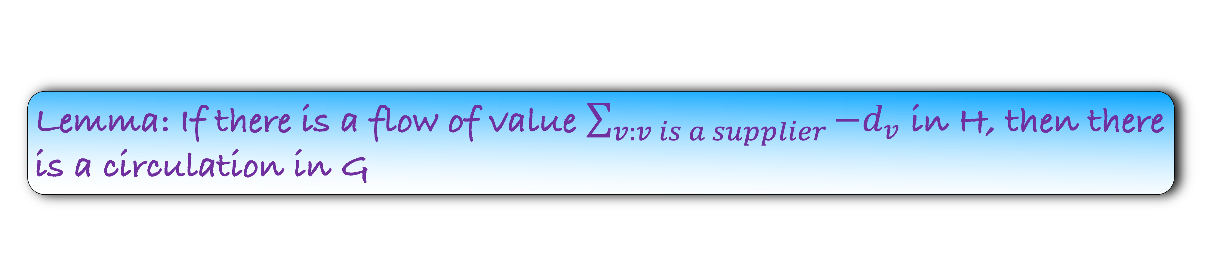
Lemma: If there is a flow of value $\sum_{v:v is a supplier}{−d_{v}}$ in H, then there is a circulation in G
s
Proof (Sketch):
Remove s and t
3
3
a|-3
H
3
3
1
3
2
3
b|-3
c|0
d|2
2
2
2
2
2
3
2
3
2
2
e|4
t
4
4

Slide 26
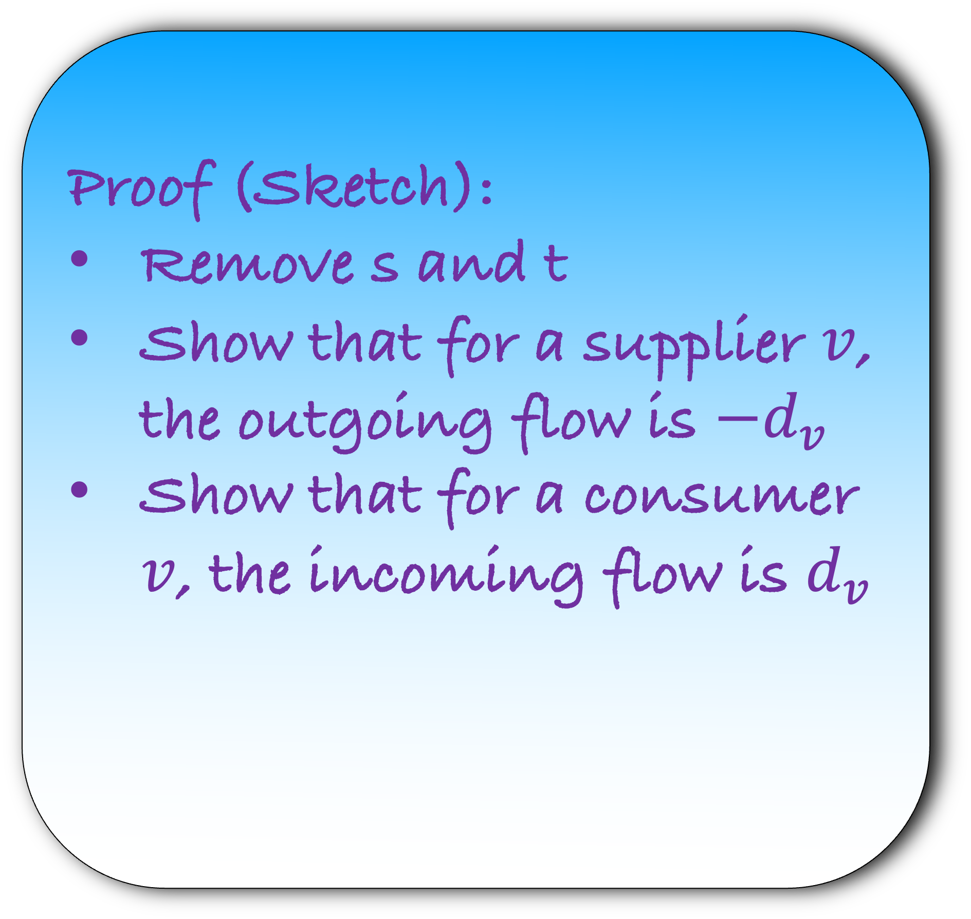
Lemma: If there is a flow of value $\sum_{v:v is a supplier}{−d_{v}}$ in H, then there is a circulation in G
Proof (Sketch):
Remove s and t
Show that for a supplier $v$, the outgoing flow is $−d_{v}$
Show that for a consumer $v$, the incoming flow is $d_{v}$
a|-3
1
3
2
3
b|-3
c|0
d|2
2
2
2
2
2
3
2
3
G
e|4

Slide 27
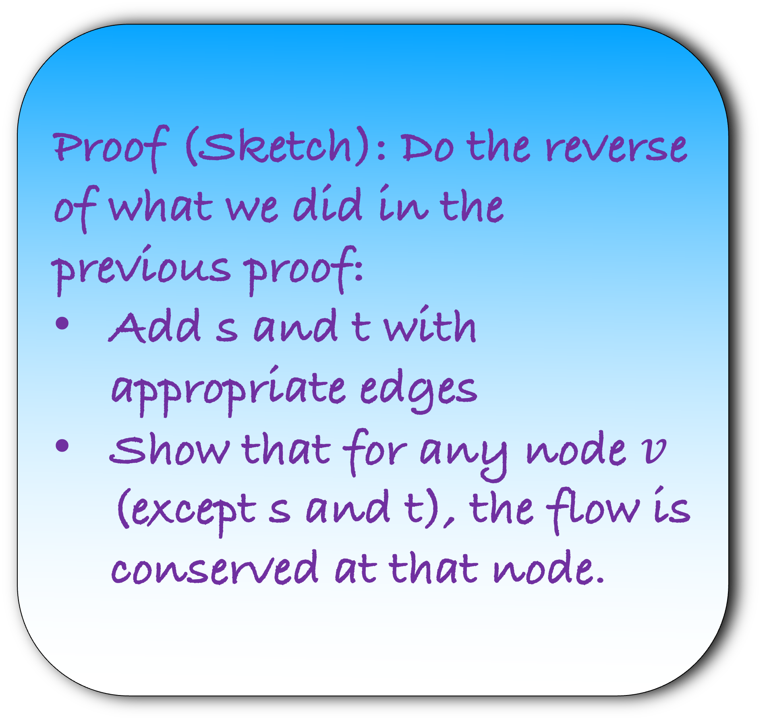
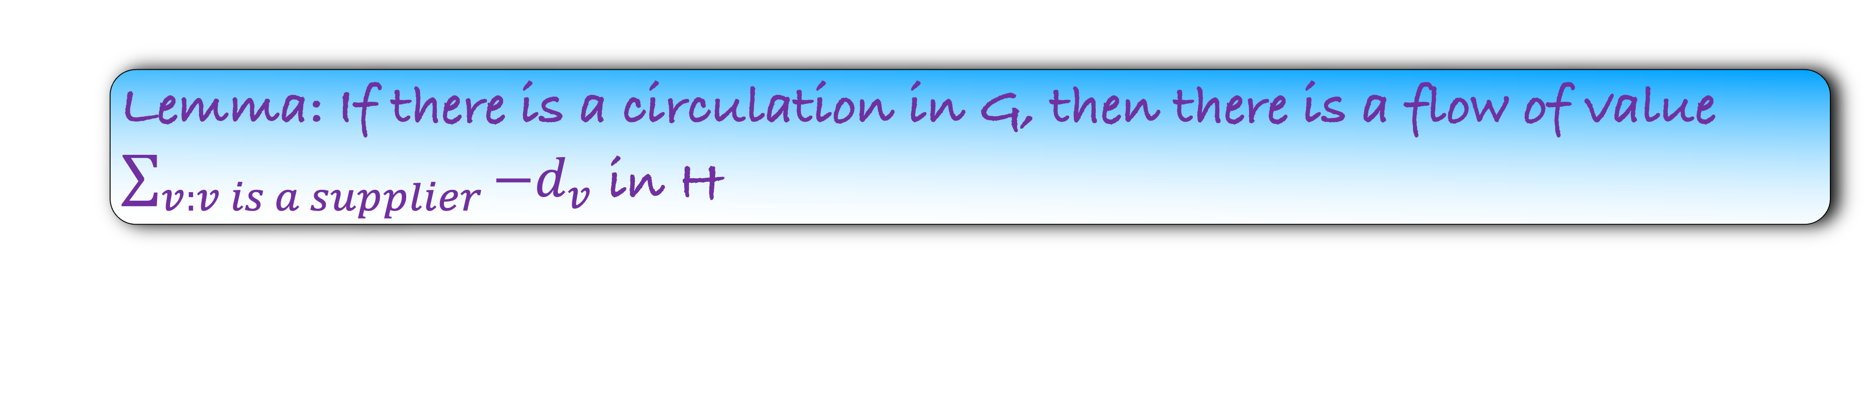
Lemma: If there is a circulation in G, then there is a flow of value $\sum_{v:v is a supplier}{−d_{v}}$ in H
Proof (Sketch): Do the reverse of what we did in the previous proof:
Add s and t with appropriate edges
Show that for any node $v$ (except s and t), the flow is conserved at that node.
a|-3
G
1
3
2
3
b|-3
c|0
d|2
2
2
2
2
2
3
2
3
e|4

Slide 28


Lemma: There is a flow of value $\sum_{v:v is a supplier}{−d_{v}}$ in H, if and only if there is a circulation in G
Lemma: If there is a circulation in G, then there is a flow of value $\sum_{v:v is a supplier}{−d_{v}}$ in H
Step 4) Prove that your answer is correct

Slide 29
Applications of Circulation: Circulation with demand and lower bound

Slide 30
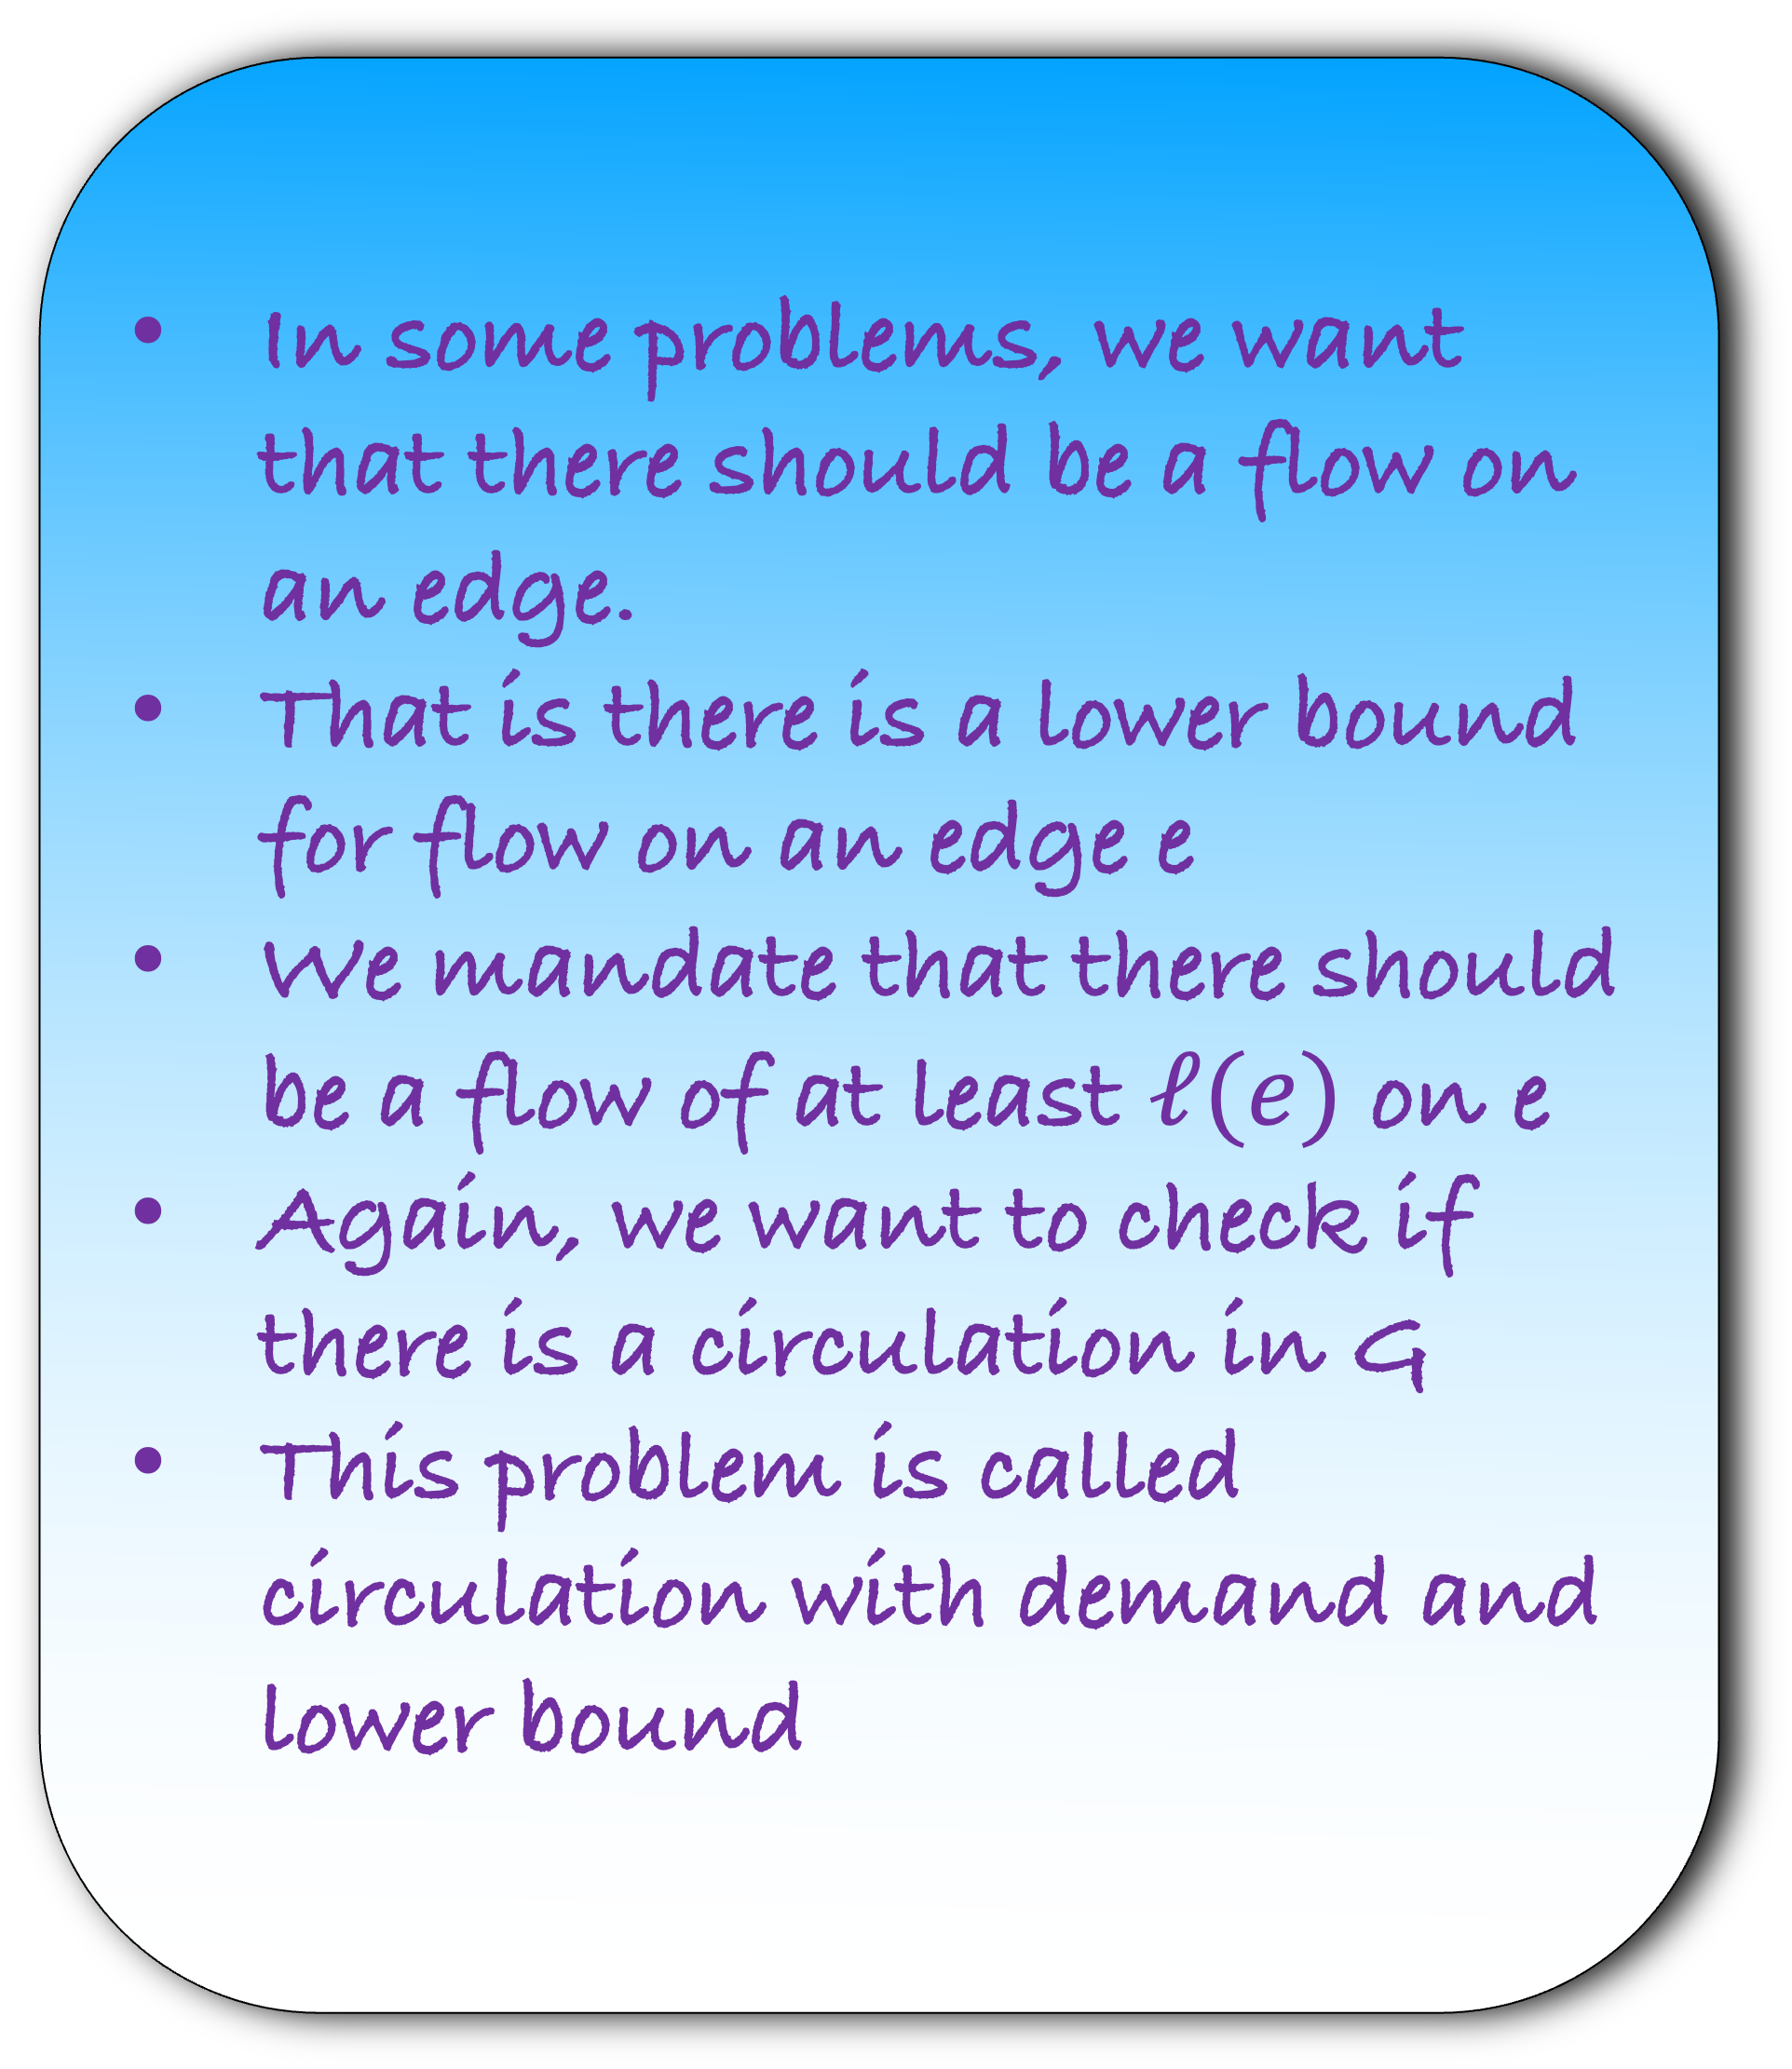
In some problems, we want that there should be a flow on an edge.
That is there is a lower bound for flow on an edge e
We mandate that there should be a flow of at least $ℓ(e)$ on e
Again, we want to check if there is a circulation in G
This problem is called circulation with demand and lower bound
a|-3
3,1
3,2
b|-3
c|0
d|2
2
2
3
3
e|4

Slide 31

For each node v,
$$\sum_{e∈Out(v)}{f(e)}−\sum_{e∈In\left(v\right)}{f\left(e\right)}=−d_{v}$$
a|-3
3,1
3,2
For each edge e, $ℓ\left(e\right)≤f\left(e\right)≤c(e)$
b|-3
c|0
d|2
2
2
Find a flow f on each edge so that each node v satisfy the above equations.
Such a flow is called a circulation.
3
3
e|4
Find a circulation in this graph

Slide 32
For each node v,
$$\sum_{e∈Out(v)}{f(e)}−\sum_{e∈In\left(v\right)}{f\left(e\right)}=−d_{v}$$
a|-3
1
3,1
2
3,2
For each edge e, $ℓ\left(e\right)≤f\left(e\right)≤c(e)$
b|-3
c|0
d|2
2
2
2
2
Find a flow f on each edge so that each node v satisfy the above equations.
Such a flow is called a circulation.
2
3
2
3
e|4
Find a circulation in this graph

Slide 33
For each node v,
$$\sum_{e∈Out(v)}{f(e)}−\sum_{e∈In\left(v\right)}{f\left(e\right)}=−d_{v}$$
a|-3
3,1
3,2
For each edge e, $ℓ\left(e\right)≤f\left(e\right)≤c(e)$
b|-3
c|0
d|2
2
2
Find a flow f on each edge so that each node v satisfy the above equations.
Such a flow is called a circulation.
3
3
e|4
How would you solve this problem?
Convert into a circulation with demand problem

Slide 34
We will reduce the problem to a circulation with demand problem
a|-3
G
3,1
3,2
b|-3
c|0
d|2
Step 1) Construct the graph H using G
2
2
3
3
Notice that lower bound force some initial flow
This initial flow is normally 0
e|4

Slide 35
We will reduce the problem to a circulation with demand problem
a|-3
G
1
3,1
2
3,2
b|-3
c|0
d|2
Step 1) Construct the graph H using G
0
2
0
2
0
3
0
3
Notice that lower bound force some initial flow
This initial flow is normally 0
e|4

Slide 36
Notice that lower bound force some initial flow
This initial flow is normally 0
The initial flow may or may not be valid
But now we can remove the lower bounds
a|-3
G
1
3,1
2
3,2
b|-3
c|0
d|2
0
2
0
2
0
3
0
3
e|4

Slide 37
Notice that lower bound force some initial flow
This initial flow is normally 0
The initial flow may or may not be valid
But now we can remove the lower bounds
Now this looks like a circulation problem but there is some initial flow
How to take care of initial flow?
a|-3
G
1
3
2
3
b|-3
c|0
d|2
0
2
0
2
0
3
0
3
e|4

Slide 38
a|-3
a|-3
G
H
1
3
2
3
3
3
b|-3
c|0
d|2
b|-3
c|0
d|2
0
2
0
2
2
2
0
3
0
3
3
3
e|4
e|4
We will assume that we have already sent some flow on each edge
But this would change demand and supply in H
Let us do that now

Slide 39
a|-3
a|-3
G
H
1
3
2
3
3
3
b|-3
c|0
d|2
b|-3
c|0
d|2
0
2
0
2
2
2
0
3
0
3
3
3
e|4
e|4
Since a has already sent a flow of 3, we make a note of it
Similarly, b has already received a flow of 1
Thus, there is an imbalance at each node

Slide 40
a|-3
a|-3
G
1
2
H
1
3
2
3
3
3
1
2
b|-3
c|0
d|2
b|-3
c|0
d|2
0
2
0
2
2
2
0
3
0
3
3
3
e|4
e|4
a has already sent a flow of 3. Or there is an imbalance of 3
Now it should not send any flow

Slide 41
a|-3
a|0
G
H
1
3
2
3
3
3
1
2
b|-3
c|0
d|2
b|-3
c|0
d|2
0
2
0
2
2
2
0
3
0
3
3
3
e|4
e|4
b has already received a flow of 1. Or there is an imbalance of 1
And it was supposed to send a flow of 3
So, now it should send a flow of 4

Slide 42
a|-3
a|0
G
H
1
3
2
3
3
3
2
b|-3
c|0
d|2
b|-4
c|0
d|2
0
2
0
2
2
2
0
3
0
3
3
3
e|4
e|4
d has already received a flow of 2. Or there is an imbalance of 2
And it was supposed to receive a flow of 2
So, now it should not receive any flow

Slide 43
a|-3
a|0
G
H
1
3
2
3
3
3
b|-3
c|0
d|2
b|-4
c|0
d|0
0
2
0
2
2
2
0
3
0
3
3
3
e|4
e|4
There is no change in e as it had no imbalance
So, we donot change it
But there is one more thing remaining. What is that?

Slide 44
a|-3
a|0
G
H
1
3
2
3
3
3
b|-3
c|0
d|2
b|-4
c|0
d|0
0
2
0
2
2
2
0
3
0
3
3
3
e|4
e|4
There is already a flow of 1 on ab and 2 of ad
We should decrease their capacities appropriately in H

Slide 45
a|-3
a|0
G
H
1
3
2
3
2
1
b|-3
c|0
d|2
b|-4
c|0
d|0
0
2
0
2
2
2
0
3
0
3
3
3
e|4
e|4
There is already a flow of 1 on ab and 2 of ad
We should decrease their capacities appropriately in H

Slide 46
a|-3
a|0
G
H
Step 2) Solve the circulation with demand problem
1
3
2
3
2
1
c|0
Note that in this circulation problem total supply is equal to total demand
Hw: Show that it will always be the case if in G, total supply is equal to total demand
b|-3
d|2
b|-4
c|0
d|0
0
2
0
2
2
2
0
3
0
3
3
3
e|4
e|4

Slide 47
a|0
H
Step 2) Solve the circulation problem
0
2
0
1
b|-4
c|0
d|0
Running Time?
1
2
1
2
3
3
O(m #total supply)
1
3
e|4

Slide 48
a|0
H
Step 3) Recover the answer to our original problem
0
2
0
1
b|-4
c|0
d|0
How?
1
2
1
2
3
3
There is a circulation in G, if and only if there is a circulation in H
1
3
e|4

Slide 49
Lemma: There is a circulation in G, if and only if there is a circulation in H
Step 4) Prove that your answer is correct

Slide 50
Lemma: If there is a circulation in H, then there is a circulation in G
a|0
a|-3
H
G
0
2
0
1
3,1
3,2
b|-4
c|0
d|0
b|-3
c|0
d|2
1
2
1
2
2
2
3
3
1
3
3
3
e|4
e|4

Slide 51
Lemma: If there is a circulation in H, then there is a circulation in G
a|0
a|-3
H
G
2
Hw: Prove that this is a circulation in G. Also, we satisfy all lower bounds
1
1
3,1
2
3,2
b|-4
c|0
d|0
b|-3
c|0
d|2
2
2
1
2
1
2
3
3
3
3
1
3
e|4
e|4

Slide 52
Lemma: If there is a circulation in G, then there is a circulation in H
a|-3
a|0
G
H
1
3,1
2
3,2
2
1
b|-3
c|0
d|2
b|-4
c|0
d|0
1
2
1
2
2
2
3
3
1
3
3
3
e|4
e|4

Slide 53
Lemma: If there is a circulation in G, then there is a circulation in H
a|-3
a|0
G
H
1
3,1
2
3,2
2
1
b|-3
c|0
d|2
b|-4
c|0
d|0
2
2
1
2
1
2
3
3
3
3
1
3
e|4
e|4

Slide 54
Lemma: If there is a circulation in G, then there is a circulation in H
a|-3
a|0
G
H
Hw: Prove that this is a circulation in H.
3,1
3,2
0
2
0
1
b|-3
c|0
d|2
b|-4
c|0
d|0
2
2
1
2
1
2
3
3
3
3
1
3
e|4
e|4

Slide 55
Applications of Circulation with demand and lower bound: Survey

Slide 56


A company sells k product to n customers
We want to design a survey in which we will ask question to customers about the products they have purchased
We have the purchase history of each customer

Slide 57

A company sells k product to n customers
We want to design a survey in which we will ask question to customers about the products they have purchased
We have the purchase history of each customer
The survey should satisfy the following conditions:
Each customer $i$ should be asked atleast $c_{i}$ questions and atmost $c_{i}′$ questions
Atleast $p_{j}$ and at most $p_{j}^{′}$ customers should be asked questions about the product j
Can you design such a survey?

Slide 58
How would you solve this problem?
Convert into a circulation with demand and lower bound

Slide 59
Step 1) Construct the graph H using the instance of our problem

Slide 60
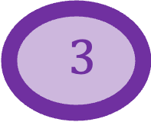
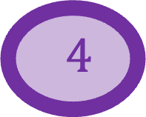
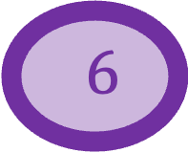
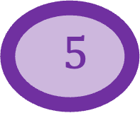

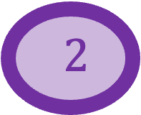
H
Step 1) Construct the graph H using the instance of our problem
$6$
$1$
$5$
$4$
$2$
$3$

Slide 61
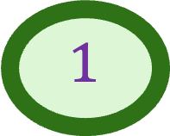
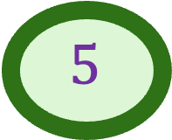
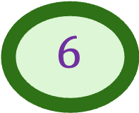
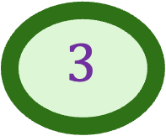
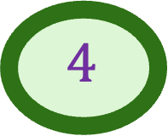
H
Step 1) Construct the graph H using the instance of our problem
$6$
$$1$$
$$3$$
$1$
$5$
$$4$$
$4$
$2$
$3$
$$5$$
$$6$$

Slide 62
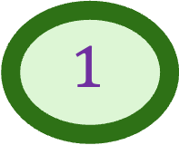
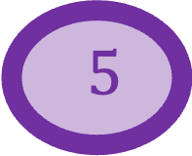
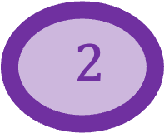
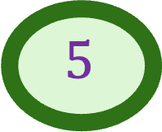
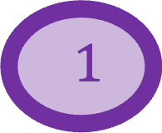
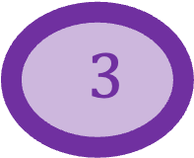
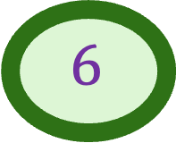
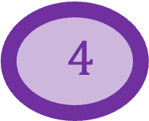
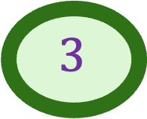
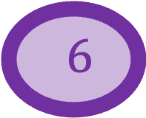
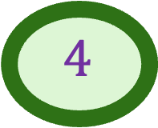
H
Step 1) Construct the graph H using the instance of our problem
$1$
$2$
$$1$$
$$3$$
$3$
Is there a source and a sink?
$$4$$
$4$
$$6$$
$5$
$$5$$
$6$
Customer
Product

Slide 63
H
Step 1) Construct the graph H using the instance of our problem
$1$
1
$2$
$$1$$
What is the capacity on middle edge?
$$3$$
$3$
s
t
$$4$$
$4$
There is a capacity of 1 on middle edges
$$6$$
$5$
$$5$$
Is there a lower bound on these edges?
$6$
No
Customer
Product

Slide 64


What is the capacity on s to 1?
H
$1$
$$c_{1}′$$
1
$2$
$$1$$
$$3$$
$3$
s
t
$$4$$
$4$
$$6$$
Is there a lower bound on this edge?
$5$
$$5$$
$$c_{1}$$
$6$
Customer
Product

Slide 65
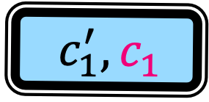

What is the capacity on s to 1?
H
$1$
$$c_{1}^{′}$$
1
$$c_{1}^{′},c_{1}$$
$2$
$$1$$
$$3$$
$3$
s
t
$$4$$
$4$
$$6$$
Is there a lower bound on these edges?
$5$
$$5$$
$$c_{1}$$
$6$
Customer
Product

Slide 66
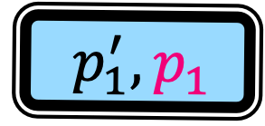


What is the capacity on 1 to t?
H
$1$
$$p_{1}^{′}$$
1
$$c_{1}^{′},c_{1}$$
$2$
$$1$$
$$p_{1}^{′},p_{1}$$
$$3$$
$3$
s
t
$$4$$
$4$
$$6$$
Is there a lower bound on this edge?
$5$
$$5$$
$$p_{1}$$
$6$
Customer
Product

Slide 67
What is the supply or demand on a customer?
H
$1$
0
1
$$c_{1}^{′},c_{1}$$
$2$
$$1$$
$$p_{1}^{′},p_{1}$$
$$3$$
$3$
s
t
$$4$$
$4$
$$6$$
$5$
$$5$$
$6$
Customer
Product

Slide 68
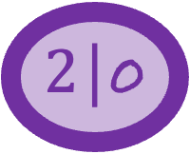
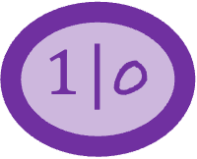
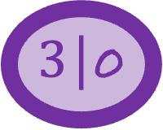
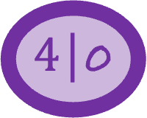
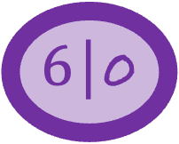

What is the supply or demand on a products?
H
$1$|0
0
1
$$c_{1}^{′},c_{1}$$
$2$|0
$$1$$
$$p_{1}^{′},p_{1}$$
$3$|0
$$3$$
s
t
$4$|0
$$4$$
$$6$$
$5$|0
$$5$$
$6$|0
Customer
Product

Slide 69





What is the supply or demand on s and t?
H
$1$|0
0
1
$1$|0
$$c_{1}^{′},c_{1}$$
$2$|0
$$p_{1}^{′},p_{1}$$
$3$|0
$3$|0
s
t
$4$|0
$4$|0
$6$|0
$5$|0
$5$|0
$6$|0
Customer
Product

Slide 70
But this makes no sense
t should not receive any net inflow. But it does not have any outgoing edge
There is no net outflow from s. But there is no incoming edge to s
So, what to do?
H
$1$|0
1
$1$|0
$$c_{1}^{′},c_{1}$$
$2$|0
$$p_{1}^{′},p_{1}$$
$3$|0
$3$|0
S|0
t|0
$4$|0
$4$|0
$6$|0
$5$|0
$5$|0
$6$|0
Customer
Product

Slide 71


Step 2) Solve the circulation problem
H
$1$|0
1
$1$|0
$$c_{1}^{′},c_{1}$$
$2$|0
Running Time?
$$p_{1}^{′},p_{1}$$
$3$|0
$3$|0
S|0
t|0
$4$|0
$4$|0
$6$|0
O(m $\sum_{i}{c_{i}^{′}}$) or O(m $\sum_{i}{p_{i}^{′}}$) whichever is minimum
$5$|0
$5$|0
$6$|0
$$∞$$
Customer
Product

Slide 72
Step 3) Recover the answer using the answer of circulation problem in H
H
$1$|0
1
$1$|0
$$c_{1}^{′},c_{1}$$
$2$|0
How?
$$p_{1}^{′},p_{1}$$
$3$|0
$3$|0
S|0
t|0
$4$|0
$4$|0
$6$|0
$5$|0
There is a way to design a survey if and only if there is a circulation in H
$5$|0
$6$|0
$$∞$$
Customer
Product

Slide 73
Lemma: There is a way to design a survey if and only if there is a circulation in H
Step 4) Prove that your answer is correct

Slide 74














Lemma: If there is a circulation in H, then there is a way to design a survey
$1$|0
Assume that there is a circulation in H
Look at the customer 1
What is the flow on s to 1?
H
1
$1$|0
$$c_{1}^{′},c_{1}$$
$2$|0
$$p_{1}^{′},p_{1}$$
$3$|0
$3$|0
S|0
t|0
$4$|0
$4$|0
$6$|0
$5$|0
$5$|0
$6$|0
Customer
Product
$$∞$$

Slide 75

Lemma: If there is a circulation in H, then there is a way to design a survey
$1$|0
Assume that there is a circulation in H
Look at the customer 1
What is the flow on s to 1?
$ℓ(s1)≤f\left(s1\right)≤c(s1)$
H
1
$1$|0
$$c_{1}^{′},c_{1}$$
$2$|0
$$p_{1}^{′},p_{1}$$
$3$|0
$3$|0
S|0
t|0
$4$|0
$4$|0
$6$|0
$5$|0
$5$|0
$6$|0
Customer
Product
$$∞$$

Slide 76

Lemma: If there is a circulation in H, then there is a way to design a survey
$1$|0
Assume that there is a circulation in H
Look at the customer 1
What is the flow on s to 1?
$c_{1}≤f\left(s1\right)≤c_{1}^{′}$
This implies that there is a flow of 1 on f(s1) outgoing edges from 1
H
1
$1$|0
$$c_{1}^{′},c_{1}$$
$2$|0
$$p_{1}^{′},p_{1}$$
$3$|0
$3$|0
S|0
t|0
$4$|0
$4$|0
$6$|0
$5$|0
$5$|0
$6$|0
Customer
Product
$$∞$$

Slide 77

Lemma: If there is a circulation in H, then there is a way to design a survey
$1$|0
Assume that there is a circulation in H
Look at the customer 1
What is the flow on s to 1?
$c_{1}≤f\left(s1\right)≤c_{1}^{′}$
This implies that there is a flow of 1 on f(s1) outgoing edges from 1
Or in other words, we have asked f(s1) question to customer 1
Or, we have asked at least $c_{1}$ and atmost $c_{1}^{′}$ questions to customer 1
Using a similar argument, show that we have asked atleast $p_{j}$ and atmost $p_{j}^{′}$ questions about product $j$
H
1
1
$1$|0
2
$$c_{1}^{′},c_{1}$$
$2$|0
1
$$p_{1}^{′},p_{1}$$
$3$|0
$3$|0
S|0
t|0
$4$|0
$4$|0
$6$|0
$5$|0
$5$|0
$6$|0
Customer
Product
$$∞$$

Slide 78
Lemma: If there is a circulation in H, then there is a way to design a survey
HW Lemma: If there is a way to design a survey, then there is a circulation in H.
Lemma: There is a way to design a survey if and only if there is a circulation in H
Step 4) Prove that your answer is correct

