Slide 1
Strongly polynomial time algorithm for flow

Slide 2
Till now all our algorithms for max flow are pseudopolynomial
That is, the running time depends on the value of the maximum capacity edge in the graph
Can we design an algorithm which does not depend on the capacity of edges in the graph?
Such an algorithm is called strongly polynomial algorithm

Slide 3
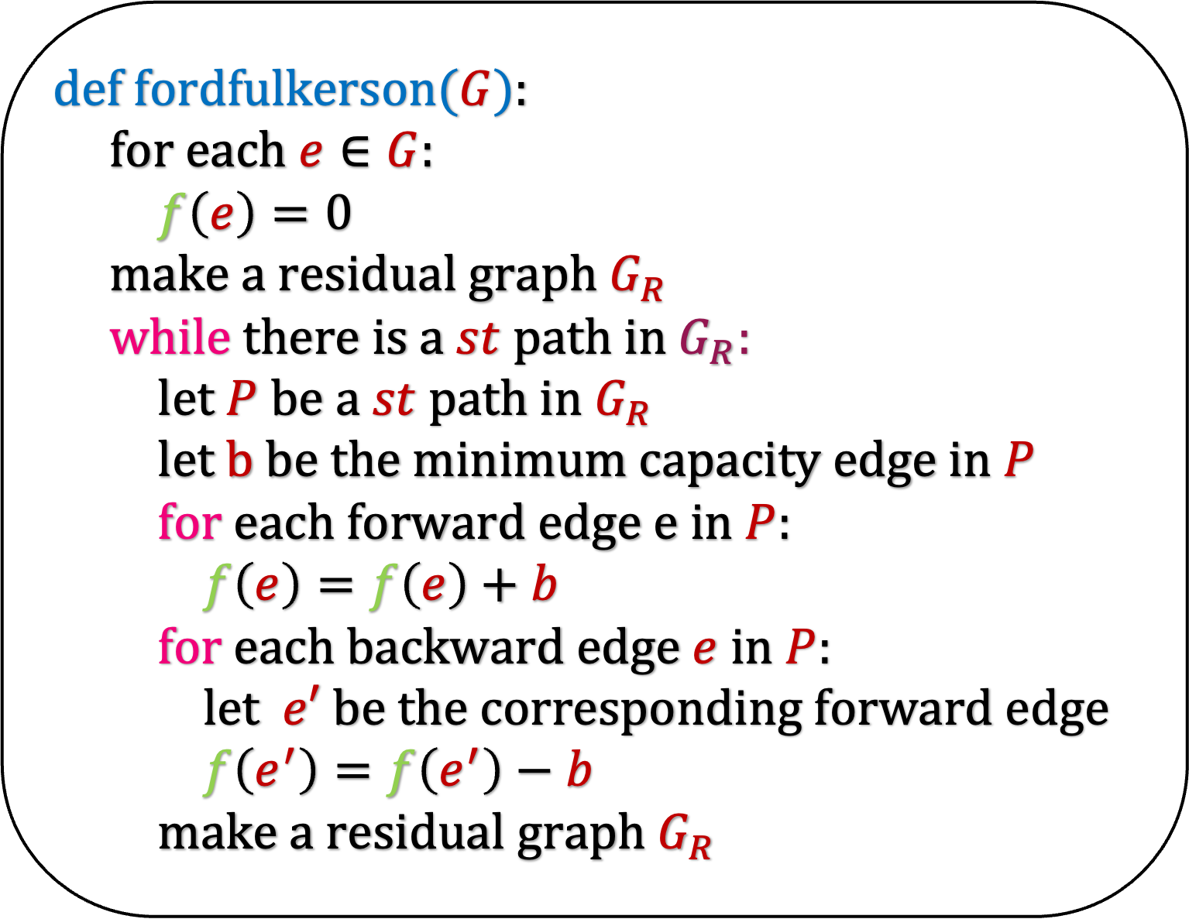
def fordfulkerson($G$):
for each $e∈G$:
$f\left(e\right)=0$
make a residual graph $G_{R}$
while there is a $st$path in $G_{R}$:
let $P$ be a $st$ path in $G_{R}$
let $b$ be the minimum capacity edge in $P$
for each forward edge $e$ in $P$:
$f\left(e\right)=f\left(e\right)+b$
for each backward edge $e$ in $P$:
let $e′$ be the corresponding forward edge
$f\left(e^{′}\right)=f\left(e^{′}\right)−b$
make a residual graph $G_{R}$
Fortunately, there is a simple change in this algorithm which makes the algorithm strongly polynomial.
But the analysis of this algorithm is not trivial
This algorithm is due to Edmonds-Karp and Dinits

Slide 4
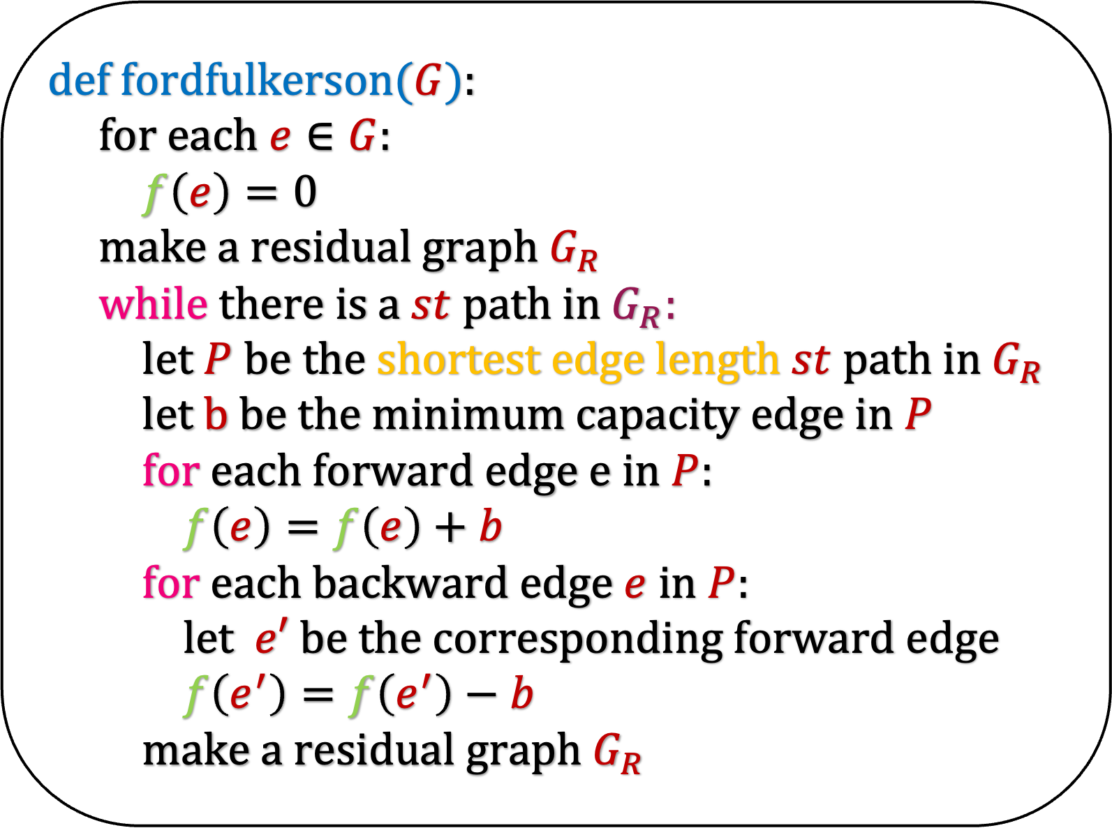
def fordfulkerson($G$):
for each $e∈G$:
$f\left(e\right)=0$
make a residual graph $G_{R}$
while there is a $st$path in $G_{R}$:
let $P$ be the shortest edge length $st$ path in $G_{R}$
let $b$ be the minimum capacity edge in $P$
for each forward edge $e$ in $P$:
$f\left(e\right)=f\left(e\right)+b$
for each backward edge $e$ in $P$:
let $e′$ be the corresponding forward edge
$f\left(e^{′}\right)=f\left(e^{′}\right)−b$
make a residual graph $G_{R}$
Fortunately, there is a simple change in this algorithm which makes the algorithm strongly polynomial.
But the analysis of this algorithm is not trivial
This algorithm is due to Edmonds-Karp and Dinits
Let us now look at the analysis of this algorithm

Slide 5
(Dis)Appearing edges in the residual graph

Slide 6
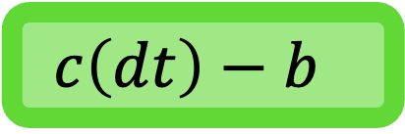
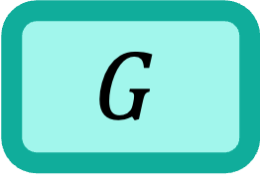
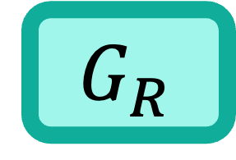
def fordfulkerson($G$):
for each $e∈G$:
$f\left(e\right)=0$
make a residual graph $G_{R}$
while there is a $st$path in $G_{R}$:
let $P$ be the shortest edge length $st$ path in $G_{R}$
let $b$ be the minimum capacity edge in $P$
for each forward edge $e$ in $P$:
$f\left(e\right)=f\left(e\right)+b$
for each backward edge $e$ in $P$:
let $e′$ be the corresponding forward edge
$f\left(e^{′}\right)=f\left(e^{′}\right)−b$
make a residual graph $G_{R}$
Claim: After each iteration of the while loop, at least one edge disappears from the residual graph
Is this claim true? Which is that edge?
What is the flow on dt?
$$G$$
s
a
d
t
$$c\left(dt\right)−b$$
C(dt)
$$G_{R}$$
s
a
d
b
t

Slide 7
def fordfulkerson($G$):
for each $e∈G$:
$f\left(e\right)=0$
make a residual graph $G_{R}$
while there is a $st$path in $G_{R}$:
let $P$ be the shortest edge length $st$ path in $G_{R}$
let $b$ be the minimum capacity edge in $P$
for each forward edge $e$ in $P$:
$f\left(e\right)=f\left(e\right)+b$
for each backward edge $e$ in $P$:
let $e′$ be the corresponding forward edge
$f\left(e^{′}\right)=f\left(e^{′}\right)−b$
make a residual graph $G_{R}$
Claim: After each iteration of the while loop, at least one edge disappears from the residual graph
Is this claim true? Which is that edge?
What happens to the flow on dt after this iteration?
$$G$$
s
a
d
t
$$c\left(dt\right)−b$$
C(dt)
$$G_{R}$$
s
a
d
b
t

Slide 8

def fordfulkerson($G$):
for each $e∈G$:
$f\left(e\right)=0$
make a residual graph $G_{R}$
while there is a $st$path in $G_{R}$:
let $P$ be the shortest edge length $st$ path in $G_{R}$
let $b$ be the minimum capacity edge in $P$
for each forward edge $e$ in $P$:
$f\left(e\right)=f\left(e\right)+b$
for each backward edge $e$ in $P$:
let $e′$ be the corresponding forward edge
$f\left(e^{′}\right)=f\left(e^{′}\right)−b$
make a residual graph $G_{R}$
Claim: After each iteration of the while loop, at least one edge disappears from the residual graph
Is this claim true? Which is that edge?
In the next iteration, dt will disappear from the residual graph
$$G$$
s
a
d
t
$$c\left(dt\right)$$
C(dt)

Slide 9
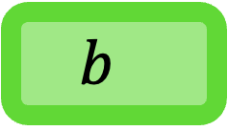
def fordfulkerson($G$):
for each $e∈G$:
$f\left(e\right)=0$
make a residual graph $G_{R}$
while there is a $st$path in $G_{R}$:
let $P$ be the shortest edge length $st$ path in $G_{R}$
let $b$ be the minimum capacity edge in $P$
for each forward edge $e$ in $P$:
$f\left(e\right)=f\left(e\right)+b$
for each backward edge $e$ in $P$:
let $e′$ be the corresponding forward edge
$f\left(e^{′}\right)=f\left(e^{′}\right)−b$
make a residual graph $G_{R}$
Claim: After each iteration of the while loop, at least one edge disappears from the residual graph
Is this claim true? Which is that edge?
What is the flow on da?
$$G$$
s
a
d
t
$$b$$
C(da)
$$G_{R}$$
s
a
b
d
t

Slide 10
def fordfulkerson($G$):
for each $e∈G$:
$f\left(e\right)=0$
make a residual graph $G_{R}$
while there is a $st$path in $G_{R}$:
let $P$ be the shortest edge length $st$ path in $G_{R}$
let $b$ be the minimum capacity edge in $P$
for each forward edge $e$ in $P$:
$f\left(e\right)=f\left(e\right)+b$
for each backward edge $e$ in $P$:
let $e′$ be the corresponding forward edge
$f\left(e^{′}\right)=f\left(e^{′}\right)−b$
make a residual graph $G_{R}$
Claim: After each iteration of the while loop, at least one edge disappears from the residual graph
Is this claim true? Which is that edge?
In the next iteration, ad will disappear from the residual graph
$$G$$
s
a
d
t
0
C(da)

Slide 11
Lemma: After each iteration of the while loop, at least one edge disappears from the residual graph
An edge may disappear from the residual graph at iteration i and reappear again at iteration j
Again imagine what would have happened in our algorithm for the edge to reappear again

Slide 12
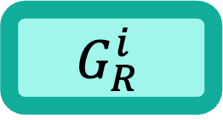
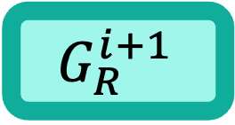
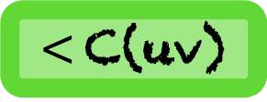
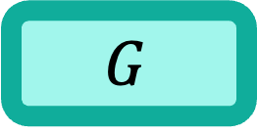
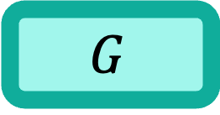
What would have happened in the i-th iteration
s
u
v
u
v
C(uv)
C(uv)
$$G_{R}^{i}$$
$$G$$
s
a
u
v
u
v
$<$C(uv)
C(uv)
$$G_{R}^{i+1}$$
$$G$$
Assume that uv is in G

Slide 13
What would have happened in the i-th iteration
s
v
u
u
v
C(uv)
C(uv)
$$G_{R}^{i}$$
$$G$$
We must have found a path in the residual graph in the i-th iteration and vu is a backward edge on this path
s
a
u
v
u
v
$<$C(uv)
C(uv)
$$G_{R}^{i+1}$$
$$G$$
Assume that uv is in G

Slide 14
s
v
v
u
u
C(uv)
$$G_{R}^{i}$$
$$G$$
s
a
u
v
v
u
C(uv)
$$G_{R}^{i+1}$$
$$G$$
Assume that vu is in G

Slide 15
What would have happened in the i-th iteration
s
v
v
u
u
0
C(uv)
$$G_{R}^{i}$$
$$G$$
s
a
u
v
v
u
>0
C(uv)
$$G_{R}^{i+1}$$
$$G$$
Assume that vu is in G

Slide 16
What would have happened in the i-th iteration
s
v
v
u
u
0
C(uv)
$$G_{R}^{i}$$
$$G$$
We must have found a path in the residual graph in the i-th iteration and vu is a forward edge on this path
s
a
u
v
v
u
>0
C(uv)
$$G_{R}^{i+1}$$
$$G$$
Assume that vu is in G

Slide 17
Lemma: After each iteration of the while loop, at least one edge disappears from the residual graph
An edge may disappear from the residual graph at iteration i and reappear again at iteration j
If uv reappears in the i-th iteration, then in i-1-th iteration, vu lies on the path found in the residual graph
How many times can an edge appear and disappear?
Surprising Lemma: An edge can appear or disappear only O(n) time
We will prove this lemma later
Let us first see its implications

Slide 18
def fordfulkerson($G$):
for each $e∈G$:
$f\left(e\right)=0$
make a residual graph $G_{R}$
while there is a $st$path in $G_{R}$:
let $P$ be the shortest edge length $st$ path in $G_{R}$
let $b$ be the minimum capacity edge in $P$
for each forward edge $e$ in $P$:
$f\left(e\right)=f\left(e\right)+b$
for each backward edge $e$ in $P$:
let $e′$ be the corresponding forward edge
$f\left(e^{′}\right)=f\left(e^{′}\right)−b$
make a residual graph $G_{R}$
Surprising Lemma: An edge can appear or disappear only O(n) time
How many times will this while loop run?
In each iteration of the while loop, at least one edge will disappear.
But the number of times an edge can disappear is O(n)
This implies the number of times all edges can disappear is O(mn)
The while loop runs O(mn) time

Slide 19
Running Time

Slide 20
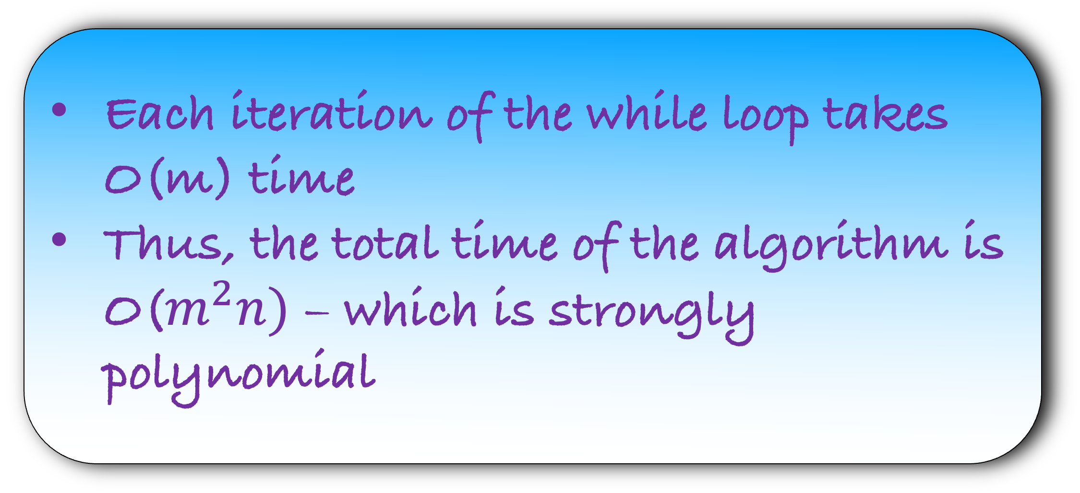
def fordfulkerson($G$):
for each $e∈G$:
$f\left(e\right)=0$
make a residual graph $G_{R}$
while there is a $st$path in $G_{R}$:
let $P$ be the shortest edge length $st$ path in $G_{R}$
let $b$ be the minimum capacity edge in $P$
for each forward edge $e$ in $P$:
$f\left(e\right)=f\left(e\right)+b$
for each backward edge $e$ in $P$:
let $e′$ be the corresponding forward edge
$f\left(e^{′}\right)=f\left(e^{′}\right)−b$
make a residual graph $G_{R}$
Surprising Lemma: An edge can appear or disappear only O(n) time
How many times will this while loop run?
O(mn)
Each iteration of the while loop takes O(m) time
Thus, the total time of the algorithm is O($m^{2}n)$ – which is strongly polynomial

Slide 21
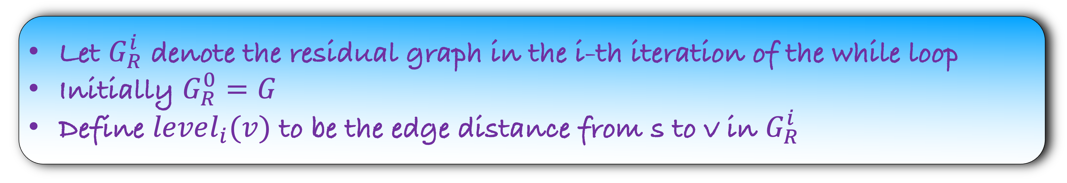
Lemma: An edge can appear or disappear only O(n) time
Let $G_{R}^{i}$ denote the residual graph in the i-th iteration of the while loop
Initially $G_{R}^{0}=G$
Define $level_{i}(v)$ to be the edge distance from s to v in $G_{R}^{i}$
Lemma: Level of each vertex is monotonically increasing

Slide 22
Lemma: An edge can appear or disappear only O(n) time
Let $G_{R}^{i}$ denote the residual graph in the i-th iteration of the while loop
Initially $G_{R}^{0}=G$
Define $level_{i}(v)$ to be the edge distance from s to v in $G_{R}^{i}$
Lemma: For each v, $level_{i}\left(v\right)≤level_{i+1}(v)$
Thus, the levels either remain same or they increase.
Can you guess when can the level increase?
Intuitively, it should happen when v is a part of a path through which we push a flow in our algorithm

Slide 23
Lemma: An edge can appear or disappear only O(n) time
Let $G_{R}^{i}$ denote the residual graph in the i-th iteration of the while loop
Initially $G_{R}^{0}=G$
Define $level_{i}(v)$ to be the edge distance from s to v in $G_{R}^{i}$
Lemma: For each v, $level_{i}\left(v\right)≤level_{i+1}(v)$
We will prove this lemma later
Let us first see its use

Slide 24
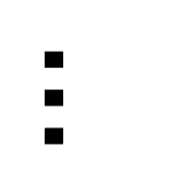
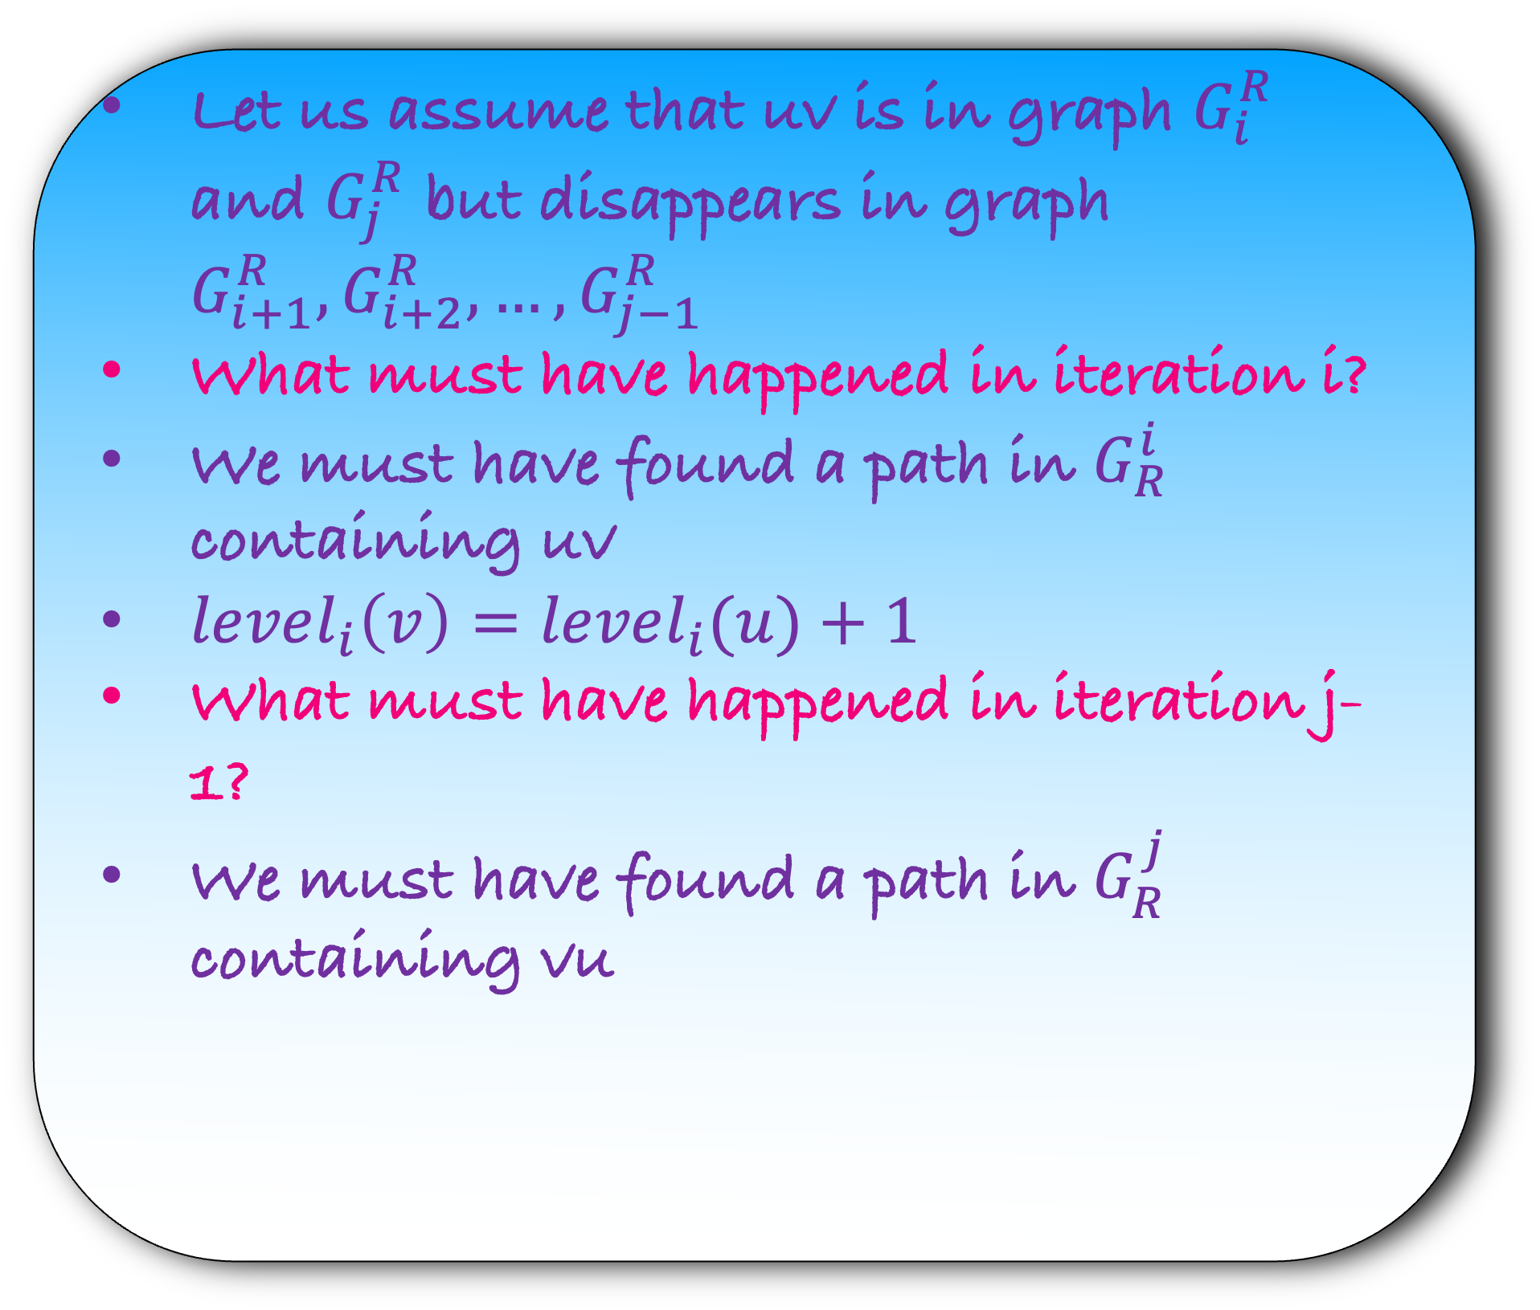
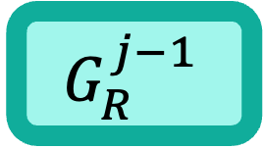
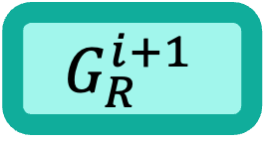
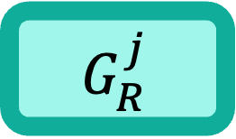
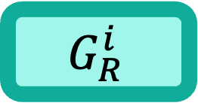
Lemma: For each v, $level_{i}\left(v\right)≤level_{i+1}(v)$
Lemma: An edge can appear or disappear only O(n) time
s
u
v
$$G_{R}^{i}$$
Let us assume that uv is in graph $G_{i}^{R}$ and $G_{j}^{R}$ but disappears in graph $G_{i+1}^{R},G_{i+2}^{R}, …, G_{j−1}^{R}$
What must have happened in iteration i?
We must have found a path in $G_{R}^{i}$ containing uv
$level_{i}\left(v\right)=level_{i}(u)+1$
What must have happened in iteration j-1?
We must have found a path in $G_{R}^{j}$ containing vu
s
u
v
$$G_{R}^{i+1}$$
$$…$$
s
u
v
$$G_{R}^{j−1}$$
s
u
v
$$G_{R}^{j}$$

Slide 25
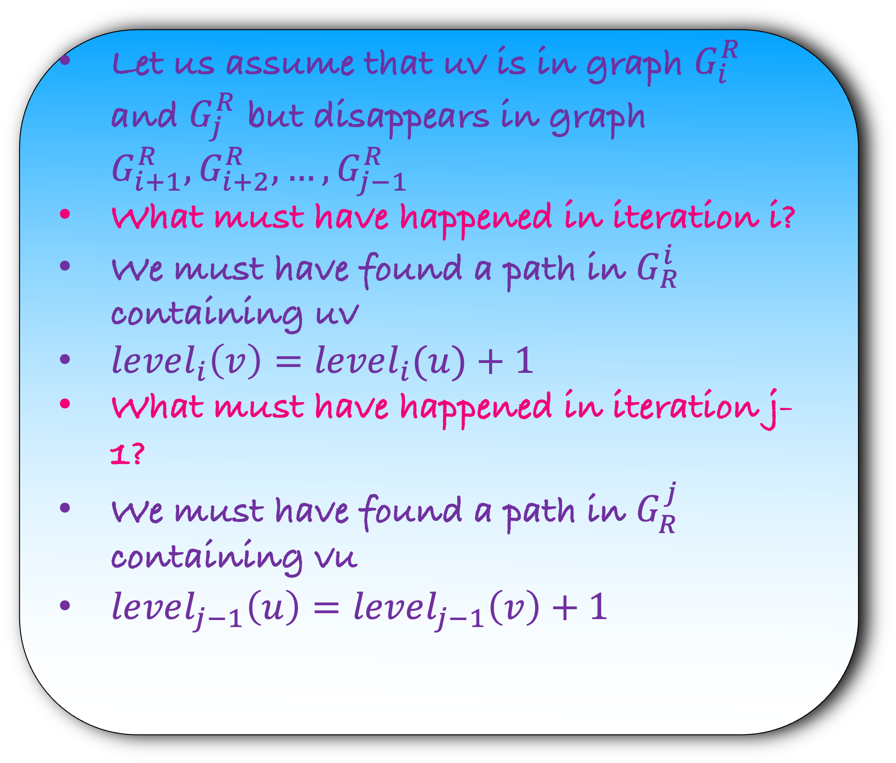
Lemma: For each v, $level_{i}\left(v\right)≤level_{i+1}(v)$
Lemma: An edge can appear or disappear only O(n) time
s
u
v
$$G_{R}^{i}$$
Let us assume that uv is in graph $G_{i}^{R}$ and $G_{j}^{R}$ but disappears in graph $G_{i+1}^{R},G_{i+2}^{R}, …, G_{j−1}^{R}$
What must have happened in iteration i?
We must have found a path in $G_{R}^{i}$ containing uv
$level_{i}\left(v\right)=level_{i}(u)+1$
What must have happened in iteration j-1?
We must have found a path in $G_{R}^{j}$ containing vu
$level_{j−1}\left(u\right)=level_{j−1}\left(v\right)+1$
s
u
v
$$G_{R}^{i+1}$$
$$…$$
s
v
u
$$G_{R}^{j−1}$$
s
u
v
$$G_{R}^{j}$$

Slide 26
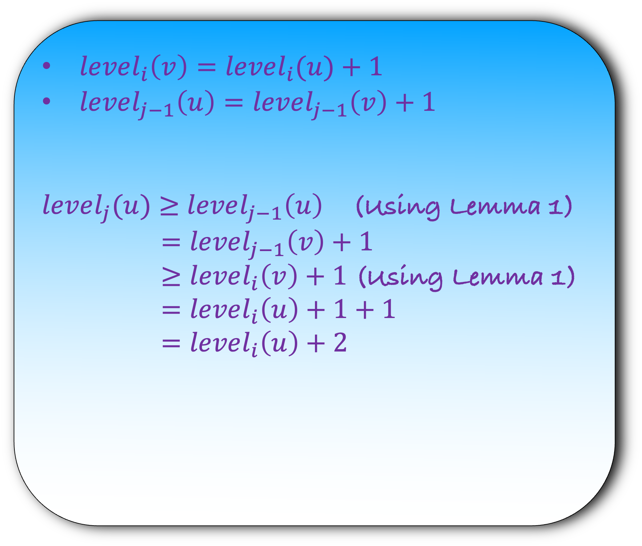
Lemma 1: For each v, $level_{i}\left(v\right)≤level_{i+1}(v)$
Lemma: An edge can appear or disappear only O(n) time
s
u
v
$$G_{R}^{i}$$
$level_{i}\left(v\right)=level_{i}(u)+1$
$level_{j−1}\left(u\right)=level_{j−1}\left(v\right)+1$
$level_{j}(u)$ $≥$ $level_{j−1}\left(u\right)$ (Using Lemma 1)
$=level_{j−1}\left(v\right)+1$
$≥level_{i}\left(v\right)+1$ (Using Lemma 1)
$=level_{i}\left(u\right)+1+1$
$=level_{i}\left(u\right)+2$
s
u
v
$$G_{R}^{i+1}$$
$$…$$
s
v
u
$$G_{R}^{j−1}$$
s
u
v
$$G_{R}^{j}$$

Slide 27
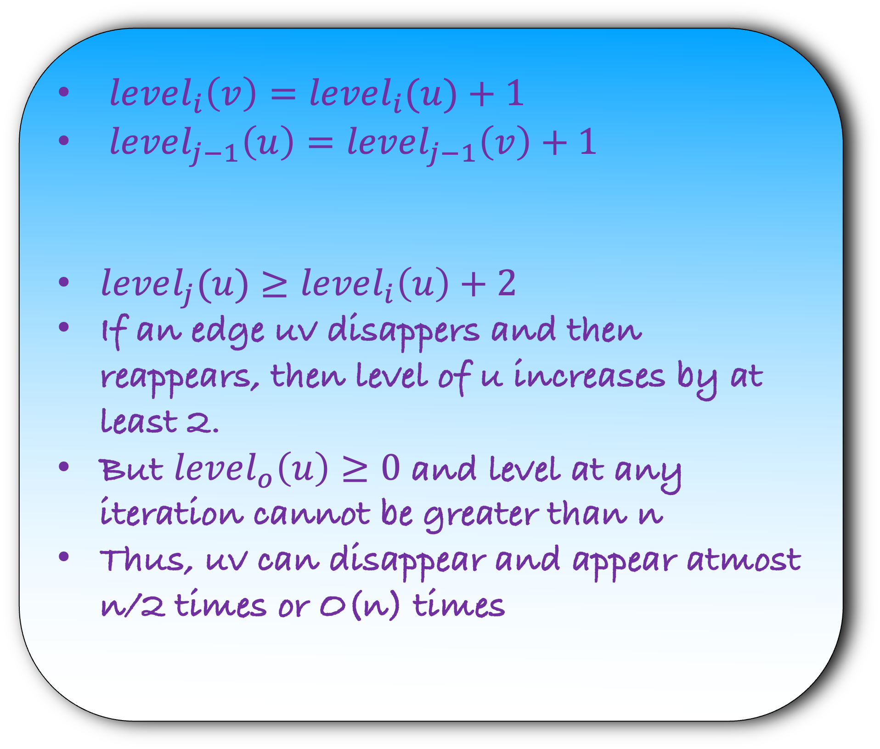
Lemma 1: For each v, $level_{i}\left(v\right)≤level_{i+1}(v)$
Lemma: An edge can appear or disappear only O(n) time
s
u
v
$$G_{R}^{i}$$
$level_{i}\left(v\right)=level_{i}(u)+1$
$level_{j−1}\left(u\right)=level_{j−1}\left(v\right)+1$
$level_{j}(u)$ $≥level_{i}\left(u\right)+2$
If an edge uv disappers and then reappears, then level of u increases by at least 2.
But $level_{o}\left(u\right)≥0$ and level at any iteration cannot be greater than n
Thus, uv can disappear and appear atmost n/2 times or O(n) times
s
u
v
$$G_{R}^{i+1}$$
$$…$$
s
v
u
$$G_{R}^{j−1}$$
s
u
v
$$G_{R}^{j}$$

Slide 28

Lemma: An edge can appear or disappear only O(n) time

Slide 29
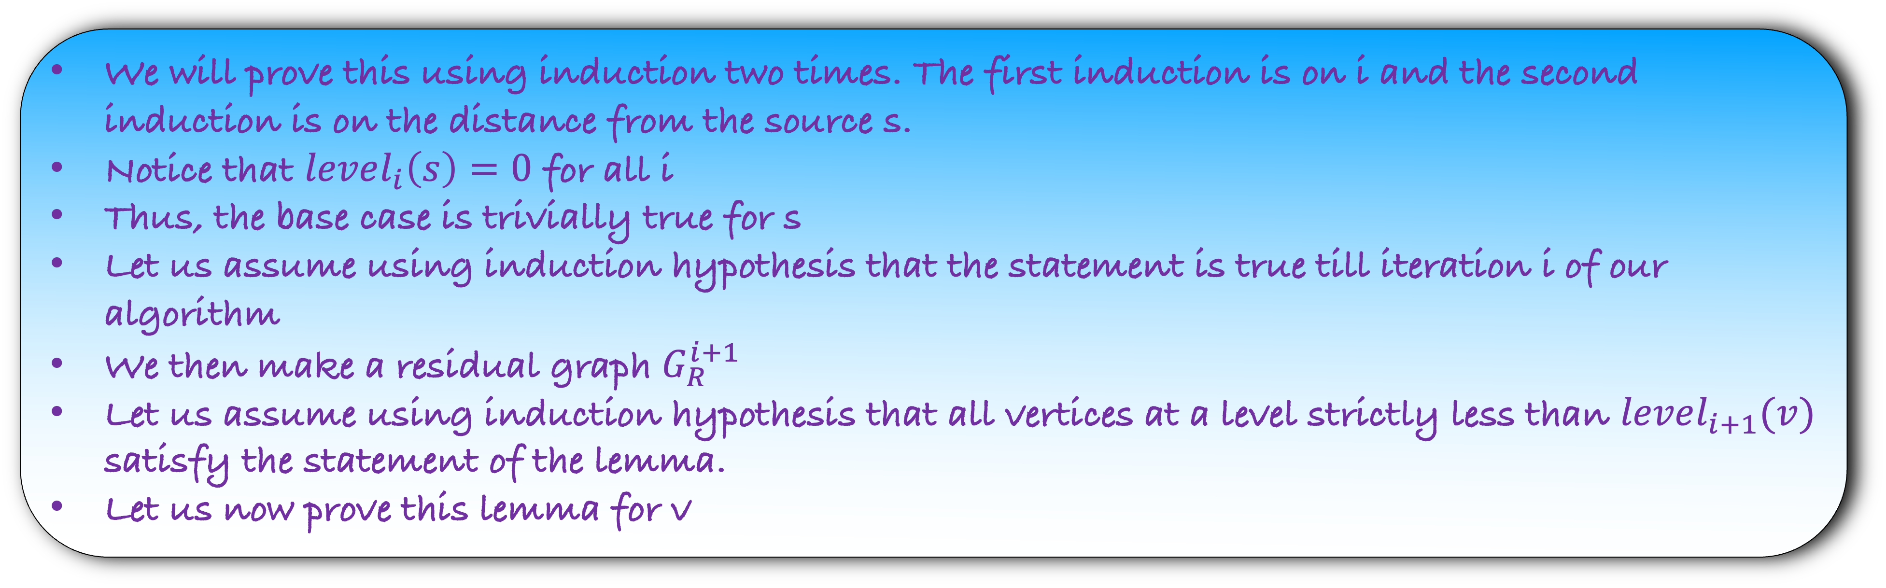
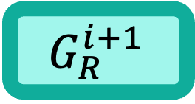
Lemma: For each v, $level_{i}\left(v\right)≤level_{i+1}(v)$
We will prove this using induction two times. The first induction is on i and the second induction is on the distance from the source s.
Notice that $level_{i}\left(s\right)=0$ for all i
Thus, the base case is trivially true for s
Let us assume using induction hypothesis that the statement is true till iteration i of our algorithm
We then make a residual graph $G_{R}^{i+1}$
Let us assume using induction hypothesis that all vertices at a level strictly less than $level_{i+1}(v)$ satisfy the statement of the lemma.
Let us now prove this lemma for v
s
a
u
v
$$G_{R}^{i+1}$$

Slide 30
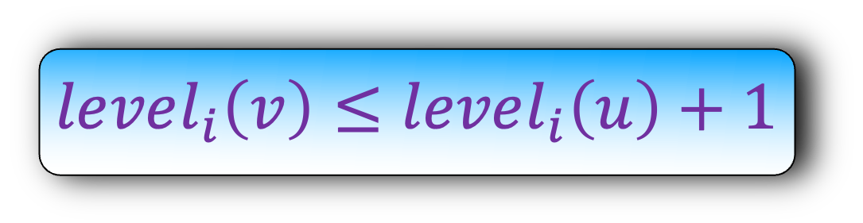
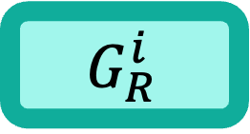

Lemma: For each v, $level_{i}\left(v\right)≤level_{i+1}(v)$
Let us look at the shortest edge length path from s to v.
Let u be the vertex second last vertex on this path.
There are two cases: edge uv exists in $G_{R}^{i}$ too
$$level_{i}\left(v\right)≤level_{i}\left(u\right)+1$$
s
u
v
s
a
u
v
$$G_{R}^{i}$$
$$G_{R}^{i+1}$$

Slide 31
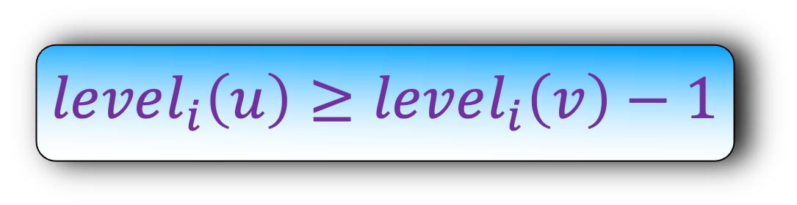
Lemma: For each v, $level_{i}\left(v\right)≤level_{i+1}(v)$
Let us look at the shortest edge length path from s to v.
Let u be the vertex second last vertex on this path.
There are two cases: edge uv exists in $G_{R}^{i}$ too
$$level_{i}\left(u\right)≥level_{i}\left(v\right)−1$$
s
u
v
s
a
u
v
$$G_{R}^{i}$$
$$G_{R}^{i+1}$$

Slide 32
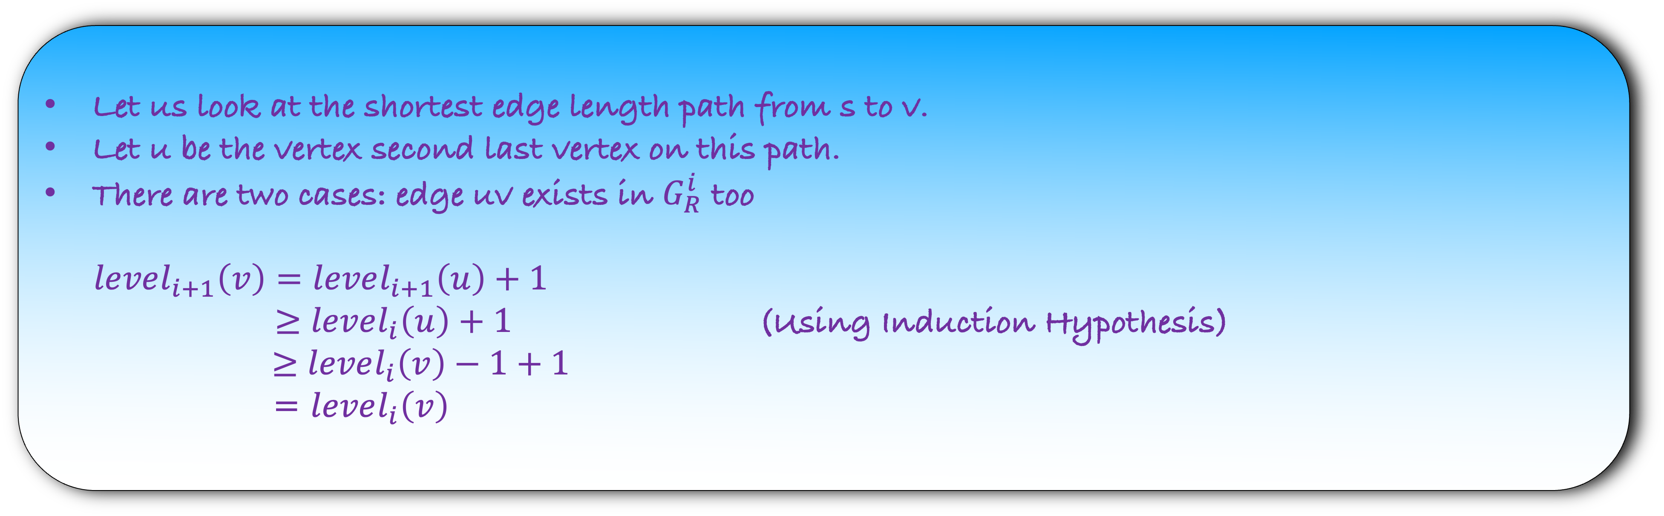
Lemma: For each v, $level_{i}\left(v\right)≤level_{i+1}(v)$
Let us look at the shortest edge length path from s to v.
Let u be the vertex second last vertex on this path.
There are two cases: edge uv exists in $G_{R}^{i}$ too
$level_{i+1}\left(v\right)=level_{i+1}\left(u\right)+1$
$≥$ $level_{i}\left(u\right)+1$ (Using Induction Hypothesis)
$≥$ $level_{i}\left(v\right)−1+1$
= $level_{i}\left(v\right)$
$$level_{i}\left(u\right)≥level_{i}\left(v\right)−1$$
s
u
v
s
a
u
v
$$G_{R}^{i}$$
$$G_{R}^{i+1}$$

Slide 33
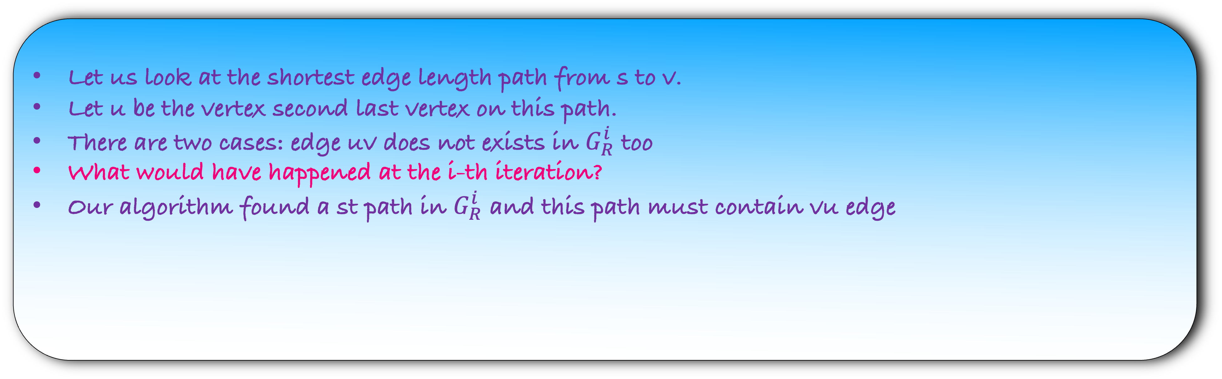
Lemma: For each v, $level_{i}\left(v\right)≤level_{i+1}(v)$
Let us look at the shortest edge length path from s to v.
Let u be the vertex second last vertex on this path.
There are two cases: edge uv does not exists in $G_{R}^{i}$ too
What would have happened at the i-th iteration?
Our algorithm found a st path in $G_{R}^{i}$ and this path must contain vu edge
s
u
v
s
a
u
v
$$G_{R}^{i}$$
$$G_{R}^{i+1}$$

Slide 34
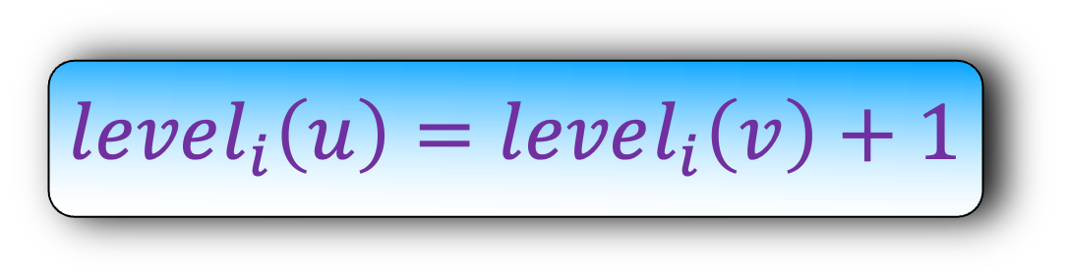
Lemma: For each v, $level_{i}\left(v\right)≤level_{i+1}(v)$
Let us look at the shortest edge length path from s to v.
Let u be the vertex second last vertex on this path.
There are two cases: edge uv does not exists in $G_{R}^{i}$ too
What would have happened at the i-th iteration?
Our algorithm found a st path in $G_{R}^{i}$ and this path must contain vu edge
We are using crucially the fact that we are sending the flow via edge length shortest paths
$$level_{i}\left(u\right)=level_{i}\left(v\right)+1$$
s
v
u
s
a
u
v
$$G_{R}^{i}$$
$$G_{R}^{i+1}$$

Slide 35
Lemma: For each v, $level_{i}\left(v\right)≤level_{i+1}(v)$
Let us look at the shortest edge length path from s to v.
Let u be the vertex second last vertex on this path.
There are two cases: edge uv does not exists in $G_{R}^{i}$ too
What would have happened at the i-th iteration?
Our algorithm found a st path in $G_{R}^{i}$ and this path must contain vu edge
$$level_{i}\left(u\right)≥level_{i}\left(v\right)−1$$
s
v
u
s
a
u
v
$$G_{R}^{i}$$
$$G_{R}^{i+1}$$

Slide 36
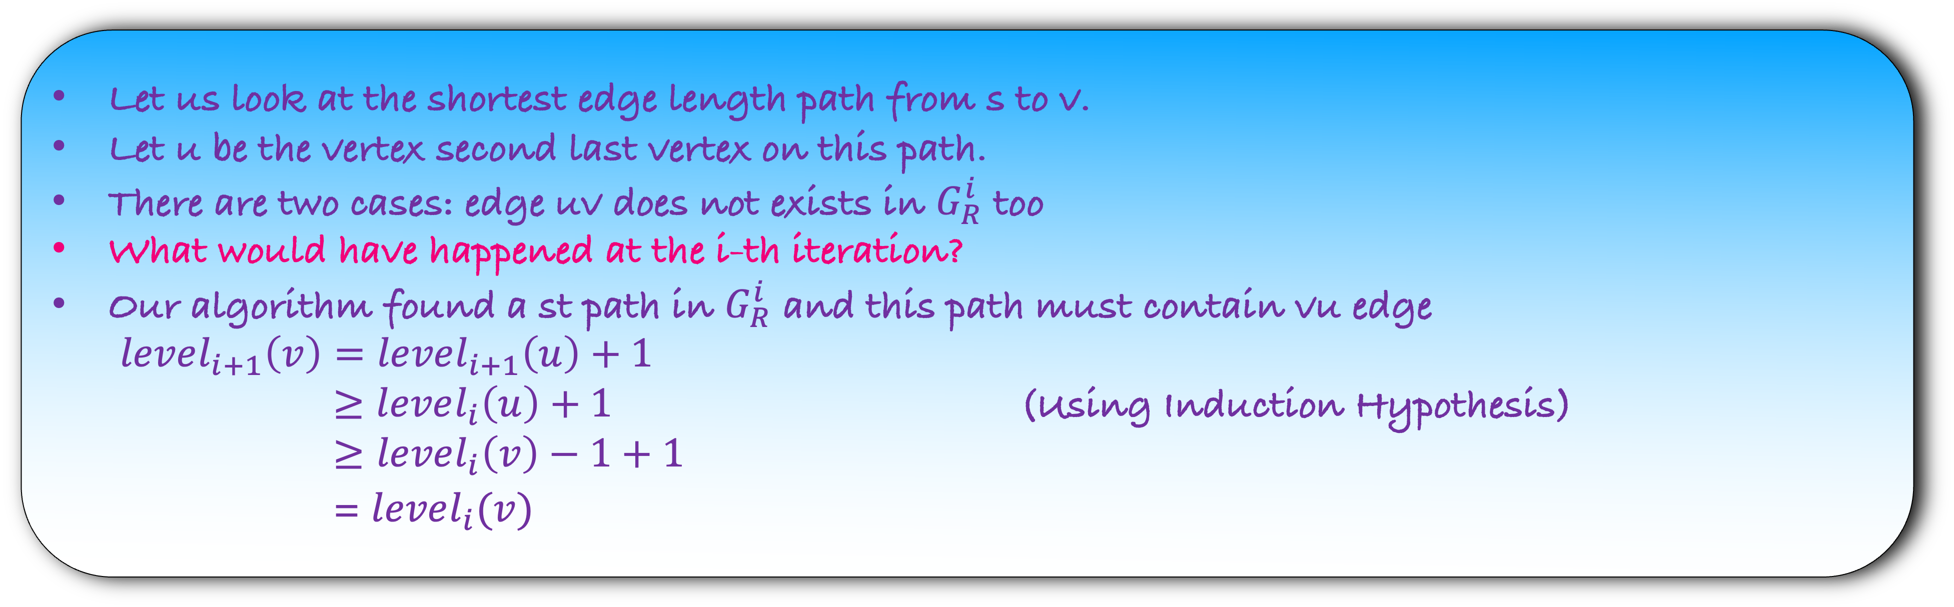
Lemma: For each v, $level_{i}\left(v\right)≤level_{i+1}(v)$
Let us look at the shortest edge length path from s to v.
Let u be the vertex second last vertex on this path.
There are two cases: edge uv does not exists in $G_{R}^{i}$ too
What would have happened at the i-th iteration?
Our algorithm found a st path in $G_{R}^{i}$ and this path must contain vu edge
$level_{i+1}\left(v\right)=level_{i+1}\left(u\right)+1$
$≥level_{i}\left(u\right)+1$ (Using Induction Hypothesis)
$≥level_{i}\left(v\right)−1+1$
= $level_{i}(v)$
$$level_{i}\left(u\right)≥level_{i}\left(v\right)−1$$
s
v
u
s
a
u
v
$$G_{R}^{i}$$
$$G_{R}^{i+1}$$

Slide 37
def fordfulkerson($G$):
for each $e∈G$:
$f\left(e\right)=0$
make a residual graph $G_{R}$
while there is a $st$path in $G_{R}$:
let $P$ be a $st$ path in $G_{R}$
let $b$ be the minimum capacity edge in $P$
for each forward edge $e$ in $P$:
$f\left(e\right)=f\left(e\right)+b$
for each backward edge $e$ in $P$:
let $e′$ be the corresponding forward edge
$f\left(e^{′}\right)=f\left(e^{′}\right)−b$
make a residual graph $G_{R}$
Surprising Lemma: An edge can appear or disappear only O(n) time
How many times will this while loop run?
O(mn)
Each iteration of the while loop takes O(m) time
Thus, the total time of the algorithm is O($m^{2}n)$ – which is strongly polynomial
Done

Slide 38
History
Maximum flow is one of the important problem in graph algorithm and even to this day we are trying to find the best algorithm for it.
The list of papers written on it is too long and cannot fit in a slide.
We will just present a subset of result
For a complete information, please look at this Wikipedia article.

Slide 39

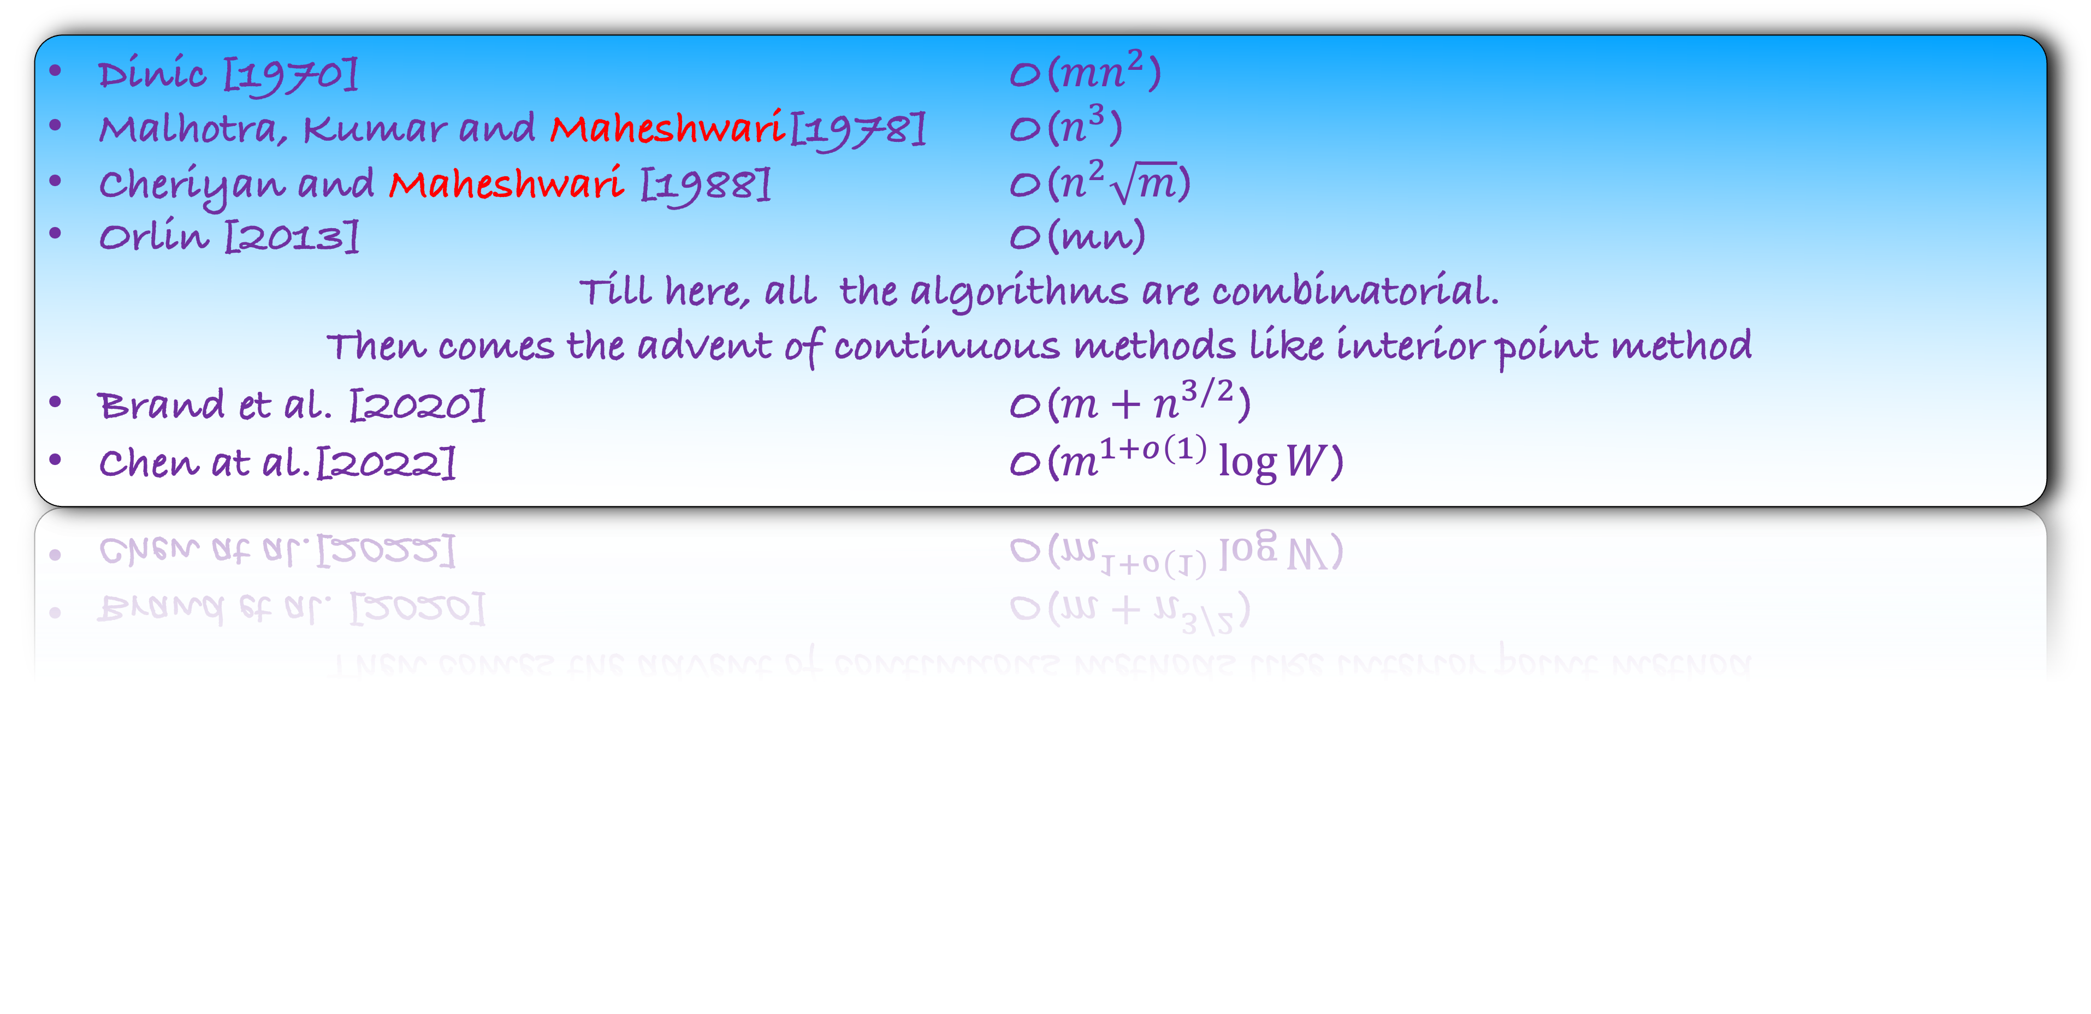

History
Dinic [1970] O($mn^{2}$)
Malhotra, Kumar and Maheshwari[1978] O($n^{3}$)
Cheriyan and Maheshwari [1988] O($n^{2}\sqrt{m}$)
Orlin [2013] O(mn)
Till here, all the algorithms are combinatorial.
Then comes the advent of continuous methods like interior point method
Brand et al. [2020] O($m+n^{3/2}$)
Chen at al.[2022] O($m^{1+o\left(1\right)}\log{W}$)
Challenging open problem: Find maximum flow in O(m) or O($n^{2}$) time.

