Slide 1
Proofs

Slide 2
A simple goal
The Ford-Fulkerson algorithm returns a valid flow.
We promised to prove this
An ambitious goal
The Ford-Fulkerson algorithm returns the maximum flow.

Slide 3
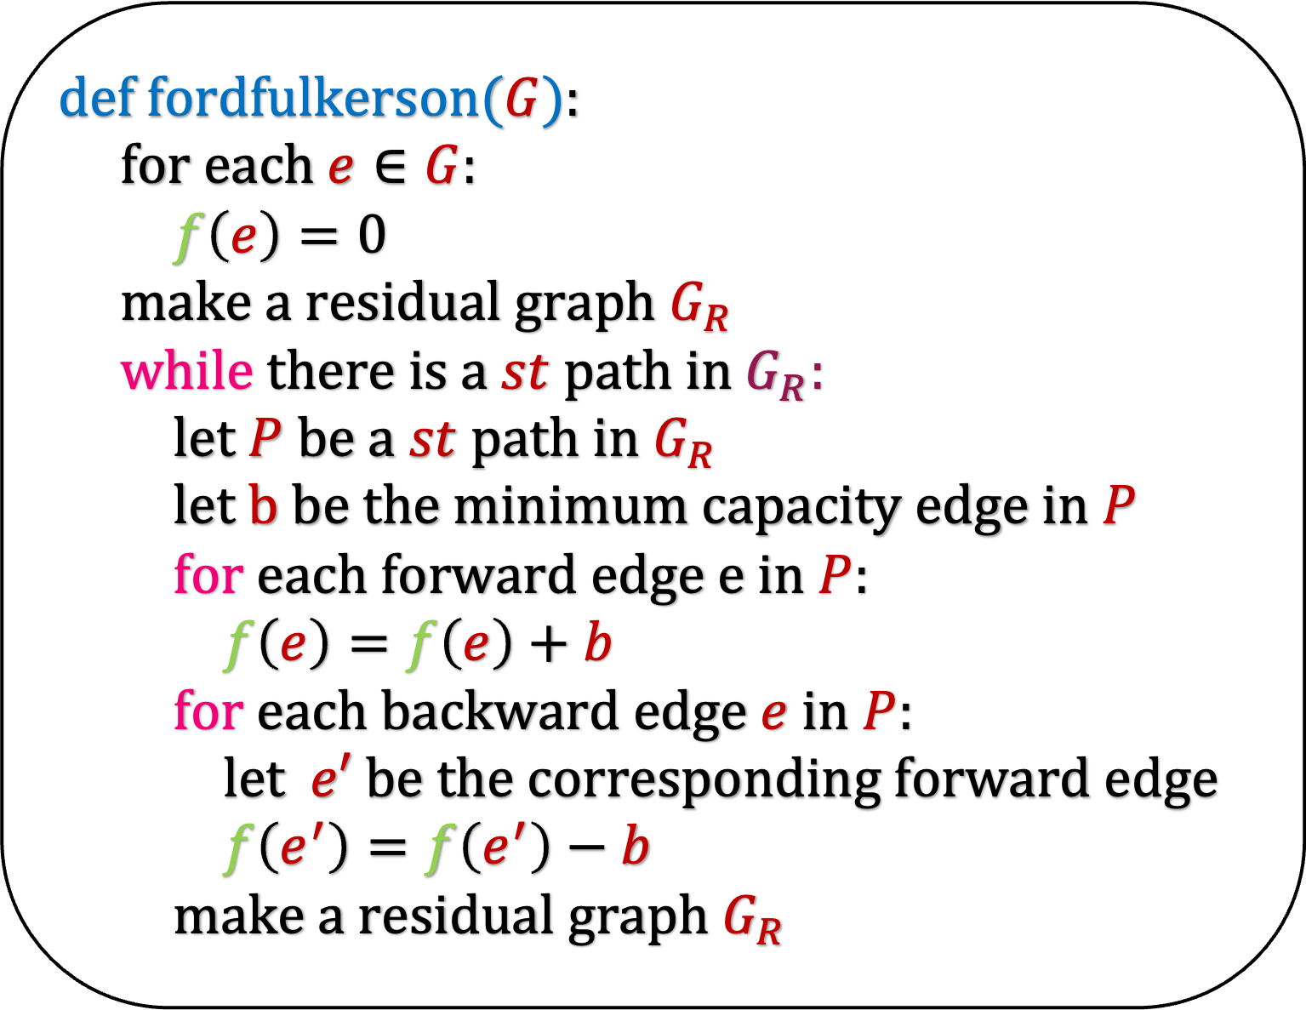
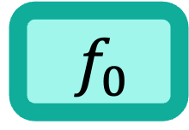
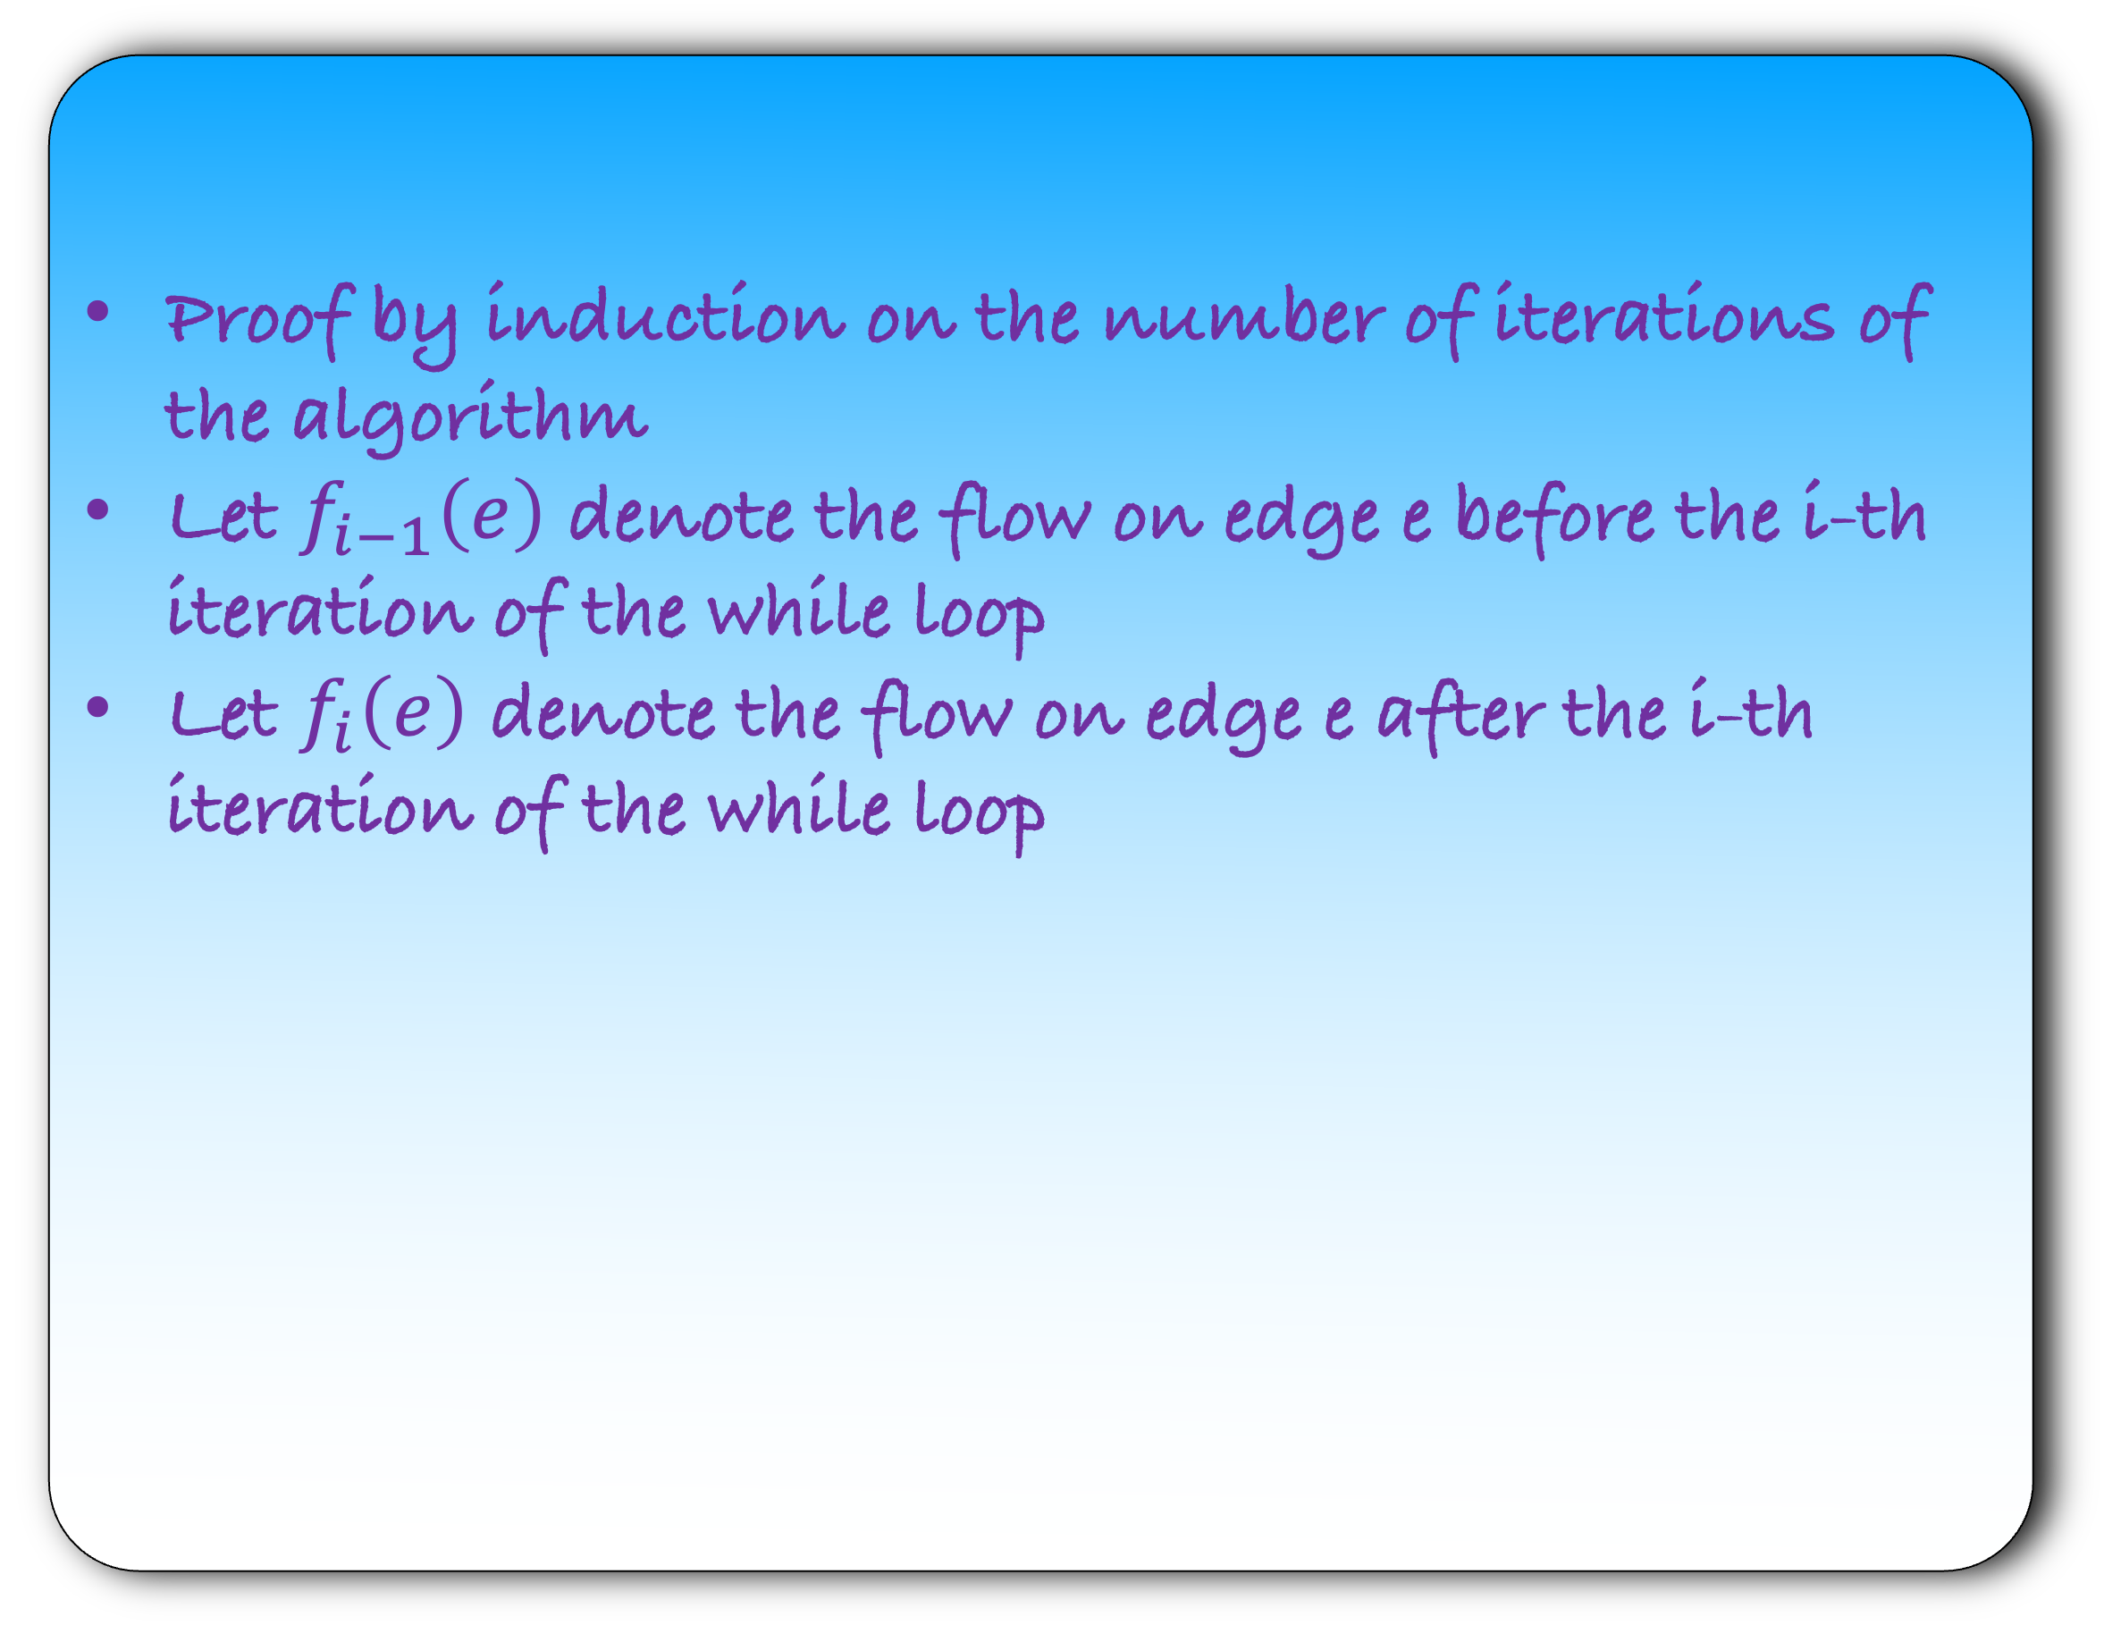
Lemma: The Ford-Fulkerson algorithm returns a valid flow.
def fordfulkerson($G$):
for each $e∈G$:
$f\left(e\right)=0$
make a residual graph $G_{R}$
while there is a $st$path in $G_{R}$:
let $P$ be a $st$ path in $G_{R}$
let $b$ be the minimum capacity edge in $P$
for each forward edge $e$ in $P$:
$f\left(e\right)=f\left(e\right)+b$
for each backward edge $e$ in $P$:
let $e′$ be the corresponding forward edge
$f\left(e^{′}\right)=f\left(e^{′}\right)−b$
make a residual graph $G_{R}$
Proof by induction on the number of iterations of the algorithm
Let $f_{i−1}\left(e\right)$ denote the flow on edge e before the i-th iteration of the while loop
Let $f_{i}\left(e\right)$ denote the flow on edge e after the i-th iteration of the while loop
$${ f}_{0}$$
Notes:
Can you animate the part f_0 goes down and becomes f_1 and f_1 become f_2 and so on

Slide 4
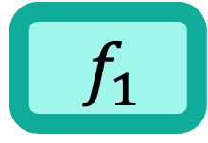
Lemma: The Ford-Fulkerson algorithm returns a valid flow.
def fordfulkerson($G$):
for each $e∈G$:
$f\left(e\right)=0$
make a residual graph $G_{R}$
while there is a $st$path in $G_{R}$:
let $P$ be a $st$ path in $G_{R}$
let $b$ be the minimum capacity edge in $P$
for each forward edge $e$ in $P$:
$f\left(e\right)=f\left(e\right)+b$
for each backward edge $e$ in $P$:
let $e′$ be the corresponding forward edge
$f\left(e^{′}\right)=f\left(e^{′}\right)−b$
make a residual graph $G_{R}$
Proof by induction on the number of iterations of the algorithm
Let $f_{i−1}\left(e\right)$ denote the flow on edge e before the i-th iteration of the while loop
Let $f_{i}\left(e\right)$ denote the flow on edge e after the i-th iteration of the while loop
$${ f}_{1}$$
Notes:
Can you animate the part f_0 goes down and becomes f_1 and f_1 become f_2 and so on

Slide 5

Lemma: The Ford-Fulkerson algorithm returns a valid flow.
def fordfulkerson($G$):
for each $e∈G$:
$f\left(e\right)=0$
make a residual graph $G_{R}$
while there is a $st$path in $G_{R}$:
let $P$ be a $st$ path in $G_{R}$
let $b$ be the minimum capacity edge in $P$
for each forward edge $e$ in $P$:
$f\left(e\right)=f\left(e\right)+b$
for each backward edge $e$ in $P$:
let $e′$ be the corresponding forward edge
$f\left(e^{′}\right)=f\left(e^{′}\right)−b$
make a residual graph $G_{R}$
Proof by induction on the number of iterations of the algorithm
Let $f_{i−1}\left(e\right)$ denote the flow on edge e before the i-th iteration of the while loop
Let $f_{i}\left(e\right)$ denote the flow on edge e after the i-th iteration of the while loop
$${ f}_{1}$$
Notes:
Can you animate the part f_0 goes down and becomes f_1 and f_1 become f_2 and so on

Slide 6

Lemma: The Ford-Fulkerson algorithm returns a valid flow.
def fordfulkerson($G$):
for each $e∈G$:
$f\left(e\right)=0$
make a residual graph $G_{R}$
while there is a $st$path in $G_{R}$:
let $P$ be a $st$ path in $G_{R}$
let $b$ be the minimum capacity edge in $P$
for each forward edge $e$ in $P$:
$f\left(e\right)=f\left(e\right)+b$
for each backward edge $e$ in $P$:
let $e′$ be the corresponding forward edge
$f\left(e^{′}\right)=f\left(e^{′}\right)−b$
make a residual graph $G_{R}$
Proof by induction on the number of iterations of the algorithm
Let $f_{i−1}\left(e\right)$ denote the flow on edge e before the i-th iteration of the while loop
Let $f_{i}\left(e\right)$ denote the flow on edge e after the i-th iteration of the while loop
$${ f}_{2}$$
Notes:
Can you animate the part f_0 goes down and becomes f_1 and f_1 become f_2 and so on

Slide 7
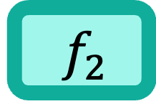
Lemma: The Ford-Fulkerson algorithm returns a valid flow.
def fordfulkerson($G$):
for each $e∈G$:
$f\left(e\right)=0$
make a residual graph $G_{R}$
while there is a $st$path in $G_{R}$:
let $P$ be a $st$ path in $G_{R}$
let $b$ be the minimum capacity edge in $P$
for each forward edge $e$ in $P$:
$f\left(e\right)=f\left(e\right)+b$
for each backward edge $e$ in $P$:
let $e′$ be the corresponding forward edge
$f\left(e^{′}\right)=f\left(e^{′}\right)−b$
make a residual graph $G_{R}$
Proof by induction on the number of iterations of the algorithm
Let $f_{i−1}\left(e\right)$ denote the flow on edge e before the i-th iteration of the while loop
Let $f_{i}\left(e\right)$ denote the flow on edge e after the i-th iteration of the while loop
$${ f}_{2}$$
Notes:
Can you animate the part f_0 goes down and becomes f_1 and f_1 become f_2 and so on

Slide 8
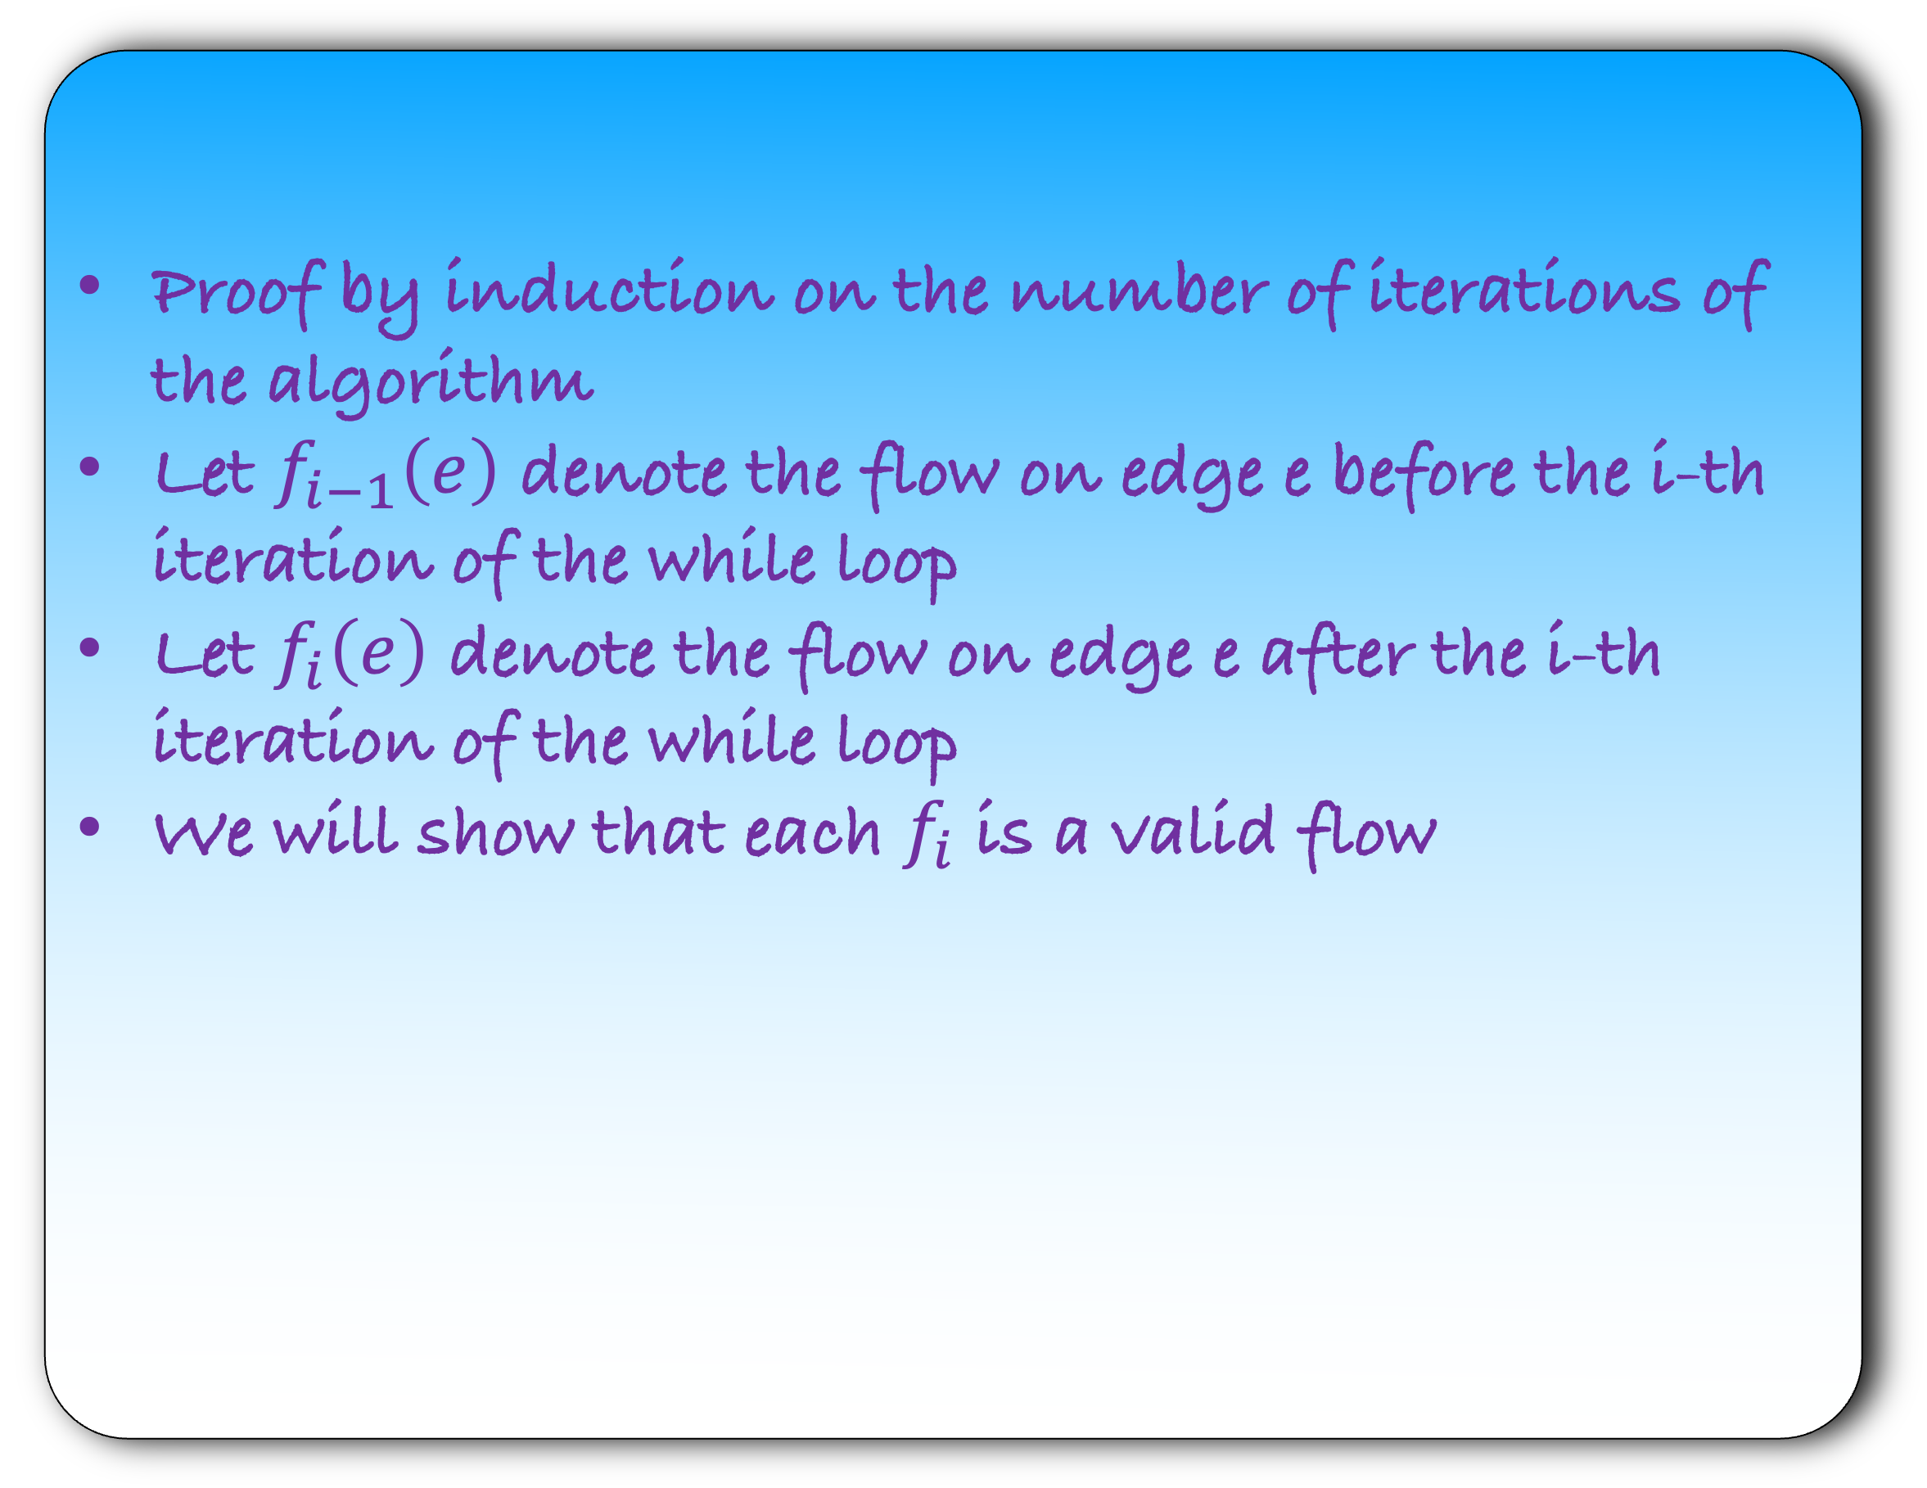
Lemma: The Ford-Fulkerson algorithm returns a valid flow.
def fordfulkerson($G$):
for each $e∈G$:
$f\left(e\right)=0$
make a residual graph $G_{R}$
while there is a $st$path in $G_{R}$:
let $P$ be a $st$ path in $G_{R}$
let $b$ be the minimum capacity edge in $P$
for each forward edge $e$ in $P$:
$f\left(e\right)=f\left(e\right)+b$
for each backward edge $e$ in $P$:
let $e′$ be the corresponding forward edge
$f\left(e^{′}\right)=f\left(e^{′}\right)−b$
make a residual graph $G_{R}$
Proof by induction on the number of iterations of the algorithm
Let $f_{i−1}\left(e\right)$ denote the flow on edge e before the i-th iteration of the while loop
Let $f_{i}\left(e\right)$ denote the flow on edge e after the i-th iteration of the while loop
We will show that each $f_{i}$ is a valid flow
Notes:
Can you animate the part f_0 goes down and becomes f_1 and f_1 become f_2 and so on

Slide 9
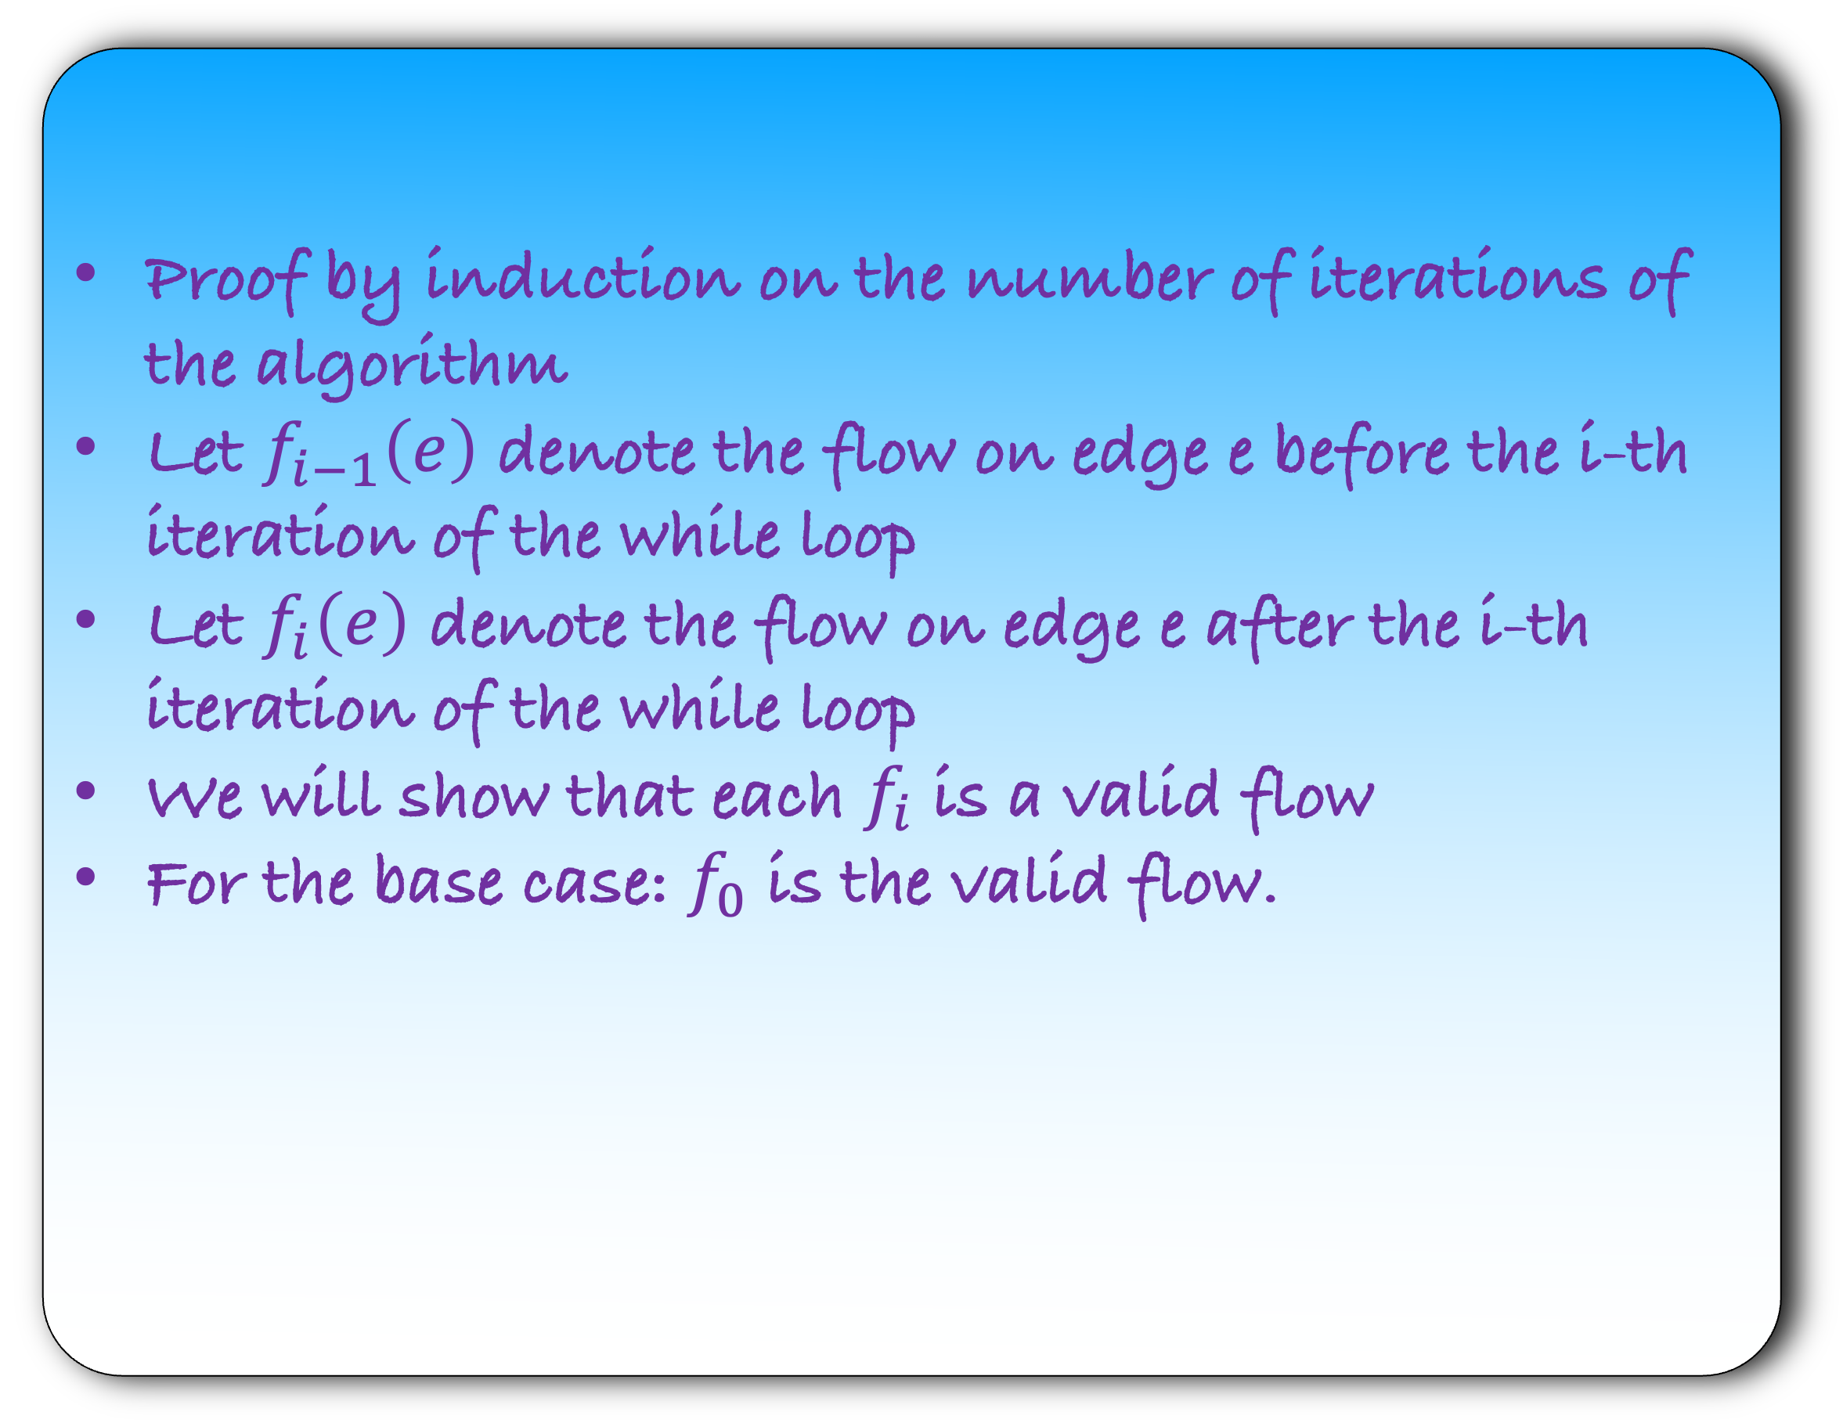
Lemma: The Ford-Fulkerson algorithm returns a valid flow.
def fordfulkerson($G$):
for each $e∈G$:
$f\left(e\right)=0$
make a residual graph $G_{R}$
while there is a $st$path in $G_{R}$:
let $P$ be a $st$ path in $G_{R}$
let $b$ be the minimum capacity edge in $P$
for each forward edge $e$ in $P$:
$f\left(e\right)=f\left(e\right)+b$
for each backward edge $e$ in $P$:
let $e′$ be the corresponding forward edge
$f\left(e^{′}\right)=f\left(e^{′}\right)−b$
make a residual graph $G_{R}$
Proof by induction on the number of iterations of the algorithm
Let $f_{i−1}\left(e\right)$ denote the flow on edge e before the i-th iteration of the while loop
Let $f_{i}\left(e\right)$ denote the flow on edge e after the i-th iteration of the while loop
We will show that each $f_{i}$ is a valid flow
For the base case: $f_{0}$ is the valid flow.

Slide 10
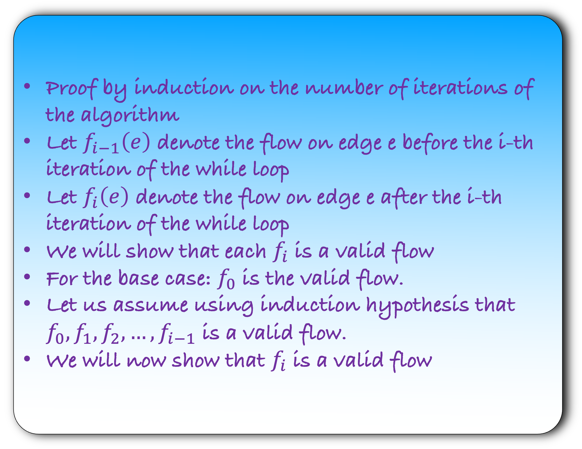
Lemma: The Ford-Fulkerson algorithm returns a valid flow.
def fordfulkerson($G$):
for each $e∈G$:
$f\left(e\right)=0$
make a residual graph $G_{R}$
while there is a $st$path in $G_{R}$:
let $P$ be a $st$ path in $G_{R}$
let $b$ be the minimum capacity edge in $P$
for each forward edge $e$ in $P$:
$f\left(e\right)=f\left(e\right)+b$
for each backward edge $e$ in $P$:
let $e′$ be the corresponding forward edge
$f\left(e^{′}\right)=f\left(e^{′}\right)−b$
make a residual graph $G_{R}$
Proof by induction on the number of iterations of the algorithm
Let $f_{i−1}\left(e\right)$ denote the flow on edge e before the i-th iteration of the while loop
Let $f_{i}\left(e\right)$ denote the flow on edge e after the i-th iteration of the while loop
We will show that each $f_{i}$ is a valid flow
For the base case: $f_{0}$ is the valid flow.
Let us assume using induction hypothesis that $f_{0},f_{1},f_{2},…,f_{i−1}$ is a valid flow.
We will now show that $f_{i}$ is a valid flow

Slide 11
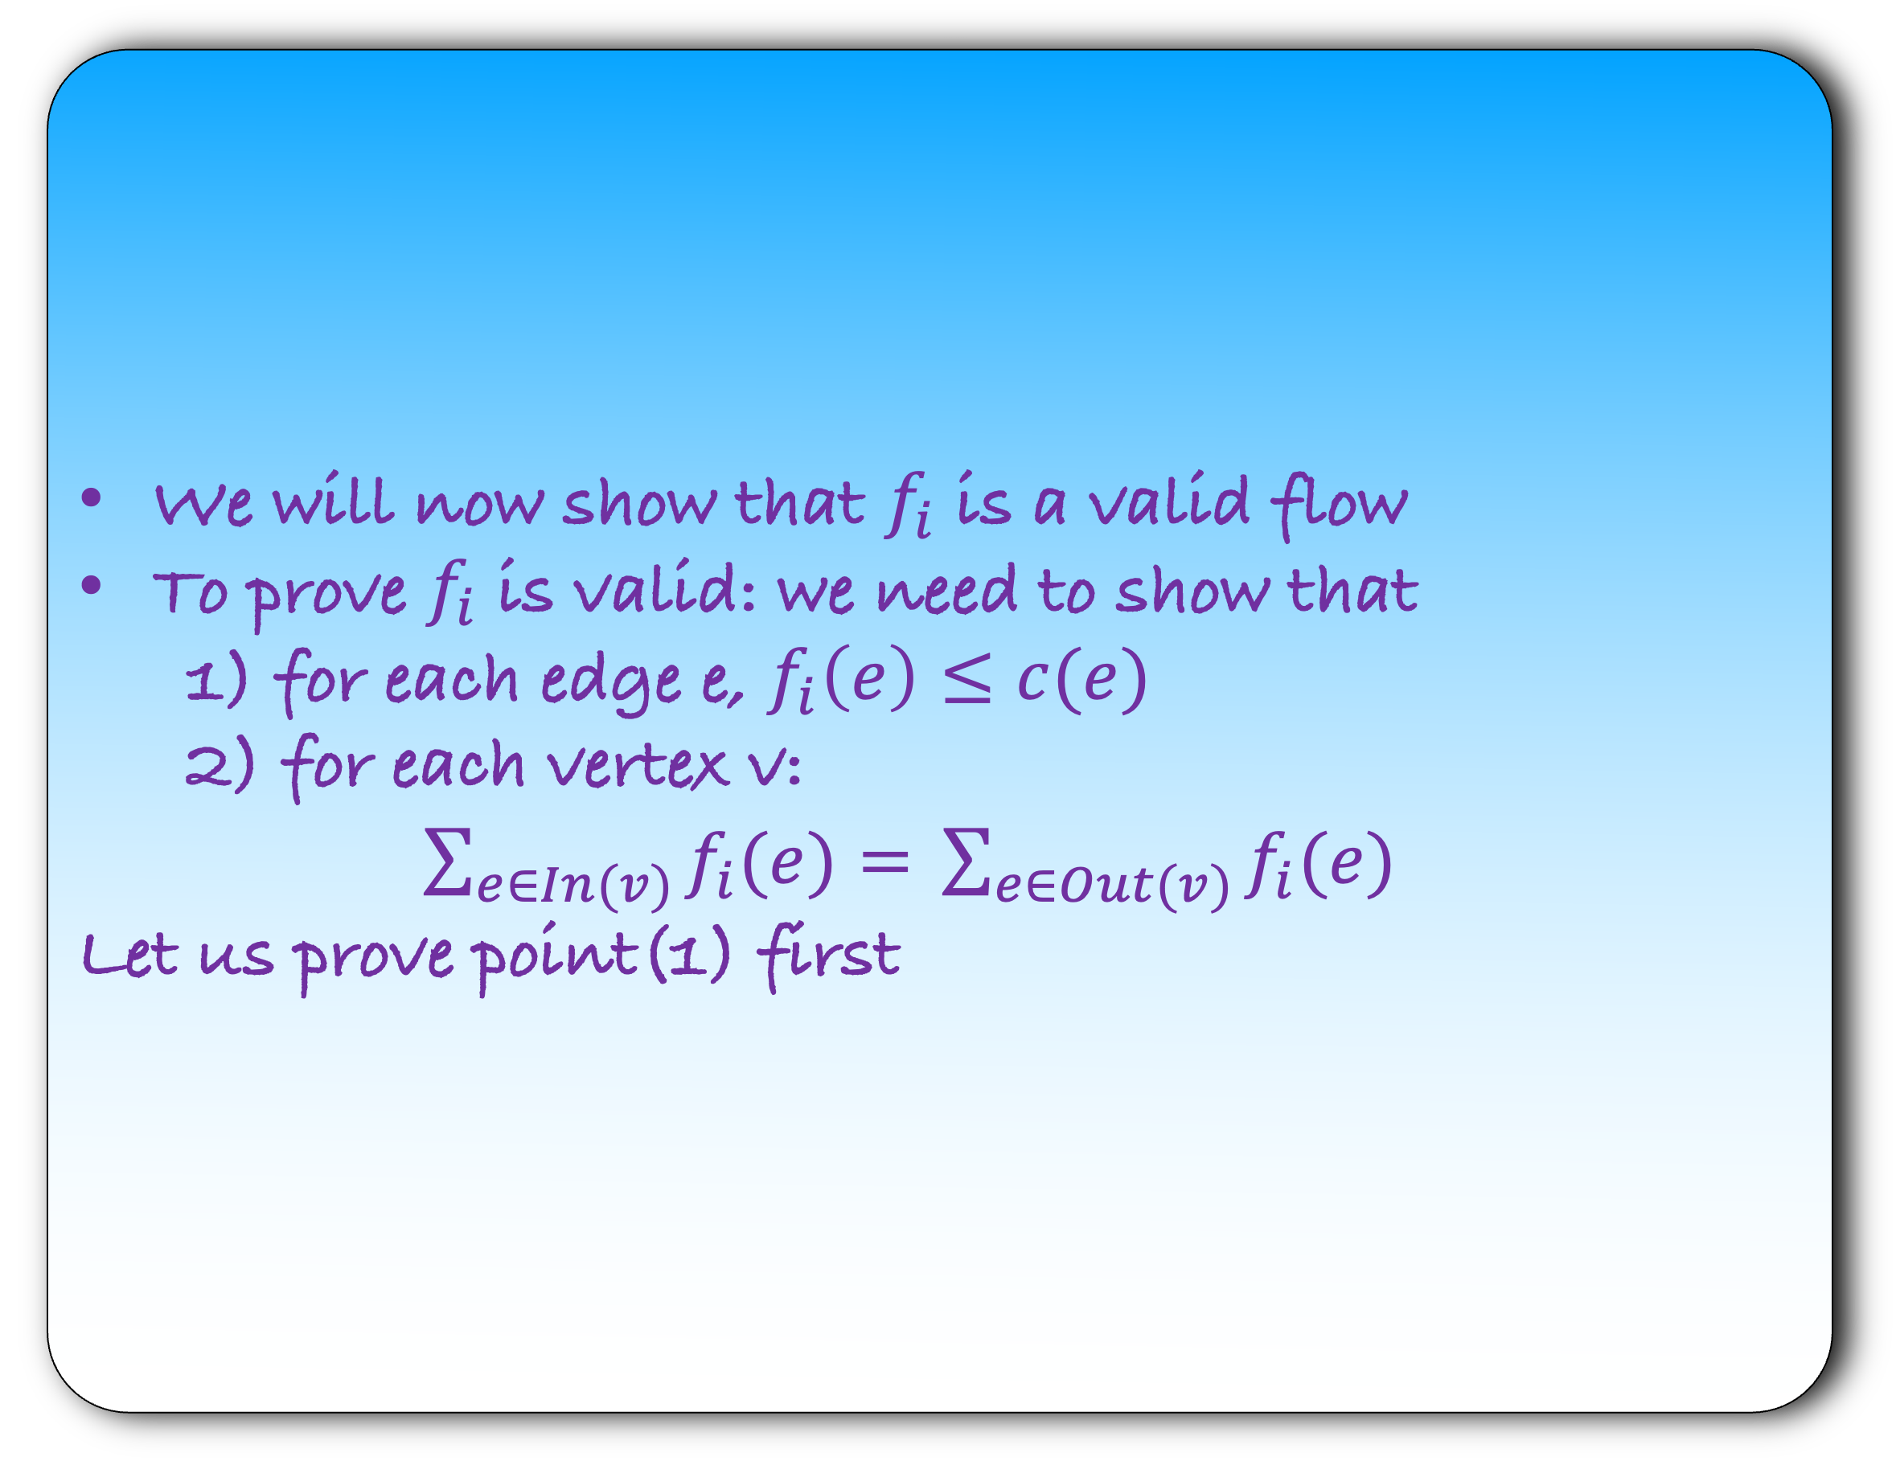
Lemma: The Ford-Fulkerson algorithm returns a valid flow.
def fordfulkerson($G$):
for each $e∈G$:
$f\left(e\right)=0$
make a residual graph $G_{R}$
while there is a $st$path in $G_{R}$:
let $P$ be a $st$ path in $G_{R}$
let $b$ be the minimum capacity edge in $P$
for each forward edge $e$ in $P$:
$f\left(e\right)=f\left(e\right)+b$
for each backward edge $e$ in $P$:
let $e′$ be the corresponding forward edge
$f\left(e^{′}\right)=f\left(e^{′}\right)−b$
make a residual graph $G_{R}$
We will now show that $f_{i}$ is a valid flow
To prove $f_{i}$ is valid: we need to show that
                1) for each edge e, $f_{i}\left(e\right)≤c(e)$
                2) for each vertex v:
                $\sum_{e∈In(v)}{f_{i}(e)= }\sum_{e∈Out(v)}{f_{i}(e) }$
                Let us prove point(1) first

Slide 12

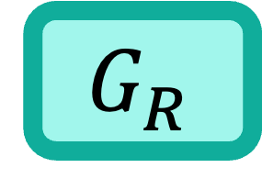
Lemma: The Ford-Fulkerson algorithm returns a valid flow.
def fordfulkerson($G$):
for each $e∈G$:
$f\left(e\right)=0$
make a residual graph $G_{R}$
while there is a $st$path in $G_{R}$:
let $P$ be a $st$ path in $G_{R}$
let $b$ be the minimum capacity edge in $P$
for each forward edge $e$ in $P$:
$f\left(e\right)=f\left(e\right)+b$
for each backward edge $e$ in $P$:
let $e′$ be the corresponding forward edge
$f\left(e^{′}\right)=f\left(e^{′}\right)−b$
make a residual graph $G_{R}$
$$G_{R}$$
s
a
b
t
$$P$$

Slide 13
Lemma: The Ford-Fulkerson algorithm returns a valid flow.
def fordfulkerson($G$):
for each $e∈G$:
$f\left(e\right)=0$
make a residual graph $G_{R}$
while there is a $st$path in $G_{R}$:
let $P$ be a $st$ path in $G_{R}$
let $b$ be the minimum capacity edge in $P$
for each forward edge $e$ in $P$:
$f\left(e\right)=f\left(e\right)+b$
for each backward edge $e$ in $P$:
let $e′$ be the corresponding forward edge
$f\left(e^{′}\right)=f\left(e^{′}\right)−b$
make a residual graph $G_{R}$
$$G_{R}$$
s
a
b
b
t
$$P$$

Slide 14
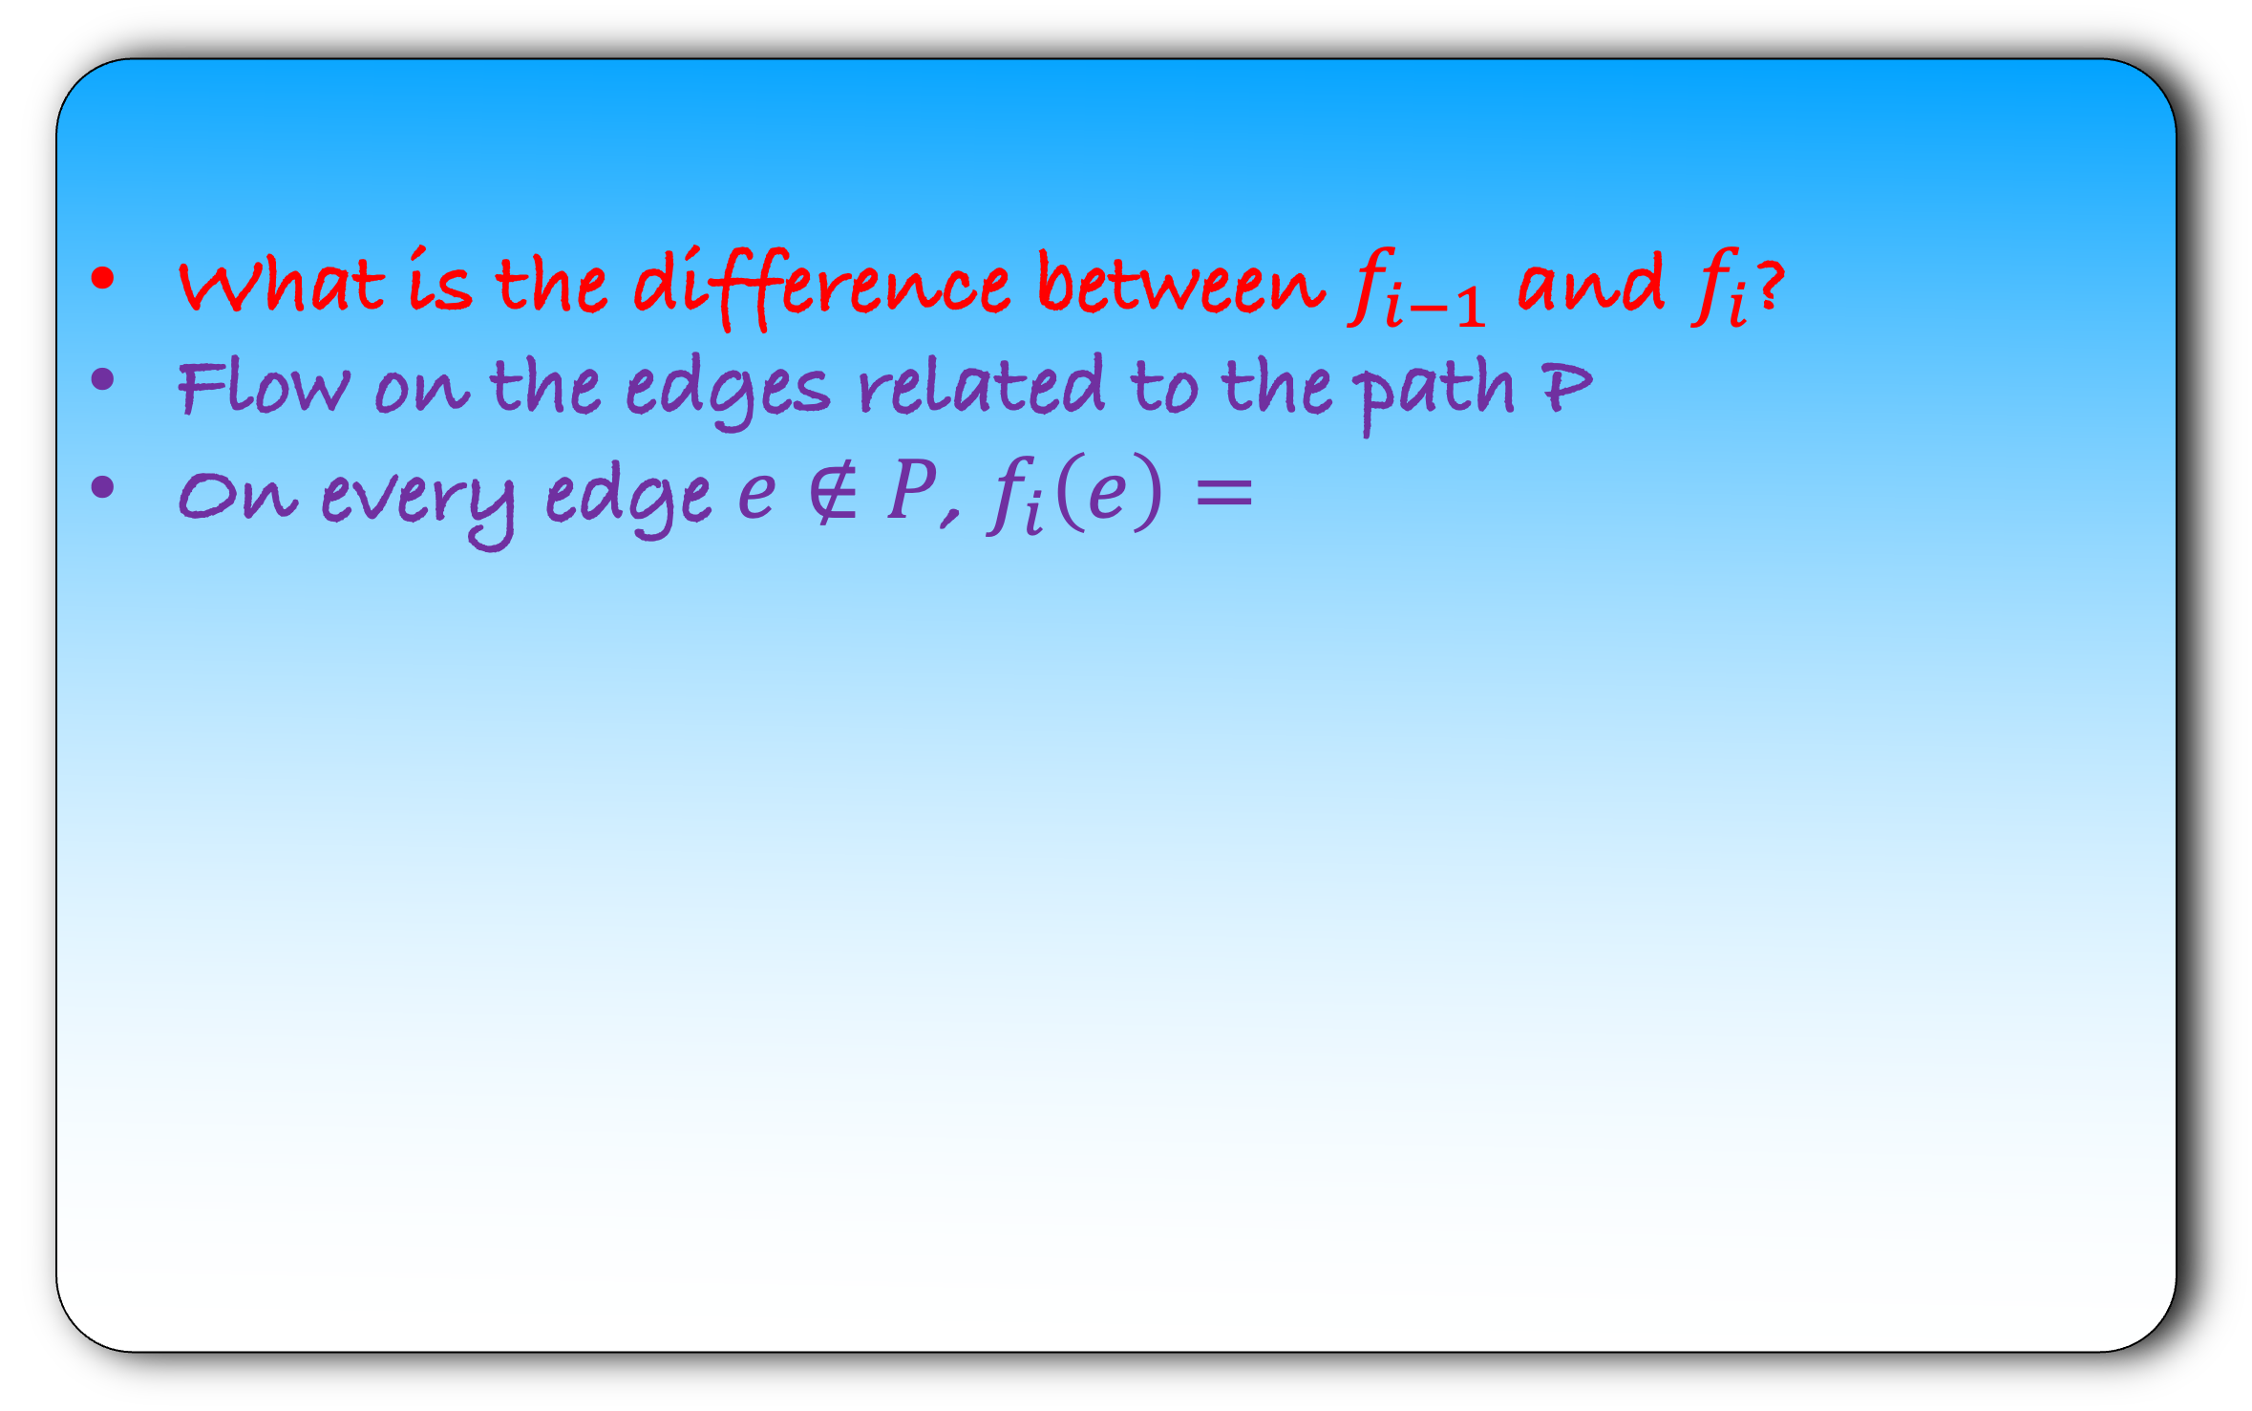
Lemma: The Ford-Fulkerson algorithm returns a valid flow.
def fordfulkerson($G$):
for each $e∈G$:
$f\left(e\right)=0$
make a residual graph $G_{R}$
while there is a $st$path in $G_{R}$:
let $P$ be a $st$ path in $G_{R}$
let $b$ be the minimum capacity edge in $P$
for each forward edge $e$ in $P$:
$f\left(e\right)=f\left(e\right)+b$
for each backward edge $e$ in $P$:
let $e′$ be the corresponding forward edge
$f\left(e^{′}\right)=f\left(e^{′}\right)−b$
make a residual graph $G_{R}$
What is the difference between $f_{i−1}$ and $f_{i}$?
Flow on the edges related to the path P
On every edge $e∉P$, $f_{i}\left(e\right)=$
$$G_{R}$$
s
a
b
b
t
$$P$$

Slide 15
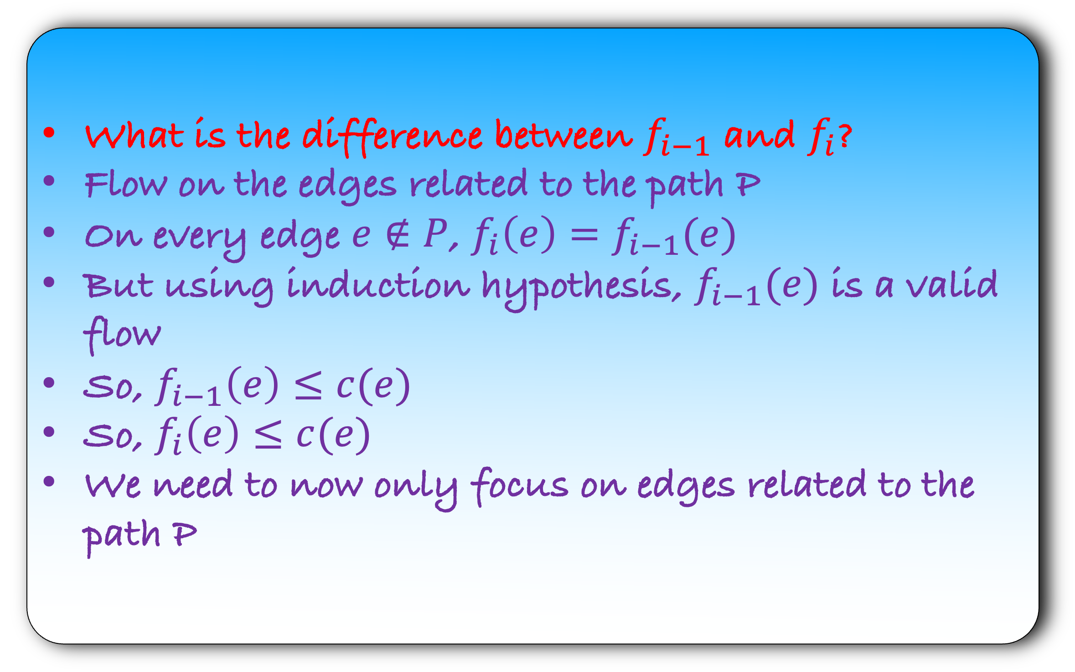
Lemma: The Ford-Fulkerson algorithm returns a valid flow.
def fordfulkerson($G$):
for each $e∈G$:
$f\left(e\right)=0$
make a residual graph $G_{R}$
while there is a $st$path in $G_{R}$:
let $P$ be a $st$ path in $G_{R}$
let $b$ be the minimum capacity edge in $P$
for each forward edge $e$ in $P$:
$f\left(e\right)=f\left(e\right)+b$
for each backward edge $e$ in $P$:
let $e′$ be the corresponding forward edge
$f\left(e^{′}\right)=f\left(e^{′}\right)−b$
make a residual graph $G_{R}$
What is the difference between $f_{i−1}$ and $f_{i}$?
Flow on the edges related to the path P
On every edge $e∉P$, $f_{i}\left(e\right)=f_{i−1}(e)$
But using induction hypothesis, $f_{i−1}(e)$ is a valid flow
So, $f_{i−1}\left(e\right)≤c(e)$
So, $f_{i}\left(e\right)≤c(e)$
We need to now only focus on edges related to the path P
$$G_{R}$$
s
a
b
b
t
$$P$$

Slide 16
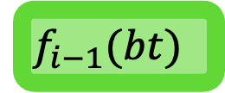


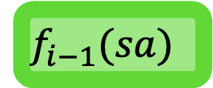


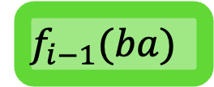


Lemma: The Ford-Fulkerson algorithm returns a valid flow.
def fordfulkerson($G$):
for each $e∈G$:
$f\left(e\right)=0$
make a residual graph $G_{R}$
while there is a $st$path in $G_{R}$:
let $P$ be a $st$ path in $G_{R}$
let $b$ be the minimum capacity edge in $P$
for each forward edge $e$ in $P$:
$f\left(e\right)=f\left(e\right)+b$
for each backward edge $e$ in $P$:
let $e′$ be the corresponding forward edge
$f\left(e^{′}\right)=f\left(e^{′}\right)−b$
make a residual graph $G_{R}$
$$G$$
s
a
b
t
$$f_{i−1}(sa)$$
$c(sa)$
$$f_{i−1}(ba)$$
$c(ba)$
$$f_{i−1}(bt)$$
$c(bt)$
$$G_{R}$$
s
a
b
b
t
$$P$$

Slide 17

Lemma: The Ford-Fulkerson algorithm returns a valid flow.
def fordfulkerson($G$):
for each $e∈G$:
$f\left(e\right)=0$
make a residual graph $G_{R}$
while there is a $st$path in $G_{R}$:
let $P$ be a $st$ path in $G_{R}$
let $b$ be the minimum capacity edge in $P$
for each forward edge $e$ in $P$:
$f\left(e\right)=f\left(e\right)+b$
for each backward edge $e$ in $P$:
let $e′$ be the corresponding forward edge
$f\left(e^{′}\right)=f\left(e^{′}\right)−b$
make a residual graph $G_{R}$
$$G$$
s
a
b
t
$$f_{i−1}(sa)$$
$c(sa)$
$$f_{i−1}(ba)$$
$c(ba)$
$$f_{i−1}(bt)$$
$c(bt)$
$$G_{R}$$
s
a
b
b
t
$$P$$
What is the capacity on the forward edge sa in $G_{R}$?

Slide 18

Lemma: The Ford-Fulkerson algorithm returns a valid flow.
def fordfulkerson($G$):
for each $e∈G$:
$f\left(e\right)=0$
make a residual graph $G_{R}$
while there is a $st$path in $G_{R}$:
let $P$ be a $st$ path in $G_{R}$
let $b$ be the minimum capacity edge in $P$
for each forward edge $e$ in $P$:
$f\left(e\right)=f\left(e\right)+b$
for each backward edge $e$ in $P$:
let $e′$ be the corresponding forward edge
$f\left(e^{′}\right)=f\left(e^{′}\right)−b$
make a residual graph $G_{R}$
$$G$$
s
a
b
t
$$f_{i−1}(sa)$$
$c(sa)$
$$f_{i−1}(ba)$$
$c(ba)$
$$f_{i−1}(bt)$$
$c(bt)$
$$G_{R}$$
s
a
b
b
t
$$P$$
What is the capacity on the forward edge sa in $G_{R}$?
$$c\left(sa\right)−f_{i−1}(sa)$$

Slide 19


Lemma: The Ford-Fulkerson algorithm returns a valid flow.
def fordfulkerson($G$):
for each $e∈G$:
$f\left(e\right)=0$
make a residual graph $G_{R}$
while there is a $st$path in $G_{R}$:
let $P$ be a $st$ path in $G_{R}$
let $b$ be the minimum capacity edge in $P$
for each forward edge $e$ in $P$:
$f\left(e\right)=f\left(e\right)+b$
for each backward edge $e$ in $P$:
let $e′$ be the corresponding forward edge
$f\left(e^{′}\right)=f\left(e^{′}\right)−b$
make a residual graph $G_{R}$
$$G$$
s
a
b
t
$$f_{i−1}(sa)$$
$c(sa)$
$$f_{i−1}(ba)$$
$c(ba)$
$$f_{i−1}(bt)$$
$c(bt)$
$$G_{R}$$
s
a
b
b
t
$$P$$
What is the capacity on the forward edge sa in $G_{R}$?
$c\left(sa\right)−f_{i−1}(sa)≥$

Slide 20


Lemma: The Ford-Fulkerson algorithm returns a valid flow.
def fordfulkerson($G$):
for each $e∈G$:
$f\left(e\right)=0$
make a residual graph $G_{R}$
while there is a $st$path in $G_{R}$:
let $P$ be a $st$ path in $G_{R}$
let $b$ be the minimum capacity edge in $P$
for each forward edge $e$ in $P$:
$f\left(e\right)=f\left(e\right)+b$
for each backward edge $e$ in $P$:
let $e′$ be the corresponding forward edge
$f\left(e^{′}\right)=f\left(e^{′}\right)−b$
make a residual graph $G_{R}$
$$G$$
s
a
b
t
$$f_{i−1}(sa)$$
$c(sa)$
$$f_{i−1}(ba)$$
$c(ba)$
$$f_{i−1}(bt)$$
$c(bt)$
$$G_{R}$$
s
a
b
b
t
$$P$$
What is the capacity on the forward edge sa in $G_{R}$?
$c\left(sa\right)−f_{i−1}(sa)≥$ $b$

Slide 21

Lemma: The Ford-Fulkerson algorithm returns a valid flow.
def fordfulkerson($G$):
for each $e∈G$:
$f\left(e\right)=0$
make a residual graph $G_{R}$
while there is a $st$path in $G_{R}$:
let $P$ be a $st$ path in $G_{R}$
let $b$ be the minimum capacity edge in $P$
for each forward edge $e$ in $P$:
$f\left(e\right)=f\left(e\right)+b$
for each backward edge $e$ in $P$:
let $e′$ be the corresponding forward edge
$f\left(e^{′}\right)=f\left(e^{′}\right)−b$
make a residual graph $G_{R}$
$$G$$
s
a
b
t
$$f_{i−1}(sa)$$
$c(sa)$
$$f_{i−1}(ba)$$
$c(ba)$
$$f_{i−1}(bt)$$
$c(bt)$
$$G_{R}$$
s
a
b
b
t
$$P$$
What is the capacity on the forward edge sa in $G_{R}$?
$f_{i−1}\left(sa\right)≤c\left(sa\right)− b$

Slide 22



Lemma: The Ford-Fulkerson algorithm returns a valid flow.
def fordfulkerson($G$):
for each $e∈G$:
$f\left(e\right)=0$
make a residual graph $G_{R}$
while there is a $st$path in $G_{R}$:
let $P$ be a $st$ path in $G_{R}$
let $b$ be the minimum capacity edge in $P$
for each forward edge $e$ in $P$:
$f\left(e\right)=f\left(e\right)+b$
for each backward edge $e$ in $P$:
let $e′$ be the corresponding forward edge
$f\left(e^{′}\right)=f\left(e^{′}\right)−b$
make a residual graph $G_{R}$
$$G$$
s
a
b
t
$$f_{i−1}(sa)$$
$c(sa)$
$$f_{i−1}(ba)$$
$c(ba)$
$$f_{i−1}(bt)$$
$c(bt)$
$$G_{R}$$
s
a
b
b
t
$$P$$
$f_{i−1}\left(sa\right)≤c\left(sa\right)− b$
What is the flow $f_{i}\left(sa\right)$ after the i-th iteration?
$$f_{i}\left(sa\right)=f_{i−1}(sa)+b$$

Slide 23
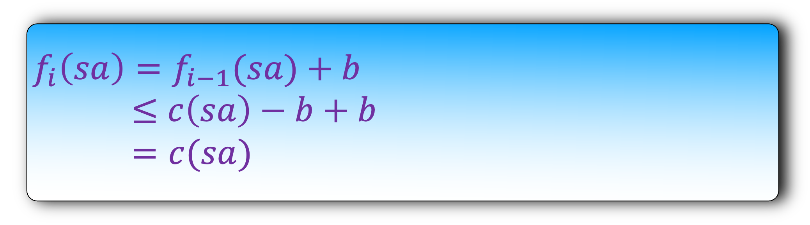
Lemma: The Ford-Fulkerson algorithm returns a valid flow.
def fordfulkerson($G$):
for each $e∈G$:
$f\left(e\right)=0$
make a residual graph $G_{R}$
while there is a $st$path in $G_{R}$:
let $P$ be a $st$ path in $G_{R}$
let $b$ be the minimum capacity edge in $P$
for each forward edge $e$ in $P$:
$f\left(e\right)=f\left(e\right)+b$
for each backward edge $e$ in $P$:
let $e′$ be the corresponding forward edge
$f\left(e^{′}\right)=f\left(e^{′}\right)−b$
make a residual graph $G_{R}$
$$G$$
s
a
b
t
$$f_{i−1}(sa)$$
$c(sa)$
$$f_{i−1}(ba)$$
$c(ba)$
$$f_{i−1}(bt)$$
$c(bt)$
$$G_{R}$$
s
a
b
b
t
$$P$$
$f_{i−1}\left(sa\right)≤c\left(sa\right)− b$
$$f_{i}\left(sa\right)=f_{i−1}(sa)+b$$
$≤$ $c\left(sa\right)−b+b$
$=c(sa)$

Slide 24
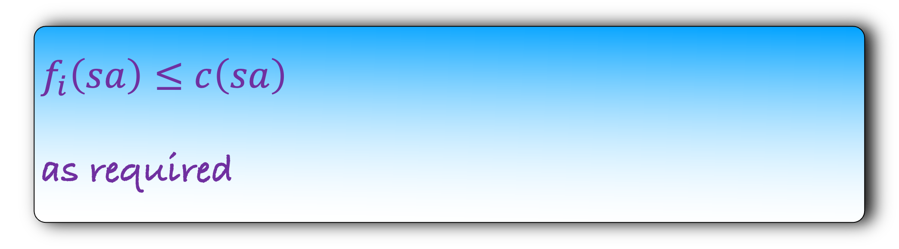
Lemma: The Ford-Fulkerson algorithm returns a valid flow.
def fordfulkerson($G$):
for each $e∈G$:
$f\left(e\right)=0$
make a residual graph $G_{R}$
while there is a $st$path in $G_{R}$:
let $P$ be a $st$ path in $G_{R}$
let $b$ be the minimum capacity edge in $P$
for each forward edge $e$ in $P$:
$f\left(e\right)=f\left(e\right)+b$
for each backward edge $e$ in $P$:
let $e′$ be the corresponding forward edge
$f\left(e^{′}\right)=f\left(e^{′}\right)−b$
make a residual graph $G_{R}$
$$G$$
s
a
b
t
$$f_{i−1}(sa)$$
$c(sa)$
$$f_{i−1}(ba)$$
$c(ba)$
$$f_{i−1}(bt)$$
$c(bt)$
$$G_{R}$$
s
a
b
b
t
$$P$$
$f_{i−1}\left(sa\right)≤c\left(sa\right)− b$
$f_{i}\left(sa\right)≤$ $c\left(sa\right)$
as required

Slide 25

Lemma: The Ford-Fulkerson algorithm returns a valid flow.
def fordfulkerson($G$):
for each $e∈G$:
$f\left(e\right)=0$
make a residual graph $G_{R}$
while there is a $st$path in $G_{R}$:
let $P$ be a $st$ path in $G_{R}$
let $b$ be the minimum capacity edge in $P$
for each forward edge $e$ in $P$:
$f\left(e\right)=f\left(e\right)+b$
for each backward edge $e$ in $P$:
let $e′$ be the corresponding forward edge
$f\left(e^{′}\right)=f\left(e^{′}\right)−b$
make a residual graph $G_{R}$
$$G$$
s
a
b
t
$$f_{i−1}(sa)$$
$c(sa)$
$$f_{i−1}(ba)$$
$c(ba)$
$$f_{i−1}(bt)$$
$c(bt)$
$$G_{R}$$
s
a
b
b
t
$$P$$
ab is a backward edge. As a homework, show that the corresponding forward edge ba satify,
$$f_{i}\left(ba\right)≤c(ba)$$

Slide 26

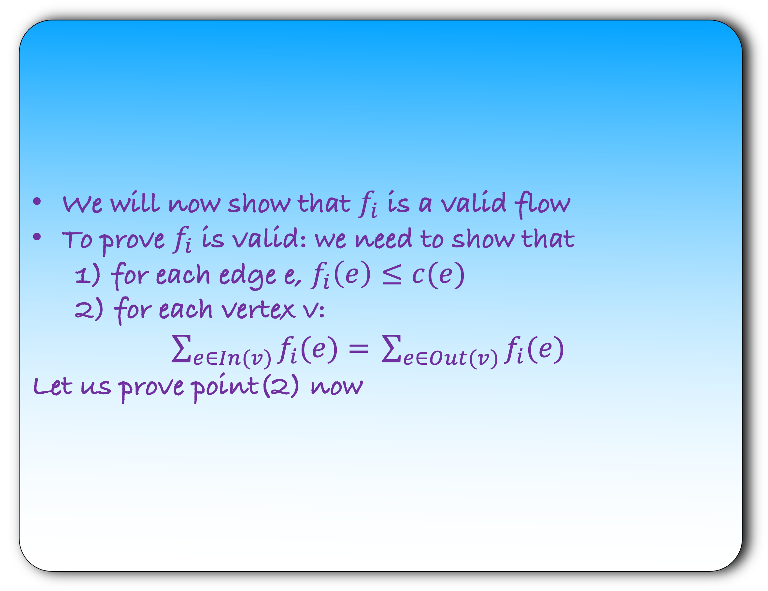
Lemma: The Ford-Fulkerson algorithm returns a valid flow.
def fordfulkerson($G$):
for each $e∈G$:
$f\left(e\right)=0$
make a residual graph $G_{R}$
while there is a $st$path in $G_{R}$:
let $P$ be a $st$ path in $G_{R}$
let $b$ be the minimum capacity edge in $P$
for each forward edge $e$ in $P$:
$f\left(e\right)=f\left(e\right)+b$
for each backward edge $e$ in $P$:
let $e′$ be the corresponding forward edge
$f\left(e^{′}\right)=f\left(e^{′}\right)−b$
make a residual graph $G_{R}$
We will now show that $f_{i}$ is a valid flow
To prove $f_{i}$ is valid: we need to show that
                1) for each edge e, $f_{i}\left(e\right)≤c(e)$
                2) for each vertex v:
                $\sum_{e∈In(v)}{f_{i}(e)= }\sum_{e∈Out(v)}{f_{i}(e) }$
                Let us prove point(2) now

Slide 27
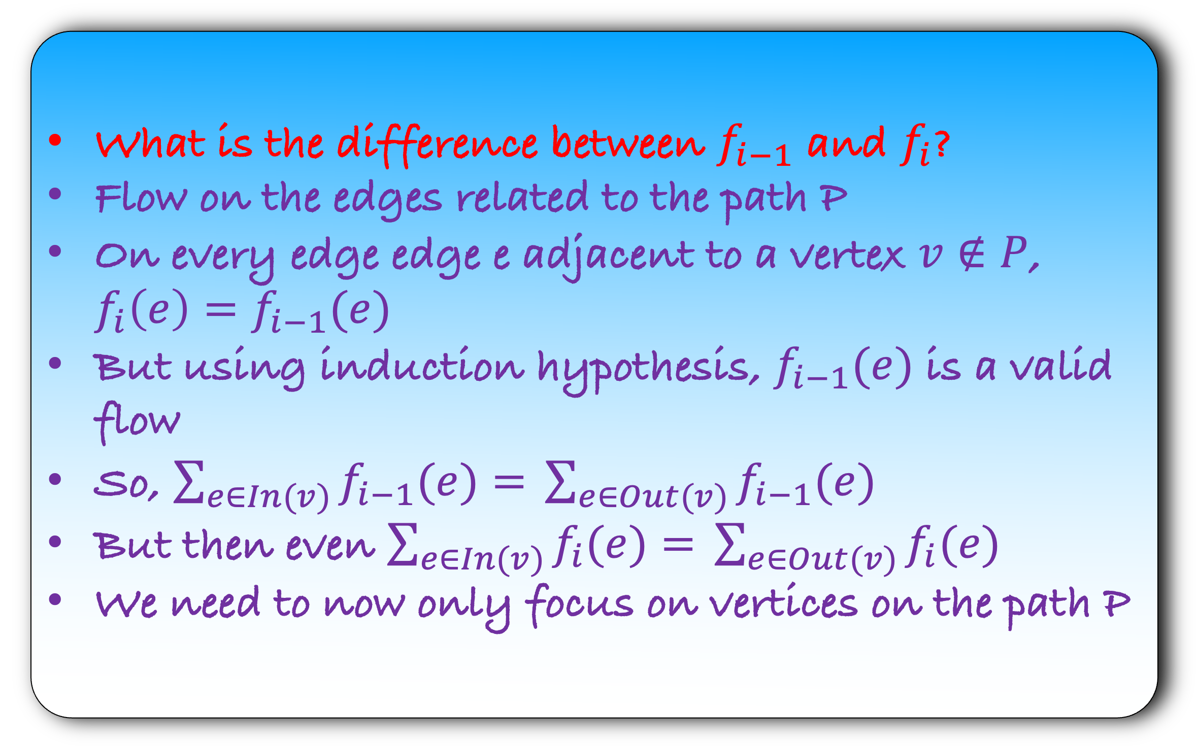
Lemma: The Ford-Fulkerson algorithm returns a valid flow.
def fordfulkerson($G$):
for each $e∈G$:
$f\left(e\right)=0$
make a residual graph $G_{R}$
while there is a $st$path in $G_{R}$:
let $P$ be a $st$ path in $G_{R}$
let $b$ be the minimum capacity edge in $P$
for each forward edge $e$ in $P$:
$f\left(e\right)=f\left(e\right)+b$
for each backward edge $e$ in $P$:
let $e′$ be the corresponding forward edge
$f\left(e^{′}\right)=f\left(e^{′}\right)−b$
make a residual graph $G_{R}$
What is the difference between $f_{i−1}$ and $f_{i}$?
Flow on the edges related to the path P
On every edge edge e adjacent to a vertex $v∉P$, $f_{i}\left(e\right)=f_{i−1}(e)$
But using induction hypothesis, $f_{i−1}(e)$ is a valid flow
So, $\sum_{e∈In(v)}{f_{i−1}(e)= }\sum_{e∈Out(v)}{f_{i−1}(e) }$
But then even $\sum_{e∈In(v)}{f_{i}(e)= }\sum_{e∈Out(v)}{f_{i}(e) }$
We need to now only focus on vertices on the path P

Slide 28
Lemma: The Ford-Fulkerson algorithm returns a valid flow.
Let us look at the vertex v
The flow on sv and bv changes in the i-th iteration
On all the other edges of v, the flow remains the same
sv is a a forward edge and vb is a backward edge in the residual graph
That’s why this case is called the forward-backward case.
$$G$$
s
v
b
t
$$f_{i−1}(sa)$$
$c(sa)$
$$f_{i−1}(ba)$$
$c(ba)$
$$f_{i−1}(bt)$$
$c(bt)$
$$G_{R}$$
s
v
b
b
t
$$P$$

Slide 29


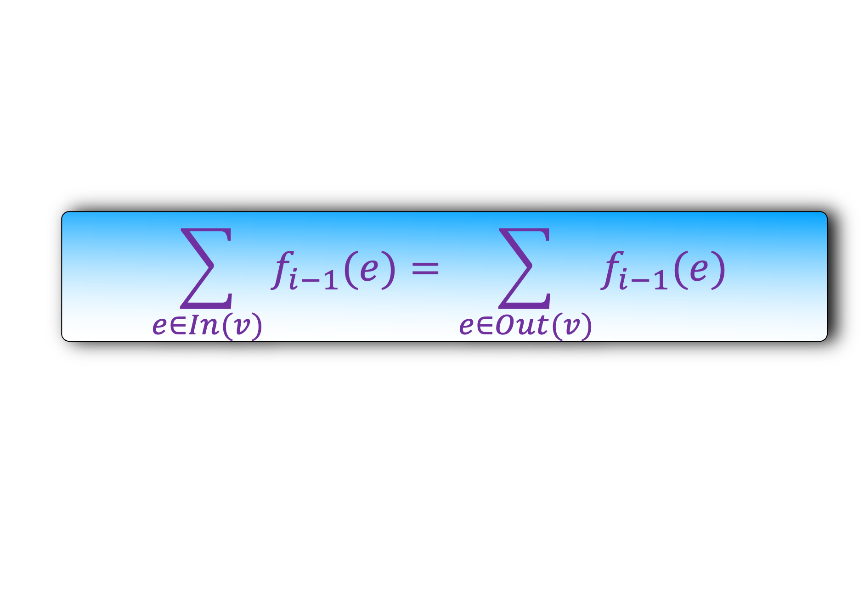
Lemma: The Ford-Fulkerson algorithm returns a valid flow.
forward-backward case
$$G$$
s
v
b
t
$$f_{i}\left(sv\right)=f_{i−1}(sv)+b$$
$c(sa)$
$$f_{i−1}(sa)$$
$$f_{i−1}(ba)$$
$c(ba)$
$$f_{i−1}(bt)$$
$c(bt)$
$$f_{i}\left(bv\right)=f_{i−1}\left(bv\right)−b$$
$$G_{R}$$
s
v
b
b
t
                $$\sum_{e∈In(v)}{f_{i−1}(e)= }\sum_{e∈Out(v)}{f_{i−1}(e) }$$
$$P$$

Slide 30
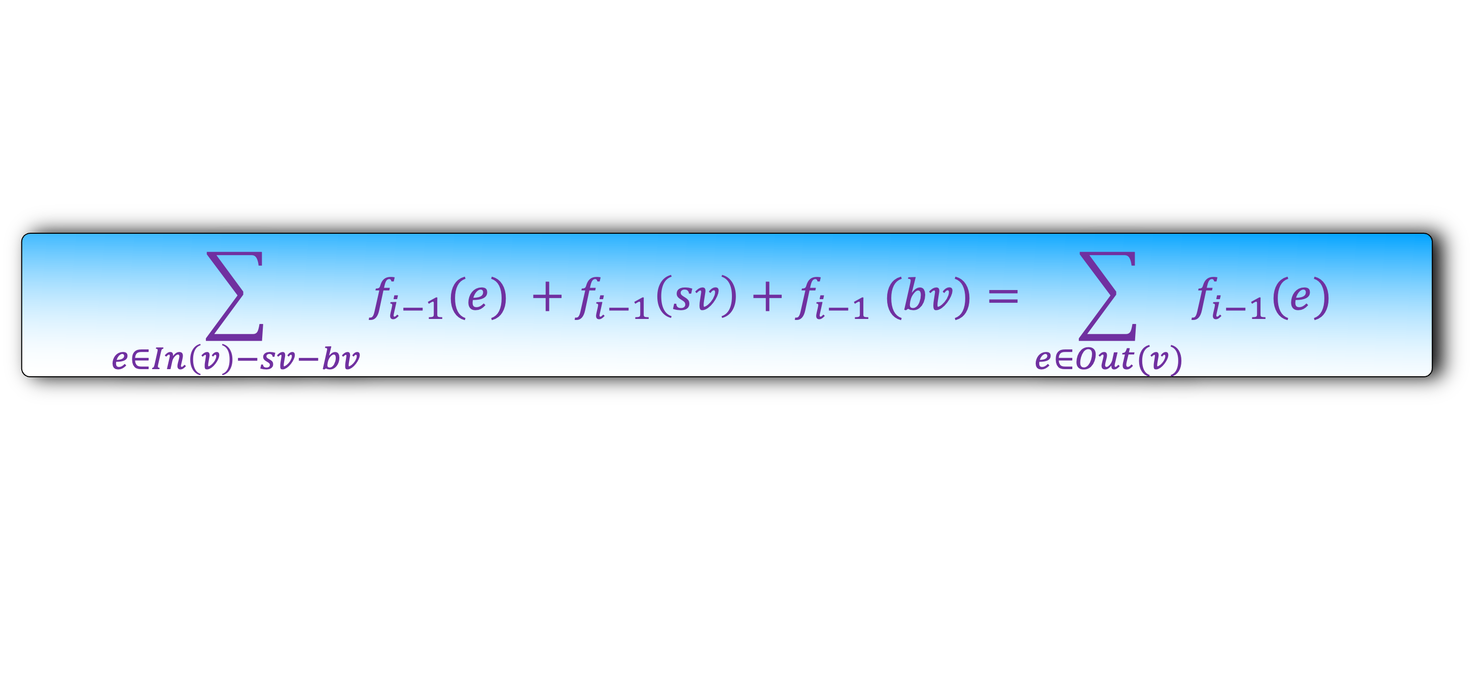
Lemma: The Ford-Fulkerson algorithm returns a valid flow.
forward-backward case
$$G$$
s
v
b
t
$$f_{i}\left(sv\right)=f_{i−1}(sv)+b$$
$c(sa)$
$$f_{i−1}(sa)$$
$$f_{i−1}(ba)$$
$c(ba)$
$$f_{i−1}(bt)$$
$c(bt)$
$$f_{i}\left(bv\right)=f_{i−1}\left(bv\right)−b$$
$$G_{R}$$
s
v
b
b
t
$$P$$
                $$\sum_{e∈In\left(v\right)−sv−bv}{f_{i−1}(e) }+f_{i−1}\left(sv\right)+f_{i−1} (bv)=\sum_{e∈Out(v)}{f_{i−1}(e) }$$

Slide 31

Lemma: The Ford-Fulkerson algorithm returns a valid flow.
forward-backward case
$$G$$
s
v
b
t
$$f_{i}\left(sv\right)=f_{i−1}(sv)+b$$
$c(sa)$
$$f_{i−1}(sa)$$
$$f_{i−1}(ba)$$
$c(ba)$
$$f_{i−1}(bt)$$
$c(bt)$
$$f_{i}\left(bv\right)=f_{i−1}\left(bv\right)−b$$
$$G_{R}$$
s
v
b
b
t
$$P$$
                $$\sum_{e∈In\left(v\right)−sv−bv}{f_{i}(e) }+f_{i−1}\left(sv\right)+f_{i−1} (bv)=\sum_{e∈Out(v)}{f_{i}(e) }$$

Slide 32

Lemma: The Ford-Fulkerson algorithm returns a valid flow.
forward-backward case
$$G$$
s
v
b
t
$$f_{i}\left(sv\right)=f_{i−1}(sv)+b$$
$c(sa)$
$$f_{i−1}(sa)$$
$$f_{i−1}(ba)$$
$c(ba)$
$$f_{i−1}(bt)$$
$c(bt)$
$$f_{i}\left(bv\right)=f_{i−1}\left(bv\right)−b$$
$$G_{R}$$
s
v
b
b
t
$$P$$
                $$\sum_{e∈In\left(v\right)−sv−bv}{f_{i}(e) }+f_{i}\left(sv\right)−b+f_{i} \left(bv\right)+b=\sum_{e∈Out(v)}{f_{i}(e) }$$

Slide 33

Lemma: The Ford-Fulkerson algorithm returns a valid flow.
forward-backward case
$$G$$
s
v
b
t
$$f_{i}\left(sv\right)=f_{i−1}(sv)+b$$
$c(sa)$
$$f_{i−1}(sa)$$
$$f_{i−1}(ba)$$
$c(ba)$
$$f_{i−1}(bt)$$
$c(bt)$
$$f_{i}\left(bv\right)=f_{i−1}\left(bv\right)−b$$
$$G_{R}$$
s
v
b
b
t
$$P$$
                $$\sum_{e∈In\left(v\right)−sv−bv}{f_{i}(e) }+f_{i}\left(sv\right)+f_{i} \left(bv\right)=\sum_{e∈Out(v)}{f_{i}(e) }$$

Slide 34
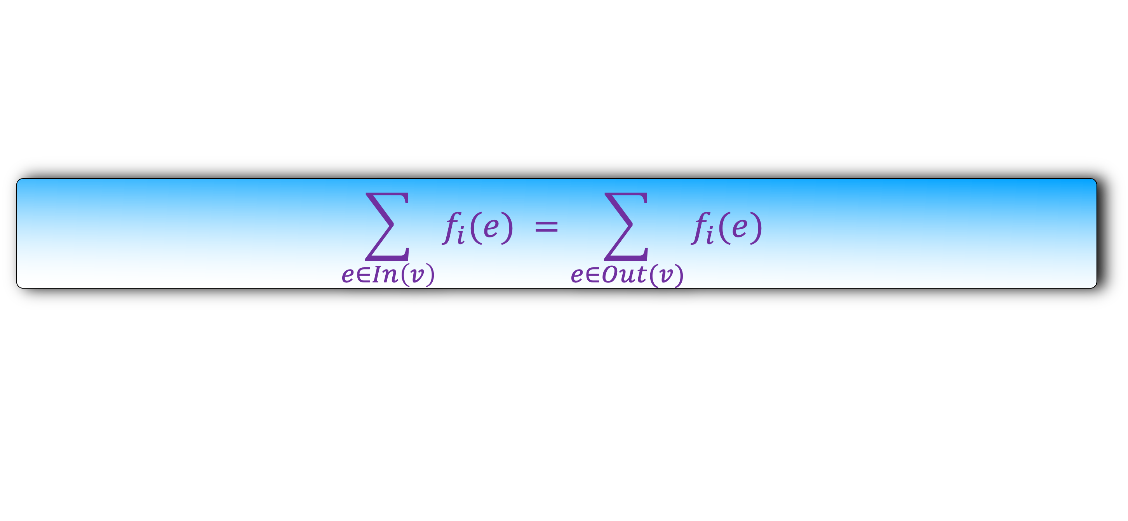
Lemma: The Ford-Fulkerson algorithm returns a valid flow.
forward-backward case
$$G$$
s
v
b
t
$$f_{i}\left(sv\right)=f_{i−1}(sv)+b$$
$c(sa)$
$$f_{i−1}(sa)$$
$$f_{i−1}(ba)$$
$c(ba)$
$$f_{i−1}(bt)$$
$c(bt)$
$$f_{i}\left(bv\right)=f_{i−1}\left(bv\right)−b$$
$$G_{R}$$
s
v
b
b
t
$$P$$
                $$\sum_{e∈In\left(v\right)}{f_{i}(e) }=\sum_{e∈Out(v)}{f_{i}(e) }$$

Slide 35
Lemma: The Ford-Fulkerson algorithm returns a valid flow.
forward-backward case. Done
$$G$$
s
v
b
t
H.W: Repeat the analysis of cases:
forward-forward
Backward-forward
Backward-backward
$$f_{i−1}(sa)$$
$c(sa)$
$$f_{i−1}(ba)$$
$c(ba)$
$$f_{i−1}(bt)$$
$c(bt)$
$$G_{R}$$
s
v
b
b
t
$$P$$

Slide 36
Lemma: The Ford-Fulkerson algorithm returns a valid flow.
Let us now move on to the more ambitious goal
Lemma: The Ford-Fulkerson algorithm returns the maximum flow.

Slide 37
a
b
c
10
5
10
10
10
s
10
t
20
10
d
e
f
20
10
A cut C is a set of edges whose removal disconnect the s and t.
Alternatively, C can be define by partitioning V into two sets A and B with the condition that A contains s and B contains t.
The edges going from A to B are called cut edge.

Slide 38
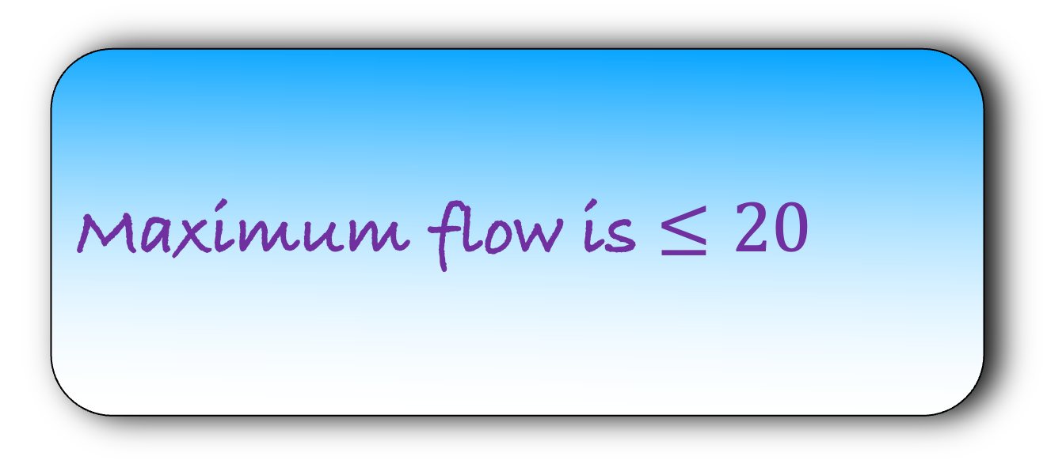
A
C = {ct,ft}
a
b
c
10
5
10
10
10
s
10
t
10
B
20
d
e
f
20
10
Looking at the cut, can you upper bound the maximum flow?
Maximum flow is $≤20$

Slide 39
C = { }
A
a
b
c
10
5
10
10
10
s
10
t
20
10
B
d
e
f
20
10
Only bc and ef are cut edges. cd is not a cut edge

Slide 40
C = {bc,ef}
A
a
b
c
10
5
10
10
10
s
10
t
20
10
B
d
e
f
20
10
Only bc and ef are cut edges. cd is not a cut edge

Slide 41

C = {bc,ef}
A
a
b
c
10
5
10
10
10
s
10
t
20
10
B
d
e
f
20
10
Looking at the cut, can you upper bound the maximum flow?
Maximum flow is $≤15$

Slide 42
C = {ab,de}
A
a
b
c
10
5
10
10
10
s
10
t
20
10
B
d
e
f
20
10

Slide 43
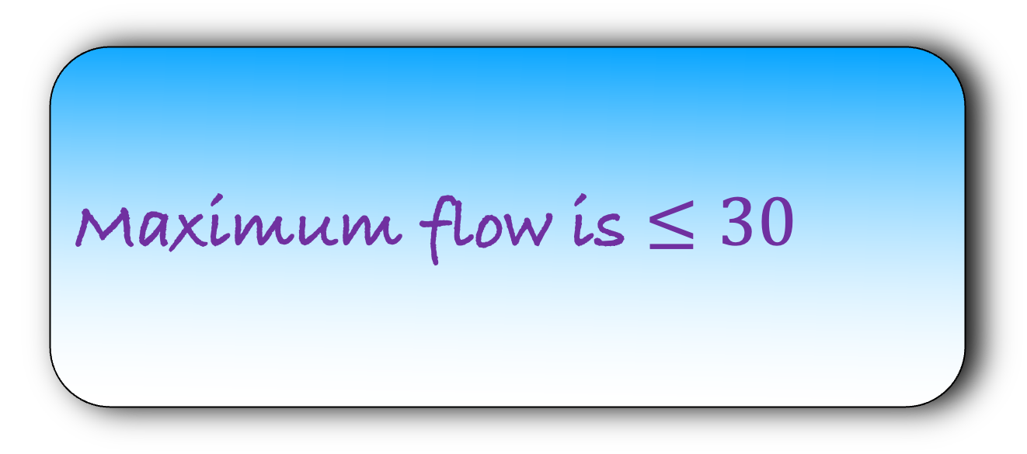
C = {ab,de}
A
a
b
c
10
5
10
10
10
s
10
t
Looking at the cut, can you upper bound the maximum flow?
20
10
B
d
e
f
20
Maximum flow is $≤30$
10

Slide 44

Lemma: Let C be a cut. Then maximum flow is $≤$ the weight of the cut.
Or in other words,
Maximum flow $≤\sum_{e∈C}{c(e)}$
But why are we bothered about cuts?
We will show that the maximum flow in the graph is equal to the weight of the minimum cut
This is a remarkable statement as we never mentioned minimum cuts while describing the algorithm
But in the analysis, we will use minimum cuts heavily
And there is a deep relation between maximum flows and minimum cuts
A feature of a elegant algorithm is that its code is easy but its analysis is even more elegant
This is one such algorithm

Slide 45

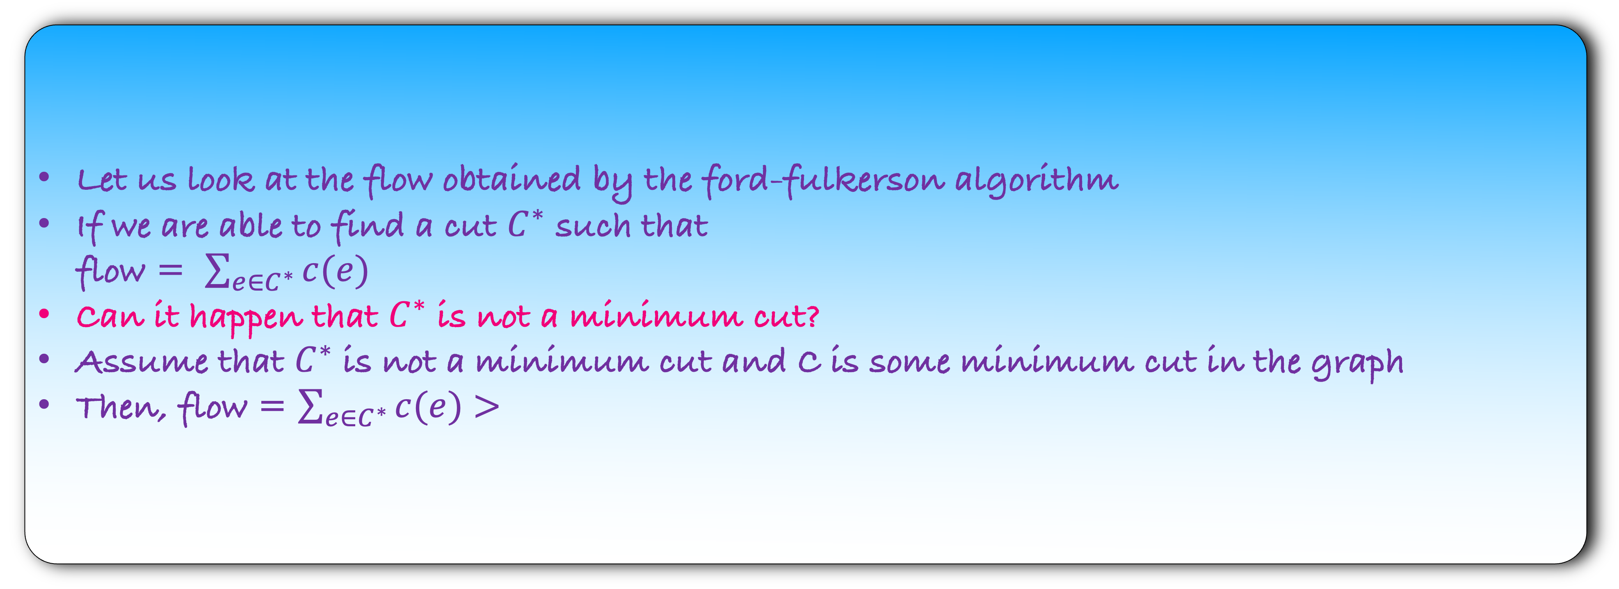
Lemma: Let C be a cut. Then maximum flow is $≤$ the weight of the cut.
Or in other words,
Maximum flow $≤\sum_{e∈C}{c(e)}$
Corollary: Let C be a minimum cut in the graph.
Maximum flow $≤\sum_{e∈C}{c(e)}$
Let us look at the flow obtained by the ford-fulkerson algorithm
If we are able to find a cut $C^{∗}$ such that
flow = $\sum_{e∈C^{∗}}{c(e)}$
Can it happen that $C^{∗}$ is not a minimum cut?
Assume that $C^{∗}$ is not a minimum cut and C is some minimum cut in the graph
Then, flow = $\sum_{e∈C^{∗}}{c(e)}$ $>$

Slide 46
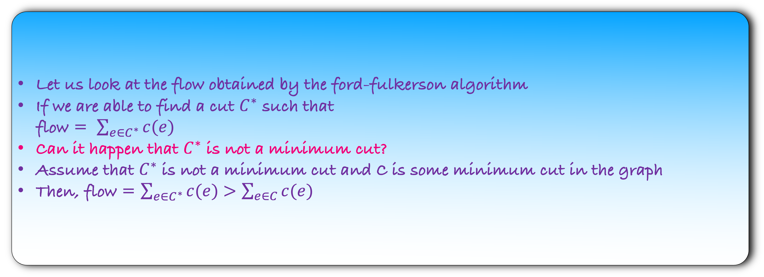
Lemma: Let C be a cut. Then maximum flow is $≤$ the weight of the cut.
Or in other words,
Maximum flow $≤\sum_{e∈C}{c(e)}$
Corollary: Let C be a minimum cut in the graph.
Maximum flow $≤\sum_{e∈C}{c(e)}$
Let us look at the flow obtained by the ford-fulkerson algorithm
If we are able to find a cut $C^{∗}$ such that
flow = $\sum_{e∈C^{∗}}{c(e)}$
Can it happen that $C^{∗}$ is not a minimum cut?
Assume that $C^{∗}$ is not a minimum cut and C is some minimum cut in the graph
Then, flow = $\sum_{e∈C^{∗}}{c(e)}$ $>\sum_{e∈C}{c(e)}$

Slide 47
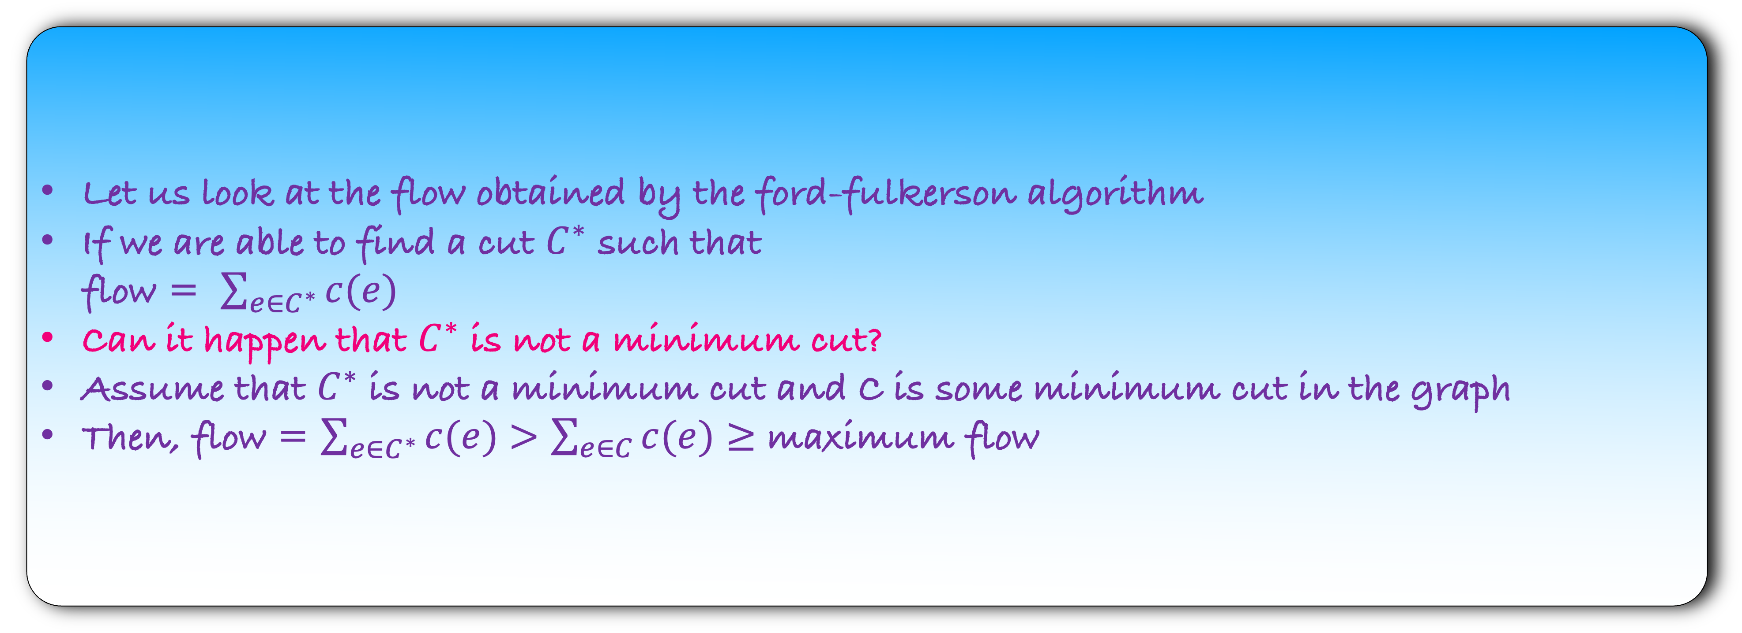

Lemma: Let C be a cut. Then maximum flow is $≤$ the weight of the cut.
Or in other words,
Maximum flow $≤\sum_{e∈C}{c(e)}$
Corollary: Let C be a minimum cut in the graph.
Maximum flow $≤\sum_{e∈C}{c(e)}$
Let us look at the flow obtained by the ford-fulkerson algorithm
If we are able to find a cut $C^{∗}$ such that
flow = $\sum_{e∈C^{∗}}{c(e)}$
Can it happen that $C^{∗}$ is not a minimum cut?
Assume that $C^{∗}$ is not a minimum cut and C is some minimum cut in the graph
Then, flow = $\sum_{e∈C^{∗}}{c(e)}$ $>\sum_{e∈C}{c(e)}≥$ maximum flow

Slide 48
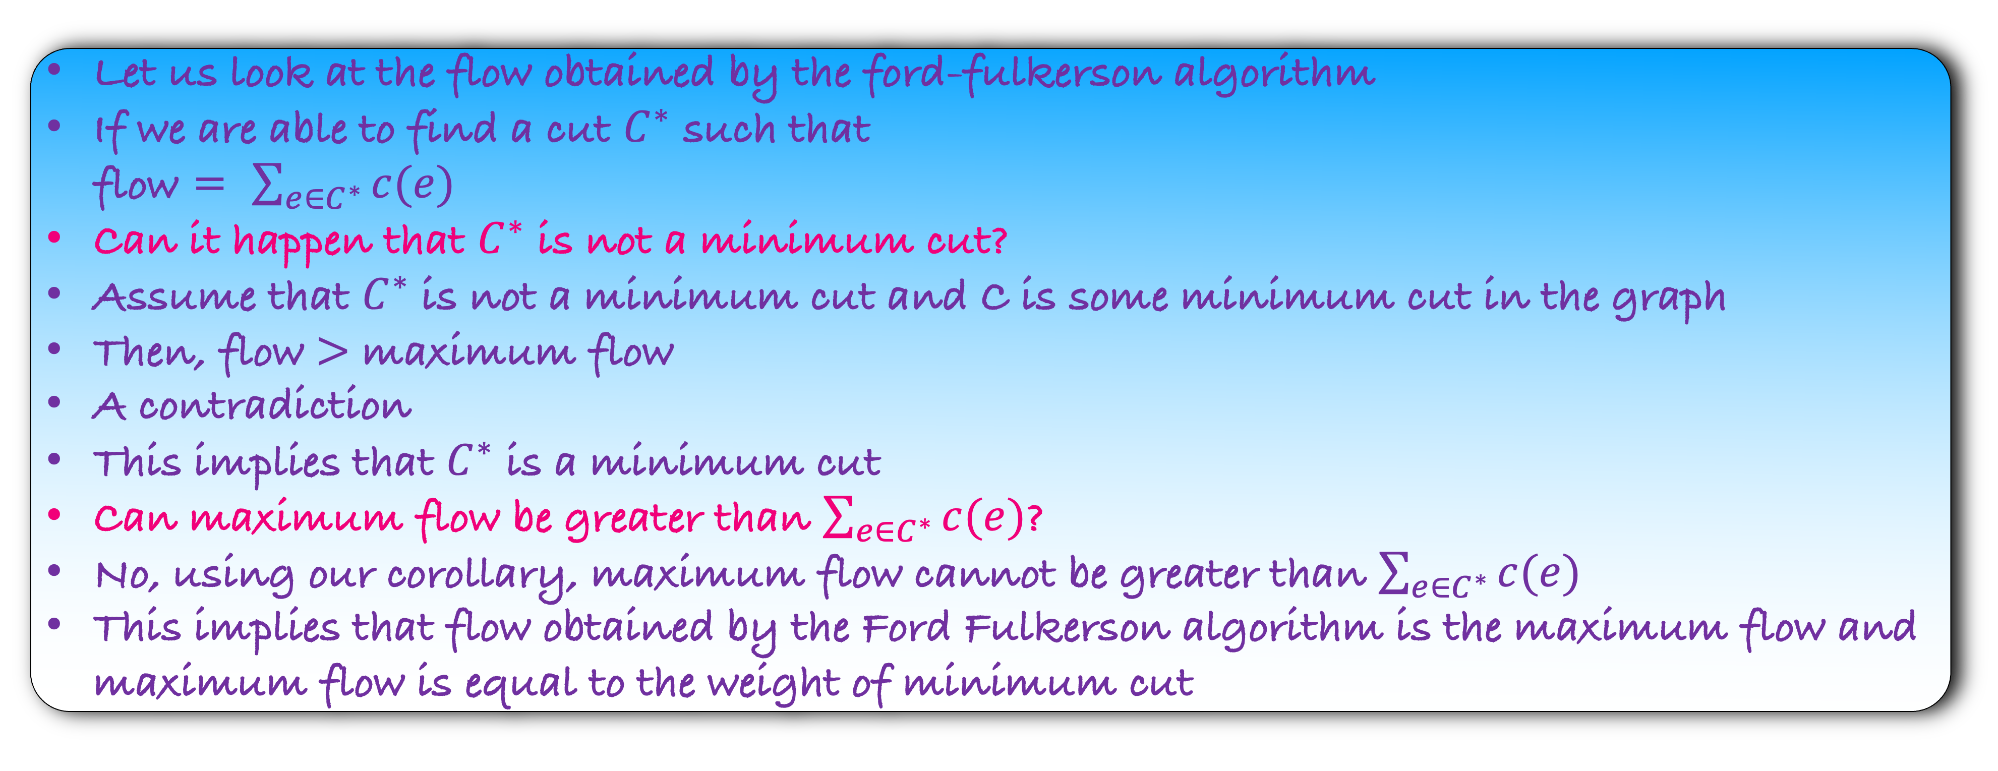
Lemma: Let C be a cut. Then maximum flow is $≤$ the weight of the cut.
Or in other words,
Maximum flow $≤\sum_{e∈C}{c(e)}$
Corollary: Let C be a minimum cut in the graph.
Maximum flow $≤\sum_{e∈C}{c(e)}$
Let us look at the flow obtained by the ford-fulkerson algorithm
If we are able to find a cut $C^{∗}$ such that
flow = $\sum_{e∈C^{∗}}{c(e)}$
Can it happen that $C^{∗}$ is not a minimum cut?
Assume that $C^{∗}$ is not a minimum cut and C is some minimum cut in the graph
Then, flow $>$ maximum flow
A contradiction
This implies that $C^{∗}$ is a minimum cut
Can maximum flow be greater than $\sum_{e∈C^{∗}}{c(e)}$?
No, using our corollary, maximum flow cannot be greater than $\sum_{e∈C^{∗}}{c(e)}$
This implies that flow obtained by the Ford Fulkerson algorithm is the maximum flow and maximum flow is equal to the weight of minimum cut

Slide 49

Lemma: Let C be a cut. Then maximum flow is $≤$ the weight of the cut.
Or in other words,
Maximum flow $≤\sum_{e∈C}{c(e)}$
Corollary: Let C be a minimum cut in the graph.
Maximum flow $≤\sum_{e∈C}{c(e)}$
Lemma: Let us look at the flow obtained by the ford-fulkerson algorithm. If we are able to find a cut $C^{∗}$ such that flow = $\sum_{e∈C^{∗}}{c(e)}$, then the ford-fulkerson algorithm returns a

Slide 50

Lemma: Let C be a cut. Then maximum flow is $≤$ the weight of the cut.
Or in other words,
Maximum flow $≤\sum_{e∈C}{c(e)}$
Corollary: Let C be a minimum cut in the graph.
Maximum flow $≤\sum_{e∈C}{c(e)}$
Lemma: Let us look at the flow obtained by the ford-fulkerson algorithm. If we are able to find a cut $C^{∗}$ such that flow = $\sum_{e∈C^{∗}}{c(e)}$, then the ford-fulkerson algorithm returns a maximum flow

Slide 51
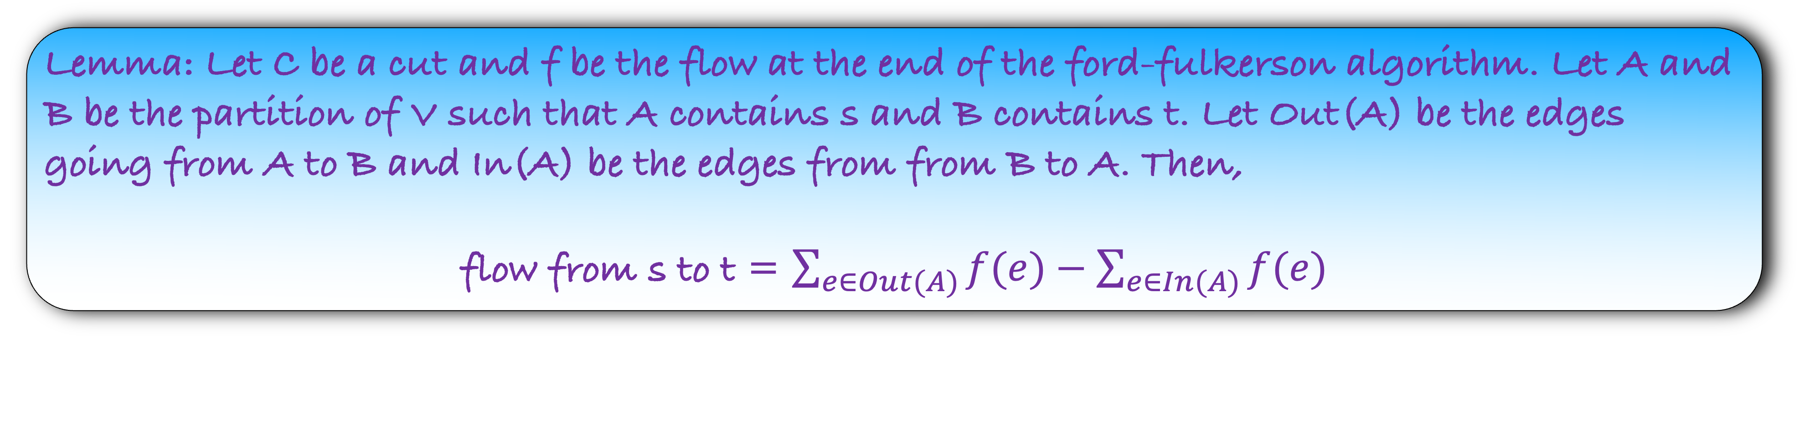

Lemma: Let us look at the flow obtained by the ford-fulkerson algorithm. If we are able to find a cut $C^{∗}$ such that flow = $\sum_{e∈C^{∗}}{c(e)}$, then the ford-fulkerson algorithm returns a maximum flow
The following lemma will play a crucial role in proving the above lemma.
Lemma: Let C be a cut and f be the flow at the end of the ford-fulkerson algorithm. Let A and B be the partition of V such that A contains s and B contains t. Let Out(A) be the edges going from A to B and In(A) be the edges from from B to A. Then,
flow from s to t = $\sum_{e∈Out(A)}{f(e)}−\sum_{e∈In(A)}{f(e)}$
Let us first visualize what this lemma means.

Slide 52
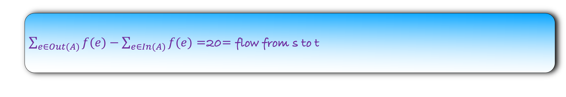
a
b
c
A
0
10
0
5
10
10
10
0
0
10
s
10
10
t
B
20
20
10
10
d
e
f
10
20
10
10
$\sum_{e∈Out(A)}{f(e)}−\sum_{e∈In(A)}{f(e)}$ =20= flow from s to t

Slide 53

Lemma: Let us look at the flow obtained by the ford-fulkerson algorithm. If we are able to find a cut $C^{∗}$ such that flow = $\sum_{e∈C^{∗}}{c(e)}$, then the ford-fulkerson algorithm returns a maximum flow
Lemma: Let C be a cut and f be the flow at the end of the ford-fulkerson algorithm. Let A and B be the partition of V such that A contains s and B contains t. Let Out(A) be the edges going from A to B and In(A) be the edges from from B to A. Then,
flow from s to t = $\sum_{e∈Out(A)}{f(e)}−\sum_{e∈In(A)}{f(e)}$
We will assume the above lemma. Now lets try to prove our main lemma.

Slide 54

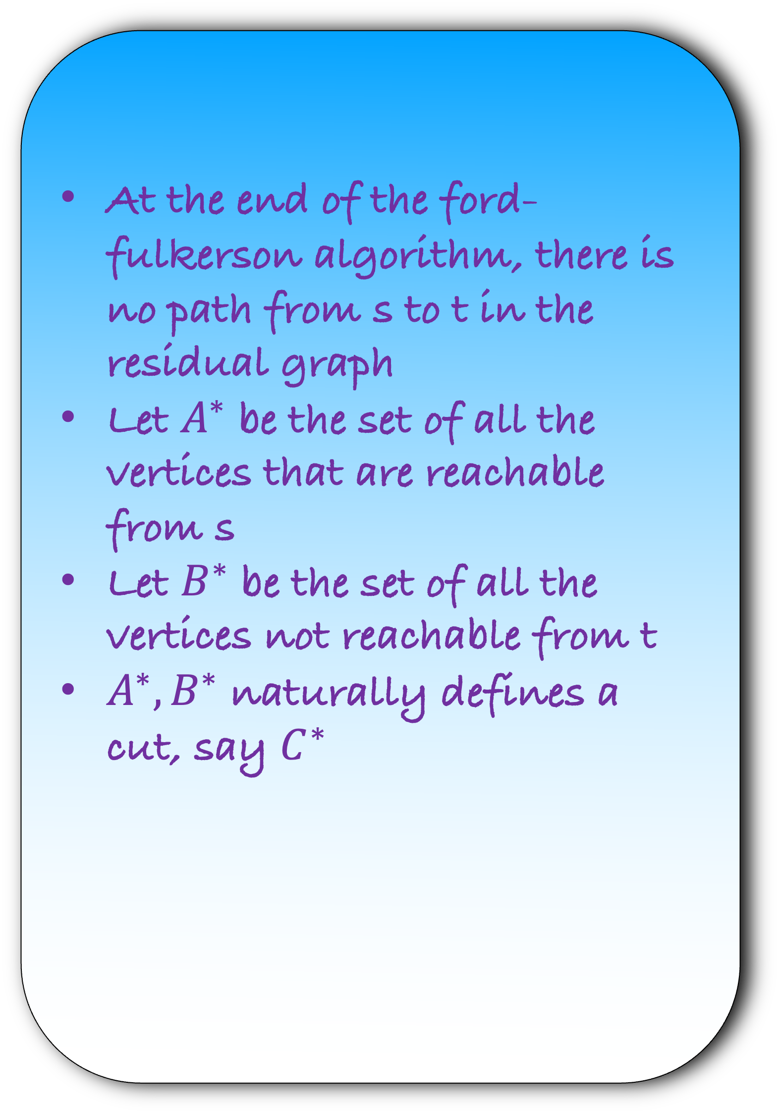


$$G_{R}$$
At the end of the ford-fulkerson algorithm, there is no path from s to t in the residual graph
Let $A^{∗}$ be the set of all the vertices that are reachable from s
Let $B^{∗}$ be the set of all the vertices not reachable from t
$A^{∗},B^{∗}$ naturally defines a cut, say $C^{∗}$
a
g
b
$$A^{∗}$$
s
t
d
e
h
$${ B}^{∗}$$

Slide 55
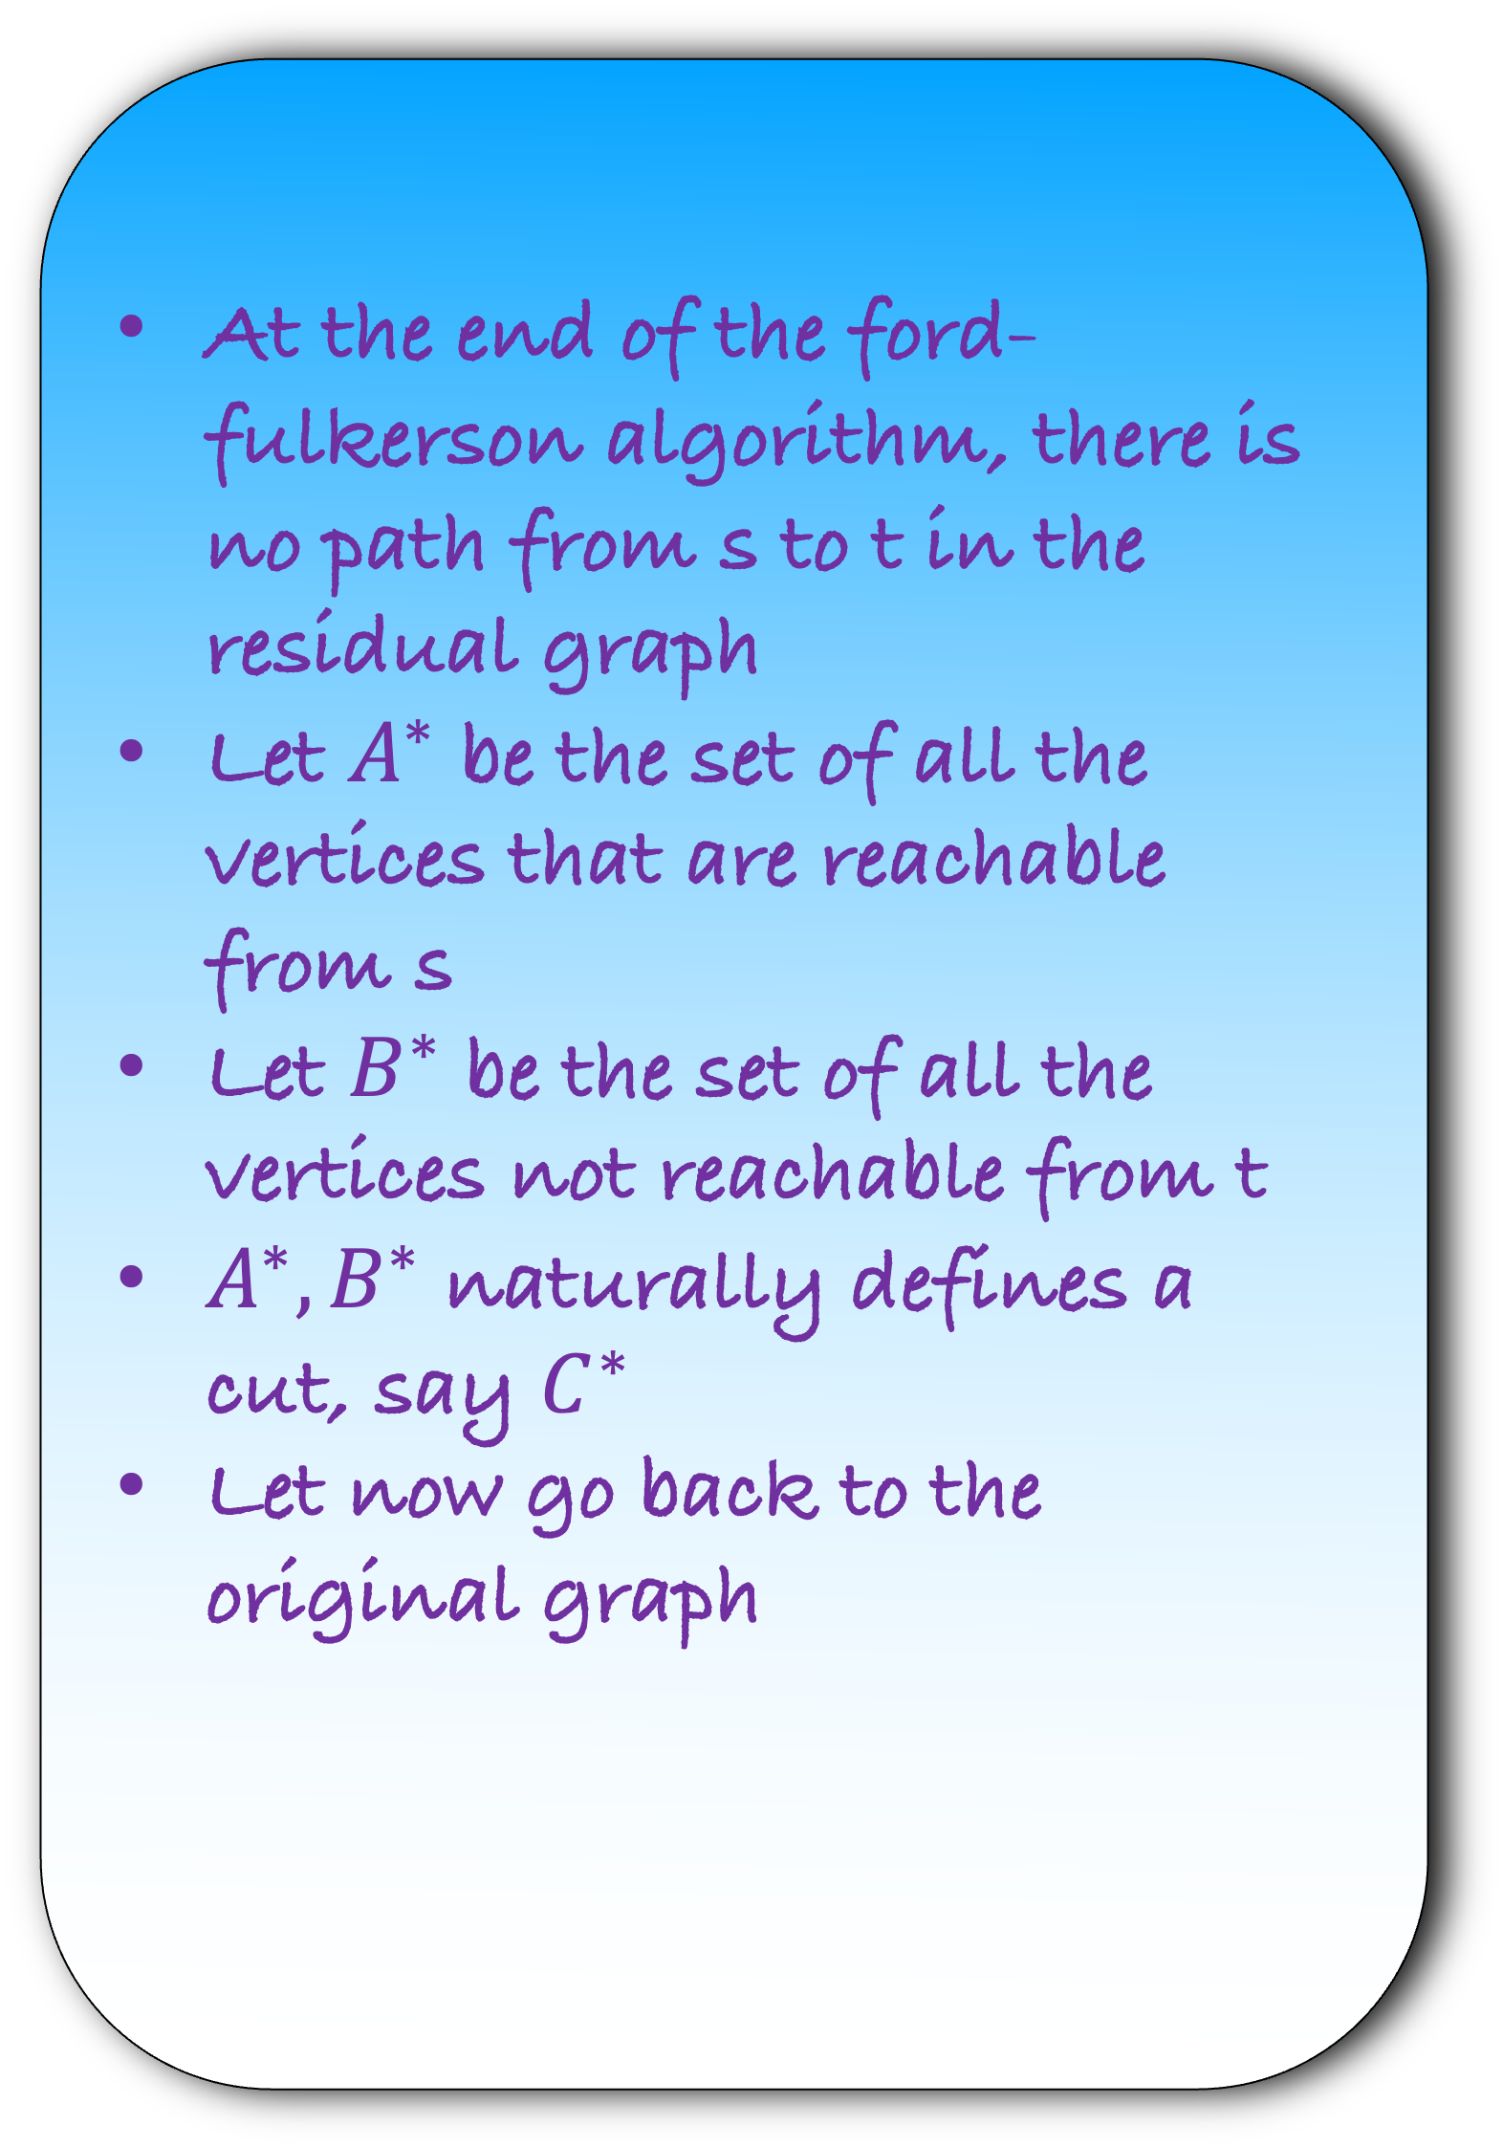
$$G_{R}$$
At the end of the ford-fulkerson algorithm, there is no path from s to t in the residual graph
Let $A^{∗}$ be the set of all the vertices that are reachable from s
Let $B^{∗}$ be the set of all the vertices not reachable from t
$A^{∗},B^{∗}$ naturally defines a cut, say $C^{∗}$
Let now go back to the original graph
a
g
b
$$A^{∗}$$
s
t
d
e
h
$${ B}^{∗}$$

Slide 56
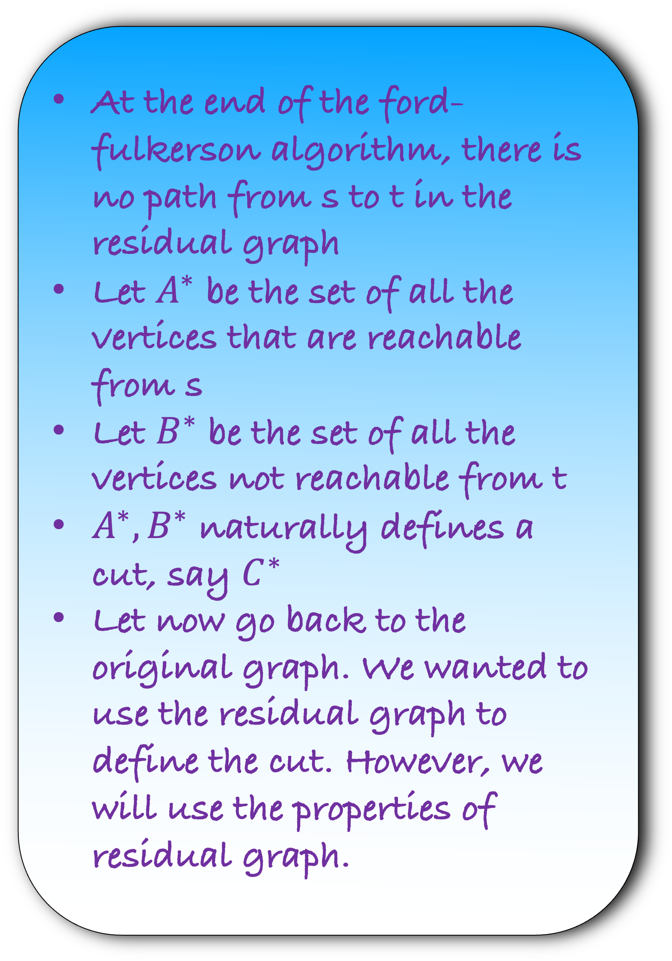
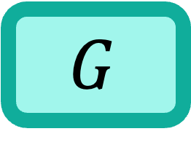
$$G$$
At the end of the ford-fulkerson algorithm, there is no path from s to t in the residual graph
Let $A^{∗}$ be the set of all the vertices that are reachable from s
Let $B^{∗}$ be the set of all the vertices not reachable from t
$A^{∗},B^{∗}$ naturally defines a cut, say $C^{∗}$
Let now go back to the original graph. We wanted to use the residual graph to define the cut. However, we will use the properties of residual graph.
a
g
b
$$A^{∗}$$
s
t
d
e
h
$${ B}^{∗}$$

Slide 57
$$G$$
Consider the edges that are going across the cut.
a
g
b
$$A^{∗}$$
s
t
d
e
h
$${ B}^{∗}$$

Slide 58
$$G$$
Consider the edges that are going across the cut.
Look at the edge, say bg
What is the flow on this edge at the end of the ford-fulkerson algorithm?
a
g
b
$$A^{∗}$$
s
t
d
e
h
$${ B}^{∗}$$

Slide 59
$$G$$
Consider the edges that are going across the cut.
Look at the edge, say bg
What is the flow on this edge at the end of the ford-fulkerson algorithm?
f(bg) = c(bg)
Why?
Let us assume that
f(bg) <c(bg)
But then, look at the residual graph.
a
g
b
$$A^{∗}$$
s
t
d
e
h
$${ B}^{∗}$$

Slide 60






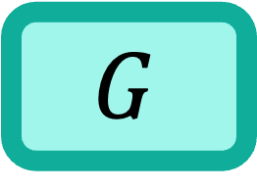
$$G$$
Consider the edges that are going across the cut.
Look at the edge, say bg
What is the flow on this edge at the end of the ford-fulkerson algorithm?
f(bg) = c(bg)
Why?
Let us assume that
f(bg) <c(bg)
But then, look at the residual graph.
a
g
b
$$A^{∗}$$
s
t
d
e
h
$${ B}^{∗}$$
$$G_{R}$$
a
g
b
$$A^{∗}$$
$$c\left(bg\right)−f(bg)$$
s
t
d
e
h
$${ B}^{∗}$$

Slide 61
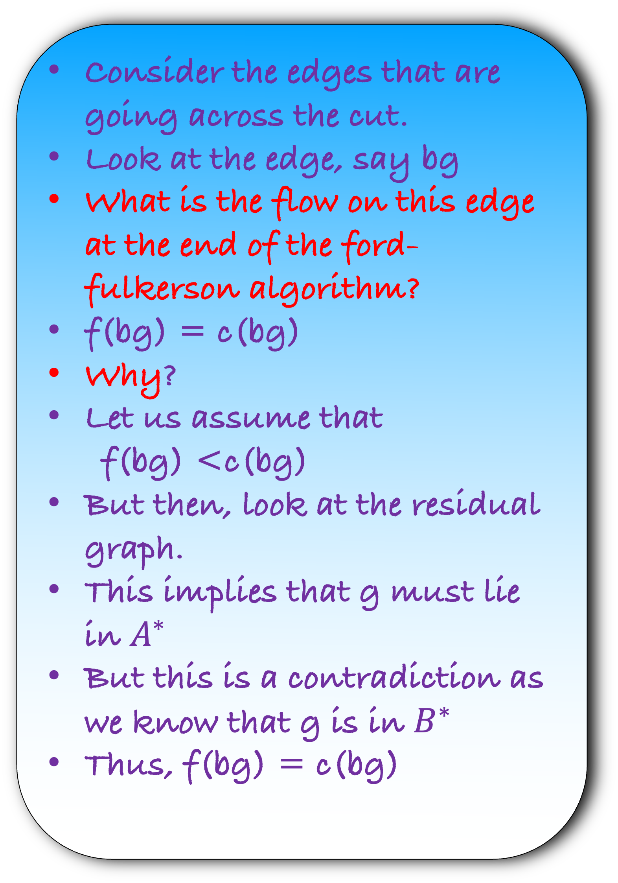

$$G$$
Consider the edges that are going across the cut.
Look at the edge, say bg
What is the flow on this edge at the end of the ford-fulkerson algorithm?
f(bg) = c(bg)
Why?
Let us assume that
f(bg) <c(bg)
But then, look at the residual graph.
This implies that g must lie in $A^{∗}$
But this is a contradiction as we know that g is in $B^{∗}$
Thus, f(bg) = c(bg)
a
g
b
$$A^{∗}$$
s
t
d
e
h
$${ B}^{∗}$$
$$G_{R}$$
a
b
$$A^{∗}$$
s
g
t
$$c\left(bg\right)−f(bg)$$
d
e
h
$${ B}^{∗}$$

Slide 62
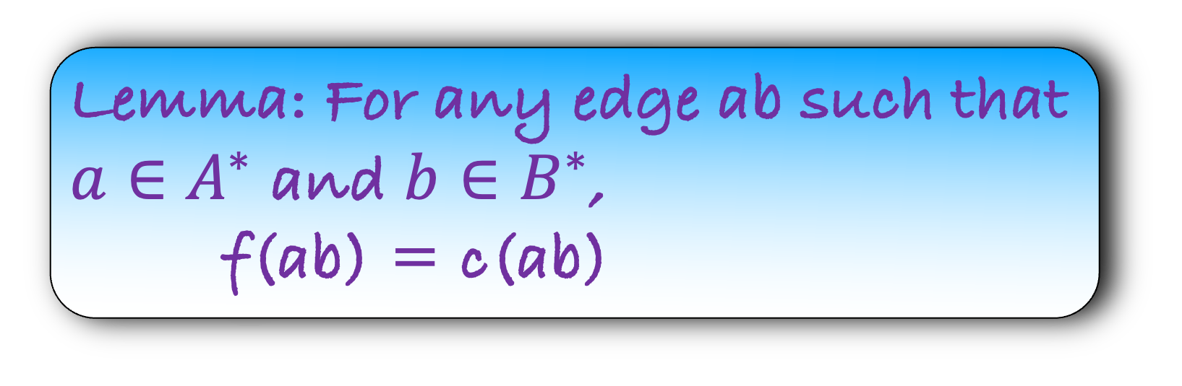

$$G$$
Lemma: For any edge ab such that $a∈A^{∗}$ and $b∈B^{∗}$,
  f(ab) = c(ab)
a
g
b
$$A^{∗}$$
s
t
h
Let us now look at edge going from $B^{∗}$ to $A^{∗}$
d
e
$${ B}^{∗}$$

Slide 63
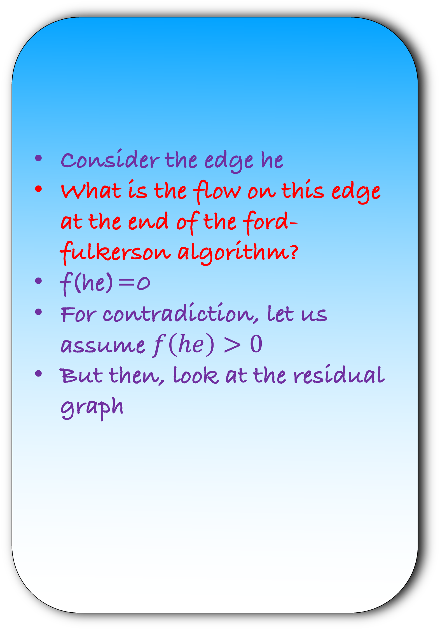
$$G$$
Consider the edge he
What is the flow on this edge at the end of the ford-fulkerson algorithm?
f(he)=0
For contradiction, let us assume $f\left(he\right)>0$
But then, look at the residual graph
a
g
b
$$A^{∗}$$
s
t
d
e
h
$${ B}^{∗}$$

Slide 64

$$G$$
Consider the edge he
What is the flow on this edge at the end of the ford-fulkerson algorithm?
f(he)=0
For contradiction, let us assume $f\left(he\right)>0$
But then, look at the residual graph
a
g
b
$$A^{∗}$$
s
t
d
e
h
$${ B}^{∗}$$
$$G_{R}$$
a
g
b
$$A^{∗}$$
s
t
d
e
h
$$f(eh)$$
$${ B}^{∗}$$

Slide 65

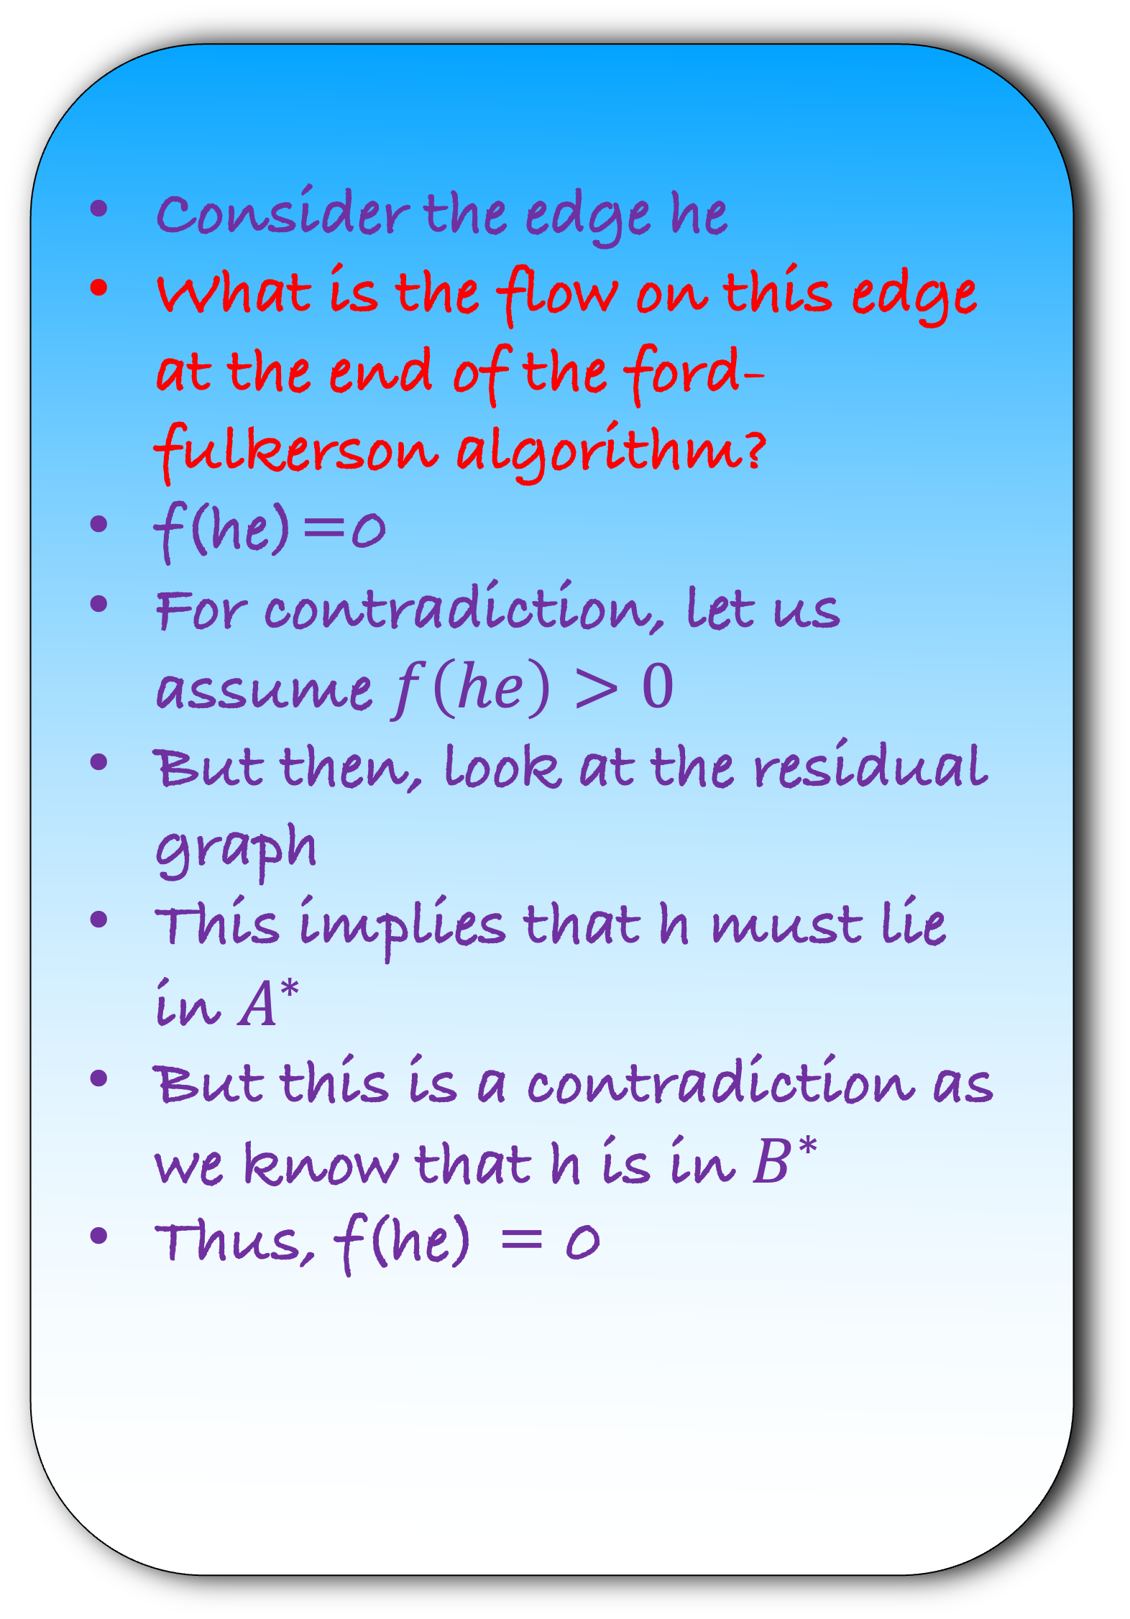

$$G$$
Consider the edge he
What is the flow on this edge at the end of the ford-fulkerson algorithm?
f(he)=0
For contradiction, let us assume $f\left(he\right)>0$
But then, look at the residual graph
This implies that h must lie in $A^{∗}$
But this is a contradiction as we know that h is in $B^{∗}$
Thus, f(he) = 0
a
g
b
$$A^{∗}$$
s
t
d
e
h
$${ B}^{∗}$$
$$G_{R}$$
a
g
b
$$A^{∗}$$
h
s
t
$$f(eh)$$
d
e
$${ B}^{∗}$$

Slide 66
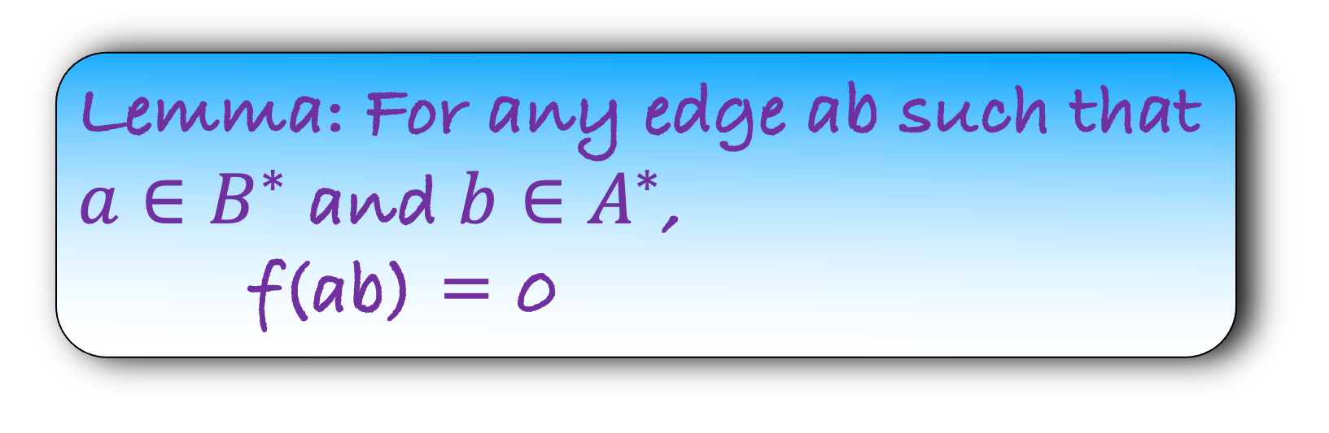
$$G$$
Lemma: For any edge ab such that $a∈A^{∗}$ and $b∈B^{∗}$,
  f(ab) = c(ab)
a
g
b
$$A^{∗}$$
s
t
Lemma: For any edge ab such that $a∈B^{∗}$ and $b∈A^{∗}$,
  f(ab) = 0
d
e
h
$${ B}^{∗}$$

Slide 67
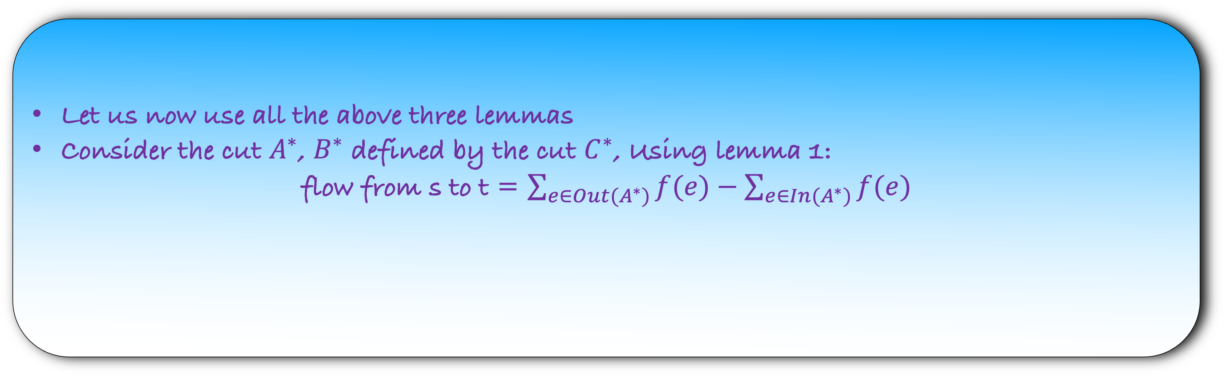
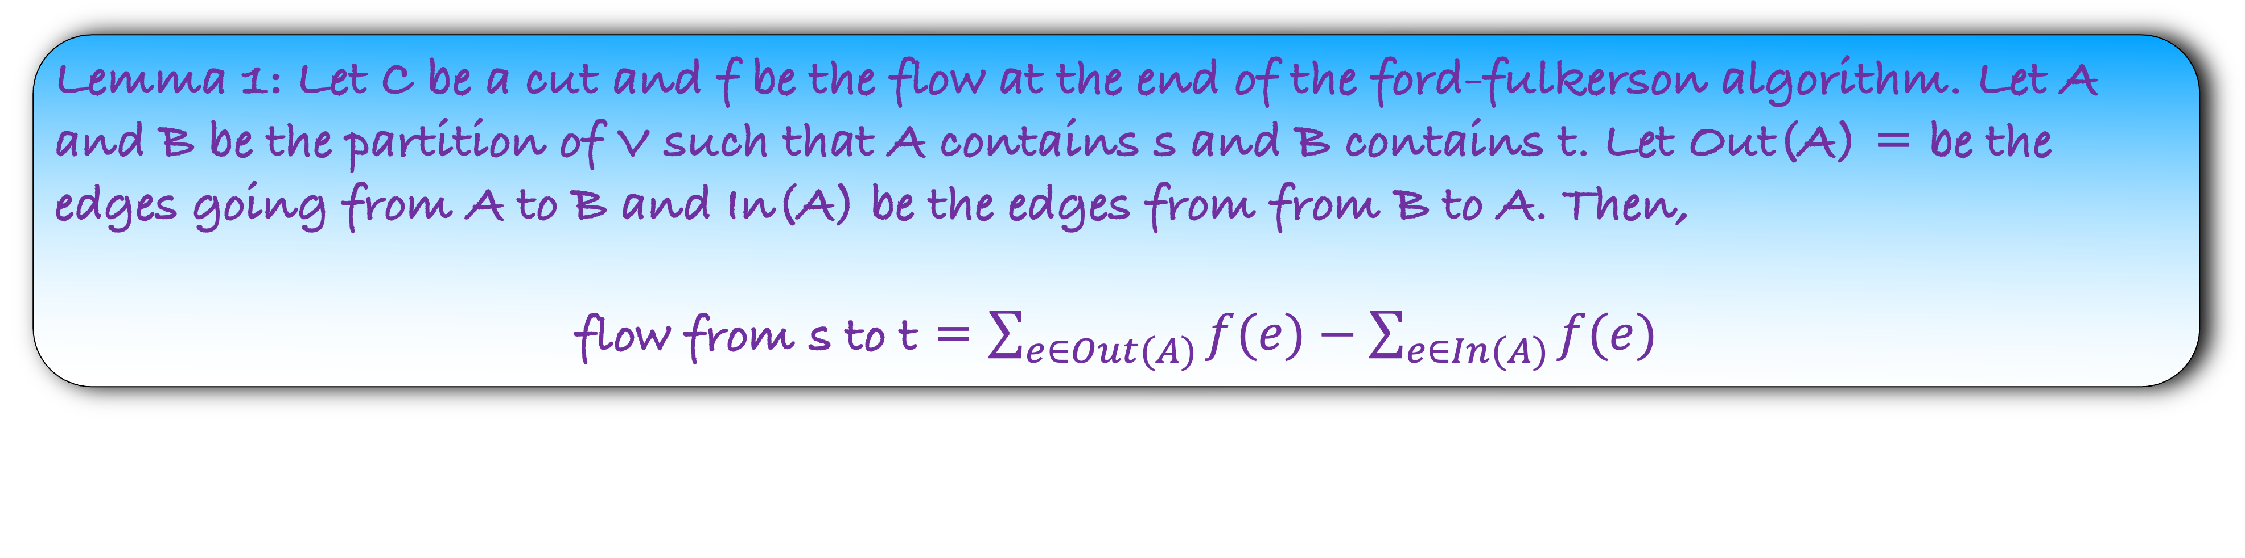
Lemma 1: Let C be a cut and f be the flow at the end of the ford-fulkerson algorithm. Let A and B be the partition of V such that A contains s and B contains t. Let Out(A) = be the edges going from A to B and In(A) be the edges from from B to A. Then,
flow from s to t = $\sum_{e∈Out(A)}{f(e)}−\sum_{e∈In(A)}{f(e)}$
Lemma 2: For any edge ab such that $a∈A^{∗}$ and $b∈B^{∗}$, f(ab) = c(ab)
Lemma 3: For any edge ab such that $a∈B^{∗}$ and $b∈A^{∗}$, f(ab) = 0
Let us now use all the above three lemmas
Consider the cut $A^{∗}$, $B^{∗}$ defined by the cut $C^{∗}$, Using lemma 1:
flow from s to t = $\sum_{e∈Out(A^{∗})}{f(e)}−\sum_{e∈In(A^{∗})}{f(e)}$

Slide 68

Lemma 1: Let C be a cut and f be the flow at the end of the ford-fulkerson algorithm. Let A and B be the partition of V such that A contains s and B contains t. Let Out(A) = be the edges going from A to B and In(A) be the edges from from B to A. Then,
flow from s to t = $\sum_{e∈Out(A)}{f(e)}−\sum_{e∈In(A)}{f(e)}$
Lemma 2: For any edge ab such that $a∈A^{∗}$ and $b∈B^{∗}$, f(ab) = c(ab)
Lemma 3: For any edge ab such that $a∈B^{∗}$ and $b∈A^{∗}$, f(ab) = 0
Let us now use all the above three lemmas
Consider the cut $A^{∗}$, $B^{∗}$ defined by the cut $C^{∗}$, Using lemma 1:
flow from s to t = $\sum_{e∈Out(A^{∗})}{f(e)}−0$
(Using Lemma 3)

Slide 69

Lemma 1: Let C be a cut and f be the flow at the end of the ford-fulkerson algorithm. Let A and B be the partition of V such that A contains s and B contains t. Let Out(A) = be the edges going from A to B and In(A) be the edges from from B to A. Then,
flow from s to t = $\sum_{e∈Out(A)}{f(e)}−\sum_{e∈In(A)}{f(e)}$
Lemma 2: For any edge ab such that $a∈A^{∗}$ and $b∈B^{∗}$, f(ab) = c(ab)
Lemma 3: For any edge ab such that $a∈B^{∗}$ and $b∈A^{∗}$, f(ab) = 0
Let us now use all the above three lemmas
Consider the cut $A^{∗}$, $B^{∗}$ defined by the cut $C^{∗}$, Using lemma 1:
flow from s to t = $\sum_{e∈Out(A^{∗})}{f(e)}$

Slide 70

Lemma 1: Let C be a cut and f be the flow at the end of the ford-fulkerson algorithm. Let A and B be the partition of V such that A contains s and B contains t. Let Out(A) = be the edges going from A to B and In(A) be the edges from from B to A. Then,
flow from s to t = $\sum_{e∈Out(A)}{f(e)}−\sum_{e∈In(A)}{f(e)}$
Lemma 2: For any edge ab such that $a∈A^{∗}$ and $b∈B^{∗}$, f(ab) = c(ab)
Lemma 3: For any edge ab such that $a∈B^{∗}$ and $b∈A^{∗}$, f(ab) = 0
Let us now use all the above three lemmas
Consider the cut $A^{∗}$, $B^{∗}$ defined by the cut $C^{∗}$, Using lemma 1:
flow from s to t = $\sum_{e∈Out(A^{∗})}{c(e)}$

Slide 71

Lemma 1: Let C be a cut and f be the flow at the end of the ford-fulkerson algorithm. Let A and B be the partition of V such that A contains s and B contains t. Let Out(A) = be the edges going from A to B and In(A) be the edges from from B to A. Then,
flow from s to t = $\sum_{e∈Out(A)}{f(e)}−\sum_{e∈In(A)}{f(e)}$
Lemma: Let us look at the flow obtained by the ford-fulkerson algorithm. If we are able to find a cut $C^{∗}$ such that flow = $\sum_{e∈C^{∗}}{c(e)}$, then the ford-fulkerson algorithm returns a maximum flow
Lemma 2: For any edge ab such that $a∈A^{∗}$ and $b∈B^{∗}$, f(ab) = c(ab)
Lemma 3: For any edge ab such that $a∈B^{∗}$ and $b∈A^{∗}$, f(ab) = 0
Let us now use all the above three lemmas
Consider the cut $A^{∗}$, $B^{∗}$ defined by the cut $C^{∗}$, Using lemma 1:
flow from s to t = $\sum_{e∈Out(A^{∗})}{c(e)}$

Slide 72

Lemma 1: Let C be a cut and f be the flow at the end of the ford-fulkerson algorithm. Let A and B be the partition of V such that A contains s and B contains t. Let Out(A) = be the edges going from A to B and In(A) be the edges from from B to A. Then,
flow from s to t = $\sum_{e∈Out(A)}{f(e)}−\sum_{e∈In(A)}{f(e)}$
Lemma: Let us look at the flow obtained by the ford-fulkerson algorithm. If we are able to find a cut $C^{∗}$ such that flow = $\sum_{e∈C^{∗}}{c(e)}$, then the ford-fulkerson algorithm returns a maximum flow
Lemma 2: For any edge ab such that $a∈A^{∗}$ and $b∈B^{∗}$, f(ab) = c(ab)
Lemma 3: For any edge ab such that $a∈B^{∗}$ and $b∈A^{∗}$, f(ab) = 0
Let us now use all the above three lemmas
Consider the cut $A^{∗}$, $B^{∗}$ defined by the cut $C^{∗}$, Using lemma 1:
flow from s to t = $\sum_{e∈C^{∗}}{c(e)}$
Applying the above lemma, ford-fulkerson algorithm returns a maximum flow and we are done.

Slide 73
Lemma: The Ford-Fulkerson algorithm returns the maximum flow.
The running time of the algorithm is O(mW) where W is the max flow in the graph
Can we do better?

