Slide 1
The last step in FFT

Slide 2

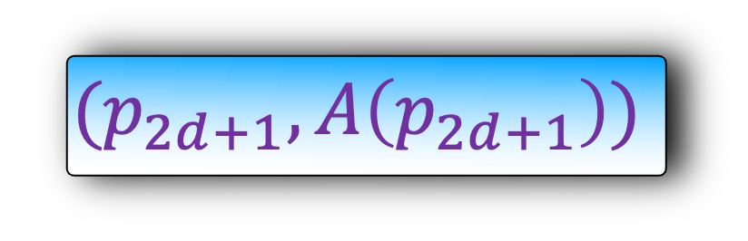
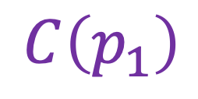
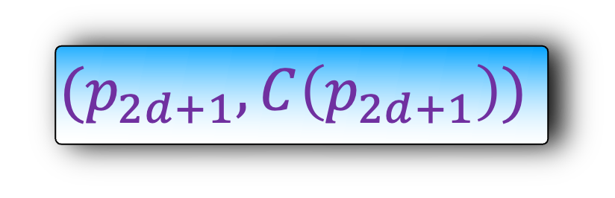

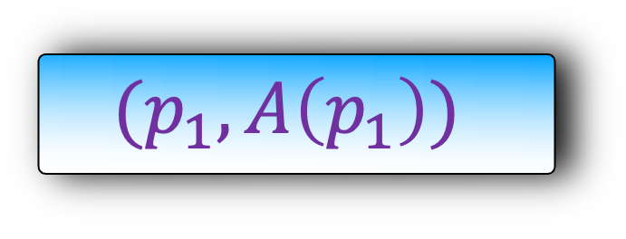
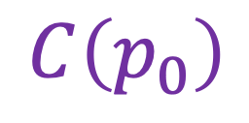
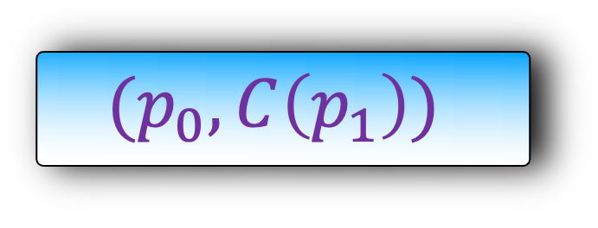
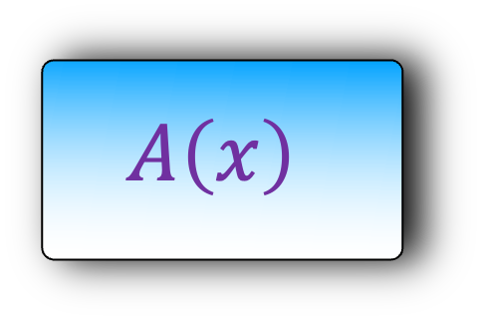
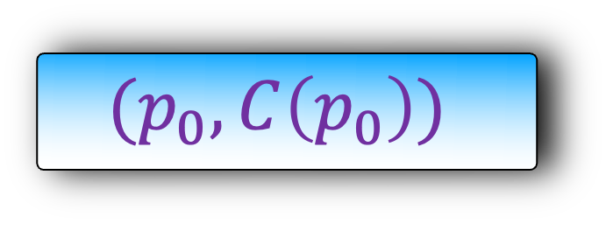
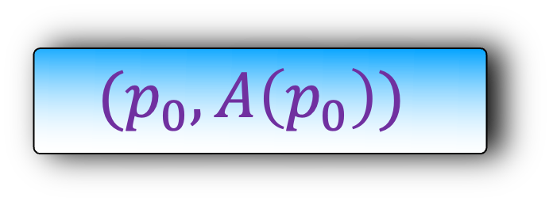
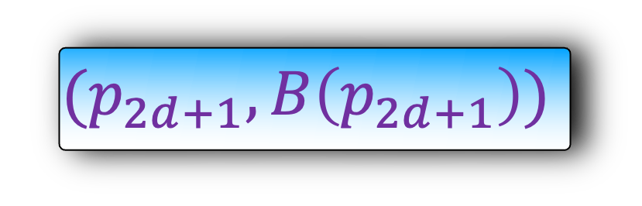


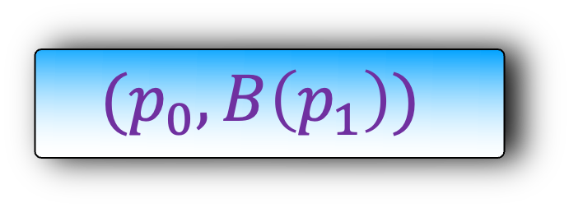


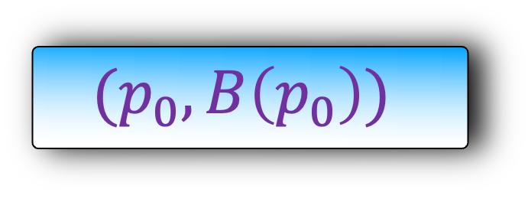
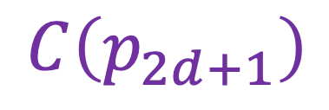
$$A\left(x\right)=(a_{d},a_{d−1},…,a_{0})$$
$$C\left(x\right)=(c_{2d+1},c_{2d},…,c_{0})$$
$$B\left(x\right)=(b_{d},b_{d−1},…,b_{0})$$
O(d log d )
Need to take care of the last step.
$$A\left(x\right)$$
$$B\left(x\right)$$
$$C\left(x\right)$$
$$(p_{0},A\left(p_{0}\right))$$
$$(p_{0},B\left(p_{0}\right))$$
$$C\left(p_{0}\right)$$
$$(p_{0},C\left(p_{0}\right))$$
$$(p_{1},A\left(p_{1}\right))$$
$$(p_{0},B\left(p_{1}\right))$$
$$(p_{0},C\left(p_{1}\right))$$
O(d) time
$$C\left(p_{1}\right)$$
….
….
….
$$(p_{2d+1},B\left(p_{2d+1}\right))$$
$$(p_{2d+1},C\left(p_{2d+1}\right))$$
$$(p_{2d+1},A\left(p_{2d+1}\right))$$
$$C\left(p_{2d+1}\right)$$

Slide 3

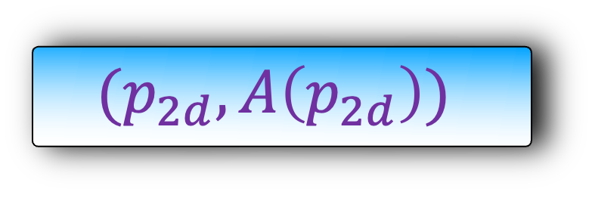


$$A\left(x\right)=(a_{d},a_{d−1},…,a_{0})$$
O(d log d )
Lets look at the first step of the algorithm
$$A\left(x\right)$$
$$(p_{0},A\left(p_{0}\right))$$
$$(p_{1},A\left(p_{1}\right))$$
….
$$(p_{2d},A\left(p_{2d}\right))$$

Slide 4
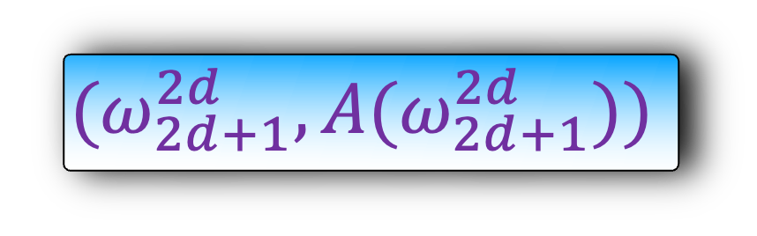
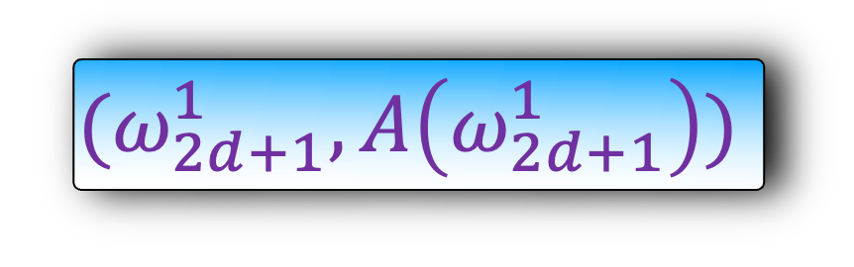

$$A\left(x\right)=(a_{d},a_{d−1},…,a_{0})$$
O(d log d )
Lets look at the first step of the algorithm
We evaluate A(x) on 2d+1 points
$$A\left(x\right)$$
$$(ω_{2d+1}^{0},A\left(ω_{2d+1}^{0}\right))$$
$$(ω_{2d+1}^{1},A\left(ω_{2d+1}^{1}\right))$$
….
$$(ω_{2d+1}^{2d},A{(ω}_{2d+1}^{2d}))$$

Slide 5
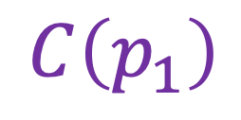
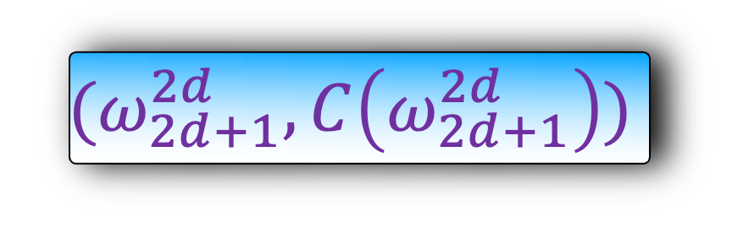
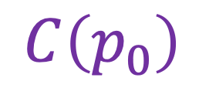
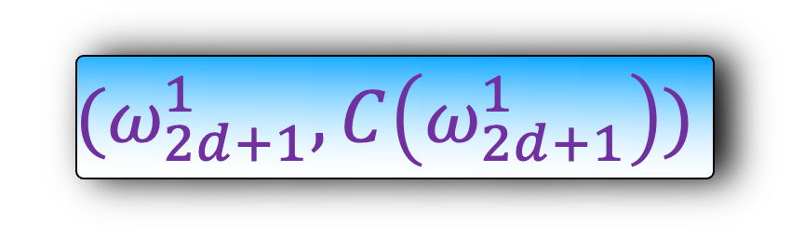
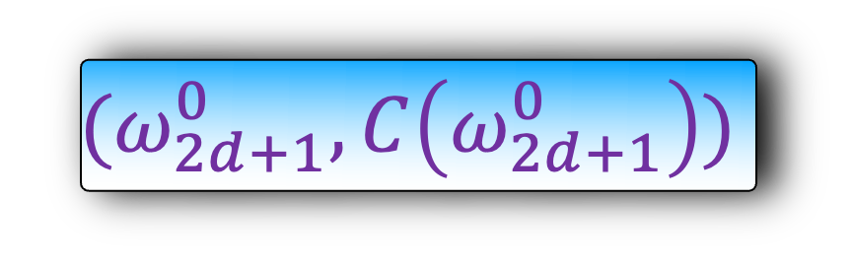
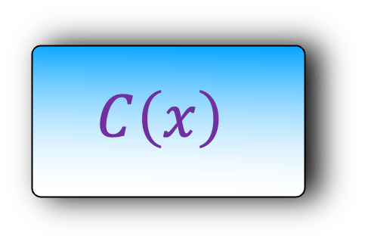
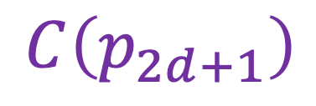

$$A\left(x\right)=(a_{d},a_{d−1},…,a_{0})$$
$$C\left(x\right)=(c_{2d+1},c_{2d},…,c_{0})$$
O(d log d )
O(d log d )
The last step is the reverse of the first step.
But as we will see, they are both same steps.
$$A\left(x\right)$$
$$C\left(x\right)$$
$$(ω_{2d+1}^{0},A\left(ω_{2d+1}^{0}\right))$$
$$C\left(p_{0}\right)$$
$$(ω_{2d+1}^{0},C\left(ω_{2d+1}^{0}\right))$$
$$(ω_{2d+1}^{1},A\left(ω_{2d+1}^{1}\right))$$
$$(ω_{2d+1}^{1},C\left(ω_{2d+1}^{1}\right))$$
$$C\left(p_{1}\right)$$
….
….
$$(ω_{2d+1}^{2d},A{(ω}_{2d+1}^{2d}))$$
$$(ω_{2d+1}^{2d},C\left(ω_{2d+1}^{2d}\right))$$
$$C\left(p_{2d+1}\right)$$

Slide 6
$$A\left(x\right)=(a_{d},a_{d−1},…,a_{0})$$
$$C\left(x\right)=(c_{2d+1},c_{2d},…,c_{0})$$
O(d log d )
O(d log d )
The last step is the reverse of the first step.
But as we will see, they are both same steps.
This will imply a running time of O(d log d) even for the last step
$$A\left(x\right)$$
$$C\left(x\right)$$
$$(ω_{2d+1}^{0},A\left(ω_{2d+1}^{0}\right))$$
$$C\left(p_{0}\right)$$
$$(ω_{2d+1}^{0},C\left(ω_{2d+1}^{0}\right))$$
$$(ω_{2d+1}^{1},A\left(ω_{2d+1}^{1}\right))$$
$$(ω_{2d+1}^{1},C\left(ω_{2d+1}^{1}\right))$$
$$C\left(p_{1}\right)$$
….
….
$$(ω_{2d+1}^{2d},A{(ω}_{2d+1}^{2d}))$$
$$(ω_{2d+1}^{2d},C\left(ω_{2d+1}^{2d}\right))$$
$$C\left(p_{2d+1}\right)$$

Slide 7
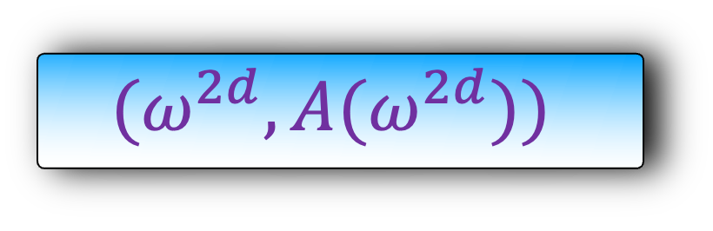


$$A\left(x\right)=(a_{d},a_{d−1},…,a_{0})$$
O(d log d )
For notational convenience, we will drop subscript 2d+1 in the rest of the presentation.
$$A\left(x\right)$$
$$(ω^{0},A\left(ω^{0}\right))$$
$$(ω^{1},A\left(ω^{1}\right))$$
….
$$(ω^{2d},A{(ω}^{2d}))$$

Slide 8

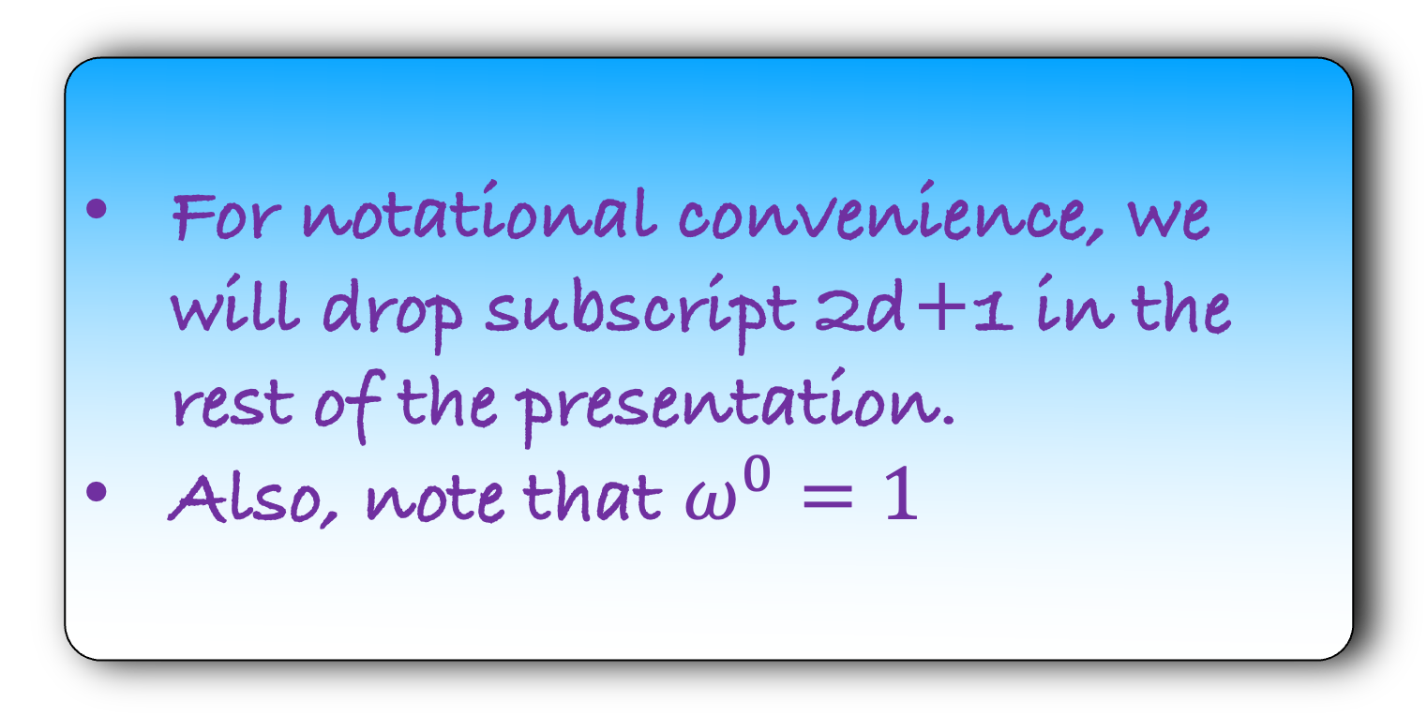
$$A\left(x\right)=(a_{d},a_{d−1},…,a_{0})$$
O(d log d )
For notational convenience, we will drop subscript 2d+1 in the rest of the presentation.
Also, note that $ω^{0}=1$
$$A\left(x\right)$$
$$(1,A\left(1\right))$$
$$(ω^{1},A\left(ω^{1}\right))$$
….
$$(ω^{2d},A{(ω}^{2d}))$$

Slide 9




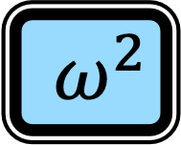
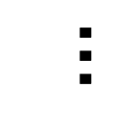







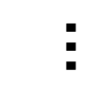

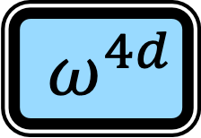

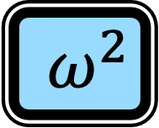










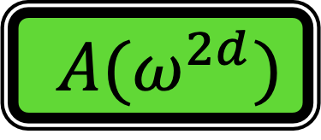
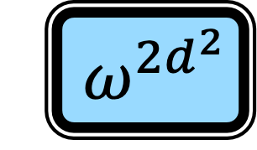



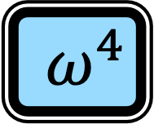
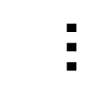
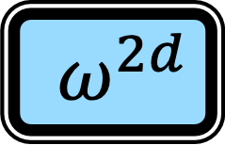
$$A\left(x\right)=(a_{d},a_{d−1},…,a_{0})$$
$$A\left(x\right)=a_{0}+a_{1}x+a_{2}x^{2}+…+{a_{d}x}^{d}$$
O(d log d )
$A(1)$
$a_{0}$
1
$a_{1}$
1
$a_{2}$
1
$$…$$
$a_{d}$
1
$A(ω)$
$a_{0}$
1
$a_{1}$
$ω$
$a_{2}$
$ω^{2}$
$$…$$
$a_{d}$
$${ ω}^{d}$$
$$A\left(x\right)$$
$A(ω^{2})$
$a_{0}$
1
$a_{1}$
$ω^{2}$
$a_{2}$
$ω^{4}$
$$…$$
$a_{d}$
$${ ω}^{2d}$$
$$(1,A\left(1\right))$$
$$…$$
$$…$$
$$…$$
$$…$$
$$…$$
$$(ω^{1},A\left(ω^{1}\right))$$
$A(ω^{2d})$
$a_{0}$
1
$a_{1}$
$ω^{2d}$
$a_{2}$
$ω^{4d}$
$$…$$
$a_{d}$
$${ ω}^{2d^{2}}$$
….
$$(ω^{2d},A{(ω}^{2d}))$$

Slide 10

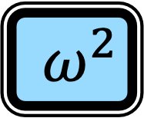


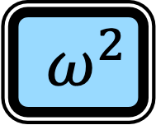
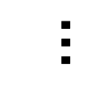


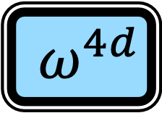




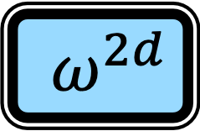

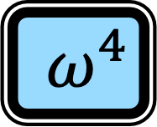



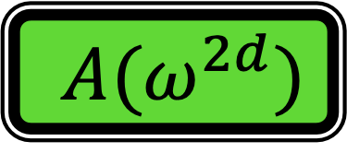

$$A\left(x\right)=(a_{d},a_{d−1},…,a_{0})$$
$$A\left(x\right)=a_{0}+a_{1}x+a_{2}x^{2}+…+{a_{d}x}^{d}$$
O(d log d )
$A(1)$
1
1
1
$$…$$
1
$a_{0}$
$A(ω)$
1
$ω$
$ω^{2}$
$$…$$
$${ ω}^{d}$$
$a_{1}$
$$A\left(x\right)$$
$a_{2}$
$A(ω^{2})$
1
$ω^{2}$
$ω^{4}$
$$…$$
$${ ω}^{2d}$$
$$(1,A\left(1\right))$$
$$…$$
$$…$$
$$…$$
$$…$$
$$…$$
$$…$$
$$(ω^{1},A\left(ω^{1}\right))$$
$A(ω^{2d})$
1
$ω^{2d}$
$ω^{4d}$
$$…$$
$${ ω}^{2d^{2}}$$
$a_{d}$
….
$$(ω^{2d},A{(ω}^{2d}))$$

Slide 11
$$A\left(x\right)=(a_{d},a_{d−1},…,a_{0})$$
$$A\left(x\right)=a_{0}+a_{1}x+a_{2}x^{2}+…+{a_{d}x}^{d}$$
O(d log d )
$A(1)$
1
1
1
$$…$$
1
$a_{0}$
$A(ω)$
1
$ω$
$ω^{2}$
$$…$$
$${ ω}^{d}$$
$a_{1}$
$$A\left(x\right)$$
$a_{2}$
$A(ω^{2})$
1
$ω^{2}$
$ω^{4}$
$$…$$
$${ ω}^{2d}$$
$$(1,A\left(1\right))$$
$$…$$
$$…$$
$$…$$
$$…$$
$$…$$
$$…$$
$$(ω^{1},A\left(ω^{1}\right))$$
$A(ω^{2d})$
1
$ω^{2d}$
$ω^{4d}$
$$…$$
$${ ω}^{2d^{2}}$$
$a_{d}$
….
What is this?
$$(ω^{2d},A{(ω}^{2d}))$$

Slide 12
$$A\left(x\right)=(a_{d},a_{d−1},…,a_{0})$$
$$A\left(x\right)=a_{0}+a_{1}x+a_{2}x^{2}+…+{a_{d}x}^{d}$$
O(d log d )
$A(1)$
1
1
1
$$…$$
1
$a_{0}$
$A(ω)$
1
$ω$
$ω^{2}$
$$…$$
$${ ω}^{d}$$
$a_{1}$
$$A\left(x\right)$$
$a_{2}$
$A(ω^{2})$
1
$ω^{2}$
$ω^{4}$
$$…$$
$${ ω}^{2d}$$
$$(1,A\left(1\right))$$
$$…$$
$$…$$
$$…$$
$$…$$
$$…$$
$$…$$
$$(ω^{1},A\left(ω^{1}\right))$$
$A(ω^{2d})$
1
$ω^{2d}$
$ω^{4d}$
$$…$$
$${ ω}^{2d^{2}}$$
$a_{d}$
….
2d+1 roots of unity
$$(ω^{2d},A{(ω}^{2d}))$$

Slide 13





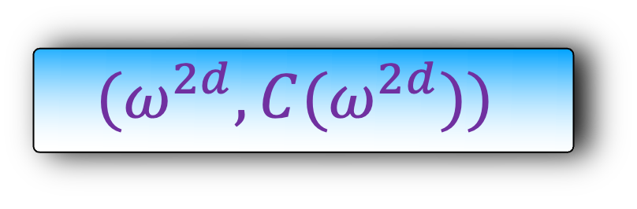



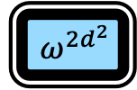


















$$A\left(x\right)=a_{0}+a_{1}x+a_{2}x^{2}+…+{a_{d}x}^{d}$$
$$C\left(x\right)=(c_{2d+1},c_{2d},…,c_{0})$$
$A(1)$
1
1
1
$$…$$
1
$a_{0}$
$A(ω)$
1
$ω$
$ω^{2}$
$$…$$
$${ ω}^{d}$$
$a_{1}$
$A(ω^{2})$
1
$ω^{2}$
$ω^{4}$
$$…$$
$${ ω}^{2d}$$
$a_{2}$
$$…$$
$$…$$
$$…$$
$$…$$
$$…$$
$$…$$
$A(ω^{2d})$
1
$ω^{2d}$
$ω^{4d}$
$$…$$
$${ ω}^{2d^{2}}$$
$a_{d}$
$$C\left(x\right)$$
Can we use the same matrix representation for the last step?
$$C\left(p_{0}\right)$$
$$(ω^{0},C\left(ω^{0}\right))$$
$$(ω^{1},C\left(ω^{1}\right))$$
$$C\left(p_{1}\right)$$
….
$$(ω^{2d},C(ω^{2d}))$$
$$C\left(p_{2d+1}\right)$$

Slide 14
























$$A\left(x\right)=a_{0}+a_{1}x+a_{2}x^{2}+…+{a_{d}x}^{d}$$
$$C\left(x\right)=(c_{2d+1},c_{2d},…,c_{0})$$
$A(1)$
1
1
1
$$…$$
1
$a_{0}$
$A(ω)$
1
$ω$
$ω^{2}$
$$…$$
$${ ω}^{d}$$
$a_{1}$
$A(ω^{2})$
1
$ω^{2}$
$ω^{4}$
$$…$$
$${ ω}^{2d}$$
$a_{2}$
$$…$$
$$…$$
$$…$$
$$…$$
$$…$$
$$…$$
$A(ω^{2d})$
1
$ω^{2d}$
$ω^{4d}$
$$…$$
$${ ω}^{2d^{2}}$$
$a_{d}$
$$C\left(x\right)$$
C$\left(x\right)=c_{0}+c_{1}x+c_{2}x^{2}+…+{c_{2d}x}^{2d}$
$$C\left(p_{0}\right)$$
$$(1,C\left(1\right))$$
C$(1)$
1
1
1
$$…$$
1
$c_{0}$
$$(ω^{1},C\left(ω^{1}\right))$$
$$C\left(p_{1}\right)$$
C$(ω)$
1
$ω$
$ω^{2}$
$$…$$
$${ ω}^{2d}$$
$c_{1}$
….
C$(ω^{2})$
1
$ω^{2}$
$ω^{4}$
$$…$$
$${ ω}^{4d}$$
$c_{2}$
$$…$$
$$…$$
$$…$$
$$…$$
$$…$$
$$…$$
$$(ω^{2d},C(ω^{2d}))$$
C$(ω^{2d})$
1
$ω^{2d}$
$ω^{4d}$
$$…$$
$${ ω}^{2d^{2}}$$
$c_{2d}$
$$C\left(p_{2d+1}\right)$$

Slide 15
$$A\left(x\right)=a_{0}+a_{1}x+a_{2}x^{2}+…+{a_{d}x}^{d}$$
$A(1)$
1
1
1
$$…$$
1
$a_{0}$
$A(ω)$
1
$ω$
$ω^{2}$
$$…$$
$${ ω}^{d}$$
$a_{1}$
In the first step, the red values are known and the green values are unknown
$A(ω^{2})$
1
$ω^{2}$
$ω^{4}$
$$…$$
$${ ω}^{2d}$$
$a_{2}$
$$…$$
$$…$$
$$…$$
$$…$$
$$…$$
$$…$$
$A(ω^{2d})$
1
$ω^{2d}$
$ω^{4d}$
$$…$$
$${ ω}^{2d^{2}}$$
$a_{d}$
C$\left(x\right)=c_{0}+c_{1}x+c_{2}x^{2}+…+{c_{2d}x}^{2d}$
C$(1)$
1
1
1
$$…$$
1
$c_{0}$
C$(ω)$
1
$ω$
$ω^{2}$
$$…$$
$${ ω}^{2d}$$
$c_{1}$
$c_{2}$
In the last step, the red values are unknown and the green values are known
C$(ω^{2})$
1
$ω^{2}$
$ω^{4}$
$$…$$
$${ ω}^{4d}$$
$$…$$
$$…$$
$$…$$
$$…$$
$$…$$
$$…$$
C$(ω^{2d})$
1
$ω^{2d}$
$ω^{4d}$
$$…$$
$${ ω}^{2d^{2}}$$
$c_{2d}$

Slide 16
Can we reuse the fft algorithm? Or do an inverse fft?
C$\left(x\right)=c_{0}+c_{1}x+c_{2}x^{2}+…+{c_{2d}x}^{2d}$
C$(1)$
1
1
1
$$…$$
1
$c_{0}$
C$(ω)$
1
$ω$
$ω^{2}$
$$…$$
$${ ω}^{2d}$$
$c_{1}$
C$(ω^{2})$
1
$ω^{2}$
$ω^{4}$
$$…$$
$${ ω}^{4d}$$
$c_{2}$
$$…$$
$$…$$
$$…$$
$$…$$
$$…$$
$$…$$
C$(ω^{2d})$
1
$ω^{2d}$
$ω^{4d}$
$$…$$
$${ ω}^{2d^{2}}$$
$c_{2d}$

Slide 17



























C$\left(x\right)=c_{0}+c_{1}x+c_{2}x^{2}+…+{c_{2d}x}^{2d}$
C$(1)$
1
1
1
$$…$$
1
$c_{0}$
C$(ω)$
1
$ω$
$ω^{2}$
$$…$$
$${ ω}^{2d}$$
$c_{1}$
C$(ω^{2})$
1
$ω^{2}$
$ω^{4}$
$$…$$
$${ ω}^{4d}$$
$c_{2}$
$$…$$
$$…$$
$$…$$
$$…$$
$$…$$
$$…$$
C$(ω^{2d})$
1
$ω^{2d}$
$ω^{4d}$
$$…$$
$${ ω}^{2d^{2}}$$
$c_{2d}$

Slide 18









C$\left(x\right)=c_{0}+c_{1}x+c_{2}x^{2}+…+{c_{2d}x}^{2d}$
-1
$c_{0}$
1
1
1
$$…$$
1
C$(1)$
$c_{1}$
1
$ω$
$ω^{2}$
$$…$$
$${ ω}^{2d}$$
C$(ω)$
$c_{2}$
1
$ω^{2}$
$ω^{4}$
$$…$$
$${ ω}^{4d}$$
C$(ω^{2})$
$$…$$
$$…$$
$$…$$
$$…$$
$$…$$
$$…$$
$c_{2d}$
1
$ω^{2d}$
$ω^{4d}$
$$…$$
$${ ω}^{2d^{2}}$$
C$(ω^{2d})$

Slide 19















C$\left(x\right)=c_{0}+c_{1}x+c_{2}x^{2}+…+{c_{2d}x}^{2d}$
$c_{0}$
1
1
1
$$…$$
1
C$(1)$
1
$ω^{−1}$
$ω^{−2}$
$$…$$
$${ ω}^{−2d}$$
C$(ω)$
$c_{1}$
$c_{2}$
$\frac{1}{2d+1}$
1
$ω^{−2}$
$ω^{−4}$
$$…$$
$${ ω}^{−4d}$$
C$(ω^{2})$
$$…$$
$$…$$
$$…$$
$$…$$
$$…$$
$$…$$
$c_{2d}$
1
$ω^{−2d}$
$ω^{−4d}$
$$…$$
$${ ω}^{−2d^{2}}$$
C$(ω^{2d})$

Slide 20




























$c_{0}$
1
1
1
$$…$$
1
C$(1)$
Take a deep look at this matrix representation.
Doesn’t it look that we are evaluating a polynomial with co-efficients C(1),C($ω)$, C($ω^{2})$, $…$, C($ω^{2d})$
$c_{1}$
1
$$ω^{−1}$$
$ω^{−2}$
$$…$$
$${ ω}^{−2d}$$
C$(ω)$
$c_{2}$
$\frac{1}{2d+1}$
1
$ω^{−2}$
$ω^{−4}$
$$…$$
$${ ω}^{−4d}$$
C$(ω^{2})$
$$…$$
$$…$$
$$…$$
$$…$$
$$…$$
$$…$$
$c_{2d}$
1
$ω^{−2d}$
$ω^{−4d}$
$$…$$
$${ ω}^{−2d^{2}}$$
C$(ω^{2d})$

Slide 21
$c_{0}$
1
1
1
$$…$$
1
C$(1)$
1
$ω^{−1}$
$ω^{−2}$
$$…$$
$${ ω}^{−2d}$$
C$(ω)$
$c_{1}$
$c_{2}$
$\frac{1}{2d+1}$
1
$ω^{−2}$
$ω^{−4}$
$$…$$
$${ ω}^{−4d}$$
C$(ω^{2})$
$$…$$
$$…$$
$$…$$
$$…$$
$$…$$
$$…$$
$c_{2d}$
1
$ω^{−2d}$
$ω^{−4d}$
$$…$$
$${ ω}^{−2d^{2}}$$
C$(ω^{2d})$

Slide 22








































$c_{0}$
$\frac{1}{2d+1}$
1
C$(1)$
1
C$(ω)$
1
C$(ω^{2})$
$$…$$
1
C$(ω^{2d})$
$c_{1}$
$\frac{1}{2d+1}$
1
C$(1)$
$ω^{−1}$
C$(ω)$
$ω^{−2}$
C$(ω^{2})$
$$…$$
$${ ω}^{−2d}$$
C$(ω^{2d})$
$c_{2}$
$\frac{1}{2d+1}$
1
C$(1)$
$ω^{−2}$
C$(ω)$
$ω^{−4}$
C$(ω^{2})$
$$…$$
$${ ω}^{−4d}$$
C$(ω^{2d})$
$$…$$
$$…$$
$$…$$
$$…$$
$$…$$
$$…$$
$c_{2d}$
$\frac{1}{2d+1}$
1
C$(1)$
$ω^{−2d}$
C$(ω)$
$ω^{−4d}$
C$(ω^{2})$
$$…$$
$${ ω}^{−2d^{2}}$$
C$(ω^{2d})$
We are evaluating the polynomial $D\left(x\right)=C\left(1\right)+C\left(ω\right)x+C\left(ω^{2}\right)x^{2}+…+C\left(ω^{2d}\right)x^{2d}$
We are evaluating this polynomial at $1,ω^{−1},ω^{−2},…,ω^{−2d}$
But in FFT algorithm, we evaluate the polynomial at $1,ω,ω^{2}, …,ω^{2d}$

Slide 23




















$$I$$
Where is $ω_{8}^{−1}$?
So, $ω_{8}^{−i}=ω_{8}^{8−i}$
Homework: Show that $ω_{2d+1}^{−i}=ω_{2d+1}^{2d+1−i}$
$$ω_{8}^{−6}$$
$$ω_{8}^{2}$$
$$ω_{8}^{−5}$$
$$ω_{8}^{−8}$$
$$ω_{8}^{3}$$
$$ω_{8}^{1}$$
$$ω_{8}^{−4}$$
$$ω_{8}^{−8}$$
$$ω_{8}^{4}$$
$$ω_{8}^{0}$$
$$R$$
$$ω_{8}^{5}$$
$$ω_{8}^{7}$$
$$ω_{8}^{−3}$$
$$ω_{8}^{−1}$$
$$ω_{8}^{6}$$
$$ω_{8}^{−2}$$

Slide 24

C$\left(x\right)=c_{0}+c_{1}x+c_{2}x^{2}+…+{c_{2d}x}^{2d}$
$c_{0}$
1
1
1
$$…$$
1
C$(1)$
1
$ω^{−1}$
$ω^{−2}$
$$…$$
$${ ω}^{−2d}$$
C$(ω)$
$c_{1}$
$c_{2}$
$\frac{1}{2d+1}$
1
$ω^{−2}$
$ω^{−4}$
$$…$$
$${ ω}^{−4d}$$
C$(ω^{2})$
$$…$$
$$…$$
$$…$$
$$…$$
$$…$$
$$…$$
$c_{2d}$
1
$ω^{−2d}$
$ω^{−4d}$
$$…$$
$${ ω}^{−2d^{2}}$$
C$(ω^{2d})$

Slide 25


























$c_{0}$
1
1
1
$$…$$
1
C$(1)$
But this is same as our fft algorithm modulo minor changes.
Here also, we are evaluating a polynomial on 2d+1 roots of unity.
Let us now implement this algorithm.
$c_{1}$
1
$ω^{−1}$
$ω^{−2}$
$$…$$
$${ ω}^{−2d}$$
C$(ω)$
$c_{2}$
$\frac{1}{2d+1}$
1
$ω^{−2}$
$ω^{−4}$
$$…$$
$${ ω}^{−4d}$$
C$(ω^{2})$
$$…$$
$$…$$
$$…$$
$$…$$
$$…$$
$$…$$
$c_{2d}$
1
$ω^{−2d}$
$ω^{−4d}$
$$…$$
$${ ω}^{−2d^{2}}$$
C$(ω^{2d})$

Slide 26
Implementation

Slide 27

def fft($A,p)$:
if p=1:
return $A(1)$
Find $A_{red}(x^{2})$ and $A_{green}(x^{2})$
$A_{red}\left(ω_{\frac{p}{2}}^{0}\right),A_{red}\left(ω_{\frac{p}{2}}^{\frac{p}{4}}\right),A_{red}\left(ω_{\frac{p}{2}}^{1}\right),A_{red}\left(ω_{\frac{p}{2}}^{1+\frac{p}{4}}\right),…,A_{red}\left(ω_{p/2}^{p/4−1}\right),A_{red}(ω_{p/2}^{p/2−1})$
= fft($A_{red},\frac{p}{2})$
$A_{green}\left(ω_{\frac{p}{2}}^{0}\right),A_{green}\left(ω_{\frac{p}{2}}^{\frac{p}{4}}\right),A_{green}\left(ω_{\frac{p}{2}}^{1}\right),A_{green}\left(ω_{\frac{p}{2}}^{1+\frac{p}{4}}\right),…,A_{green}\left(ω_{p/2}^{p/4−1}\right),A_{green}(ω_{p/2}^{p/2−1})$
= fft($A_{green},\frac{p}{2})$
$ω_{p}=e^{\frac{2πi}{p}}$
for $i=0$ to $p$/2-1:
$A\left(ω_{p}^{i}\right)=$ $A_{red}\left(ω_{p/2}^{i}\right)+ω_{p}^{i}A_{green}\left(ω_{p/2}^{i}\right)$
$A\left(ω_{p}^{i+p/2}\right)=A_{red}\left(ω_{p/2}^{i}\right)+ω_{p}^{i+p/2}A_{green}\left(ω_{p/2}^{i}\right)$
return $A\left(ω_{p}^{0}\right),A\left(ω_{p}^{\frac{p}{2}}\right),A\left(ω_{p}^{1}\right),A\left(ω_{p}^{1+\frac{p}{2}}\right),…,A\left(ω_{p}^{p/2−1}\right),A(ω_{p}^{p−1})$

Slide 28

def ifft($A,p)$:
if p=1:
return $A(1)$
Find $A_{red}(x^{2})$ and $A_{green}(x^{2})$
$A_{red}\left(ω_{\frac{p}{2}}^{0}\right),A_{red}\left(ω_{\frac{p}{2}}^{\frac{p}{4}}\right),A_{red}\left(ω_{\frac{p}{2}}^{1}\right),A_{red}\left(ω_{\frac{p}{2}}^{1+\frac{p}{4}}\right),…,A_{red}\left(ω_{p/2}^{p/4−1}\right),A_{red}(ω_{p/2}^{p/2−1})$
= ifft($A_{red},\frac{p}{2})$
$A_{green}\left(ω_{\frac{p}{2}}^{0}\right),A_{green}\left(ω_{\frac{p}{2}}^{\frac{p}{4}}\right),A_{green}\left(ω_{\frac{p}{2}}^{1}\right),A_{green}\left(ω_{\frac{p}{2}}^{1+\frac{p}{4}}\right),…,A_{green}\left(ω_{p/2}^{p/4−1}\right),A_{green}(ω_{p/2}^{p/2−1})$
= ifft($A_{green},\frac{p}{2})$
$ω_{p}=e^{\frac{2πi}{p}}$
for $i=0$ to $p$/2-1:
$A\left(ω_{p}^{i}\right)=$ $A_{red}\left(ω_{p/2}^{i}\right)+ω_{p}^{i}A_{green}\left(ω_{p/2}^{i}\right)$
$A\left(ω_{p}^{i+p/2}\right)=A_{red}\left(ω_{p/2}^{i}\right)+ω_{p}^{i+p/2}A_{green}\left(ω_{p/2}^{i}\right)$
return $A\left(ω_{p}^{0}\right),A\left(ω_{p}^{\frac{p}{2}}\right),A\left(ω_{p}^{1}\right),A\left(ω_{p}^{1+\frac{p}{2}}\right),…,A\left(ω_{p}^{p/2−1}\right),A(ω_{p}^{p−1})$

Slide 29

def ifft($A,p)$:
if p=1:
return $A(1)$
Find $A_{red}(x^{2})$ and $A_{green}(x^{2})$
$A_{red}\left(ω_{\frac{p}{2}}^{0}\right),A_{red}\left(ω_{\frac{p}{2}}^{\frac{p}{4}}\right),A_{red}\left(ω_{\frac{p}{2}}^{1}\right),A_{red}\left(ω_{\frac{p}{2}}^{1+\frac{p}{4}}\right),…,A_{red}\left(ω_{p/2}^{p/4−1}\right),A_{red}(ω_{p/2}^{p/2−1})$
= ifft($A_{red},\frac{p}{2})$
$A_{green}\left(ω_{\frac{p}{2}}^{0}\right),A_{green}\left(ω_{\frac{p}{2}}^{\frac{p}{4}}\right),A_{green}\left(ω_{\frac{p}{2}}^{1}\right),A_{green}\left(ω_{\frac{p}{2}}^{1+\frac{p}{4}}\right),…,A_{green}\left(ω_{p/2}^{p/4−1}\right),A_{green}(ω_{p/2}^{p/2−1})$
= ifft($A_{green},\frac{p}{2})$
$ω_{p}=e^{\frac{−2πi}{p}}$
for $i=0$ to $p$/2-1:
$A\left(ω_{p}^{i}\right)=$ $A_{red}\left(ω_{p/2}^{i}\right)+ω_{p}^{i}A_{green}\left(ω_{p/2}^{i}\right)$
$A\left(ω_{p}^{i+p/2}\right)=A_{red}\left(ω_{p/2}^{i}\right)+ω_{p}^{i+p/2}A_{green}\left(ω_{p/2}^{i}\right)$
return $A\left(ω_{p}^{0}\right),A\left(ω_{p}^{\frac{p}{2}}\right),A\left(ω_{p}^{1}\right),A\left(ω_{p}^{1+\frac{p}{2}}\right),…,A\left(ω_{p}^{p/2−1}\right),A(ω_{p}^{p−1})$

Slide 30


def ifft($A,p)$:
if p=1:
return $A(1)$
Find $A_{red}(x^{2})$ and $A_{green}(x^{2})$
$A_{red}\left(ω_{\frac{p}{2}}^{0}\right),A_{red}\left(ω_{\frac{p}{2}}^{\frac{p}{4}}\right),A_{red}\left(ω_{\frac{p}{2}}^{1}\right),A_{red}\left(ω_{\frac{p}{2}}^{1+\frac{p}{4}}\right),…,A_{red}\left(ω_{p/2}^{p/4−1}\right),A_{red}(ω_{p/2}^{p/2−1})$
= ifft($A_{red},\frac{p}{2})$
$A_{green}\left(ω_{\frac{p}{2}}^{0}\right),A_{green}\left(ω_{\frac{p}{2}}^{\frac{p}{4}}\right),A_{green}\left(ω_{\frac{p}{2}}^{1}\right),A_{green}\left(ω_{\frac{p}{2}}^{1+\frac{p}{4}}\right),…,A_{green}\left(ω_{p/2}^{p/4−1}\right),A_{green}(ω_{p/2}^{p/2−1})$
= ifft($A_{green},\frac{p}{2})$
$ω_{p}=e^{\frac{−2πi}{p}}$
for $i=0$ to $p$/2-1:
$A\left(ω_{p}^{i}\right)=A_{red}\left(ω_{p/2}^{i}\right)+ω_{p}^{i}A_{green}\left(ω_{p/2}^{i}\right)$
$A\left(ω_{p}^{i+p/2}\right)=A_{red}\left(ω_{p/2}^{i}\right)+ω_{p}^{i+p/2}A_{green}\left(ω_{p/2}^{i}\right)$
return $A\left(ω_{p}^{0}\right),A\left(ω_{p}^{\frac{p}{2}}\right),A\left(ω_{p}^{1}\right),A\left(ω_{p}^{1+\frac{p}{2}}\right),…,A\left(ω_{p}^{p/2−1}\right),A(ω_{p}^{p−1})$
def fft($A,p)$:
if p=1:
return $A(1)$
Find $A_{red}(x)$ and $A_{green}(x)$
$A_{red}\left(ω_{\frac{p}{2}}^{0}\right),A_{red}\left(ω_{\frac{p}{2}}^{\frac{p}{4}}\right),A_{red}\left(ω_{\frac{p}{2}}^{1}\right),A_{red}\left(ω_{\frac{p}{2}}^{1+\frac{p}{4}}\right),…,A_{red}\left(ω_{p/2}^{p/4−1}\right),A_{red}(ω_{p/2}^{p/2−1})$
= fft($A_{red},\frac{p}{2})$
$A_{green}\left(ω_{\frac{p}{2}}^{0}\right),A_{green}\left(ω_{\frac{p}{2}}^{\frac{p}{4}}\right),A_{green}\left(ω_{\frac{p}{2}}^{1}\right),A_{green}\left(ω_{\frac{p}{2}}^{1+\frac{p}{4}}\right),…,A_{green}\left(ω_{p/2}^{p/4−1}\right),A_{green}(ω_{p/2}^{p/2−1})$
= fft($A_{green},\frac{p}{2})$
$ω_{p}=e^{\frac{2πi}{p}}$
for $i=0$ to $p$/2-1:
$A\left(ω_{p}^{i}\right)=$ $A_{red}\left(ω_{p/2}^{i}\right)+ω_{p}^{i}A_{green}\left(ω_{p/2}^{i}\right)$
$A\left(ω_{p}^{i+p/2}\right)=A_{red}\left(ω_{p/2}^{i}\right)+ω_{p}^{i+p/2}A_{green}\left(ω_{p/2}^{i}\right)$
return $A\left(ω_{p}^{0}\right),A\left(ω_{p}^{\frac{p}{2}}\right),A\left(ω_{p}^{1}\right),A\left(ω_{p}^{1+\frac{p}{2}}\right),…,A\left(ω_{p}^{p/2−1}\right),A(ω_{p}^{p−1})$
Both the algorithm take O(d log d) time

Slide 31
$$A\left(x\right)=(a_{d},a_{d−1},…,a_{0})$$
$$C\left(x\right)=(c_{2d+1},c_{2d},…,c_{0})$$
$$B\left(x\right)=(b_{d},b_{d−1},…,b_{0})$$
O(d log d )
Need to take care of the last step.
O(d log d )
$$A\left(x\right)$$
$$B\left(x\right)$$
$$C\left(x\right)$$
$$(p_{0},A\left(p_{0}\right))$$
$$(p_{0},B\left(p_{0}\right))$$
$$C\left(p_{0}\right)$$
$$(p_{0},C\left(p_{0}\right))$$
$$(p_{1},A\left(p_{1}\right))$$
$$(p_{0},B\left(p_{1}\right))$$
$$(p_{0},C\left(p_{1}\right))$$
O(d) time
$$C\left(p_{1}\right)$$
….
….
….
$$(p_{2d+1},B\left(p_{2d+1}\right))$$
$$(p_{2d+1},C\left(p_{2d+1}\right))$$
$$(p_{2d+1},A\left(p_{2d+1}\right))$$
$$C\left(p_{2d+1}\right)$$

Slide 32
$$A\left(x\right)=(a_{d},a_{d−1},…,a_{0})$$
$$C\left(x\right)=(c_{2d+1},c_{2d},…,c_{0})$$
$$B\left(x\right)=(b_{d},b_{d−1},…,b_{0})$$
O(d log d )
O(d log d )
$$A\left(x\right)$$
$$B\left(x\right)$$
$$C\left(x\right)$$
$$(p_{0},A\left(p_{0}\right))$$
$$(p_{0},B\left(p_{0}\right))$$
$$C\left(p_{0}\right)$$
$$(p_{0},C\left(p_{0}\right))$$
$$(p_{1},A\left(p_{1}\right))$$
$$(p_{0},B\left(p_{1}\right))$$
$$(p_{0},C\left(p_{1}\right))$$
O(d) time
$$C\left(p_{1}\right)$$
….
….
….
$$(p_{2d+1},B\left(p_{2d+1}\right))$$
$$(p_{2d+1},C\left(p_{2d+1}\right))$$
$$(p_{2d+1},A\left(p_{2d+1}\right))$$
$$C\left(p_{2d+1}\right)$$

Slide 33

HomeWork
If you want to see a beautiful animated video of the fft algorithm, you may see this half hour video.
We have handwaved corner cases in our presentation. Try to code the fft algorithm completely.

