Slide 1
Edit Distance

Slide 2
Edit Distance or Levenshtein Distance is minimum number of single character edits (insertion, deletion, or substitution) required to transform from one string to another string
Edit distance is very useful in bioinformatics
It is used to compare DNA, RNA – to identify genetic similarity

Slide 3
F
O
C
S
S
S
S
S
T
T
O
O
P
P

Slide 4
F
S
O
C
S
Substitution
S
S
T
S
T
O
O
P
P

Slide 5
F
S
O
C
S
Substitution
S
S
T
S
T
O
O
P
P

Slide 6
F
S
T
O
C
S
Substitution
Insertion
S
T
O
P
S
O
P
S

Slide 7
F
S
T
O
C
S
Substitution
Insertion
S
T
O
P
S
O
P
S

Slide 8
O
F
S
T
O
C
S
Substitution
Insertion
Match
S
T
O
P
S
P
S

Slide 9
O
F
S
T
O
C
S
Substitution
Insertion
Match
S
T
O
P
S
P
S

Slide 10
O
F
S
T
O
C
P
S
Substitution
Insertion
Substitution
Match
S
T
O
P
S
S

Slide 11
O
F
S
T
O
C
P
S
S
Substitution
Insertion
Match
Match
Substitution
S
T
O
P
S

Slide 12
O
F
S
T
O
C
P
S
S
Substitution
Insertion
Edit Distance or Levenshtein Distance is minimum number of single character edits (insertion, deletion, or substitution) required to transform from one string to another string
Match
Substitution
Match

Slide 13
O
F
S
T
O
C
P
S
S
Substitution
Edit Distance or Levenshtein Distance is minimum number of single character edits (insertion, deletion, or substitution) required to transform from one string to another string
Insertion
Match
Substitution
Match
Edit Distance = 3
How would you solve the Edit Distance Problem?

Slide 14
Let us assume that we want to find the edit distance between A[1…n] and B[1…m]
Let EDIT(i,j) be the edit distance between A[1..i] and B[1…j]
We want to find EDIT(n,m)
Look at the last step of edit distance in our example.

Slide 15
F
O
C
S
S
T
O
P
S
S

Slide 16
S
F
O
C
S
S
T
O
P
S

Slide 17
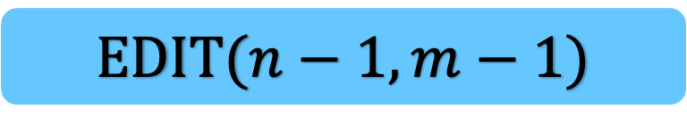

S
F
O
C
S
S
T
O
P
S
Match
EDIT($n−1,m−1$)
if the last step is a match:
EDIT($n,m$) =

Slide 18
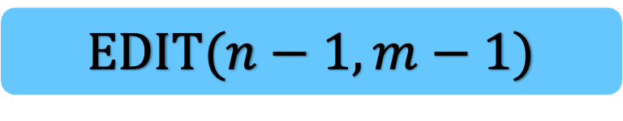
S
F
O
C
S
S
T
O
P
S
Match
if the last step is a match:
EDIT($n,m$) =
EDIT($n−1,m−1$)

Slide 19
F
O
C
D
S
T
O
P
S
S

Slide 20
F
O
C
D
S
S
T
O
P
S

Slide 21

F
O
C
D
S
S
T
O
P
S
EDIT($n−1,m−1$)
Substitution
if the last step is a substitution:
EDIT($n,m$) =

Slide 22
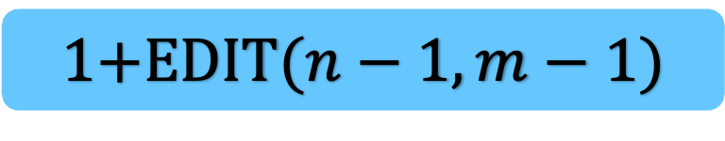
F
O
C
D
S
S
T
O
P
S
if the last step is a substitution:
EDIT($n,m$) =
Substitution
1+EDIT($n−1,m−1$)

Slide 23
F
O
C
P
S
S
T
O
P

Slide 24


F
O
C
P
S
S
T
O
P
Deletion
EDIT($n−1,m$)
if the last step is a deletion:
EDIT($n,m$) =

Slide 25

F
O
C
P
S
S
T
O
P
Deletion
if the last step is a deletion:
EDIT($n,m$) =
1+EDIT($n−1,m$)

Slide 26
F
O
C
P
S
T
O
P
S
S

Slide 27


F
O
C
P
S
S
T
O
P
S
Insertion
EDIT($n,m−1$)
if the last step is an insertion:
EDIT($n,m$) =

Slide 28


F
O
C
P
S
S
T
O
P
S
Insertion
if the last step is an insertion :
EDIT($n,m$) =
1+EDIT($n,m−1$)

Slide 29
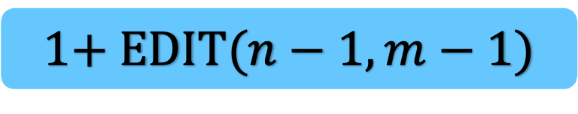

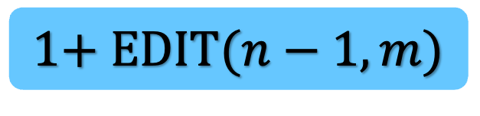

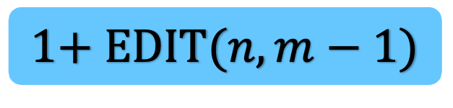



if the last step is a match:
EDIT($n,m$) = EDIT($n−1,m−1$)
EDIT($n−1,m−1$)
if the last step is a substitution :
EDIT($n,m$) = 1+ EDIT($n−1,m−1$)
1+ EDIT($n−1,m−1$)
if the last step is a deletion:
EDIT($n,m$) = 1+EDIT($n−1,m$)
1+ EDIT($n−1,m$)
if the last step is an insertion:
EDIT($n,m$) = 1+ EDIT($n,m−1$)
1+ EDIT($n,m−1$)
But we donot know what is the last step
But it is one of the above four possibilities
Try all possibilities

Slide 30



EDIT($n−1,m−1$)
if $A\left[n\right]=A[m]$
1+ EDIT($n−1,m−1$)
if $A\left[n\right]≠A[m]$
EDIT($n,m$)
min
1+ EDIT($n−1,m$)
1+ EDIT($n,m−1$)

Slide 31

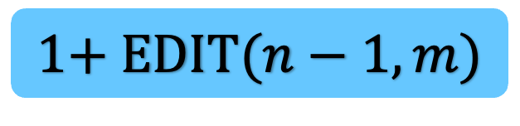

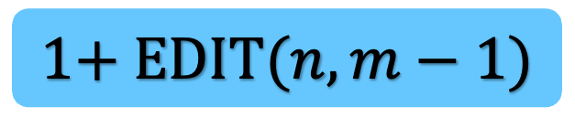

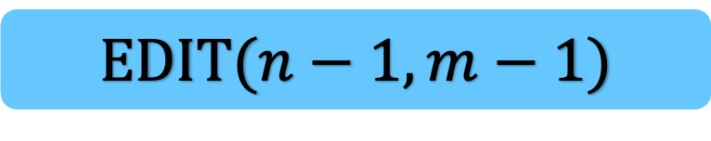
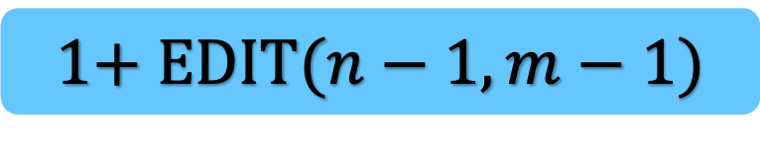
def
EDIT($n,m$)
What is the base case?
EDIT($n−1,m−1$)
if $A\left[n\right]=A[m]$
1+ EDIT($n−1,m−1$)
if $A\left[n\right]≠A[m]$
return
min
1+ EDIT($n−1,m$)
1+ EDIT($n,m−1$)

Slide 32

def
if $n=0$:
EDIT($n,m$)
EDIT($n−1,m−1$)
if $A\left[n\right]=A[m]$
1+ EDIT($n−1,m−1$)
if $A\left[n\right]≠A[m]$
return
min
1+ EDIT($n−1,m$)
1+ EDIT($n,m−1$)

Slide 33

def
if $n=0$:
return $m$
EDIT($n,m$)
EDIT($n−1,m−1$)
if $A\left[n\right]=A[m]$
1+ EDIT($n−1,m−1$)
if $A\left[n\right]≠A[m]$
return
min
1+ EDIT($n−1,m$)
1+ EDIT($n,m−1$)

Slide 34

What is the running time of this algorithm?
def
if $n=0$:
return $m$
if $m=0$:
return $n$
EDIT($n,m$)
Exponential.
For example, EDIT(2,3) may be called exponential number of times.
EDIT($n−1,m−1$)
if $A\left[n\right]=A[m]$
1+ EDIT($n−1,m−1$)
if $A\left[n\right]≠A[m]$
return
min
1+ EDIT($n−1,m$)
1+ EDIT($n,m−1$)

Slide 35
def
if $n=0$:
return $m$
if $m=0$:
return $n$
We will store EDIT(i,j) in edit[i,j]
Initially, edit[i,j] is NULL for all possible (i,j) pair
for any (0,j), we can set edit[0,j] := j
for any (i,0), we can set edit[i,0] :=i
We now modify the algorithm using memoization
EDIT($n,m$)
EDIT($n−1,m−1$)
1+ EDIT($n−1,m−1$)
return
min
1+ EDIT($n−1,m$)
1+ EDIT($n,m−1$)

Slide 36
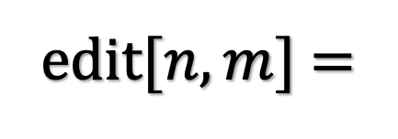
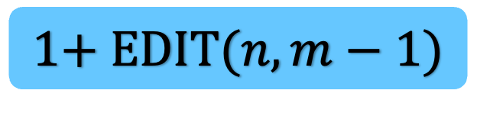



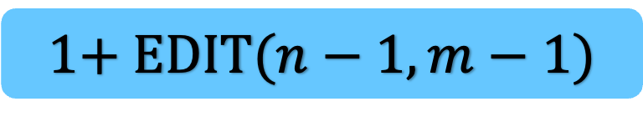
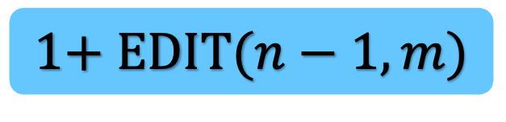
def
if edit[$n,m$] is null
EDIT($n,m$)
We will store EDIT(i,j) in edit[i,j]
Initially, edit[i,j] is NULL for all possible (i,j) pair
for any (0,j), we can set edit[0,j] := j
for any (i,0), we can set edit[i,0] :=i
We now modify the algorithm using memoization
EDIT($n−1,m−1$)
1+ EDIT($n−1,m−1$)
edit[$n,m$] =
min
1+ EDIT($n−1,m$)
1+ EDIT($n,m−1$)

Slide 37

def
if edit[$n,m$] is null
return edit[$n,m$]
EDIT($n,m$)
We will store EDIT(i,j) in edit[i,j]
Initially, edit[i,j] is NULL for all possible (i,j) pair
for any (0,j), we can set edit[0,j] := j
for any (i,0), we can set edit[i,0] :=i
We now modify the algorithm using memoization
EDIT($n−1,m−1$)
1+ EDIT($n−1,m−1$)
edit[$n,m$] =
min
1+ EDIT($n−1,m$)
1+ EDIT($n,m−1$)

Slide 38
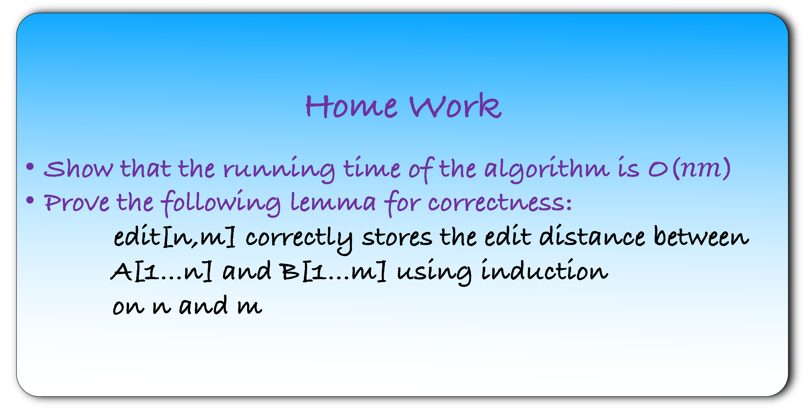
Home Work
Show that the running time of the algorithm is O($nm$)
Prove the following lemma for correctness:
    edit[n,m] correctly stores the edit distance between
    A[1…n] and B[1…m] using induction
    on n and m

Slide 39
Remember that every dynamic programming algorithm can be represented using an implicit DAG
This DAG also gives us the execution order of the non-recursive algorithm
What is the DAG for this problem?

Slide 40
3,3

Slide 41
2,2
2,3
3,2
3,3

Slide 42
1,1
1,2
1,3
2,1
2,2
2,3
3,1
3,2
3,3

Slide 43
0,0
0,1
0,2
0,3
1,0
1,1
1,2
1,3
2,0
2,1
2,2
2,3
3,0
3,1
3,2
3,3

Slide 44
0,0
0,1
0,2
0,3
base case
1,0
1,1
1,2
1,3
2,0
2,1
2,2
2,3
3,0
3,1
3,2
3,3

Slide 45
0,0
0,1
0,2
0,3
base case
1,0
1,1
1,2
1,3
2,0
2,1
2,2
2,3
3,0
3,1
3,2
3,3

Slide 46
0,0
0,1
0,2
0,3
base case
1,0
1,1
1,2
1,3
2,0
2,1
2,2
2,3
3,0
3,1
3,2
3,3
base case

Slide 47
0,0
0,1
0,2
0,3
base case
1,0
1,1
1,2
1,3
Solve second row
2,0
2,1
2,2
2,3
3,0
3,1
3,2
3,3
base case

Slide 48
0,0
0,1
0,2
0,3
base case
1,0
1,1
1,2
1,3
Solve second row
2,0
2,1
2,2
2,3
Solve third row
3,0
3,1
3,2
3,3
Solve fourth row
base case

Slide 49

def
if $n=0$:
return $m$
if $m=0$:
return $n$
def EditDistance($n,m$)
EDIT($n,m$)
EDIT($n−1,m−1$)
1+ EDIT($n−1,m−1$)
return
min
1+ EDIT($n−1,m$)
1+ EDIT($n,m−1$)

Slide 50

def
if $n=0$:
return $m$
if $m=0$:
return $n$
def EditDistance($n,m$)
for $i=0$ to $m$:
$edit\left(0,i\right)=i$
EDIT($n,m$)
EDIT($n−1,m−1$)
1+ EDIT($n−1,m−1$)
return
min
1+ EDIT($n−1,m$)
1+ EDIT($n,m−1$)

Slide 51

def
if $n=0$:
return $m$
if $m=0$:
return $n$
def EditDistance($n,m$)
for $i=0$ to $m$:
$edit\left(0,i\right)=i$
for $i=0$ to $n$:
$edit\left(i,0\right)=i$
for $i=1$ to $n$:
for $j=1$ to $m$:
$edit\left(i,j\right)= ∞$
EDIT($n,m$)
EDIT($n−1,m−1$)
1+ EDIT($n−1,m−1$)
return
min
1+ EDIT($n−1,m$)
1+ EDIT($n,m−1$)

Slide 52
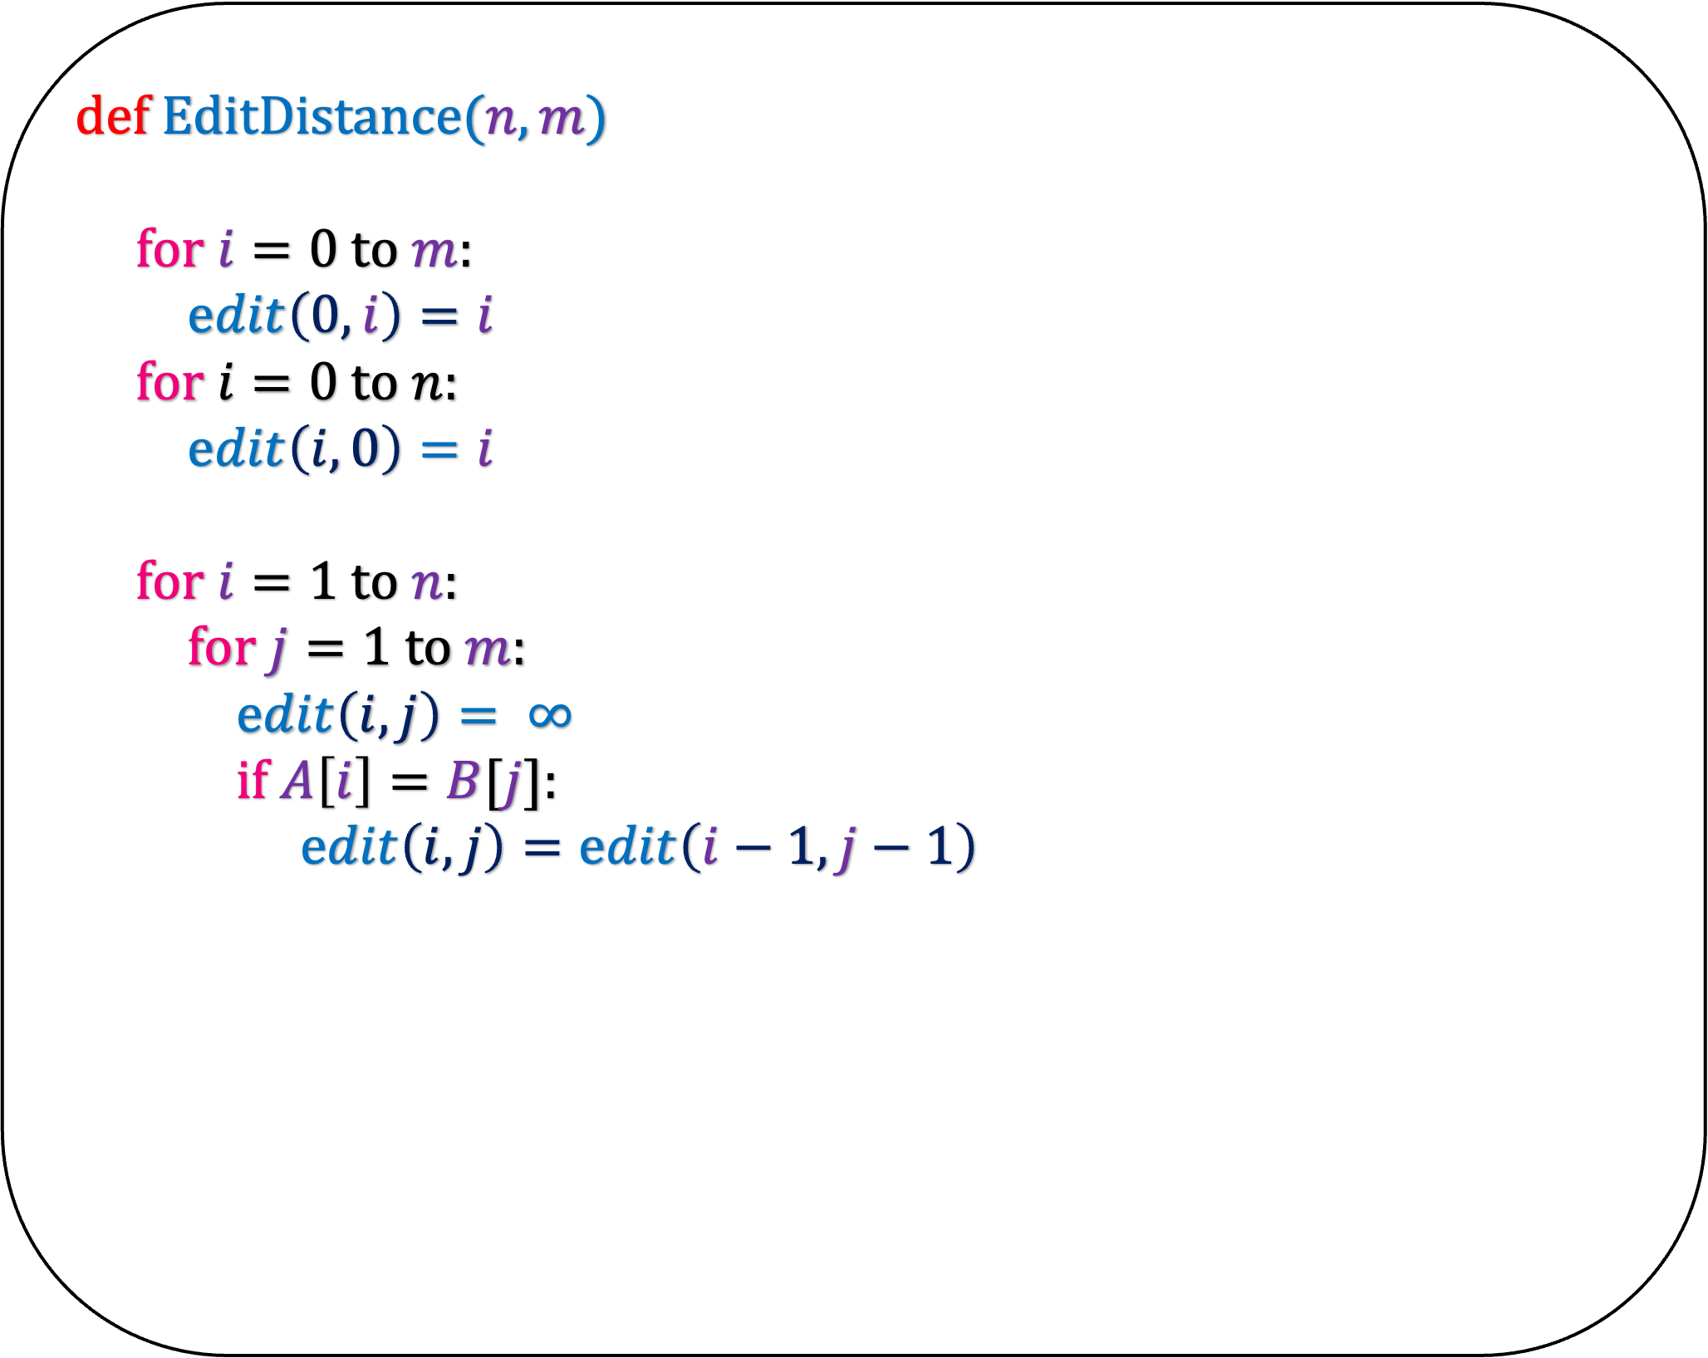
def
if $n=0$:
return $m$
if $m=0$:
return $n$
def EditDistance($n,m$)
for $i=0$ to $m$:
$edit\left(0,i\right)=i$
for $i=0$ to $n$:
$edit\left(i,0\right)=i$
for $i=1$ to $n$:
for $j=1$ to $m$:
$edit\left(i,j\right)= ∞$
if $A\left[i\right]=B[j]$:
$edit\left(i,j\right)=edit\left(i−1,j−1\right)$
EDIT($n,m$)
EDIT($n−1,m−1$)
1+ EDIT($n−1,m−1$)
return
min
1+ EDIT($n−1,m$)
1+ EDIT($n,m−1$)

Slide 53
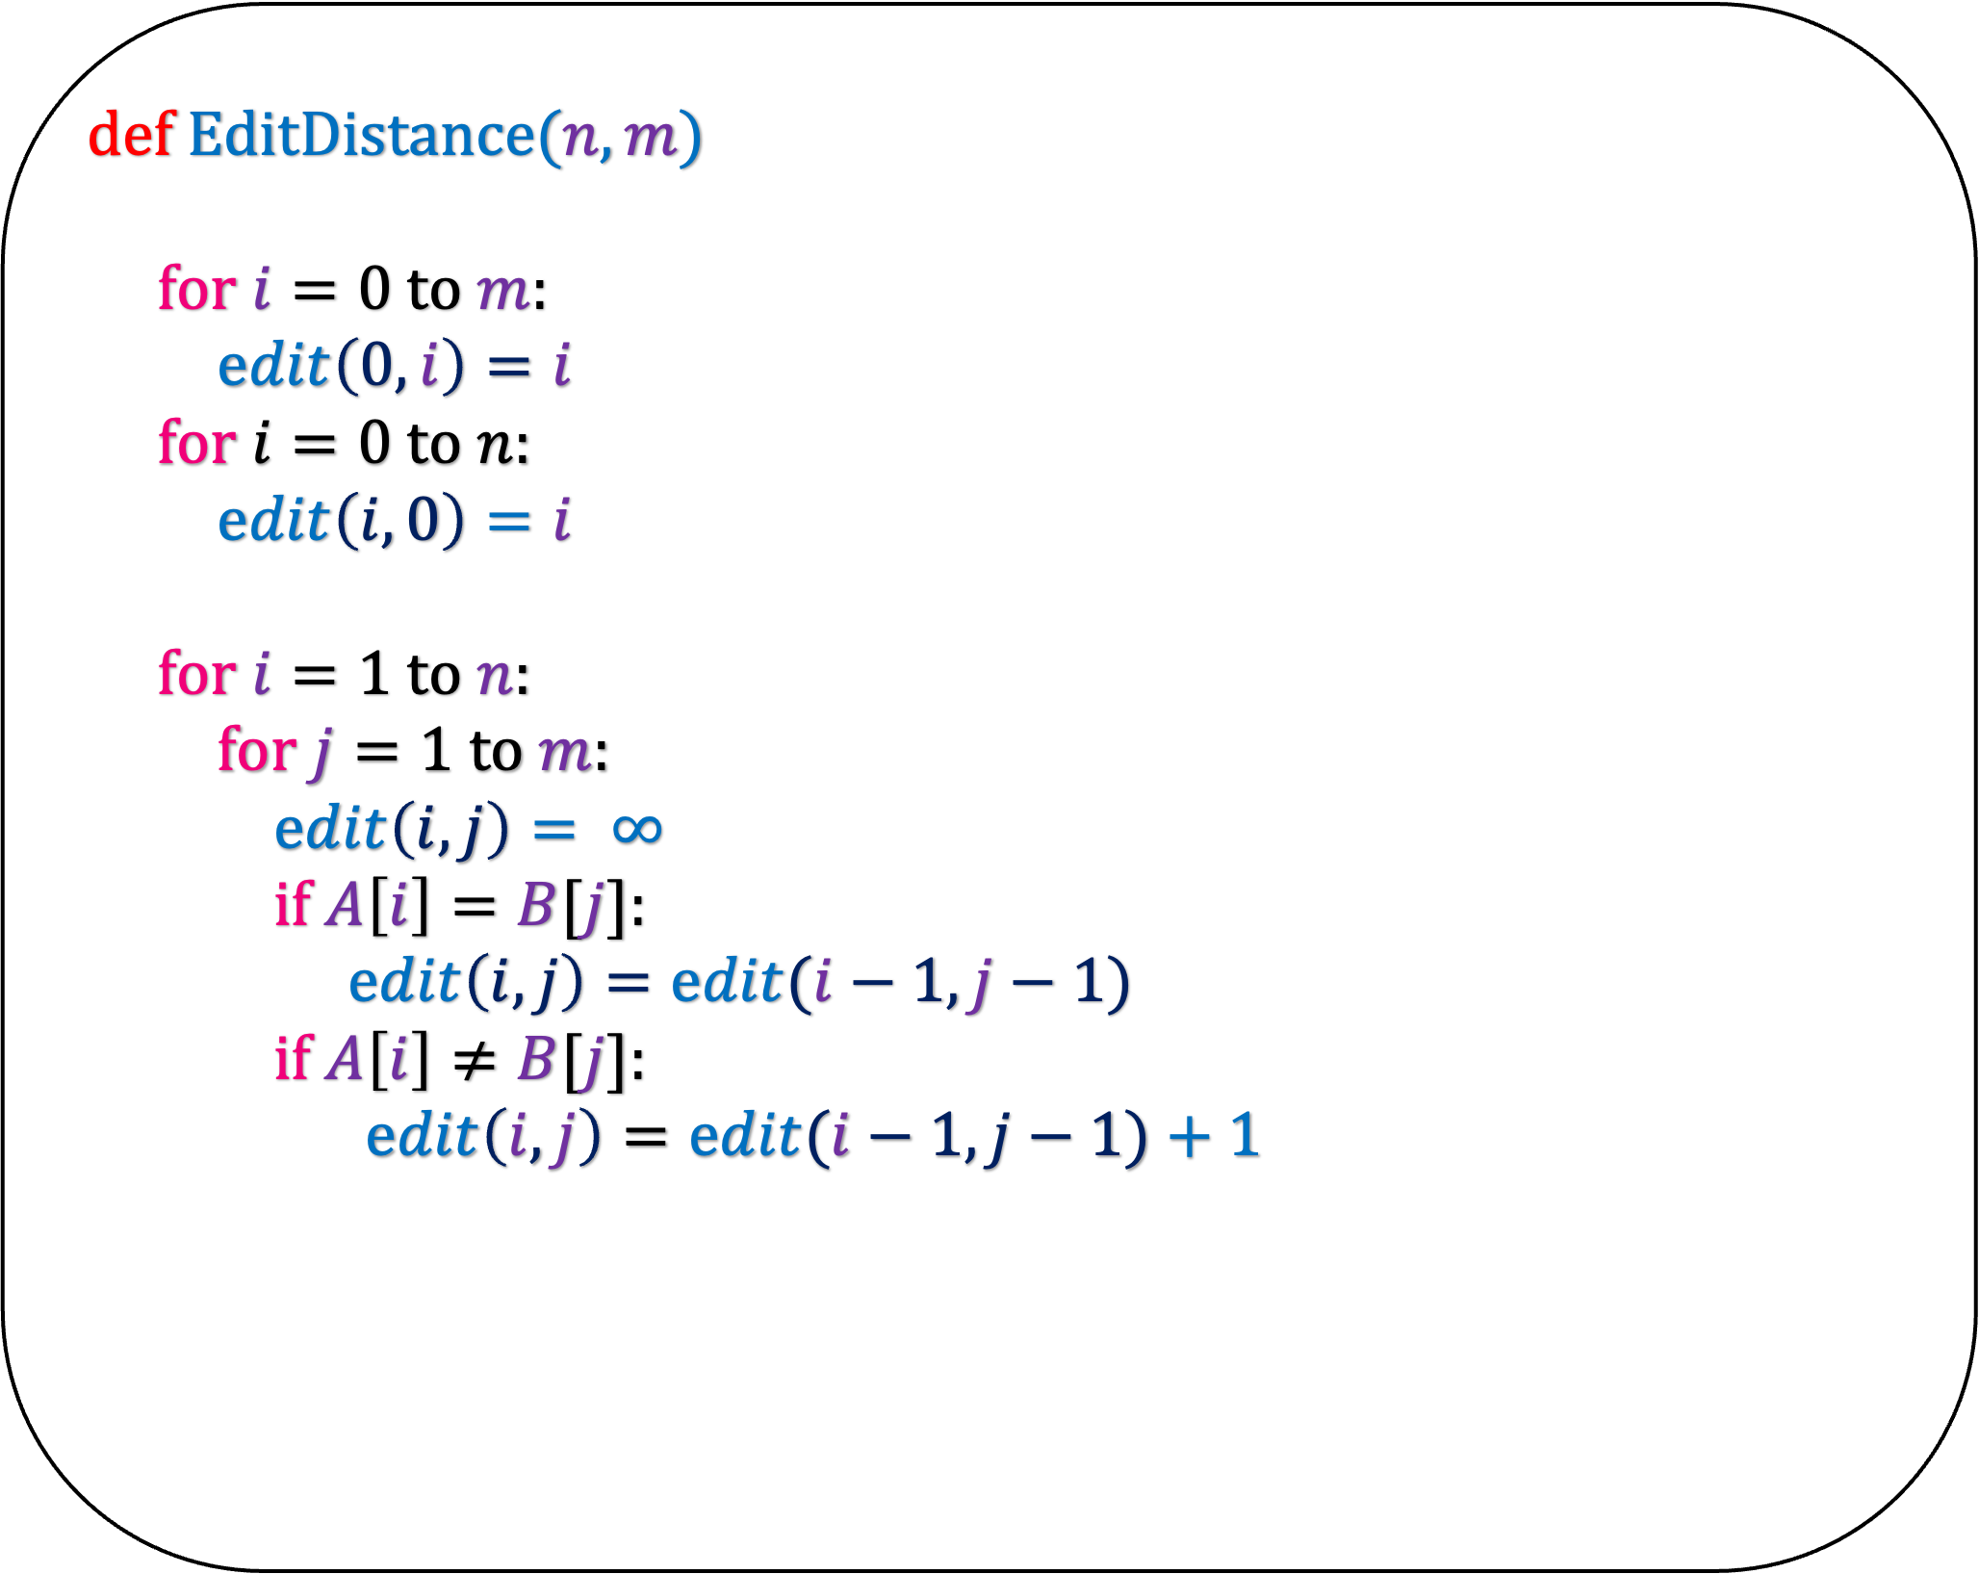
def
if $n=0$:
return $m$
if $m=0$:
return $n$
def EditDistance($n,m$)
for $i=0$ to $m$:
$edit\left(0,i\right)=i$
for $i=0$ to $n$:
$edit\left(i,0\right)=i$
for $i=1$ to $n$:
for $j=1$ to $m$:
$edit\left(i,j\right)= ∞$
if $A\left[i\right]=B[j]$:
$edit\left(i,j\right)=edit(i−1,j−1)$
if $A\left[i\right]≠B[j]$:
$edit\left(i,j\right)=edit(i−1,j−1)+1$
EDIT($n,m$)
EDIT($n−1,m−1$)
1+ EDIT($n−1,m−1$)
return
min
1+ EDIT($n−1,m$)
1+ EDIT($n,m−1$)

Slide 54
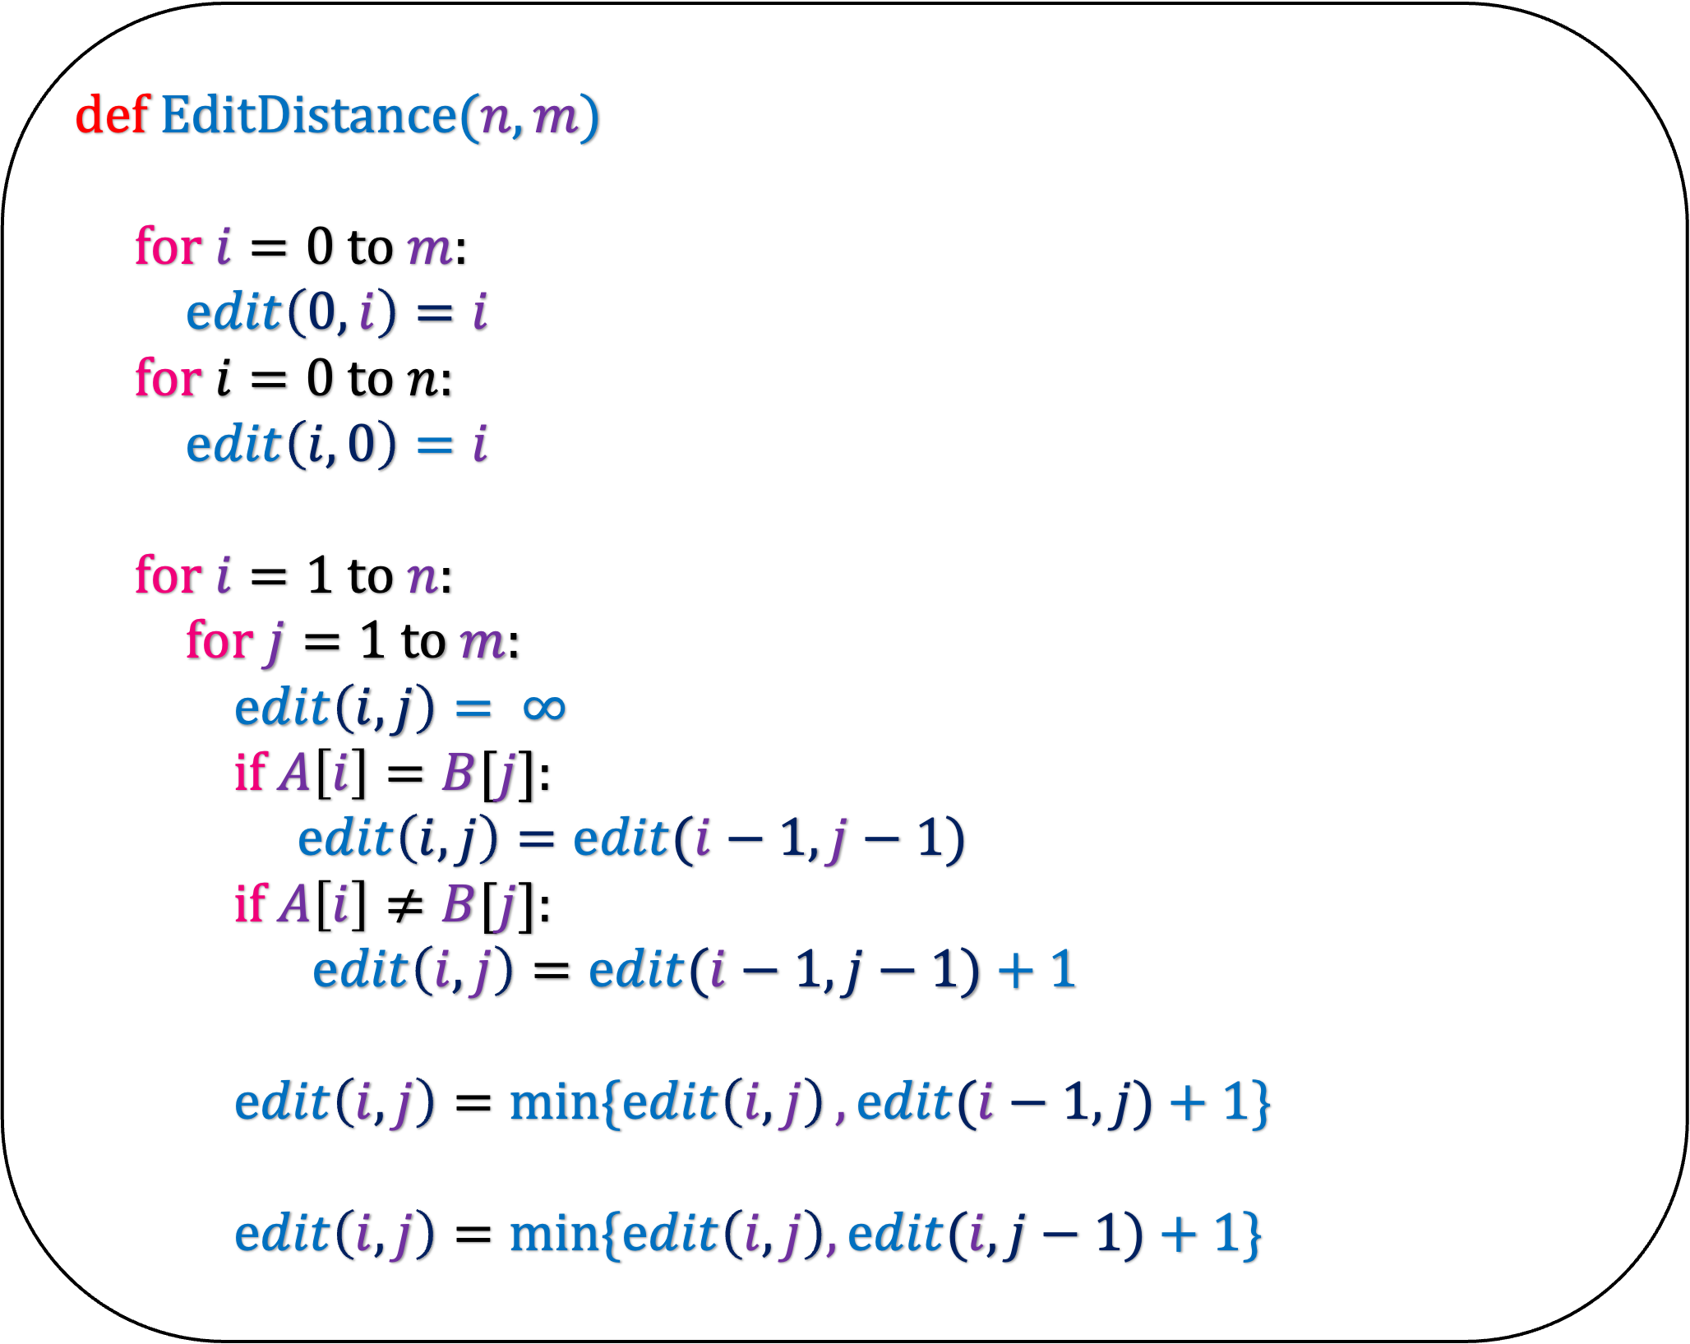
def
if $n=0$:
return $m$
if $m=0$:
return $n$
def EditDistance($n,m$)
for $i=0$ to $m$:
$edit\left(0,i\right)=i$
for $i=0$ to $n$:
$edit\left(i,0\right)=i$
for $i=1$ to $n$:
for $j=1$ to $m$:
$edit\left(i,j\right)= ∞$
if $A\left[i\right]=B[j]$:
$edit\left(i,j\right)=edit(i−1,j−1)$
if $A\left[i\right]≠B[j]$:
$edit\left(i,j\right)=edit(i−1,j−1)+1$
$edit\left(i,j\right)=\min{\{edit\left(i,j\right)},edit(i−1,j)+1\}$
$edit\left(i,j\right)=min⁡\{edit\left(i,j\right),edit(i,j−1)+1\}$
EDIT($n,m$)
EDIT($n−1,m−1$)
1+ EDIT($n−1,m−1$)
return
min
1+ EDIT($n−1,m$)
1+ EDIT($n,m−1$)

Slide 55
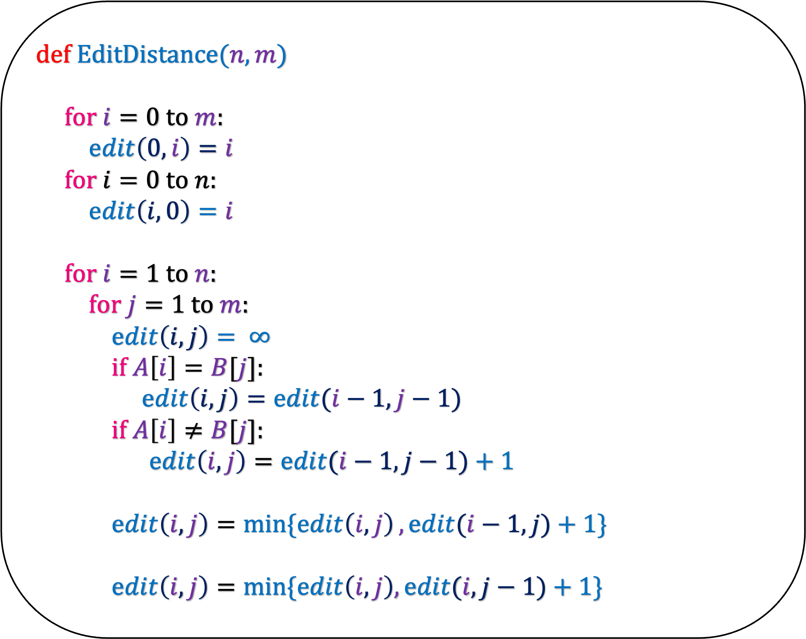
def EditDistance($n,m$)
for $i=0$ to $m$:
$edit\left(0,i\right)=i$
for $i=0$ to $n$:
$edit\left(i,0\right)=i$
for $i=1$ to $n$:
for $j=1$ to $m$:
$edit\left(i,j\right)= ∞$
if $A\left[i\right]=B[j]$:
$edit\left(i,j\right)=edit(i−1,j−1)$
if $A\left[i\right]≠B[j]$:
$edit\left(i,j\right)=edit(i−1,j−1)+1$
$edit\left(i,j\right)=\min{\{edit\left(i,j\right)},edit(i−1,j)+1\}$
$edit\left(i,j\right)=min⁡\{edit\left(i,j\right),edit(i,j−1)+1\}$
It is easy to see that the running time of this algorithm is O(nm)
Prove its correctness too

Slide 56
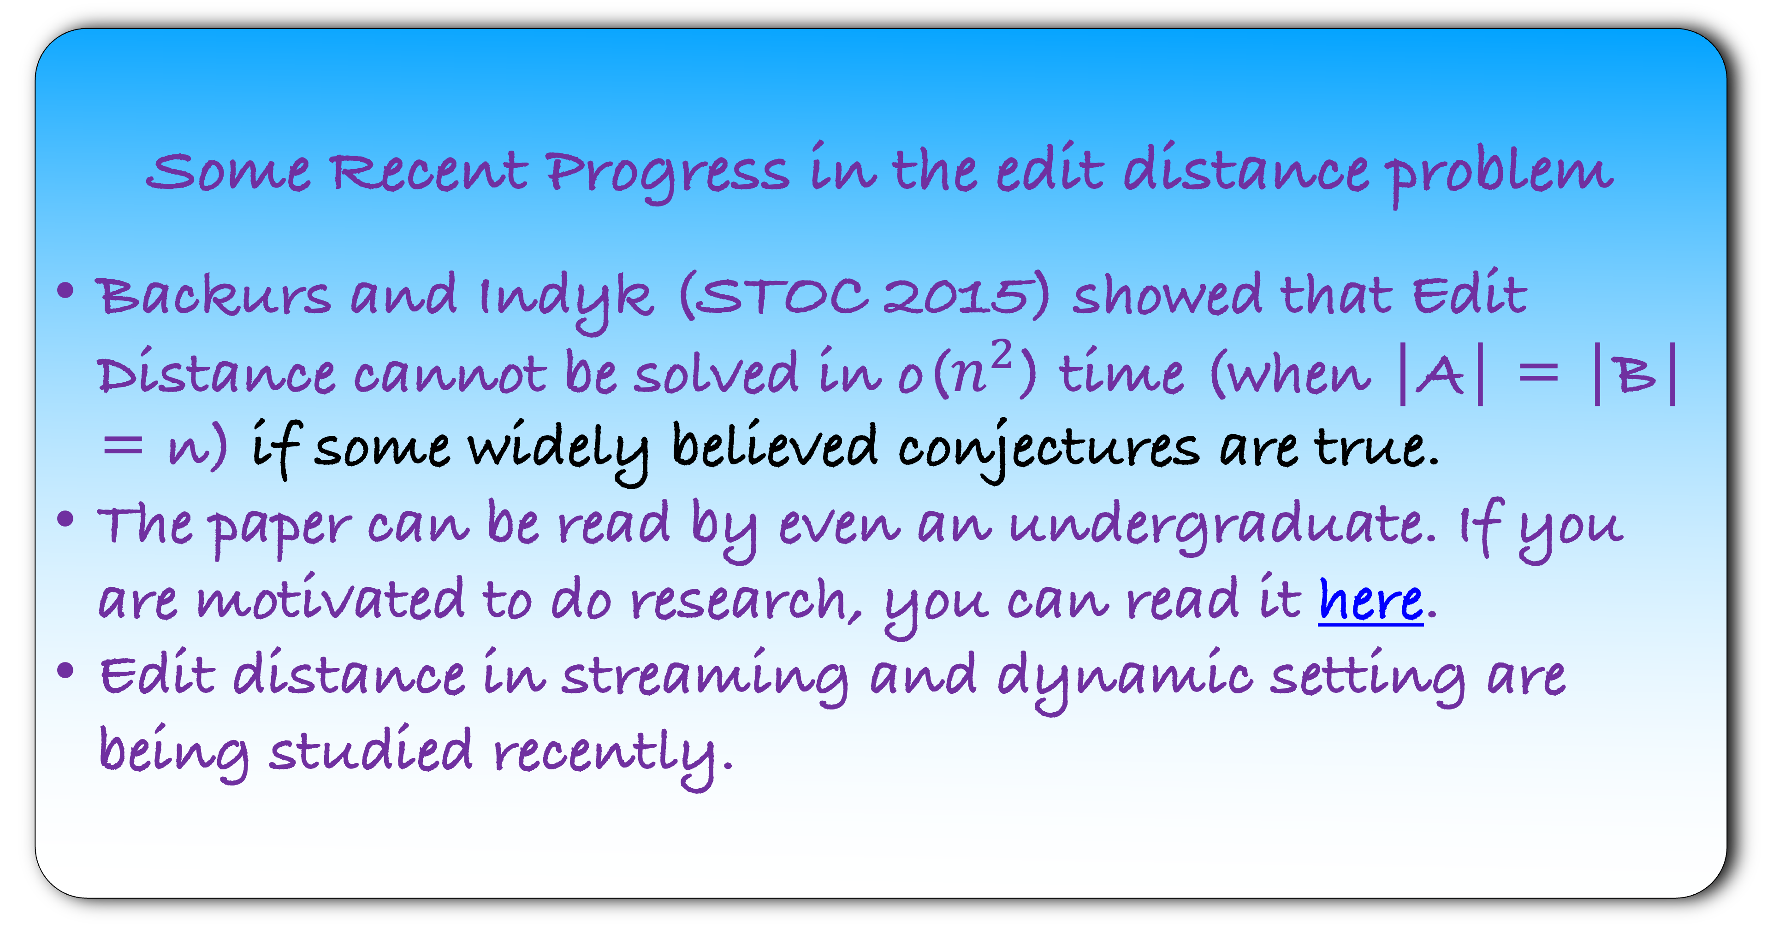
Some Recent Progress in the edit distance problem
Backurs and Indyk (STOC 2015) showed that Edit Distance cannot be solved in o($n^{2}$) time (when |A| = |B| = n) if some widely believed conjectures are true.
The paper can be read by even an undergraduate. If you are motivated to do research, you can read it here.
Edit distance in streaming and dynamic setting are being studied recently.

