Slide 1
Weighted Scheduling

Slide 2
You are given n intervals with their start and end times. The start and end times are integers. Each class has a credit associated with it.
Schedule non-overlapping classes to maximize the total number of credits.

Slide 3
1
2
20
10
10
5
3
What is the solution to this problem?

Slide 4
1
2
20
10
10
5
3
How will you solve this problem?
Greedy: Pick the interval that ends first
But this strategy does not work even for the above example.

Slide 5
1
2
20
10
10
5
3
Sort the intervals according their start times

Slide 6
1
2
20
10
10
5
3
1
2
3
4
5
6
7
If we select interval 1 in our answer, then we cannot select interval 2 and 3
Thus, we say that pair(1,2) and (1,3) are incompatible
Make an edge between all compatible pairs

Slide 7
1
2
20
10
10
5
3
1
2
3
4
5
6
7
So, there is an edge between (1,4), (1,5), (1,6) and (1,7)
Lets add all the edges in the graph.

Slide 8
1
2
20
10
10
5
3
1
2
3
4
5
6
7
Let L(i) be the maximum credits from scheduling non-overlapping intervals in {1,2,…,i} including the i-th interval.

Slide 9
1
2
1
20
10
10
5
3
1
2
3
4
5
6
7
L
What is L(1)?

Slide 10
1
2
20
10
10
5
3
1
2
3
4
5
6
7
L
1

Slide 11
1
2
20
10
10
10
5
3
1
2
3
4
5
6
7
L
1
What is L(2)?

Slide 12
1
2
20
10
10
5
5
3
1
2
3
4
5
6
7
L
1
10
What is L(2)?

Slide 13
1
2
20
10
10
5
3
1
2
3
4
5
6
7
L
1
10
5

Slide 14
2
1
2
20
10
10
5
3
1
2
3
4
5
6
7
L
1
1
10
5
5
What is L(4)?

Slide 15
1
2
20
10
10
5
3
1
2
3
4
5
6
7
L
1
10
5
max {
}
,
1
5
2

Slide 16
1
2
20
10
10
5
3
1
2
3
4
5
6
7
L
1
10
5
2
7
5

Slide 17
1
2
20
10
10
5
3
1
2
3
4
5
6
7
L
1
10
5
2
7
5
What is L(5)?

Slide 18
1
2
20
10
10
5
3
1
2
3
4
5
6
7
L
1
10
5
2
7
5
max {
}
,
1
5
3

Slide 19
1
2
20
10
10
5
3
1
2
3
4
5
6
7
L
1
10
5
2
5
7
8
5
3

Slide 20
1
2
20
10
10
5
3
1
2
3
4
5
6
7
L
1
10
5
2
5
7
8
20
5
3

Slide 21
1
2
20
10
10
5
3
1
2
3
4
5
6
7
L
1
10
5
2
5
7
8
20
30
5
3

Slide 22
1
2
20
10
10
5
3
1
2
3
4
5
6
7
L
1
10
5
2
5
7
8
20
30
5
3
Where is our answer?
Scan the array to find the answer

Slide 23
Implementation

Slide 24
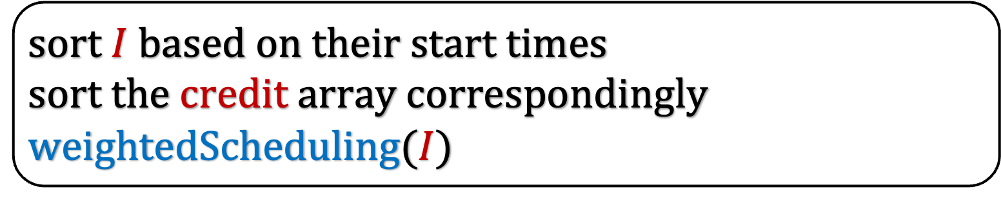
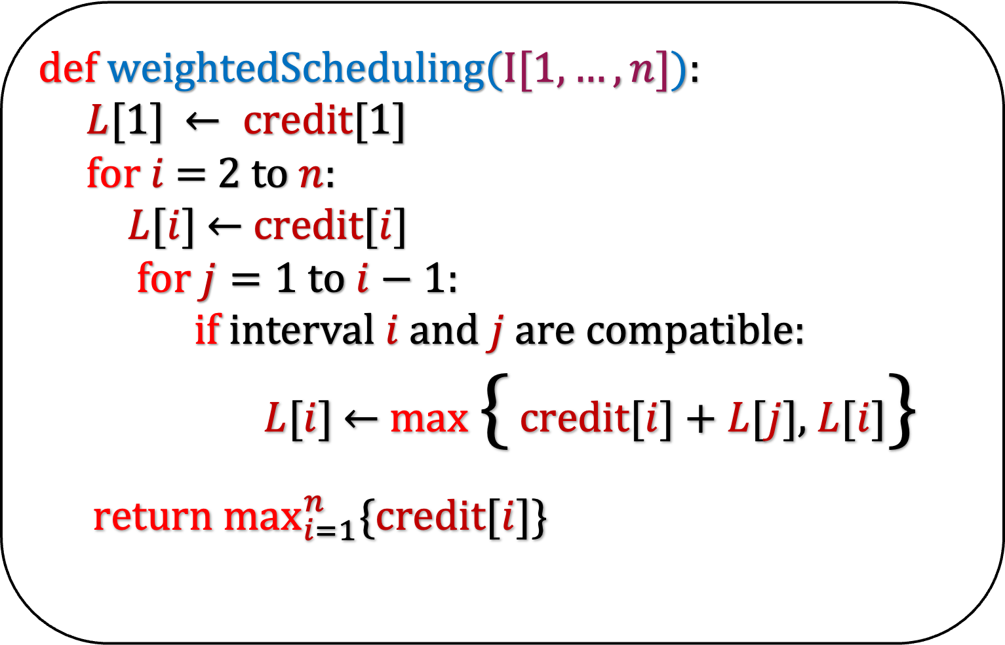
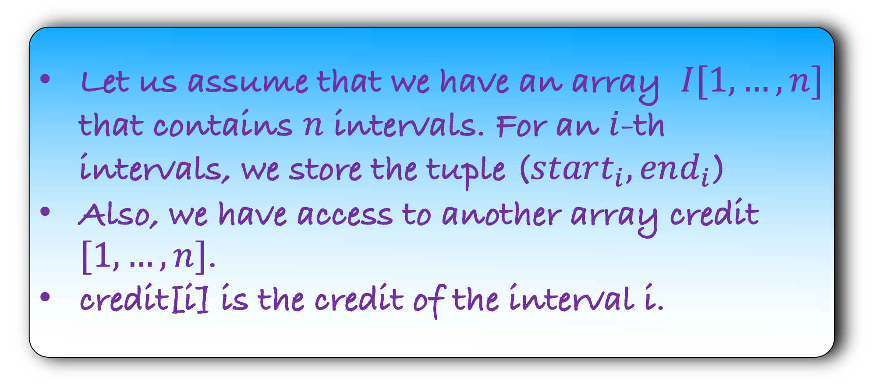
def w$eightedScheduling(I[1,…,n]$):
$L[1]$ $← credit[1]$
for $i$ = 2 to $n$:
$L$[$i$]$←$ credit[$i$]
for $j=1$ to $i−1$:
if interval $i$ and $j$ are compatible:
$L$[$i$] $←$ max { credit[$i$] + $L$[$j$], $L$[$i$]}
return $\max_{i=1}^{n}{\{credit[i]\}}$
Let us assume that we have an array $I[1,…,n]$ that contains $n$ intervals. For an $i$-th intervals, we store the tuple ($start_{i},end_{i}$)
Also, we have access to another array credit $[1,…,n]$.
credit[i] is the credit of the interval i.
HW
Write a recursive solution for this problem
sort $I$ based on their start times
sort the credit array correspondingly
weightedScheduling($I$)

Slide 25
Running Time

Slide 26



def w$eightedScheduling(I[1,…,n]$):
$L[1]$ $← credit[1]$
for $i$ = 2 to $n$:
$L$[$i$]$←$ credit[$i$]
for $j=1$ to $i−1$:
if interval $i$ and $j$ are compatible:
$L$[$i$] $←$ max { credit[$i$] + $L$[$j$], $L$[$i$]}
return $\max_{i=1}^{n}{\{credit[i]\}}$
O($n^{2}$)
sort $I$ based on their start times
sort the credit array correspondingly
weightedScheduling($I$)
O($n\log{n}$)

Slide 27

def w$eightedScheduling(I[1,…,n]$):
$L[1]$ $← credit[1]$
for $i$ = 2 to $n$:
$L$[$i$]$←$ credit[$i$]
for $j=1$ to $i−1$:
if interval $i$ and $j$ are compatible:
$L$[$i$] $←$ max { credit[$i$] + $L$[$j$], $L$[$i$]}
return $\max_{i=1}^{n}{\{credit[i]\}}$
Total Running Time =
O($n^{2}$)
sort $I$ based on their start times
sort the credit array correspondingly
weightedScheduling($I$)

Slide 28
Correctness

Slide 29
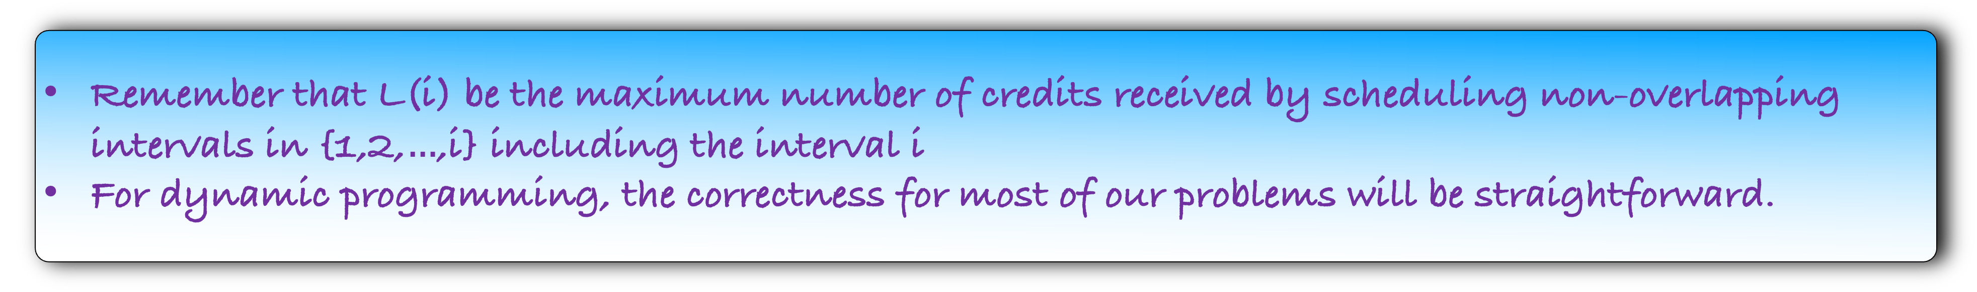

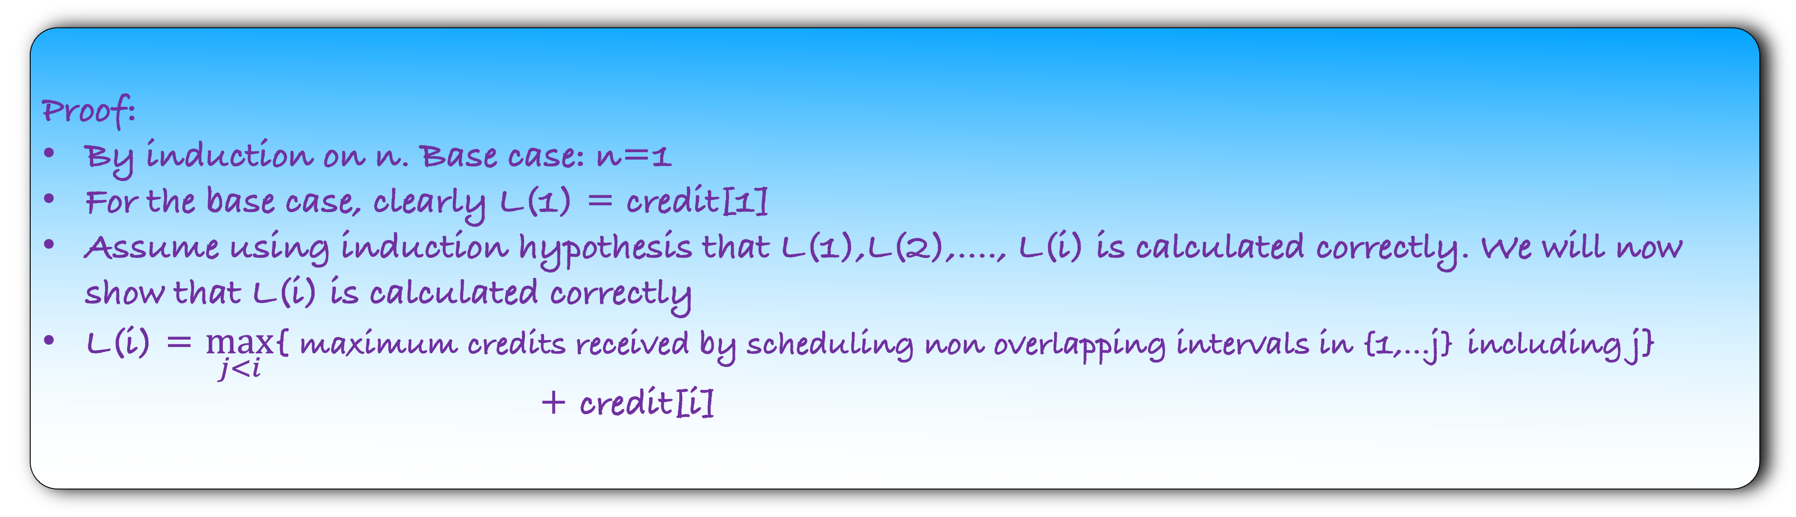
Remember that L(i) be the maximum number of credits received by scheduling non-overlapping intervals in {1,2,$…$,i} including the interval i
For dynamic programming, the correctness for most of our problems will be straightforward.
Lemma: For all 1 $≤$ i $≤$ n, L(i) is calculated correctly
Proof:
By induction on n. Base case: n=1
For the base case, clearly L(1) = credit[1]
Assume using induction hypothesis that L(1),L(2),…., L(i) is calculated correctly. We will now show that L(i) is calculated correctly
L(i) = $\max_{j<i}${ maximum credits received by scheduling non overlapping intervals in {1,…j} including j}
+ credit[i]
$$st \left(j,i\right) are compatible$$

Slide 30
Remember that L(i) be the maximum number of credits received by scheduling non-overlapping intervals in {1,2,$…$,i} including the interval i
For dynamic programming, the correctness for most of our problems will be straightforward.
Lemma: For all 1 $≤$ i $≤$ n, L(i) is calculated correctly
Proof:
By induction on n. Base case: n=1
For the base case, clearly L(1) = credit[1]
Assume using induction hypothesis that L(1),L(2),…., L(i) is calculated correctly. We will now show that L(i) is calculated correctly
L(i) = $\max_{j<i}${ maximum credits received by scheduling non overlapping intervals in {1,…j} including j}
+ credit[i]
Using induction hypothesis
$$st \left(j,i\right) are compatible$$

Slide 31

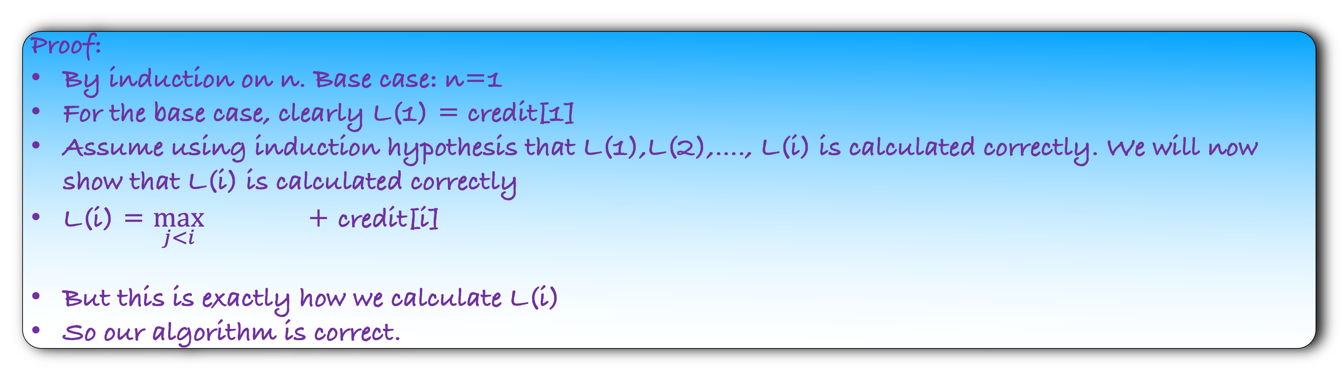
Remember that L(i) be the maximum number of credits received by scheduling non-overlapping intervals in {1,2,$…$,i} including the interval i
For dynamic programming, the correctness for most of our problems will be straightforward.
Lemma: For all 1 $≤$ i $≤$ n, L(i) is calculated correctly
Proof:
By induction on n. Base case: n=1
For the base case, clearly L(1) = credit[1]
Assume using induction hypothesis that L(1),L(2),…., L(i) is calculated correctly. We will now show that L(i) is calculated correctly
L(i) = $\max_{j<i}$ + credit[i]
But this is exactly how we calculate L(i)
So our algorithm is correct.
{L(j)}
$$st \left(j,i\right) are compatible$$

