Slide 1
Pingala Series

Slide 2
Fibonacci series is a famous series in mathematics
It is normally attributed to Fibonacci but the series was described as early as 200 BC by the Indian poet/mathematician Pingala
Fibonacci introduced amoung many other things the Pingala Series to European in his book Liber Abaci

Slide 3
Pingala Series
P(1) = 1
P(2) = 1
P(n) = P(n-1)+P(n-2) for n>2
It is amazing that these numbers appear in nature
Let us see a beautiful video that shows this relation

Slide 4
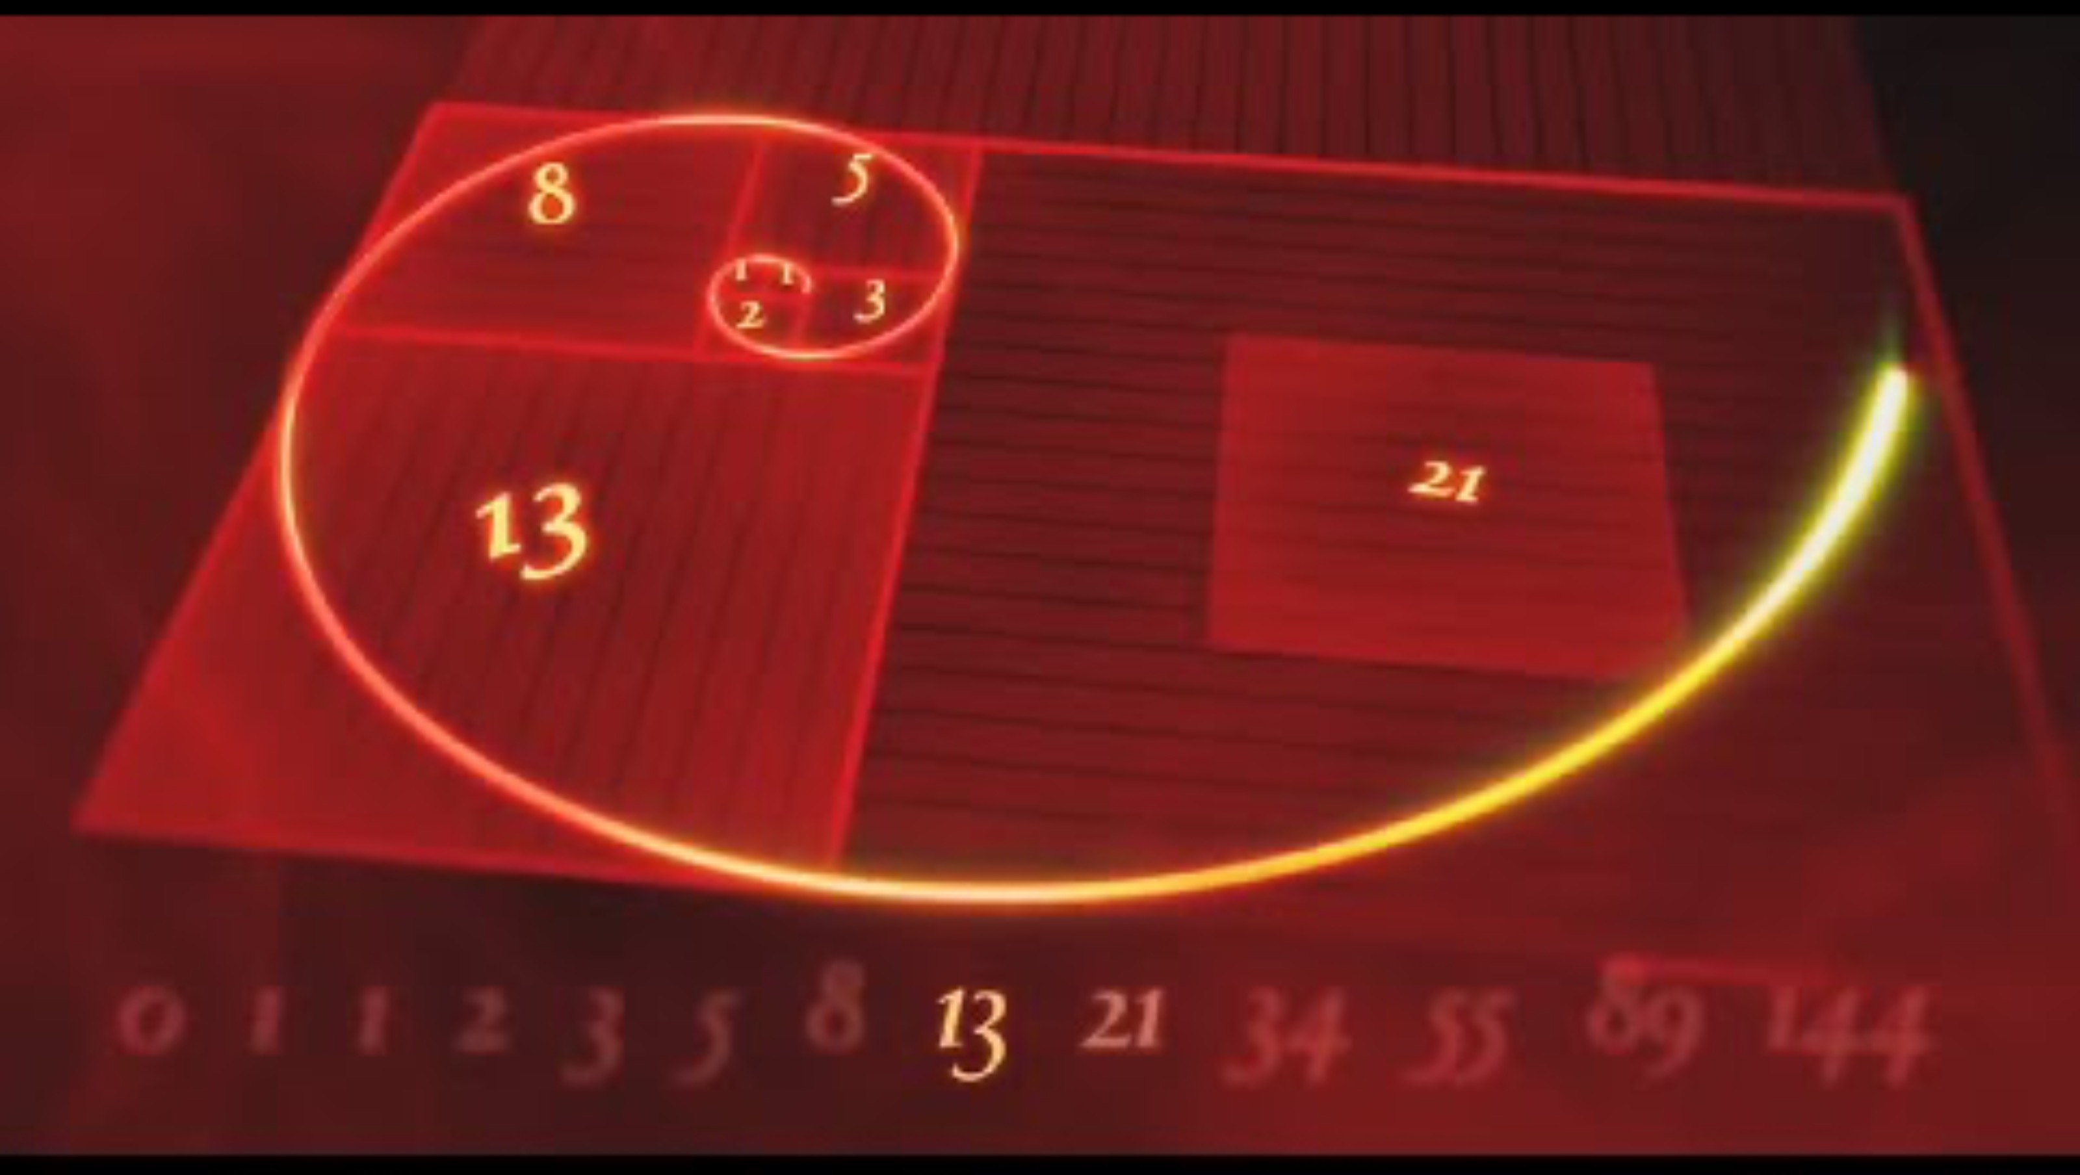

Slide 5
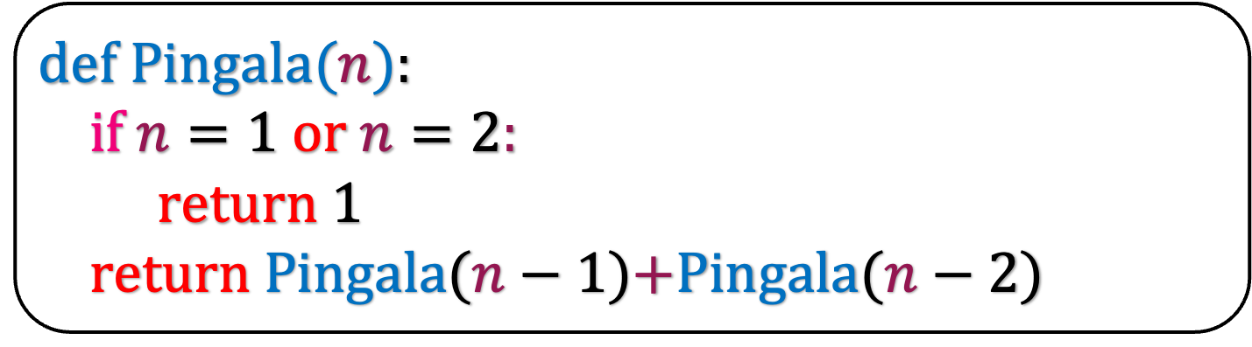
T(n)
def Pingala($n$):
if $n=1$ or $n=2$:
return 1
return Pingala($n−1$)+Pingala($n−2$)
c
T(n-1)
T(n-2)
What is the running time of this algorithm?

Slide 6
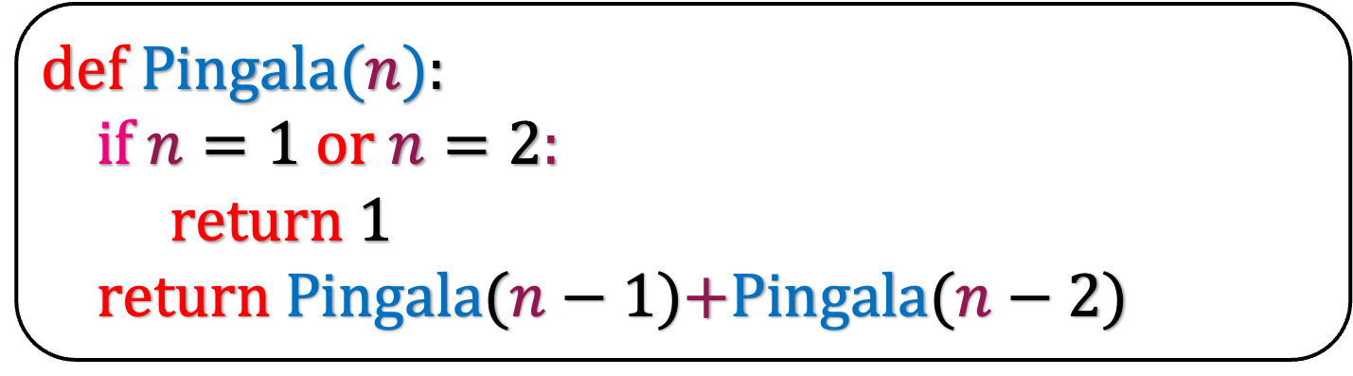
def Pingala($n$):
if $n=1$ or $n=2$:
return 1
return Pingala($n−1$)+Pingala($n−2$)
T(n)
T(n-1)
T(n-2)
T(1)
c
T(2)
c
What is the solution of this recurrence relation?

Slide 7
T(n)
T(n-1)
T(n-2)

Slide 8

T(n)
$$≤$$
T(n-1)
T(n-1)

Slide 9

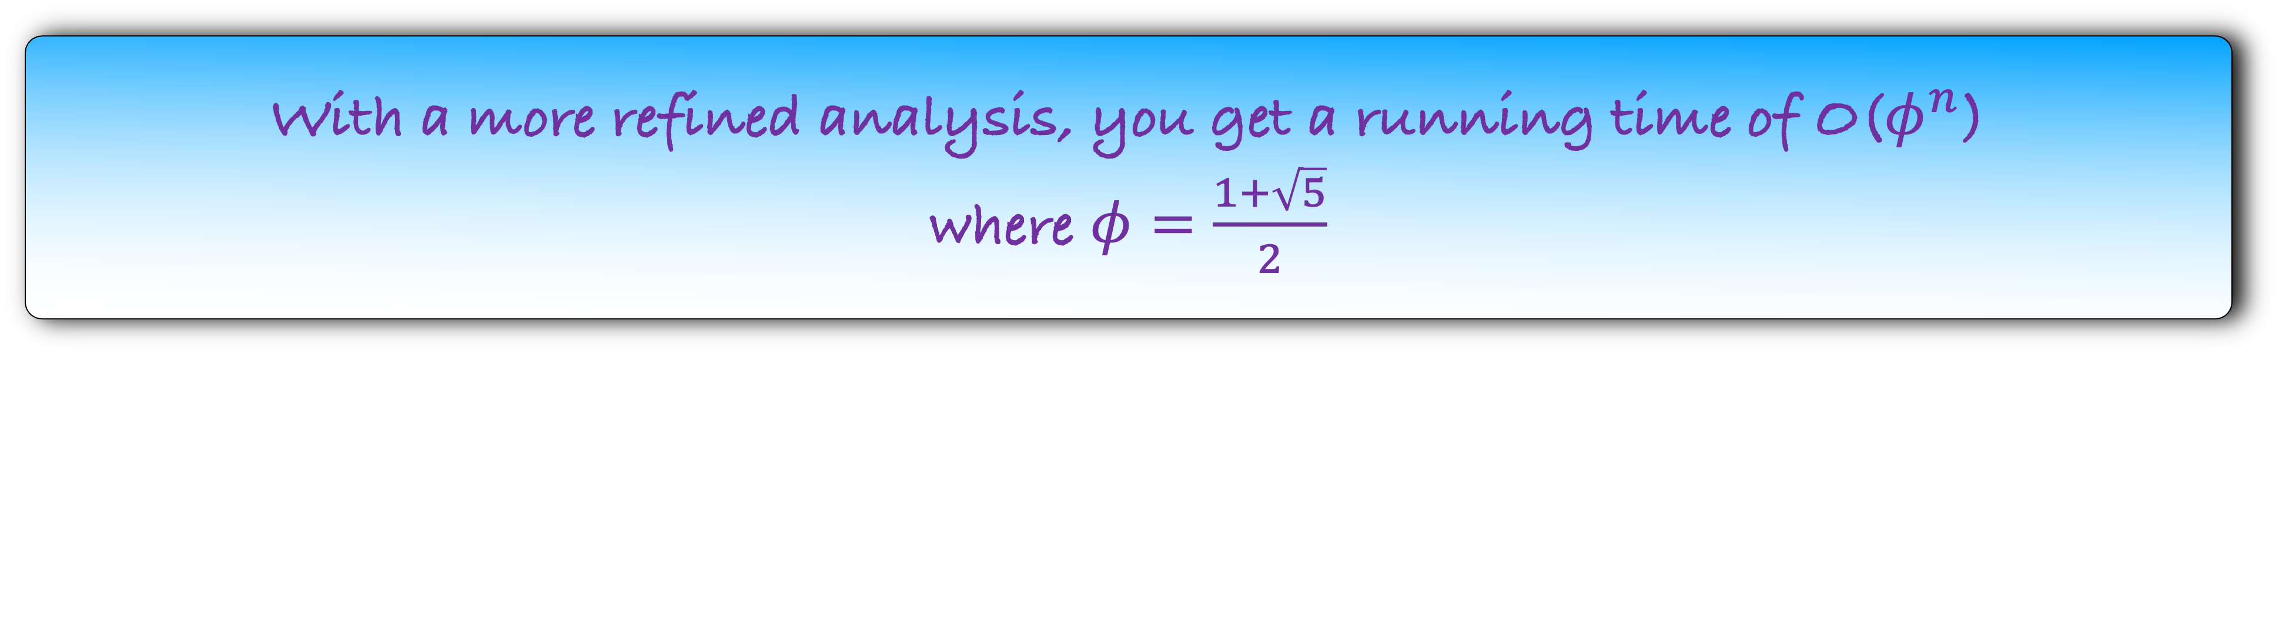
T(n)
$$≤$$
2T(n-1)
=
T(n)
O($2^{n}$)
With a more refined analysis, you get a running time of O($φ^{n}$)
where $φ=\frac{1+\sqrt{5}}{2}$
But why are we getting bad running time for such a simple problem?

Slide 10
5
4
3
3
2
2
1
2
1

Slide 11
5
Idea: Calculate Pingala(3) only once and return the calculated value when called again.
Memoization
4
3
3
2
2
1
2
1
Why are we calculating Pingala(3) multiple time?

Slide 12
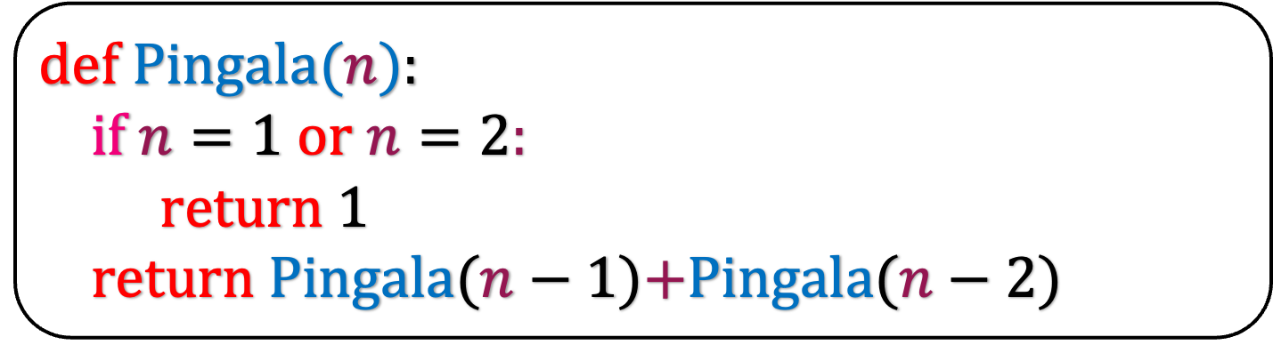
def Pingala($n$):
if $n=1$ or $n=2$:
return 1
return Pingala($n−1$)+Pingala($n−2$)
Let us assume that we store the i-th Pingala number in P{i]
Initially, we set P[1] = P[2] = 1 indicating that we have calculated the first and the second Pingala number
For i>2, we set P[i] = 0 indicating that we have not calculated these Pingala number

Slide 13
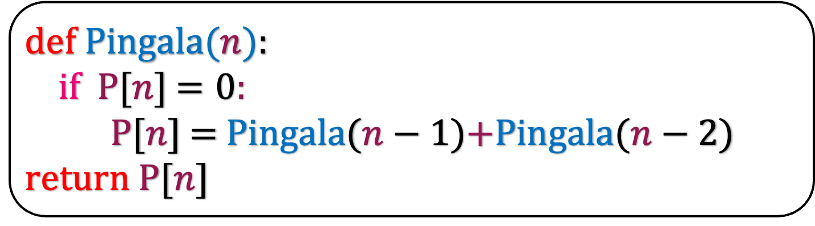
def Pingala($n$):
if P[$n$] $=0$:
P[$n$] = Pingala($n−1$)+Pingala($n−2$)
return P[$n$]
Let us assume that we store the i-th Pingala number in P{i]
Initially, we set P[1] = P[2] = 1 indicating that we have calculated the first and the second Pingala number
For i>2, we set P[i] = 0 indicating that we have not calculated these Pingala number
Why is this algorithm better than the previous version?

Slide 14
5
4
3
This is not executed as by the time we reach here, we have already calculated P[3] and we just return it.
Thus, the running time of our algorithm is O(n)
There is another way to view the algorithm.
3
2
2
1
2
1

Slide 15
5
4
3
We can view this graph in another way
3
2
2
1
2
1

Slide 16
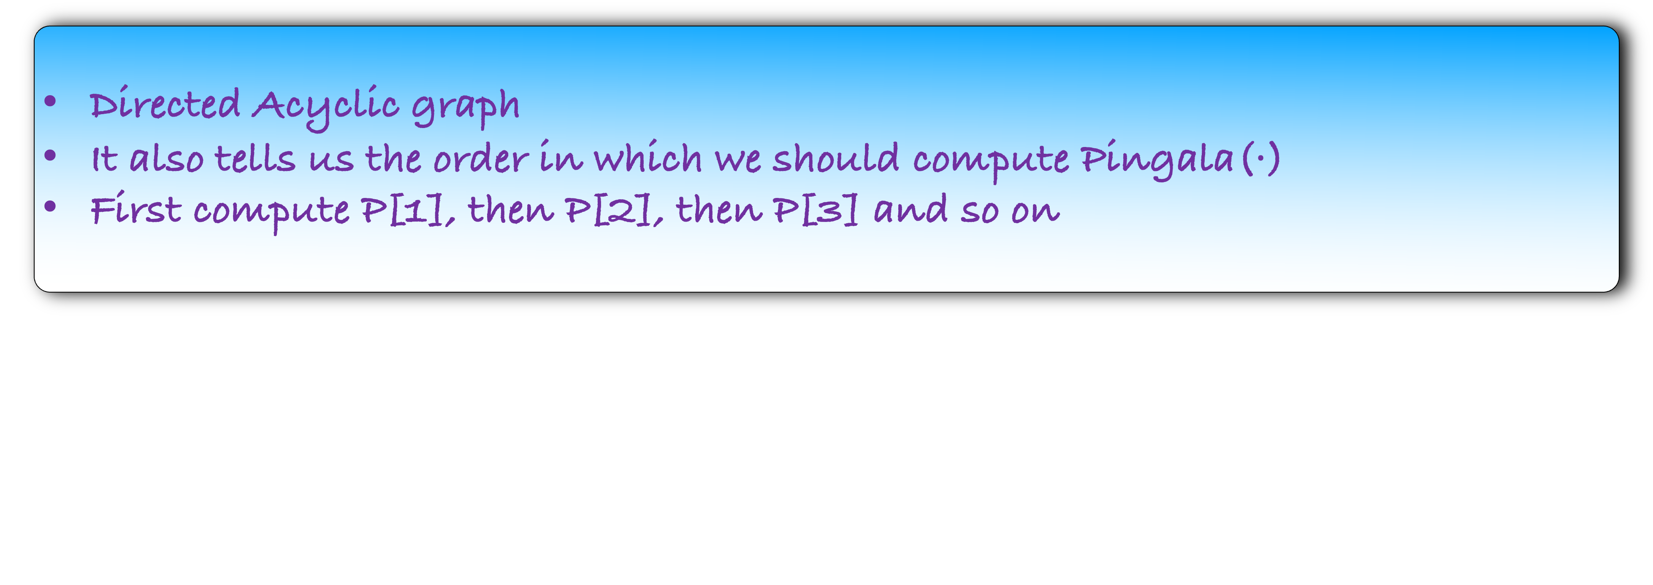
3
1
3
4
5
1
2
2
2
What is this graph?
Directed Acyclic graph
It also tells us the order in which we should compute Pingala($⋅$)
First compute P[1], then P[2], then P[3] and so on

Slide 17
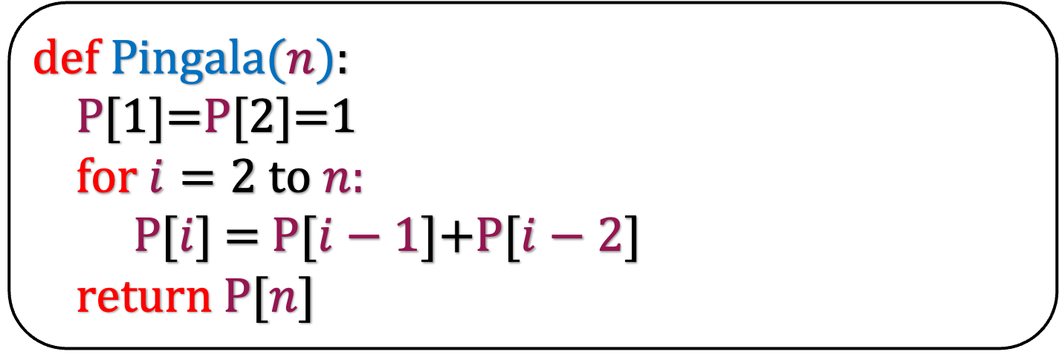
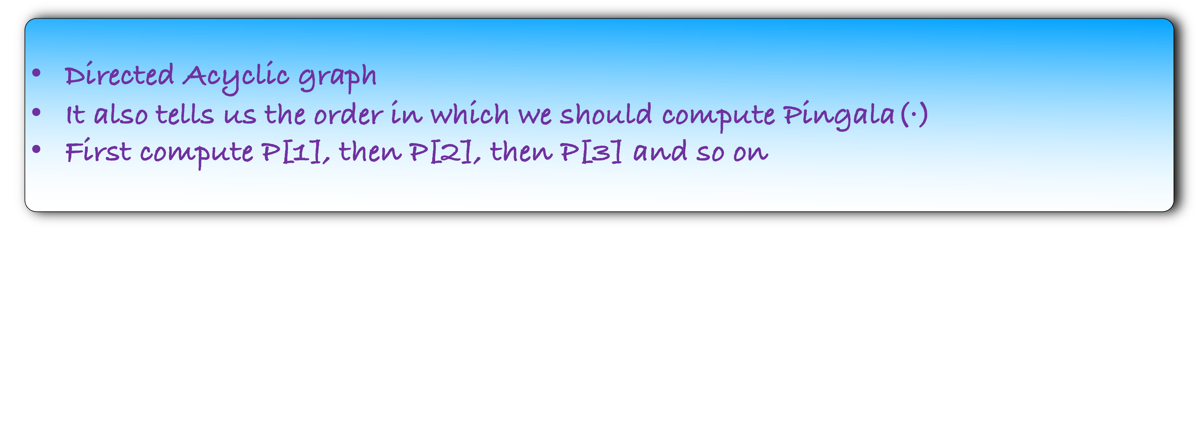
Directed Acyclic graph
It also tells us the order in which we should compute Pingala($⋅$)
First compute P[1], then P[2], then P[3] and so on
def Pingala($n$):
P[1]=P[2]=1
for $i=2$ to $n$:
P[$i$] = P[$i−1$]+P[$i−2$]
return P[$n$]
This method is called Dynamic Programming
        Identify smaller subproblems, solve them first, and then combine them to solve the main problem
      This property is called Optimal Substructure in algorithmic jargon

Slide 18
This method is called Dynamic Programming
        Identify smaller subproblems, solve them first, and then combine them to solve the main problem
      This property is called Optimal Substructure in algorithmic jargon
But the above points are true even for Divide and Conquer? So how is Dynamic Programming different from Divide and Conquer?

Slide 19
Merge Sort
8
5
8
1
6
2
4
3
7

Slide 20
Merge Sort
8
4
5
8
1
6
4
2
4
3
7

Slide 21
Merge Sort
8
4
4
2
5
8
2
1
6
2
2
4
2
3
7

Slide 22
Merge Sort
8
4
4
2
2
2
2
5
8
1
6
2
4
3
7
1
1
1
1
1
1
1
1

Slide 23
Merge Sort
8
4
4
2
5
8
2
1
6
2
2
4
2
3
7
1
1
1
1
1
1
1
1

Slide 24
Merge Sort
8
4
1
5
6
8
4
2
3
4
7
2
2
2
2
1
1
1
1
1
1
1
1

Slide 25
Merge Sort
8
1
2
3
4
5
6
7
8
4
4
2
2
2
2
1
1
1
1
1
1
1
1

Slide 26
Merge Sort
8
4
4
2
2
2
2
1
1
1
1
1
1
1
1

Slide 27
Divide and Conquer
Dynamic Programming
8
3
1
3
4
5
1
2
2
2
4
4
2
2
2
2
1
1
1
1
1
1
1
1
All the problems are disjoint
Thus, we can write a recursive algorithm
The graph is a tree
The subproblems are not disjoint
We can write a recursive algorithm but have to use memorization
The graph is a DAG

Slide 28
Dynamic Programming
The subproblems are not disjoint
We can write a recursive algorithm but have to use memorization
The graph is a DAG
Apart from this, dynamic programming is same as divide and conquer
3
1
3
4
5
1
2
2
2
But then why is it called Dynamic Programming? What does dynamic refer to?

Slide 29
I spent the Fall quarter (of 1950) at RAND. My first task was to find a name for multistage decision processes. An interesting question is, "Where did the name, dynamic programming, come from?" The 1950s were not good years for mathematical research. We had a very interesting gentleman in Washington named Wilson. He was Secretary of Defense, and he actually had a pathological fear and hatred of the word "research". I'm not using the term lightly; I'm using it precisely. His face would suffuse, he would turn red, and he would get violent if people used the term research in his presence. You can imagine how he felt, then, about the term mathematical. The RAND Corporation was employed by the Air Force, and the Air Force had Wilson as its boss, essentially. Hence, I felt I had to do something to shield Wilson and the Air Force from the fact that I was really doing mathematics inside the RAND Corporation. What title, what name, could I choose? In the first place I was interested in planning, in decision making, in thinking. But planning, is not a good word for various reasons. I decided therefore to use the word "programming". I wanted to get across the idea that this was dynamic, this was multistage, this was time-varying. I thought, let's kill two birds with one stone. Let's take a word that has an absolutely precise meaning, namely dynamic, in the classical physical sense. It also has a very interesting property as an adjective, and that is it's impossible to use the word dynamic in a pejorative sense. Try thinking of some combination that will possibly give it a pejorative meaning. It's impossible. Thus, I thought dynamic programming was a good name. It was something not even a Congressman could object to. So I used it as an umbrella for my activities.
— Richard Bellman,
Eye of the Hurricane: An Autobiography (1984, page 159)

