Slide 1
NP-Completeness

Slide 2

Till now, we have done problems that can be solved using
Greedy
Divide and Conquer
Dynamic Programming
Flows
One nice feature of these algorithms is that their running time is
polynomial of the $input size$

Slide 3

Till now, we have done problems that can be solved using
Greedy
Divide and Conquer
Dynamic Programming
Flows
One nice feature of these algorithms is that their running time is
${\left(input size\right)}^{c}$

Slide 4

Till now, we have done problems that can be solved using
Greedy
Divide and Conquer
Dynamic Programming
Flows
One nice feature of these algorithms is that their running time is
$$n^{c}$$

Slide 5
P

Slide 6
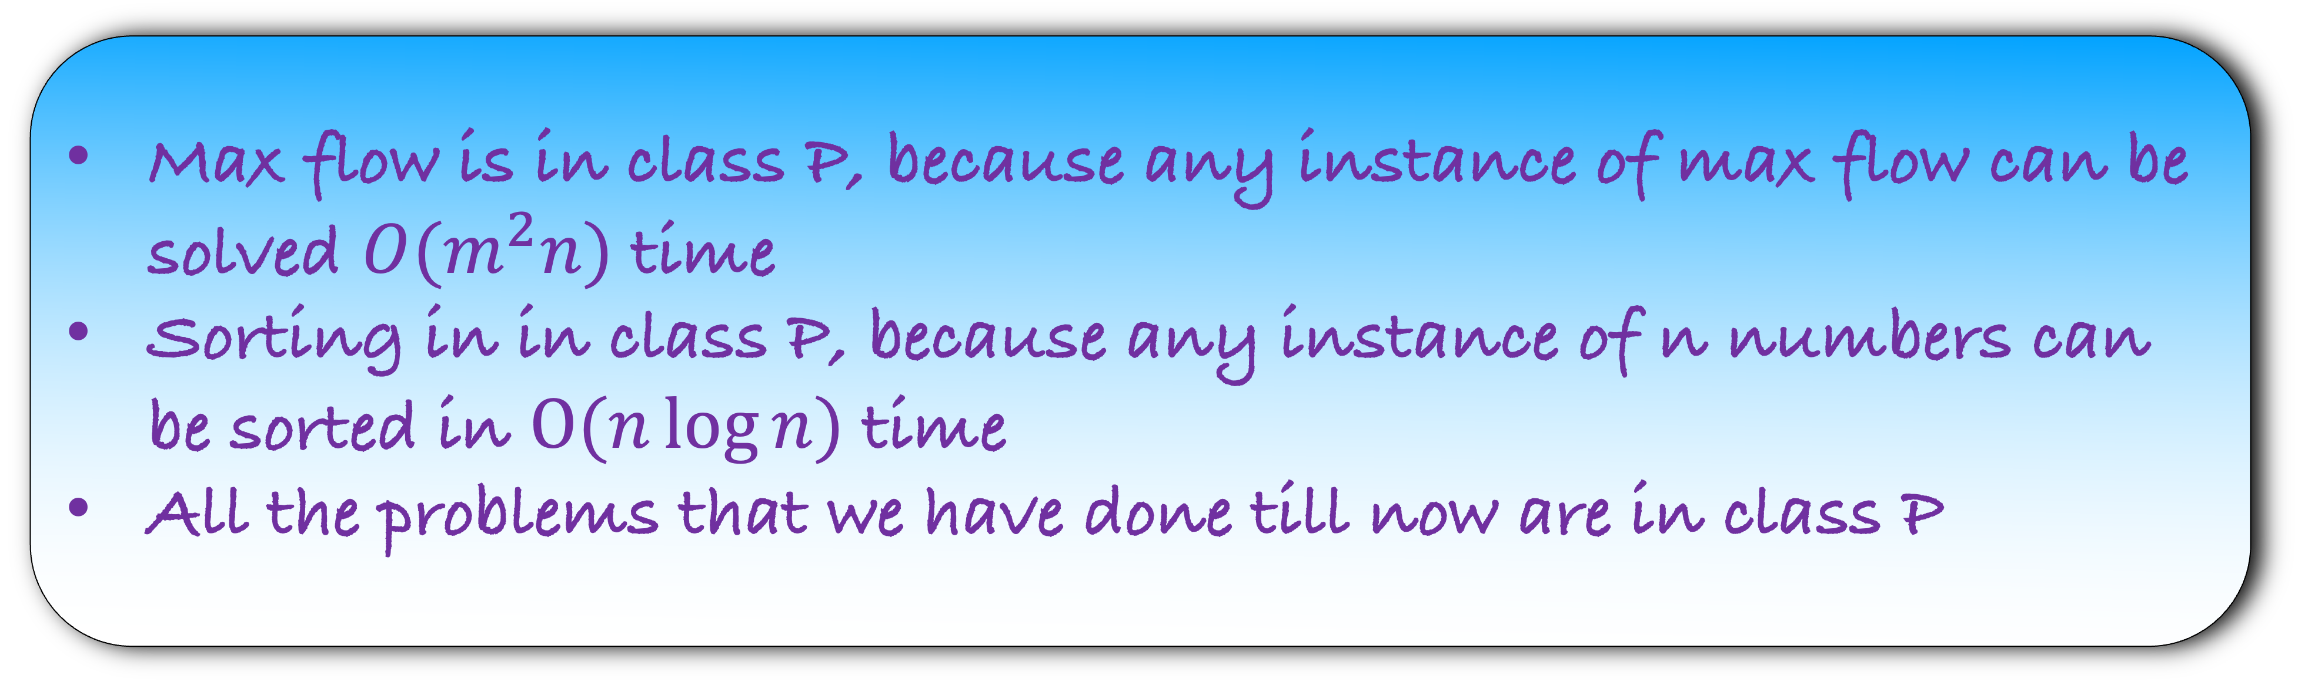
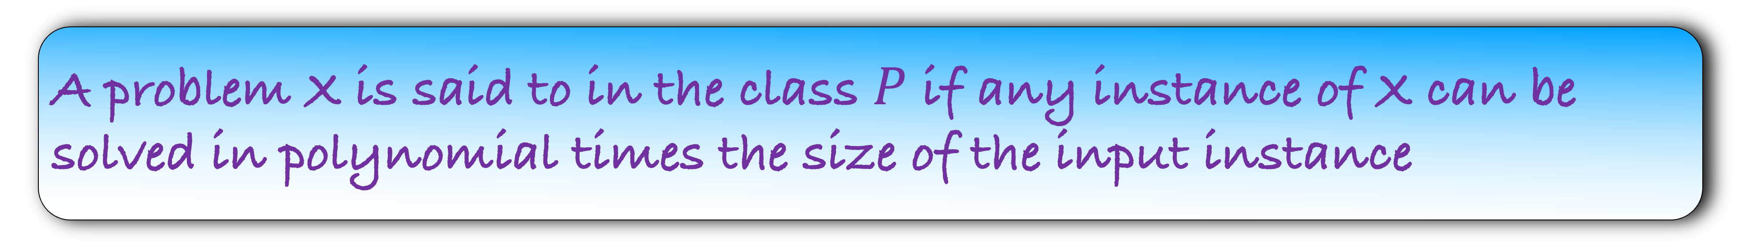
A problem X is said to in the class $P$ if any instance of X can be solved in polynomial times the size of the input instance
Max flow is in class P, because any instance of max flow can be solved $O(m^{2}n)$ time
Sorting in in class P, because any instance of n numbers can be sorted in $O(n\log{n})$ time
All the problems that we have done till now are in class P

Slide 7
Class P
Sorting
Max flow
Closest Pair
Shortest path
Majority
Edit distance

Slide 8
Class P
Sorting
Closest Pair
Max flow
Majority
Shortest path
Edit distance

Slide 9
Class P
Sorting
Are there any problems outside the class P?
Closest Pair
Max flow
Majority
Shortest path
Edit distance

Slide 10
Are there any problems outside the class P?
Can you think of any problem?
Write a program that outputs all permutations of n numbers
Write a program that outputs all cycles in a graph
Write a program that outputs all shortest paths from s to t in a graph

Slide 11
Write a program that outputs all permutations of n numbers
Write a program that outputs all cycles in a graph
Write a program that outputs all shortest paths from s to t in a graph
These are pathological problems.
The output size itself is exponential. Therefore, the running time is exponential
Is there a problem, whose output size is polynomial, but we cannot solve it in polynomial time

Slide 12
In a graph G, a vertex cover is a set of vertices such that each edge is adjacent to at least one vertex in the vertex cover. Find a vertex cover of minimum size.
d
Find a vertex cover in this graph?
e
b
a
c
f

Slide 13
In a graph G, a vertex cover is a set of vertices such that each edge is adjacent to at least one vertex in the vertex cover. Find a vertex cover of minimum size.
d
Find a vertex cover in this graph?
e
b
a
Find a minimum vertex cover in this graph?
c
f

Slide 14
In a graph G, a vertex cover is a set of vertices such that each edge is adjacent to at least one vertex in the vertex cover. Find a vertex cover of minimum size.
d
Find a vertex cover in this graph?
e
b
a
Find a minimum vertex cover in this graph?
c
f

Slide 15
In a graph G, an independent set is a set of vertices such that no two vertex in the set share an edge. Find an independent set of maximum size.
d
Find an independent set in this graph?
e
b
a
c
f

Slide 16
In a graph G, an independent set is a set of vertices such that no two vertex in the set share an edge. Find an independent set of maximum size.
d
Find an independent set in this graph?
e
b
a
Find the maximum independent set in this graph?
c
f

Slide 17
In a graph G, an independent set is a set of vertices such that no two vertex in the set share an edge. Find an independent set of maximum size.
d
Find an independent set in this graph?
e
b
a
Find the maximum independent set in this graph?
c
f

Slide 18
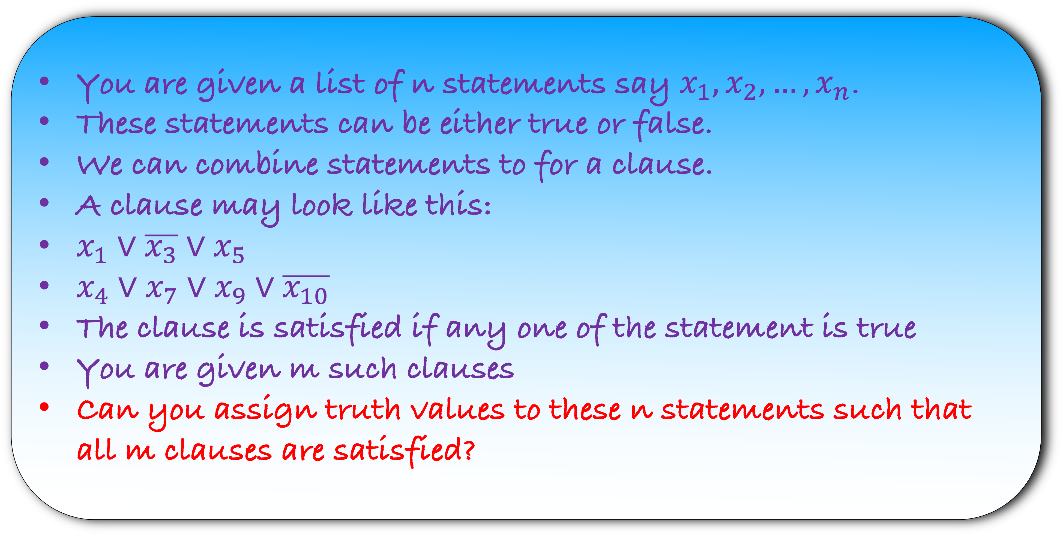
You are given a list of n statements say $x_{1},x_{2},…,x_{n}$.
These statements can be either true or false.
We can combine statements to for a clause.
A clause may look like this:
$x_{1}∨\overline{x_{3}}∨x_{5}$
$x_{4}∨x_{7}∨x_{9}∨\overline{x_{10}}$
The clause is satisfied if any one of the statement is true
You are given m such clauses
Can you assign truth values to these n statements such that all m clauses are satisfied?

Slide 19
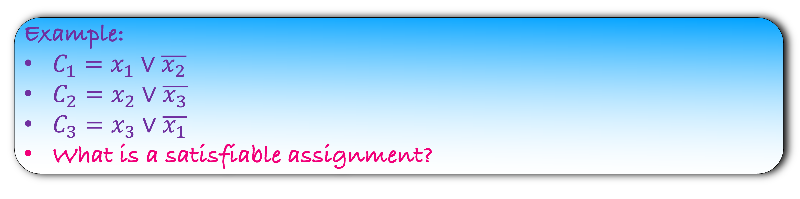
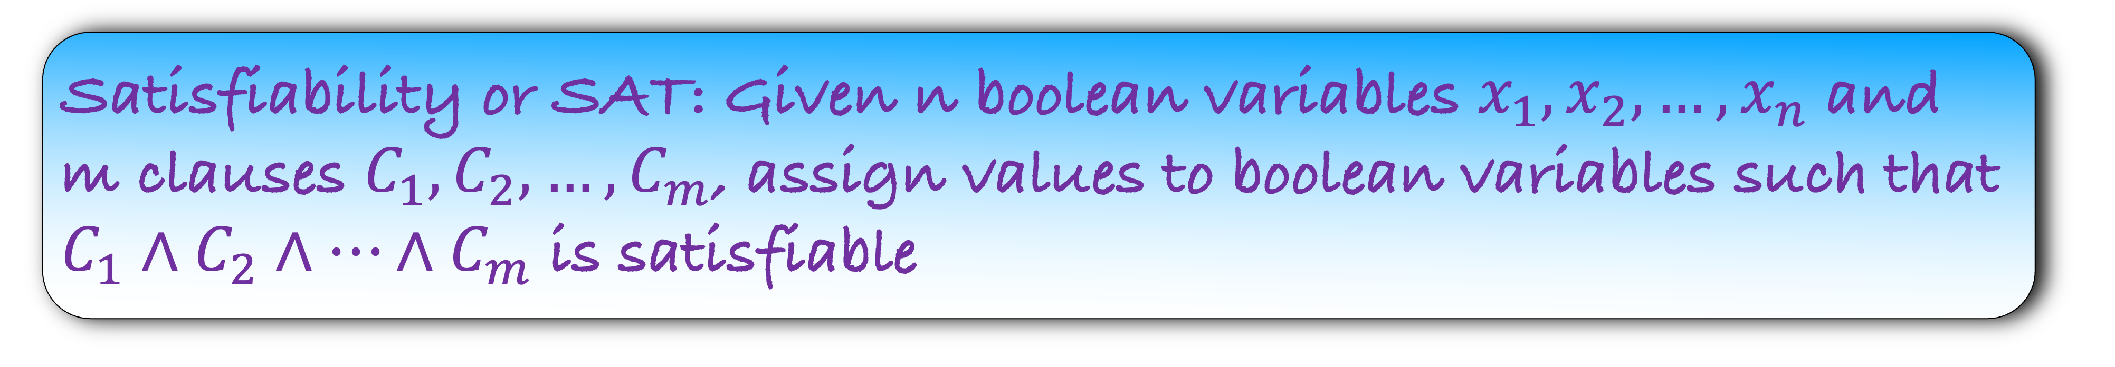
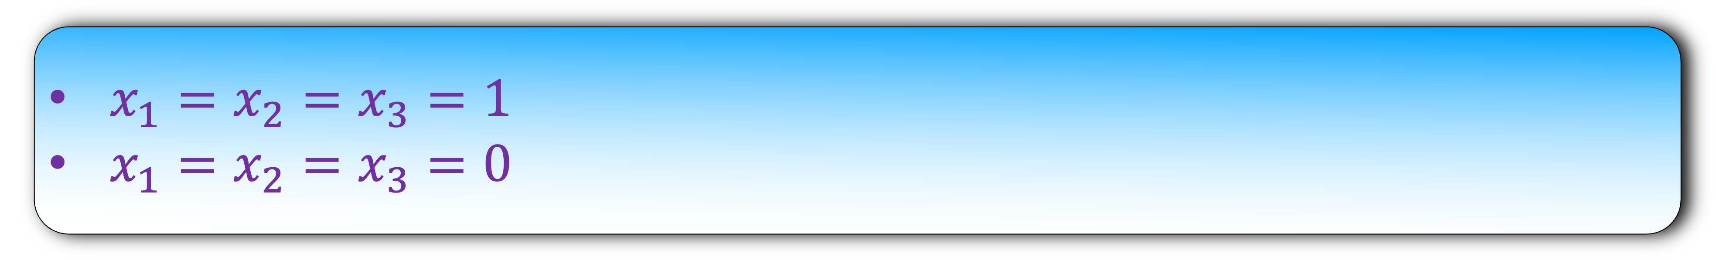
Satisfiability or SAT: Given n boolean variables $x_{1},x_{2},…,x_{n}$ and m clauses $C_{1},C_{2},…,C_{m}$, assign values to boolean variables such that $C_{1}∧C_{2}∧…∧C_{m}$ is satisfiable
Example:
$C_{1}=x_{1}∨\overline{x_{2}}$
$C_{2}=x_{2}∨\overline{x_{3}}$
$C_{3}=x_{3}∨\overline{x_{1}}$
What is a satisfiable assignment?
$x_{1}=x_{2}=x_{3}=1$
$x_{1}=x_{2}=x_{3}=0$

Slide 20
Satisfiability or SAT: Given n boolean variables $x_{1},x_{2},…,x_{n}$ and m clauses $C_{1},C_{2},…,C_{m}$, assign values to boolean variables such that $C_{1}∧C_{2}∧…∧C_{m}$ is satisfiable
Design an algorithm for the SAT problem

Slide 21
Factorization
Researchers have tried hard to solve these problems
But even our best efforts have failed
We are unable to understand why we are not able to solve these problems in polynomial time
The current consensus is that all these problems cannot be solved in polynomial time
But it is just a consensus, a belief
There is no proof and its frustating
Vertex Cover
Independent Set
Satisfiability
Clique
Coloring

Slide 22
Vertex Cover
Factorization
Independent Set
Satisfiability
Class P
Clique
Coloring
Our belief

Slide 23
Factorization
Vertex Cover
All these problems look different, but they have one common property
However, we need a slight modification in these problem to get there
Independent Set
Satisfiability
Clique
Coloring

Slide 24


Optimization version
Decision version
Find a satisfiable assignment
Is there a satisfiable assignment?
Find the minimum vertex cover
Is there a vertex cover of size $≤$ k?
Find the maximum independent set
Is there a maximum independent set of size $≥$ k?

Slide 25

Optimization version
Decision version
Find the maximum independent set
Is there a maximum independent set of size $≥$ k?
If you can solve the optimization version of the problem, you can use it to solve the decision version
If we can solve the decision version, then we can use it to solve the optimization version
Think how to do this

Slide 26
Factorization
Vertex Cover
Henceforth, we will assume that we are working with the decision version of the problem
All these problems look different, but they have one common property
Independent Set
Satisfiability
Clique
Coloring

Slide 27
NP

Slide 28
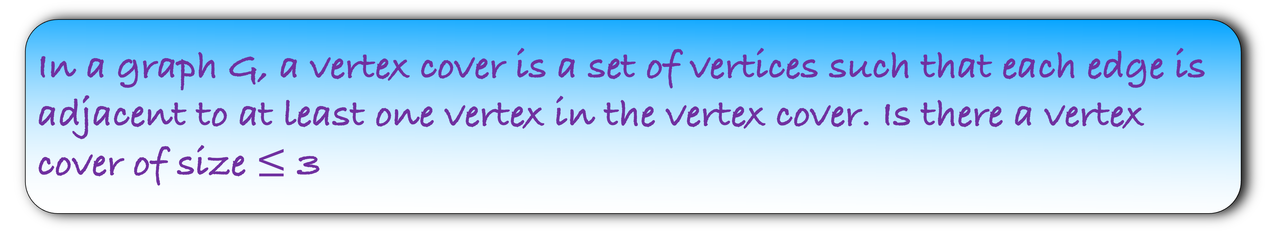
In a graph G, a vertex cover is a set of vertices such that each edge is adjacent to at least one vertex in the vertex cover. Is there a vertex cover of size $≤$ 3
Ans = {a,c,b}
Given the Ans, can you solve the problem in polynomial time?
Yes
Using the verifier, I can conclude the answer of this instance to be Yes
d
e
b
a
c
f

Slide 29
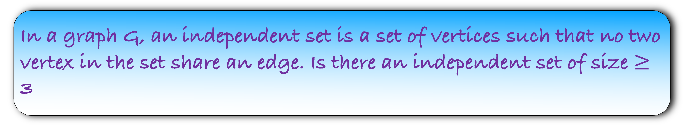
In a graph G, an independent set is a set of vertices such that no two vertex in the set share an edge. Is there an independent set of size $≥$ 3
Ans = {d,e,f}
Given the Ans, can you solve the problem in polynomial time?
Yes
Using the verifier, I can conclude the answer of this instance to be Yes
d
e
b
a
c
f

Slide 30
A problem X is in class NP, if it has an efficient verifier
X is in NP if
There exists a verifier Y and an Ans
Y is able to verify (using or without using Ans) if answer to an instance of X is Yes or No

Slide 31
Vertex Cover
Independent Set
We don’t know how to solve these problems in polynomial time
But these algorithms have efficient verifiers
All these problems are in NP
Satisfiability
Clique
Coloring

Slide 32
Relation between P and NP

Slide 33
Shortest Path
Sorting
These problems are in P
But are these problems in NP?
Max Flow
Edit Distance
Majority

Slide 34
A problem X is in class NP, if it has an efficient verifier
X is in NP if
There exists a verifier Y and an Ans
Y is able to verify (using or without using Ans) if answer to an instance of X is Yes or No
For problems in P, there is no need of an Ans
Or Ans can be a null answer
The verifier Y is the algorithm that solves the problem in polynomial time

Slide 35
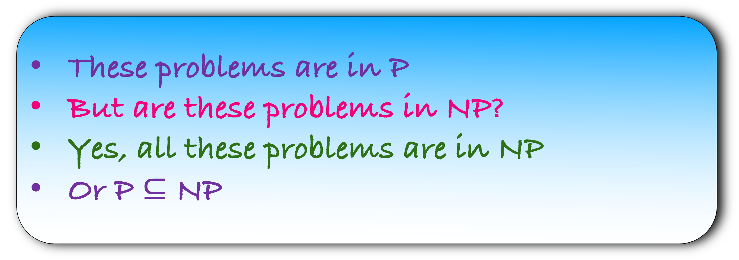
Shortest Path
Sorting
These problems are in P
But are these problems in NP?
Yes, all these problems are in NP
Or P $⊆$ NP
Max Flow
Edit Distance
Majority

Slide 36
Vertex Cover
Independent Set
Satisfiability
Class P
NP
Coloring
Clique

Slide 37
Vertex Cover
Satisfiability
Independent Set
Class P
Clique
Coloring
NP

Slide 38
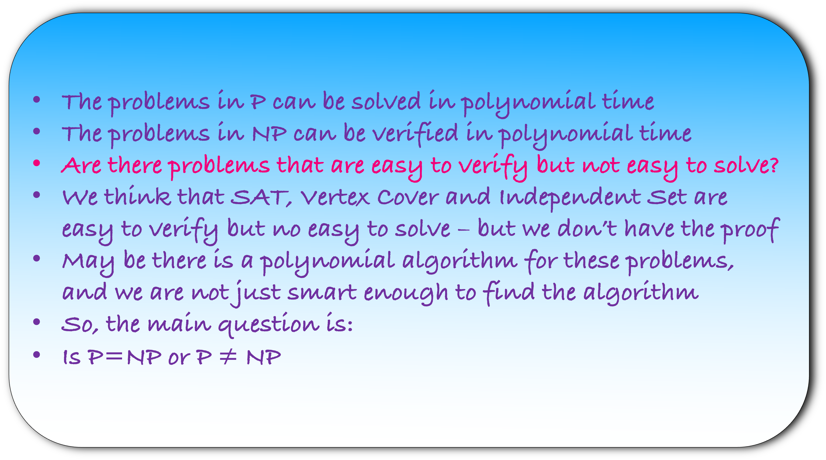
The problems in P can be solved in polynomial time
The problems in NP can be verified in polynomial time
Are there problems that are easy to verify but not easy to solve?
We think that SAT, Vertex Cover and Independent Set are easy to verify but no easy to solve – but we don’t have the proof
May be there is a polynomial algorithm for these problems, and we are not just smart enough to find the algorithm
So, the main question is:
Is P=NP or P $≠$ NP

Slide 39
The Millennium Prize Problems
Seven deep and difficult problems in mathematics
Birch and Swinnerton-Dyer Conjecture
Hodge Conjecture
Navier-Stokes Equation
P vs NP
Riemann Hypothesis
Yang-Mills and The Mass Gap
Poincaré Conjecture (Solved by Grigoriy Perelman in 2002)

Slide 40
Again, remember that we are not able to solve these problems in polynomial time
We believe that there is no polynomial time algorithm possible for these problem
However, we have noticed a pattern in these problems
A pattern so beautiful that it has created a whole new field of study
Let us now see it
Vertex Cover
Independent Set
Satisfiability
Clique
Coloring

Slide 41
Relation between problems in NP

Slide 42
Reduction
Maximum Matching
Maximum Flow
G
H
polynomial time
Recover the maximum matching using maximum flow answer

Slide 43
Maximum Matching
Maximum Flow
G
H
polynomial time
A problem A is polynomially time reducible to another problem B if
an instance of A can be solved in:
polynomial time and
using some polynomial call to instances of B

Slide 44
Maximum Matching
Maximum Flow
G
H
polynomial time
A problem A is polynomially time reducible to another problem B if
an instance of A can be solved in:
polynomial time and
using some polynomial call to instances of B

Slide 45
Maximum Matching
Maximum Flow
G
H
polynomial time
A problem A is polynomially time reducible to another problem B if
an instance of A can be solved in:
polynomial time and
using some polynomial call to instances of B

Slide 46
Maximum Matching
Maximum Flow
G
H
polynomial time
A problem A is polynomially time reducible to another problem B if
an instance of A can be solved in:
polynomial time and
using some polynomial call to instances of B

Slide 47
Maximum Matching
Maximum Flow
G
H
polynomial time
A problem A is polynomially time reducible to another problem B if
an instance of A can be solved in:
polynomial time and
using one call to an instance of B

Slide 48
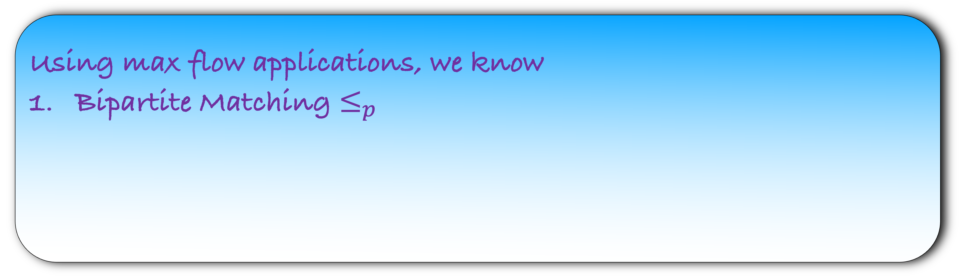
A problem A is polynomially time reducible to another problem B if
an instance of A can be solved in:
polynomial time and
using polynomial call to instances of B
In short, we write $A≤_{p}B$
Using max flow applications, we know
Bipartite Matching $≤_{p}$

Slide 49
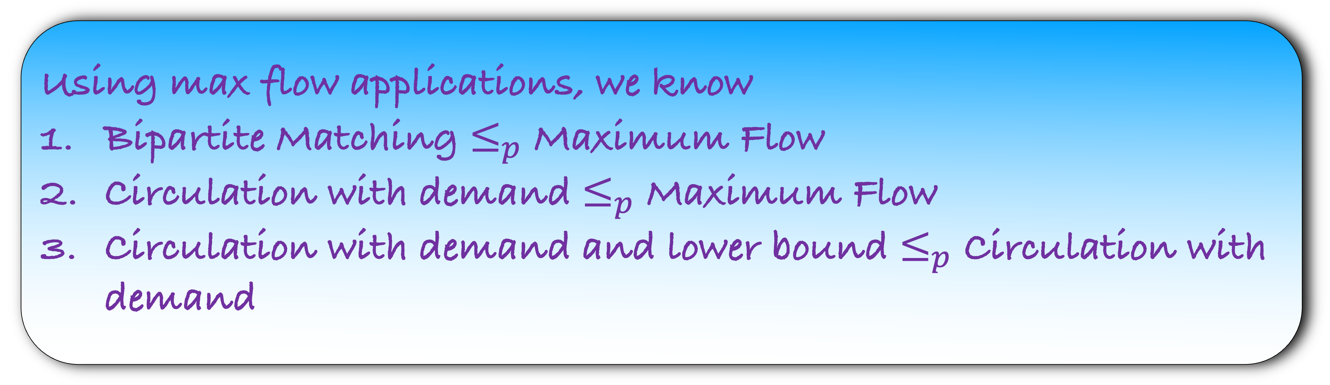
A problem A is polynomially time reducible to another problem B if
an instance of A can be solved in:
polynomial time and
using polynomial call to instances of B
In short, we write $A≤_{p}B$
Using max flow applications, we know
Bipartite Matching $≤_{p}$ Maximum Flow
Circulation with demand $≤_{p}$ Maximum Flow
Circulation with demand and lower bound $≤_{p}$ Circulation with demand

Slide 50

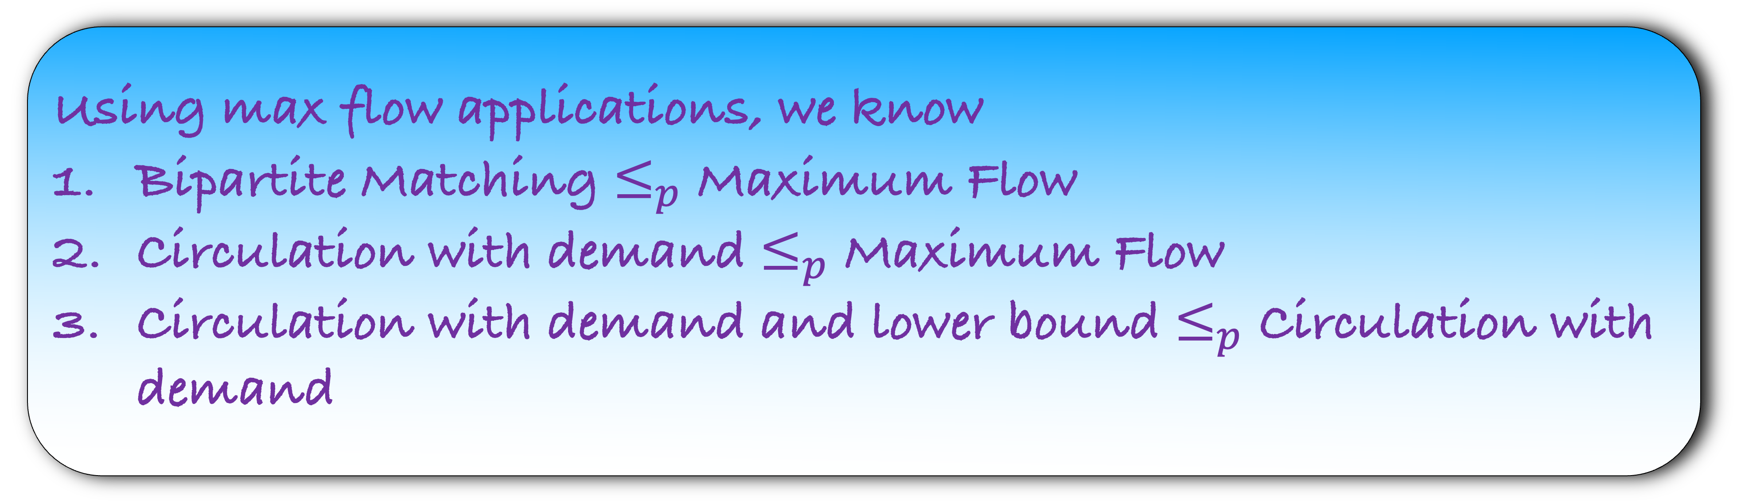
Using max flow applications, we know
Bipartite Matching $≤_{p}$ Maximum Flow
Circulation with demand $≤_{p}$ Maximum Flow
Circulation with demand and lower bound $≤_{p}$ Circulation with demand
Can we say that Circulation with demand $≤_{p}$ Maximum Flow?
Yes, but it requires proof

Slide 51



Can we say that Circulation with demand $≤_{p}$ Maximum Flow?
Yes, but it requires proof
Lemma: If $A≤_{p} B$ and $B≤_{p} C$, then show that $A≤_{p}C$
HW: Try to prove this just using the definition of $≤_{p}$

Slide 52
Remember that want to find relation between problems in NP
We now have all notations in place
Hope that you see what relation we want to find:

Slide 53
Remember that want to find relation between problems in NP
We now have all notations in place
Hope that you see what relation we want to find: reductions

Slide 54
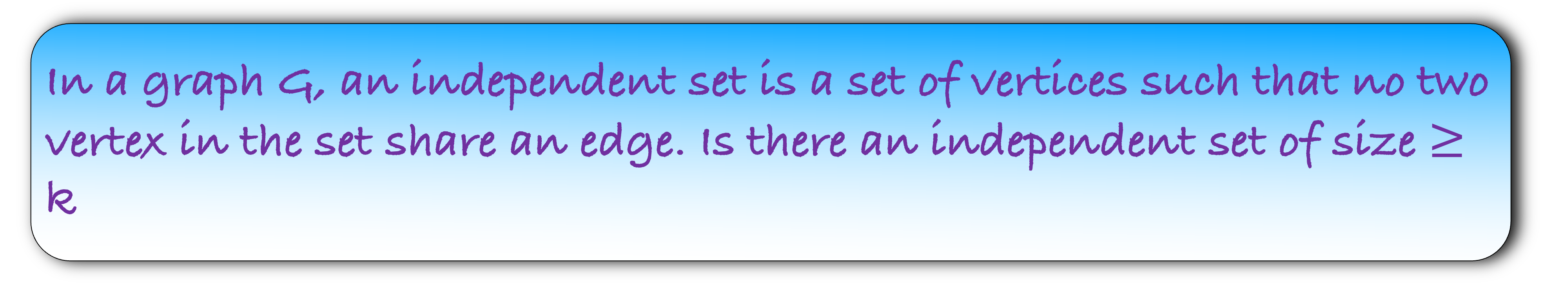
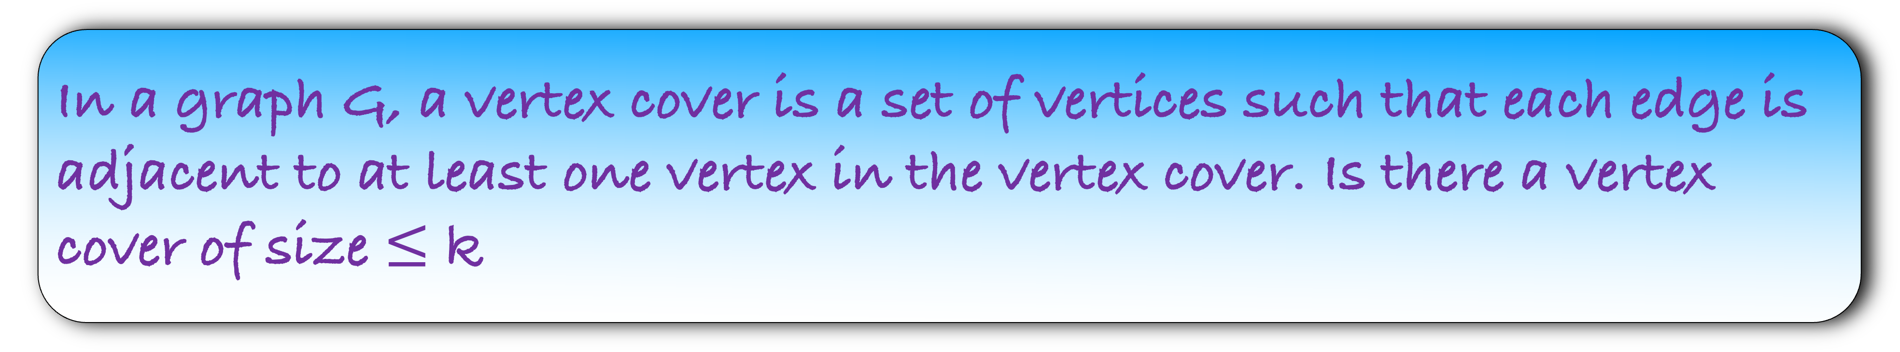
In a graph G, a vertex cover is a set of vertices such that each edge is adjacent to at least one vertex in the vertex cover. Is there a vertex cover of size $≤$ k
In a graph G, an independent set is a set of vertices such that no two vertex in the set share an edge. Is there an independent set of size $≥$ k
Show that Independent Set $≤_{p}$ Vertex Cover

Slide 55
Show that Independent Set $≤_{p}$ Vertex Cover
Step 1) Convert the instance of problem A into an instance of
Problem B (which we know how to solve)
Step 2) Solve the instance of problem B
Step 3) Using the solution of problem B recover the answer of
problem A
Step 4) Prove that your answer is correct

Slide 56
Show that Independent Set $≤_{p}$ Vertex Cover
Step 1) Convert the instance of problem A into an instance of
Problem B (which we know how to solve)
Step 2) Solve the instance of problem B
Step 3) Using the solution of problem B recover the answer of
problem A
Step 4) Prove that your answer is correct

Slide 57
Show that Independent Set $≤_{p}$ Vertex Cover
Step 1) Convert the instance of problem A into an instance of
Problem B (which we know how to solve)
Step 2) Assume an oracle that solves the instance of problem B
Step 3) Using the solution of problem B recover the answer of
problem A
Step 4) Prove that your answer is correct

Slide 58
Show that Independent Set $≤_{p}$ Vertex Cover
d
Step 1) Construct H using G
e
b
a
c
f
G

Slide 59
Show that Independent Set $≤_{p}$ Vertex Cover
Step 2) Assume that an oracle solves the vertex cover problem
H
d
e
For the independent set the parameter is k
But for the vertex cover, we can choose our parameter
What parameter should we choose?
b
a
c
f
This will require some insights about the relation between independent set and vertex cover

Slide 60
Independent Set
Vertex Cover
d
d
e
e
b
b
a
a
c
f
c
f
All the vertices that not in independent set are in the vertex cover in this example

Slide 61
Independent Set
Vertex Cover
d
d
e
e
b
b
a
a
c
f
c
f
All the vertices that not in independent set are in the vertex cover in this example

Slide 62
Lemma: If X be an independent set in G, then V-X is a vertex cover in G
Proof:
Let us assume for contradiction that V-X is not a vertex cover
This implies that there is an edge in G such that none of its endpoint is in V-X
This edge must not have any of its endpoint in V-X
d
e
b
a
c
f
Independent set
Vertex Cover

Slide 63
Lemma: If X be an independent set in G, then V-X is a vertex cover in G
Proof:
Let us assume for contradiction that V-X is not a vertex cover
This implies that there is an edge in G such that none of its endpoint is in V-X
This edge must not have any of its endpoint in V-X
Without loss of generality, let ef be that edge
Can you see the contradiction?
But then both e and f cannot be in the independent set
A contradiction
d
e
b
a
c
f
Independent set
Vertex Cover

Slide 64
Lemma: If V-X be a vertex cover in G, then X is a vertex cover in G
Proof:
Let us assume for contradiction that X is not an independent set
This implies that there is an edge between two vertices in independent set
d
e
b
a
c
f
Independent set
Vertex Cover

Slide 65
Lemma: If V-X be a vertex cover in G, then X is a vertex cover in G
Proof:
Let us assume for contradiction that X is not an independent set
This implies that there is an edge between two vertices in independent set
Without loss of generality, let bc be that edge
Can you see the contradiction?
But the endpoints of the edge bc are not in the vertex cover
So, V-X is not a vertex cover
A contradiction
d
e
b
a
c
f
Independent set
Vertex Cover

Slide 66
Lemma: If X be an independent set in G, then V-X is a vertex cover in G
Lemma: If V-X be a vertex cover in G, then X is a vertex cover in G
Lemma: X is an independent set in G, iff V-X is a vertex cover in G
Let us now go back to our reduction

Slide 67

Show that Independent Set $≤_{p}$ Vertex Cover
Step 2) Assume that an oracle solves the vertex cover problem
H
d
For the independent set the parameter is k
But for the vertex cover, we can choose our parameter
What parameter should we choose?
e
b
a
c
f
Is there a vertex cover in H of size $≤$ n-k?

Slide 68

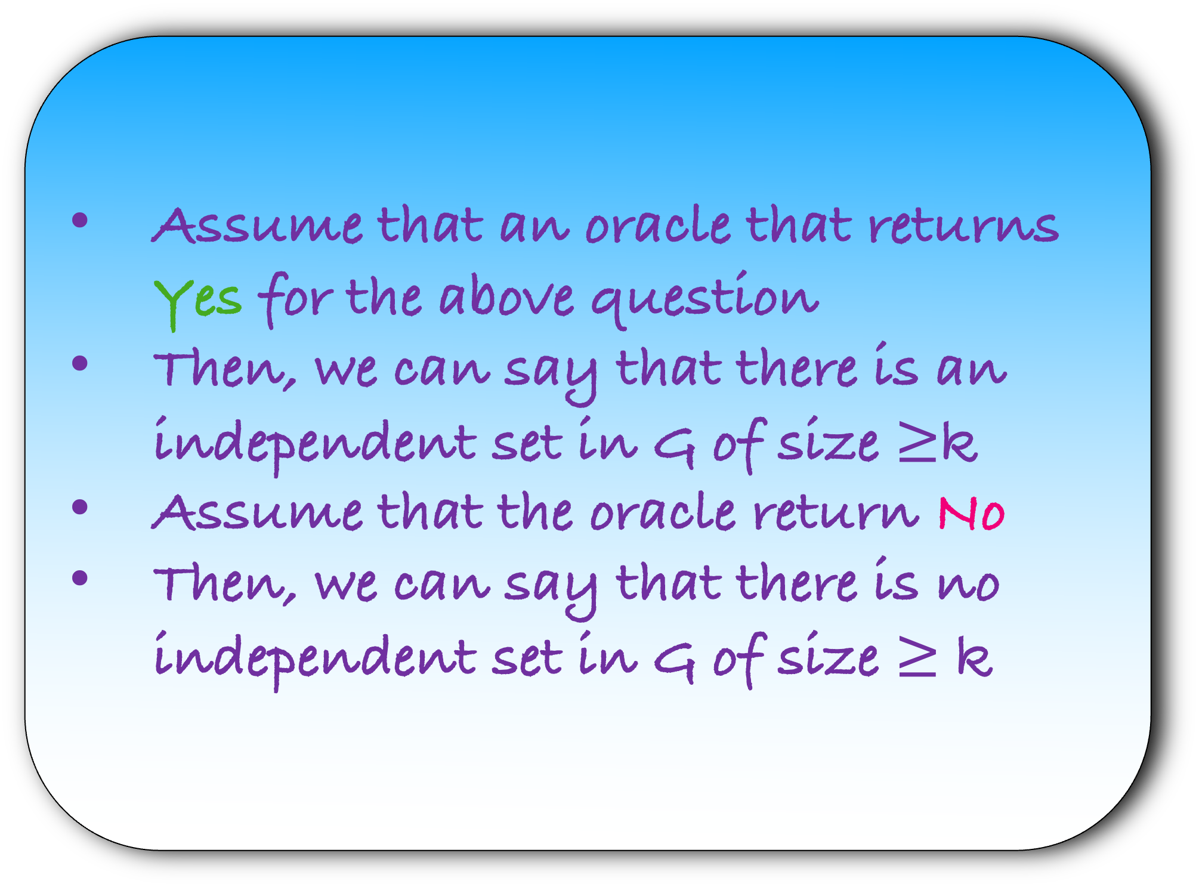
Show that Independent Set $≤_{p}$ Vertex Cover
Is there a vertex cover in H of size $≤$ n-k?
H
d
e
Assume that an oracle that returns Yes for the above question
Then, we can say that there is an independent set in G of size $≥$k
Assume that the oracle return No
Then, we can say that there is no independent set in G of size $≥$ k
b
a
c
f
Step 3) Recover the independent set answer using vertex cover answer

Slide 69
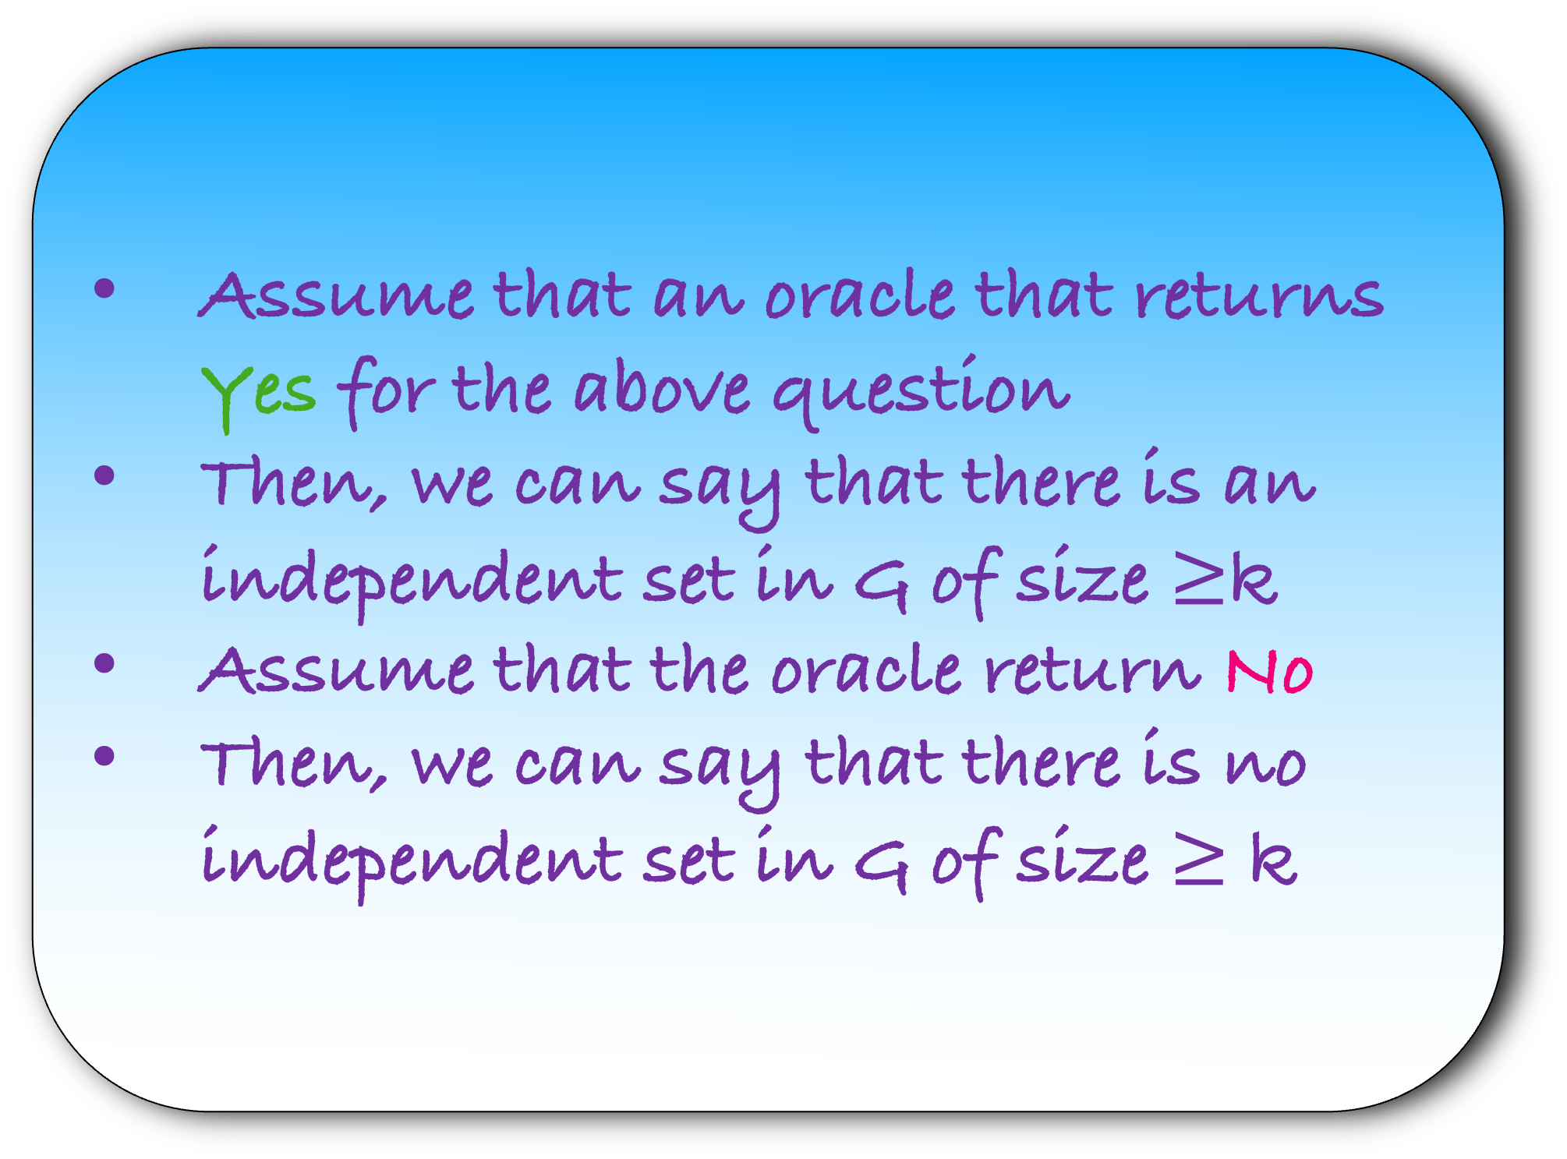
Show that Independent Set $≤_{p}$ Vertex Cover
Assume that an oracle that returns Yes for the above question
Then, we can say that there is an independent set in G of size $≥$k
Assume that the oracle return No
Then, we can say that there is no independent set in G of size $≥$ k
Step 4) Prove that your answer is correct
Lemma: X is an independent set in G, iff V-X is a vertex cover in G

Slide 70

H.W: Show that Vertex Cover $≤_{p}$Independent Set

Slide 71
You are given m mobile towers and n customers. Each mobile tower can serve a subset of n customers. Choose minimum number of mobile towers that can server all the customers
Note the difference between this problem and the one we managed to solve using flows
We donot know how to solve this problem in polynomial time
Let us formally define this problem

Slide 72
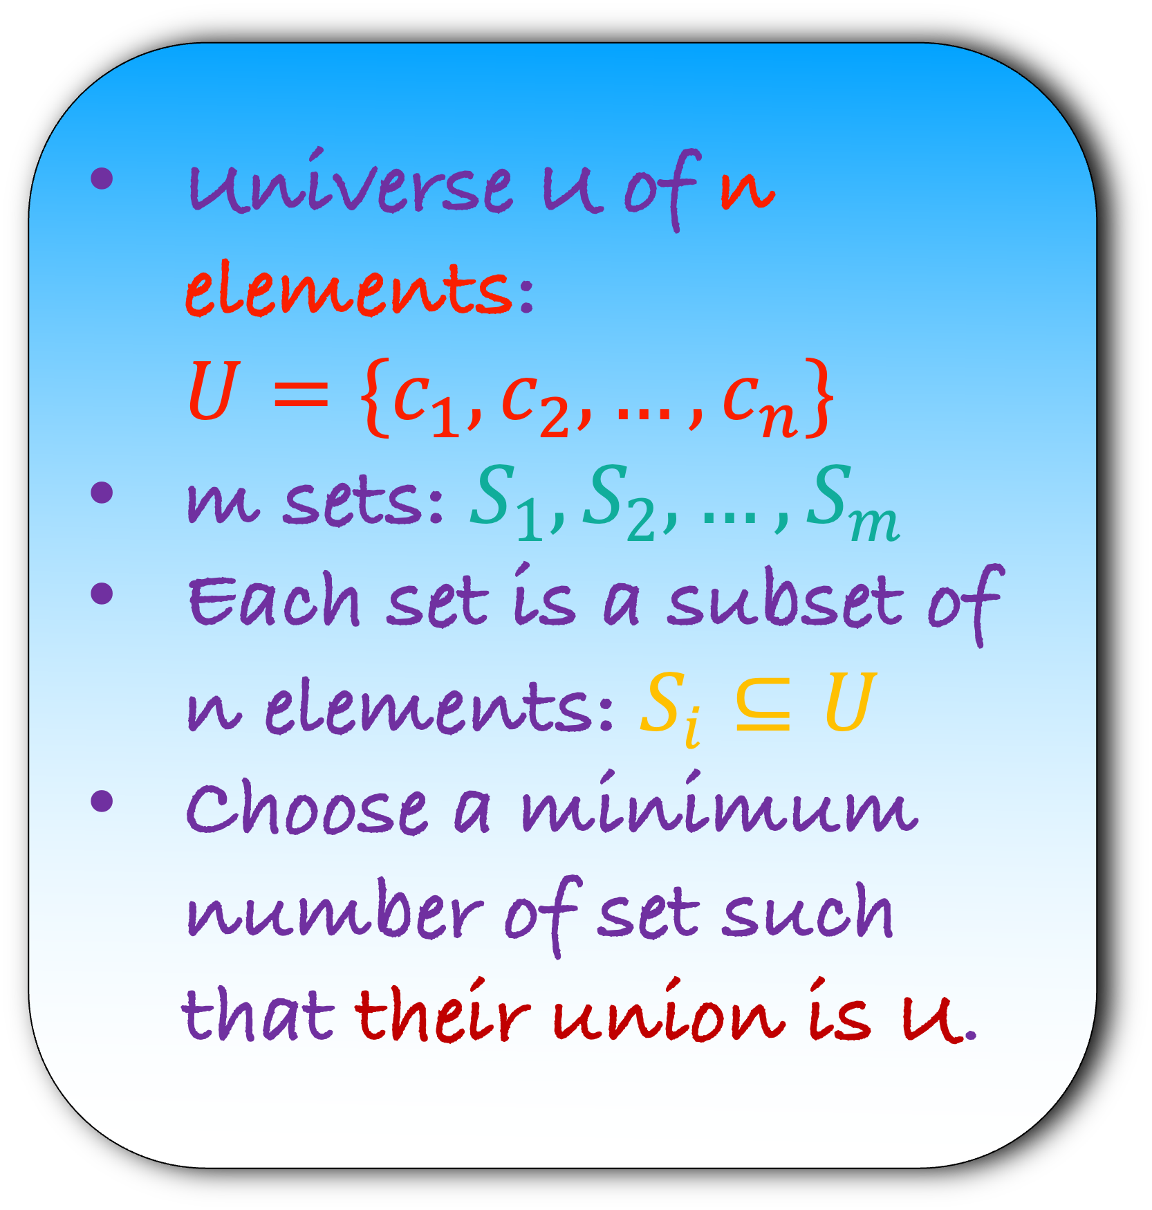
You are given m mobile towers and n customers. Each mobile tower can server a subset of n customers. Choose minimum number of mobile towers that can server all the customers
Universe U of n elements: ${U=\{c}_{1},c_{2},…,c_{n}\}$
m sets: $S_{1},S_{2},…,S_{m}$
Each set is a subset of n elements: $S_{i}⊆U$
Choose a minimum number of set such that their union is U.
Set Cover

Slide 73


Set Cover: You are given a universe U of n elements and m sets. Each set is a subset of U. Is there a set cover of size $≤$ k
Decision Version of Set Cover
Lemma: Vertex Cover $≤$ Set Cover

Slide 74

Lemma: Vertex Cover $≤$ Set Cover
d
Step 1) Construct an instance of set cover using an instance of vertex cover
e
b
a
Note that unlike our previous problem we are not creating a. graph H
This is because Set Cover is not a graph problem
We have to create an instance of Set Cover problem
How would you do that?
c
f
G

Slide 75
Lemma: Vertex Cover $≤$ Set Cover
What is the universe U?
d
e
1
1
1
1
5
5
5
b
5
a
4
4
4
4
4
2
2
2
2
c
3
f
3
3
3
G

Slide 76

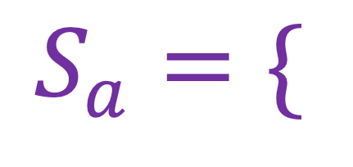
Lemma: Vertex Cover $≤$ Set Cover
What is the universe U?
d
U ={ }
1
2
3
4
5
e
1
1
1
5
5
b
5
What are the sets?
a
$$S_{a}=\{$$
$$\}$$
4
4
4
4
2
2
2
c
3
f
3
3
G

Slide 77

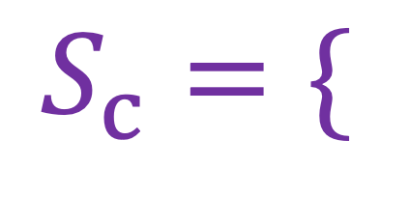


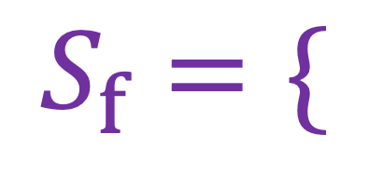
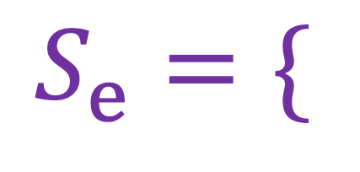

Lemma: Vertex Cover $≤$ Set Cover
What is the universe U?
d
U ={ }
1
2
3
4
5
e
1
1
5
5
b
5
What are the sets?
a
$$S_{a}=\{$$
$$\}$$
1
2
4
4
4
4
2
2
$$S_{b}=\{$$
$$\}$$
c
3
f
3
3
$$S_{c}=\{$$
$$\}$$
G
$$S_{d}=\{$$
$$\}$$
$$S_{e}=\{$$
$$\}$$
$$S_{f}=\{$$
$$\}$$

Slide 78
Lemma: Vertex Cover $≤$ Set Cover
What is the universe U?
d
U ={ }
1
2
3
4
5
e
1
b
5
What are the sets?
a
$$S_{a}=\{$$
$$\}$$
1
2
4
4
2
$$S_{b}=\{$$
5
4
$$\}$$
c
3
f
$$S_{c}=\{$$
3
2
$$\}$$
G
$$S_{d}=\{$$
1
$$\}$$
$$S_{e}=\{$$
5
$$\}$$
$$S_{f}=\{$$
4
3
$$\}$$

Slide 79
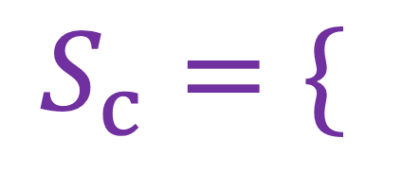






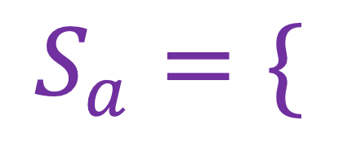
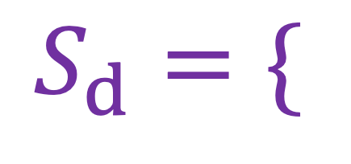
Lemma: Vertex Cover $≤$ Set Cover
U ={ }
1
2
3
4
5
d
$$S_{a}=\{$$
1
2
$$\}$$
e
1
5
$$S_{b}=\{$$
5
4
$$\}$$
b
a
$$S_{c}=\{$$
3
2
$$\}$$
4
4
2
$$S_{d}=\{$$
1
$$\}$$
c
3
f
$$S_{e}=\{$$
$$\}$$
5
G
$$S_{f}=\{$$
4
3
$$\}$$
Step 2) Assume that an oracle solves the set cover problem
But what question will you ask the oracle?

Slide 80
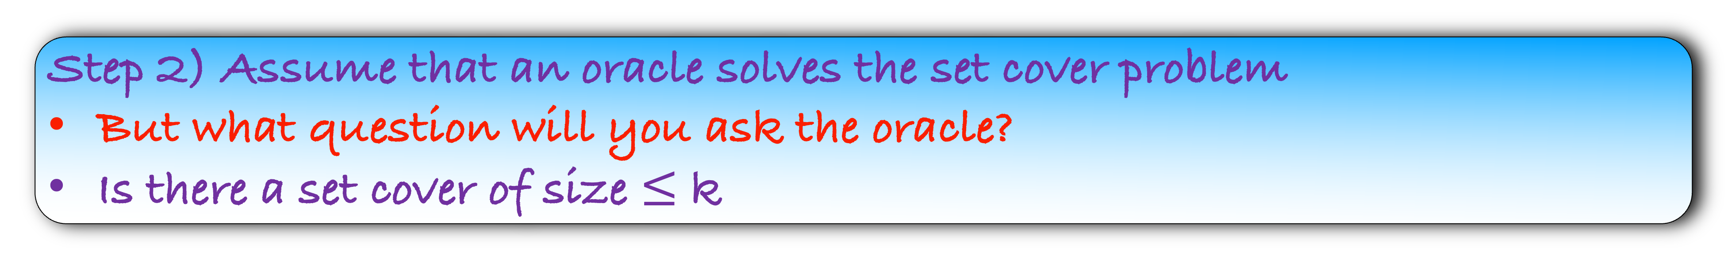
Lemma: Vertex Cover $≤$ Set Cover
U ={ }
1
2
3
4
5
d
$$S_{a}=\{$$
1
2
$$\}$$
e
1
5
$$S_{b}=\{$$
5
4
$$\}$$
b
a
$$S_{c}=\{$$
3
2
$$\}$$
4
4
2
$$S_{d}=\{$$
1
$$\}$$
c
3
f
$$S_{e}=\{$$
$$\}$$
5
G
$$S_{f}=\{$$
4
3
$$\}$$
Step 2) Assume that an oracle solves the set cover problem
But what question will you ask the oracle?
Is there a set cover of size $≤$ k

Slide 81
Lemma: Vertex Cover $≤$ Set Cover
U ={ }
1
2
3
4
5
d
$$S_{a}=\{$$
1
2
$$\}$$
e
1
5
$$S_{b}=\{$$
5
4
$$\}$$
b
a
$$S_{c}=\{$$
3
2
$$\}$$
4
4
2
$$S_{d}=\{$$
1
$$\}$$
c
3
f
$$S_{e}=\{$$
$$\}$$
5
G
$$S_{f}=\{$$
4
3
$$\}$$
Step 3) Recover the vertex cover answer using set cover answer
How to do that?
If the oracle returns Yes, we also return Yes
If the oracle returns No, we also return No

Slide 82
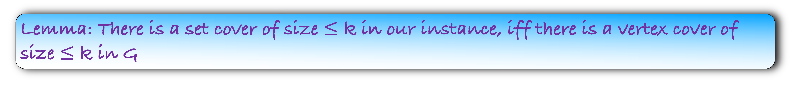
Step 4) Prove that your answer is correct
Lemma: There is a set cover of size $≤$ k in our instance, iff there is a vertex cover of size $≤$ k in G

Slide 83
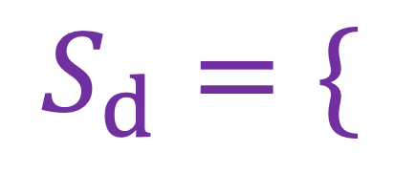
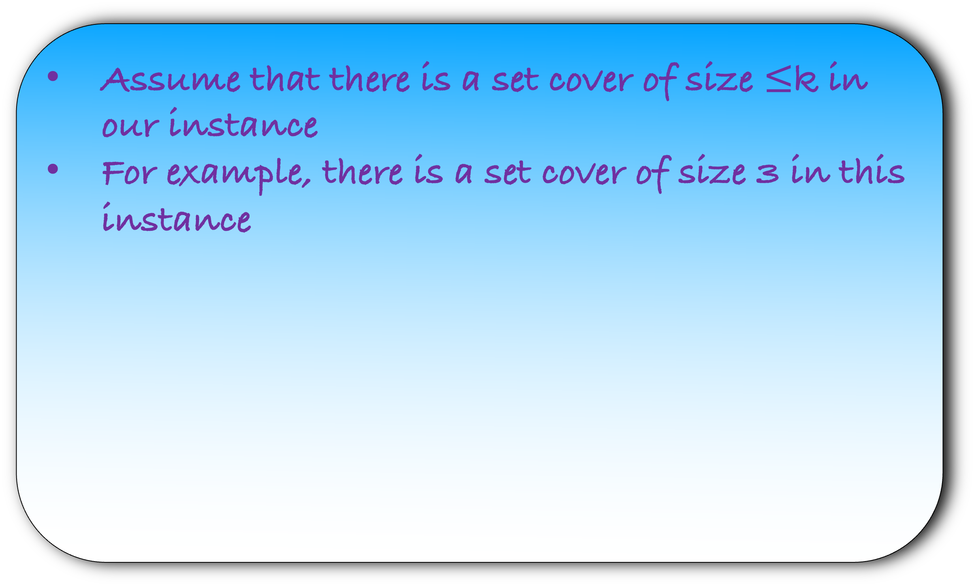
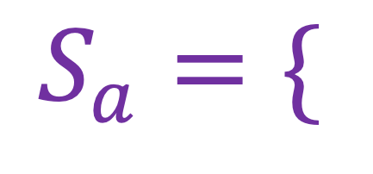
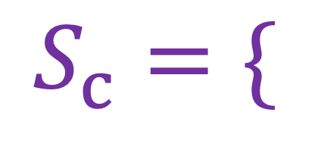




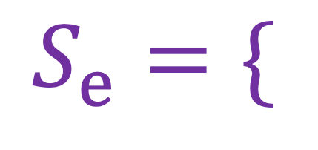


Lemma: If there is a set cover of size $≤$ k in our instance, then there is a vertex cover of size $≤$ k in G
U ={ }
Assume that there is a set cover of size $≤$k in our instance
For example, there is a set cover of size 3 in this instance
1
2
3
4
5
$$S_{a}=\{$$
1
2
$$\}$$
$$S_{b}=\{$$
5
4
$$\}$$
$$S_{c}=\{$$
3
2
$$\}$$
$$S_{d}=\{$$
1
$$\}$$
$$S_{e}=\{$$
5
$$\}$$
$$S_{f}=\{$$
4
3
$$\}$$

Slide 84
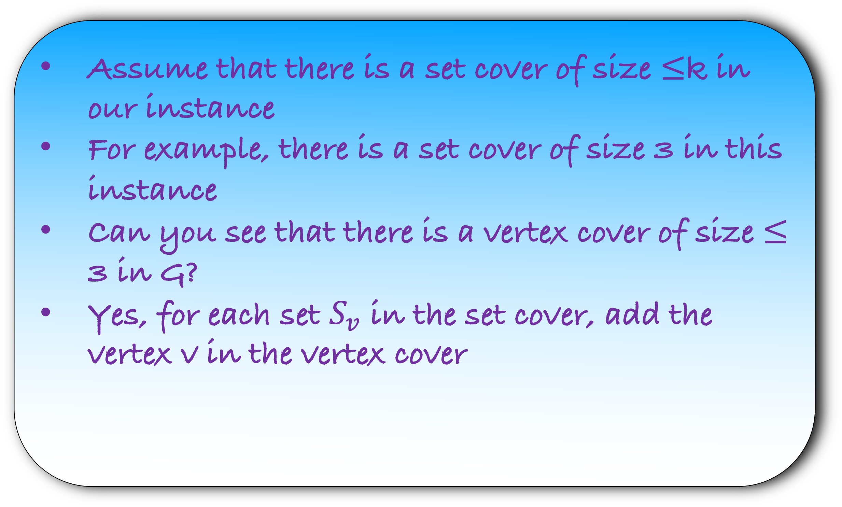
Lemma: If there is a set cover of size $≤$ k in our instance, then there is a vertex cover of size $≤$ k in G
U ={ }
Assume that there is a set cover of size $≤$k in our instance
For example, there is a set cover of size 3 in this instance
Can you see that there is a vertex cover of size $≤$ 3 in G?
Yes, for each set $S_{v}$ in the set cover, add the vertex v in the vertex cover
1
2
3
4
5
$$S_{a}=\{$$
1
2
$$\}$$
$$S_{b}=\{$$
5
4
$$\}$$
$$S_{c}=\{$$
3
2
$$\}$$
$$S_{d}=\{$$
1
$$\}$$
$$S_{e}=\{$$
5
$$\}$$
$$S_{f}=\{$$
4
3
$$\}$$

Slide 85
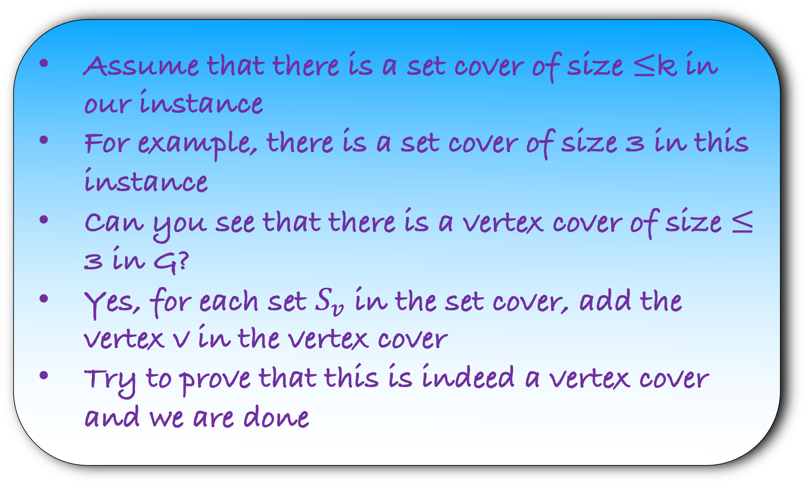
Lemma: If there is a set cover of size $≤$ k in our instance, then there is a vertex cover of size $≤$ k in G
d
Assume that there is a set cover of size $≤$k in our instance
For example, there is a set cover of size 3 in this instance
Can you see that there is a vertex cover of size $≤$ 3 in G?
Yes, for each set $S_{v}$ in the set cover, add the vertex v in the vertex cover
Try to prove that this is indeed a vertex cover and we are done
e
1
b
5
a
4
4
2
c
3
f
G

Slide 86

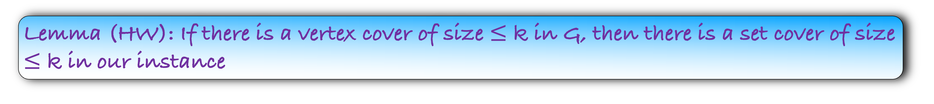

Lemma: If there is a set cover of size $≤$ k in our instance, then there is a vertex cover of size $≤$ k in G
Lemma (HW): If there is a vertex cover of size $≤$ k in G, then there is a set cover of size $≤$ k in our instance
Lemma: There is a vertex cover of size $≤$ k in G, iff there is a set cover of size $≤$ k in our instance
Step 4) Prove that your answer is correct

