Slide 1
NP-Completeness

Slide 2
A problem A is polynomially time reducible to another problem B if
an instance of A can be solved in:
polynomial time and
using polynomial call to instances of B
In short, we write $A≤_{p}B$
Very Important Observation: If B is solvable in polynomial time, then

Slide 3
A problem A is polynomially time reducible to another problem B if
an instance of A can be solved in:
polynomial time and
using polynomial call to instances of B
In short, we write $A≤_{p}B$
Very Important Observation: If B is solvable in polynomial time, then A is solvable in polynomial time
Very Important Observation: If A is not solvable in polynomial time, then

Slide 4
A problem A is polynomially time reducible to another problem B if
an instance of A can be solved in:
polynomial time and
using polynomial call to instances of B
In short, we write $A≤_{p}B$
Very Important Observation: If B is solvable in polynomial time, then A is solvable in polynomial time
Very Important Observation: If A is not solvable in polynomial time, then B is not solvable in polynomial time

Slide 5
Very Important Observation: If B is solvable in polynomial time, then A is solvable in polynomial time
Very Important Observation: If A is not solvable in polynomial time, then B is not solvable in polynomial time
Proof (Sketch):
Assume for contradiction that B is solvable in polynomial time. But then using the first observation A is also solvable in polynomial time.
The above two statements are logically equivalent

Slide 6
You are working in a company
Your boss gives you a new problem X and asks you to find an efficient solution to this problem
You think about it for a month but are unable to solve it
But one day, you come to know why you are not able to solve the problem
You show that Vertex Cover $≤$ X

Slide 7
You show that Vertex Cover $≤$ X
$$A≤_{p}B$$
Very Important Observation: If B is solvable in polynomial time, then A is solvable in polynomial time
Very Important Observation: If A is not solvable in polynomial time, then B is not solvable in polynomial time
You go back to your boss and say that it is highly unlikely that X is solvable efficiently

Slide 8
The most important problem in NP

Slide 9




Vertex Cover
$$≤$$
$$≤$$
Satisfiability
Independent Set
$$≤$$
$$≤$$
Class P
Clique
$$≤$$
Coloring
NP

Slide 10

Vertex Cover
$$≤$$
$$≤$$
Satisfiability
Independent Set
$$≤$$
$$≤$$
Class P
Clique
Coloring
NP

Slide 11
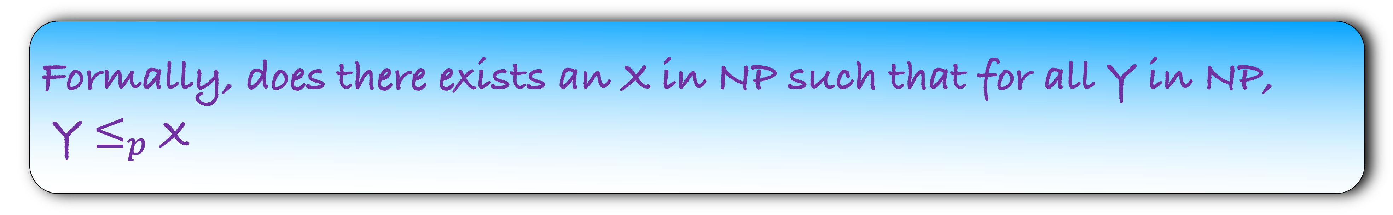
Is there a problem in NP such that all other problems in NP can be reduced to it?
Formally, does there exists an X in NP such that for all Y in NP,
Y $≤_{p}$ X
My intuition would be that such a problem does not exists
There may be crores of problems in NP each with different degree of difficulty
How can all of them reduce to one single problem
But surprisingly, such a problem exists

Slide 12
Is there a problem in NP such that all other problems in NP can be reduced to it?
Formally, does there exists an X in NP such that for all Y in NP,
Y $≤_{p}$ X
Circuit Satisfiability
A remarkable result proved by Cook and Levin (1971)
We will not prove this result as it is out of scope of this course
Let us see the problem

Slide 13
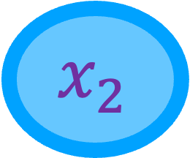
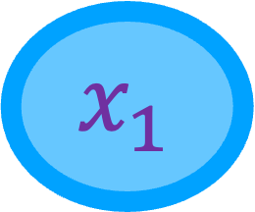
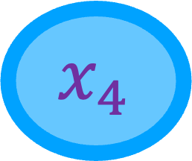
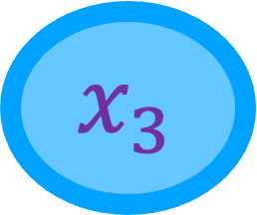
You have k Boolean variables
$${ x}_{1}$$
$${ x}_{2}$$
$${ x}_{3}$$
$${ x}_{4}$$

Slide 14

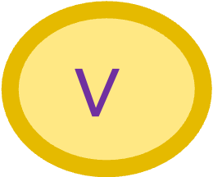

You have k Boolean variables
And three gates, AND, OR and NOT
$${ x}_{1}$$
$${ x}_{2}$$
$${ x}_{3}$$
$${ x}_{4}$$
$$∧$$
$$∨$$
$$¬$$

Slide 15

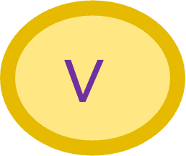


You have k Boolean variables
And three gates, AND, OR and NOT
The variables and gates form a circuit
$${ x}_{1}$$
$${ x}_{2}$$
$${ x}_{3}$$
$${ x}_{4}$$
$$∧$$
$$∨$$
$$∧$$
$$¬$$
Does there exists an input for which the output=1?
Output

Slide 16
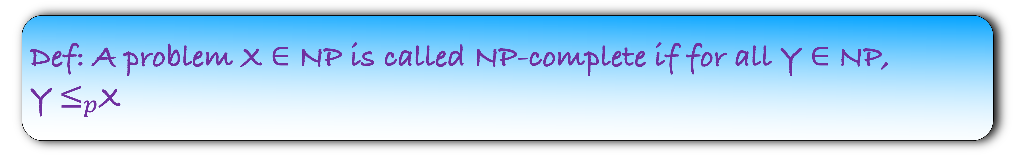
Circuit Satisfiability is the most important problem in NP
But we use a CS jargon for it
It is NP-complete
Def: A problem X $∈$ NP is called NP-complete if for all Y $∈$ NP, Y$≤_{p}$X

Slide 17
Circuit Satisfiability is NP-Complete
But we use a CS jargon for it
It is NP-complete
Def: A problem X $∈$ NP is called NP-complete if for all Y $∈$ NP, Y$≤_{p}$X

Slide 18

Circuit Satisfiability is NP-Complete
But we use a CS jargon for it
It is NP-complete
Def: A problem X $∈$ NP is called NP-complete if for all Y $∈$ NP, Y$≤_{p}$X
Suppose, I am able to show that Circuit Satisfiability $≤_{p}$ SAT, then

Slide 19
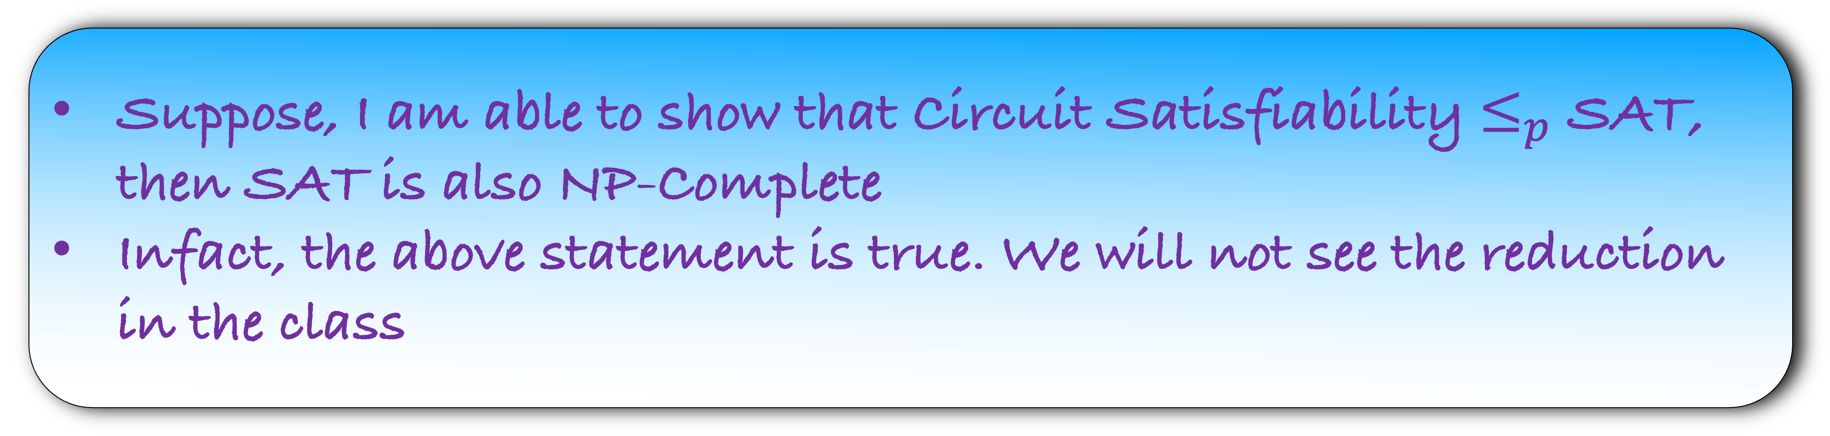
Circuit Satisfiability is NP-Complete
But we use a CS jargon for it
It is NP-complete
Def: A problem X $∈$ NP is called NP-complete if for all Y $∈$ NP, Y$≤_{p}$X
Suppose, I am able to show that Circuit Satisfiability $≤_{p}$ SAT, then SAT is also NP-Complete
Infact, the above statement is true. We will not see the reduction in the class

Slide 20
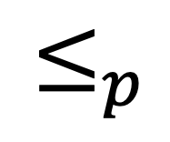
NP-complete Problems
Circuit Satisfiability
SAT
Vertex Cover
$$≤_{p}$$

Slide 21
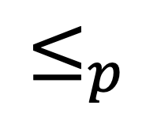
NP-complete Problems
Circuit Satisfiability
SAT
Vertex Cover
Independent Set
$$≤_{p}$$

Slide 22
NP-complete Problems
In fact, there are thousands of problems that are NP-Complete
We have seen few of them in the class
Circuit Satisfiability
SAT
Vertex Cover
Independent Set

