Slide 1

Prims Algorithm
Robert Prim
1957

Slide 2
Start with a trivial cut {a}, V-{a}.
5
d
a
Apply the cut property.
15
V-S
10
1
9
6
S
b
7
f
2
3
8
c
4
e

Slide 3
Start with a trivial cut {a}, V-{a}.
5
d
a
Apply the cut property.
15
V-S
10
1
9
6
S
b
7
f
2
3
8
c
4
e

Slide 4
Start with a trivial cut {a}, V-{a}.
5
d
a
Apply the cut property.
15
V-S
1
10
Apply the cut property again.
9
b
6
7
3
f
S
2
8
c
4
e

Slide 5
Start with a trivial cut {a}, V-{a}.
5
d
a
Apply the cut property.
15
V-S
1
10
Apply the cut property again.
9
b
6
7
3
f
S
2
8
c
4
e

Slide 6
Start with a trivial cut {a}, V-{a}.
5
d
a
Apply the cut property.
15
V-S
1
10
Apply the cut property again.
6
9
b
7
2
3
f
8
c
4
e
S

Slide 7
Start with a trivial cut {a}, V-{a}.
5
d
a
Apply the cut property.
15
V-S
1
10
Apply the cut property again.
6
9
But why is (a,c) not in the minimum spanning tree?
b
7
3
f
Can we formally prove it?
2
8
c
4
e
S

Slide 8
Cycle Property: Let C be a cycle in the graph, then the heaviest edge in the cycle is not in the MST.
5
d
a
10
9
1
b
7
6
4
2
f
8
e
c
3

Slide 9
Cycle Property: Let C be a cycle in the graph, then the heaviest edge in the cycle is not in the MST.
5
d
a
10
9
1
b
7
6
4
2
f
8
e
c
3

Slide 10
Proof:
Let us assume that the edge (a,f) is in the minimum spanning tree T.
5
d
a
10
1
b
2
f
e
c
3

Slide 11
Proof:
Let us assume that the edge (a,f) is in the minimum spanning tree T.
Consider the cut (S,V-s) obtained by removing the edge (a,f).
We claim there is an edge going across the cut with weight less than w(a,f)
Remember the cycle C
5
a
d
10
V-S
1
b
2
f
e
c
3
S

Slide 12
Proof:
Let us assume that the edge (a,f) is in the minimum spanning tree T.
Consider the cut (S,V-s) obtained by removing the edge (a,f).
We claim there is an edge going across the cut with weight less than w(a,f)
Remember the cycle C
Remove (a,f) from T and add (e,f) to T
5
a
d
10
V-S
1
b
4
2
f
8
e
c
3
S

Slide 13
Proof:
Let us assume that the edge (a,f) is in the minimum spanning tree T.
Consider the cut (S,V-s) obtained by removing the edge (a,f).
We claim there is an edge going across the cut with weight less than w(a,f)
Remember the cycle C
Remove (a,f) from T and add (e,f) to T
T-(a,f)+(e,f) is a tree with lesser weight.
But we started out with a minimum spanning tree T.
This implies that our assumption is wrong.
Or, in words, (a,f) is not in the minimum spanning tree.
5
a
d
V-S
1
b
2
f
8
e
c
3
S

Slide 14
Coming back to Prim’s algorithm example.
5
d
a
But why is (a,c) not in the minimum spanning tree?
15
V-S
1
Can we formally prove it?
10
6
9
Can you see that there is a cycle in which (a,c) is the heaviest edge?
b
7
2
3
f
8
c
4
e
S

Slide 15
Coming back to Prim’s algorithm example.
5
d
a
But why is (a,c) not in the minimum spanning tree?
15
V-S
1
Can we formally prove it?
10
6
9
Can you see that there is a cycle in which (a,c) is the heaviest edge?
b
7
2
3
f
This cycle take all the MST edges with one non-MST edge, that is (a,c)
8
c
Homework: Convince yourself that for all edges not in MST, such a cycle always exists.
4
e
S

Slide 16
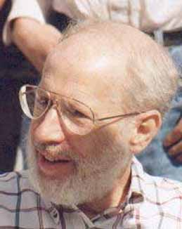
Kruskal’s Algorithm
Joseph Kruskal
1956

Slide 17
9
d
a
10
15
5
1
b
7
6
4
2
f
8
e
c
3

Slide 18
9
d
Add edges in the MST in increasing order of their weights
a
10
15
5
1
b
7
6
4
2
f
8
e
c
3

Slide 19
9
d
Add edges in the MST in increasing order of their weights
a
10
15
5
Homework: Use the cut property to show that (a,b) is in the MST
1
b
7
6
4
2
f
8
e
c
3

Slide 20
9
d
Add edges in the MST in increasing order of their weights
a
10
15
5
Homework: Use the cut property to show that (b,c) is in the MST
1
b
7
6
4
2
f
8
e
c
3

Slide 21
9
d
Add edges in the MST in increasing order of their weights
a
10
15
5
Homework: Use the cut property to show that (c,e) is in the MST
1
b
7
6
4
2
f
8
e
c
3

Slide 22
9
d
Add edges in the MST in increasing order of their weights
a
10
15
5
What about (b,e)?
1
Homework: Use the cycle property to show that (b,e) is not in the MST
b
7
6
4
2
f
8
e
c
3

Slide 23
9
d
Add edges in the MST in increasing order of their weights
a
10
15
5
Homework: Use the cut property to show that (d,f) is in the MST
1
b
7
6
Observation: we are building a forest here which will eventually become a tree.
2
f
8
e
c
3

Slide 24
9
d
Add edges in the MST in increasing order of their weights
a
10
15
5
Homework: Use the cycle property to show that (a,c) is not in the MST
1
b
7
6
2
f
8
e
c
3

Slide 25
9
d
Add edges in the MST in increasing order of their weights
a
10
15
5
Homework: Use the cut property to show that (b,f) is in the MST
1
b
7
Completely visualize this algorithm.
2
f
8
e
c
3

Slide 26
Implementation

Slide 27
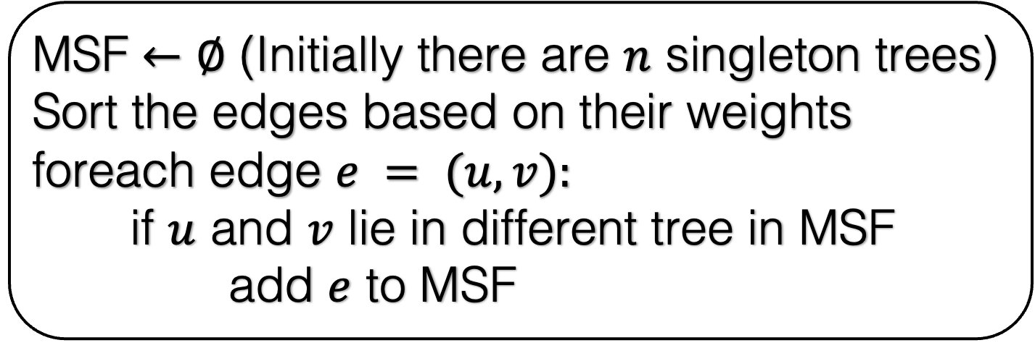
MSF $←∅$ (Initially there are $n$ singleton trees)
Sort the edges based on their weights
foreach edge $e = (u,v):$
if $u$ and $v$ lie in different tree in MSF
add $e$ to MSF

Slide 28
d
MSF $←∅$ (Initially there are $n$ singleton trees)
Sort the edges based on their weights
foreach edge $e = (u,v):$
if $u$ and $v$ lie in different tree in MSF
add $e$ to MSF
a
10
15
5
1
b
7
6
4
2
f
8
e
c
3

Slide 29
d
MSF $←∅$ (Initially there are $n$ singleton trees)
Sort the edges based on their weights
foreach edge $e = (u,v):$
if $u$ and $v$ lie in different tree in MSF
add $e$ to MSF
a
10
15
5
1
b
7
6
4
2
f
8
e
c
3

Slide 30
d
MSF $←∅$ (Initially there are $n$ singleton trees)
Sort the edges based on their weights
foreach edge $e = (u,v):$
if $u$ and $v$ lie in different tree in MSF
add $e$ to MSF
a
10
15
5
1
b
7
6
4
2
f
8
e
c
3

Slide 31
d
MSF $←∅$ (Initially there are $n$ singleton trees)
Sort the edges based on their weights
foreach edge $e = (u,v):$
if $u$ and $v$ lie in different tree in MSF
add $e$ to MSF
a
10
15
5
1
b
7
6
4
2
f
8
e
c
3

Slide 32
d
MSF $←∅$ (Initially there are $n$ singleton trees)
Sort the edges based on their weights
foreach edge $e = (u,v):$
if $u$ and $v$ lie in different tree in MSF
add $e$ to MSF
a
10
15
5
1
b
7
6
4
2
f
8
e
c
3

Slide 33
d
MSF $←∅$ (Initially there are $n$ singleton trees)
Sort the edges based on their weights
foreach edge $e = (u,v):$
if $u$ and $v$ lie in different tree in MSF
add $e$ to MSF
a
10
15
5
1
b
7
6
4
2
f
8
e
c
3

Slide 34
d
MSF $←∅$ (Initially there are $n$ singleton trees)
Sort the edges based on their weights
foreach edge $e = (u,v):$
if $u$ and $v$ lie in different tree in MSF
add $e$ to MSF
a
10
15
5
1
b
7
6
4
2
f
8
e
c
3

Slide 35
d
MSF $←∅$ (Initially there are $n$ singleton trees)
Sort the edges based on their weights
foreach edge $e = (u,v):$
if $u$ and $v$ lie in different tree in MSF
add $e$ to MSF
a
10
15
5
1
b
7
6
4
2
f
8
e
c
3

Slide 36
d
MSF $←∅$ (Initially there are $n$ singleton trees)
Sort the edges based on their weights
foreach edge $e = (u,v):$
if $u$ and $v$ lie in different tree in MSF
add $e$ to MSF
a
10
15
5
1
b
7
6
4
2
f
8
e
c
3

Slide 37
d
MSF $←∅$ (Initially there are $n$ singleton trees)
Sort the edges based on their weights
foreach edge $e = (u,v):$
if $u$ and $v$ lie in different tree in MSF
add $e$ to MSF
a
10
15
5
1
b
7
6
4
2
f
8
e
c
3

Slide 38
d
MSF $←∅$ (Initially there are $n$ singleton trees)
Sort the edges based on their weights
foreach edge $e = (u,v):$
if $u$ and $v$ lie in different tree in MSF
add $e$ to MSF
a
10
15
5
1
b
7
6
4
2
f
8
e
c
3

Slide 39
d
MSF $←∅$ (Initially there are $n$ singleton trees)
Sort the edges based on their weights
foreach edge $e = (u,v):$
if $u$ and $v$ lie in different tree in MSF
add $e$ to MSF
a
10
15
5
1
b
7
6
4
2
f
8
e
c
3

Slide 40
d
MSF $←∅$ (Initially there are $n$ singleton trees)
Sort the edges based on their weights
foreach edge $e = (u,v):$
if $u$ and $v$ lie in different tree in MSF
add $e$ to MSF
a
10
15
5
1
b
7
6
4
2
f
8
e
c
3

Slide 41
d
MSF $←∅$ (Initially there are $n$ singleton trees)
Sort the edges based on their weights
foreach edge $e = (u,v):$
if $u$ and $v$ lie in different tree in MSF
add $e$ to MSF
a
10
15
5
1
b
7
6
4
2
f
8
e
c
3

Slide 42
d
MSF $←∅$ (Initially there are $n$ singleton trees)
Sort the edges based on their weights
foreach edge $e = (u,v):$
if $u$ and $v$ lie in different tree in MSF
add $e$ to MSF
a
10
15
5
1
b
7
6
4
2
f
8
e
c
3

Slide 43
d
MSF $←∅$ (Initially there are $n$ singleton trees)
Sort the edges based on their weights
foreach edge $e = (u,v):$
if $u$ and $v$ lie in different tree in MSF
add $e$ to MSF
a
10
15
5
1
b
7
6
4
2
f
8
e
c
3

Slide 44
d
MSF $←∅$ (Initially there are $n$ singleton trees)
Sort the edges based on their weights
foreach edge $e = (u,v):$
if $u$ and $v$ lie in different tree in MSF
add $e$ to MSF
a
10
15
5
1
b
7
6
4
2
f
8
e
c
3

Slide 45
d
MSF $←∅$ (Initially there are $n$ singleton trees)
Sort the edges based on their weights
foreach edge $e = (u,v):$
if $u$ and $v$ lie in different tree in MSF
add $e$ to MSF
a
10
15
5
1
b
7
6
4
2
f
8
e
c
3

Slide 46
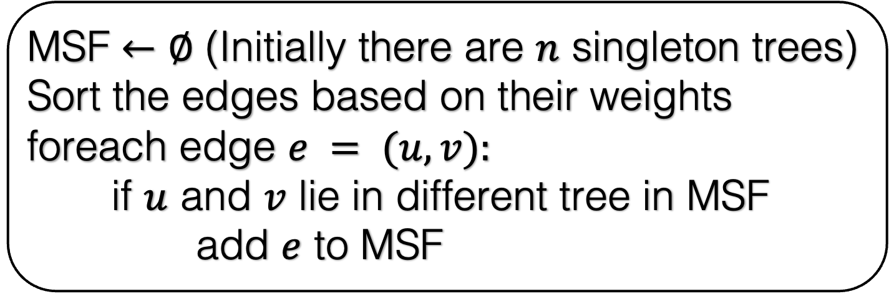
MSF $←∅$ (Initially there are $n$ singleton trees)
Sort the edges based on their weights
foreach edge $e = (u,v):$
if $u$ and $v$ lie in different tree in MSF
add $e$ to MSF
Required here
Required here
A data-structure problem.
Maintain a forest under the following operations.
Insert(e) : Add an edge e that connect two different trees in the forest
Query(u,v): Given two vertices u and v, are they in the same tree in the forest.

Slide 47
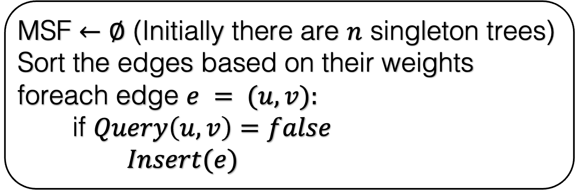
MSF $←∅$ (Initially there are $n$ singleton trees)
Sort the edges based on their weights
foreach edge $e = (u,v):$
if $Query\left(u,v\right)=false$
$Insert(e)$
How will you design this data-structure?
How many times do we insert?
n-1
How many times do we query?
m
Design a data structure optimized for quick Query time with the trade-off of potentially longer insertion times.

Slide 48
A data-structure problem.
Maintain a forest under the following operations.
Insert(e) : Add an edge e that connect two different trees in the forest
Query(u,v): Given two vertices u and v, are they in the same tree in the forest.
Let us assume that the vertices are numbered from 1 to n.
We will maintain an array Label[1..n].
Label[v] contains the label of tree that contains v.
We will maintain the following invariant: all the vertices in a tree have same label

Slide 49
4
We will create a label array.
Intially each node is a singleton
1
1
1
What shold be the label for node 1?
2
6
5
3
Label

Slide 50
4
4
We will create a label array.
Intially each node is a singleton
1
1
What shold be the label for node 1?
2
2
6
6
5
5
3
3
Label
1
1

Slide 51
4
1
1
2
6
5
3
Label
1
2
3
4
5
6
2
3
4
5
6

Slide 52
4
What should you do if the edge (1,2) is added?
1
1
Change the label of 1 or 2.
2
6
5
3
Label
1
2
3
4
5
6

Slide 53
4
What should you do if the edge (1,2) is added?
1
1
Change the label of 1 or 2.
2
6
5
3
Label
1
1
3
4
5
6

Slide 54
4
What should you do if the edge (4,6) is added?
1
1
Change the label of 4 or 6.
2
6
5
3
Label
1
1
3
4
5
6

Slide 55
4
1
1
2
6
5
3
Label
1
1
3
4
5
4

Slide 56
4
What should you do if the edge (2,6) is added?
1
1
Look at the two trees before the insertion.
Either change the label of all the nodes in the tree that contains 2.
Or change the label of all the nodes in the tree that contain 6.
2
6
5
3
Label
1
1
3
4
5
4

Slide 57
4
1
1
2
Let us now implement this algorithm.
6
5
3
Label
1
1
3
1
5
1

Slide 58
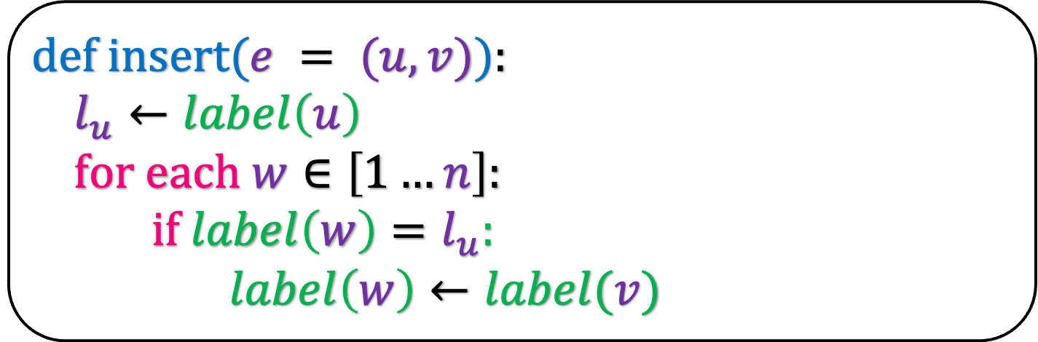

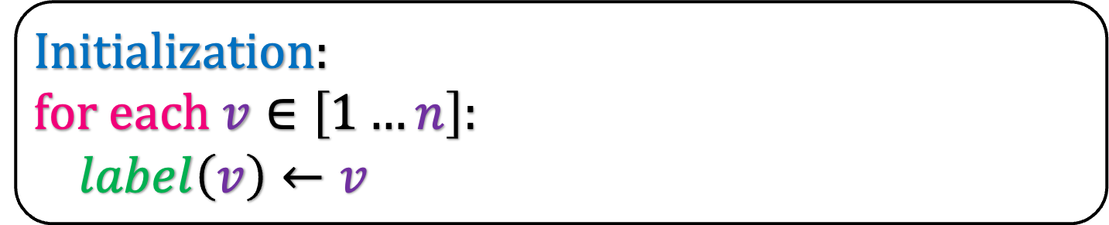


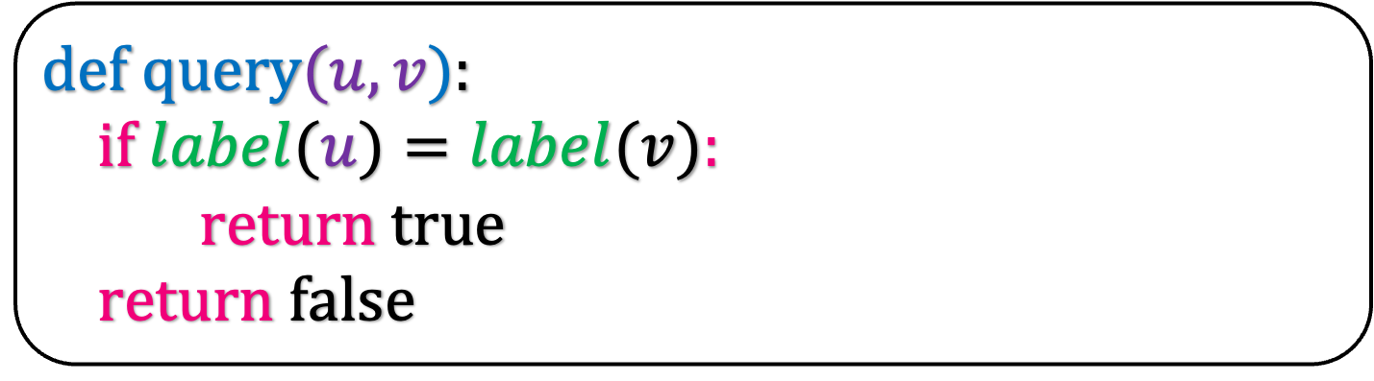
Initialization:
for each $v∈\left[1…n\right]:$
$label\left(v\right)←v$
O($n$)
def insert($e = (u,v)$):
$l_{u}←label\left(u\right)$
for each $w∈\left[1…n\right]:$
if $label\left(w\right)=l_{u}:$
$label\left(w\right)←label(v)$
O($n$)
def query$(u,v$):
if $label(u)=label(v):$
return true
return false
O($1$)

Slide 59
Initialization:
for each $v∈\left[1…n\right]:$
$label\left(v\right)←v$
O($n$)
def insert($e = (u,v)$):
$l_{u}←label\left(u\right)$
for each $w∈\left[1…n\right]:$
if $label\left(w\right)=l_{u}:$
$label\left(w\right)←label(v)$
Initialization takes O(n) time.
Insert takes O(n) time.
Query takes O(1) time.
O($n$)
def query$(u,v$):
if $label(u)=label(v):$
return true
return false
O($1$)

Slide 60
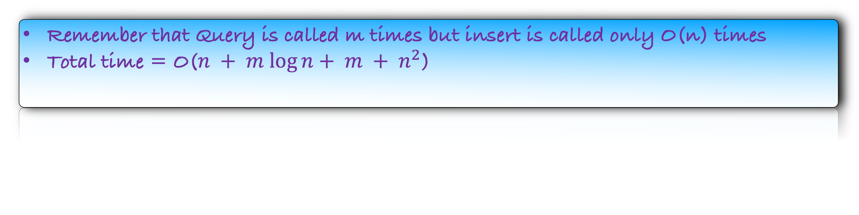
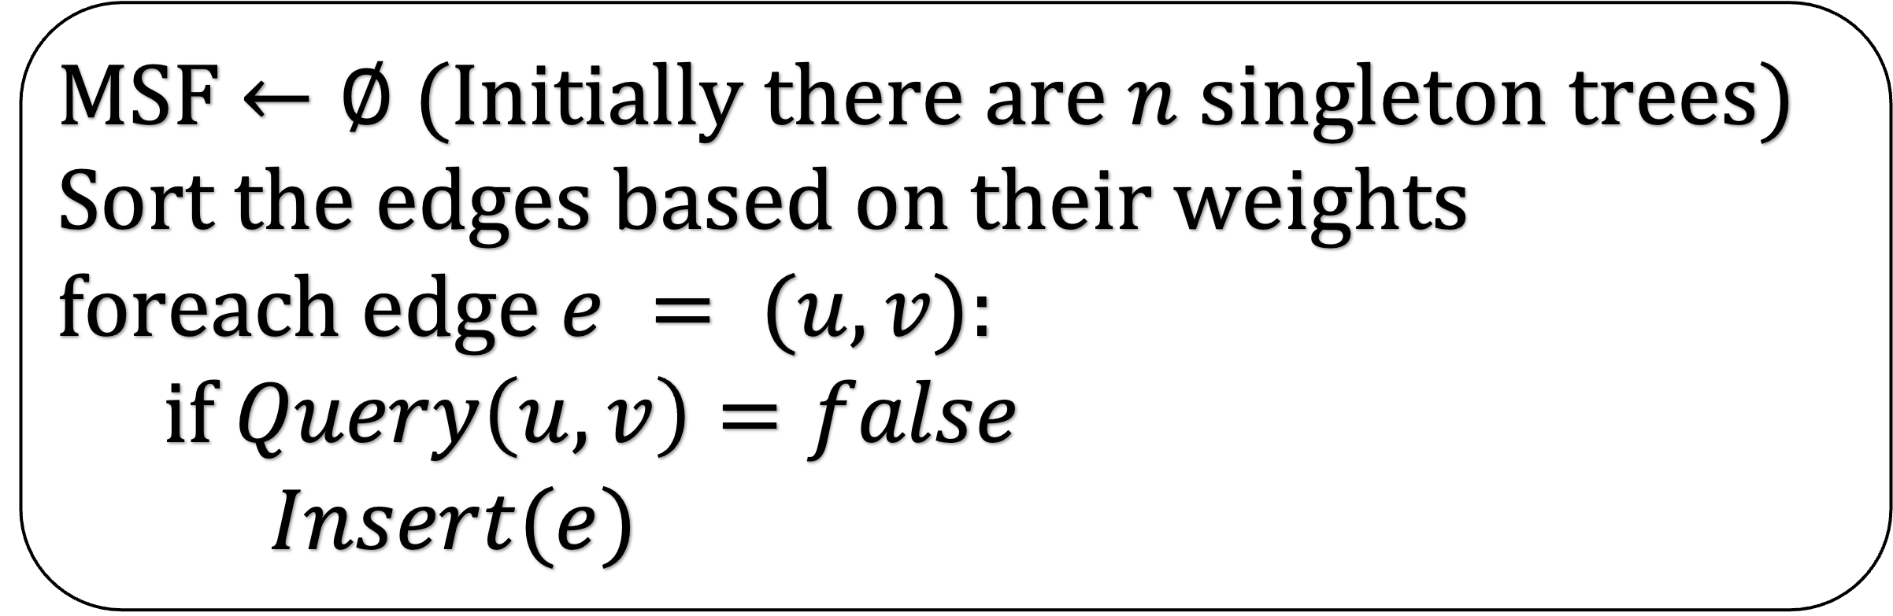
MSF $←∅$ (Initially there are $n$ singleton trees)
Sort the edges based on their weights
foreach edge $e = (u,v):$
if $Query\left(u,v\right)=false$
$Insert(e)$
O(n)
O(m log n)
O(1)
O(n)
Remember that Query is called m times but insert is called only O(n) times
Total time = O($n + m log⁡n+ m + n^{2}$)

Slide 61
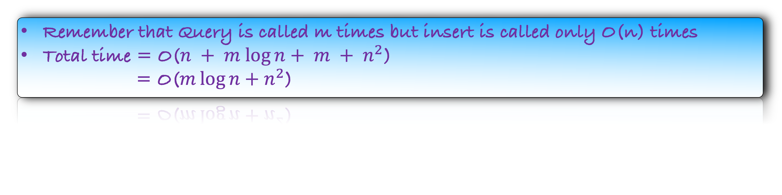
MSF $←∅$ (Initially there are $n$ singleton trees)
Sort the edges based on their weights
foreach edge $e = (u,v):$
if $Query\left(u,v\right)=false$
$Insert(e)$
O(n)
O(m log n)
O(1)
O(n)
Remember that Query is called m times but insert is called only O(n) times
Total time = O($n + m log⁡n+ m + n^{2}$)
= O($m\log{n}+n^{2}$)

Slide 62

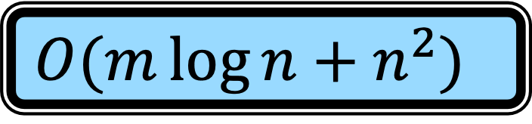
The story so far….
But we can do better.
As a homework, try to show that we can insert in “amortized” O(log n) time and query in O(1) time.
This will reduce the Kruskal’s algorithm time to O(m log n).
Later in this course, we will revisit this question, or the famous Union-Find Problem.
Robert Prim
Joseph Kruskal
1957
1956
$$O(m log⁡n)$$
$$O(m\log{n}+n^{2})$$

Slide 63
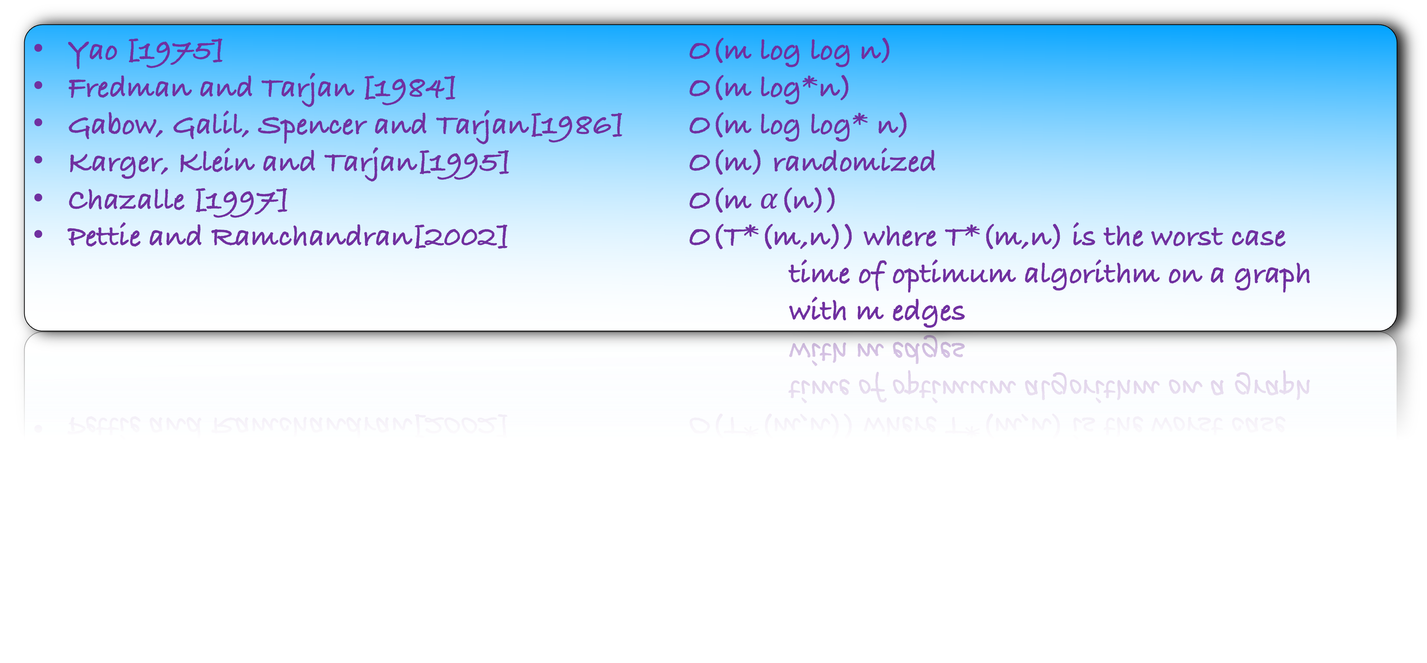
The story so far….
Yao [1975] O(m log log n)
Fredman and Tarjan [1984] O(m log*n)
Gabow, Galil, Spencer and Tarjan[1986] O(m log log* n)
Karger, Klein and Tarjan[1995] O(m) randomized
Chazalle [1997] O(m $α$(n))
Pettie and Ramchandran[2002] O(T*(m,n)) where T*(m,n) is the worst case
time of optimum algorithm on a graph
with m edges
A challenging open question.
Is there a deterministic algorithm for Minimum Spanning tree that runs in O(m) time?

