Slide 1
Maximum Overlap

Slide 2
You are given n intervals with their start and end times.
The start and end times are integers.
Find two intervals whose overlap is the maximum.

Slide 5
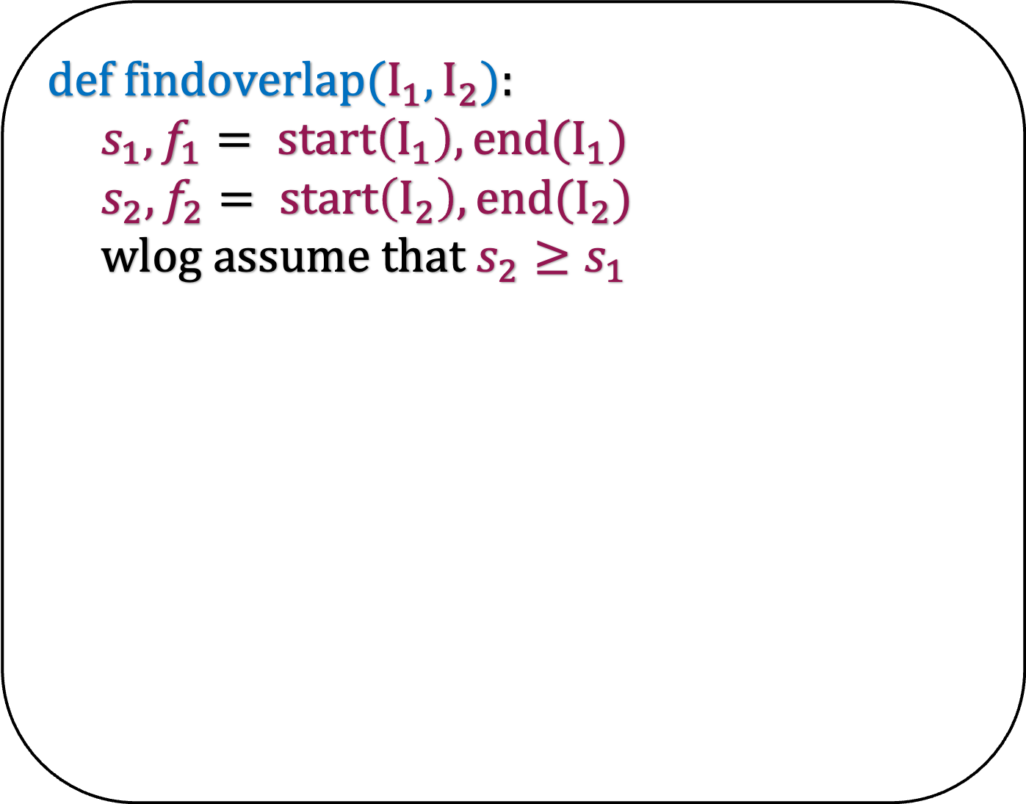
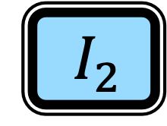
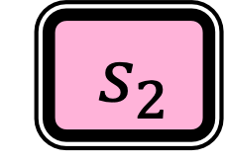
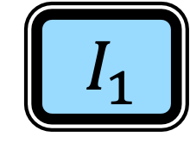
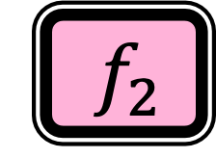

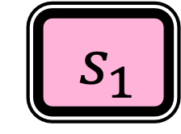
How to find the overlap between two intervals?
$${ s}_{2}$$
$${ I}_{2}$$
$${ f}_{2}$$
def f$indoverlap(I_{1},I_{2}$):
$s_{1},f_{1}= start\left(I_{1}\right),end(I_{1})$
$s_{2},f_{2}= start\left(I_{2}\right),end(I_{2})$
wlog assume that $s_{2}≥s_{1}$
$${ s}_{1}$$
$${ I}_{1}$$
$${ f}_{1}$$

Slide 6
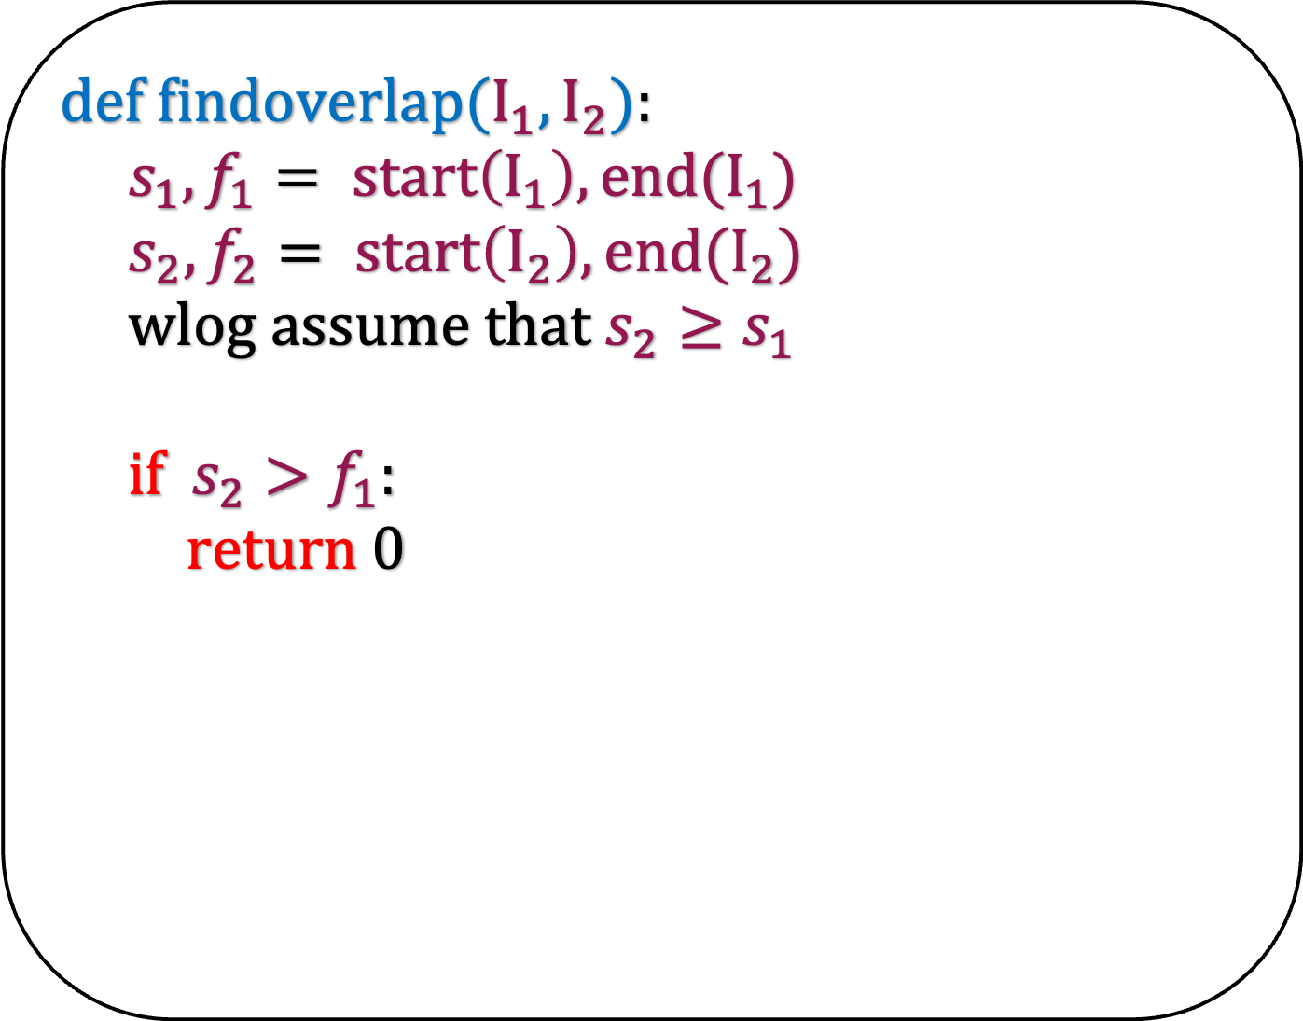
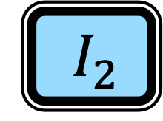
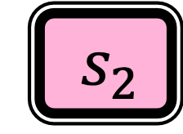


How to find the overlap between two intervals?
$${ s}_{2}$$
$${ I}_{2}$$
$${ f}_{2}$$
def f$indoverlap(I_{1},I_{2}$):
$s_{1},f_{1}= start\left(I_{1}\right),end(I_{1})$
$s_{2},f_{2}= start\left(I_{2}\right),end(I_{2})$
wlog assume that $s_{2}≥s_{1}$
if $s_{2}>f_{1}$:
return 0
$${ s}_{1}$$
$${ I}_{1}$$
$${ f}_{1}$$

Slide 7
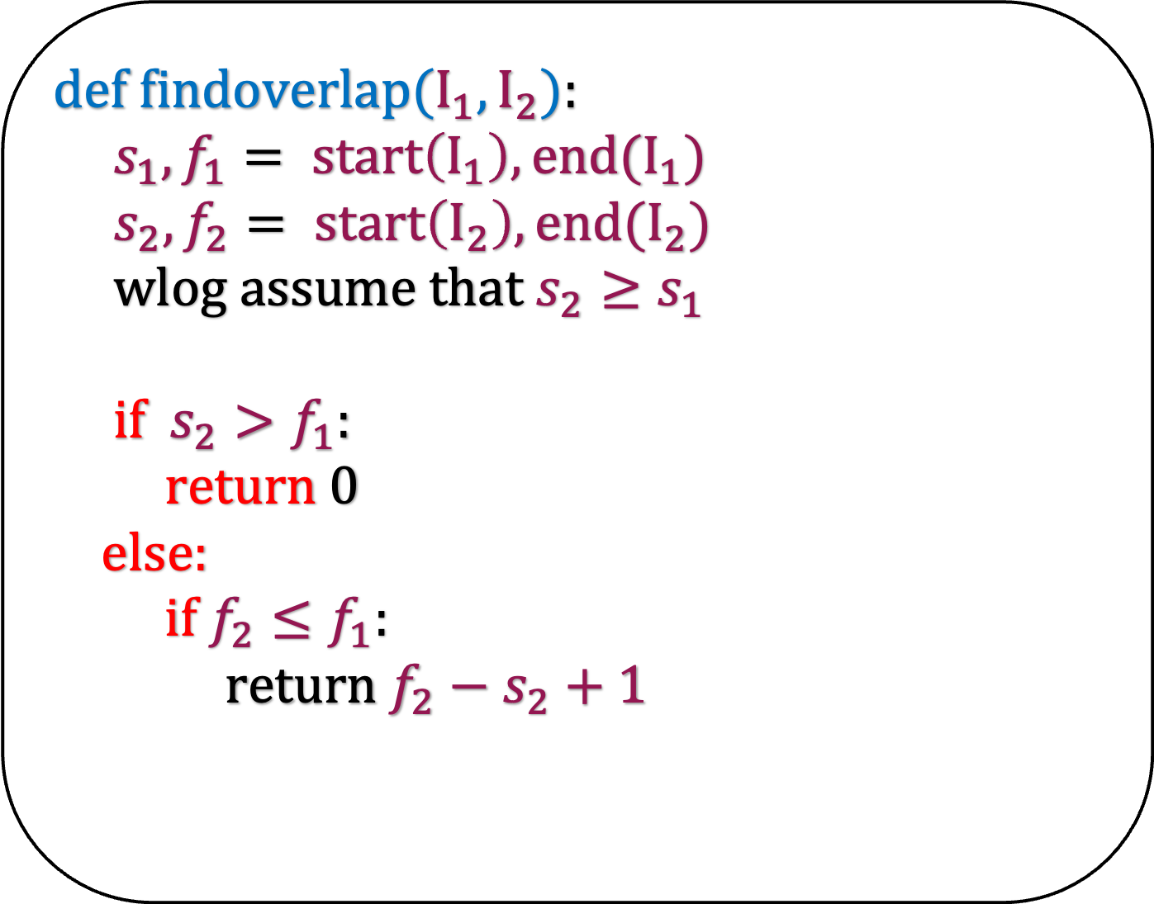
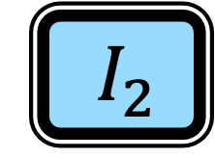



How to find the overlap between two intervals?
$${ s}_{2}$$
$${ I}_{2}$$
$${ f}_{2}$$
def f$indoverlap(I_{1},I_{2}$):
$s_{1},f_{1}= start\left(I_{1}\right),end(I_{1})$
$s_{2},f_{2}= start\left(I_{2}\right),end(I_{2})$
wlog assume that $s_{2}≥s_{1}$
if $s_{2}>f_{1}$:
return 0
else:
if $f_{2}≤f_{1}$:
return $f_{2}−s_{2}+1$
$${ s}_{1}$$
$${ I}_{1}$$
$${ f}_{1}$$

Slide 8
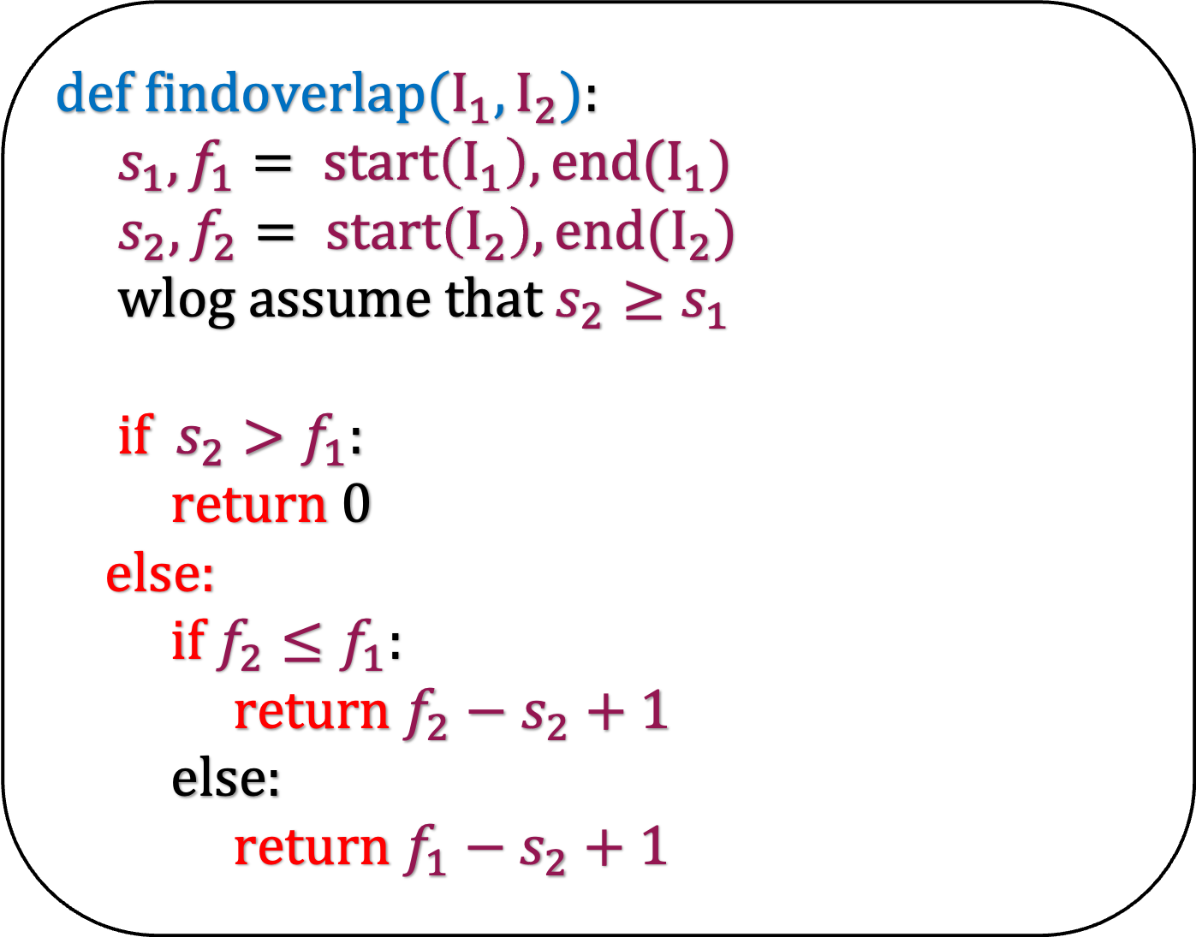
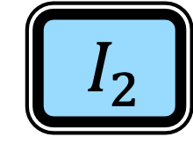



How to find the overlap between two intervals?
$${ s}_{2}$$
$${ I}_{2}$$
$${ f}_{2}$$
def f$indoverlap(I_{1},I_{2}$):
$s_{1},f_{1}= start\left(I_{1}\right),end(I_{1})$
$s_{2},f_{2}= start\left(I_{2}\right),end(I_{2})$
wlog assume that $s_{2}≥s_{1}$
if $s_{2}>f_{1}$:
return 0
else:
if $f_{2}≤f_{1}$:
return $f_{2}−s_{2}+1$
else:
return $f_{1}−s_{2}+1$
$${ s}_{1}$$
$${ I}_{1}$$
$${ f}_{1}$$

Slide 9
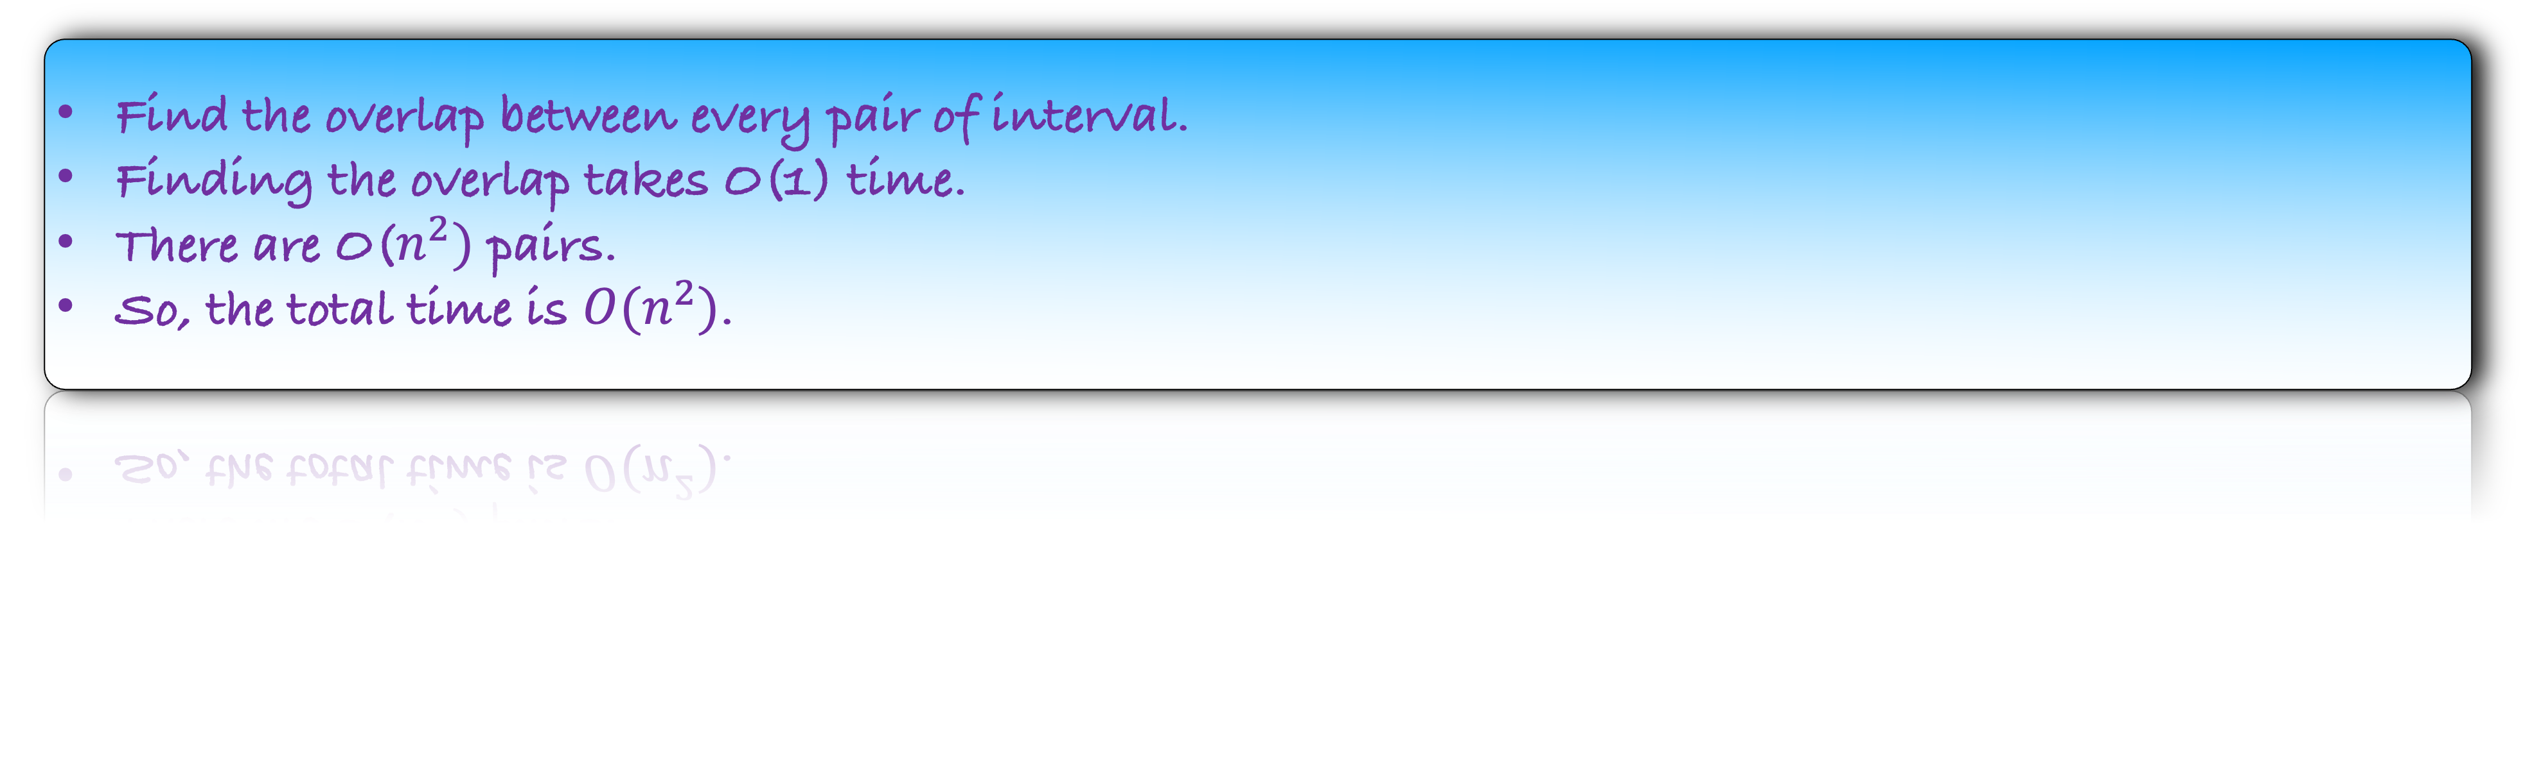
How would you solve this problem?
Find the overlap between every pair of interval.
Finding the overlap takes O(1) time.
There are O($n^{2})$ pairs.
So, the total time is $O(n^{2})$.
Can we improve the running time?

Slide 11
Left Half
Right Half

Slide 12
Recursively find the maximum overlap in the left half.

Slide 13
Recursively find the maximum overlap in the left half.

Slide 14
Recursively find the maximum overlap in the right half.

Slide 15
Recursively find the maximum overlap in the right half.

Slide 16
Are we done?
No, because the overlap can be between a left half and a right half interval.

Slide 17
How to find the maximum overlap if the first interval is in the left half and the second interval is in the right half?

Slide 18
There is an interval in the first half that we can choose with our eyes closed as the first interval.
Which is that interval?

Slide 19
There is an interval in the first half that we can choose with our eyes closed as the first interval.
Which is that interval?
The interval that has the largest ending time.
This interval will have the largest overlap with any interval in the right half.

Slide 20
How do you find the second interval in the right half?
Brute force. Try every other interval in the second half.
Visualize this algorithm before encoding it.

Slide 21
Implementation

Slide 22
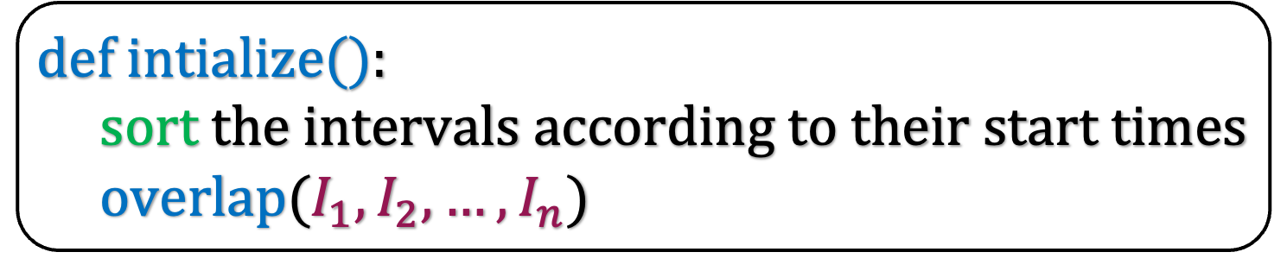
def i$ntialize($):
sort the intervals according to their start times
overlap($I_{1},I_{2},…,I_{n}$)

Slide 23

def i$ntialize($):
sort the intervals according to their start times
overlap($I_{1},I_{2},…,I_{n}$)
def o$verlap(I_{1},I_{2},…,I_{n}$):

Slide 24

def i$ntialize($):
sort the intervals according to their start times
overlap($I_{1},I_{2},…,I_{n}$)
def o$verlap(I_{1},I_{2},…,I_{n}$):
left = $I_{1},…,I_{\frac{n}{2}}$
right = $I_{\frac{n}{2}+1},…,I_{n}$

Slide 25

def i$ntialize($):
sort the intervals according to their start times
overlap($I_{1},I_{2},…,I_{n}$)
def o$verlap(I_{1},I_{2},…,I_{n}$):
left = $I_{1},…,I_{\frac{n}{2}}$
right = $I_{\frac{n}{2}+1},…,I_{n}$
Find the maximum overlap in the left half

Slide 26
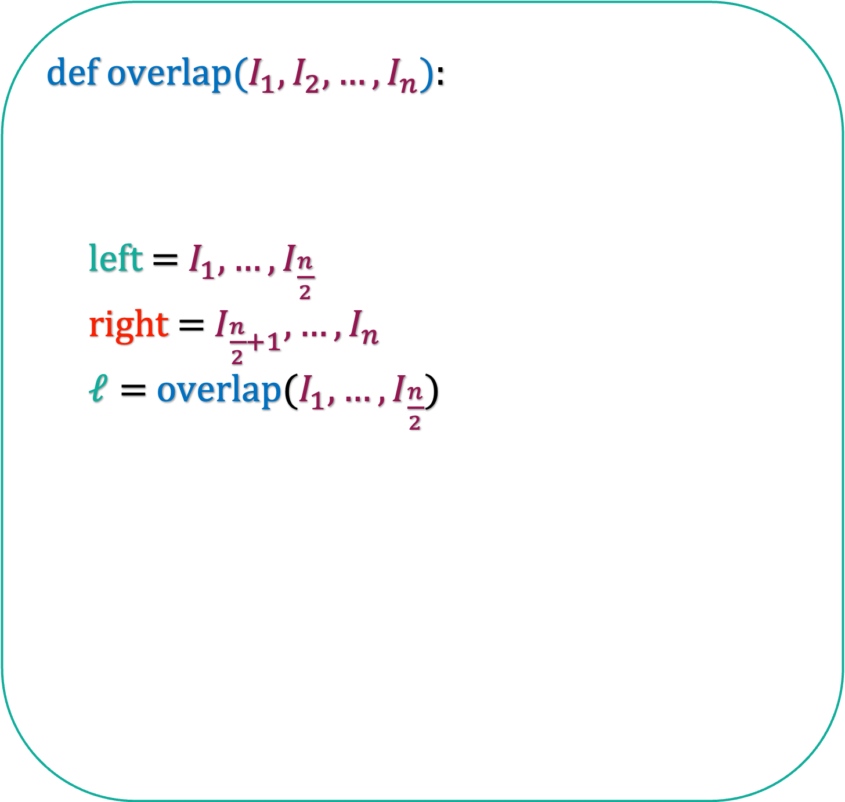
def i$ntialize($):
sort the intervals according to their start times
overlap($I_{1},I_{2},…,I_{n}$)
def o$verlap(I_{1},I_{2},…,I_{n}$):
left = $I_{1},…,I_{\frac{n}{2}}$
right = $I_{\frac{n}{2}+1},…,I_{n}$
$ℓ=$ overlap($I_{1},…,I_{\frac{n}{2}}$)
Find the maximum overlap in the left half

Slide 27
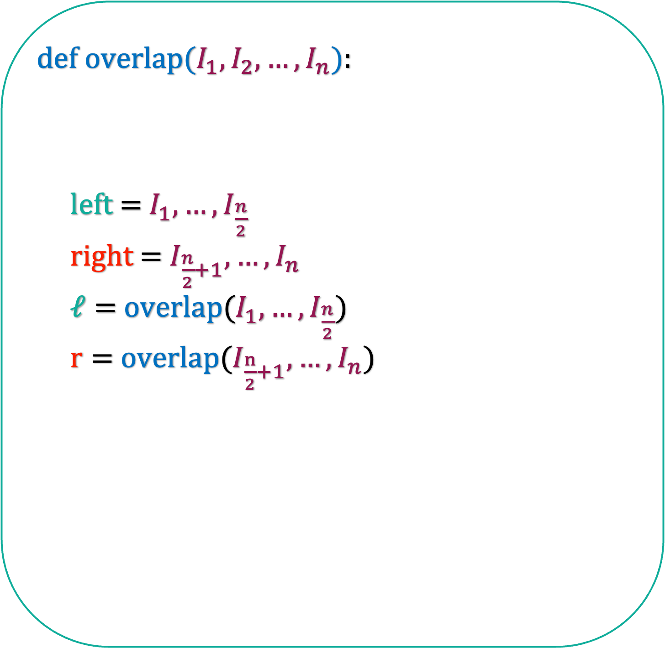
def i$ntialize($):
sort the intervals according to their start times
overlap($I_{1},I_{2},…,I_{n}$)
def o$verlap(I_{1},I_{2},…,I_{n}$):
left = $I_{1},…,I_{\frac{n}{2}}$
right = $I_{\frac{n}{2}+1},…,I_{n}$
$ℓ=$ overlap($I_{1},…,I_{\frac{n}{2}}$)
$r=$ overlap($I_{\frac{n}{2}+1},…,I_{n}$)
Find the maximum overlap in the right half

Slide 28
def i$ntialize($):
sort the intervals according to their start times
overlap($I_{1},I_{2},…,I_{n}$)
def o$verlap(I_{1},I_{2},…,I_{n}$):
left = $I_{1},…,I_{\frac{n}{2}}$
right = $I_{\frac{n}{2}+1},…,I_{n}$
$ℓ=$ overlap($I_{1},…,I_{\frac{n}{2}}$)
$r=$ overlap($I_{\frac{n}{2}+1},…,I_{n}$)
Find the overlap when the first interval is in the left half and the second interval is in the right half.

Slide 29
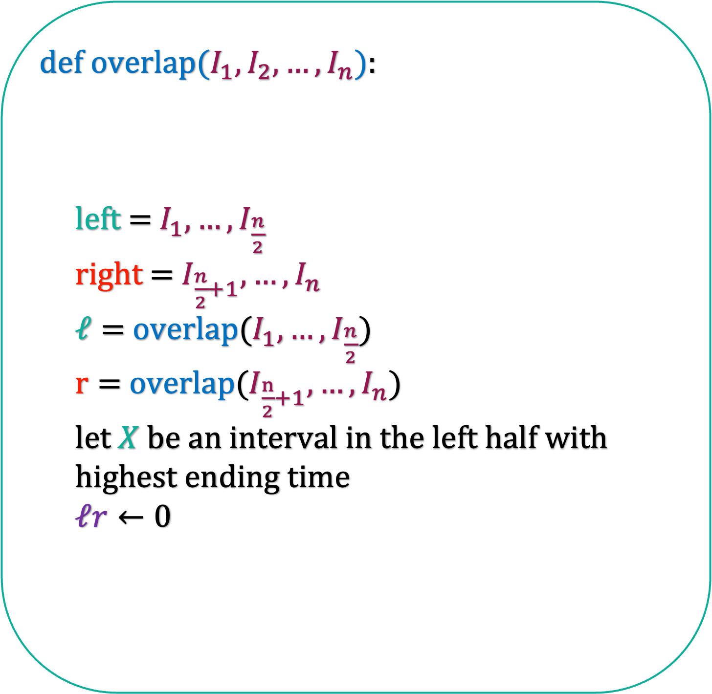
def i$ntialize($):
sort the intervals according to their start times
overlap($I_{1},I_{2},…,I_{n}$)
X
def o$verlap(I_{1},I_{2},…,I_{n}$):
left = $I_{1},…,I_{\frac{n}{2}}$
right = $I_{\frac{n}{2}+1},…,I_{n}$
$ℓ=$ overlap($I_{1},…,I_{\frac{n}{2}}$)
$r=$ overlap($I_{\frac{n}{2}+1},…,I_{n}$)
let $X$ be an interval in the left half with
highest ending time
$ℓr←0$
Find the overlap when the first interval is in the left half and the second interval is in the right half.

Slide 30
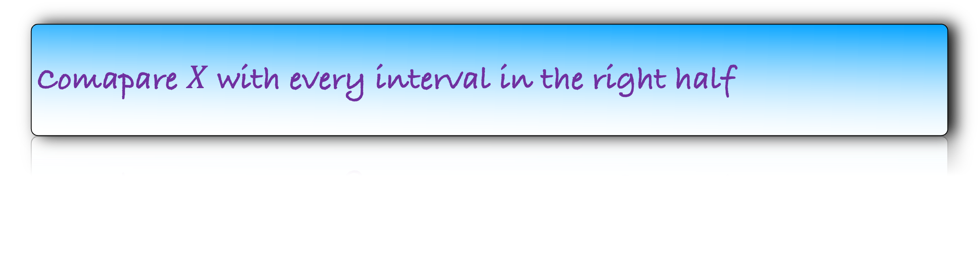
def i$ntialize($):
sort the intervals according to their start times
overlap($I_{1},I_{2},…,I_{n}$)
X
def o$verlap(I_{1},I_{2},…,I_{n}$):
left = $I_{1},…,I_{\frac{n}{2}}$
right = $I_{\frac{n}{2}+1},…,I_{n}$
$ℓ=$ overlap($I_{1},…,I_{\frac{n}{2}}$)
$r=$ overlap($I_{\frac{n}{2}+1},…,I_{n}$)
let $X$ be an interval in the left half with
highest ending time
$ℓr←0$
Comapare $X$ with every interval in the right half

Slide 31
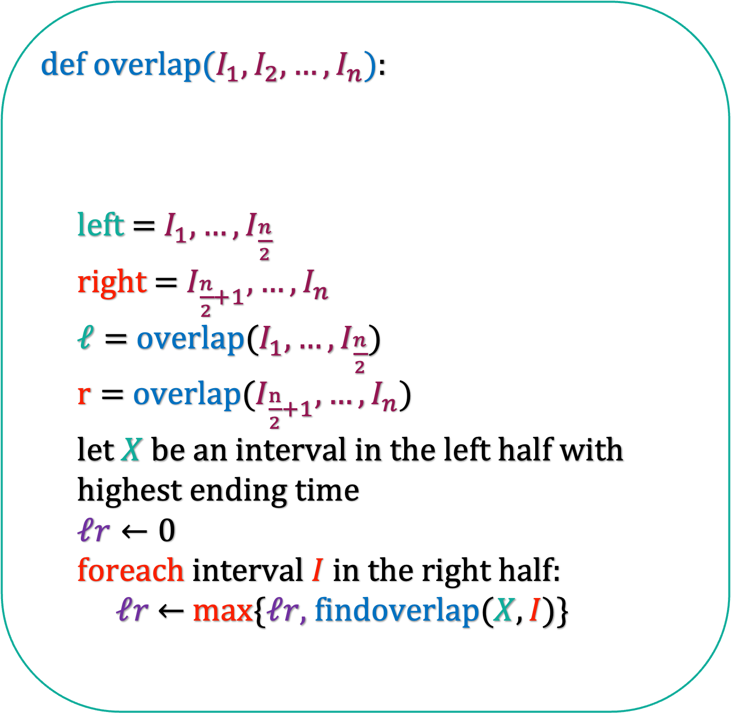
def i$ntialize($):
sort the intervals according to their start times
overlap($I_{1},I_{2},…,I_{n}$)
X
def o$verlap(I_{1},I_{2},…,I_{n}$):
left = $I_{1},…,I_{\frac{n}{2}}$
right = $I_{\frac{n}{2}+1},…,I_{n}$
$ℓ=$ overlap($I_{1},…,I_{\frac{n}{2}}$)
$r=$ overlap($I_{\frac{n}{2}+1},…,I_{n}$)
let $X$ be an interval in the left half with
highest ending time
$ℓr←0$
foreach interval $I$ in the right half:
$ℓr$ $←$ max{$ℓr,$findoverlap($X,I$)}
Comapare $X$ with every interval in the right half

Slide 32
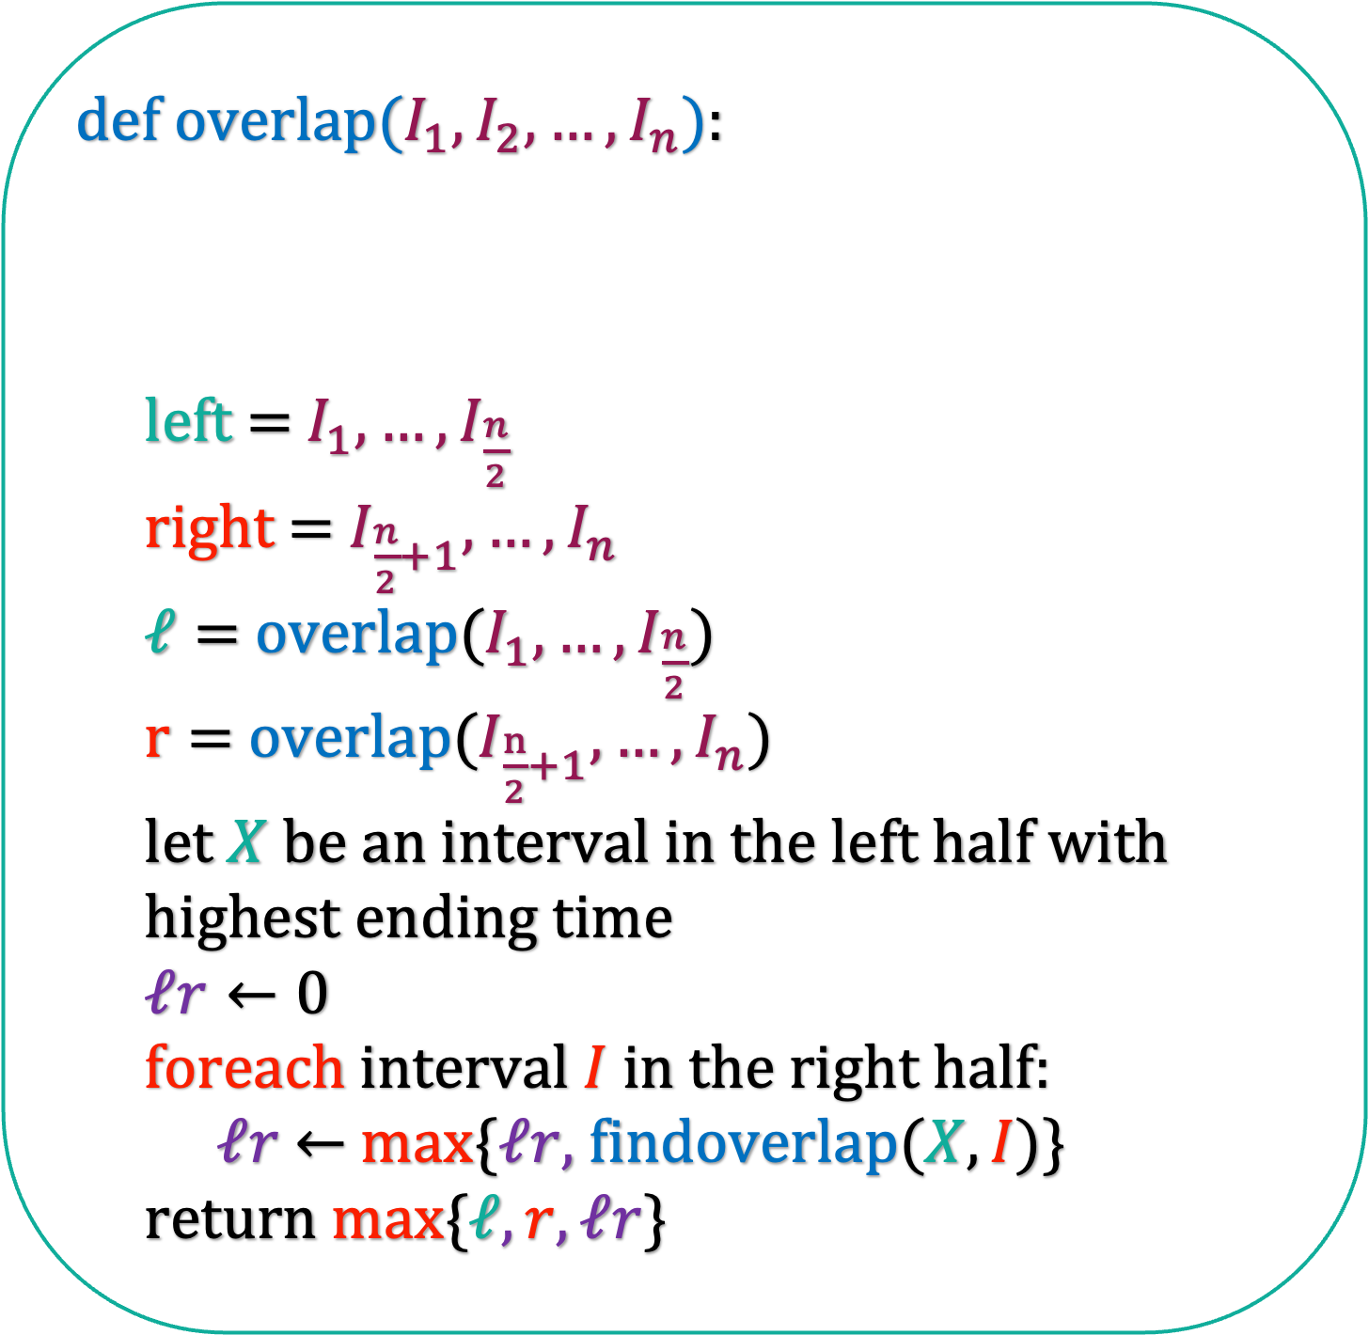
def i$ntialize($):
sort the intervals according to their start times
overlap($I_{1},I_{2},…,I_{n}$)
X
def o$verlap(I_{1},I_{2},…,I_{n}$):
left = $I_{1},…,I_{\frac{n}{2}}$
right = $I_{\frac{n}{2}+1},…,I_{n}$
$ℓ=$ overlap($I_{1},…,I_{\frac{n}{2}}$)
$r=$ overlap($I_{\frac{n}{2}+1},…,I_{n}$)
let $X$ be an interval in the left half with
highest ending time
$ℓr←0$
foreach interval $I$ in the right half:
$ℓr$ $←$ max{$ℓr,$findoverlap($X,I$)}
return max{$ℓ,r,ℓr$}
Comapare $X$ with every interval in the right half

Slide 33
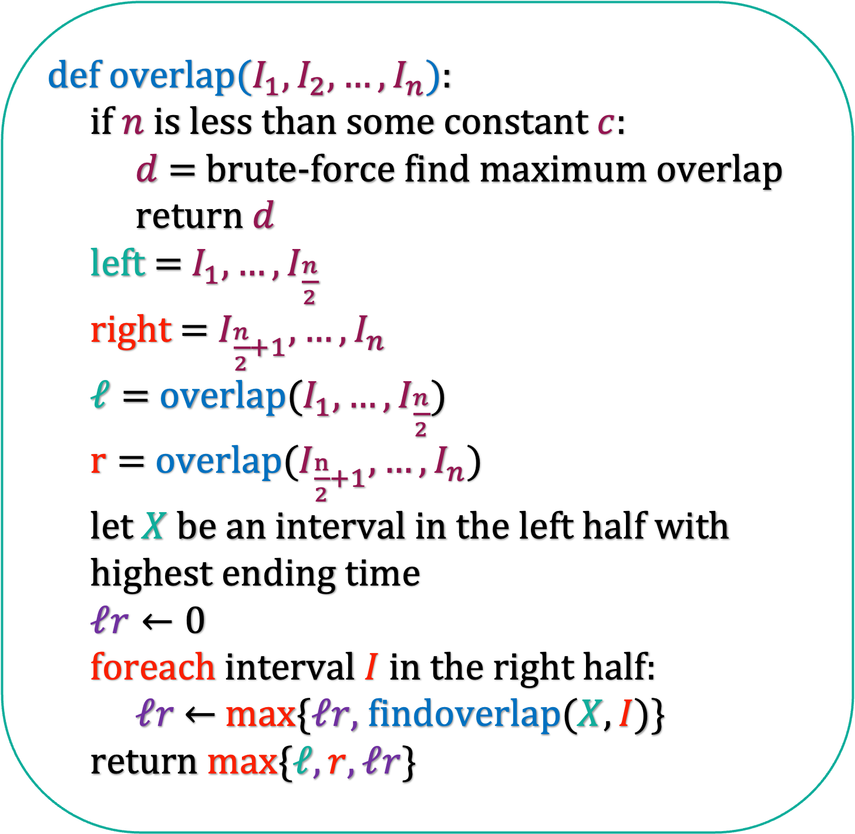
def i$ntialize($):
sort the intervals according to their start times
overlap($I_{1},I_{2},…,I_{n}$)
def o$verlap(I_{1},I_{2},…,I_{n}$):
if $n$ is less than some constant $c$:
$d$ = brute-force find maximum overlap
return $d$
left = $I_{1},…,I_{\frac{n}{2}}$
right = $I_{\frac{n}{2}+1},…,I_{n}$
$ℓ=$ overlap($I_{1},…,I_{\frac{n}{2}}$)
$r=$ overlap($I_{\frac{n}{2}+1},…,I_{n}$)
let $X$ be an interval in the left half with
highest ending time
$ℓr←0$
foreach interval $I$ in the right half:
$ℓr$ $←$ max{$ℓr,$findoverlap($X,I$)}
return max{$ℓ,r,ℓr$}
Just need to write the base case.

Slide 34
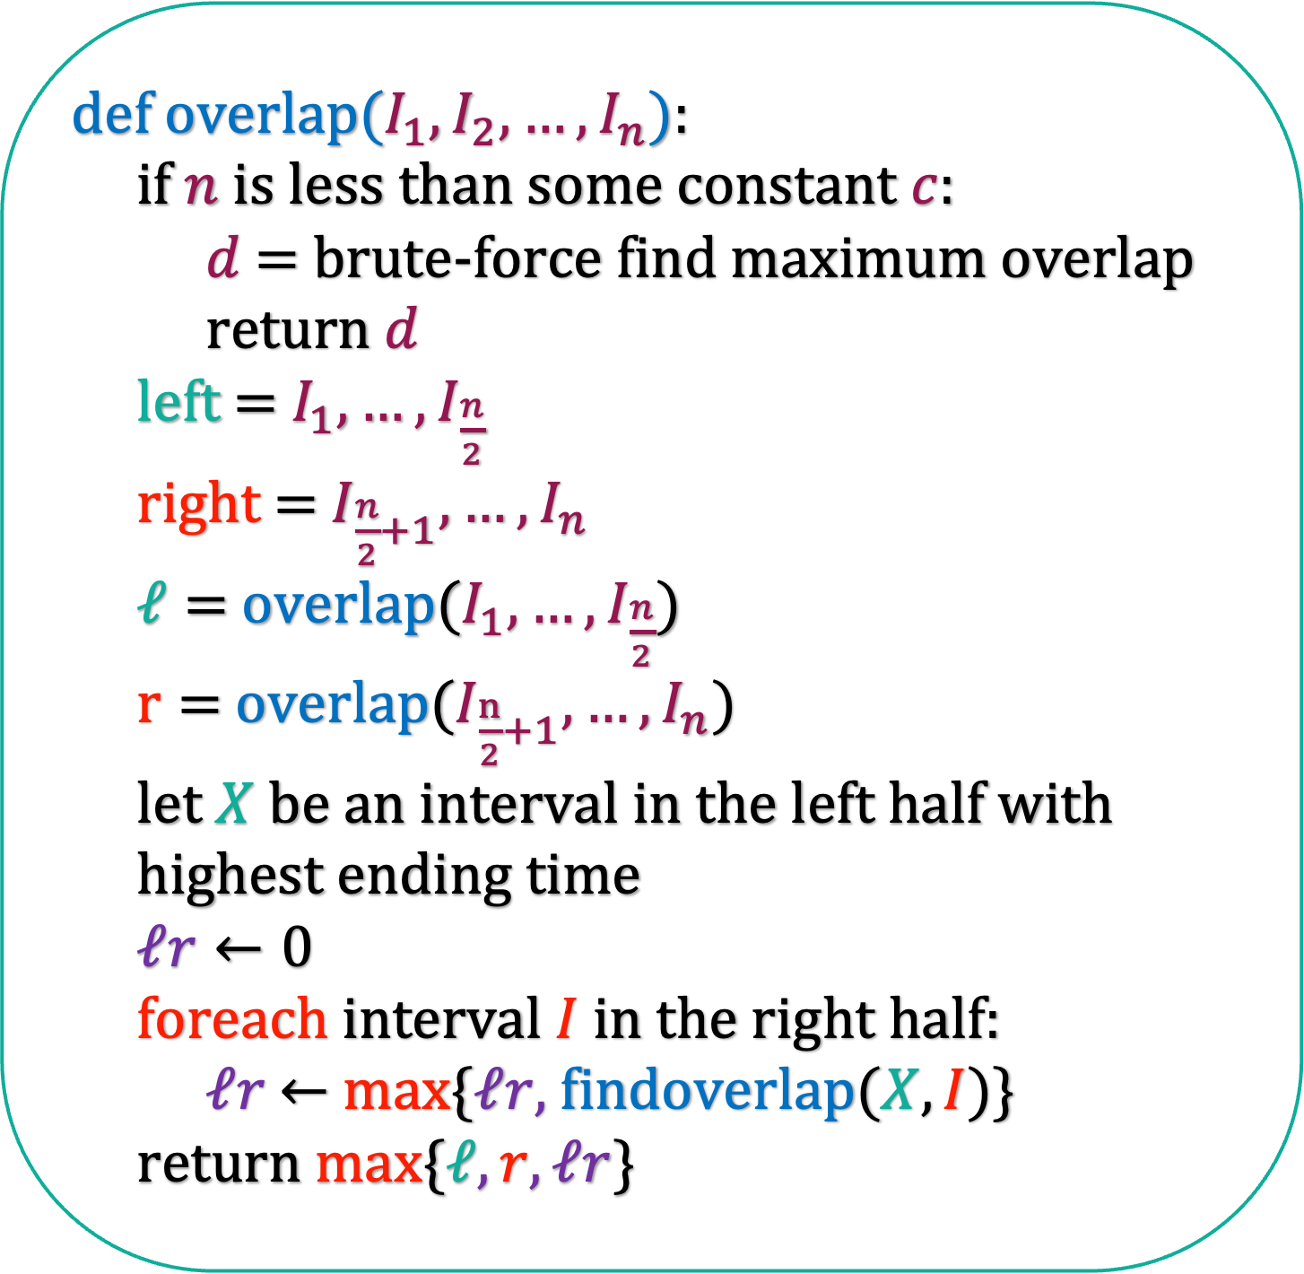
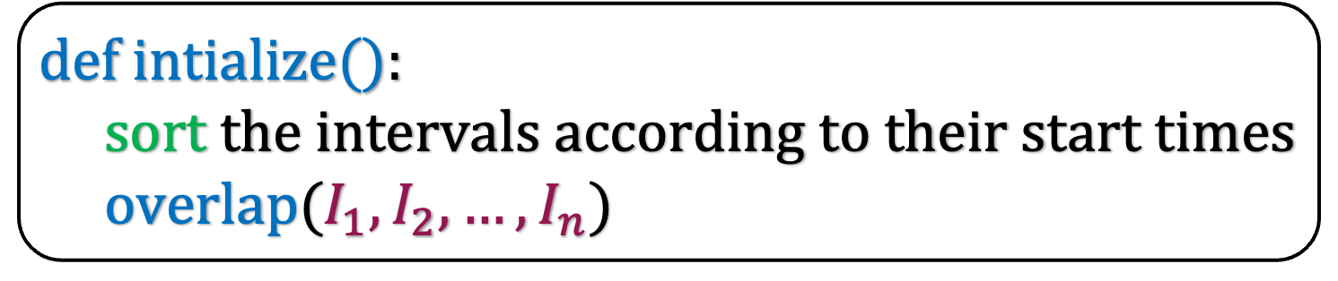
def i$ntialize($):
sort the intervals according to their start times
overlap($I_{1},I_{2},…,I_{n}$)
def o$verlap(I_{1},I_{2},…,I_{n}$):
if $n$ is less than some constant $c$:
$d$ = brute-force find maximum overlap
return $d$
left = $I_{1},…,I_{\frac{n}{2}}$
right = $I_{\frac{n}{2}+1},…,I_{n}$
$ℓ=$ overlap($I_{1},…,I_{\frac{n}{2}}$)
$r=$ overlap($I_{\frac{n}{2}+1},…,I_{n}$)
let $X$ be an interval in the left half with
highest ending time
$ℓr←0$
foreach interval $I$ in the right half:
$ℓr$ $←$ max{$ℓr,$findoverlap($X,I$)}
return max{$ℓ,r,ℓr$}
What is the running time of this algorithm?

Slide 35
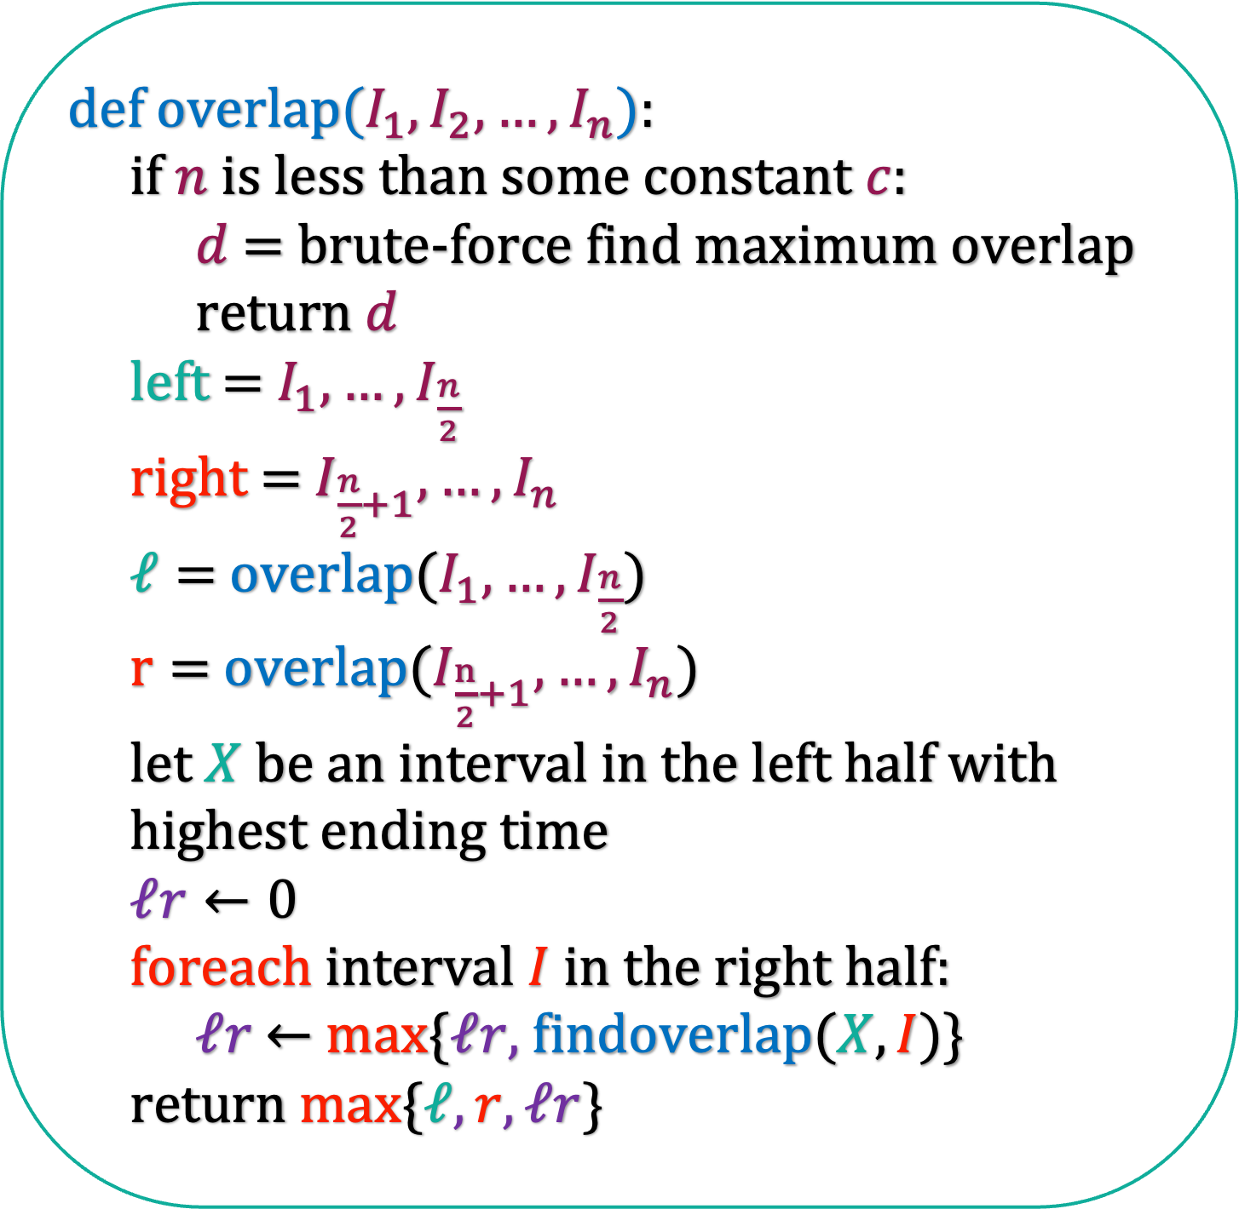
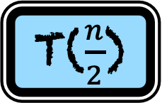
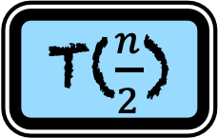

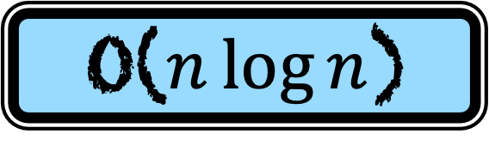
def i$ntialize($):
sort the intervals according to their start times
overlap($I_{1},I_{2},…,I_{n}$)
O($n\log{n}$)
def o$verlap(I_{1},I_{2},…,I_{n}$):
if $n$ is less than some constant $c$:
$d$ = brute-force find maximum overlap
return $d$
left = $I_{1},…,I_{\frac{n}{2}}$
right = $I_{\frac{n}{2}+1},…,I_{n}$
$ℓ=$ overlap($I_{1},…,I_{\frac{n}{2}}$)
$r=$ overlap($I_{\frac{n}{2}+1},…,I_{n}$)
let $X$ be an interval in the left half with
highest ending time
$ℓr←0$
foreach interval $I$ in the right half:
$ℓr$ $←$ max{$ℓr,$findoverlap($X,I$)}
return max{$ℓ,r,ℓr$}
T($n$)
T($\frac{n}{2}$)
T($\frac{n}{2}$)
cn
cn

Slide 36
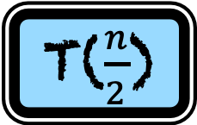
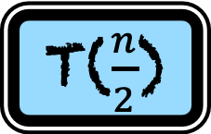
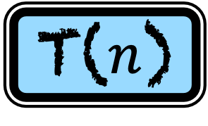
def i$ntialize($):
sort the intervals according to their start times
overlap($I_{1},I_{2},…,I_{n}$)
O($n\log{n}$)
def o$verlap(I_{1},I_{2},…,I_{n}$):
if $n$ is less than some constant $c$:
$d$ = brute-force find maximum overlap
return $d$
left = $I_{1},…,I_{\frac{n}{2}}$
right = $I_{\frac{n}{2}+1},…,I_{n}$
$ℓ=$ overlap($I_{1},…,I_{\frac{n}{2}}$)
$r=$ overlap($I_{\frac{n}{2}+1},…,I_{n}$)
let $X$ be an interval in the left half with
highest ending time
$ℓr←0$
foreach interval $I$ in the right half:
$ℓr$ $←$ max{$ℓr,$findoverlap($X,I$)}
return max{$ℓ,r,ℓr$}
T($n$)
T($\frac{n}{2}$)
T($\frac{n}{2}$)
2cn

Slide 37
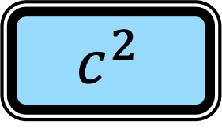
def i$ntialize($):
sort the intervals according to their start times
overlap($I_{1},I_{2},…,I_{n}$)
O($n\log{n}$)
def o$verlap(I_{1},I_{2},…,I_{n}$):
if $n$ is less than some constant $c$:
$d$ = brute-force find maximum overlap
return $d$
left = $I_{1},…,I_{\frac{n}{2}}$
right = $I_{\frac{n}{2}+1},…,I_{n}$
$ℓ=$ overlap($I_{1},…,I_{\frac{n}{2}}$)
$r=$ overlap($I_{\frac{n}{2}+1},…,I_{n}$)
let $X$ be an interval in the left half with
highest ending time
$ℓr←0$
foreach interval $I$ in the right half:
$ℓr$ $←$ max{$ℓr,$findoverlap($X,I$)}
return max{$ℓ,r,ℓr$}
$$c^{2}$$
T($n$)
T($\frac{n}{2}$)
T($\frac{n}{2}$)
2cn

Slide 38
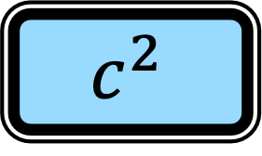
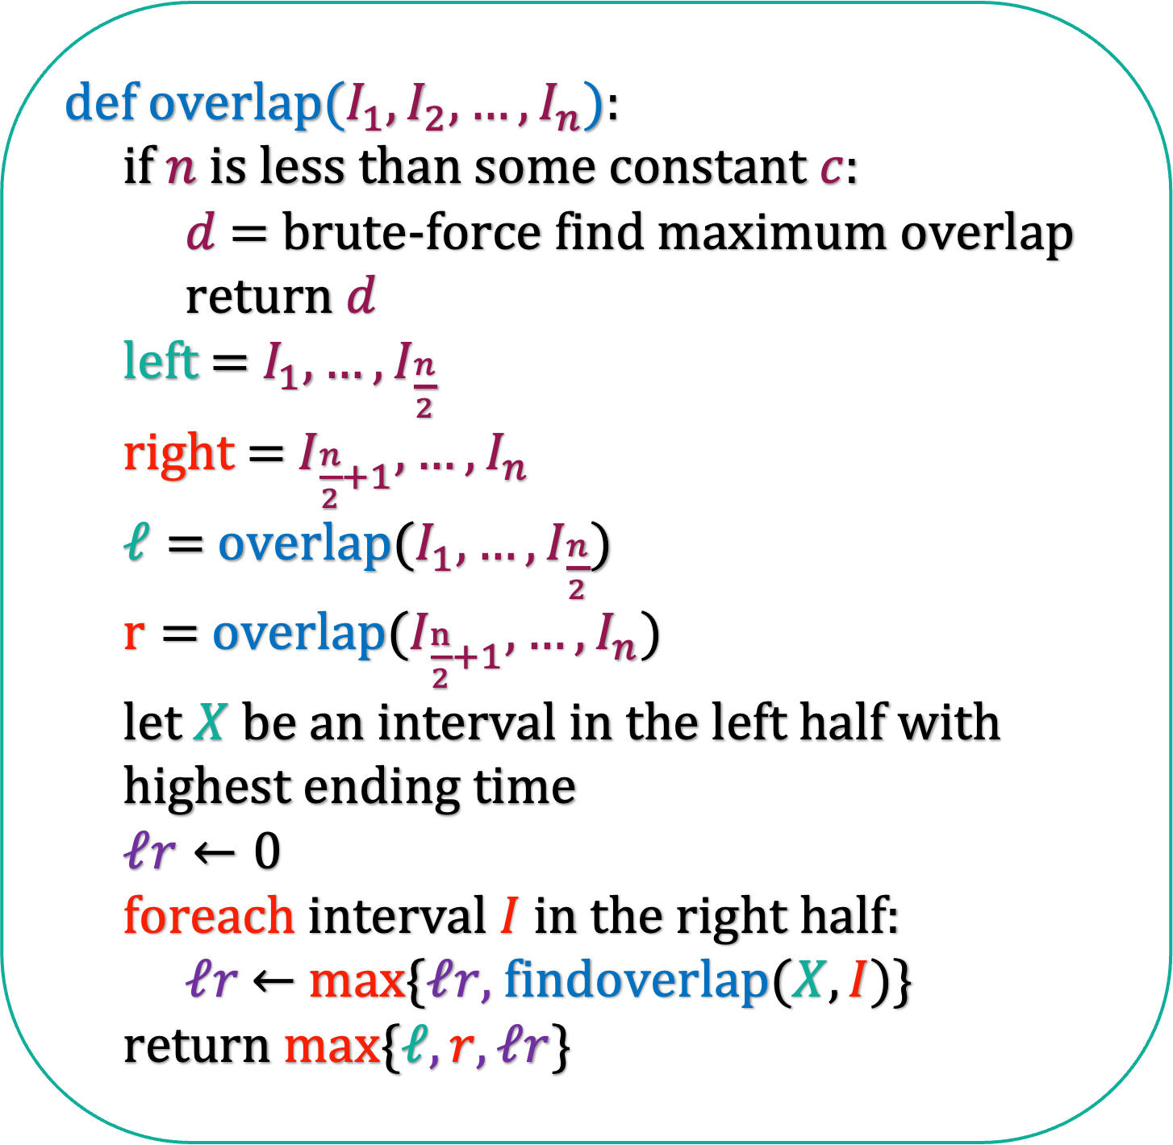
def i$ntialize($):
sort the intervals according to their start times
overlap($I_{1},I_{2},…,I_{n}$)
O($n\log{n}$)
def o$verlap(I_{1},I_{2},…,I_{n}$):
if $n$ is less than some constant $c$:
$d$ = brute-force find maximum overlap
return $d$
left = $I_{1},…,I_{\frac{n}{2}}$
right = $I_{\frac{n}{2}+1},…,I_{n}$
$ℓ=$ overlap($I_{1},…,I_{\frac{n}{2}}$)
$r=$ overlap($I_{\frac{n}{2}+1},…,I_{n}$)
let $X$ be an interval in the left half with
highest ending time
$ℓr←0$
foreach interval $I$ in the right half:
$ℓr$ $←$ max{$ℓr,$findoverlap($X,I$)}
return max{$ℓ,r,ℓr$}
T($n$)
T($\frac{n}{2}$)
T($\frac{n}{2}$)
2cn
T(c)
$$c^{2}$$

Slide 39
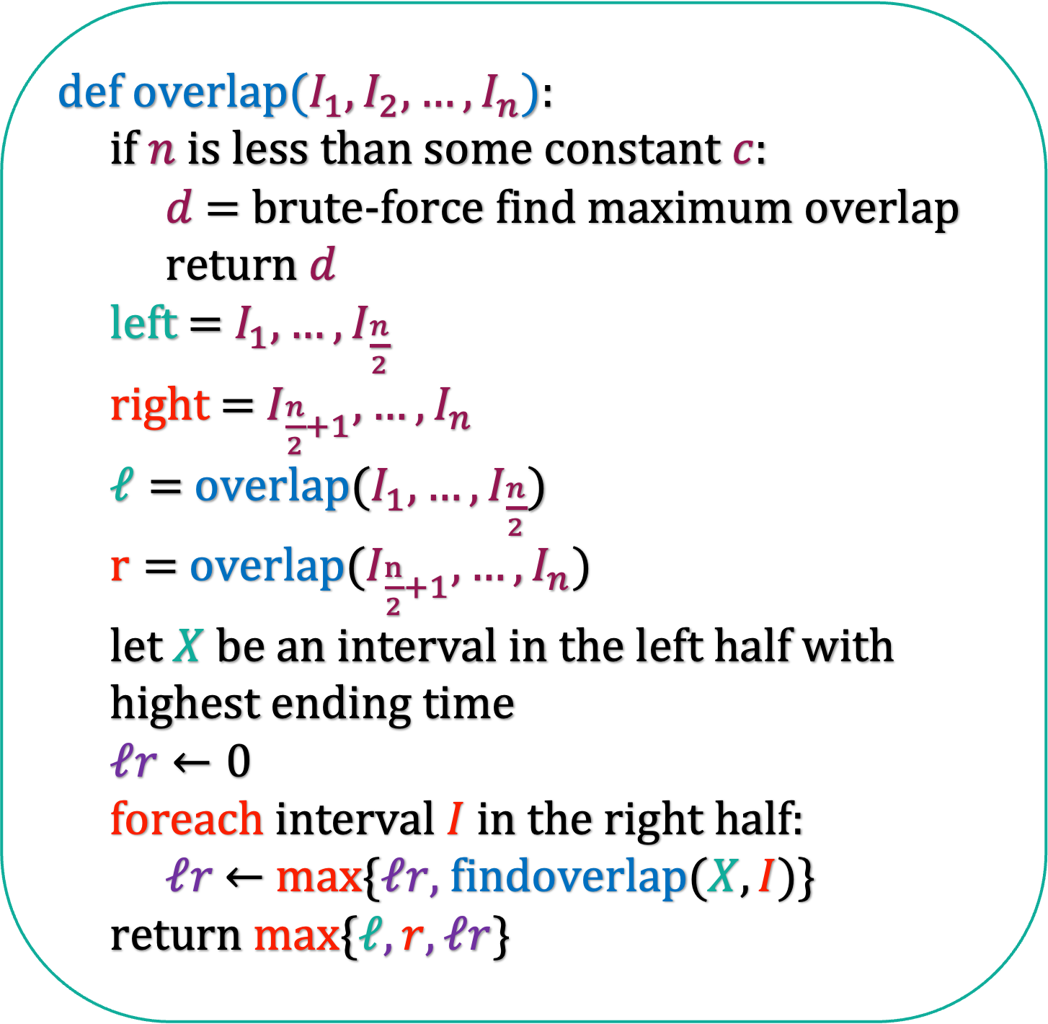

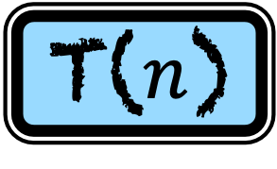
def i$ntialize($):
sort the intervals according to their start times
overlap($I_{1},I_{2},…,I_{n}$)
O($n\log{n}$)
def o$verlap(I_{1},I_{2},…,I_{n}$):
if $n$ is less than some constant $c$:
$d$ = brute-force find maximum overlap
return $d$
left = $I_{1},…,I_{\frac{n}{2}}$
right = $I_{\frac{n}{2}+1},…,I_{n}$
$ℓ=$ overlap($I_{1},…,I_{\frac{n}{2}}$)
$r=$ overlap($I_{\frac{n}{2}+1},…,I_{n}$)
let $X$ be an interval in the left half with
highest ending time
$ℓr←0$
foreach interval $I$ in the right half:
$ℓr$ $←$ max{$ℓr,$findoverlap($X,I$)}
return max{$ℓ,r,ℓr$}
T($n$)
T($\frac{n}{2}$)
T($\frac{n}{2}$)
2cn
T(c)
$$c^{2}$$
T($n$)
O($n\log{n}$)

Slide 40
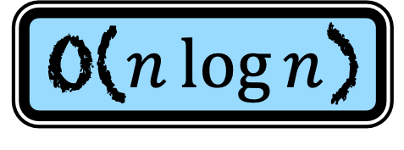
def i$ntialize($):
sort the intervals according to their start times
overlap($I_{1},I_{2},…,I_{n}$)
O($n\log{n}$)
def o$verlap(I_{1},I_{2},…,I_{n}$):
if $n$ is less than some constant $c$:
$d$ = brute-force find maximum overlap
return $d$
left = $I_{1},…,I_{\frac{n}{2}}$
right = $I_{\frac{n}{2}+1},…,I_{n}$
$ℓ=$ overlap($I_{1},…,I_{\frac{n}{2}}$)
$r=$ overlap($I_{\frac{n}{2}+1},…,I_{n}$)
let $X$ be an interval in the left half with
highest ending time
$ℓr←0$
foreach interval $I$ in the right half:
$ℓr$ $←$ max{$ℓr,$findoverlap($X,I$)}
return max{$ℓ,r,ℓr$}
O($n\log{n}$)

Slide 41
Correctness

Slide 42
def i$ntialize($):
sort the intervals according to their start times
overlap($I_{1},I_{2},…,I_{n}$)
A template for writing correctness proof for divide and conquer algorithms in this course
def o$verlap(I_{1},I_{2},…,I_{n}$):
if $n$ is less than some constant $c$:
$d$ = brute-force find maximum overlap
return $d$
left = $I_{1},…,I_{\frac{n}{2}}$
right = $I_{\frac{n}{2}+1},…,I_{n}$
$ℓ=$ overlap($I_{1},…,I_{\frac{n}{2}}$)
$r=$ overlap($I_{\frac{n}{2}+1},…,I_{n}$)
let $X$ be an interval in the left half with
highest ending time
$ℓr←0$
foreach interval $I$ in the right half:
$ℓr$ $←$ max{$ℓr,$findoverlap($X,I$)}
return max{$ℓ,r,ℓr$}
Lemma: Our algorithm correctly works for inputs containing n elements
Proof:
1) Write the base case.
2) Assume, using induction hypothesis, that our algorithm for inputs containing 1,2,…, n-1 numbers.
3) Prove that the algorithm runs correctly for n elements.

Slide 43
def i$ntialize($):
sort the intervals according to their start times
overlap($I_{1},I_{2},…,I_{n}$)
A key ingredient for the proof for this problem
Observation: In the optimal solution, if the first interval is in the left half and the second in the right, then the first interval has the maximum ending time among those in the left half.
def o$verlap(I_{1},I_{2},…,I_{n}$):
if $n$ is less than some constant $c$:
$d$ = brute-force find maximum overlap
return $d$
left = $I_{1},…,I_{\frac{n}{2}}$
right = $I_{\frac{n}{2}+1},…,I_{n}$
$ℓ=$ overlap($I_{1},…,I_{\frac{n}{2}}$)
$r=$ overlap($I_{\frac{n}{2}+1},…,I_{n}$)
let $X$ be an interval in the left half with
highest ending time
$ℓr←0$
foreach interval $I$ in the right half:
$ℓr$ $←$ max{$ℓr,$findoverlap($X,I$)}
return max{$ℓ,r,ℓr$}

Slide 44
def i$ntialize($):
sort the intervals according to their start times
overlap($I_{1},I_{2},…,I_{n}$)
Observation: In the optimal solution, if the first interval is in the left half and the second in the right, then the first interval has the maximum ending time among those in the left half.
def o$verlap(I_{1},I_{2},…,I_{n}$):
if $n$ is less than some constant $c$:
$d$ = brute-force find maximum overlap
return $d$
left = $I_{1},…,I_{\frac{n}{2}}$
right = $I_{\frac{n}{2}+1},…,I_{n}$
$ℓ=$ overlap($I_{1},…,I_{\frac{n}{2}}$)
$r=$ overlap($I_{\frac{n}{2}+1},…,I_{n}$)
let $X$ be an interval in the left half with
highest ending time
$ℓr←0$
foreach interval $I$ in the right half:
$ℓr$ $←$ max{$ℓr,$findoverlap($X,I$)}
return max{$ℓ,r,ℓr$}
Lemma: The algorithm Overlap runs correctly for n intervals.
Proof: By induction on n

Slide 45
def i$ntialize($):
sort the intervals according to their start times
overlap($I_{1},I_{2},…,I_{n}$)
Observation: In the optimal solution, if the first interval is in the left half and the second in the right, then the first interval has the maximum ending time among those in the left half.
def o$verlap(I_{1},I_{2},…,I_{n}$):
if $n$ is less than some constant $c$:
$d$ = brute-force find maximum overlap
return $d$
left = $I_{1},…,I_{\frac{n}{2}}$
right = $I_{\frac{n}{2}+1},…,I_{n}$
$ℓ=$ overlap($I_{1},…,I_{\frac{n}{2}}$)
$r=$ overlap($I_{\frac{n}{2}+1},…,I_{n}$)
let $X$ be an interval in the left half with
highest ending time
$ℓr←0$
foreach interval $I$ in the right half:
$ℓr$ $←$ max{$ℓr,$findoverlap($X,I$)}
return max{$ℓ,r,ℓr$}
Lemma: The algorithm Overlap runs correctly for n intervals.
Proof: By induction on n
Base Case (n<C intervals)
When there are less than c intervals, then we use brute force algorithm to find the overlap.
Let us assume using induction hypothesis that the algorithm Overlap runs correctly for 1,2,…, n-1 intervals.
There are three cases for n intervals:

Slide 46
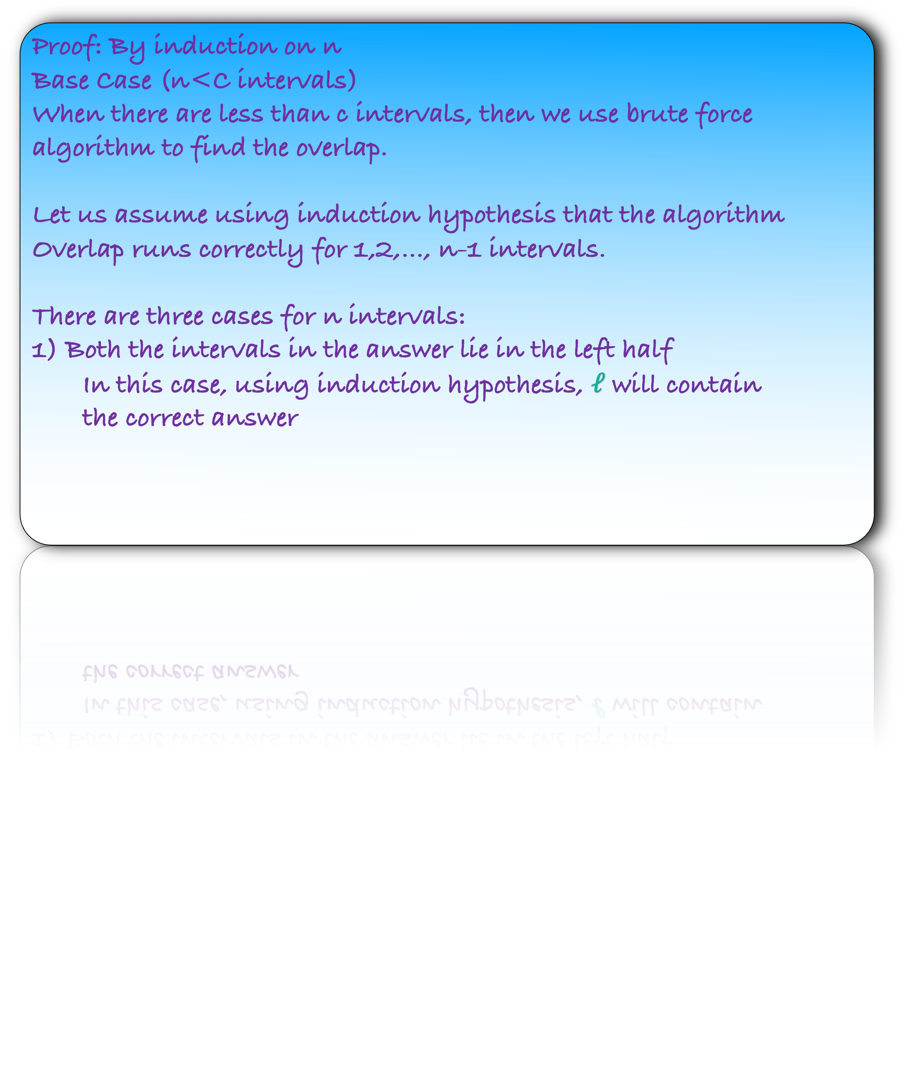
def i$ntialize($):
sort the intervals according to their start times
overlap($I_{1},I_{2},…,I_{n}$)
Observation: In the optimal solution, if the first interval is in the left half and the second in the right, then the first interval has the maximum ending time among those in the left half.
def o$verlap(I_{1},I_{2},…,I_{n}$):
if $n$ is less than some constant $c$:
$d$ = brute-force find maximum overlap
return $d$
left = $I_{1},…,I_{\frac{n}{2}}$
right = $I_{\frac{n}{2}+1},…,I_{n}$
$ℓ=$ overlap($I_{1},…,I_{\frac{n}{2}}$)
$r=$ overlap($I_{\frac{n}{2}+1},…,I_{n}$)
let $X$ be an interval in the left half with
highest ending time
$ℓr←0$
foreach interval $I$ in the right half:
$ℓr$ $←$ max{$ℓr,$findoverlap($X,I$)}
return max{$ℓ,r,ℓr$}
Lemma: The algorithm Overlap runs correctly for n intervals.
Proof: By induction on n
Base Case (n<C intervals)
When there are less than c intervals, then we use brute force algorithm to find the overlap.
Let us assume using induction hypothesis that the algorithm Overlap runs correctly for 1,2,…, n-1 intervals.
There are three cases for n intervals:
1) Both the intervals in the answer lie in the left half
In this case, using induction hypothesis, $ℓ$ will contain
the correct answer

Slide 47
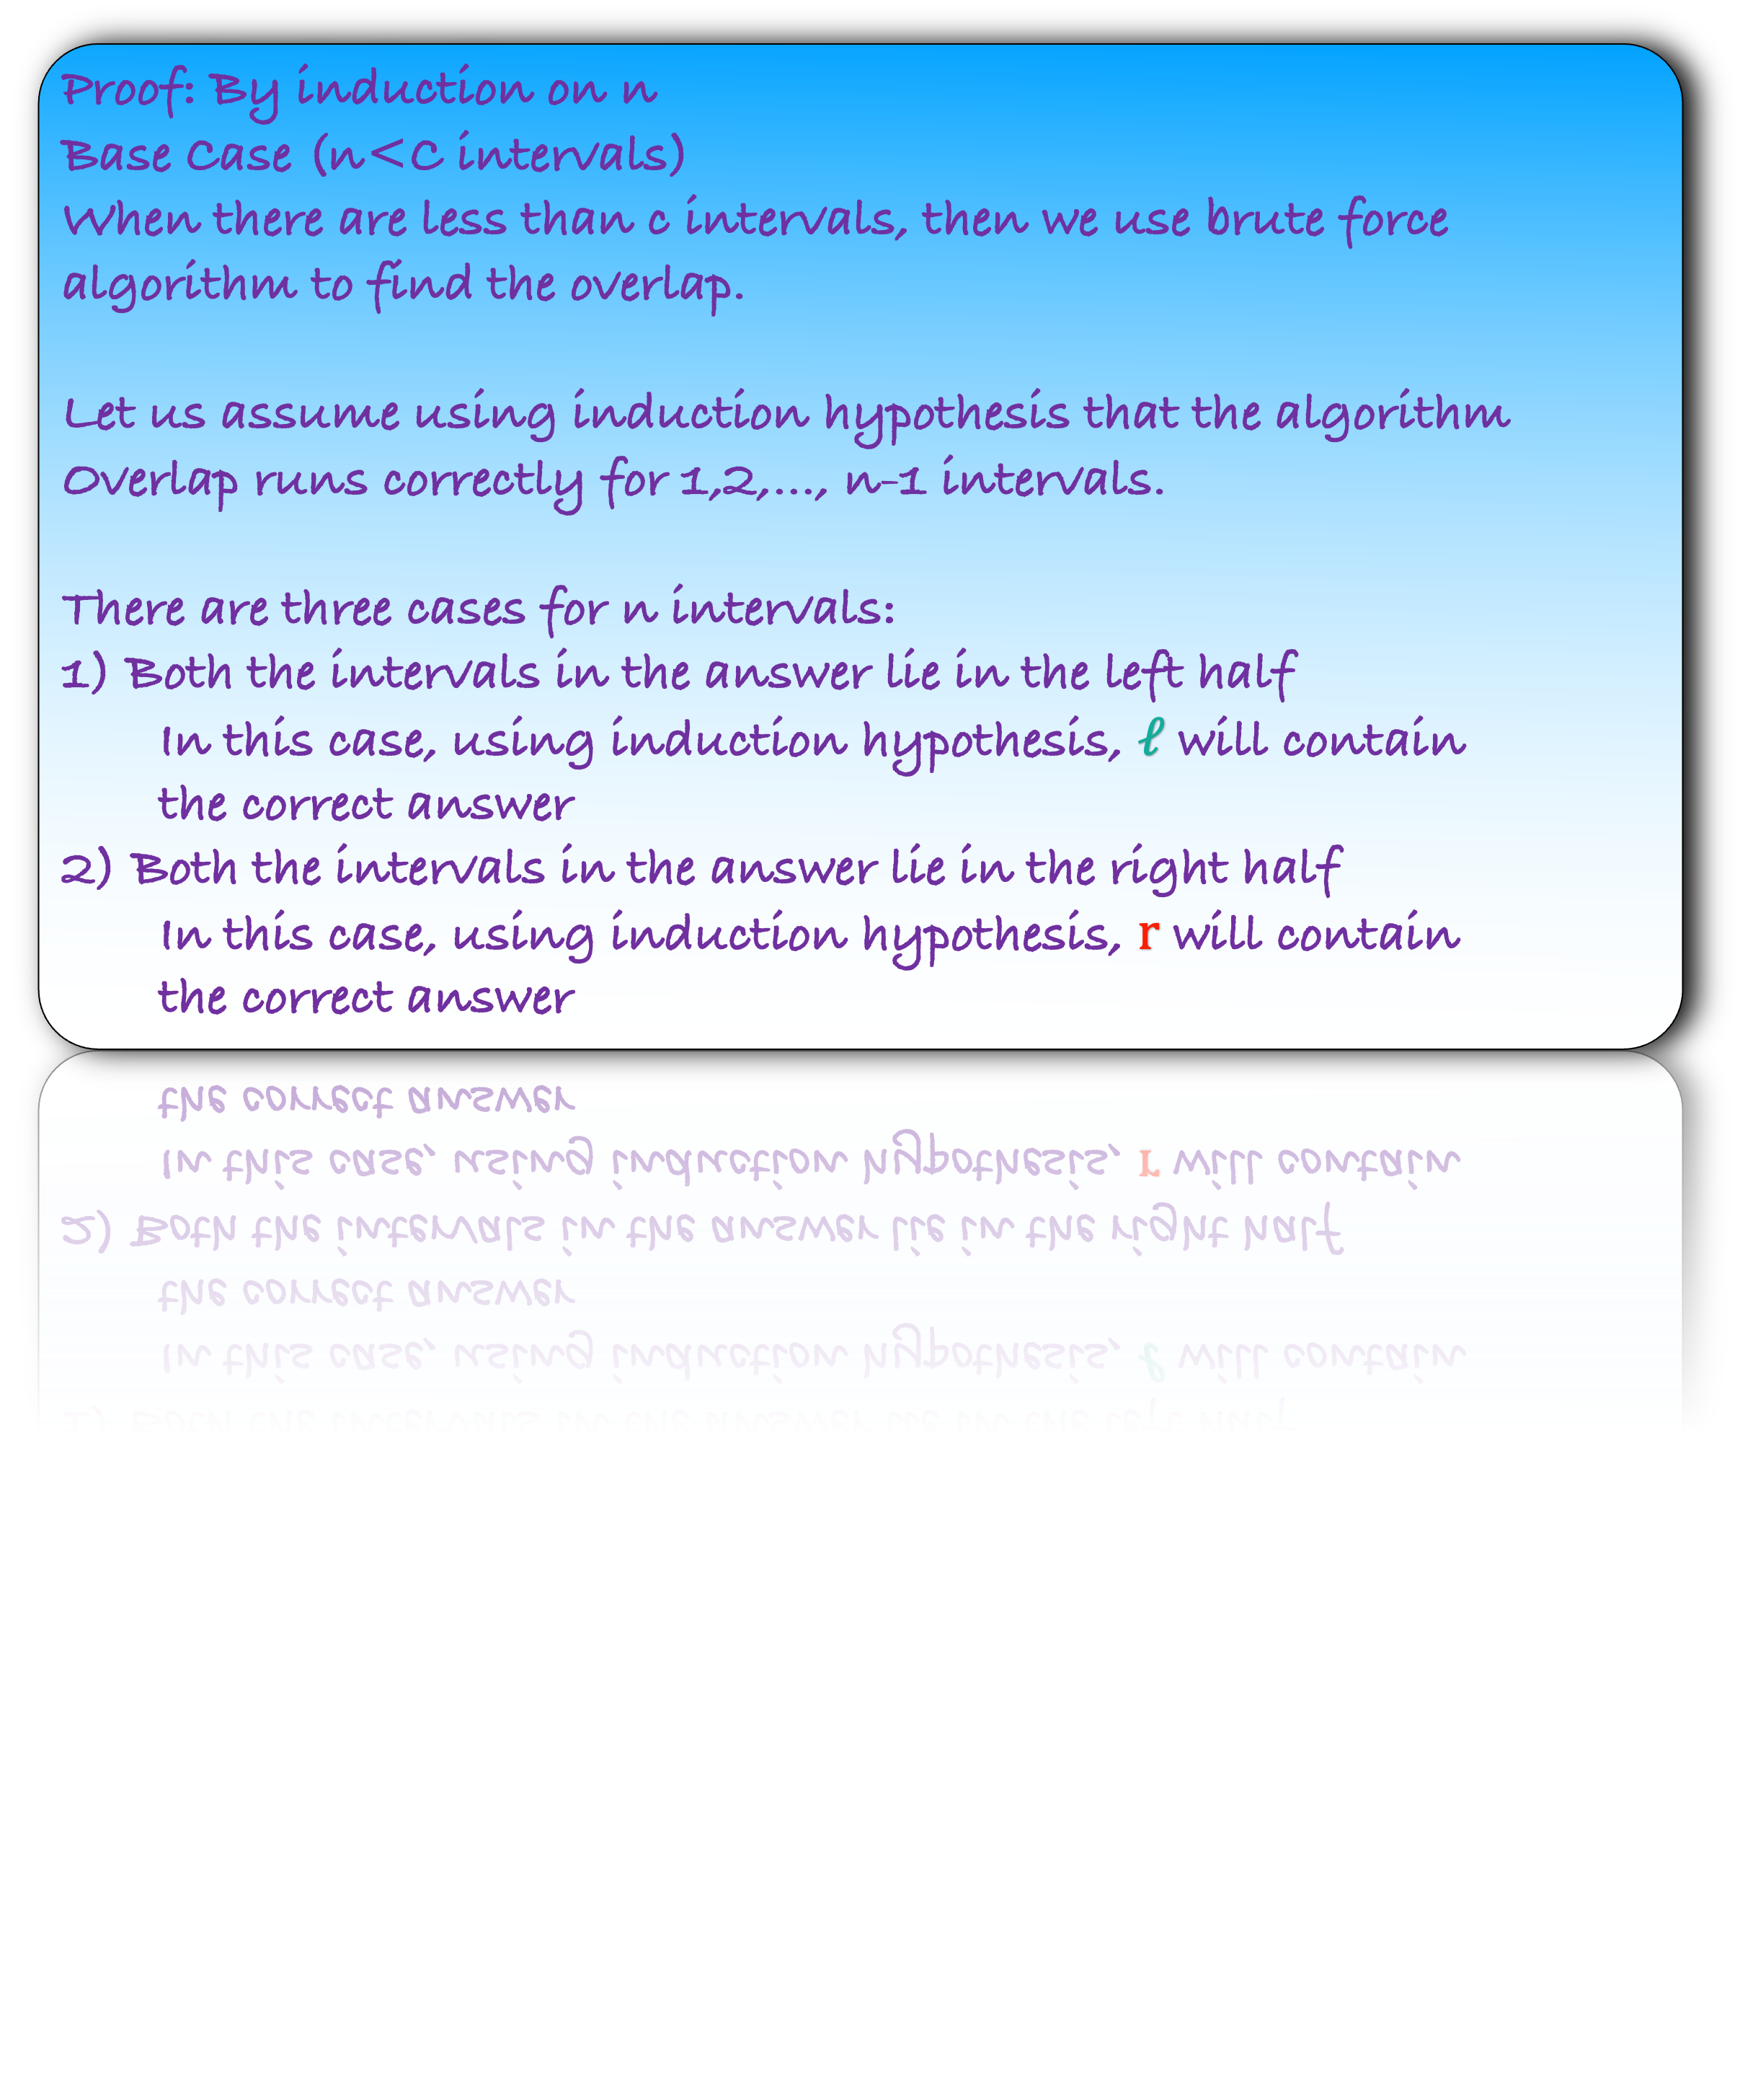
def i$ntialize($):
sort the intervals according to their start times
overlap($I_{1},I_{2},…,I_{n}$)
Observation: In the optimal solution, if the first interval is in the left half and the second in the right, then the first interval has the maximum ending time among those in the left half.
def o$verlap(I_{1},I_{2},…,I_{n}$):
if $n$ is less than some constant $c$:
$d$ = brute-force find maximum overlap
return $d$
left = $I_{1},…,I_{\frac{n}{2}}$
right = $I_{\frac{n}{2}+1},…,I_{n}$
$ℓ=$ overlap($I_{1},…,I_{\frac{n}{2}}$)
$r=$ overlap($I_{\frac{n}{2}+1},…,I_{n}$)
let $X$ be an interval in the left half with
highest ending time
$ℓr←0$
foreach interval $I$ in the right half:
$ℓr$ $←$ max{$ℓr,$findoverlap($X,I$)}
return max{$ℓ,r,ℓr$}
Lemma: The algorithm Overlap runs correctly for n intervals.
Proof: By induction on n
Base Case (n<C intervals)
When there are less than c intervals, then we use brute force algorithm to find the overlap.
Let us assume using induction hypothesis that the algorithm Overlap runs correctly for 1,2,…, n-1 intervals.
There are three cases for n intervals:
1) Both the intervals in the answer lie in the left half
In this case, using induction hypothesis, $ℓ$ will contain
the correct answer
2) Both the intervals in the answer lie in the right half
In this case, using induction hypothesis, $r$ will contain
the correct answer

Slide 48
def i$ntialize($):
sort the intervals according to their start times
overlap($I_{1},I_{2},…,I_{n}$)
Observation: In the optimal solution, if the first interval is in the left half and the second in the right, then the first interval has the maximum ending time among those in the left half.
def o$verlap(I_{1},I_{2},…,I_{n}$):
if $n$ is less than some constant $c$:
$d$ = brute-force find maximum overlap
return $d$
left = $I_{1},…,I_{\frac{n}{2}}$
right = $I_{\frac{n}{2}+1},…,I_{n}$
$ℓ=$ overlap($I_{1},…,I_{\frac{n}{2}}$)
$r=$ overlap($I_{\frac{n}{2}+1},…,I_{n}$)
let $X$ be an interval in the left half with
highest ending time
$ℓr←0$
foreach interval $I$ in the right half:
$ℓr$ $←$ max{$ℓr,$findoverlap($X,I$)}
return max{$ℓ,r,ℓr$}
Lemma: The algorithm Overlap runs correctly for n intervals.
Proof: By induction on n
Base Case (n<C intervals)
When there are less than c intervals, then we use brute force algorithm to find the overlap.
Let us assume using induction hypothesis that the algorithm Overlap runs correctly for 1,2,…, n-1 intervals.
There are three cases for n intervals:
3) The first interval lies in the left half and the second interval lies in the right half

Slide 49
def i$ntialize($):
sort the intervals according to their start times
overlap($I_{1},I_{2},…,I_{n}$)
Observation: In the optimal solution, if the first interval is in the left half and the second in the right, then the first interval has the maximum ending time among those in the left half.
def o$verlap(I_{1},I_{2},…,I_{n}$):
if $n$ is less than some constant $c$:
$d$ = brute-force find maximum overlap
return $d$
left = $I_{1},…,I_{\frac{n}{2}}$
right = $I_{\frac{n}{2}+1},…,I_{n}$
$ℓ=$ overlap($I_{1},…,I_{\frac{n}{2}}$)
$r=$ overlap($I_{\frac{n}{2}+1},…,I_{n}$)
let $X$ be an interval in the left half with
highest ending time
$ℓr←0$
foreach interval $I$ in the right half:
$ℓr$ $←$ max{$ℓr,$findoverlap($X,I$)}
return max{$ℓ,r,ℓr$}
Lemma: The algorithm Overlap runs correctly for n intervals.
Proof: By induction on n
Base Case (n<C intervals)
When there are less than c intervals, then we use brute force algorithm to find the overlap.
Let us assume using induction hypothesis that the algorithm Overlap runs correctly for 1,2,…, n-1 intervals.
There are three cases for n intervals:
3) The first interval lies in the left half and the second interval lies in the right half
By our observation the first interval must have the maximum ending time.
But that is what we are also doing in our algorithm. Thus, it is correct.

