Slide 1
Implementation

Slide 2
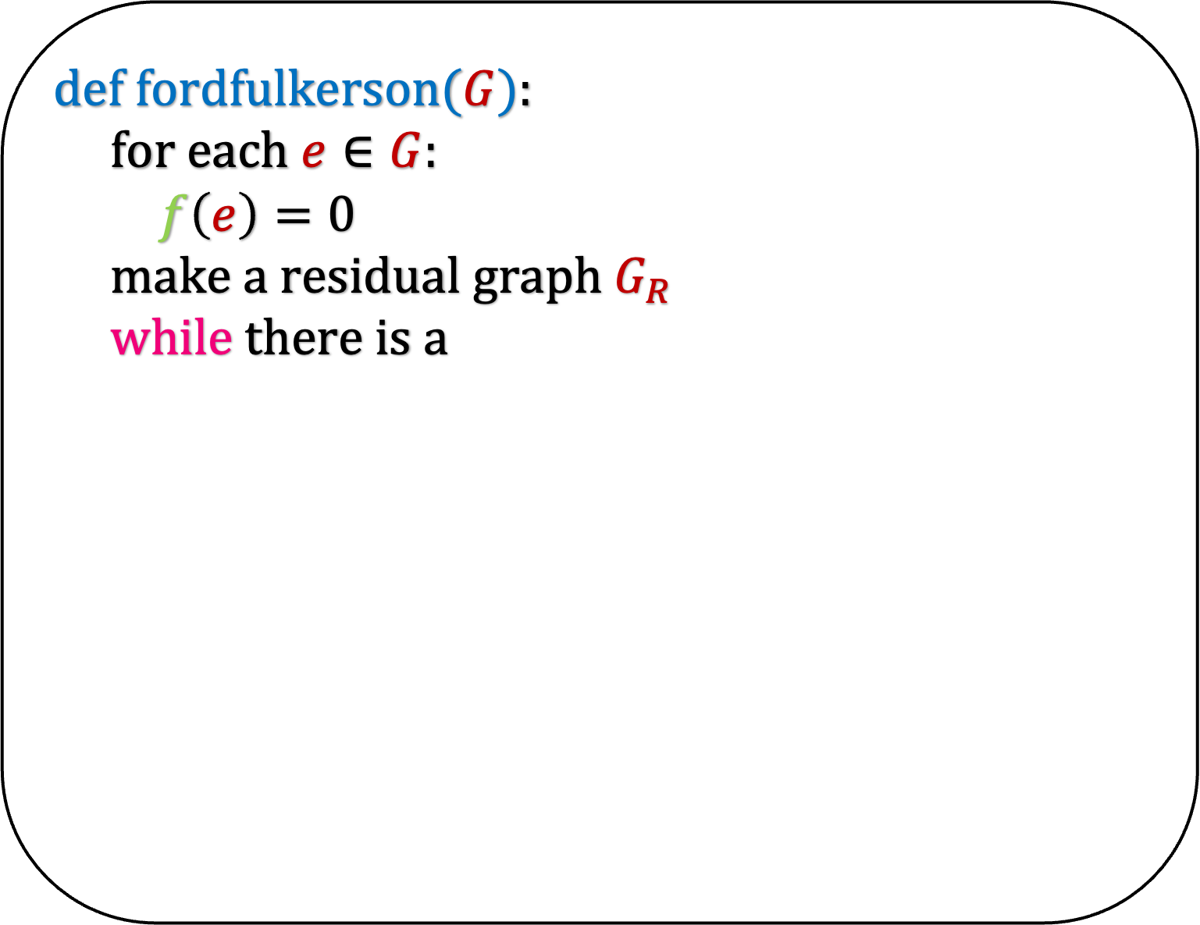
def fordfulkerson($G$):
for each $e∈G$:
$f\left(e\right)=0$
make a residual graph $G_{R}$
while there is a

Slide 3
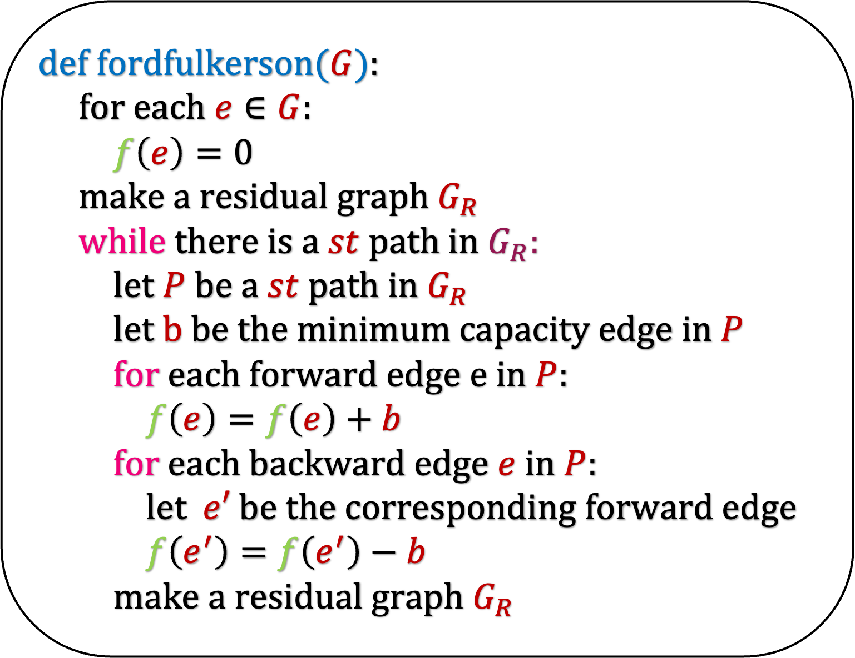
def fordfulkerson($G$):
for each $e∈G$:
$f\left(e\right)=0$
make a residual graph $G_{R}$
while there is a $st$path in $G_{R}$:
let $P$ be a $st$ path in $G_{R}$
let $b$ be the minimum capacity edge in $P$
for each forward edge $e$ in $P$:
$f\left(e\right)=f\left(e\right)+b$
for each backward edge $e$ in $P$:
let $e′$ be the corresponding forward edge
$f\left(e^{′}\right)=f\left(e^{′}\right)−b$
make a residual graph $G_{R}$

Slide 4
def fordfulkerson($G$):
for each $e∈G$:
$f\left(e\right)=0$
make a residual graph $G_{R}$
while there is a $st$path in $G_{R}$:
let $P$ be a $st$ path in $G_{R}$
let $b$ be the minimum capacity edge in $P$
for each forward edge $e$ in $P$:
$f\left(e\right)=f\left(e\right)+b$
for each backward edge $e$ in $P$:
let $e′$ be the corresponding forward edge
$f\left(e^{′}\right)=f\left(e^{′}\right)−b$
make a residual graph $G_{R}$
a
5
10
0
0
s
10
t
0
10
10
0
0
b

Slide 5
def fordfulkerson($G$):
for each $e∈G$:
$f\left(e\right)=0$
make a residual graph $G_{R}$
while there is a $st$path in $G_{R}$:
let $P$ be a $st$ path in $G_{R}$
let $b$ be the minimum capacity edge in $P$
for each forward edge $e$ in $P$:
$f\left(e\right)=f\left(e\right)+b$
for each backward edge $e$ in $P$:
let $e′$ be the corresponding forward edge
$f\left(e^{′}\right)=f\left(e^{′}\right)−b$
make a residual graph $G_{R}$
a
0
10
0
5
s
0
10
t
0
10
0
10
b

Slide 6
def fordfulkerson($G$):
for each $e∈G$:
$f\left(e\right)=0$
make a residual graph $G_{R}$
while there is a $st$path in $G_{R}$:
let $P$ be a $st$ path in $G_{R}$
let $b$ be the minimum capacity edge in $P$
for each forward edge $e$ in $P$:
$f\left(e\right)=f\left(e\right)+b$
for each backward edge $e$ in $P$:
let $e′$ be the corresponding forward edge
$f\left(e^{′}\right)=f\left(e^{′}\right)−b$
make a residual graph $G_{R}$
a
0
10
0
5
s
0
10
t
0
10
0
10
b

Slide 7
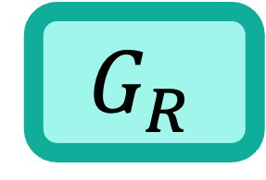
def fordfulkerson($G$):
for each $e∈G$:
$f\left(e\right)=0$
make a residual graph $G_{R}$
while there is a $st$path in $G_{R}$:
let $P$ be a $st$ path in $G_{R}$
let $b$ be the minimum capacity edge in $P$
for each forward edge $e$ in $P$:
$f\left(e\right)=f\left(e\right)+b$
for each backward edge $e$ in $P$:
let $e′$ be the corresponding forward edge
$f\left(e^{′}\right)=f\left(e^{′}\right)−b$
make a residual graph $G_{R}$
a
0
10
0
5
s
0
10
t
0
10
0
10
b
a
10
5
$$G_{R}$$
s
10
t
10
10
b

Slide 8
def fordfulkerson($G$):
for each $e∈G$:
$f\left(e\right)=0$
make a residual graph $G_{R}$
while there is a $st$path in $G_{R}$:
let $P$ be a $st$ path in $G_{R}$
let $b$ be the minimum capacity edge in $P$
for each forward edge $e$ in $P$:
$f\left(e\right)=f\left(e\right)+b$
for each backward edge $e$ in $P$:
let $e′$ be the corresponding forward edge
$f\left(e^{′}\right)=f\left(e^{′}\right)−b$
make a residual graph $G_{R}$
a
0
10
0
5
s
0
10
t
0
10
0
10
b
a
10
5
$$G_{R}$$
s
10
t
10
10
b

Slide 9
def fordfulkerson($G$):
for each $e∈G$:
$f\left(e\right)=0$
make a residual graph $G_{R}$
while there is a $st$path in $G_{R}$:
let $P$ be a $st$ path in $G_{R}$
let $b$ be the minimum capacity edge in $P$
for each forward edge $e$ in $P$:
$f\left(e\right)=f\left(e\right)+b$
for each backward edge $e$ in $P$:
let $e′$ be the corresponding forward edge
$f\left(e^{′}\right)=f\left(e^{′}\right)−b$
make a residual graph $G_{R}$
a
0
10
0
5
s
0
10
t
0
10
0
10
b
a
10
5
$$G_{R}$$
s
10
t
10
10
b

Slide 10
def fordfulkerson($G$):
for each $e∈G$:
$f\left(e\right)=0$
make a residual graph $G_{R}$
while there is a $st$path in $G_{R}$:
let $P$ be a $st$ path in $G_{R}$
let $b$ be the minimum capacity edge in $P$
for each forward edge $e$ in $P$:
$f\left(e\right)=f\left(e\right)+b$
for each backward edge $e$ in $P$:
let $e′$ be the corresponding forward edge
$f\left(e^{′}\right)=f\left(e^{′}\right)−b$
make a residual graph $G_{R}$
a
0
10
0
5
s
0
10
t
0
10
0
10
b
a
10
5
$$G_{R}$$
s
10
t
10
10
b

Slide 11
def fordfulkerson($G$):
for each $e∈G$:
$f\left(e\right)=0$
make a residual graph $G_{R}$
while there is a $st$path in $G_{R}$:
let $P$ be a $st$ path in $G_{R}$
let $b$ be the minimum capacity edge in $P$
for each forward edge $e$ in $P$:
$f\left(e\right)=f\left(e\right)+b$
for each backward edge $e$ in $P$:
let $e′$ be the corresponding forward edge
$f\left(e^{′}\right)=f\left(e^{′}\right)−b$
make a residual graph $G_{R}$
a
0
10
0
5
s
0
10
t
0
10
0
10
b
a
10
5
$$G_{R}$$
s
10
t
10
10
b

Slide 12
def fordfulkerson($G$):
for each $e∈G$:
$f\left(e\right)=0$
make a residual graph $G_{R}$
while there is a $st$path in $G_{R}$:
let $P$ be a $st$ path in $G_{R}$
let $b$ be the minimum capacity edge in $P$
for each forward edge $e$ in $P$:
$f\left(e\right)=f\left(e\right)+b$
for each backward edge $e$ in $P$:
let $e′$ be the corresponding forward edge
$f\left(e^{′}\right)=f\left(e^{′}\right)−b$
make a residual graph $G_{R}$
a
10
10
0
5
s
10
10
t
0
10
10
10
b
a
10
5
$$G_{R}$$
s
10
t
10
10
b

Slide 13
def fordfulkerson($G$):
for each $e∈G$:
$f\left(e\right)=0$
make a residual graph $G_{R}$
while there is a $st$path in $G_{R}$:
let $P$ be a $st$ path in $G_{R}$
let $b$ be the minimum capacity edge in $P$
for each forward edge $e$ in $P$:
$f\left(e\right)=f\left(e\right)+b$
for each backward edge $e$ in $P$:
let $e′$ be the corresponding forward edge
$f\left(e^{′}\right)=f\left(e^{′}\right)−b$
make a residual graph $G_{R}$
a
10
10
0
5
s
10
10
t
0
10
10
10
b

Slide 14
def fordfulkerson($G$):
for each $e∈G$:
$f\left(e\right)=0$
make a residual graph $G_{R}$
while there is a $st$path in $G_{R}$:
let $P$ be a $st$ path in $G_{R}$
let $b$ be the minimum capacity edge in $P$
for each forward edge $e$ in $P$:
$f\left(e\right)=f\left(e\right)+b$
for each backward edge $e$ in $P$:
let $e′$ be the corresponding forward edge
$f\left(e^{′}\right)=f\left(e^{′}\right)−b$
make a residual graph $G_{R}$
a
10
10
0
5
s
10
10
t
0
10
10
10
b
a
10
5
$$G_{R}$$
s
10
t
10
10
b

Slide 15
def fordfulkerson($G$):
for each $e∈G$:
$f\left(e\right)=0$
make a residual graph $G_{R}$
while there is a $st$path in $G_{R}$:
let $P$ be a $st$ path in $G_{R}$
let $b$ be the minimum capacity edge in $P$
for each forward edge $e$ in $P$:
$f\left(e\right)=f\left(e\right)+b$
for each backward edge $e$ in $P$:
let $e′$ be the corresponding forward edge
$f\left(e^{′}\right)=f\left(e^{′}\right)−b$
make a residual graph $G_{R}$
a
10
10
0
5
s
10
10
t
0
10
10
10
b
a
10
5
$$G_{R}$$
s
10
t
10
10
b

Slide 16
def fordfulkerson($G$):
for each $e∈G$:
$f\left(e\right)=0$
make a residual graph $G_{R}$
while there is a $st$path in $G_{R}$:
let $P$ be a $st$ path in $G_{R}$
let $b$ be the minimum capacity edge in $P$
for each forward edge $e$ in $P$:
$f\left(e\right)=f\left(e\right)+b$
for each backward edge $e$ in $P$:
let $e′$ be the corresponding forward edge
$f\left(e^{′}\right)=f\left(e^{′}\right)−b$
make a residual graph $G_{R}$
a
10
10
0
5
s
10
10
t
0
10
10
10
b
a
10
5
$$G_{R}$$
s
10
t
10
10
b

Slide 17
def fordfulkerson($G$):
for each $e∈G$:
$f\left(e\right)=0$
make a residual graph $G_{R}$
while there is a $st$path in $G_{R}$:
let $P$ be a $st$ path in $G_{R}$
let $b$ be the minimum capacity edge in $P$
for each forward edge $e$ in $P$:
$f\left(e\right)=f\left(e\right)+b$
for each backward edge $e$ in $P$:
let $e′$ be the corresponding forward edge
$f\left(e^{′}\right)=f\left(e^{′}\right)−b$
make a residual graph $G_{R}$
a
10
10
0
5
s
10
10
t
0
10
10
10
b
a
10
5
$$G_{R}$$
s
10
t
10
10
b

Slide 18
def fordfulkerson($G$):
for each $e∈G$:
$f\left(e\right)=0$
make a residual graph $G_{R}$
while there is a $st$path in $G_{R}$:
let $P$ be a $st$ path in $G_{R}$
let $b$ be the minimum capacity edge in $P$
for each forward edge $e$ in $P$:
$f\left(e\right)=f\left(e\right)+b$
for each backward edge $e$ in $P$:
let $e′$ be the corresponding forward edge
$f\left(e^{′}\right)=f\left(e^{′}\right)−b$
make a residual graph $G_{R}$
a
10
10
0
5
s
10
10
t
0
10
10
10
b
a
10
5
$$G_{R}$$
s
10
t
10
10
b

Slide 19
def fordfulkerson($G$):
for each $e∈G$:
$f\left(e\right)=0$
make a residual graph $G_{R}$
while there is a $st$path in $G_{R}$:
let $P$ be a $st$ path in $G_{R}$
let $b$ be the minimum capacity edge in $P$
for each forward edge $e$ in $P$:
$f\left(e\right)=f\left(e\right)+b$
for each backward edge $e$ in $P$:
let $e′$ be the corresponding forward edge
$f\left(e^{′}\right)=f\left(e^{′}\right)−b$
make a residual graph $G_{R}$
a
10
10
5
5
s
10
10
t
5
10
10
10
b
a
10
5
$$G_{R}$$
s
10
t
10
10
b

Slide 20
def fordfulkerson($G$):
for each $e∈G$:
$f\left(e\right)=0$
make a residual graph $G_{R}$
while there is a $st$path in $G_{R}$:
let $P$ be a $st$ path in $G_{R}$
let $b$ be the minimum capacity edge in $P$
for each forward edge $e$ in $P$:
$f\left(e\right)=f\left(e\right)+b$
for each backward edge $e$ in $P$:
let $e′$ be the corresponding forward edge
$f\left(e^{′}\right)=f\left(e^{′}\right)−b$
make a residual graph $G_{R}$
a
10
10
5
5
s
10
10
t
5
10
10
10
b
a
10
5
$$G_{R}$$
s
10
t
10
10
b

Slide 21
def fordfulkerson($G$):
for each $e∈G$:
$f\left(e\right)=0$
make a residual graph $G_{R}$
while there is a $st$path in $G_{R}$:
let $P$ be a $st$ path in $G_{R}$
let $b$ be the minimum capacity edge in $P$
for each forward edge $e$ in $P$:
$f\left(e\right)=f\left(e\right)+b$
for each backward edge $e$ in $P$:
let $e′$ be the corresponding forward edge
$f\left(e^{′}\right)=f\left(e^{′}\right)−b$
make a residual graph $G_{R}$
a
10
10
5
5
s
5
10
t
5
10
10
10
b
a
10
5
$$G_{R}$$
s
10
t
10
10
b

Slide 22
def fordfulkerson($G$):
for each $e∈G$:
$f\left(e\right)=0$
make a residual graph $G_{R}$
while there is a $st$path in $G_{R}$:
let $P$ be a $st$ path in $G_{R}$
let $b$ be the minimum capacity edge in $P$
for each forward edge $e$ in $P$:
$f\left(e\right)=f\left(e\right)+b$
for each backward edge $e$ in $P$:
let $e′$ be the corresponding forward edge
$f\left(e^{′}\right)=f\left(e^{′}\right)−b$
make a residual graph $G_{R}$
a
10
10
5
5
s
5
10
t
5
10
10
10
b

Slide 23
def fordfulkerson($G$):
for each $e∈G$:
$f\left(e\right)=0$
make a residual graph $G_{R}$
while there is a $st$path in $G_{R}$:
let $P$ be a $st$ path in $G_{R}$
let $b$ be the minimum capacity edge in $P$
for each forward edge $e$ in $P$:
$f\left(e\right)=f\left(e\right)+b$
for each backward edge $e$ in $P$:
let $e′$ be the corresponding forward edge
$f\left(e^{′}\right)=f\left(e^{′}\right)−b$
make a residual graph $G_{R}$
a
10
10
5
5
s
5
10
t
5
10
10
10
b
a
10
5
5
$$G_{R}$$
s
5
t
5
5
10
b

Slide 24
def fordfulkerson($G$):
for each $e∈G$:
$f\left(e\right)=0$
make a residual graph $G_{R}$
while there is a $st$path in $G_{R}$:
let $P$ be a $st$ path in $G_{R}$
let $b$ be the minimum capacity edge in $P$
for each forward edge $e$ in $P$:
$f\left(e\right)=f\left(e\right)+b$
for each backward edge $e$ in $P$:
let $e′$ be the corresponding forward edge
$f\left(e^{′}\right)=f\left(e^{′}\right)−b$
make a residual graph $G_{R}$
a
10
10
5
5
s
5
10
t
5
10
10
10
b
a
10
5
5
$$G_{R}$$
s
5
t
5
5
10
b

Slide 25
def fordfulkerson($G$):
for each $e∈G$:
$f\left(e\right)=0$
make a residual graph $G_{R}$
while there is a $st$path in $G_{R}$:
let $P$ be a $st$ path in $G_{R}$
let $b$ be the minimum capacity edge in $P$
for each forward edge $e$ in $P$:
$f\left(e\right)=f\left(e\right)+b$
for each backward edge $e$ in $P$:
let $e′$ be the corresponding forward edge
$f\left(e^{′}\right)=f\left(e^{′}\right)−b$
make a residual graph $G_{R}$
a
10
10
5
5
s
5
10
t
5
10
10
10
b
a
10
5
5
$$G_{R}$$
s
5
t
5
5
10
b

Slide 26
Running Time

Slide 27





def fordfulkerson($G$):
for each $e∈G$:
$f\left(e\right)=0$
make a residual graph $G_{R}$
while there is a $st$path in $G_{R}$:
let $P$ be a $st$ path in $G_{R}$
let $b$ be the minimum capacity edge in $P$
for each forward edge $e$ in $P$:
$f\left(e\right)=f\left(e\right)+b$
for each backward edge $e$ in $P$:
let $e′$ be the corresponding forward edge
$f\left(e^{′}\right)=f\left(e^{′}\right)−b$
make a residual graph $G_{R}$
O($m$)
O($m+n$)
O($m+n$)
O($n$)
O($m+n$)

Slide 28

def fordfulkerson($G$):
for each $e∈G$:
$f\left(e\right)=0$
make a residual graph $G_{R}$
while there is a $st$path in $G_{R}$:
let $P$ be a $st$ path in $G_{R}$
let $b$ be the minimum capacity edge in $P$
for each forward edge $e$ in $P$:
$f\left(e\right)=f\left(e\right)+b$
for each backward edge $e$ in $P$:
let $e′$ be the corresponding forward edge
$f\left(e^{′}\right)=f\left(e^{′}\right)−b$
make a residual graph $G_{R}$
O($m$)
O($m+n$)
O($m+n$)

Slide 29

def fordfulkerson($G$):
for each $e∈G$:
$f\left(e\right)=0$
make a residual graph $G_{R}$
while there is a $st$path in $G_{R}$:
let $P$ be a $st$ path in $G_{R}$
let $b$ be the minimum capacity edge in $P$
for each forward edge $e$ in $P$:
$f\left(e\right)=f\left(e\right)+b$
for each backward edge $e$ in $P$:
let $e′$ be the corresponding forward edge
$f\left(e^{′}\right)=f\left(e^{′}\right)−b$
make a residual graph $G_{R}$
Running Time = #number of times the loop runs x
O($m+n$)
But how many times is the loop running?

Slide 30
Unfortunately, the algorithm takes exponential time for real weighted graphs
Moreover, it does not even give the correct answer
Let us look at a simple example due to Uri Zwick
This is a pathological example in which everything that can go wrong, goes wrong.

Slide 31


a
0
2
0
0
2
$φ$
$φ$ is a real number less than 1
We will calculate its value later
b
0
2
s
0
2
0
1
t
What is the maxmimum flow in this graph?
c
0
2
0
2
0
1
d

Slide 32
a
The maximum flow in this graph is 5
Let us now see how our algorithm works.
We will not make backward edges from/to s or t in our example for brevity
2
2
0
2
2
$φ$
b
1
2
s
1
2
1
1
t
c
2
2
2
2
0
1
d

Slide 33


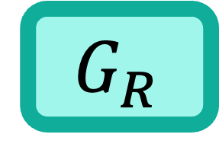
a
Flow = $0$
$$G_{R}$$
a
0
2
0
0
2
$φ$
2
2
$φ$
b
b
0
2
2
s
0
2
0
1
t
s
t
2
1
c
c
0
2
0
2
0
1
2
2
1
d
d

Slide 34
a
Flow = $0$
$$G_{R}$$
a
0
2
0
0
2
$φ$
2
2
$φ$
b
b
0
2
2
s
0
2
0
1
t
s
t
2
1
c
c
0
2
0
2
0
1
2
2
1
d
d

Slide 35


a
Flow = $1$
$$G_{R}$$
a
0
2
0
0
2
$φ$
2
2
$φ$
b
b
1
2
1
s
1
2
1
1
t
s
1
t
1
c
c
0
2
0
2
0
1
2
2
1
d
d

Slide 36
Path A
a
Flow = $1$
$$G_{R}$$
a
0
2
0
0
2
$φ$
2
2
$φ$
b
b
1
2
1
s
1
2
1
1
t
s
1
t
1
c
c
0
2
0
2
0
1
2
2
1
d
d

Slide 37






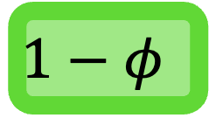






Path A
a
Flow = $1+φ$
$$G_{R}$$
a
$$φ$$
2
$$φ$$
0
2
$φ$
2
$φ$
$$2−φ$$
b
b
1
2
1
s
1
2
$$1−φ$$
1
t
s
$$φ$$
$$1−φ$$
t
1
c
c
0
2
$$φ$$
2
$$φ$$
1
2
$$2−φ$$
$$φ$$
$$1−φ$$
d
d

Slide 38
Path A - B
a
Flow = $1+φ$
$$G_{R}$$
a
$$φ$$
2
$$φ$$
0
2
$φ$
2
$φ$
$$2−φ$$
b
b
1
2
1
s
1
2
$$1−φ$$
1
t
s
$$φ$$
$$1−φ$$
t
1
c
c
0
2
$$φ$$
2
$$φ$$
1
2
$$2−φ$$
$$φ$$
$$1−φ$$
d
d

Slide 39


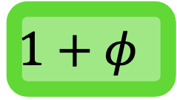



Path A - B
a
Flow = $1+2φ$
$$G_{R}$$
a
$$φ$$
2
0
$$φ$$
2
$φ$
$φ$
$$2−φ$$
$$2−φ$$
b
b
1
2
1
s
$$1+φ$$
2
1
1
t
s
1
t
$$1−φ$$
c
c
0
2
$$φ$$
2
$$φ$$
1
2
$$2−φ$$
$$φ$$
$$1−φ$$
d
d

Slide 40
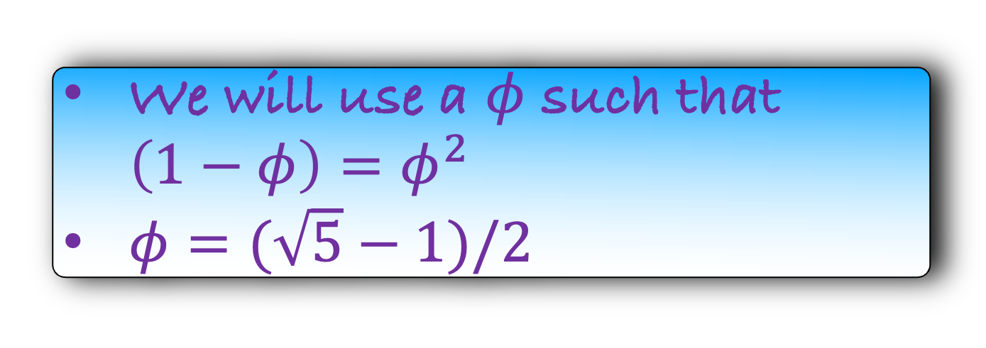
Path A – B - A
a
Flow = $1+2φ$
$$G_{R}$$
a
$$φ$$
2
0
$$φ$$
2
$φ$
$φ$
$$2−φ$$
$$2−φ$$
b
b
1
2
1
s
$$1+φ$$
2
1
1
t
s
1
t
$$1−φ$$
c
c
0
2
$$φ$$
2
$$φ$$
1
2
$$2−φ$$
$$φ$$
$$1−φ$$
d
We will use a $φ$ such that $\left(1−φ\right)=φ^{2}$
$φ=(\sqrt{5}−1)/2$
d

Slide 41
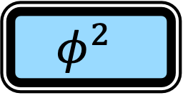
Path A – B - A
a
Flow = $1+2φ$
$$G_{R}$$
a
$$φ$$
2
0
$$φ$$
2
$φ$
$φ$
$$2−φ$$
$$2−φ$$
b
b
1
2
1
s
$$1+φ$$
2
1
1
t
s
1
t
$$1−φ$$
c
c
0
2
$$φ$$
2
$$φ$$
1
2
$$2−φ$$
$$φ$$
$$φ^{2}$$
d
We will use a $φ$ such that $\left(1−φ\right)=φ^{2}$
$φ=(\sqrt{5}−1)/2$
d

Slide 42

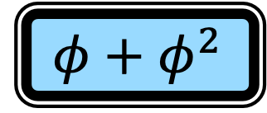




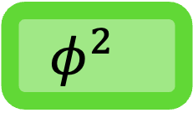
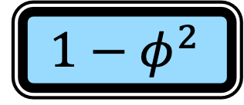


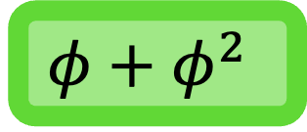

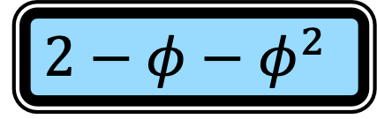
Path A – B - A
a
Flow = $1+2φ+φ^{2}$
$$G_{R}$$
a
$$φ+φ^{2}$$
2
$$φ^{2}$$
$$φ$$
2
$φ−φ^{2}$
$φ$
$$2−φ$$
$φ^{2}$
$$2−φ$$
b
b
1
2
1
s
$$1+φ$$
2
$$1−φ^{2}$$
1
t
s
$$φ^{2}$$
$$1−φ^{2}$$
t
$$1−φ$$
c
c
0
2
$$φ+φ^{2}$$
2
$$φ+φ^{2}$$
1
2
$$1−φ−φ^{2}$$
$$2−φ−φ^{2}$$
$$φ+φ^{2}$$
d
d

Slide 43
Path A – B – A - C
a
Flow = $1+2φ+φ^{2}$
$$G_{R}$$
a
$$φ+φ^{2}$$
2
$$φ^{2}$$
$$φ$$
2
$φ−φ^{2}$
$φ$
$$2−φ$$
$φ$
$$2−φ$$
b
b
1
2
1
s
$$1+φ$$
2
$$1−φ^{2}$$
1
t
s
$$φ^{2}$$
$$1−φ^{2}$$
t
$$1−φ$$
c
c
0
2
$$φ+φ^{2}$$
2
$$φ+φ^{2}$$
1
2
$$1−φ−φ^{2}$$
$$2−φ−φ^{2}$$
$$φ+φ^{2}$$
d
d

Slide 44
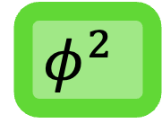

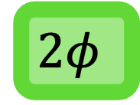

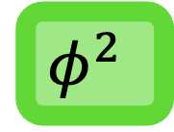
Path A – B – A - C
a
Flow = $1+2φ+{2φ}^{2}$
$$2φ$$
2
$$φ^{2}$$
$$φ$$
2
$φ$
b
$$1+φ^{2}$$
2
s
$$1+φ$$
2
1
1
t
c
$$φ^{2}$$
2
$$φ+φ^{2}$$
2
$$φ$$
1
d

Slide 45

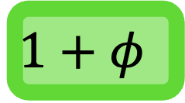
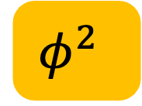
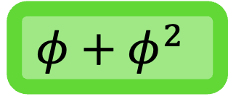
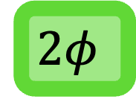

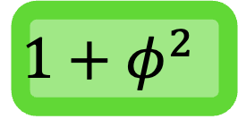


Path A – B – A - C
Flow = $1+2φ+{2φ}^{2}$
a
$$2φ$$
2
$$φ^{2}$$
$$φ$$
2
$φ$
b
$$1+φ^{2}$$
2
s
$$1+φ$$
2
1
1
t
c
$$φ^{2}$$
2
$$φ+φ^{2}$$
2
$$φ$$
1
d

Slide 46

Path A – B – A - C
a
Flow = $1+2φ+{2φ}^{2}$
a
0
2
0
0
2
$$2φ$$
2
$$φ$$
2
$φ$
$$φ^{2}$$
$φ$
b
b
1
2
$$1+φ^{2}$$
2
s
1
2
1
1
t
s
$$1+φ$$
2
1
1
t
c
c
0
2
0
2
$$φ^{2}$$
2
$$φ+φ^{2}$$
2
0
1
$$φ$$
1
d
d

Slide 47
Path A – B – A - C
a
Flow = $1+2φ+{2φ}^{2}$
a
2
0
2
2
2
$φ$
$$φ^{2}$$
$φ$
b
b
2
2
s
2
1
t
s
2
1
t
c
c
2
2
2
2
0
1
$$φ$$
1
d
d

Slide 48

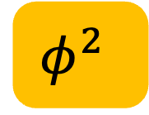


Path A – B – A - C
a
a
Flow = $1+2φ+{2φ}^{2}$
2
2
2
$$φ^{2}$$
2
0
$φ$
$φ$
b
b
2
2
s
2
t
s
2
1
t
1
c
c
2
2
2
2
0
1
$$φ$$
1
d
d

Slide 49
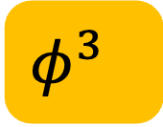

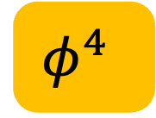
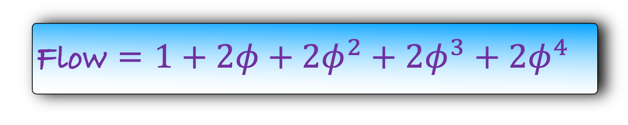
Path A – B – A - C
a
Flow = $1+2φ+{2φ}^{2}+2φ^{3}+2φ^{4}$
a
2
$$φ^{2}$$
2
2
$φ$
$$φ^{4}$$
$φ$
2
b
b
2
2
s
2
1
t
s
2
t
1
c
c
2
2
2
2
$$φ$$
1
$$φ^{3}$$
1
d
d

Slide 50
Flow = $1+2φ+{2φ}^{2}+2φ^{3}+2φ^{4}$
Final Flow =

Slide 51
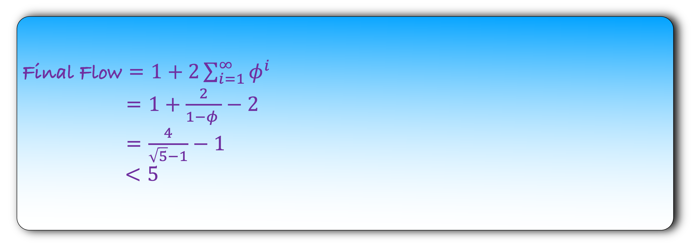
Flow = $1+2φ+{2φ}^{2}+2φ^{3}+2φ^{4}$
Final Flow = $1+2\sum_{i=1}^{∞}{φ^{i}}$
= $1+\frac{2}{1−φ }−2$
= $\frac{4}{\sqrt{5}−1}−1$
$<5$

Slide 52
Our algorithm does not work for irrational numbers
Fortunately, it does work for integers
Henceforth, we will analyse our algorithm assuming all capacities are integers.

Slide 53
Running Time
(assuming integer capacity)

Slide 54
We will assume that all the capacities on the edges are positive integers
Our aim in this lecture is to show that the Ford-Fulkerson algorithm terminates for positive integer capacities

Slide 55
def fordfulkerson($G$):
for each $e∈G$:
$f\left(e\right)=0$
make a residual graph $G_{R}$
while there is a $st$path in $G_{R}$:
let $P$ be a $st$ path in $G_{R}$
let $b$ be the minimum capacity edge in $P$
for each forward edge $e$ in $P$:
$f\left(e\right)=f\left(e\right)+b$
for each backward edge $e$ in $P$:
let $e′$ be the corresponding forward edge
$f\left(e^{′}\right)=f\left(e^{′}\right)−b$
make a residual graph $G_{R}$

Slide 56
def fordfulkerson($G$):
for each $e∈G$:
$f\left(e\right)=0$
make a residual graph $G_{R}$
while there is a $st$path in $G_{R}$:
let $P$ be a $st$ path in $G_{R}$
let $b$ be the minimum capacity edge in $P$
for each forward edge $e$ in $P$:
$f\left(e\right)=f\left(e\right)+b$
for each backward edge $e$ in $P$:
let $e′$ be the corresponding forward edge
$f\left(e^{′}\right)=f\left(e^{′}\right)−b$
make a residual graph $G_{R}$
O($m$)
O($m+n$)
O($m+n$)

Slide 57
def fordfulkerson($G$):
for each $e∈G$:
$f\left(e\right)=0$
make a residual graph $G_{R}$
while there is a $st$path in $G_{R}$:
let $P$ be a $st$ path in $G_{R}$
let $b$ be the minimum capacity edge in $P$
for each forward edge $e$ in $P$:
$f\left(e\right)=f\left(e\right)+b$
for each backward edge $e$ in $P$:
let $e′$ be the corresponding forward edge
$f\left(e^{′}\right)=f\left(e^{′}\right)−b$
make a residual graph $G_{R}$
Running Time = #number of times the loop runs x
O($m+n$)
But how many times is the loop running?

Slide 58
def fordfulkerson($G$):
for each $e∈G$:
$f\left(e\right)=0$
make a residual graph $G_{R}$
while there is a $st$path in $G_{R}$:
let $P$ be a $st$ path in $G_{R}$
let $b$ be the minimum capacity edge in $P$
for each forward edge $e$ in $P$:
$f\left(e\right)=f\left(e\right)+b$
for each backward edge $e$ in $P$:
let $e′$ be the corresponding forward edge
$f\left(e^{′}\right)=f\left(e^{′}\right)−b$
make a residual graph $G_{R}$
Let us first state some simple properties about our algorithm
Our algorithm maintains a flow f on each edge
We will assume that the flow after each iteration is valid

Slide 59
def fordfulkerson($G$):
for each $e∈G$:
$f\left(e\right)=0$
make a residual graph $G_{R}$
while there is a $st$path in $G_{R}$:
let $P$ be a $st$ path in $G_{R}$
let $b$ be the minimum capacity edge in $P$
for each forward edge $e$ in $P$:
$f\left(e\right)=f\left(e\right)+b$
for each backward edge $e$ in $P$:
let $e′$ be the corresponding forward edge
$f\left(e^{′}\right)=f\left(e^{′}\right)−b$
make a residual graph $G_{R}$
Let us first state some simple properties about our algorithm
Our algorithm maintains a flow f on each edge
We will assume that the flow after each iteration is valid
Note that initially the flow is valid
Lemma: Our algorithm outputs a valid flow (if it stops).
We will prove this lemma later

Slide 60

def fordfulkerson($G$):
for each $e∈G$:
$f\left(e\right)=0$
make a residual graph $G_{R}$
while there is a $st$path in $G_{R}$:
let $P$ be a $st$ path in $G_{R}$
let $b$ be the minimum capacity edge in $P$
for each forward edge $e$ in $P$:
$f\left(e\right)=f\left(e\right)+b$
for each backward edge $e$ in $P$:
let $e′$ be the corresponding forward edge
$f\left(e^{′}\right)=f\left(e^{′}\right)−b$
make a residual graph $G_{R}$
s
a
b
t
$$P$$

Slide 61

def fordfulkerson($G$):
for each $e∈G$:
$f\left(e\right)=0$
make a residual graph $G_{R}$
while there is a $st$path in $G_{R}$:
let $P$ be a $st$ path in $G_{R}$
let $b$ be the minimum capacity edge in $P$
for each forward edge $e$ in $P$:
$f\left(e\right)=f\left(e\right)+b$
for each backward edge $e$ in $P$:
let $e′$ be the corresponding forward edge
$f\left(e^{′}\right)=f\left(e^{′}\right)−b$
make a residual graph $G_{R}$
What is the value of b?
$$b≥$$
s
a
b
b
t
$$P$$

Slide 62

def fordfulkerson($G$):
for each $e∈G$:
$f\left(e\right)=0$
make a residual graph $G_{R}$
while there is a $st$path in $G_{R}$:
let $P$ be a $st$ path in $G_{R}$
let $b$ be the minimum capacity edge in $P$
for each forward edge $e$ in $P$:
$f\left(e\right)=f\left(e\right)+b$
for each backward edge $e$ in $P$:
let $e′$ be the corresponding forward edge
$f\left(e^{′}\right)=f\left(e^{′}\right)−b$
make a residual graph $G_{R}$
What is the value of b?
$$b≥1$$
This is a direct consequence of the fact that all capacities are positive integers
s
a
b
b
t
$$P$$
Notes:
Todo: We can say here that b \ge 1 and compare it with the problem in the real weighted graph.
In the real weighted graph, b decreases. But here b is always \ge 1 and never decreases
Add this to the slide

Slide 63


def fordfulkerson($G$):
for each $e∈G$:
$f\left(e\right)=0$
make a residual graph $G_{R}$
while there is a $st$path in $G_{R}$:
let $P$ be a $st$ path in $G_{R}$
let $b$ be the minimum capacity edge in $P$
for each forward edge $e$ in $P$:
$f\left(e\right)=f\left(e\right)+b$
for each backward edge $e$ in $P$:
let $e′$ be the corresponding forward edge
$f\left(e^{′}\right)=f\left(e^{′}\right)−b$
make a residual graph $G_{R}$
What is the value of b?
$$b≥1$$
This is a direct consequence of the fact that all capacities are positive integers
s
a
b
t
s
a
b
t
b
b
$$P$$
$$P$$
Can bt be a backward edge?
Notes:
The context is missing.
How did we go to this next slide.
Think about it more

Slide 64

s
a
b
t
s
a
b
t
b
b
$$P$$
$$P$$
Can bt be a backward edge?
If bt is a backward edge, then there is an edge tb in the graph.
But there is no outgoing edge from t in the graph.
A contradiction
So, bt is a forward edge

Slide 65
def fordfulkerson($G$):
for each $e∈G$:
$f\left(e\right)=0$
make a residual graph $G_{R}$
while there is a $st$path in $G_{R}$:
let $P$ be a $st$ path in $G_{R}$
let $b$ be the minimum capacity edge in $P$
for each forward edge $e$ in $P$:
$f\left(e\right)=f\left(e\right)+b$
for each backward edge $e$ in $P$:
let $e′$ be the corresponding forward edge
$f\left(e^{′}\right)=f\left(e^{′}\right)−b$
make a residual graph $G_{R}$
What is the value of b?
$$b≥1$$
This is a direct consequence of the fact that all capacities are positive integers
If bt is a backward edge, then there is an edge tb in the graph.
But there is no outgoing edge from t in the graph.
A contradiction
So, bt is a forward edge
This implies that in each iteration, the flow to t increase by at least 1.

Slide 66
def fordfulkerson($G$):
for each $e∈G$:
$f\left(e\right)=0$
make a residual graph $G_{R}$
while there is a $st$path in $G_{R}$:
let $P$ be a $st$ path in $G_{R}$
let $b$ be the minimum capacity edge in $P$
for each forward edge $e$ in $P$:
$f\left(e\right)=f\left(e\right)+b$
for each backward edge $e$ in $P$:
let $e′$ be the corresponding forward edge
$f\left(e^{′}\right)=f\left(e^{′}\right)−b$
make a residual graph $G_{R}$
What is the value of b?
$$b≥1$$
This is a direct consequence of the fact that all capacities are positive integers
Lemma: In each iteration of Ford-Fulkerson algorithm, the flow increases by atleast 1.

Slide 67
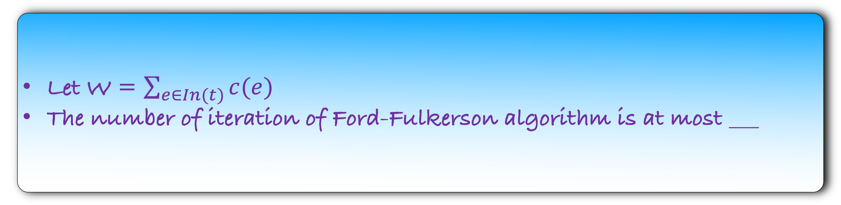
Lemma: In each iteration of Ford-Fulkerson algorithm, the flow increases by atleast 1.
How many iterations can Ford-Fulkerson run while increasing the flow?
Let W = $\sum_{e∈In(t)}{c(e) }$
The number of iteration of Ford-Fulkerson algorithm is at most ___

Slide 68
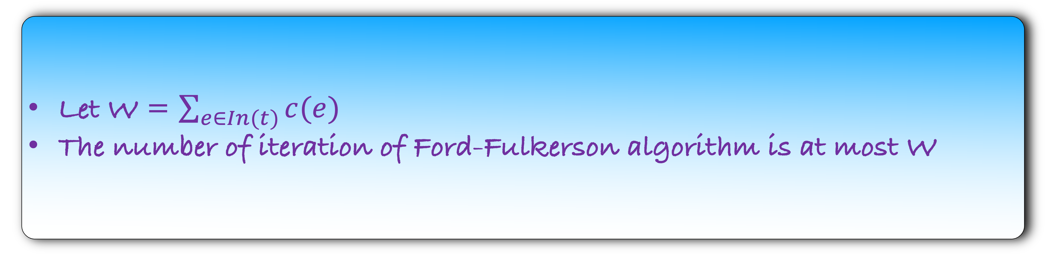
Lemma: In each iteration of Ford-Fulkerson algorithm, the flow increases by atleast 1.
How many iterations can Ford-Fulkerson run while increasing the flow?
Let W = $\sum_{e∈In(t)}{c(e) }$
The number of iteration of Ford-Fulkerson algorithm is at most W

Slide 69
def fordfulkerson($G$):
for each $e∈G$:
$f\left(e\right)=0$
make a residual graph $G_{R}$
while there is a $st$path in $G_{R}$:
let $P$ be a $st$ path in $G_{R}$
let $b$ be the minimum capacity edge in $P$
for each forward edge $e$ in $P$:
$f\left(e\right)=f\left(e\right)+b$
for each backward edge $e$ in $P$:
let $e′$ be the corresponding forward edge
$f\left(e^{′}\right)=f\left(e^{′}\right)−b$
make a residual graph $G_{R}$
Running Time = #number of times the loop runs x
O($m+n$)

Slide 70

def fordfulkerson($G$):
for each $e∈G$:
$f\left(e\right)=0$
make a residual graph $G_{R}$
while there is a $st$path in $G_{R}$:
let $P$ be a $st$ path in $G_{R}$
let $b$ be the minimum capacity edge in $P$
for each forward edge $e$ in $P$:
$f\left(e\right)=f\left(e\right)+b$
for each backward edge $e$ in $P$:
let $e′$ be the corresponding forward edge
$f\left(e^{′}\right)=f\left(e^{′}\right)−b$
make a residual graph $G_{R}$
Running Time = W x
O($m+n$)

Slide 71

def fordfulkerson($G$):
for each $e∈G$:
$f\left(e\right)=0$
make a residual graph $G_{R}$
while there is a $st$path in $G_{R}$:
let $P$ be a $st$ path in $G_{R}$
let $b$ be the minimum capacity edge in $P$
for each forward edge $e$ in $P$:
$f\left(e\right)=f\left(e\right)+b$
for each backward edge $e$ in $P$:
let $e′$ be the corresponding forward edge
$f\left(e^{′}\right)=f\left(e^{′}\right)−b$
make a residual graph $G_{R}$
Running Time =
O($mW$)

