Slide 1
Closest Pair

Slide 2
You are given n points on a plane. Find two points that are closest to each other.

Slide 4

$$δ$$

Slide 5
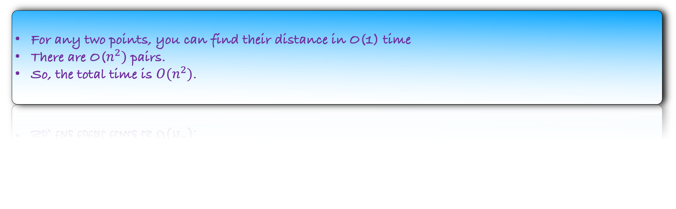
How would you solve this problem?
For any two points, you can find their distance in O(1) time
There are O($n^{2})$ pairs.
So, the total time is $O(n^{2})$.
Can we improve the running time?

Slide 7
Left Half
Right Half

Slide 8
Recursively solve the problem in the left half
Right Half

Slide 9
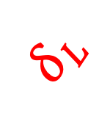
$$δ_{L}$$
Recursively solve the problem in the left half
Right Half

Slide 10


Can we return min{$δ_{L},δ_{R}$}?
$$δ_{R}$$
$$δ_{L}$$
Recursively solve the problem in the left half
Recursively solve the problem in the right half

Slide 11

Can we return min{$δ_{L},δ_{R}$}?
No, because the answer may contains one point from the left half and the other from the right half.
$$δ$$
$$δ_{R}$$
$$δ_{L}$$

Slide 12
What points should we check to combine the two answers?
Points that are close to the middle line
$$δ_{R}$$
$$δ_{L}$$
But how much close?

Slide 13
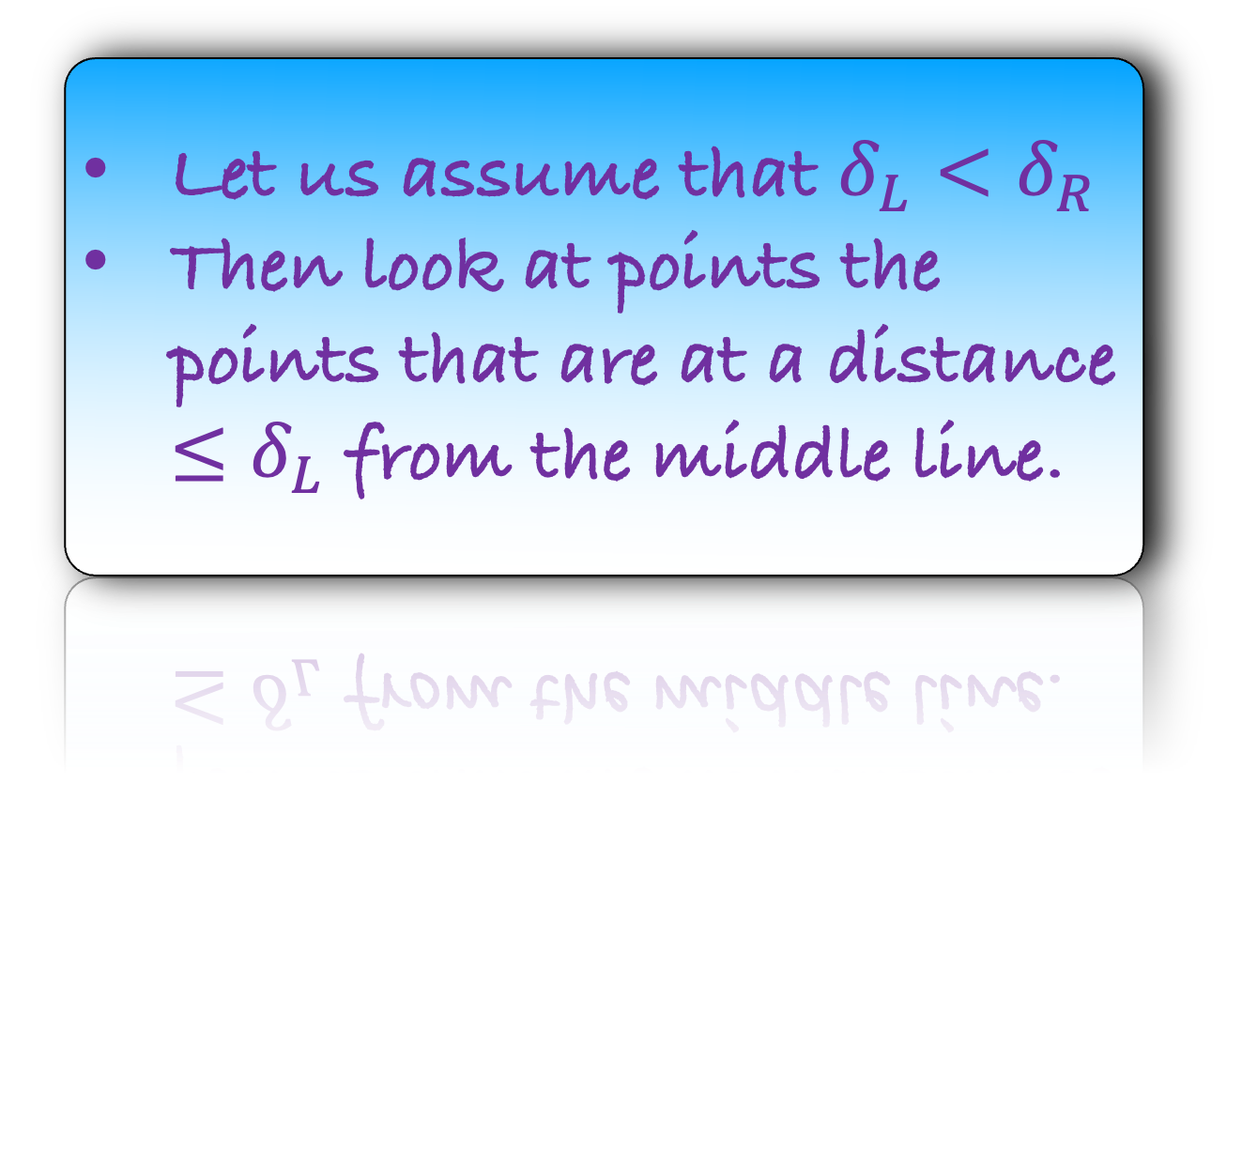
What points should we check to combine the two answers?
Points that are close to the middle line
$$δ_{R}$$
$$δ_{L}$$
But how much close?
Let us assume that $δ_{L}<δ_{R}$
Then look at points the points that are at a distance $≤δ_{L}$ from the middle line.

Slide 14

What points should we check to combine the two answers?
Points that are close to the middle line
$$δ_{R}$$
$$δ_{L}$$
But how much close?
Let us assume that $δ_{L}<δ_{R}$
Then look at points the points that are at a distance $≤δ_{L}$ from the middle line.

Slide 15
How many pairs do we have to check here in the worst case?
$$δ_{R}$$
$$δ_{L}$$

Slide 16
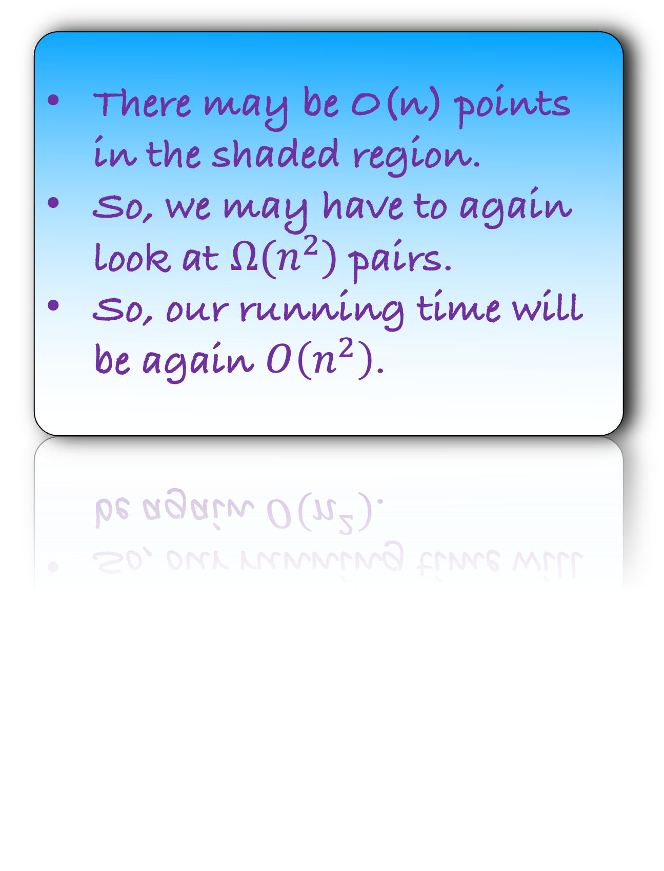
How many pairs do we have to check here in the worst case?
There may be O(n) points in the shaded region.
So, we may have to again look at $Ω(n^{2})$ pairs.
So, our running time will be again $O\left(n^{2}\right)$.
$$δ_{R}$$
$$δ_{L}$$
How to improve the running time?

Slide 17


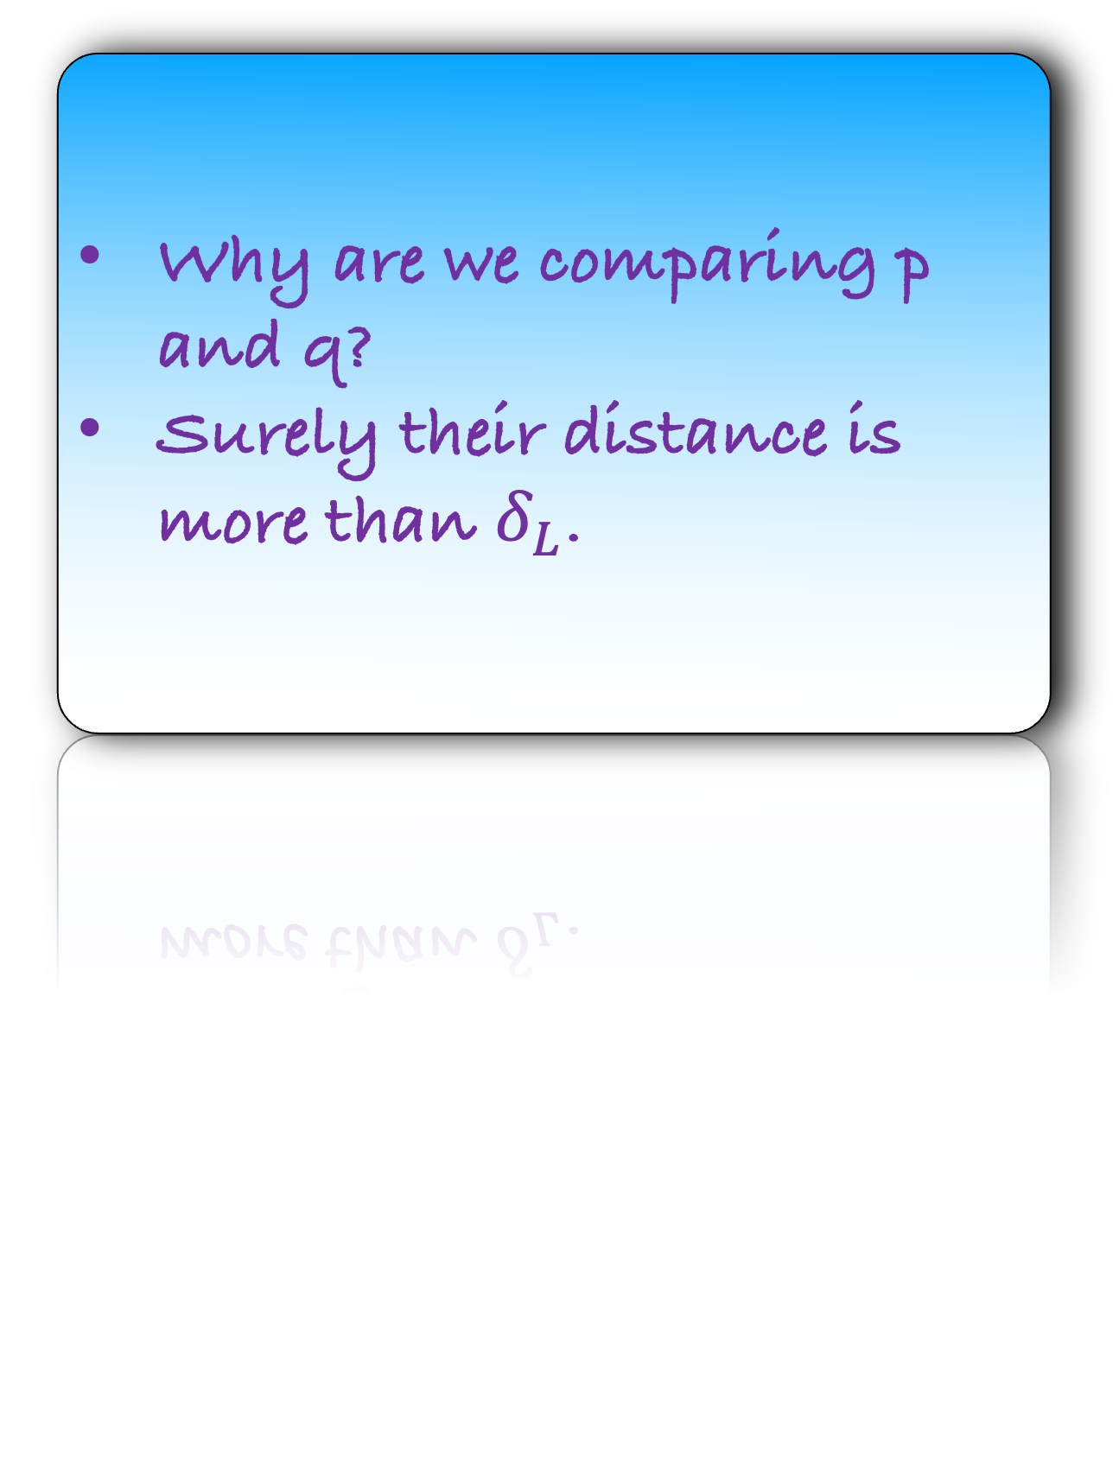
$$q$$
Why are we comparing p and q?
Surely their distance is more than $δ_{L}$.
$$δ_{R}$$
$$δ_{L}$$
$$p$$

Slide 18
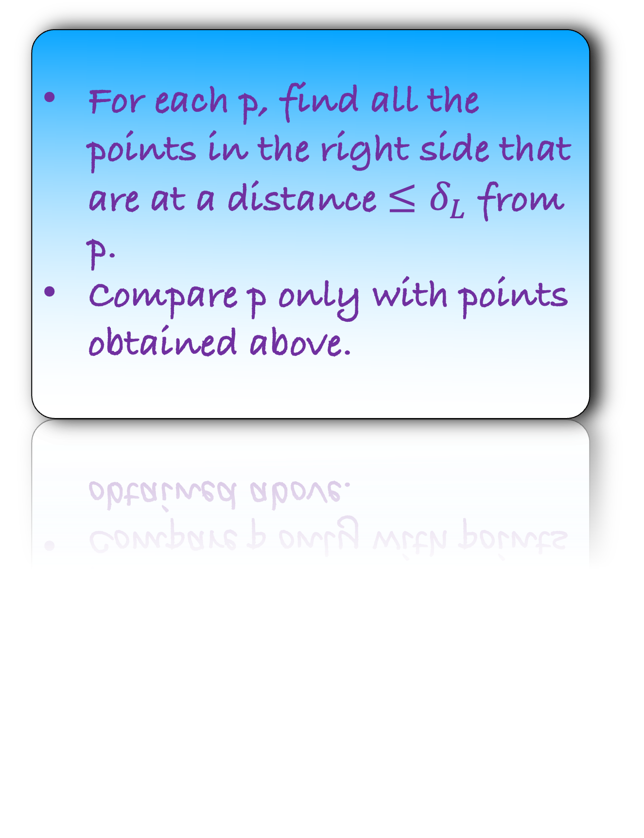
For each p, find all the points in the right side that are at a distance ${≤δ}_{L}$ from p.
Compare p only with points obtained above.
$$δ_{R}$$
$$δ_{L}$$
But don’t we land up at the same problem? There can be O(n) such points
$$p$$

Slide 19
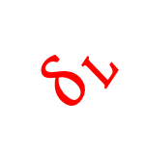
For each p, find all the points in the right side that are at a distance ${≤δ}_{L}$ from p.
Compare p only with points obtained above.
$$δ_{R}$$
$$δ_{L}$$
$$δ_{L}$$
But don’t we land up at the same problem? There can be O(n) such points
$$p$$
Can there be O(n) such points?

Slide 20
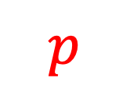

$$δ_{R}$$
$$δ_{L}$$
$$δ_{L}$$
$$p$$

Slide 21
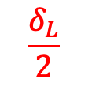


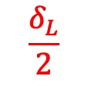
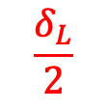


Imagine 8 squares around the point p on the right side, each of length $\frac{δ_{L}}{2}$.
$$δ_{R}$$
$$δ_{L}$$
$$\frac{δ_{L}}{2}$$
$$\frac{δ_{L}}{2}$$
$$p$$
$$\frac{δ_{L}}{2}$$
$$\frac{δ_{L}}{2}$$
$$\frac{δ_{L}}{2}$$
$$\frac{δ_{L}}{2}$$

Slide 22

Imagine 8 squares around the point p on the right side, each of length $\frac{δ_{L}}{2}$.
$$q$$
We need not calculate the distance between p and q, if q lies outside the square.
$$δ_{R}$$
$$δ_{L}$$
$$\frac{δ_{L}}{2}$$
$$\frac{δ_{L}}{2}$$
$$p$$
$$\frac{δ_{L}}{2}$$
$$\frac{δ_{L}}{2}$$
$$\frac{δ_{L}}{2}$$
$$\frac{δ_{L}}{2}$$

Slide 23

Imagine 8 squares around the point p on the right side, each of length $\frac{δ_{L}}{2}$.
We need not calculate the distance between p and q, if q lies outside the square.
$$δ_{R}$$
We only need to calculate the distance between p and q if q lies in the eight right squares.
$$δ_{L}$$
$$\frac{δ_{L}}{2}$$
But there can be more than one point in this square? Or can it be?
$$\frac{δ_{L}}{2}$$
$$p$$
$$q$$
$$\frac{δ_{L}}{2}$$
$$\frac{δ_{L}}{2}$$
$$\frac{δ_{L}}{2}$$
$$\frac{δ_{L}}{2}$$

Slide 24
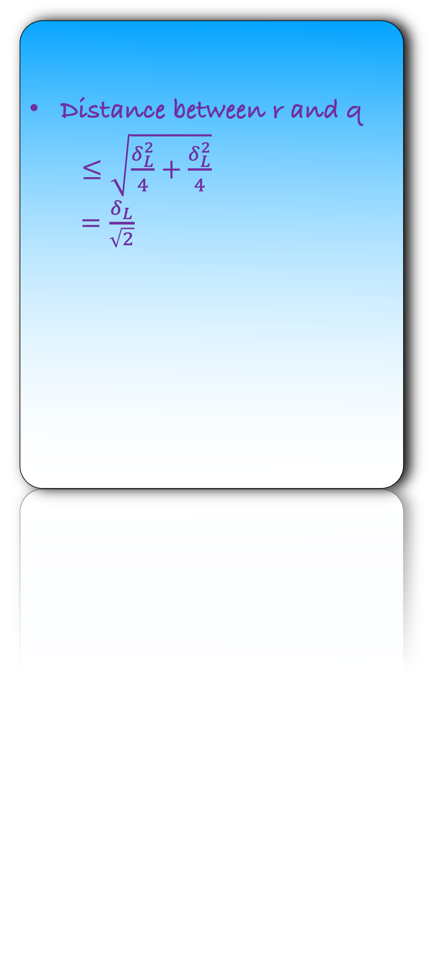

Can there be one more point r in this square?
Distance between r and q
$≤\sqrt{\frac{δ_{L}^{2}}{4}+\frac{δ_{L}^{2}}{4}}$
$=\frac{δ_{L}}{\sqrt{2}}$
$$δ_{R}$$
$$δ_{L}$$
$$r$$
$$\frac{δ_{L}}{2}$$
$$\frac{δ_{L}}{2}$$
$$p$$
$$q$$
$$\frac{δ_{L}}{2}$$
$$\frac{δ_{L}}{2}$$
$$\frac{δ_{L}}{2}$$
$$\frac{δ_{L}}{2}$$

Slide 25
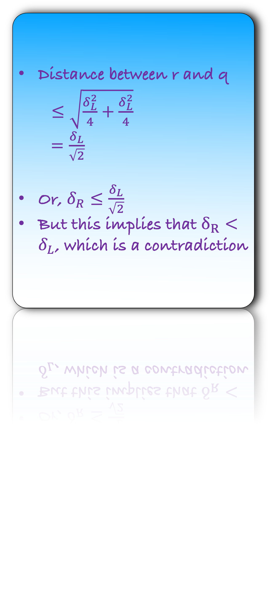

Can there be one more point r in this square?
Distance between r and q
$≤\sqrt{\frac{δ_{L}^{2}}{4}+\frac{δ_{L}^{2}}{4}}$
$=\frac{δ_{L}}{\sqrt{2}}$
Or, $δ_{R}≤\frac{δ_{L}}{\sqrt{2}}$
But this implies that $δ_{R}<δ_{L}$, which is a contradiction
$$δ_{L}$$
$$r$$
$$\frac{δ_{L}}{2}$$
$$δ_{R}$$
$$\frac{δ_{L}}{2}$$
$$p$$
$$q$$
$$\frac{δ_{L}}{2}$$
$$\frac{δ_{L}}{2}$$
$$\frac{δ_{L}}{2}$$
$$\frac{δ_{L}}{2}$$

Slide 26
Observation: There can be at most 8 points in these eight squares.
Can you design a data-structure that can find these eight points efficiently?
$$δ_{R}$$
$$δ_{L}$$
$$\frac{δ_{L}}{2}$$
$$\frac{δ_{L}}{2}$$
$$p$$
$$q$$
$$\frac{δ_{L}}{2}$$
$$\frac{δ_{L}}{2}$$
$$\frac{δ_{L}}{2}$$
$$\frac{δ_{L}}{2}$$

Slide 27
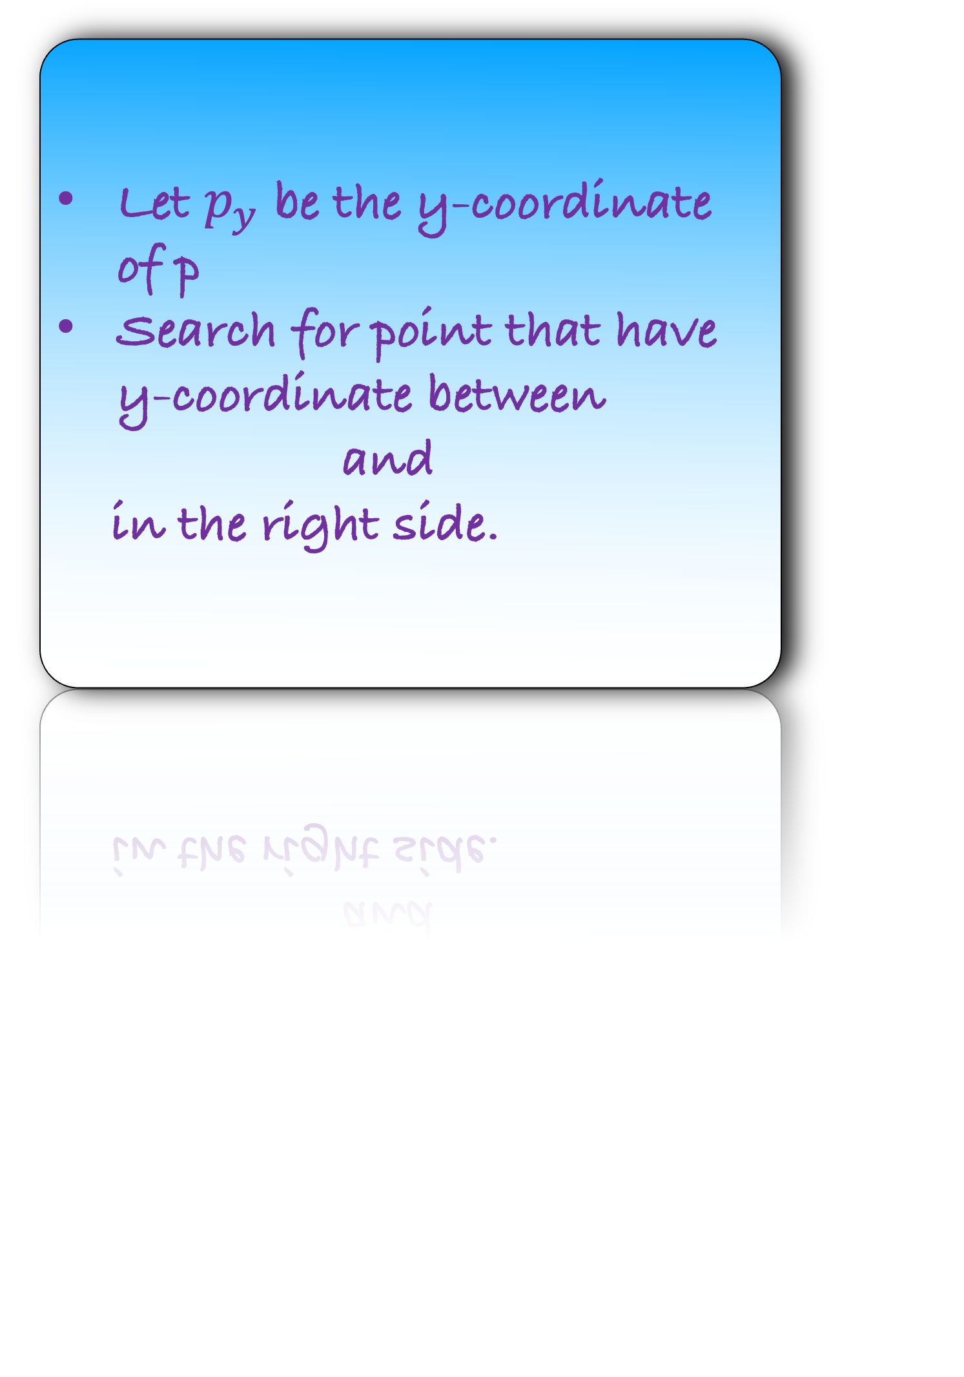

Observation: There can be at most 8 points in these eight squares.
Let $p_{y}$ be the y-coordinate of p
Search for point that have y-coordinate between and
in the right side.
$$δ_{R}$$
$$δ_{L}$$
$$\frac{δ_{L}}{2}$$
$$\frac{δ_{L}}{2}$$
$$q$$
$$p_{y}$$
$$p$$
$$\frac{δ_{L}}{2}$$
$$\frac{δ_{L}}{2}$$
$$\frac{δ_{L}}{2}$$
$$\frac{δ_{L}}{2}$$

Slide 28

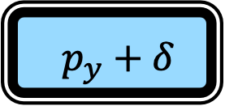
Observation: There can be at most 8 points in these eight squares.
Let $p_{y}$ be the y-coordinate of p
Search for point that have y-coordinate between and
in the right side.
$$δ_{R}$$
$$δ_{L}$$
$$\frac{δ_{L}}{2}$$
$p_{y}−δ$
$p_{y}+δ$
$$\frac{δ_{L}}{2}$$
$$q$$
$$p_{y}$$
$$p$$
$$\frac{δ_{L}}{2}$$
$$\frac{δ_{L}}{2}$$
$$\frac{δ_{L}}{2}$$
$$\frac{δ_{L}}{2}$$

Slide 29
Observation: There can be at most 8 points in these eight squares.
Let $p_{y}$ be the y-coordinate of p
Search for point that have y-coordinate between and
in the right side.
$$δ_{R}$$
$$δ_{L}$$
$$\frac{δ_{L}}{2}$$
$p_{y}−δ$
$p_{y}+δ$
$$\frac{δ_{L}}{2}$$
$$q$$
$$p_{y}$$
$$p$$
$$\frac{δ_{L}}{2}$$
But how to do this efficiently?
$$\frac{δ_{L}}{2}$$
$$\frac{δ_{L}}{2}$$
$$\frac{δ_{L}}{2}$$

Slide 30
Observation: There can be at most 8 points in these eight squares.
Sort the points on the right using their y-coordinate.
$$δ_{R}$$
$$δ_{L}$$
$$\frac{δ_{L}}{2}$$
$$\frac{δ_{L}}{2}$$
$$q$$
$$p_{y}$$
$$p$$
$$\frac{δ_{L}}{2}$$
$$\frac{δ_{L}}{2}$$
$$\frac{δ_{L}}{2}$$
$$\frac{δ_{L}}{2}$$

Slide 31
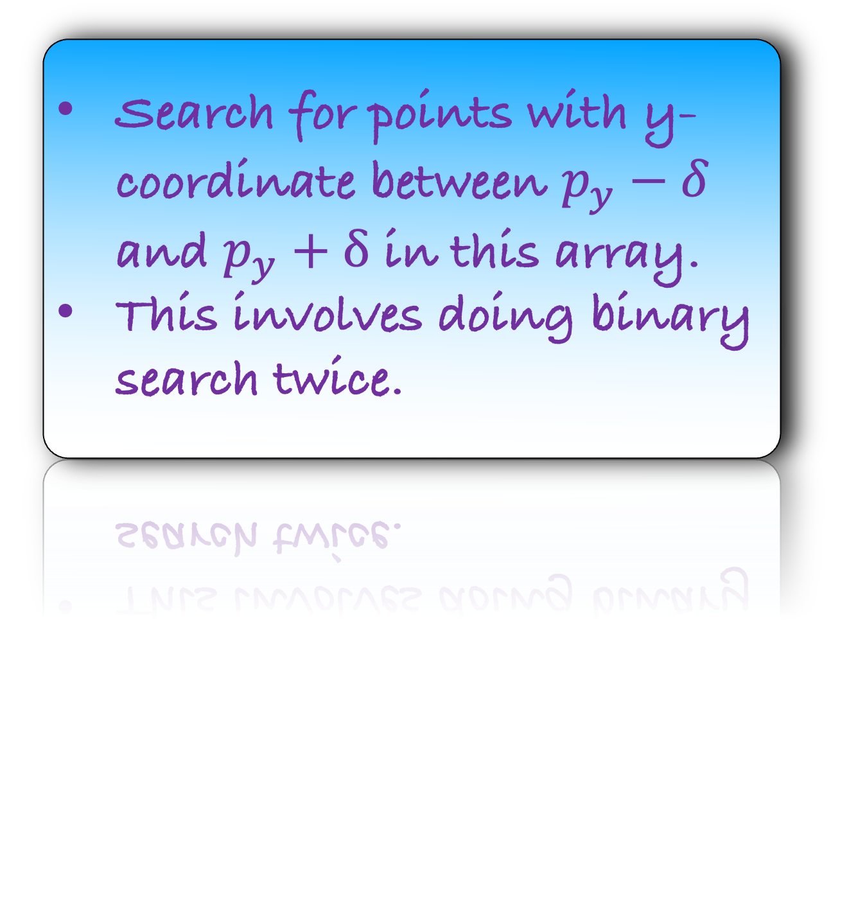
Observation: There can be at most 8 points in these eight squares.
Sort the points on the right using their y-coordinate.
$$δ_{R}$$
$$δ_{L}$$
Search for points with y-coordinate between $p_{y}−δ$ and $p_{y}+δ$ in this array.
This involves doing binary search twice.
$$\frac{δ_{L}}{2}$$
$$\frac{δ_{L}}{2}$$
$$q$$
$$p_{y}$$
$$p$$
$$\frac{δ_{L}}{2}$$
$$\frac{δ_{L}}{2}$$
$$\frac{δ_{L}}{2}$$
$$\frac{δ_{L}}{2}$$

Slide 32
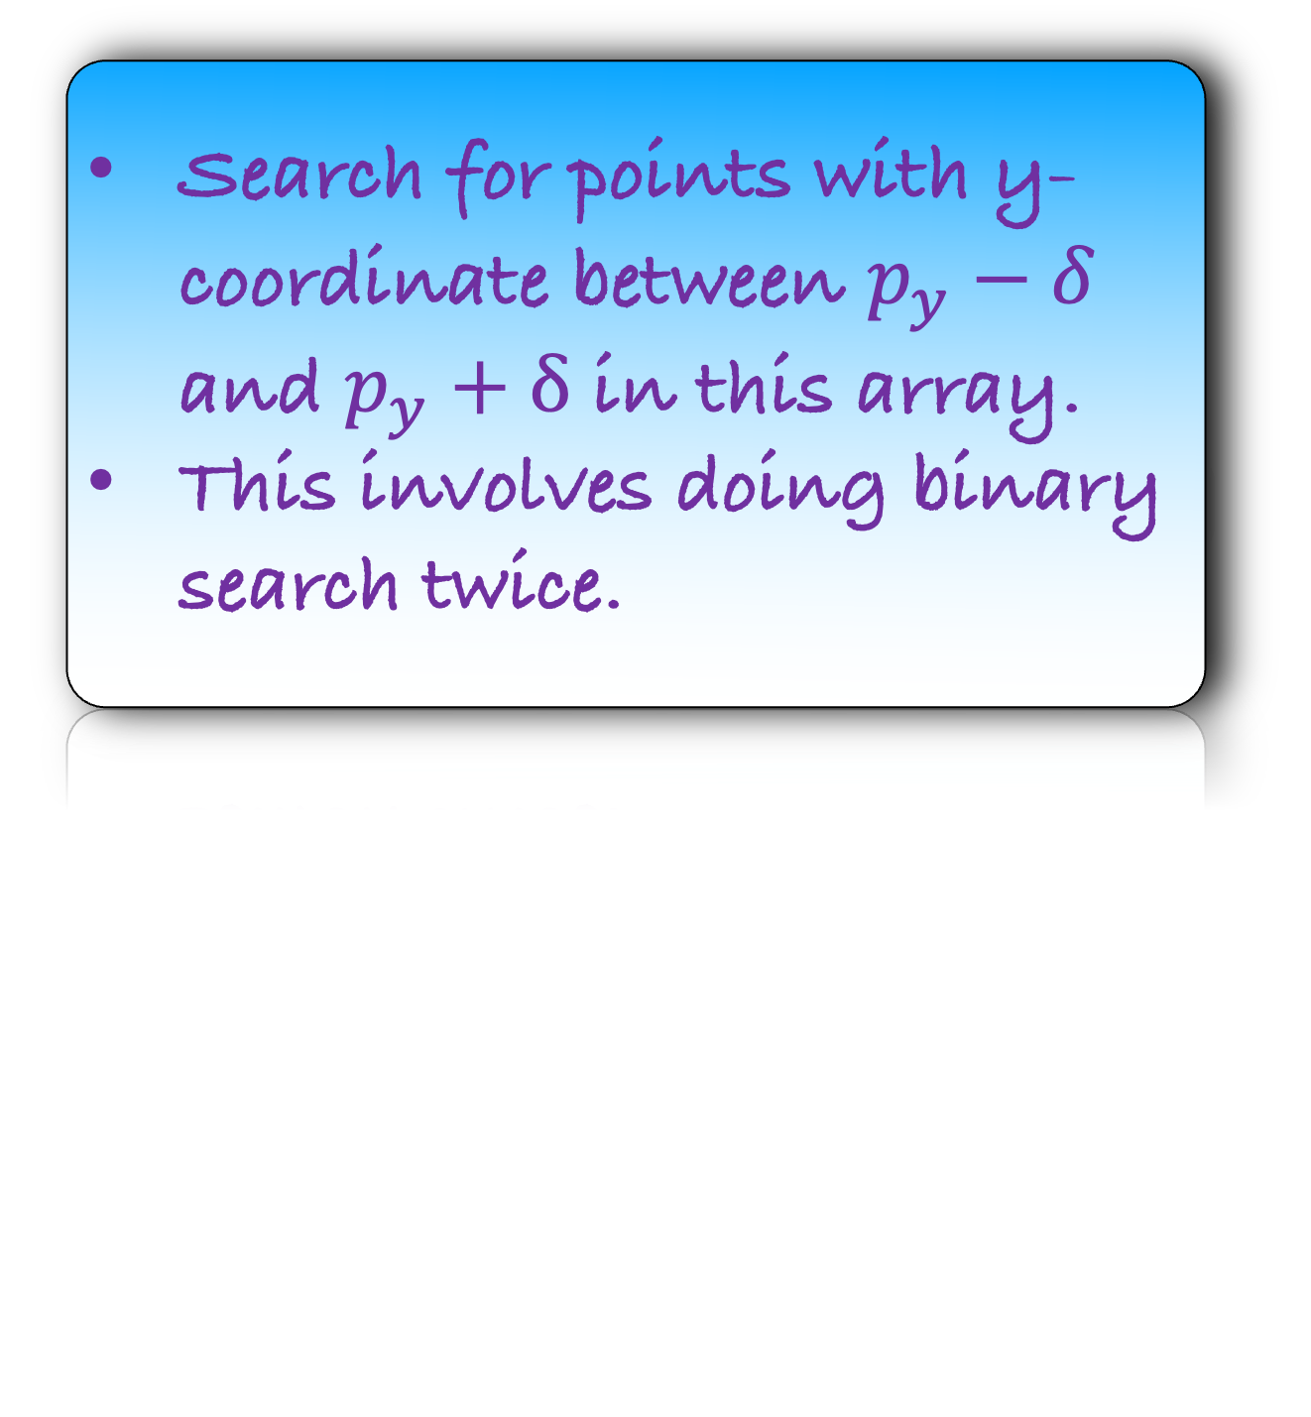
Observation: There can be at most 8 points in these eight squares.
Sort the points on the right on using their y-coordinate.
$$δ_{R}$$
$$δ_{L}$$
Search for points with y-coordinate between $p_{y}−δ$ and $p_{y}+δ$ in this array.
This involves doing binary search twice.
$$\frac{δ_{L}}{2}$$
$$\frac{δ_{L}}{2}$$
$$q$$
$$p_{y}$$
$$p$$
$$\frac{δ_{L}}{2}$$
Using the above observation, you will get a subarray of size at most 8.
Now you can find the distance between p and these eight points
$$\frac{δ_{L}}{2}$$
$$\frac{δ_{L}}{2}$$
$$\frac{δ_{L}}{2}$$

Slide 33
Implementation

Slide 34

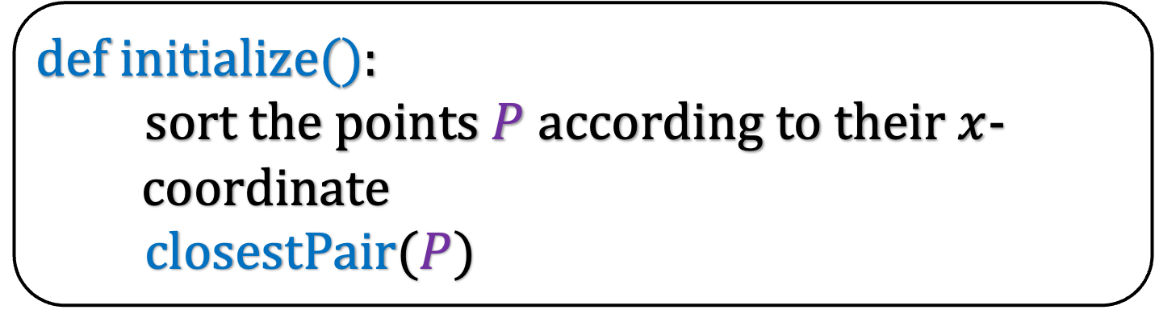
def i$nitialize($):
sort the points $P$ according to their $x$-
coordinate
closestPair($P$)
def closestPair$(P$):

Slide 35
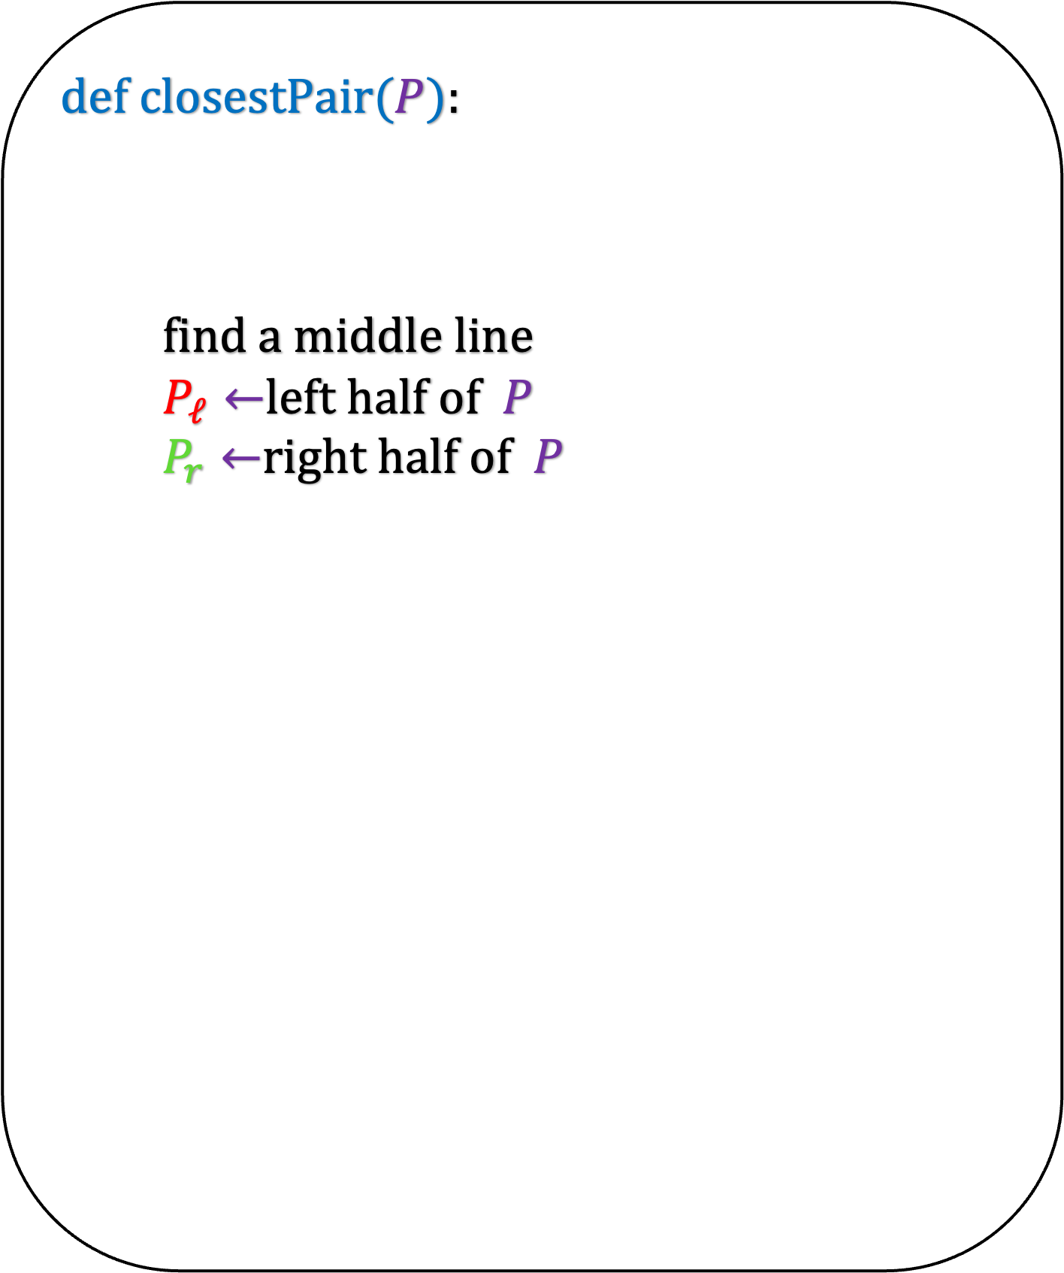


def i$nitialize($):
sort the points $P$ according to their $x$-
coordinate
closestPair($P$)
def closestPair$(P$):
find a middle line
$P_{ℓ}←$left half of $P$
$P_{r}←$right half of $P$
$$P_{ℓ}$$
$${ P}_{r}$$

Slide 36
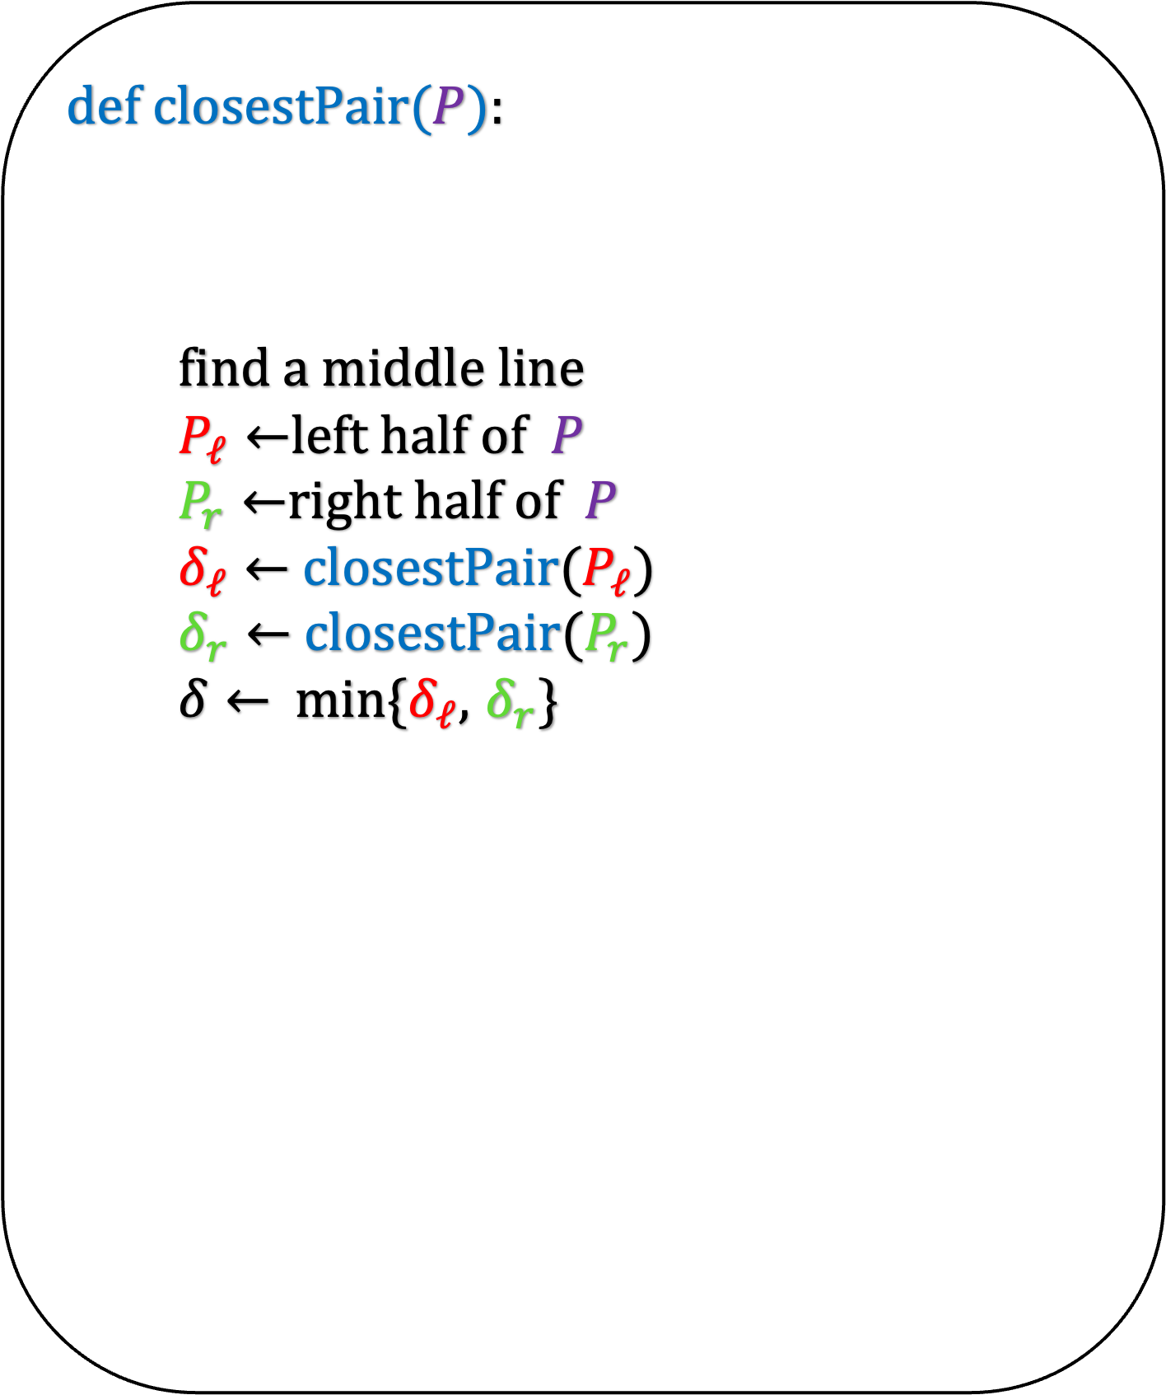

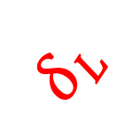
def i$nitialize($):
sort the points $P$ according to their $x$-
coordinate
closestPair($P$)
def closestPair$(P$):
find a middle line
$P_{ℓ}←$left half of $P$
$P_{r}←$right half of $P$
$δ_{ℓ}←$ closestPair($P_{ℓ}$)
$δ_{r}←$ closestPair($P_{r}$)
$δ←$min{$δ_{ℓ}$, $δ_{r}$}
$$δ_{R}$$
$$δ_{L}$$
$$P_{ℓ}$$
$${ P}_{r}$$

Slide 37
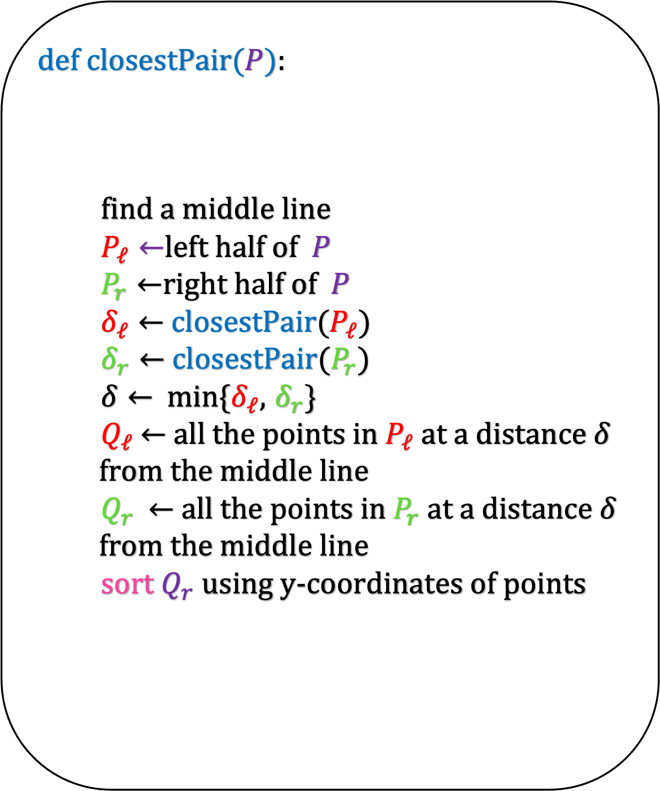


def i$nitialize($):
sort the points $P$ according to their $x$-
coordinate
closestPair($P$)
def closestPair$(P$):
find a middle line
$P_{ℓ}←$left half of $P$
$P_{r}←$right half of $P$
$δ_{ℓ}←$ closestPair($P_{ℓ}$)
$δ_{r}←$ closestPair($P_{r}$)
$δ←$min{$δ_{ℓ}$, $δ_{r}$}
$Q_{ℓ}$ $←$ all the points in $P_{ℓ}$at a distance $δ$
from the middle line
$Q_{r}$ $←$ all the points in $P_{r}$ at a distance $δ$
from the middle line
sort $Q_{r}$ using y-coordinates of points
$$δ_{R}$$
$$δ_{L}$$
$$Q_{ℓ}$$
$${ Q}_{r}$$

Slide 38
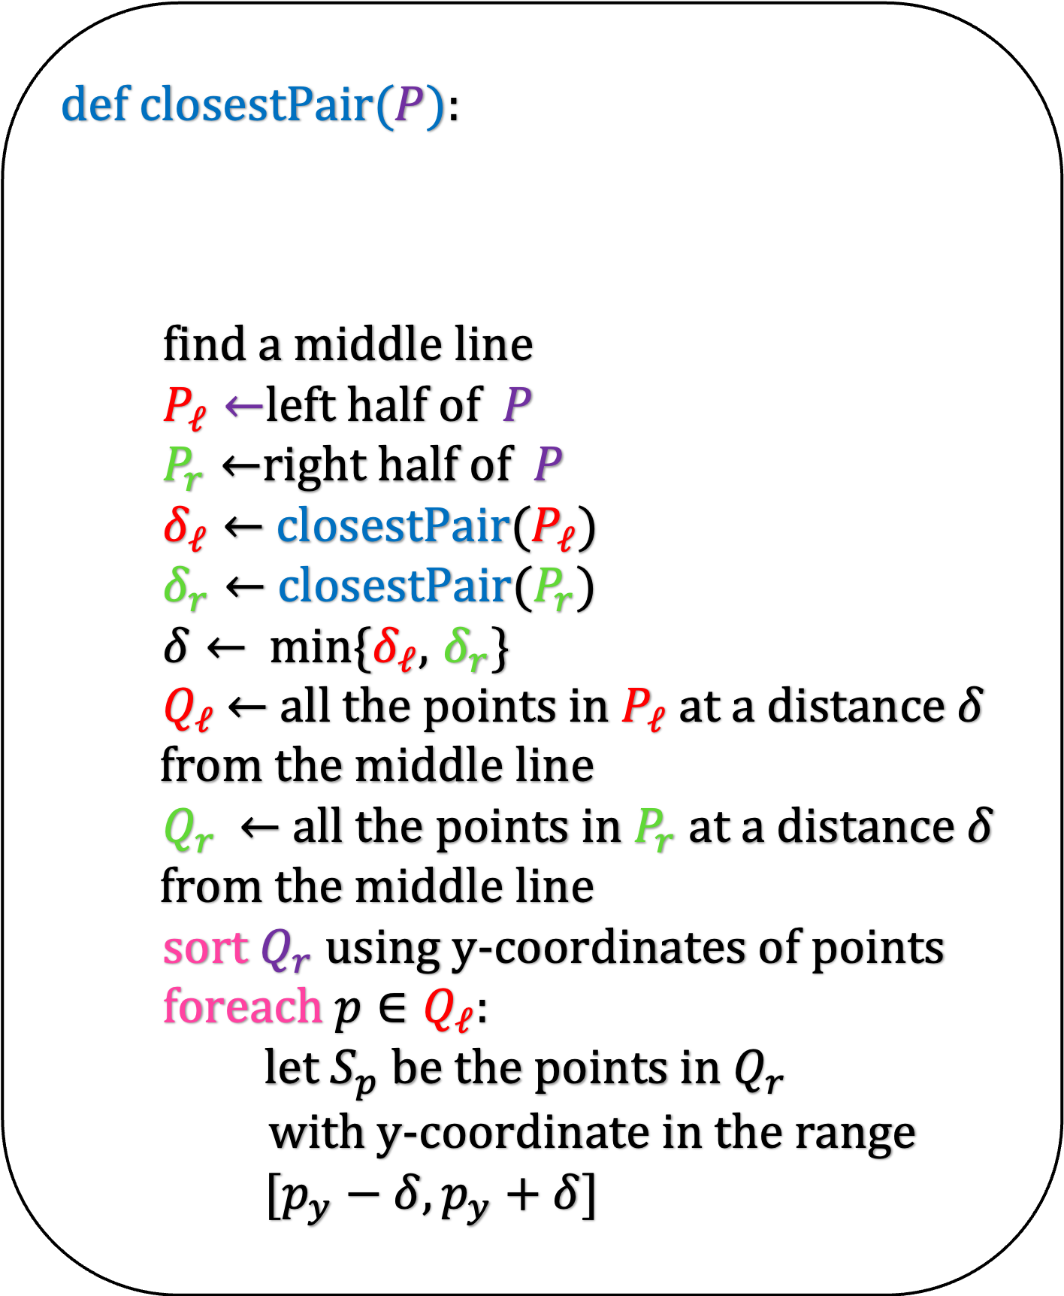
def i$nitialize($):
sort the points $P$ according to their $x$-
coordinate
closestPair($P$)
def closestPair$(P$):
find a middle line
$P_{ℓ}←$left half of $P$
$P_{r}←$right half of $P$
$δ_{ℓ}←$ closestPair($P_{ℓ}$)
$δ_{r}←$ closestPair($P_{r}$)
$δ←$min{$δ_{ℓ}$, $δ_{r}$}
$Q_{ℓ}$ $←$ all the points in $P_{ℓ}$at a distance $δ$
from the middle line
$Q_{r}$ $←$ all the points in $P_{r}$ at a distance $δ$
from the middle line
sort $Q_{r}$ using y-coordinates of points
foreach $p∈Q_{ℓ}$:
let $S_{p}$ be the points in $Q_{r}$
with y-coordinate in the range
$[p_{y}−δ,p_{y}+δ]$
$$δ_{R}$$
$$δ_{L}$$
$$Q_{ℓ}$$
$${ Q}_{r}$$

Slide 39
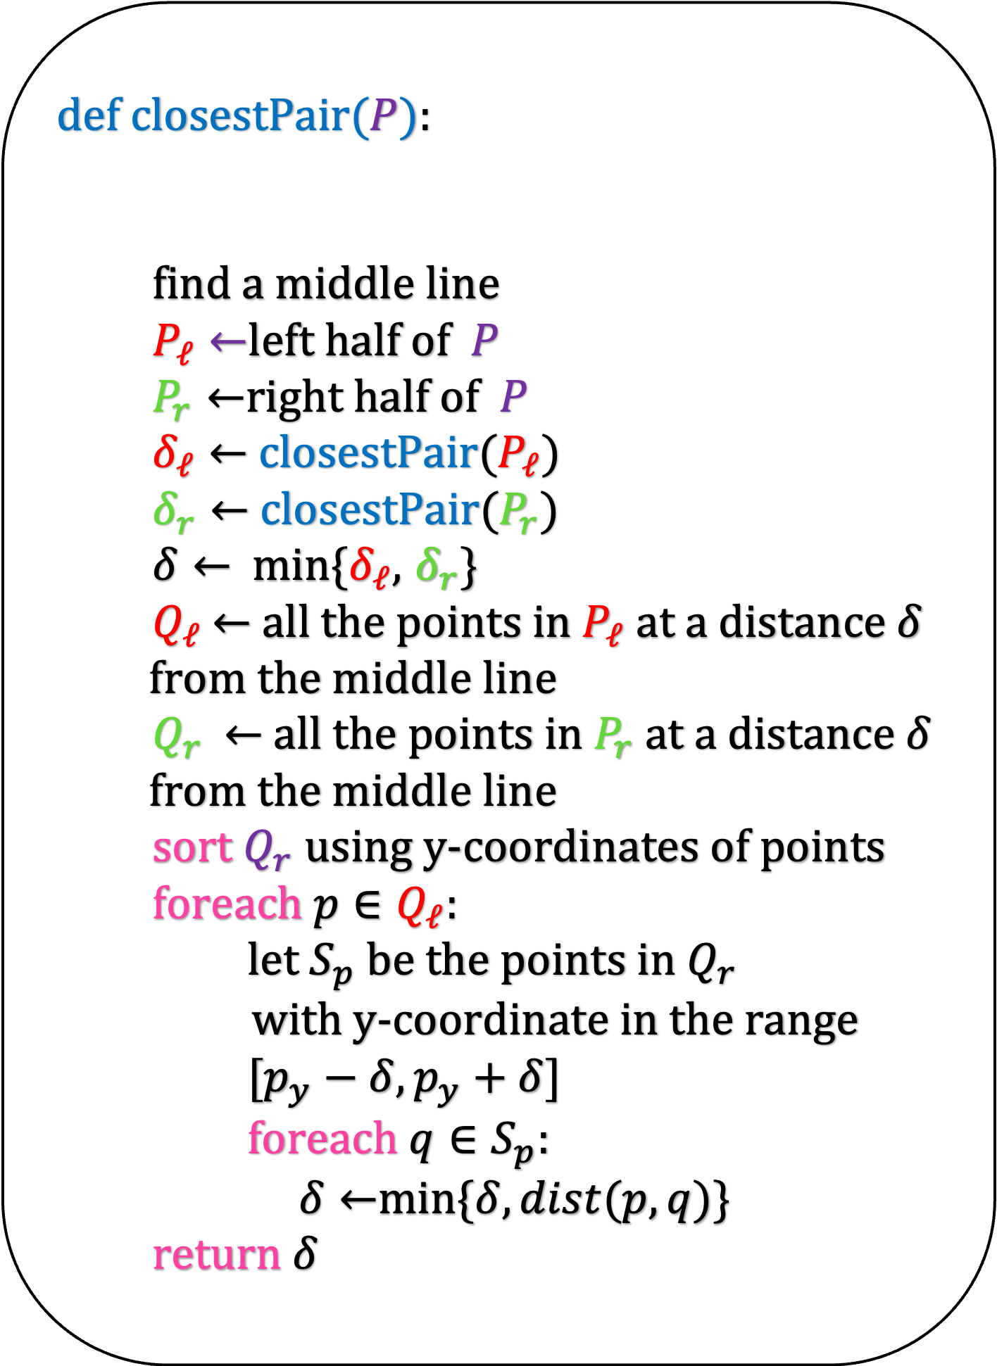
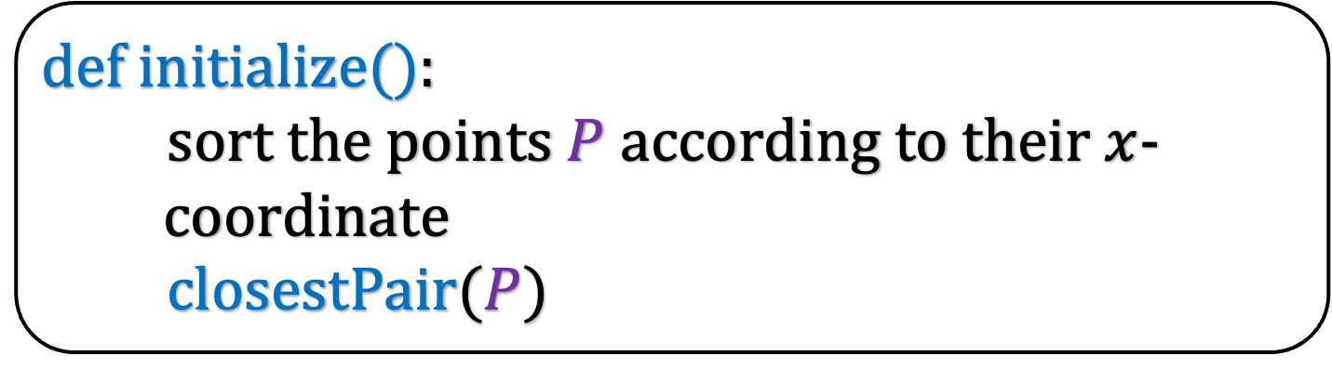
def closestPair$(P$):
find a middle line
$P_{ℓ}←$left half of $P$
$P_{r}←$right half of $P$
$δ_{ℓ}←$ closestPair($P_{ℓ}$)
$δ_{r}←$ closestPair($P_{r}$)
$δ←$min{$δ_{ℓ}$, $δ_{r}$}
$Q_{ℓ}$ $←$ all the points in $P_{ℓ}$at a distance $δ$
from the middle line
$Q_{r}$ $←$ all the points in $P_{r}$ at a distance $δ$
from the middle line
sort $Q_{r}$ using y-coordinates of points
foreach $p∈Q_{ℓ}$:
let $S_{p}$ be the points in $Q_{r}$
with y-coordinate in the range
$[p_{y}−δ,p_{y}+δ]$
foreach $q∈S_{p}$:
$δ←$min{$δ,dist(p,q)$}
return $δ$
def i$nitialize($):
sort the points $P$ according to their $x$-
coordinate
closestPair($P$)

Slide 40
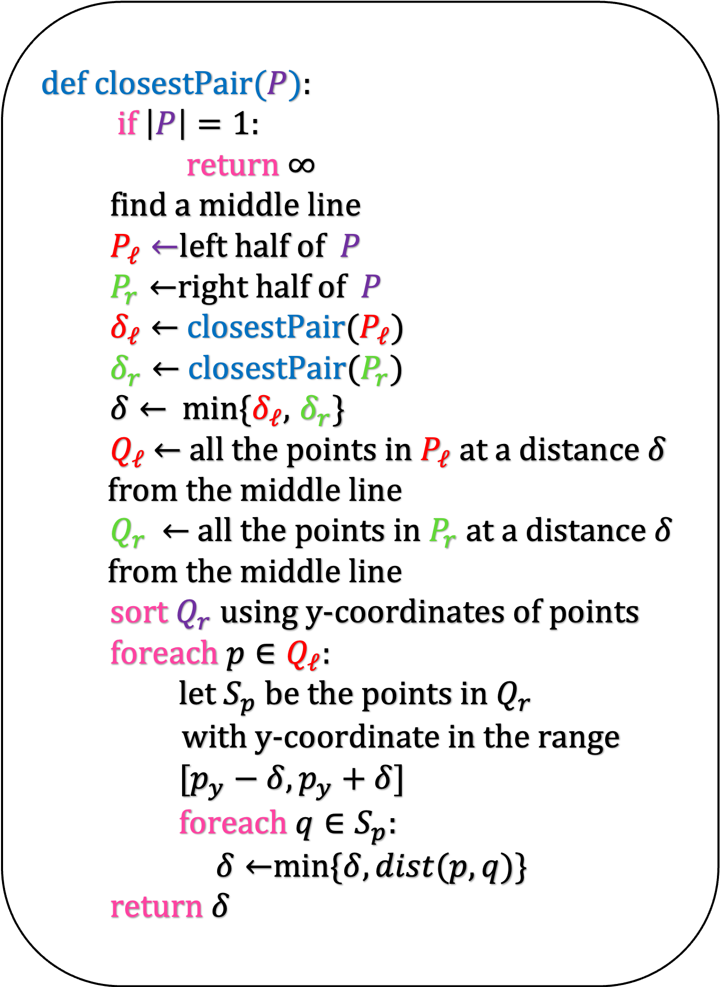
def closestPair$(P$):
if $\left|P\right|=1:$
return $∞$
find a middle line
$P_{ℓ}←$left half of $P$
$P_{r}←$right half of $P$
$δ_{ℓ}←$ closestPair($P_{ℓ}$)
$δ_{r}←$ closestPair($P_{r}$)
$δ←$min{$δ_{ℓ}$, $δ_{r}$}
$Q_{ℓ}$ $←$ all the points in $P_{ℓ}$at a distance $δ$
from the middle line
$Q_{r}$ $←$ all the points in $P_{r}$ at a distance $δ$
from the middle line
sort $Q_{r}$ using y-coordinates of points
foreach $p∈Q_{ℓ}$:
let $S_{p}$ be the points in $Q_{r}$
with y-coordinate in the range
$[p_{y}−δ,p_{y}+δ]$
foreach $q∈S_{p}$:
$δ←$min{$δ,dist(p,q)$}
return $δ$
def i$nitialize($):
sort the points $P$ according to their $x$-
coordinate
closestPair($P$)

Slide 41
Running Time

Slide 42

def closestPair$(P$):
if $\left|P\right|=1:$
return $∞$
find a middle line
$P_{ℓ}←$left half of $P$
$P_{r}←$right half of $P$
$δ_{ℓ}←$ closestPair($P_{ℓ}$)
$δ_{r}←$ closestPair($P_{r}$)
$δ←$min{$δ_{ℓ}$, $δ_{r}$}
$Q_{ℓ}$ $←$ all the points in $P_{ℓ}$at a distance $δ$
from the middle line
$Q_{r}$ $←$ all the points in $P_{r}$ at a distance $δ$
from the middle line
sort $Q_{r}$ using y-coordinates of points
foreach $p∈Q_{ℓ}$:
let $S_{p}$ be the points in $Q_{r}$
with y-coordinate in the range
$[p_{y}−δ,p_{y}+δ]$
foreach $q∈S_{p}$:
$δ←$min{$δ,dist(p,q)$}
return $δ$
def i$nitialize($):
sort the points $P$ according to their $x$-
coordinate
closestPair($P$)
O($n\log{n}$)

Slide 43
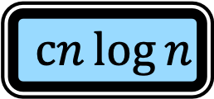
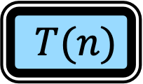

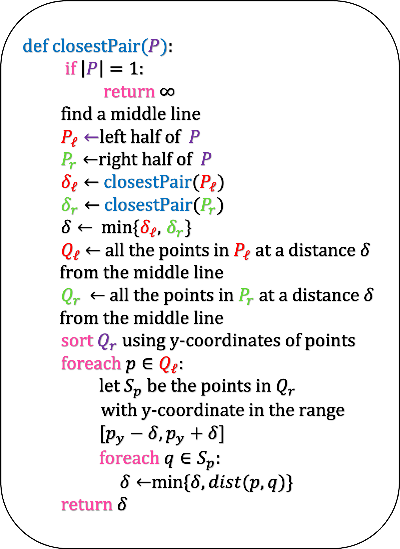
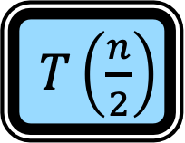

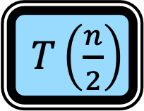
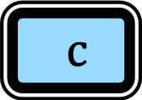
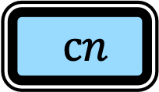
def closestPair$(P$):
if $\left|P\right|=1:$
return $∞$
find a middle line
$P_{ℓ}←$left half of $P$
$P_{r}←$right half of $P$
$δ_{ℓ}←$ closestPair($P_{ℓ}$)
$δ_{r}←$ closestPair($P_{r}$)
$δ←$min{$δ_{ℓ}$, $δ_{r}$}
$Q_{ℓ}$ $←$ all the points in $P_{ℓ}$at a distance $δ$
from the middle line
$Q_{r}$ $←$ all the points in $P_{r}$ at a distance $δ$
from the middle line
sort $Q_{r}$ using y-coordinates of points
foreach $p∈Q_{ℓ}$:
let $S_{p}$ be the points in $Q_{r}$
with y-coordinate in the range
$[p_{y}−δ,p_{y}+δ]$
foreach $q∈S_{p}$:
$δ←$min{$δ,dist(p,q)$}
return $δ$
$T(n)$
$c$
$cn$
$T\left(\frac{n}{2}\right)$
$T\left(\frac{n}{2}\right)$
$cn$
$cn\log{n}$
$cn\log{n}$

Slide 44
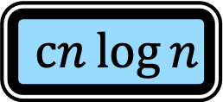
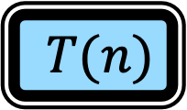
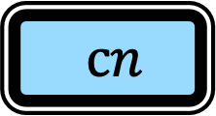
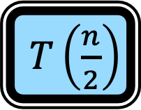
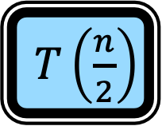
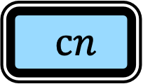
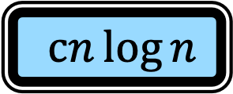
def closestPair$(P$):
if $\left|P\right|=1:$
return $∞$
find a middle line
$P_{ℓ}←$left half of $P$
$P_{r}←$right half of $P$
$δ_{ℓ}←$ closestPair($P_{ℓ}$)
$δ_{r}←$ closestPair($P_{r}$)
$δ←$min{$δ_{ℓ}$, $δ_{r}$}
$Q_{ℓ}$ $←$ all the points in $P_{ℓ}$at a distance $δ$
from the middle line
$Q_{r}$ $←$ all the points in $P_{r}$ at a distance $δ$
from the middle line
sort $Q_{r}$ using y-coordinates of points
foreach $p∈Q_{ℓ}$:
let $S_{p}$ be the points in $Q_{r}$
with y-coordinate in the range
$[p_{y}−δ,p_{y}+δ]$
foreach $q∈S_{p}$:
$δ←$min{$δ,dist(p,q)$}
return $δ$
$c$
$T(n)$
$T\left(\frac{n}{2}\right)$
$T\left(\frac{n}{2}\right)$
$cn$
$cn$
$cn\log{n}$
$cn\log{n}$

Slide 45

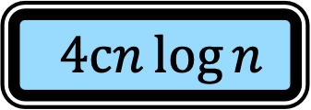
def closestPair$(P$):
if $\left|P\right|=1:$
return $∞$
find a middle line
$P_{ℓ}←$left half of $P$
$P_{r}←$right half of $P$
$δ_{ℓ}←$ closestPair($P_{ℓ}$)
$δ_{r}←$ closestPair($P_{r}$)
$δ←$min{$δ_{ℓ}$, $δ_{r}$}
$Q_{ℓ}$ $←$ all the points in $P_{ℓ}$at a distance $δ$
from the middle line
$Q_{r}$ $←$ all the points in $P_{r}$ at a distance $δ$
from the middle line
sort $Q_{r}$ using y-coordinates of points
foreach $p∈Q_{ℓ}$:
let $S_{p}$ be the points in $Q_{r}$
with y-coordinate in the range
$[p_{y}−δ,p_{y}+δ]$
foreach $q∈S_{p}$:
$δ←$min{$δ,dist(p,q)$}
return $δ$
$c$
$T(n)$
$≤$
$T\left(\frac{n}{2}\right)$
$T\left(\frac{n}{2}\right)$
$4cn\log{n}$

Slide 46
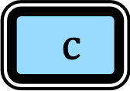

def closestPair$(P$):
if $\left|P\right|=1:$
return $∞$
find a middle line
$P_{ℓ}←$left half of $P$
$P_{r}←$right half of $P$
$δ_{ℓ}←$ closestPair($P_{ℓ}$)
$δ_{r}←$ closestPair($P_{r}$)
$δ←$min{$δ_{ℓ}$, $δ_{r}$}
$Q_{ℓ}$ $←$ all the points in $P_{ℓ}$at a distance $δ$
from the middle line
$Q_{r}$ $←$ all the points in $P_{r}$ at a distance $δ$
from the middle line
sort $Q_{r}$ using y-coordinates of points
foreach $p∈Q_{ℓ}$:
let $S_{p}$ be the points in $Q_{r}$
with y-coordinate in the range
$[p_{y}−δ,p_{y}+δ]$
foreach $q∈S_{p}$:
$δ←$min{$δ,dist(p,q)$}
return $δ$
$T(n)$
$≤$
$T\left(\frac{n}{2}\right)$
$T\left(\frac{n}{2}\right)$
$4cn\log{n}$
$T(1)$
$c$

Slide 47
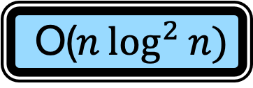
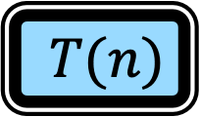
def closestPair$(P$):
if $\left|P\right|=1:$
return $∞$
find a middle line
$P_{ℓ}←$left half of $P$
$P_{r}←$right half of $P$
$δ_{ℓ}←$ closestPair($P_{ℓ}$)
$δ_{r}←$ closestPair($P_{r}$)
$δ←$min{$δ_{ℓ}$, $δ_{r}$}
$Q_{ℓ}$ $←$ all the points in $P_{ℓ}$at a distance $δ$
from the middle line
$Q_{r}$ $←$ all the points in $P_{r}$ at a distance $δ$
from the middle line
sort $Q_{r}$ using y-coordinates of points
foreach $p∈Q_{ℓ}$:
let $S_{p}$ be the points in $Q_{r}$
with y-coordinate in the range
$[p_{y}−δ,p_{y}+δ]$
foreach $q∈S_{p}$:
$δ←$min{$δ,dist(p,q)$}
return $δ$
$T(n)$
$≤$
$T\left(\frac{n}{2}\right)$
$T\left(\frac{n}{2}\right)$
$4cn\log{n}$
$T(1)$
$c$
$T(n)$
O($n\log^{2}{n)}$

Slide 48
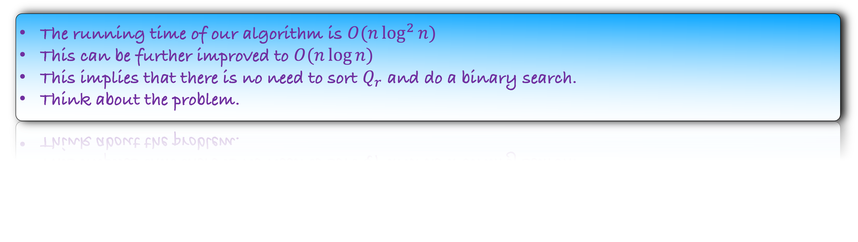
Homework
Prove that the algorithm is correct.
Lemma: Our algorithm finds a closest pair in a point set of size n.
Prove the above lemma by induction on n.
The running time of our algorithm is $O(n\log^{2}{n})$
This can be further improved to $O(n\log{n)}$
This implies that there is no need to sort $Q_{r}$ and do a binary search.
Think about the problem.

